Slide 1
Meeting 4 update
Automatic Synthesis of VMC - Hasan

Slide 2
Overview
This week:
Implemented rudimentary GA
Tested with different parameters
Discuss:
Brief overview of GA and results
How parameters can change
How initial setup can change
What can be done over next week

Slide 3
GA
Key parameters:
Population size
Number of generations
Tournament size
Cross over probability
Mutation probability
Elite Size
Fitness function

Slide 4
Fitness Function
Factors
Final height
Stability
Number of tendons
Deviation from centre
Contact

Slide 5
Results
Different parameters for the GA were used

Slide 6
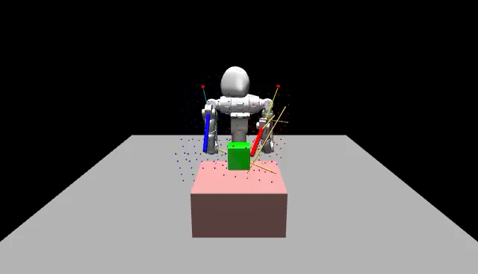
Test 1
POPULATION_SIZE = 20
NUM_GENERATIONS = 30
TOURNAMENT_SIZE = 2
CROSSOVER_PROB = 0.7
MUTATION_PROB = 0.2
ELITE_SIZE = 2
BUG that tried to maximize distance from centre

Slide 7
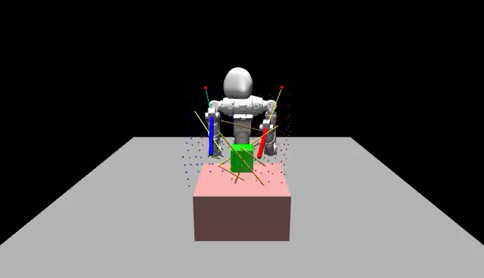
Test 2
POPULATION_SIZE = 20
NUM_GENERATIONS = 30
TOURNAMENT_SIZE = 2
CROSSOVER_PROB = 0.7
MUTATION_PROB = 0.2
ELITE_SIZE = 2

Slide 8
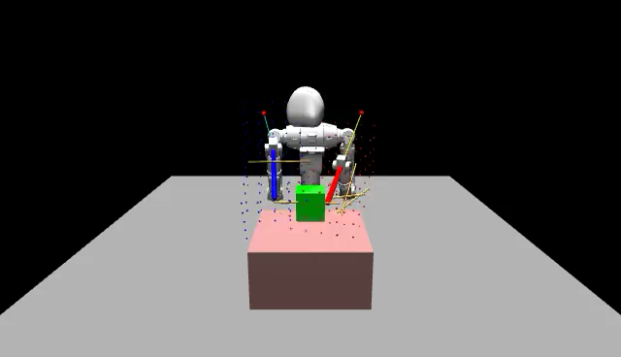
Test 3
POPULATION_SIZE = 30
NUM_GENERATIONS = 30
TOURNAMENT_SIZE = 3
CROSSOVER_PROB = 0.7
MUTATION_PROB = 0.4
ELITE_SIZE = 3

Slide 9
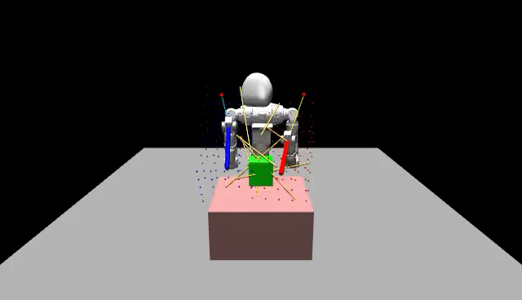
Test 4
POPULATION_SIZE = 30
NUM_GENERATIONS = 50
TOURNAMENT_SIZE = 3
CROSSOVER_PROB = 0.7
MUTATION_PROB = 0.3
ELITE_SIZE = 5

Slide 10

Test 5
POPULATION_SIZE = 30
NUM_GENERATIONS = 25
TOURNAMENT_SIZE = 3
CROSSOVER_PROB = 0.7
MUTATION_PROB = 0.3
ELITE_SIZE = 5

Slide 11
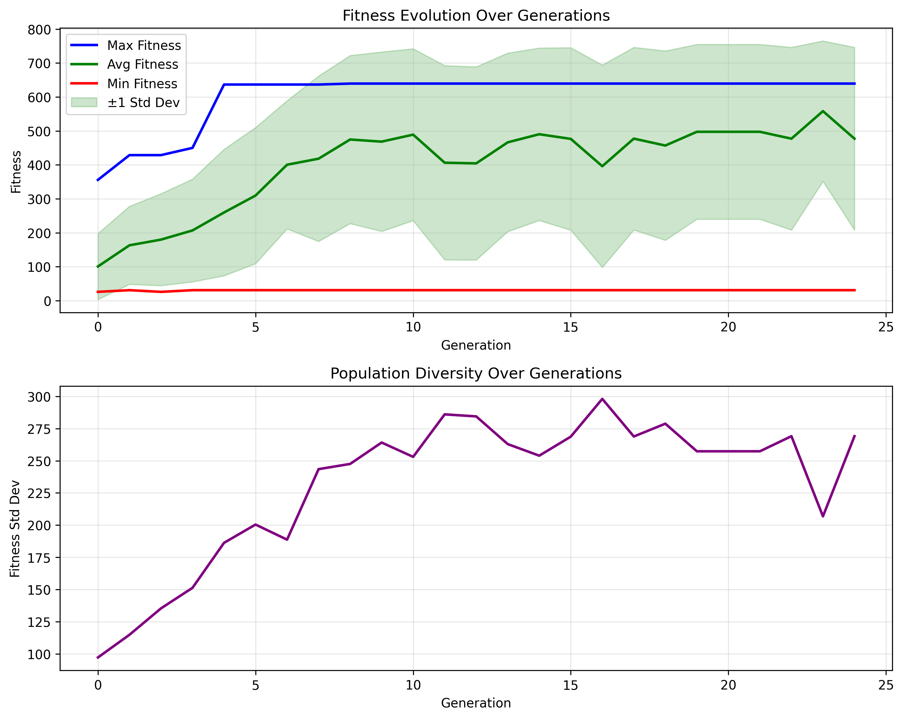
Test 5 stats

Slide 12
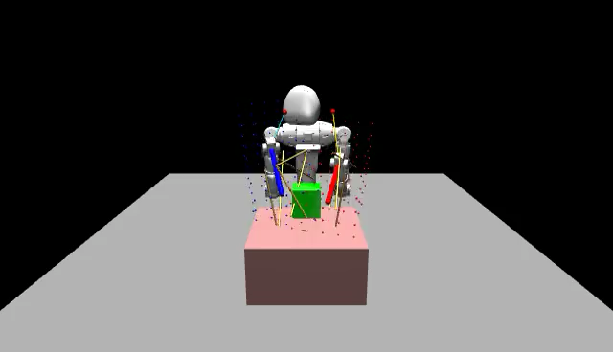
Test 6
POPULATION_SIZE = 30
NUM_GENERATIONS = 25
TOURNAMENT_SIZE = 10
CROSSOVER_PROB = 0.7
MUTATION_PROB = 0.3
ELITE_SIZE = 5

Slide 13
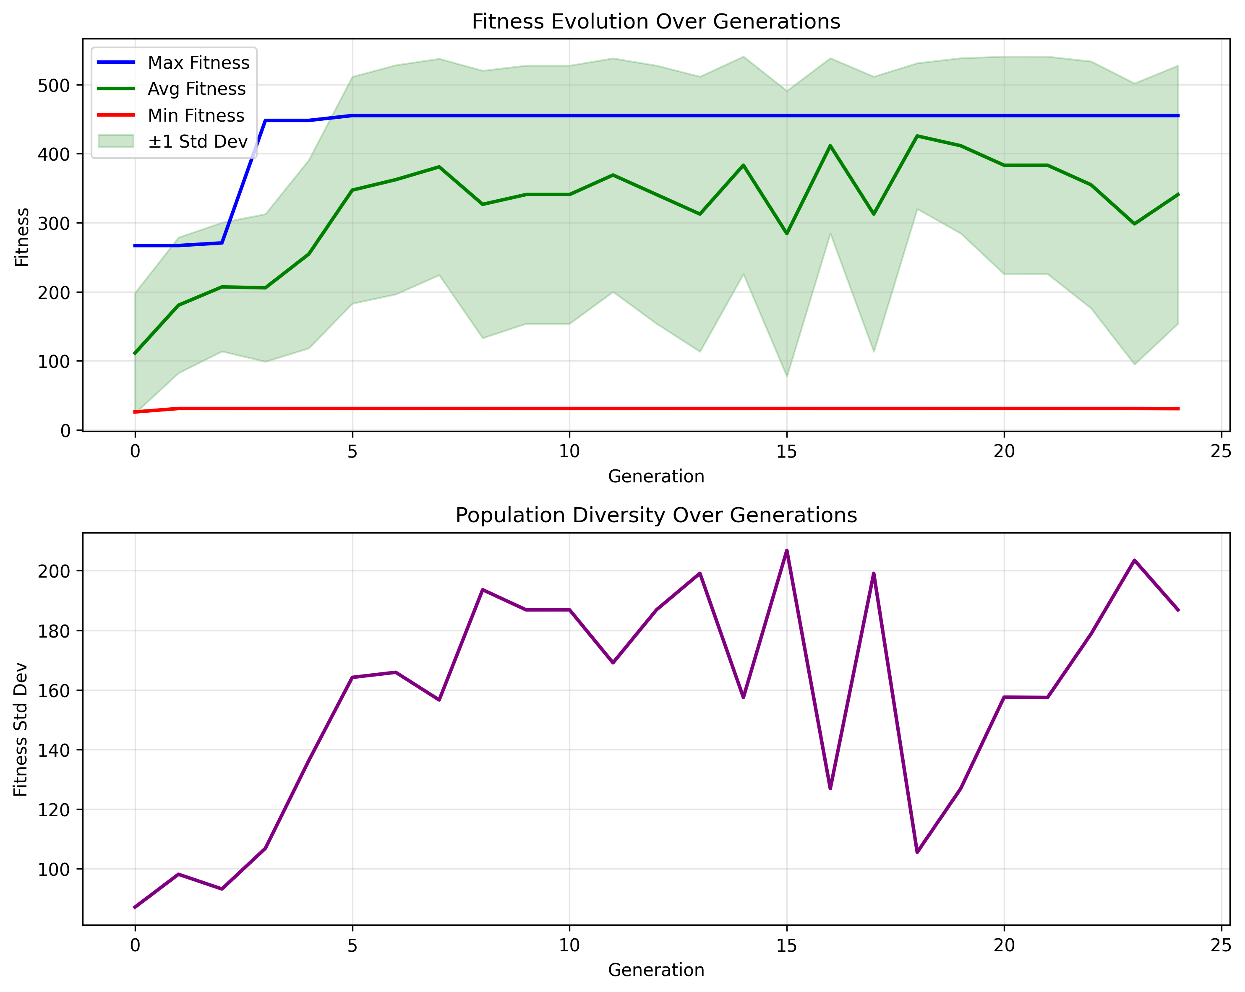
Test 6 stats

Slide 14

Test 7
POPULATION_SIZE = 30
NUM_GENERATIONS = 15
TOURNAMENT_SIZE = 1
CROSSOVER_PROB = 0.7
MUTATION_PROB = 0.4
ELITE_SIZE = 2

Slide 15
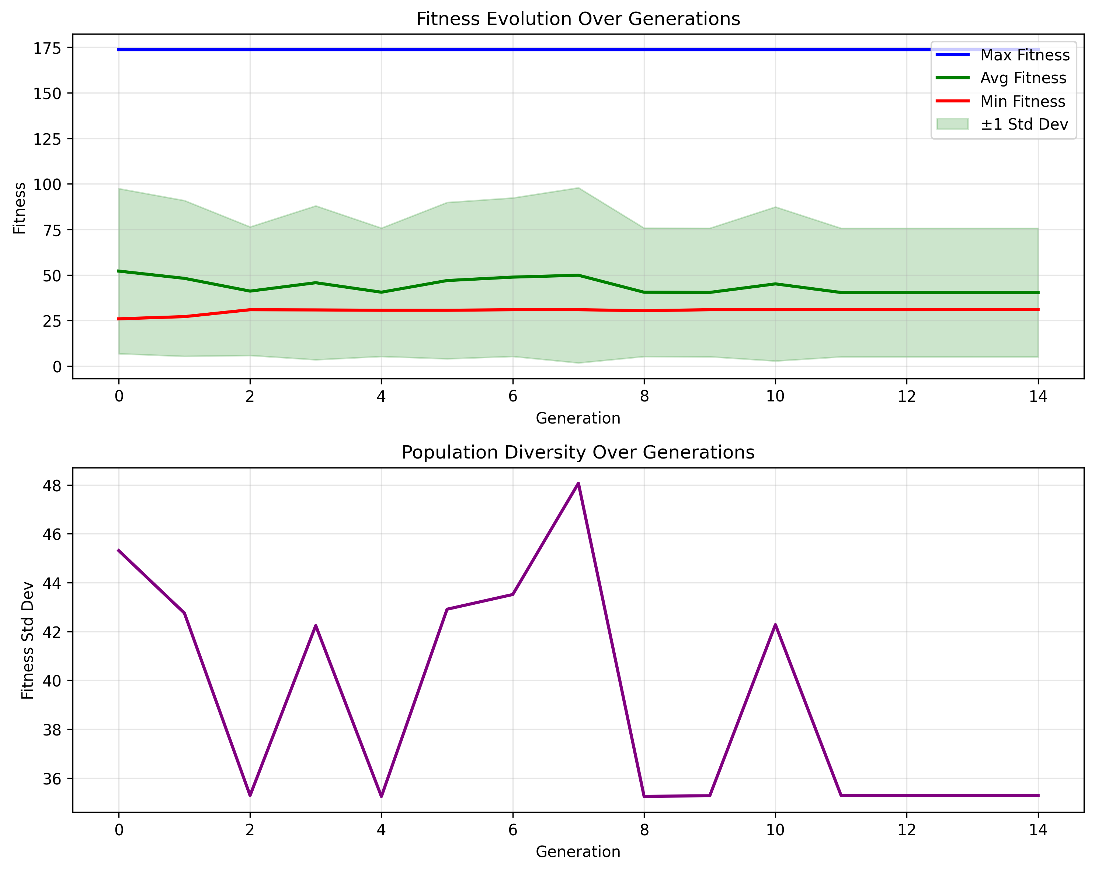
Test 7 Stats

Slide 16

Test 8
POPULATION_SIZE = 50
NUM_GENERATIONS = 15
TOURNAMENT_SIZE = 3
CROSSOVER_PROB = 0.7
MUTATION_PROB = 0.4
ELITE_SIZE = 5

Slide 17
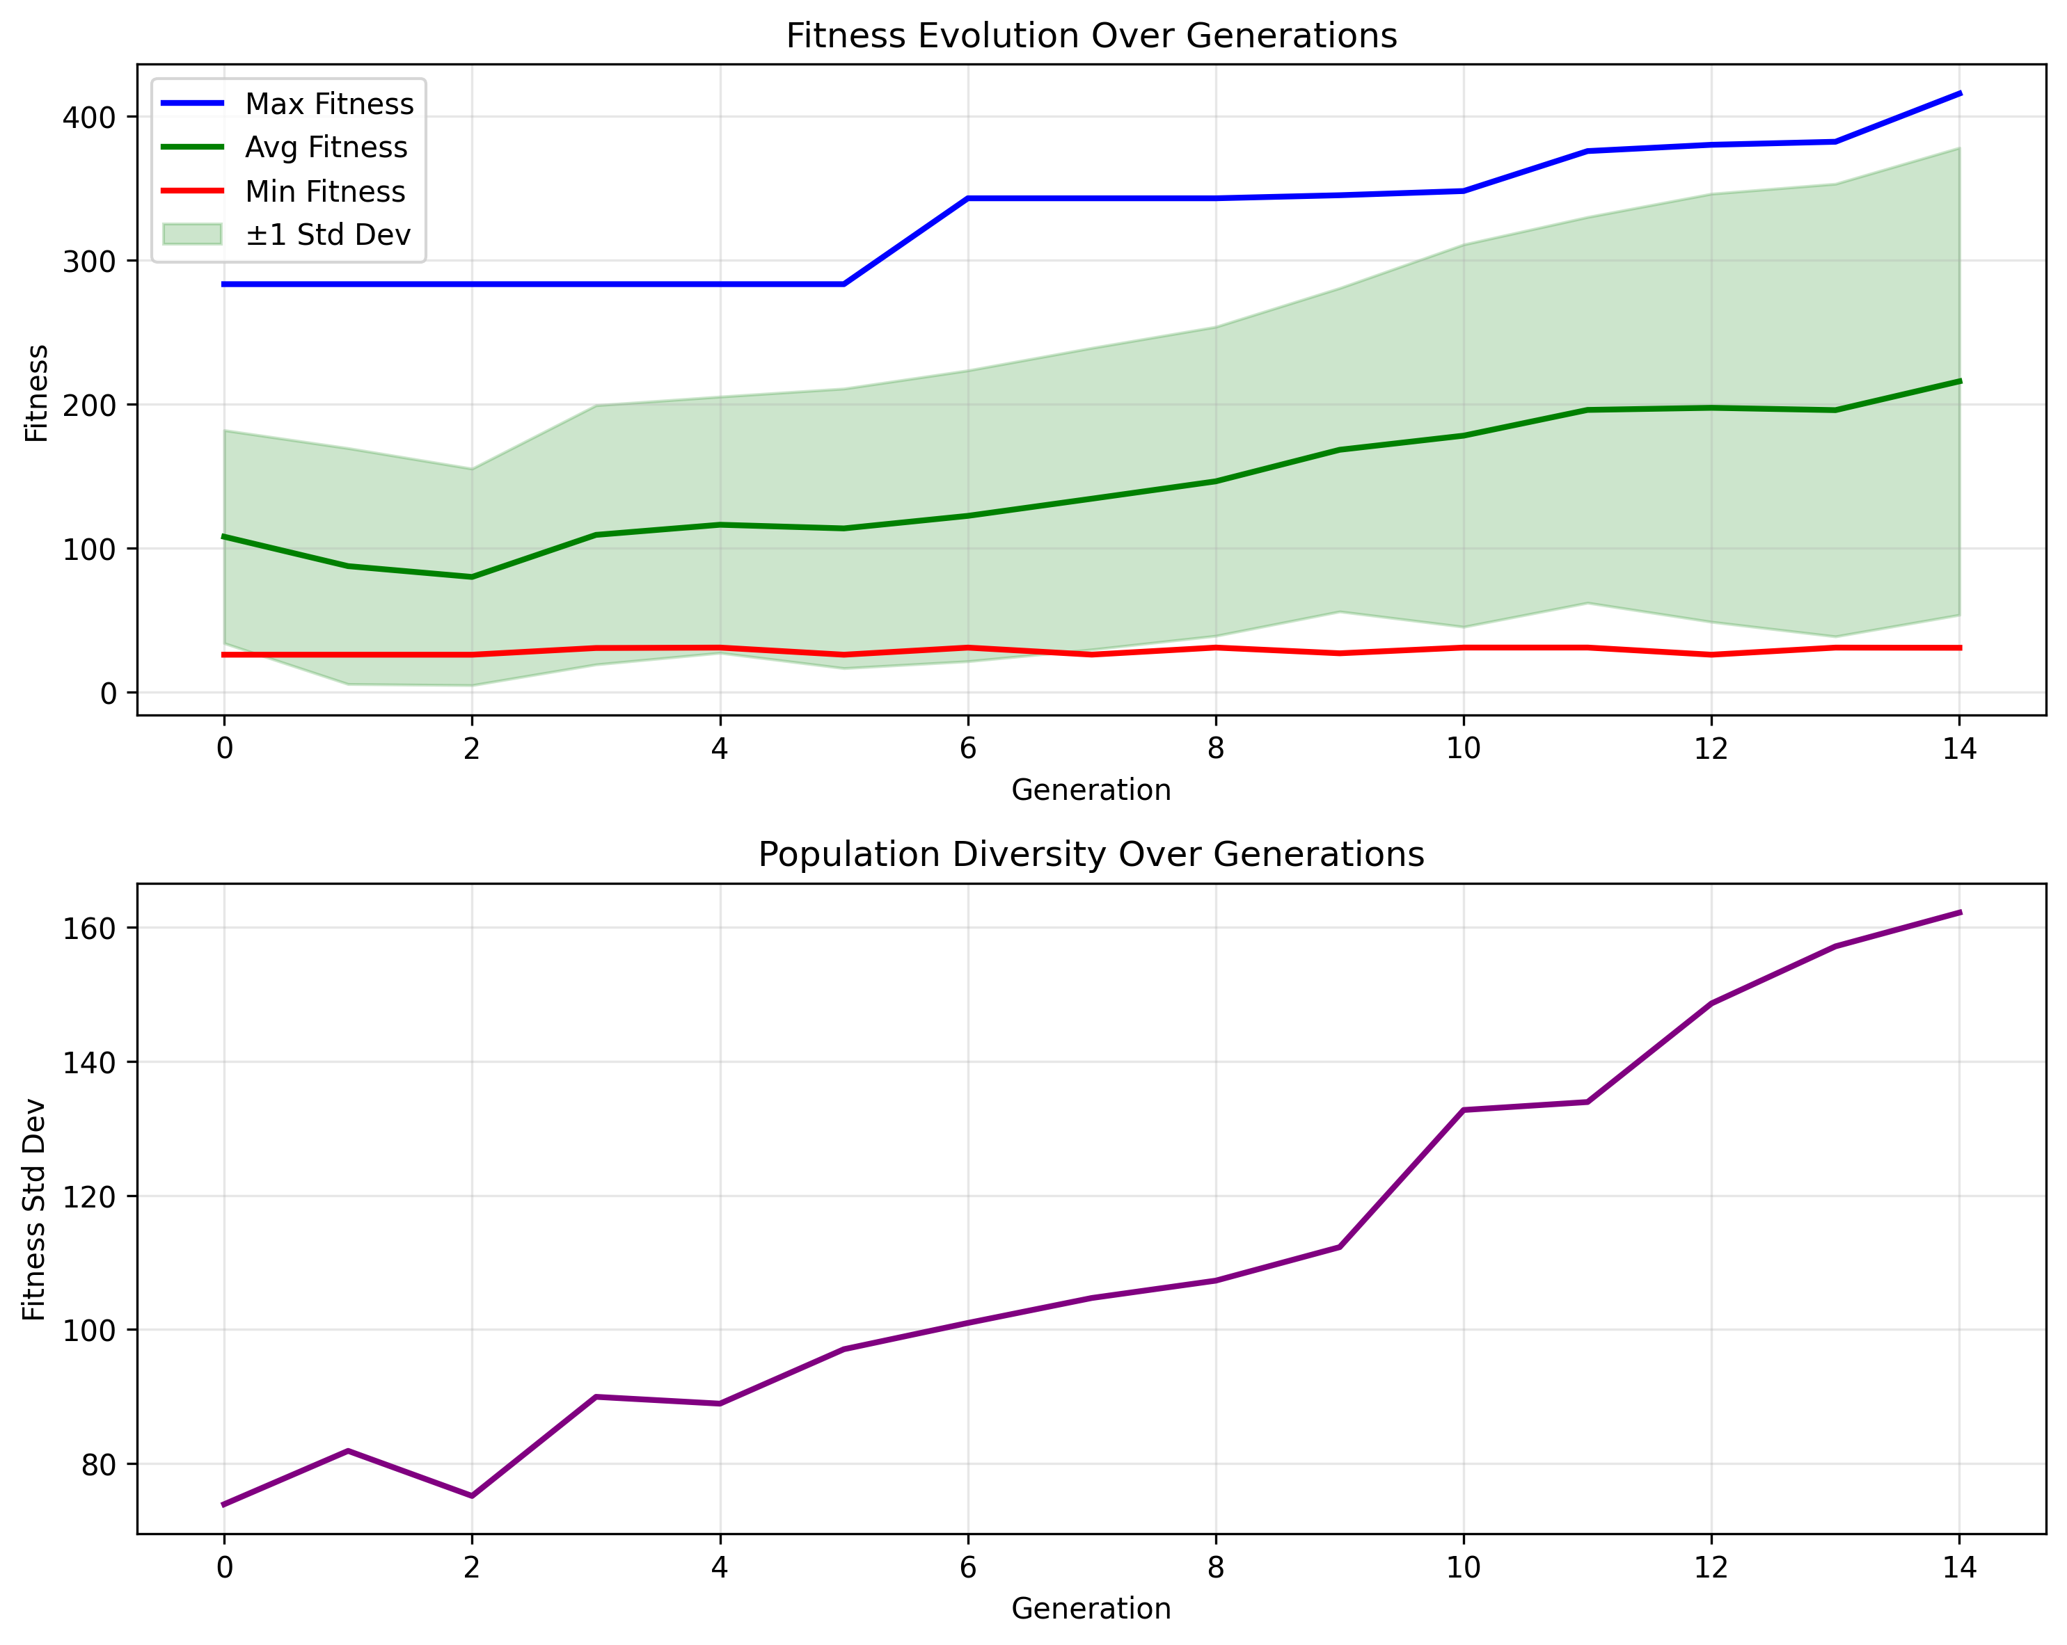
Test 8 stats

Slide 18
Plans
Tweak
Fitness function
GA parameters
Train over multiple starting positions of the block
Change underlying setup
Research GA use in other cases and learn from that

