Slide 1
Meeting 5
(Useless) changes

Slide 2
Overview
Things I worked on
Soft objects in Mujoco
Connecting the arms
Improved tooling
Minor changes
Challenges
Things I read
An overview of 3D object grasp synthesis algorithms
A Survey on Learning-Based Robotic Grasping
Discuss next steps

Slide 3
Exploring contact

Slide 4
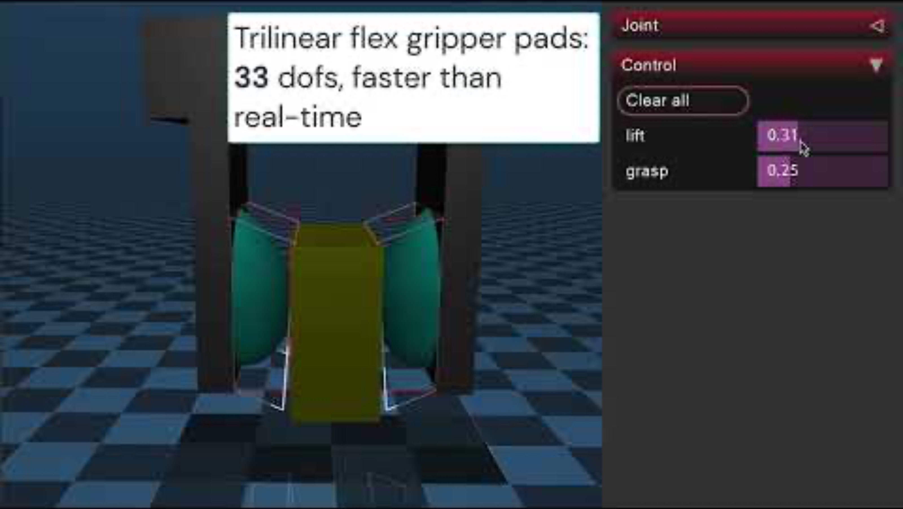
Mujoco soft body (flexcomp) - goal
Could not get this to work.
Although increasing friction and reducing the weight of the object did the trick.

Slide 5
Connecting the arms
Connecting the arms would require adding a variable length to the attributes of the tendons which is doable but blows up the search space in the current method.
Connecting the arms also increases the number of tendons/potential connections which has been causing issues.
Not connecting the arms has been working for this trivial grabbing task for now.

Slide 6
Improved Tooling
Now all changes and their effects can be tracked.
Changes can be compared easily
Apply different results to different configurations

Slide 7
Minor changes
Changed the hand shape (cylindrical to rectangular) to increase contact surface and effect of friction
Tweaked fitness function parameters and the method of computing it.
Ignore unstable configurations
Implented parallel (multi-core) which increased speed.
Normalizing stiffness based on number of tendons

Slide 8
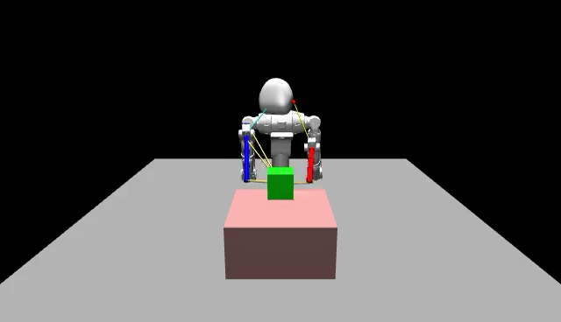
One semi-successful attempt

Slide 9
Challenges
This current method seems to increase number of tendons as we progress. (This maybe due to fitness function or number of tendons naturally growing).
This method results in many unstable configurations (leading to many unviable results and nonsense values)
Most changes made had a negative effect on the results.
Fix number of tendons and allow sites to move around?

Slide 10
Reading
An overview of 3D object grasp synthesis algorithms
Introduced Analytical / Empirical grasp synthesis methods
Analytical approach:
stability and force-closure
Task based
Empirical:
Learning from observations
Shape matching
Finding graspable surfaces

Slide 11
Reading
A survey on Learning based robot grasping
Two approaches:
Object recognition and grab technique are separate:
Object pose estimation methods (useful for our application)
Planning the grasp method
One learned model (end-to-end) learns how to manipulate objects
The paper discusses many other papers which approached the problem in different ways but did not go into much detail on each.

