Slide 1
Meeting 7
Hasan Shahrestani

Slide 2
Overview
Updating the encoding – Crossover and mutation
General Improvements
Testing on block pickup
Testing on block flipping
Fitness function
Example of rising block
Reading
Multi-objective GA search
Simulated Binary Crossover

Slide 3
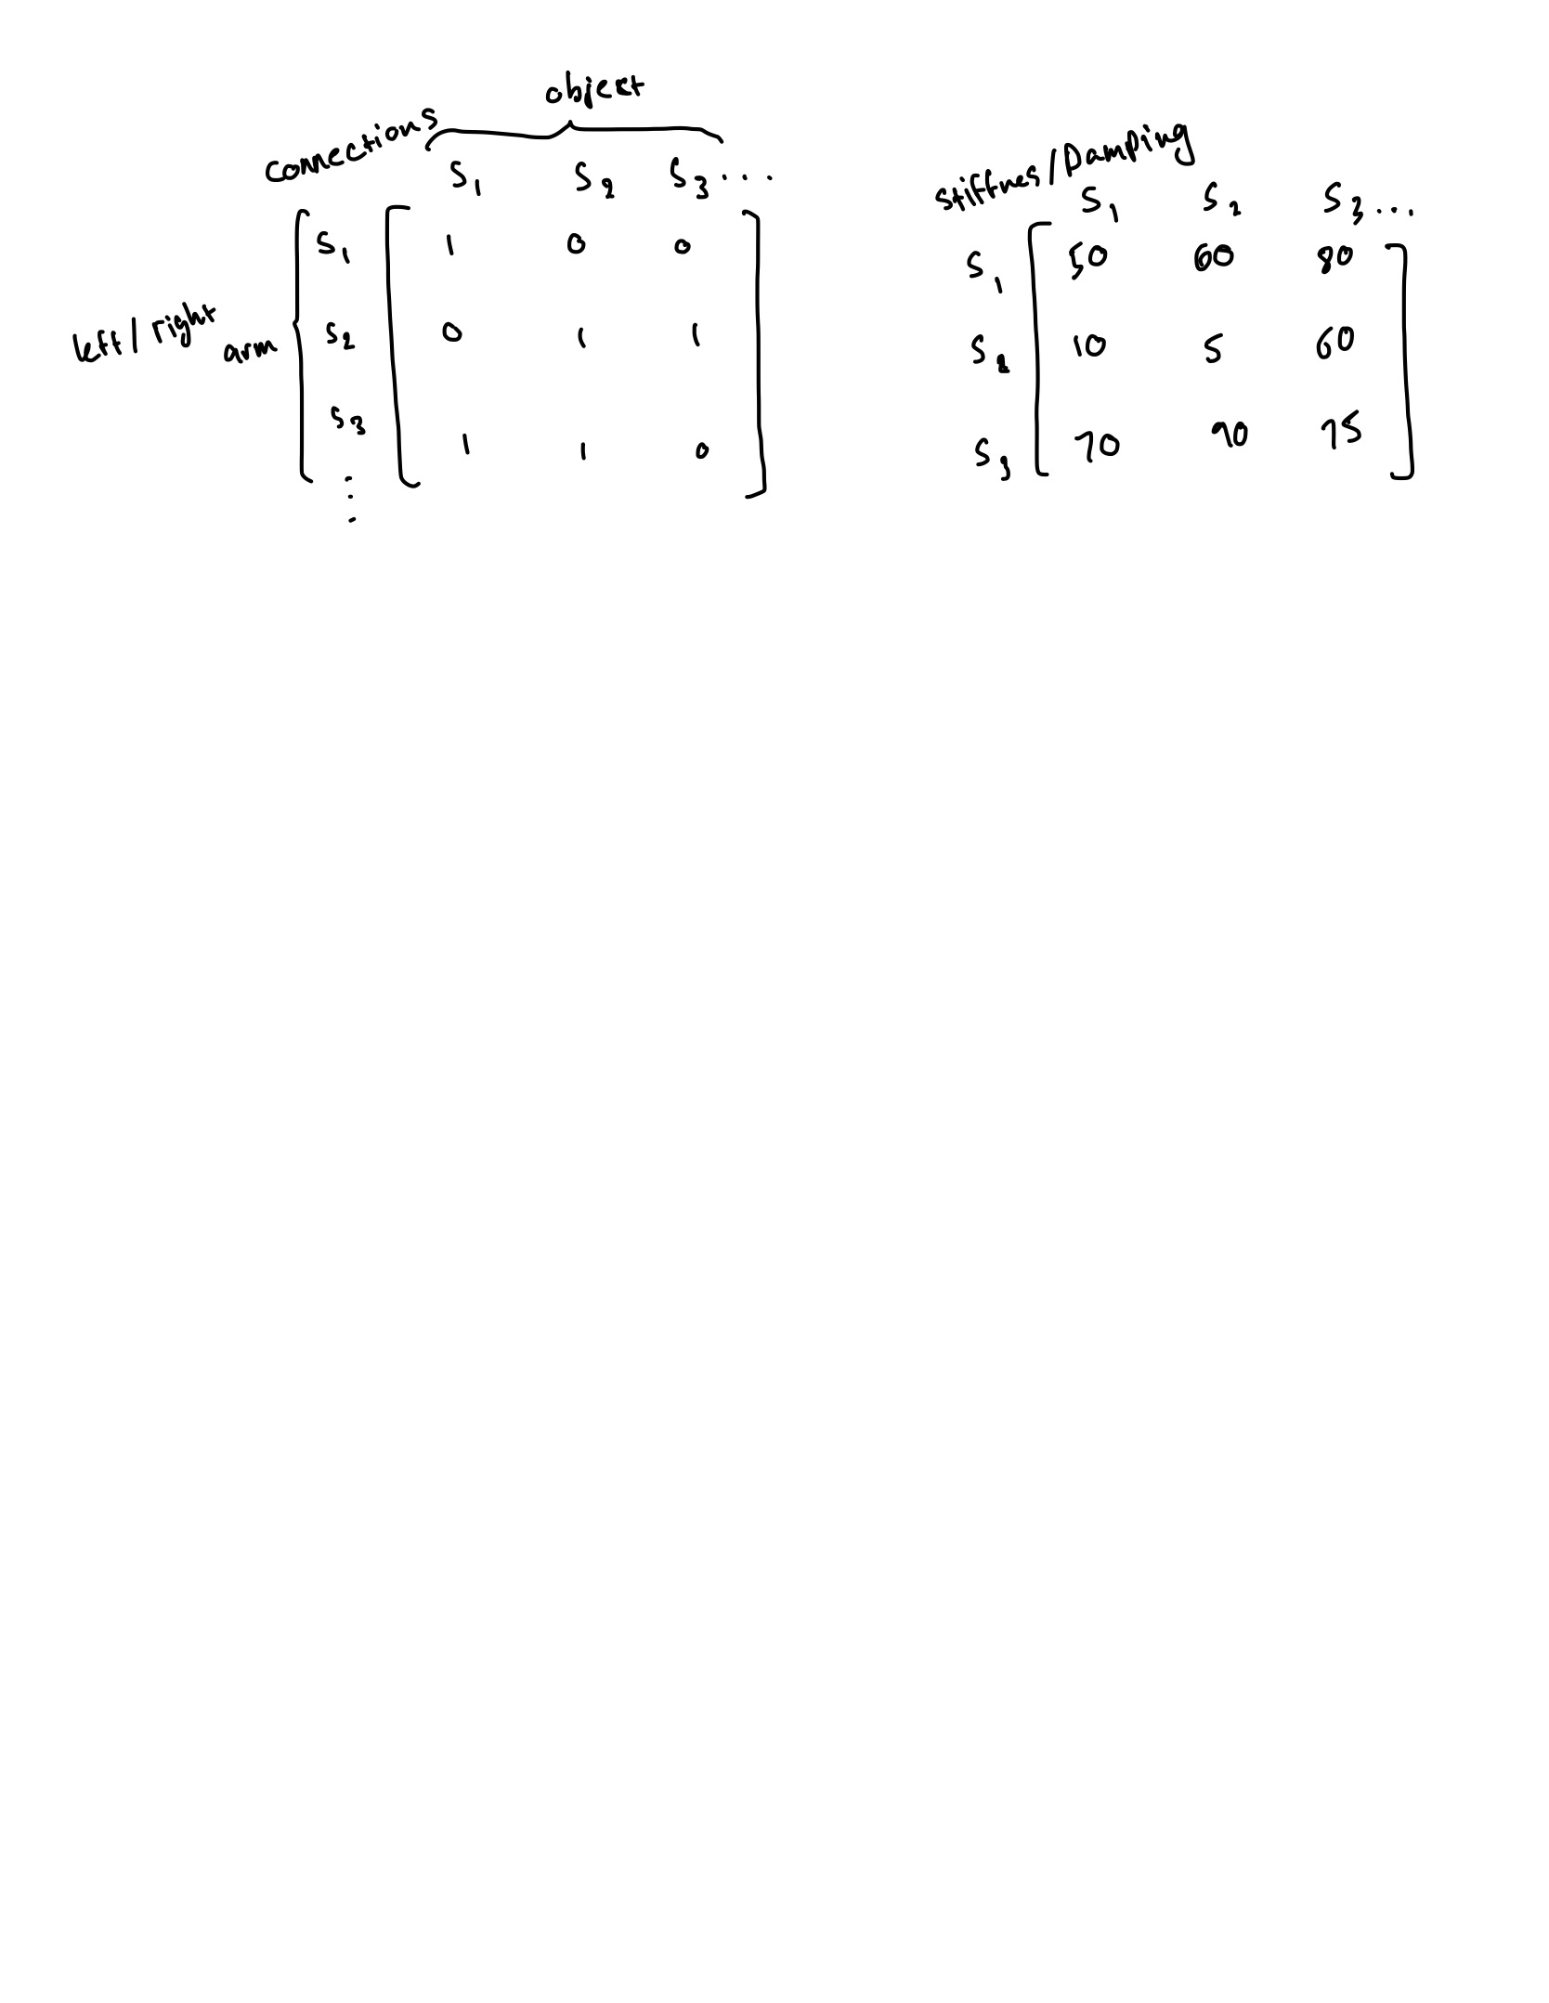
Updating the encoding – Old version
Problems:
Unlimited tendons
Very large search space
Unstable
Mutation and cross over were also not ideal

Slide 4
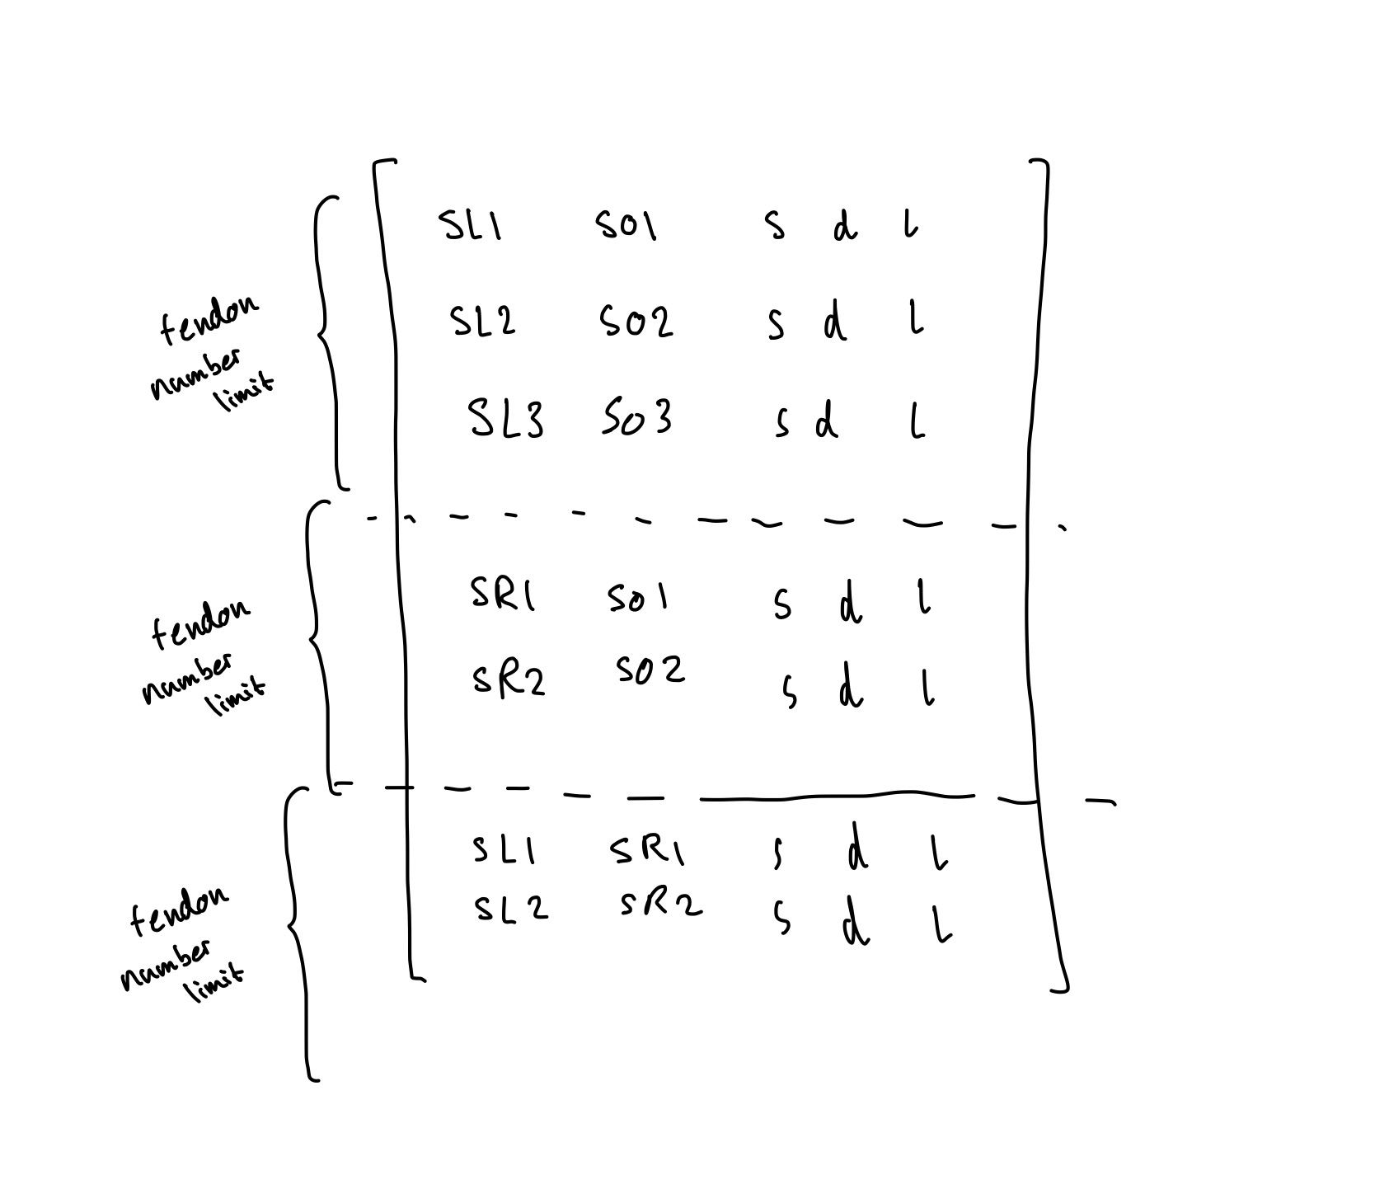
Updating the encoding – New version

Slide 5
Updating crossover / mutation method
SBX was used to cross over the continues stiffness, damping, length values.
Two point cross over of connections was used.
Mutation is done by adding/subtracting between 1,2,3 to a site number. (Maybe can improve this)
Polynomial mutation used for continues values

Slide 6
General Improvements
Fitness checks three different starting positions rather than a random one each time.
Allowed length to be changed also
Allowed tendons between arms
Updated encoding/crossover/mutation

Slide 7
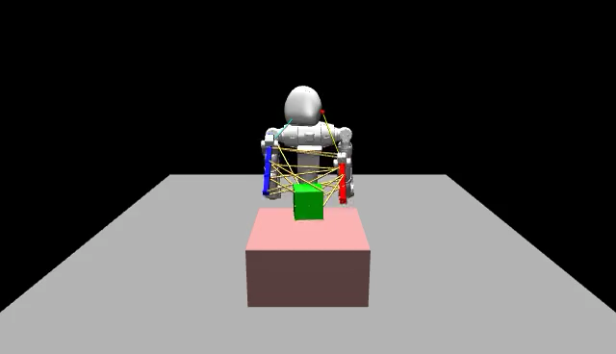
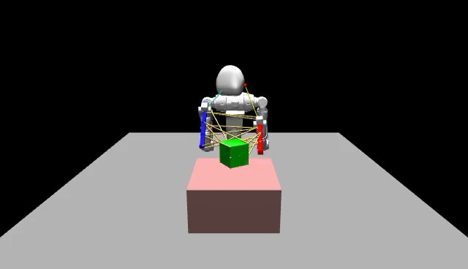
Results – Picking up the block – random start – length always 0

Slide 8
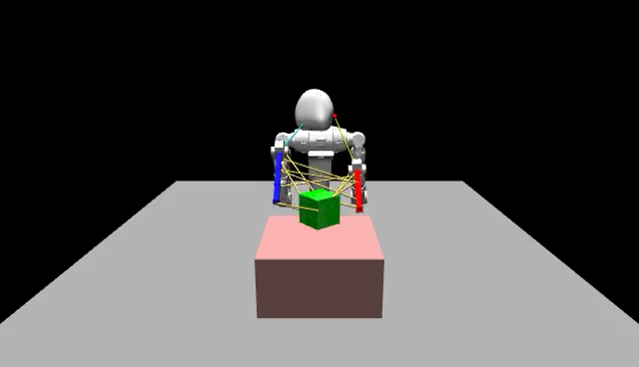
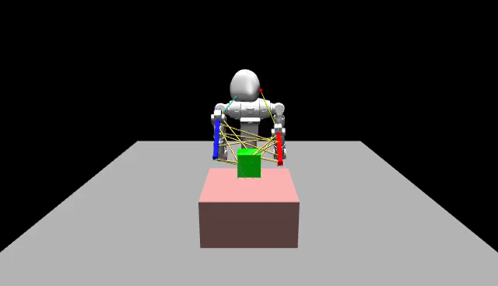
Results – Picking up the block – averaged fitness – allow length change

Slide 9
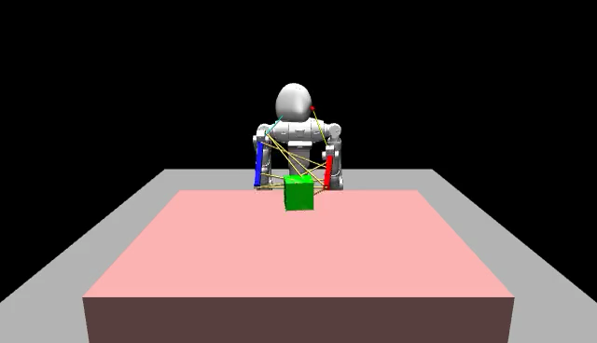
Flipping the block – work in progress

Slide 10
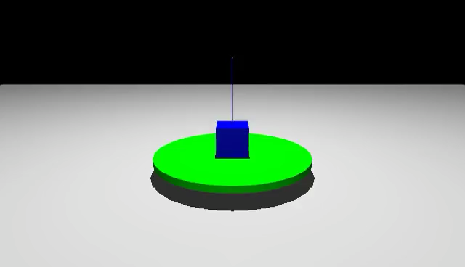
Rising block example

Slide 11
Reading
Simulated Binary Crossover for Continues search space
Introduces the SBX for continues variables to match the Binary crossover to improve on simple binary encodings ( hamming cliff, precision)
Explains how to apply to multivariable problems
Shows results of using it instead of the simple method
A Fast and Elitist Multiobjective Genetic Algorithm - NSGA-II:
Introduces new Multiobjective algorithms to find ‘diverse’ solutions on the pareto-frontier faster than older methods.
Shows results on experiments
Shows how constraints can be applied also

