Slide 1
Meeting 8
Hasan shahrestani

Slide 2
overview
Added compatibility for meshes
Pyramid tested
Using server for faster computation
Notes:
Why try a genetic algorithms opposed to other algorithms
start with genetic and then a use other optimisation
understanding the litreture
why are we doing what we are doing
Write a milestone report (17 January)
- Tendon to Jacobian mapping
- Continues space rather than discrete space
- what is a good solution (shape of hand, robust) need to check quality of grasping
- Who is using genetic algorithm in manipulation
- sim to real (is it robust - or does it need a bootstrap)
report needs to showcase what others have done in using genetic algorithm.
establishing a pipline from simulaiton to robot.
robust to differences in position
Think about it in terms of selling to a company

Slide 3
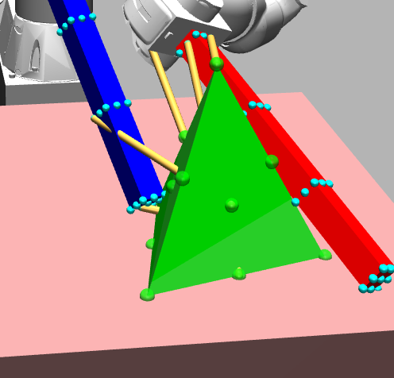
Compatibility for meshes

Slide 4
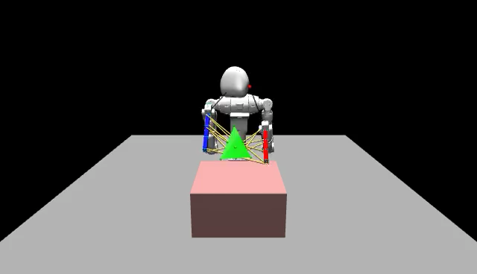
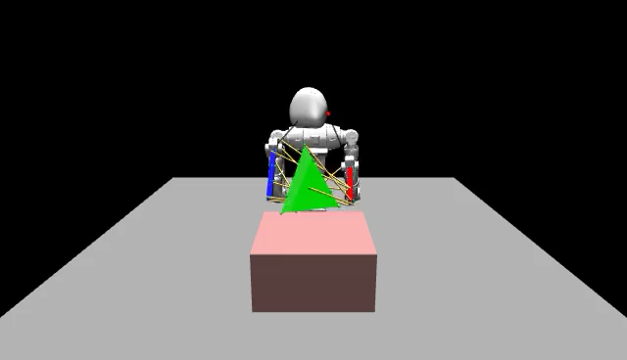
Pyramid tested

