Slide 1
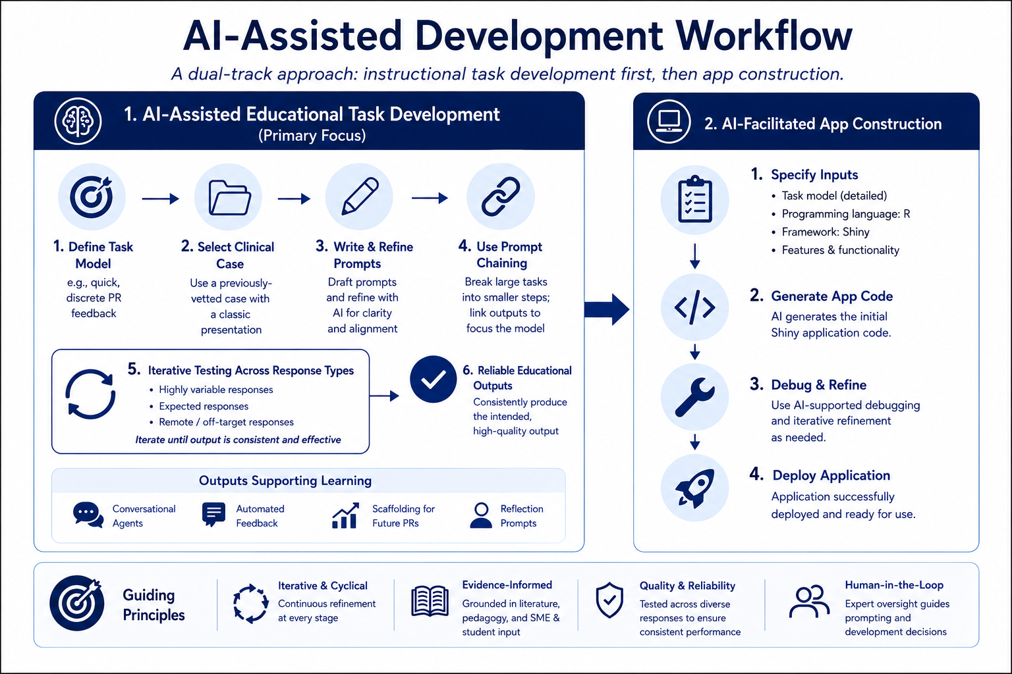
Prompting
Notes:
Quicker
PR – define PR importance – related to CR, and often to diagnostic accuracy. Pitfalls often include lack of prioritization of case information and incomplete or inaccurate illness scripts CR (includes PR) not universally taught in schools – research suggests that CR often not explicitly addressed in medical education instruction due to lack of curricular time
Given these constraints, finding time to explicitly teach CR, let alone develop tools resource to support and augment said instruction, may be scarce
Advances in AI/technology present an opportunity to leverage speed. Tools designed to implement well thought out pedagogy/tasks can be designed and deployed in a fraction of the time it might have taken with humans alone, especially those without expertise in computer science/information technology
This shift allows users to optimize the valuable time they have by dedicating it to thought work, the important thinking and planning that elevates an educational tool from novel and interesting to effective for identified student outcomes. For this purpose, AI can also be used, though not as an assistant, but rather as a thought partner.

Slide 2
App Development Required Tools
Generative AI Platform of choice
e.g., Anthropic, OpenAI, Copilot, Gemini
Positron R console/IDE
For app building
Posit Connect Cloud
For app deployment
Notes:
Don’t spend a ton of time here

Slide 3

Shiny Web Application Framework
Notes:
Cut in case

Slide 4
Student | Clinical Reasoning Coach
This is a 55 year-old man with dyspnea | I agree that this patient’s main problem is dyspnea. In your problem representation (PR), you want to add one or two key details about the patient’s past medical history (PMH) which frame how we should think about dyspnea. Are there any problems that stand out in this patient’s PMH that impact the possible causes of his dyspnea?
I guess his HPV and his COPD are important. And he has really severe gout. | I agree HIV and COPD shape how we think about the differential. But do you think his gout changes your approach to his dyspnea? If not, you will want to leave that out. Let’s try your PR again with the relevant information added.
This is a 55 year-old man with HIV and COPD presenting with dyspnea. | That’s better. Now, are there any key features of his presentation that further define his dyspnea? For example, what was the time course? Was dyspnea associated with any other major symptoms?
Connor DM, Dhaliwal G. When less is more for the struggling clinical reasoner. Diagnosis (Berl). 2015;2(3):159–162. doi:10.1515/dx-2015-0014
Notes:
We started this process by consuming literature around PR and PR pedagogy, specifically the work of Bordage and McQuade. We also drew heavily from meetings with subject matter experts who provided feedback to another Clinical Reasoning tool we developed, paying particular attention to their comments and recommendations related to PR.
We then began planning and developing applications. What began initially as a categorization exercise (e.g., categorizing case information into one of McQuade’s three categories) slowly evolved over time to include prioritization of case information and PR composition. After consulting with internal SMEs, we noted that the application was becoming too comprehensive, potentially jeopardizing usability. We elected instead to explore a series of app variants that focused on more specific and granular tasks (e.g., prioritization, categorization). We will model one such variant today.
The tasks within each variant were strategically aligned with literature and known pedagogy. The app we will demo today is closely aligned with a Dr. Connor/Dr. Dhaliwahl’s recommendation to provide short, iterative feedback to an existing PR by prompting the user to enter a PR and provide immediate feedback on each attempt. The feedback is powered by AI (Anthropic – Sonnet).

Slide 5
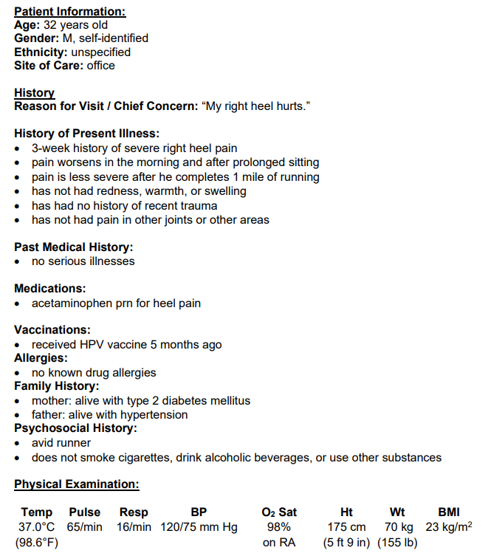
Runyon CR, Paniagua MA, Rosenthal FA, Veneziano AL, McNaughton L, Murray CT, Harik P. SHARP (SHort Answer, Rationale Provision): a new item format to assess clinical reasoning. Acad Med. 2024;99(9):976-980. doi:10.1097/ACM.0000000000005769
Notes:
AI gen cases not excellent – these have been evaluated informed by SMEs – subject matter experts (physician educators) (like yourselves ) We started this process by consuming literature around PR and PR pedagogy, specifically the work of Bordage and McQuade. We also drew heavily from meetings with subject matter experts who provided feedback to another Clinical Reasoning tool we developed, paying particular attention to their comments and recommendations related to PR.
We then began planning and developing applications. What began initially as a categorization exercise (e.g., categorizing case information into one of McQuade’s three categories) slowly evolved over time to include prioritization of case information and PR composition. After consulting with internal SMEs, we noted that the application was becoming too comprehensive, potentially jeopardizing usability. We elected instead to explore a series of app variants that focused on more specific and granular tasks (e.g., prioritization, categorization). We will model one such variant today.
The tasks within each variant were strategically aligned with literature and known pedagogy. The app we will demo today is closely aligned with a Dr. Connor/Dr. Dhaliwahl’s recommendation to provide short, iterative feedback to an existing PR by prompting the user to enter a PR and provide immediate feedback on each attempt. The feedback is powered by AI (Anthropic – Sonnet).

