Slide 1
APS Telescope Stimulus
Jenny Roberts
Peer Review
June 2, 2016
TMT Confidential
The Information herein contains Cost Estimates and Business Strategies which are proprietary to the TMT Project and may be used by the recipient only for the purpose of performing a confidential internal review of TMT. Disclosure outside of the TMT Project and its review panel is subject to the prior written approval of the TMT Project Manager.

Slide 2
Telescope Simulator
Purpose
Simulate telescope (on-sky operation) for the purpose of testing APS functionality like, segment phasing measurements, segment phasing control, pupil alignment
Testing of APS measurement capabilities is required, software/algorithm testing is a goal
Simulate telescope for APS LOWFS to align/test LOWFS
Functionality
Located before initial beamsplitter to provide common source for all paths on APS bench (APS SH, APS Pupil, APT, LOWFS)
Used primarily on-axis (2” FOV is sufficient)
Other goals
Designed to fit in path permanently (bench space + beam selection [sky vs stimulus])
Designed to work in the telescope environment
Control software incorporated into APS (ICS and PEAS) (stage, DM)

Slide 3
Stimulus Required Elements
Pupil stop
Simulate telescope pupil (outer/inner obscuration, M2 supports, no segment gaps)
Other goals
Multiple, interchangeable stops (i.e.., with/without obscuration)
Motorized rotation (to simulate pupil rotation and test K-mirror)
Motorized translation (enough to test PIT loop)
Segmented deformable mirror
Hex segments, tip/tilt, piston
Ability to remove DM from path and replace with flat that covers the full pupil
Light source
Broadband source (Broad enough for CPH-30, 600-950nm)
Seeing size image, uniform illumination, very low aberration
Variable intensity
Tip/tilt control

Slide 4
Notes and Caveats
DM is already selected, so there are associated constraints
No atmospheric simulation
No simulation of M2 or M3
No segment aberrations/WH simulations - This will be done via modeling and based on experience at Keck
We can test pupil tracking, and SH measurements separately
This means we can rotate and translate the pupil mask vs requiring a K-mirror and tilt plate for the full beam
Not used to verify telescope pupil mapping to APS re-imaged pupil masks
Not used to calibrate the WFE of APS. We will have reference sources internal to APS for this.

Slide 5
Stimulus Optical Design

Slide 6
Design Parameters
Design optical system to simulate PM of TMT telescope, using small DM (IRISAO)
Pupil 1: diameter 14.528 mm (60/4.13 mm, DM or flat mirror)
Pupil 2: diameter 60 mm (for pupil masks)
Input: fiber optic white light source WL 600 nm to 950 nm
White light point source (fiber) is collimated by the collimating lens, and followed by a Pupil 1 (DM)
Pupil 1 is relayed to expanded Pupil 2 (SF: 4.13)
F/15 focusing lens simulates Cass focus

Slide 7
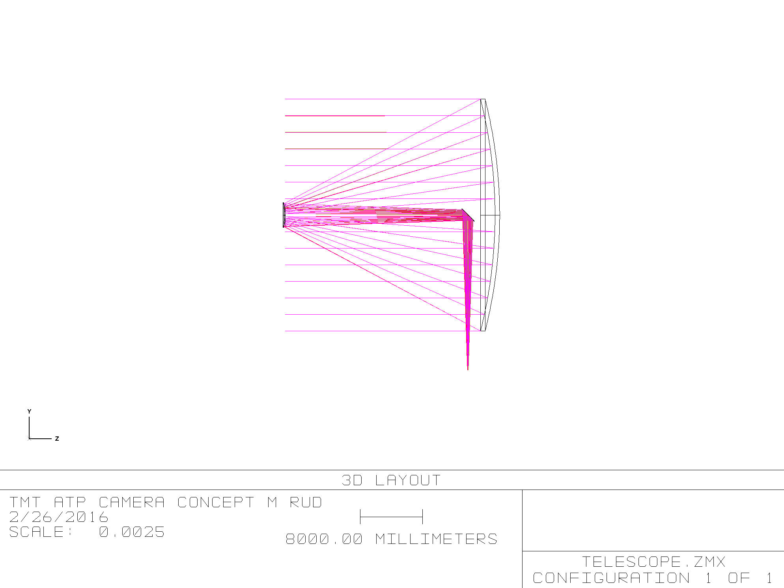
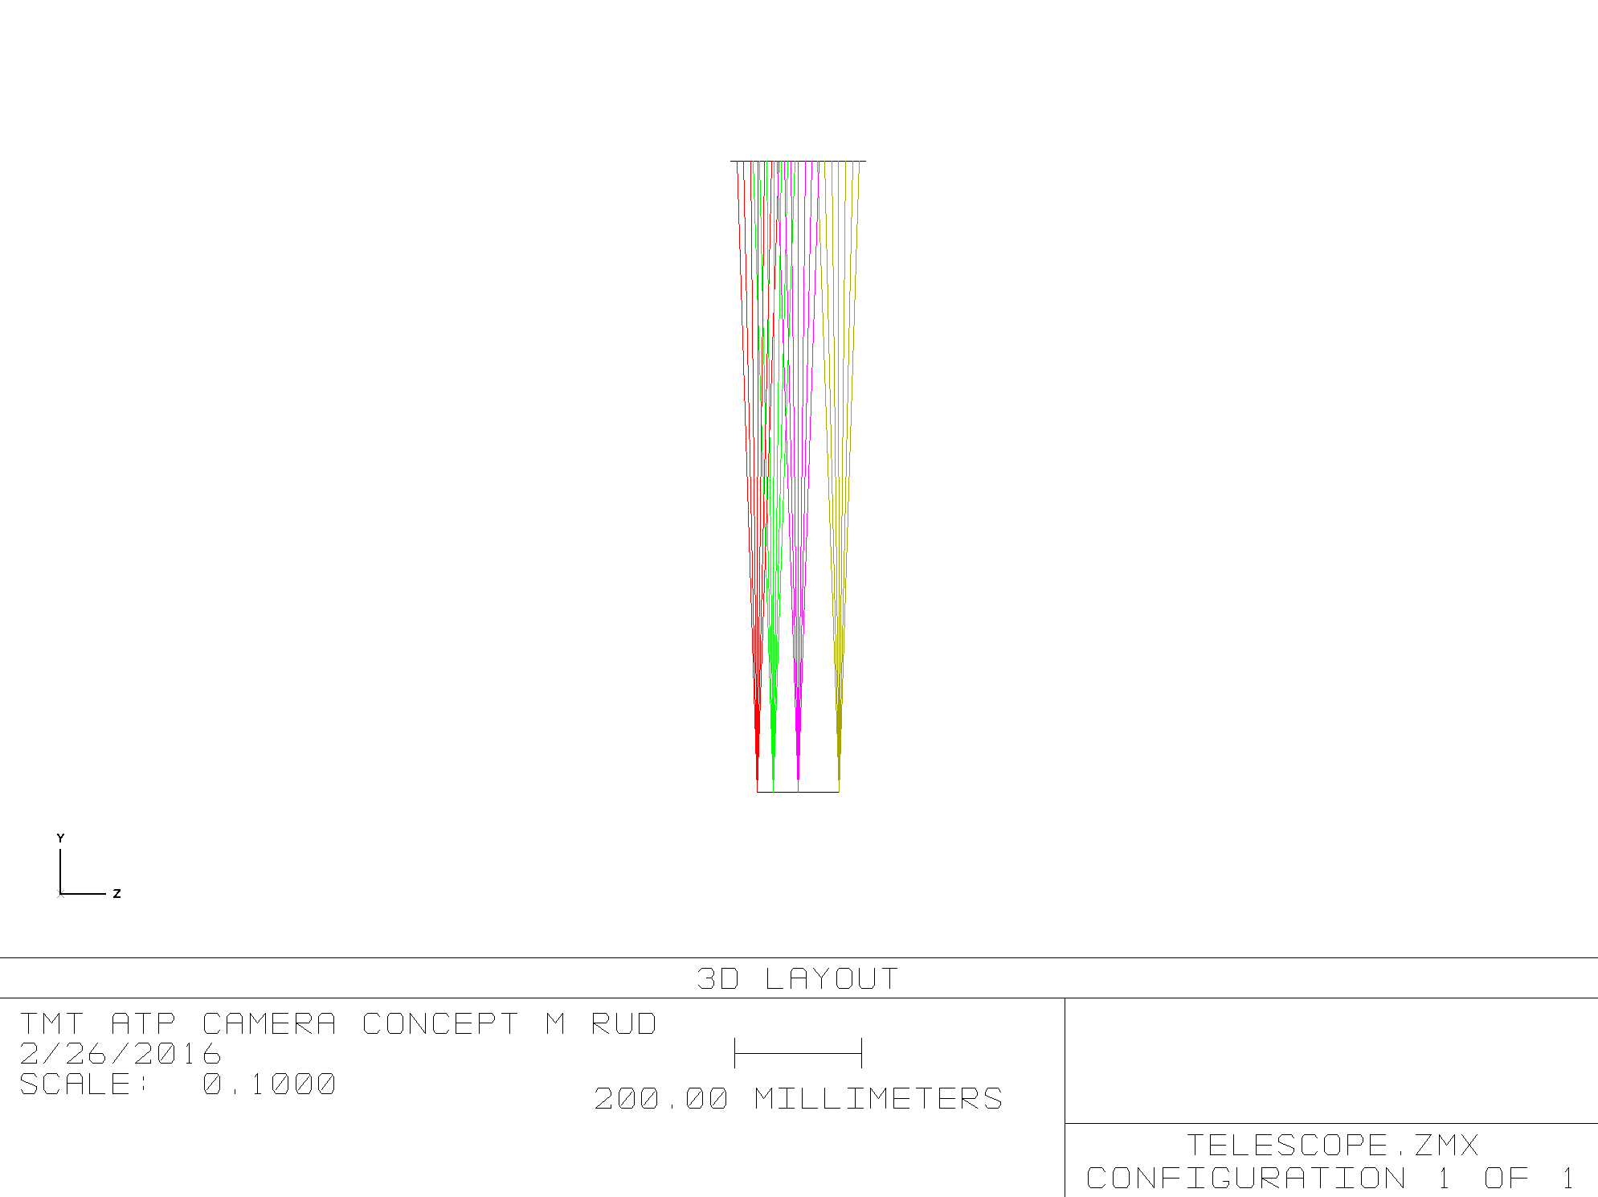
Existing Conditions
TMT Telescope
f/15, Telecentric at Cass Focus

Slide 8
Reflective (OAPs) vs Refractive
Broadband imaging performance on-axis
Reflective performs better, but refractive meets needs
Broadband imaging performance off-axis
Even over the small FOV refractive performs better, but we did not spend significant effort to improve reflective
Focal plane tilt
Significant for reflective design (corrective measures were not explored)
Alignment tolerances
Much looser for refractive design
Refractive was selected because it meets the needed performance and it is much simpler to implement

Slide 9
Simulator Optical Design
Collimated in both pupil spaces
Pupil for masks: 60mm
DM Pupil: 14.5mm/7.7mm
Telescope focus: f/15
Source

Slide 10
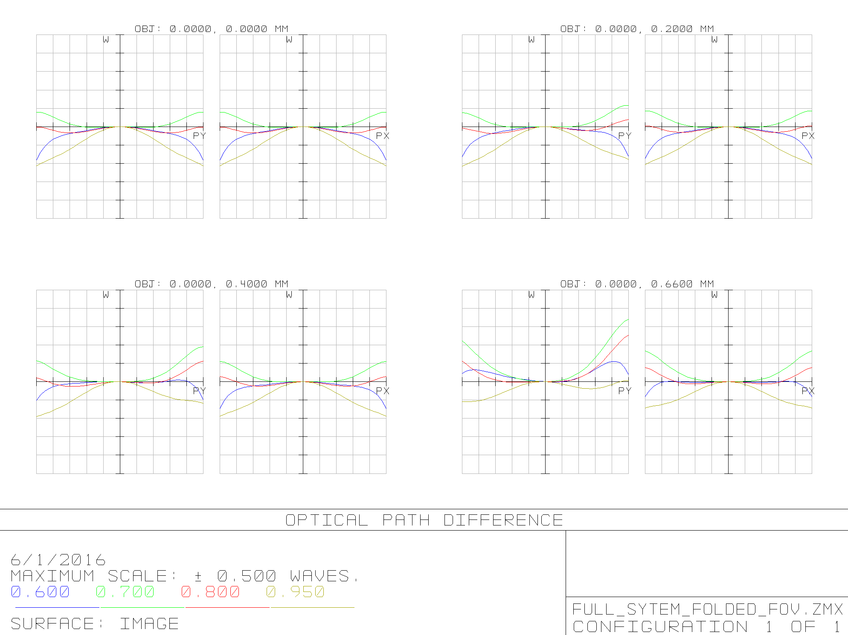
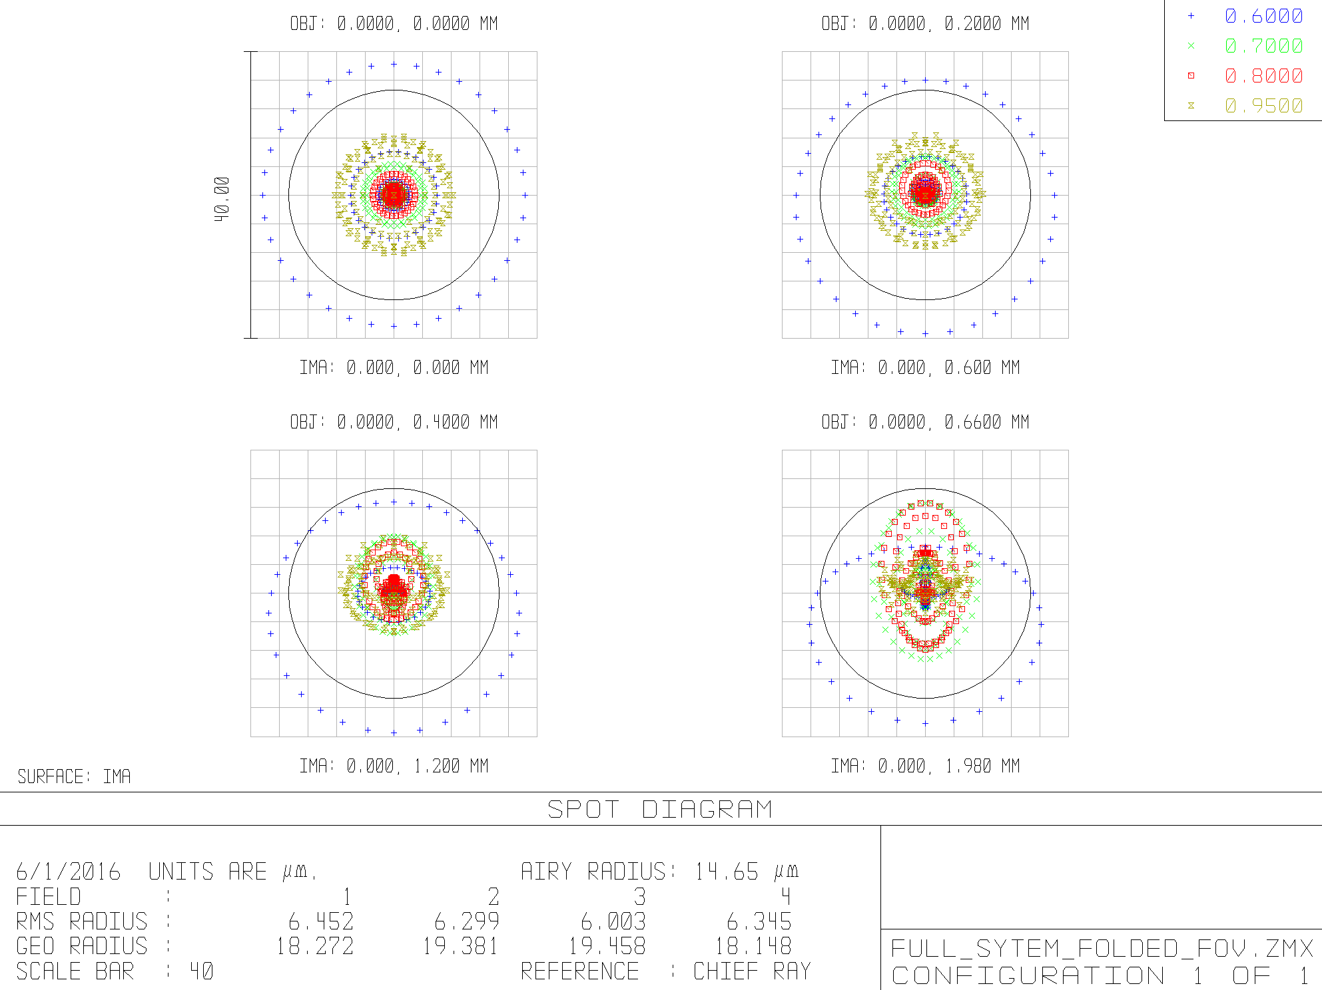
System Optical Performance
OPD vs. FOV
Spot Diagram vs. FOV
Diffraction limit for WL 600 nm
WFE (as-designed): ~ 0.25 wave P-V (~ 0.05 wave RMS )

Slide 11
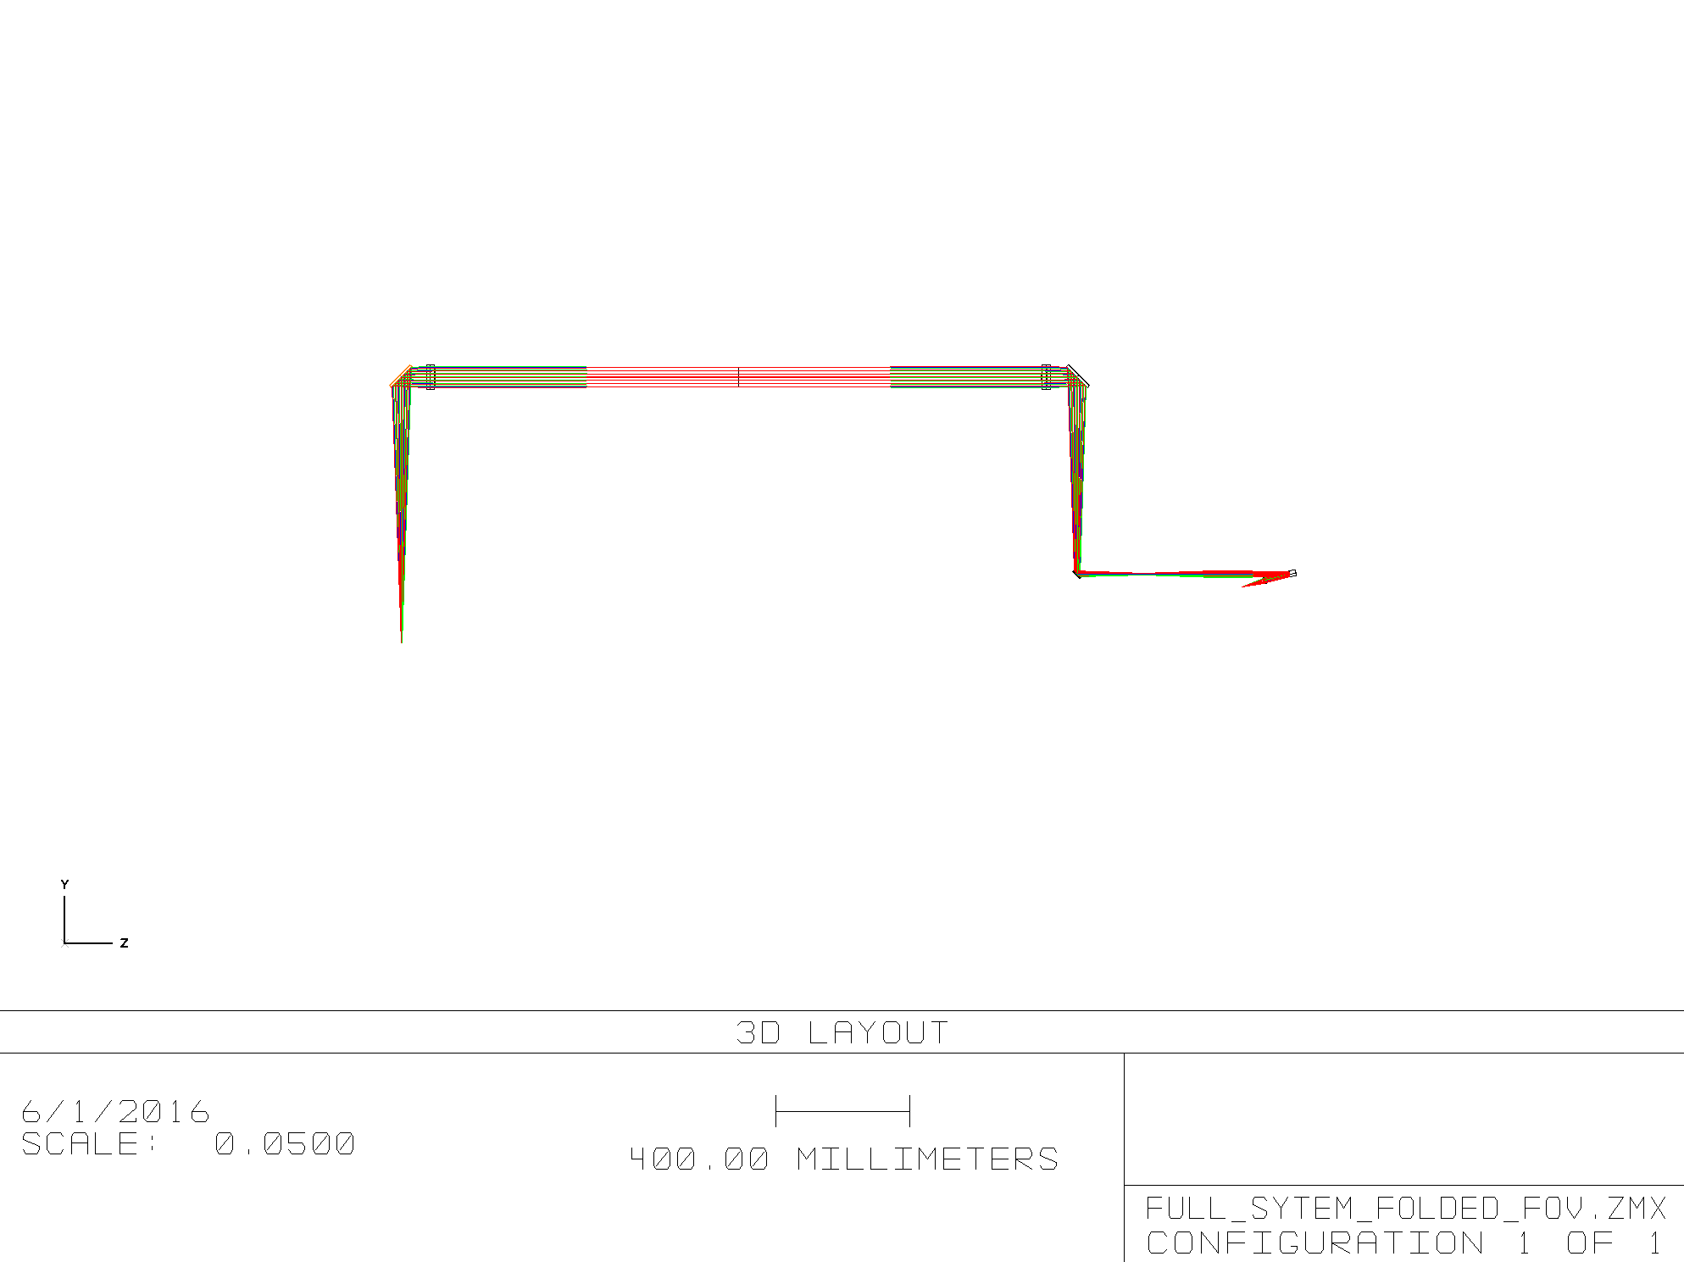
Simulator Optics
Collimator lens: Achromatic F/5 doublet, 15 mm CA
Relay lens 1: Achromatic F/15 doublet, 15 mm CA
Relay lens 2: Achromatic F/15 doublet, 65 mm CA
Cass focusing lens: Achromatic F/15 doublet, 65 mm CA (same as Relay Lens 2)
Cass focusing lens
Pupil 2 (dia. 60 mm)
F/15 Relay
F/15
(telecentric)
Pupil 1 (dia. 14.528 mm,
DM or flat, AOI 7.5 deg.)
F/15 Cass focus lens
Point source
(white light)
F/5 Fiber Collimator

Slide 12
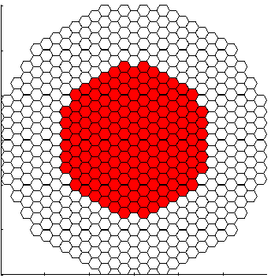
IRIS DM
489 actuators, 163 segments
5um stroke
7.7mm inscribed CA
700um per segment, across corners
+/-4mrad (825”) tilt
7nm RMS surface per segment
Resolution
0.3nm
Open-loop positioning accuracy
5nm rms
Stability
0.5 nm over 15 min
Piston maps one-to-one
Positioning accuracy (5nm) is very close to desired minimum motion of 10nm
Tilt maps 1” on-sky to 1042” at the DM
For the 4mrad option, we could introduce 0.79” of tilt per segment
APS 12cm spot on sky will be 58um at the DM (and 239um at the mask pupil)
Map central portion of telescope onto DM

Slide 13
BB Pupil Scale at DM
On-axis: 2-3um across 600-950nm
1” off-axis: 4-7um across 600-950nm
Compare to 12cm=58um
3-12% shift across wavelengths

Slide 14
Stimulus Mechanical Design

Slide 15
Existing Conditions at the Bench
PIT
SH
3.4m
Collimator
LOWFS
25 arcsec FOV
Fore-optics
APT
Telescope Focus
1 arcmin FOV
4.4m

Slide 16
Proposed Addition to Bench
PIT
Stimulus
SH
3.4m
Collimator
LOWFS
25 arcsec FOV
Fore-optics
APT
Telescope Focus
1 arcmin FOV
4.4m

Slide 17
Stimulus Opto-Mechanical
Pupil Masks
DM
Source
Telescope focus
Stimulus Insertion Stage
Pupil Rotation Stage
DM/Flat Stage
Fiber Source 3-axis stage

Slide 18
Mounting

Slide 19
Stimulus Insertion
Initial fold translates to insert stimulus or allow telescope beam to pass
Aerotech ATS100-200, 8” travel
Final collimating lens will travel with this as well due to space constraints
Possible interference
Change stage orientation
Add block

Slide 20
Sources
Single mode fiber
White light source (Ocean, CVI)
Filters in source before fiber coupling
Laser option for alignment
Manual fiber swap
3 axis stage for tip/tilt/focus image control
Thorlabs MAX343, 4mm travel per axis, 60nm resolution
Implementing seeing size spot not yet determined
Diffuser?

Slide 21
Pupils
DM Pupil
14.5mm full telescope, 7.7mm DM
Translate between DM and 25mm flat
Aerotech ANT-50-95L, 50mm travel, 5nm resolution
Pupil for masks
60mm
Full rotation, X-Y positioning
Aerotech ALAR rotation stage, 100mm CA
Aerotech AVSI125 (lift/y-axis), 25mm travel, 0.5um resolution
Aerotech ATS03005 (x-axis), 50mm travel, 0.12um resolution

Slide 22
List of components

Slide 23
Procurements
Lenses
Glasses were selected from a “preferred” catalog offered by Optimax (a vendor Mike has used for custom lenses)
Iris DM
To be procured by TMT
May have a long lead time and should be ordered soon (flat can be used until DM is available)
Aerotech stages
Can have a long lead time, but this has improved for catalog products
Controller? We’re not planning to use Aerotech for APS, so we should discuss what to do for this

Slide 24
Still to do
Fix X-Y stages for pupil rotator
Re-orient insertion stage and check
Look at imaging from pupil to pupil (rather than image to image)
Source size
Tolerance on pupil magnification

Slide 25
Acknowledgments
The TMT Project gratefully acknowledges the support of the TMT collaborating institutions. They are the Association of Canadian Universities for Research in Astronomy (ACURA), the California Institute of Technology, the University of California, the National Astronomical Observatory of Japan, the National Astronomical Observatories of China and their consortium partners, and the Department of Science and Technology of India and their supported institutes. This work was supported as well by the Gordon and Betty Moore Foundation, the Canada Foundation for Innovation, the Ontario Ministry of Research and Innovation, the National Research Council of Canada, the Natural Sciences and Engineering Research Council of Canada, the British Columbia Knowledge Development Fund, the Association of Universities for Research in Astronomy (AURA) and the U.S. National Science Foundation.

