Slide 1

LinuxChixLA
LinuxChix Los Angeles
Be polite, Be Helpful
LinuxChix is a community for women who like Linux and for anyone who wants to support women in computing. We are an international group of Free Software users and developers, founded in 1999 with the aim of supporting women in technology specifically free and open source technology.
http://linuxchixla.org
Twitter: (Sharon) @smichelleism
Google+: (Jill) https://plus.google.com/106856186739549581615/
Website: (Betty) http://www.99alliancegroup.com/

Slide 2
LinuxChixLA
LinuxChix Los Angeles
Be polite, Be Helpful
UPCOMING EVENTS
Web Server Instation/Cloud Services TBD TBD
- Watch our mailing list and Meetup
page for more information
SoCal Code Camp USC December 2-3
- https://www.socalcodecamp.com/
Southern California Linux Expo (SCALE) Pasadena March 8-11
- https://www.socallinuxexpo.org/

Slide 3




LinuxChixLA / Sponsors
@verizondigital
https://plus.google.com/111016396826991377281
https://www.facebook.com/verizondigital/

Slide 4


LinuxChixLA / Sponsors
https://linuxacademy.com/
High quality Linux & cloud training for teams & individuals.
Twitter: @linuxacademyCOM
Facebook: https://www.facebook.com/linuxacademycom
Google+: +LinuxAcademycom
http://www.oreilly.com/
Twitter: @OReillyMedia
Facebook: https://www.facebook.com/OReilly/
Google+: +oreillymedia

Slide 5
LinuxChixLA / CLI Intro
https://lifehacker.com/5633909/who-needs-a-mouse-learn-to-use-the-command-line-for-almost-anything
Why the Command Line Interface (CLI)?
  Linux is EVERYWHERE
  The Graphical User Interface (GUI) is not (always) available to interaction with remote servers
  You will be presented with a CLI sometime in your career as a Dev.

Slide 6
LinuxChixLA / CLI Intro
http://linuxcommand.org/lc3_lts0010.php
The “Terminal” is not a fatal disease.
  It is a program which allows you to interact with the shell. The default shell on most Linux distributions is BASH (Bourne Again Shell).
  Other shell's include ksh, sh, zsh, etc.
The shell is a program that takes your commands (CLI) and passes them on to the OS for execution.
  Working with the shell in a terminal window is where you'll be headed for the remainder of the this event!

Slide 7
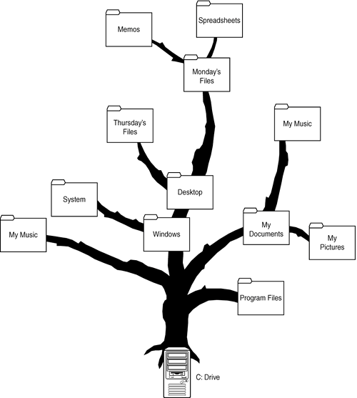
LinuxChixLA / CLI Intro
http://linuxcommand.org/lc3_lts0040.php
Tree Structure Windows

Slide 8
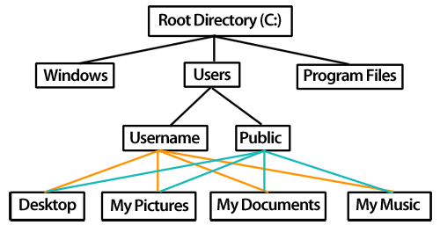
LinuxChixLA / CLI Intro
http://linuxcommand.org/lc3_lts0040.php
Top Down Structure Windows

Slide 9
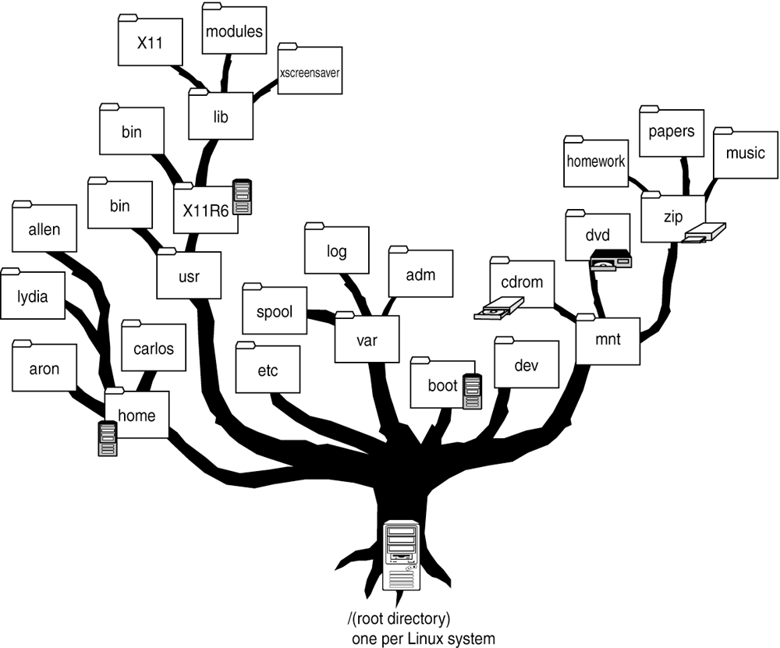
LinuxChixLA / CLI Intro
http://linuxcommand.org/lc3_lts0040.php
Tree Structure Linux

Slide 10
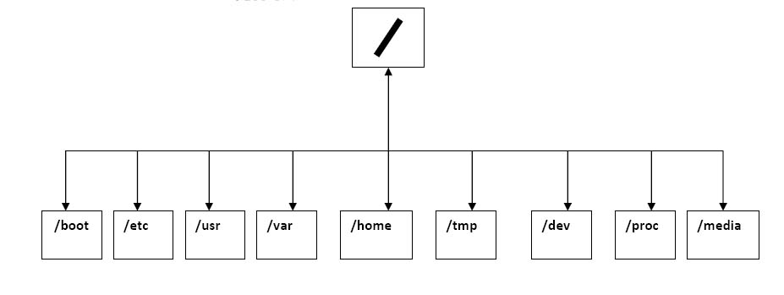
LinuxChixLA / CLI Intro
http://linuxcommand.org/lc3_lts0040.php
Top Down Structure Linux
root filestem
root
user
user

Slide 11
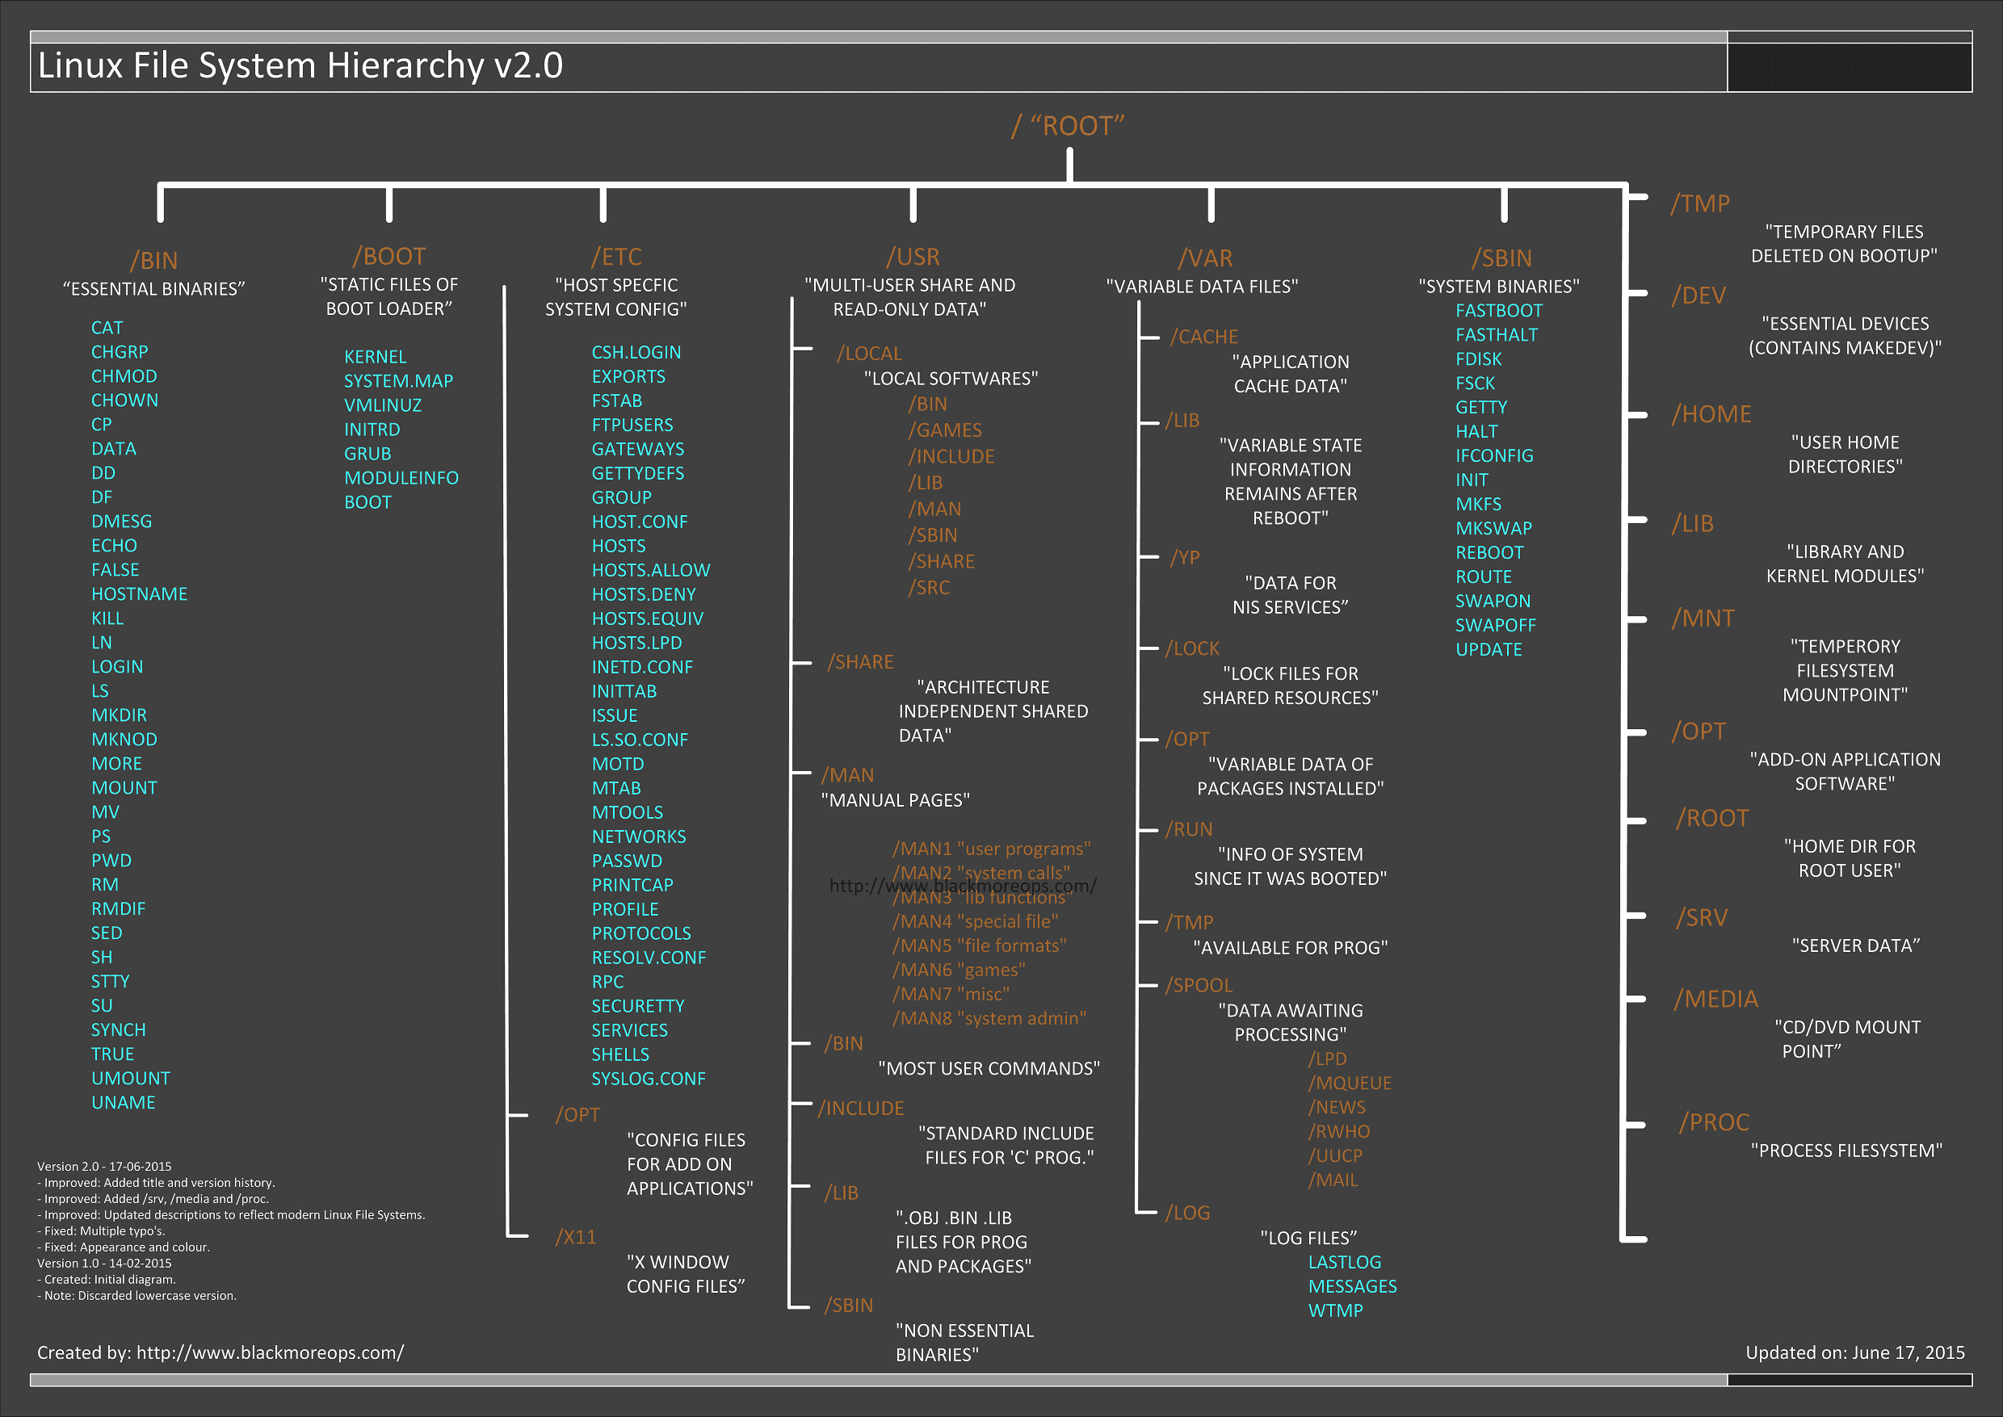
LinuxChixLA / CLI Intro
http://linuxcommand.org/lc3_lts0040.php

Slide 12
LinuxChixLA / CLI Intro
http://linuxcommand.org/lc3_lts0030.php
Looking around
  ls (lists files and directories)
  less <filename> (what's inside)
  file <filename> (what type of file is it)
  clear (clears the terminal)
CASE Matters! Linux commands are case sensitive, i.e., 'LS' is not the same is 'ls'

Slide 13
LinuxChixLA / CLI Intro
http://linuxcommand.org/lc3_lts0030.php
Options to commands
  ls -a
    -a option shows the “hidden” files
  ls -l
    -l option shows long listing
  ls -la
    You can combine options

Slide 14
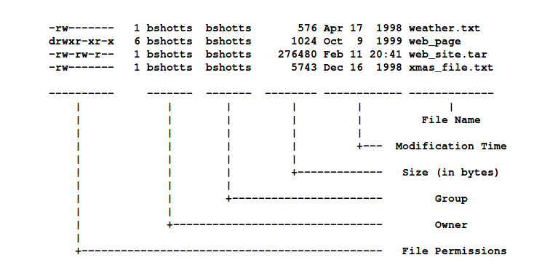
LinuxChixLA / CLI Intro
http://linuxcommand.org/lc3_lts0030.php
Triplet permissions (Owner, Group, Everyone)
  ls -l

Slide 15
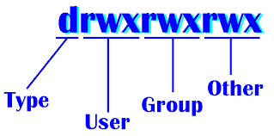
LinuxChixLA / CLI Intro
https://www.linux.com/learn/understanding-linux-file-permissions
https://ryanstutorials.net/linuxtutorial/permissions.php
Triplet permissions (User, Group, Others)
  UGO
RWX
  Read Write eXecute

Slide 16
LinuxChixLA / CLI Intro
https://unix.stackexchange.com/questions/19451/difference-between-help-info-and-man-command
Getting more information
  man (Manual)
    man <command>
    man -k
    apropos
  Help
    <command> --help or -h
  Info
    info <command>

Slide 17
LinuxChixLA / CLI Intro
http://linuxcommand.org/lc3_lts0020.php
Getting Around
  cd <directory> (changes to a new directories)
    the . directory (current)
    the .. directory (parent)
    always go home with cd or cd ~
    return from whence you came with cd -
  pwd (print working directory, “Where am I?”)

Slide 18
LinuxChixLA / CLI Intro
http://linuxcommand.org/lc3_lts0020.php
Absolute vs. Relative
  ls /etc vs. ls ../../etc
root filestem
root
user
user

Slide 19
LinuxChixLA / CLI Intro
http://linuxcommand.org/lc3_lts0050.php
Changing things up
  cp (copy files and directories)
    cp <filename> <filename>
    cp -i
    cp -r
  rm (removes files)
    rm <filename>
  mv (moves, aka renames, files and directories)
    mv <filename> <filename>
rm -r -f (DANGER WILL ROBINSON!)

Slide 20
LinuxChixLA / CLI Intro
Changing things up
  rmdir (removes EMPTY directories)
    rmdir -p
  mkdir (makes directories)
    mkdir -p
rm -r -f (DANGER WILL ROBINSON!)

Slide 21
LinuxChixLA / CLI Intro
https://www.tecmint.com/13-basic-cat-command-examples-in-linux/
Looking Inside
  less <filename> (file pager)
  cat <filename> (concatenate)
    cat -n
    cat > test.txt
    cat >> test.txt
  head
  tail

Slide 22
LinuxChixLA / CLI Intro
http://linuxcommand.org/lc3_lts0090.php
Permissions Redux
  whoami
  su (Super user)
  sudo (Super user Do)

Slide 23
LinuxChixLA / CLI Intro
http://linuxcommand.org/lc3_lts0090.php
Permissions Redux
  chmod (CHange, or modify, a file/directory access permissions)
    chmod o+w <filename/directory>
    gives write permissions to Others
  chown (CHange file/directory owner)
    chown <from> <to> <filename/directory>
  chgrp (CHange file/directory group)
    chgrp <from> <to> <filename/directory>

