Slide 1

Teach Your Kid to Code
Justin Michelotti
Steve Michelotti
http://geekswithblogs.net/michelotti

Slide 2
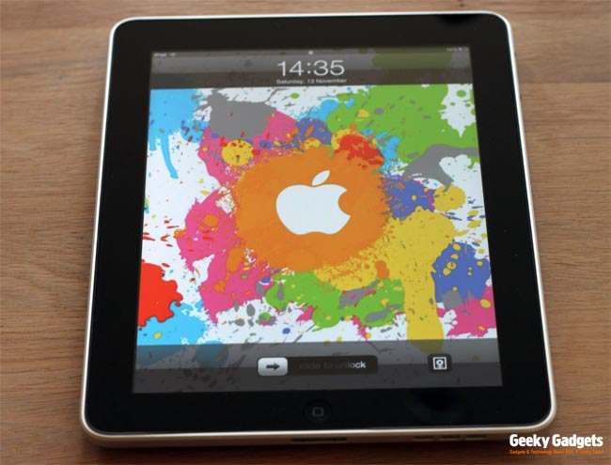
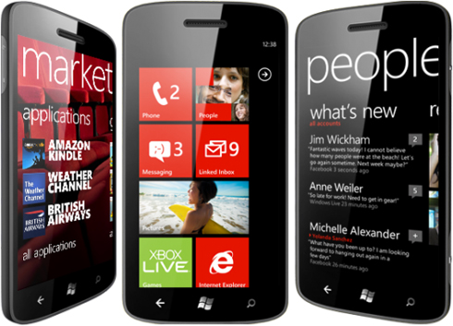
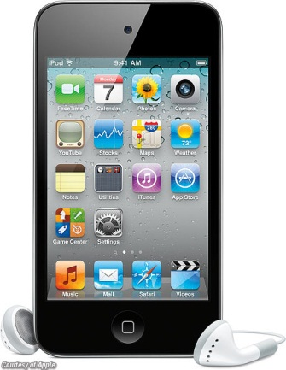

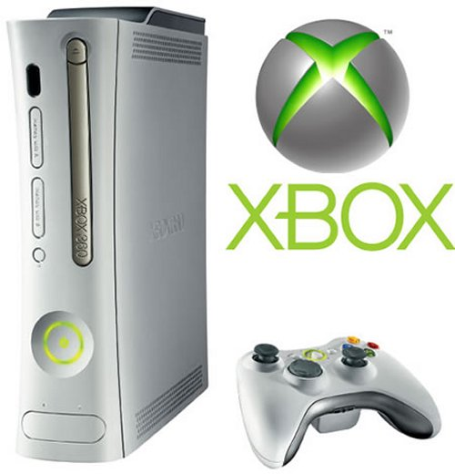
Have you ever used these?

Slide 3
What is my job?
Software Developer
Software Engineer
Software Architect
Computer Programmer

Slide 4
Programming
Telling a computer what to do
Computer MUST follow your instructions

Slide 5
How?
We often program with “things”
These “things” have “actions” and/or “characteristics”

Slide 6
Demo
Introduction

Slide 7
What you just saw…
“things” and “actions”
Loops
Commands
Re-usable Code
Events

Slide 8
Going further…
Sometimes we need to store information
We use variables

Slide 9
Going further…
Sometimes we need to make decisions
We use IF statements

Slide 10
Demo
Small Basic Calculator

Slide 11
What you just saw…
Variables
IF statements

Slide 12
Demo
Win8 Calculator & Paddle Game

Slide 13
Kodu
Kodu enables creation of games in 3D worlds!
Programming is done with a visual control tile instead of textual code
Same programming concepts apply (e.g., logic with “when” and “do”)
Games run on PC or XBox

Slide 14
Demo
Kodu Intro

Slide 15
What you just saw…
Characters
Movements
Scoring
Worlds
Interaction
Sounds
Pages

Slide 16
What else does Kodu have?
Movement with Paths
Advanced Scoring
Power Ups
…and more!
Clones and Creatables

Slide 17
Demo
Kodu Paths and Creatables

Slide 18
What we covered
Variables
IF statements
Events
Functions
Commands
Math Calculations
Characters
Game interaction
Pages
Paths
Control Flow
Loops
Scoring
Assignments
Sounds
Character Movement

Slide 19
Do you have to be an adult?
No!

Slide 20
Additional Resources
Small Basic
http://smallbasic.com
http://msdn.microsoft.com/en-us/beginner/ff384126.aspx
Kudo
http://research.microsoft.com/en-us/projects/kodu/
http://fuse.microsoft.com/page/kodu
http://www.teachingkidsprogramming.org/

