Slide 1
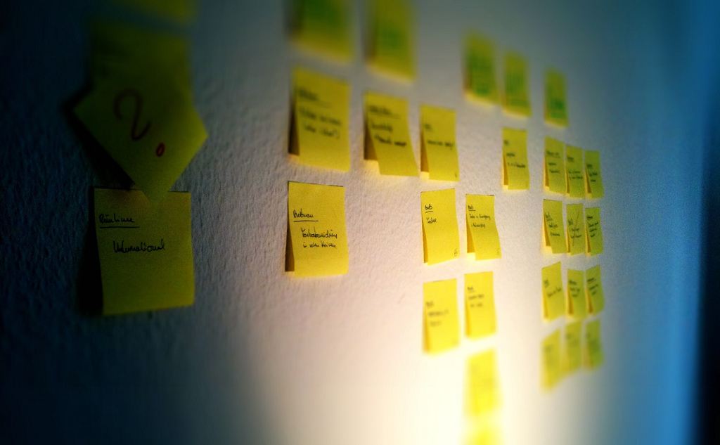

Smidig 2012
5-6. november
Radisson Blu Plaza Hotel, Oslo
http://smidig2012.no
http://twitter.com/smidig
http://facebook.com/smidigkonferansen
http://www.flickr.com/photos/blambar/5392387797/

