Slide 1
Model Checking of PLTL
王兆蕾 17214688
李圣辉 17214644
陶久成 17214680
林奇峰 17214656
陈子轩 17214595

Slide 2
Outline
ω-regular expressions
ω-regular expression and Büchi Automaton
Generating Automata
How to construct automata A and B
State Explosion Problem

Slide 3
ω-regular expressions
王兆蕾
Grace
17214688

Slide 4
ω-regular expressions
Use to describe the form of executions satisfying φ or not satisfying φ, especially for infinite positions.
The extension of regular expression.
Symbols:
+ represent union (the possible choice).
* represent an arbitrary but finite number of repetitions.
ω means an infinite number of repetitions. New symbols

Slide 5
ω-regular expressions
Example : the formula
The executions satisfy ф have the form :
executions don’t satisfy ф have the form :
Model checking PLTL associate with each PLTL formula φ an ω-regular expression ε, describing the form imposed on an execution by its satisfaction of φ. The "does A |= ф ?" question then reduces to a "are all the executions of A of the form described by ε ?"question.

Slide 6
ω-regular expression and Büchi Automaton
Li Shenghui 17214644 李圣辉

Slide 7
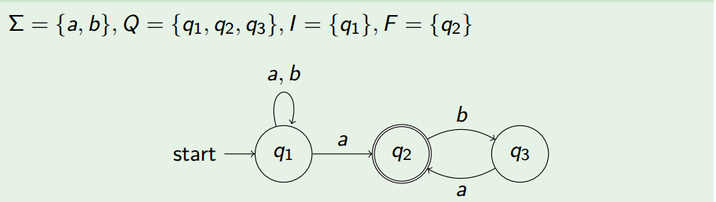
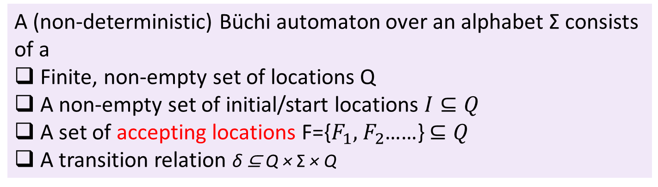
Büchi Automaton
Definition (Büchi automaton)
A (non-deterministic) Büchi automaton over an alphabet Σ consists of a
Finite, non-empty set of locations Q
A non-empty set of initial/start locations $I⊆Q$
A set of accepting locations F={$F_{1},$ $F_{2}$……} $⊆Q$
A transition relation δ ⊆ Q × Σ × Q
Example

Slide 8
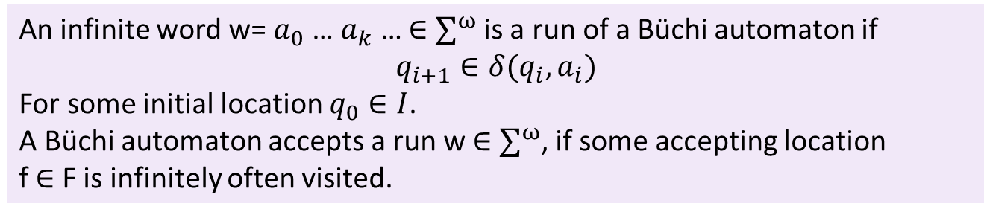
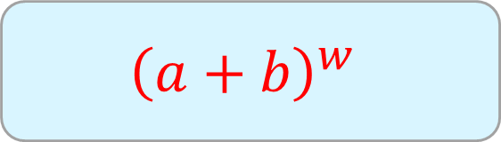
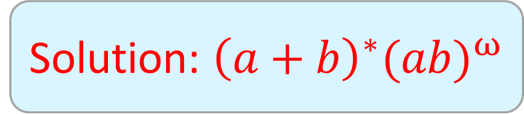
Acceptance
Definition (Run and Accepted Run)
An infinite word w= $a_{0}$… $a_{k}$ … $∈$ $∑^{ω}$ is a run of a Büchi automaton if
$$q_{i+1}∈δ(q_{i},a_{i})$$
For some initial location $q_{0}∈I$.
A Büchi automaton accepts a run w $∈$ $∑^{ω}$, if some accepting location
f $∈$ F is infinitely often visited.
Example: which language is accepted?
$${\left(a+b\right)}^{w}$$
Solution: ${\left(a+b\right)}^{∗}{(ab)}^{ω}$

Slide 9
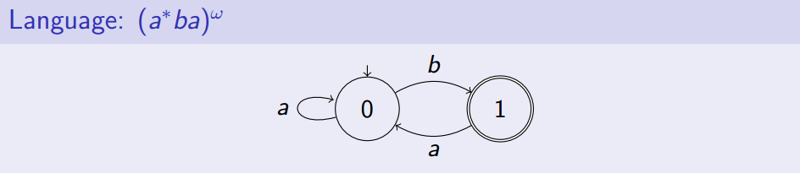
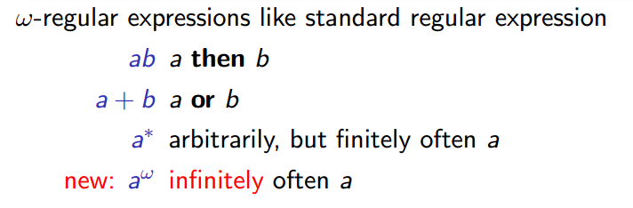
Examples

Slide 10
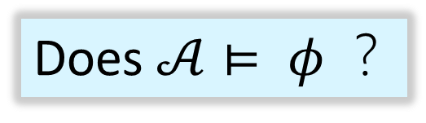
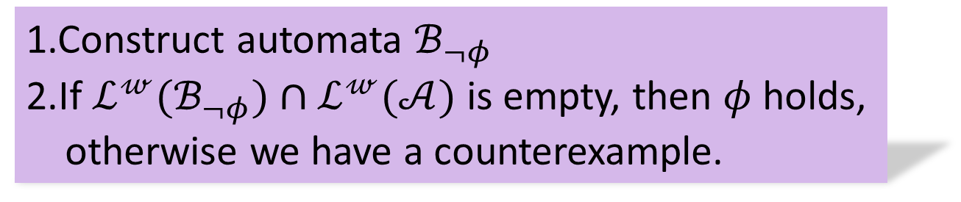
Basic principle
Does $𝒜⊨ φ$ ？
1.Construct automata $ℬ_{¬φ}$
2.If $ℒ^{𝓌}(ℬ_{¬φ})∩$ $ℒ^{𝓌}(𝒜)$ is empty, then $φ$ holds,
otherwise we have a counterexample.

Slide 11
Generating Automata 17214680 Tao
Approach
PLTL formula rewriting
Core translation

Slide 12
Generating Automata 17214680 Tao
PLTL formula rewriting
Negation normal form
¬G ϕ = F ¬ϕ
¬¬ϕ = ϕ
¬F ϕ = G ¬ϕ
¬(ϕ U ψ) = (¬ϕ) V (¬ψ)
¬(ϕ V ψ) = (¬ϕ) U (¬ψ)
Release operator(R or V)
ϕ V ψ

Slide 13
Generating Automata 17214680 Tao
PLTL formula rewriting
Some rules
α ∧β=¬(¬αV¬β) α→β=¬αVβ
α ↔β=(¬αVβ) ∧ =(αV¬β) αRβ=¬(¬αU¬β)
Gα=falseRα Fα=trueUα
Example
Φ = (A U B)→F C
=¬(A U B)V(F C) = ¬(A U B)V(True U C)
= ((¬A)R(¬B))V(True U C)

Slide 14
Generating Automata 17214680 Tao
Core Translation
Generalized Büchi Automata
4-tuple ⟨S, I, δ, F ⟩
S is a finite set of states
I ⊆ S is a set of initial states
δ ⊆ S × S is a transition relation
F = {F₁, …, F_{n}} ⊆ 2^{S} is a set of sets of accepting states

Slide 15
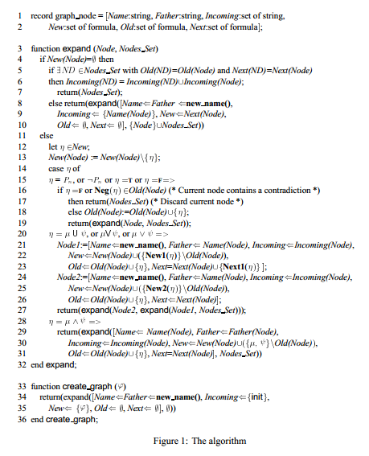
Generating Automata 17214680 Tao
Core Translation
Node
Old : past properties
New : present properties
Next : future properties
Incoming : r in it, there is an
edge form r to current state
q.

Slide 16
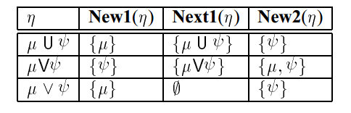
Generating Automata 17214680 Tao
Core Translation
Expansion
Select a formula from the New field
If it is a literal, add it to the Old field
Otherwise
ϕ U ψ ≡ ψ ∨ (ϕ ∧ X(ϕ U ψ))
ϕ V ψ ≡ ψ ∧ (ϕ ∨ X(ϕ V ψ))

Slide 17
Generating Automata 17214680 Tao
Core Translation
F p
Old:{}
New:{T U p}
Next:{}
(T U p)
T U p = p ∨ (T ∧ X(T U p))
Old:{T U p}
New:{T}
Next:{T U p}
Old_1:{T U p}
New_1:{T}
Next_1:{T U p}
Old:{T U p}
New:{p}
Next:{}
Old_2:{T U p}
New_2:{p}
Next_2:{}

Slide 18
Generating Automata 17214680 Tao
Core Translation
Recursion
Expand new sub-formulas
Reclaim expanded node q
Reference
Gerth R, Peled D, Vardi M Y, et al. Simple on-the-fly automatic verification of linear temporal logic[C]// Fifteenth Ifip Wg6.1 International Symposium on Protocol Specification, Testing and Verification Xv. Chapman & Hall, Ltd. 1995:3-18.
Vardi M Y. An automata-theoretic approach to linear temporal logic[C]// Viii Banff Higher Order Workshop Conference on Logics for Concurrency : Structure Versus Automata: Structure Versus Automata. Springer-Verlag New York, Inc. 1996:238-266.

Slide 19
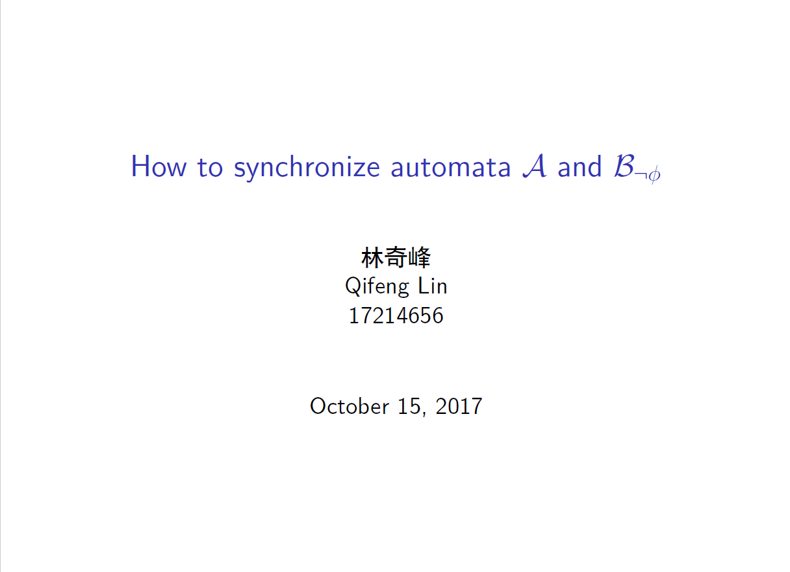

Slide 20
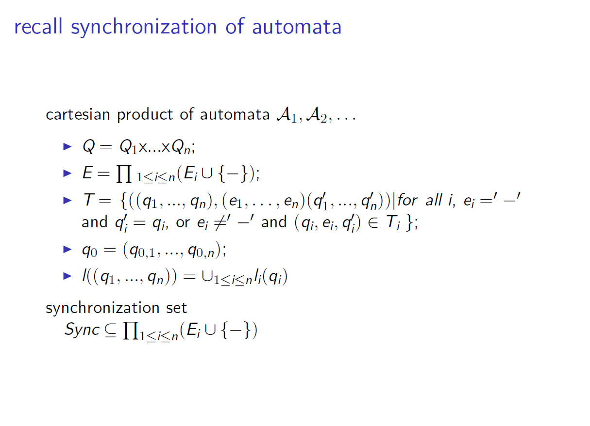

Slide 21
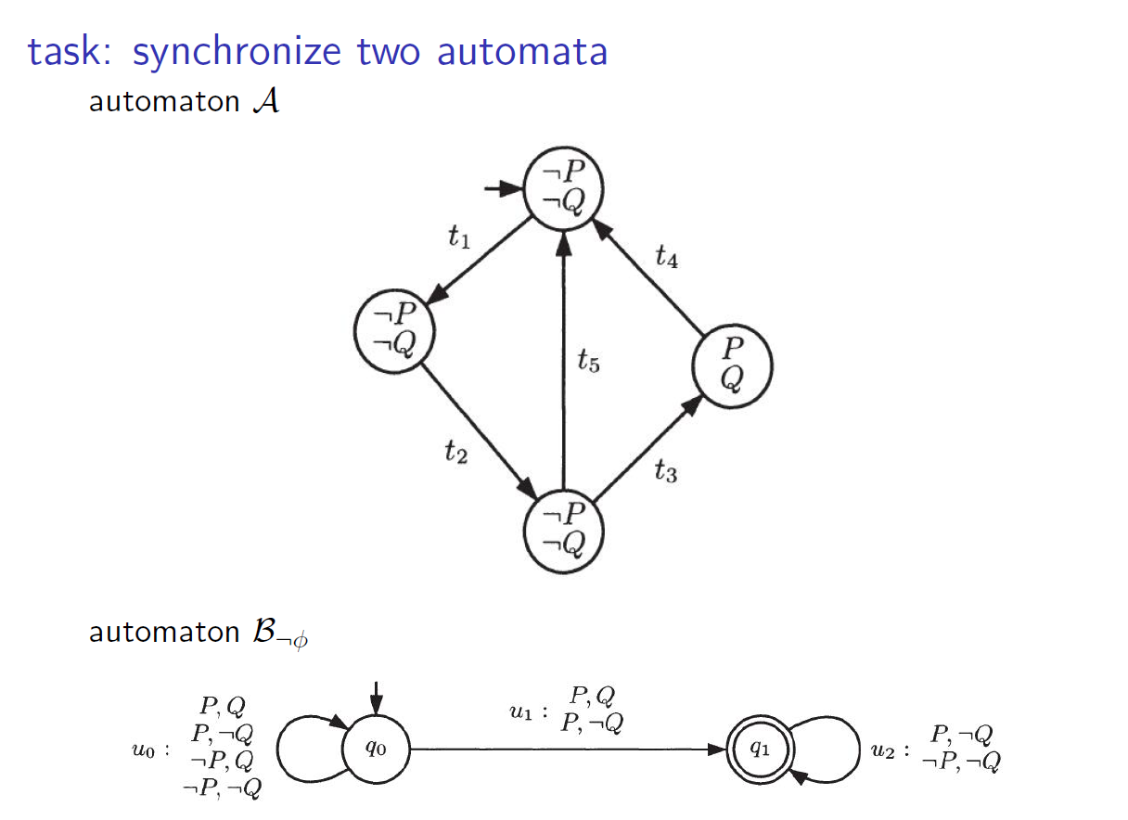


Slide 22
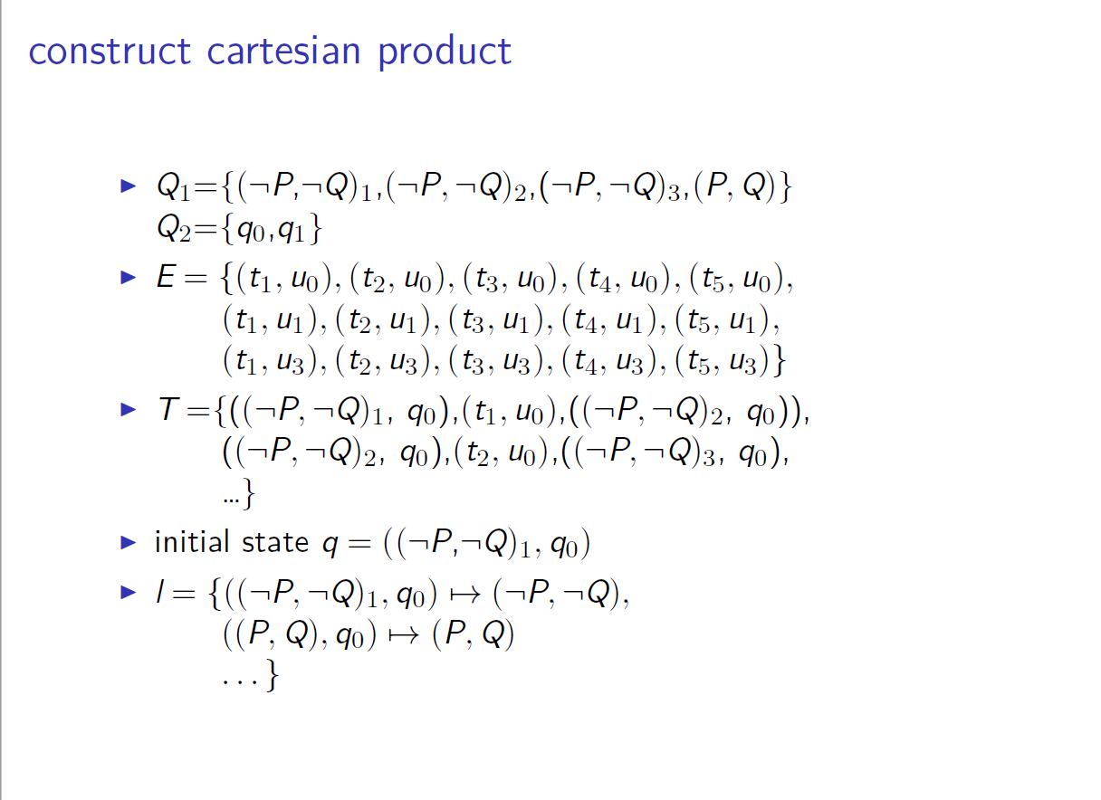

Slide 23
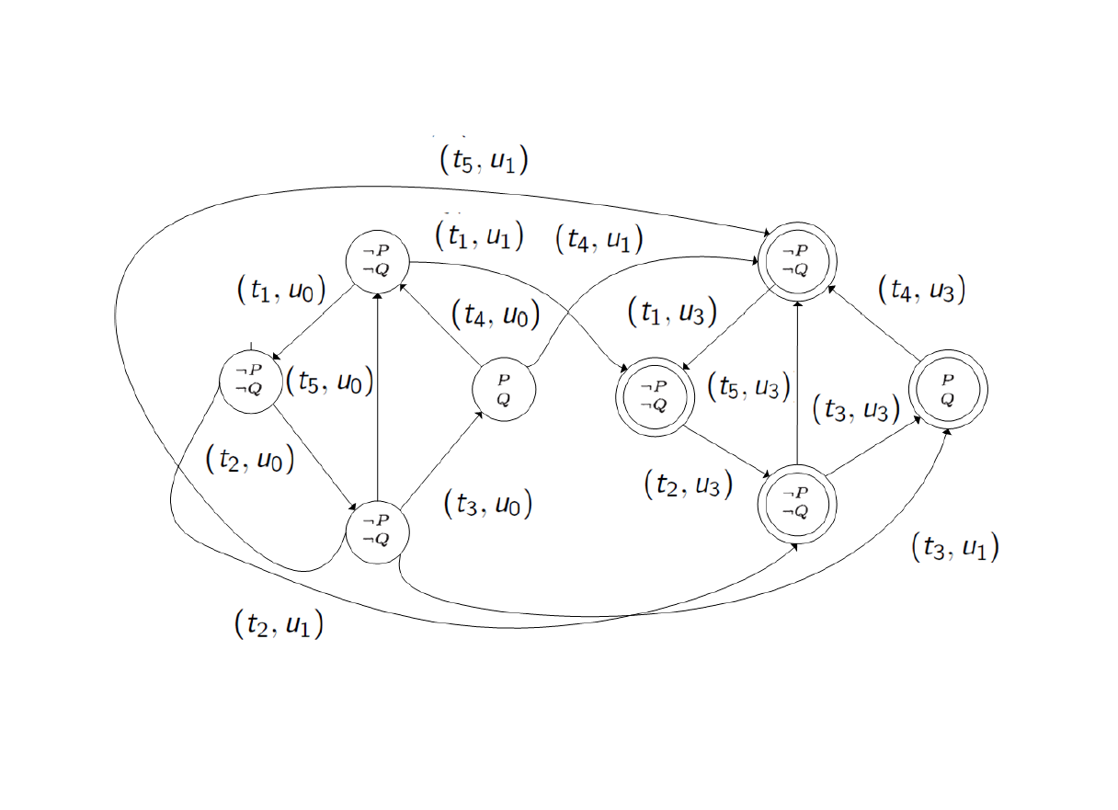

Slide 24
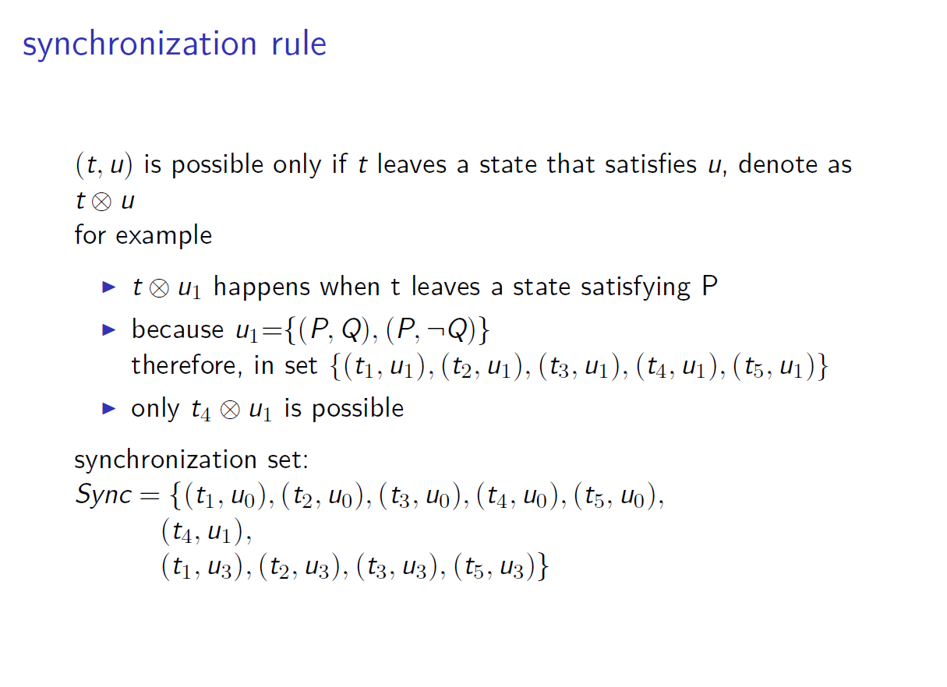
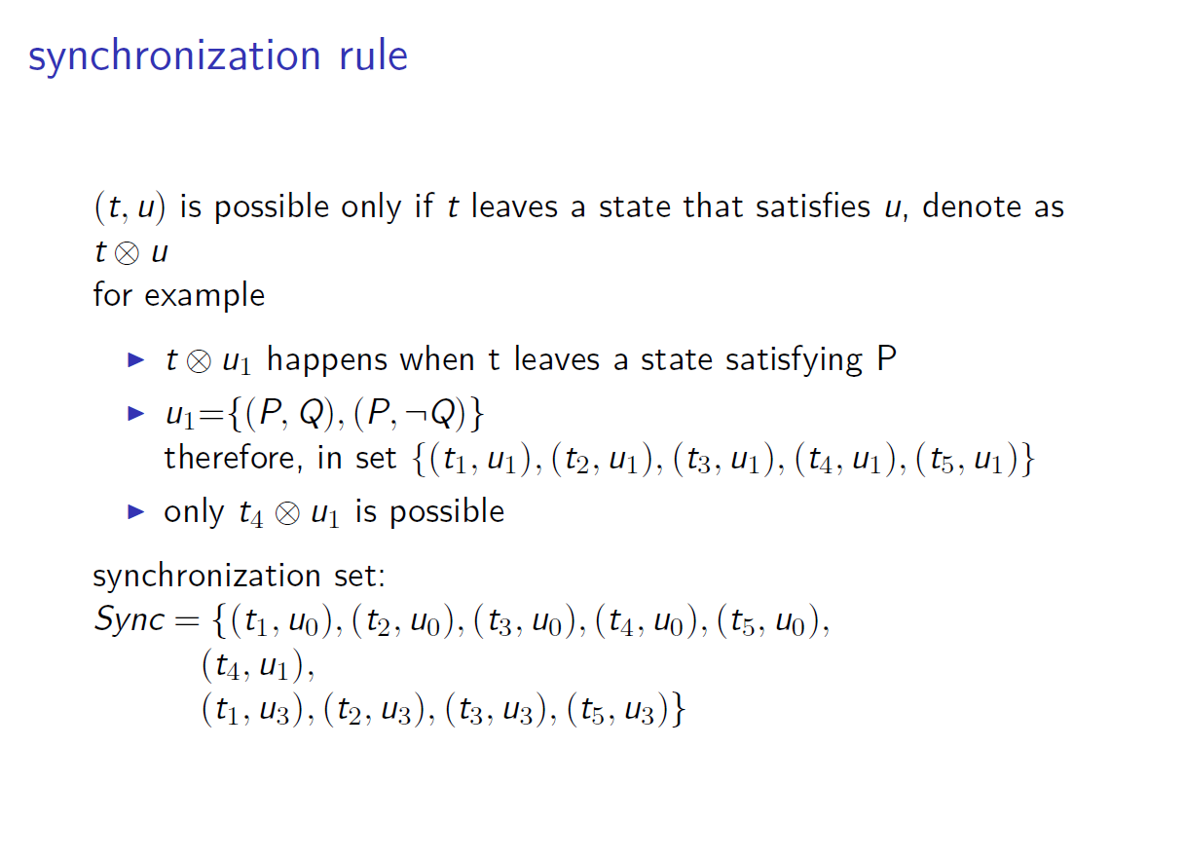

Slide 25
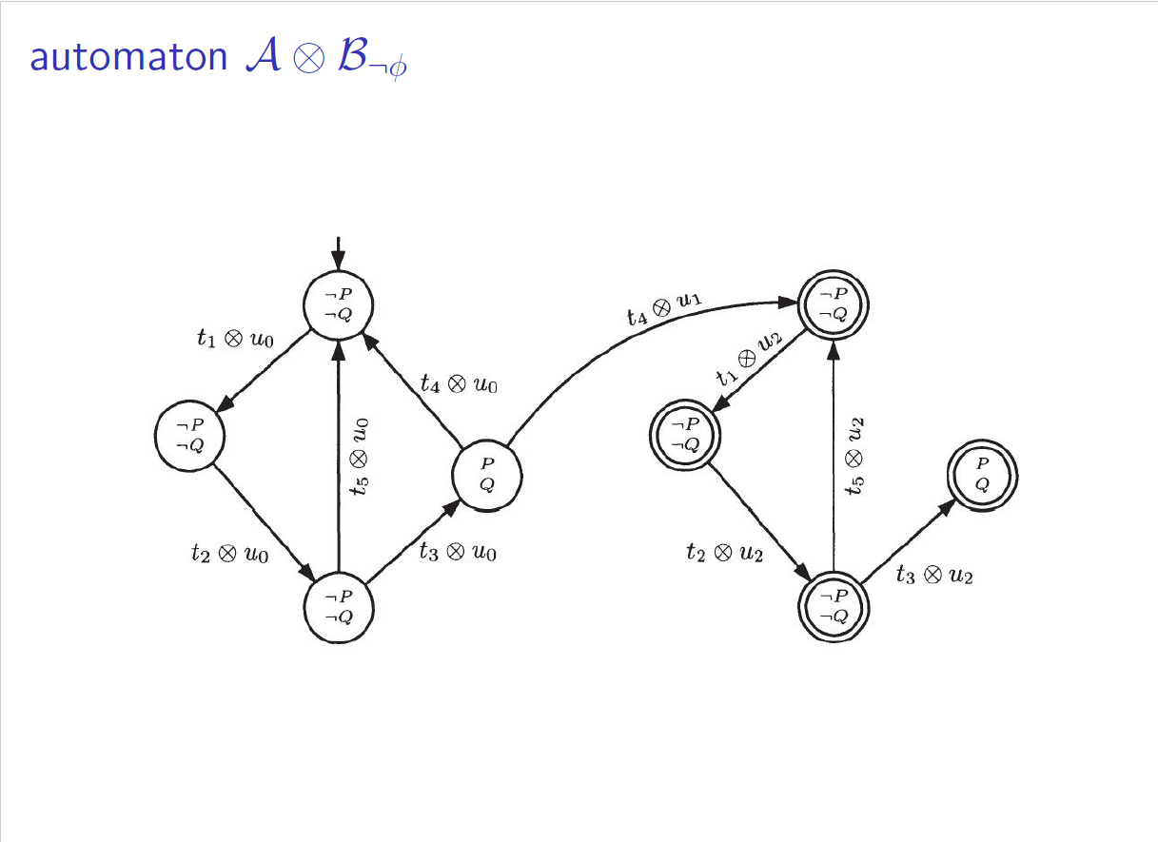

Slide 26
State Explosion Problem
Software Engineering
Chen Zixuan
17214595

Slide 27
What is the state explosion problem?
Model checking is an algorithm that checks all reachable states and loops exhaustively in an explicit construction of the automaton. But in practice, the number of states of almost any automata of interest is huge, especially when an automaton is built by some synchronizing components.
Since a model has numerous states, it is impossible to check all its states exhaustively, the state explosion problem occurs.

Slide 28
The size of automata
The size of automata depends on the values of its variables and its synchronous components.
For each automaton A_{i}, the size of A_{i}, which is denoted as |A_{i}| is related to the values of its variables. For example, an automaton has m control states and n merely boolean state variables, the result of |A_{i}| is equal to m×2^{n}.
The number of states of the automata A (as A is built by synchronizing the components A₁, A₂,, A_{n}) is in the order of |A₁|×|A₂|××|A_{n}|

Slide 29
Some unexpected situation
Though the book gives some methods to figure out the value of the size of automata, but in practice some unexpected situations still occur so that such methods don’t work.
For each automaton A_{i}, when it requires global states to record values that are not an explicit range and type so that the automaton would have infinite number of states.
To the automata A, if it is built by asynchronous components (A₁,A₂,,A_{n}), the size of A isn’t in the order of |A₁|×|A₂|××|A_{n}|. Because their states are changed asynchronously, we don’t know what time do an automaton A_{i} change its state (though we can use some constraints such as promise function in javascript to make them change its state synchronously).

Slide 30
How to alleviate state explosion problem
There are some methods to reduce state space in order to alleviate state explosion problem.
Transparent construction-time reduction and Guided construction-time reduction. Both of them construct an equivalent reduced state space instead of full state space.
Preprocessing the model. State explosion can be alleviated also by modifying the system description before starting the construction of the state space, or by taking the needs of state space methods into account already when modelling the system.
Packed state spaces. A packed state space is a nonstandard, dense way of storing the state space or a part of it. The packed state space may contain full or incomplete information on the interleaved (or even true concurrency) behavior of the system. The symmetry method, the unfolding method, and BDDs are examples of packed state space methods that preserve full information.

Slide 31
Thank You

