Slide 1
Chapter 14 (Lec 1)
Operational Amplifier (Op-Amps)

Slide 2
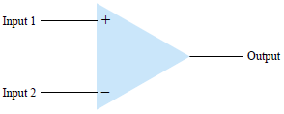
Introduction
Op amps are very high gain differential amplifier.
Has high input impedance.
Low output impedance.
Useage:
Voltage amplitude changes.
Oscillators, filter circuits, etc.
Contains a number of diff. amplifiers to achieve a high voltage gain.
The figure shows a basic op-amp with 2 inputs and 1 output.
Each input results in the same or an opposite polarity output, depending on the input type (+ or - ve)

Slide 3
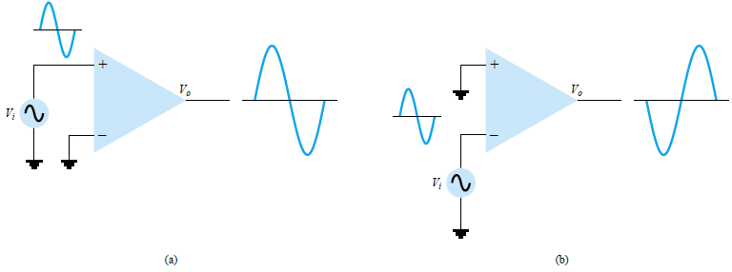
Single-ended Input
When the input signal is connected to one input while the other input is connected to the ground.

Slide 4
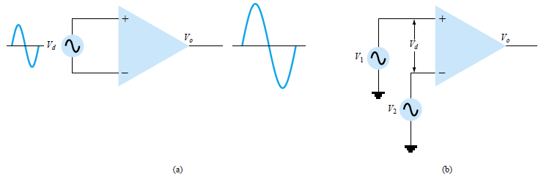

Double-ended (differential) Input
In the figure below, $v_{d}$ is applied at both the input terminals, with the resulting amplified output in phase with that applied between the + and the – ve terminals. (b) has input $v_{d}$ which is equal to $v_{1}−v_{2}$ where these 2 signals are different.

Slide 5
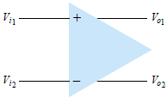
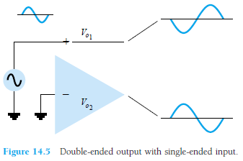
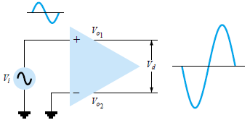
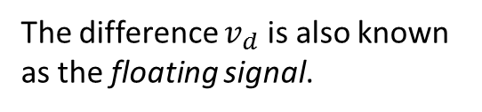
Double ended output
An input applied to either input will result in outputs from both outputs. These outputs are always opposite in polarity.
The difference $v_{d}$ is also known as the floating signal.

Slide 6
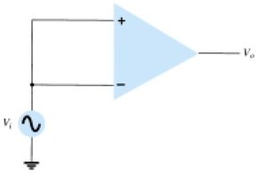
Common Mode Operation (CMO)
When two inputs are supplied with the same voltage, the result is a common mode operation. The 2 inputs are equally amplified, and at the output, they cancel each other and becomes 0 v. i.e.- a very small output voltage will be the resultant.

Slide 7
Common Mode Rejection (CMR)
A significant feature of a differential connection is that the signal which are opposite at the inputs are highly amplified, while those which are common to the two inputs are slightly amplified. i.e.- overall, it amplifies the difference signal while rejecting the common signals at he two inputs. Since noise (any unwanted input signal) is generally common to both inputs, the differential connection tends to provide attenuation of this unwanted input while providing an amplified output of the difference signal applied to the inputs. This operational feature is known as the common-mode rejection.

Slide 8
Differential and CM Operation
Objective of a differential circuit, as in an Op-Amp is the greatly amplify the signal that are opposite at the input terminals and only slightly amplify the signals that are common to both inputs.
An Op-Amp provides an output component that is due to the amplification of the difference of the signals at the input and a component due to the signals common to both inputs (+ & -).
Since amplification of the opposite signals > than common input signals, the circuit provides a CM mode rejection defined by a numerical value and is known as CMRR.

Slide 9
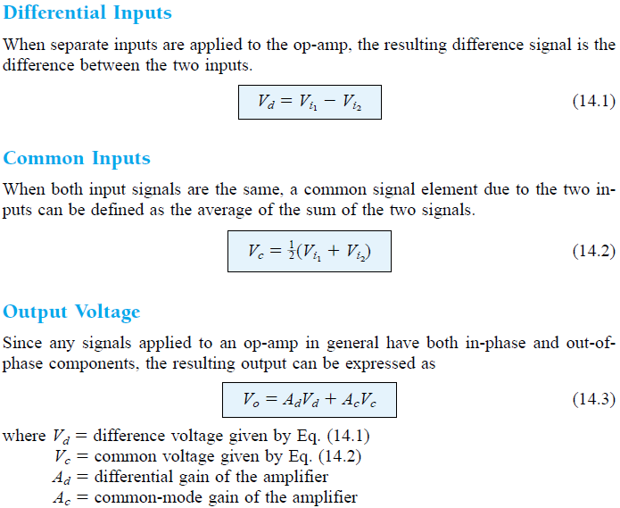

Slide 10
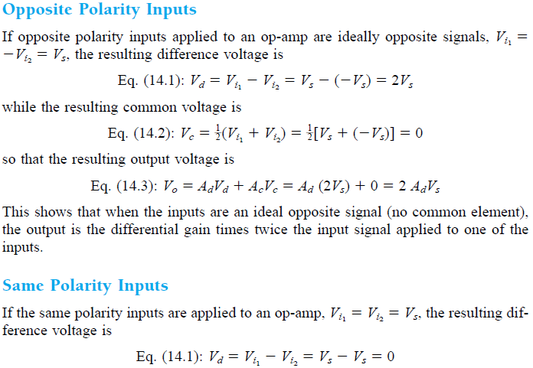

Slide 11
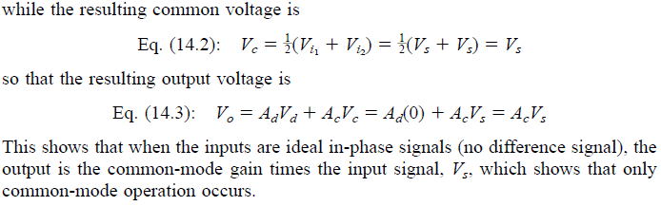

Slide 12
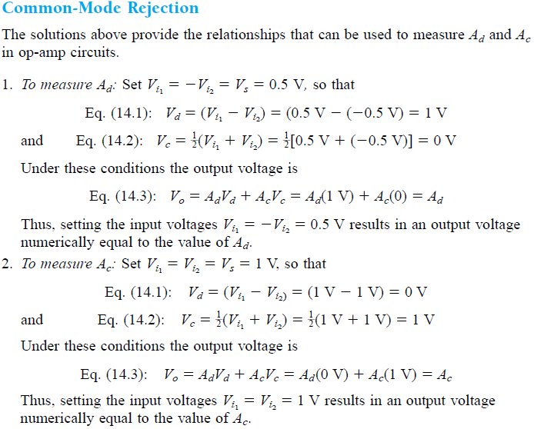



CMR

Slide 13
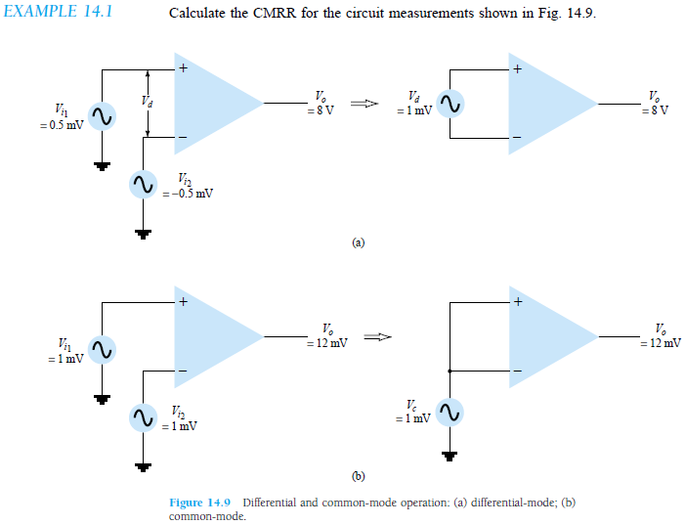
Class Example 14.1

Slide 14
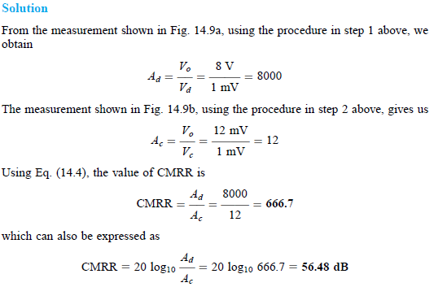

Slide 15
Op-Amp Basics
High gain amplifier
Very high input impedance (in Mega Ohms).
Very low output impedance (in 100 Ohms).
The basic circuit is made using a differential amplifier having 2 inputs.
Typically have one output.
+ve input produces an output that is in phase with the applied signal.
-ve input produces an opposite polarity output the signal applied.
The AC equivalent circuit is shown in the next slide.
Used for constant gain multiplier.

Slide 16
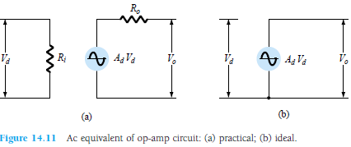
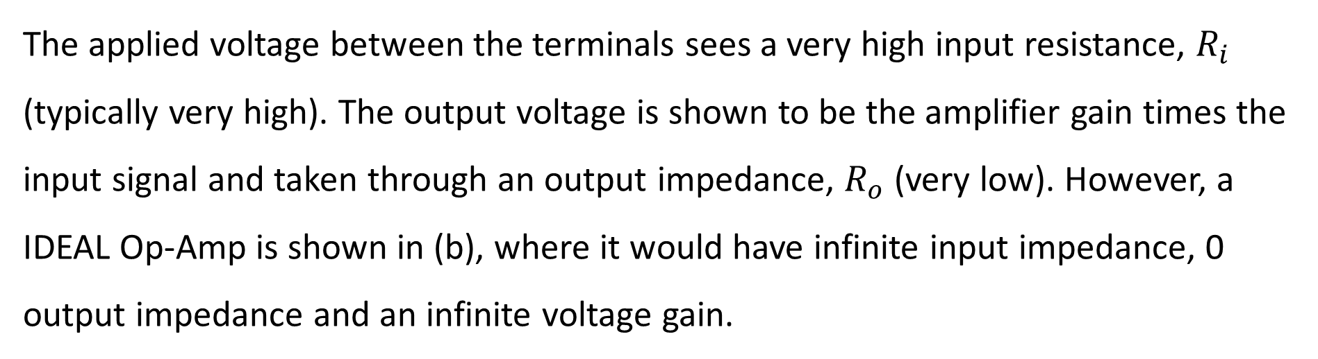
The applied voltage between the terminals sees a very high input resistance, $R_{i}$ (typically very high). The output voltage is shown to be the amplifier gain times the input signal and taken through an output impedance, $R_{o}$ (very low). However, a IDEAL Op-Amp is shown in (b), where it would have infinite input impedance, 0 output impedance and an infinite voltage gain.

Slide 17
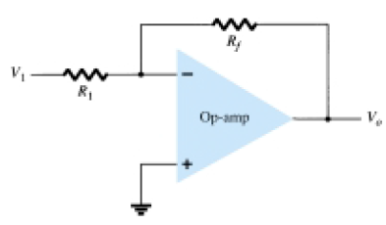

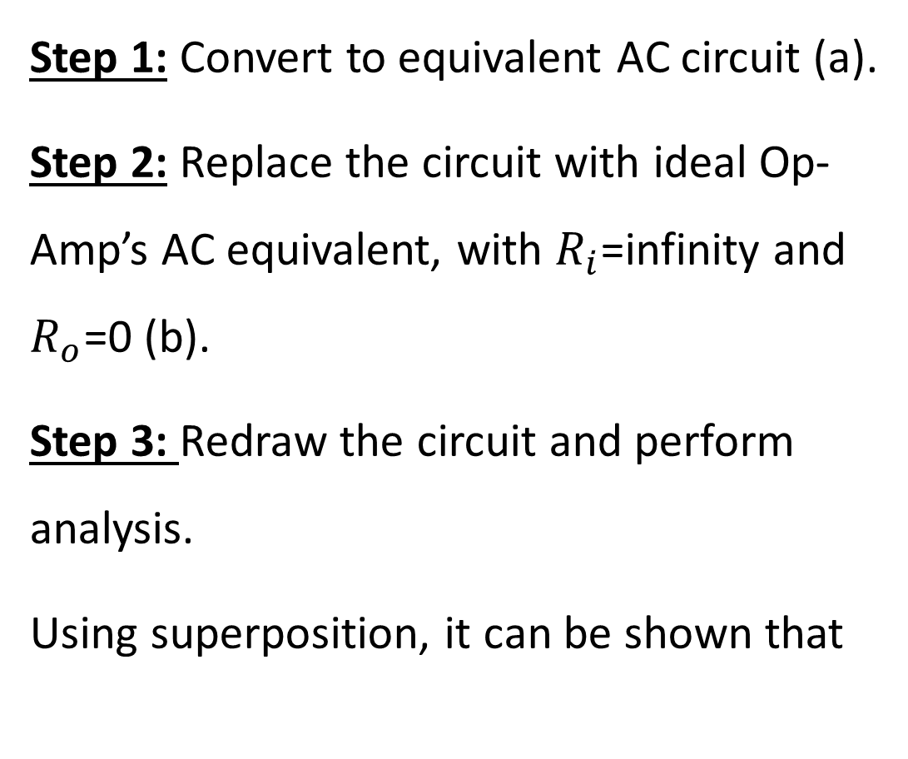
3 Steps for Op-Amp analysis (making)
Step 1: Convert to equivalent AC circuit (a).
Step 2: Replace the circuit with ideal Op-Amp’s AC equivalent, with $R_{i}$=infinity and $R_{o}$=0 (b).
Step 3: Redraw the circuit and perform analysis.
Using superposition, it can be shown that

Slide 18
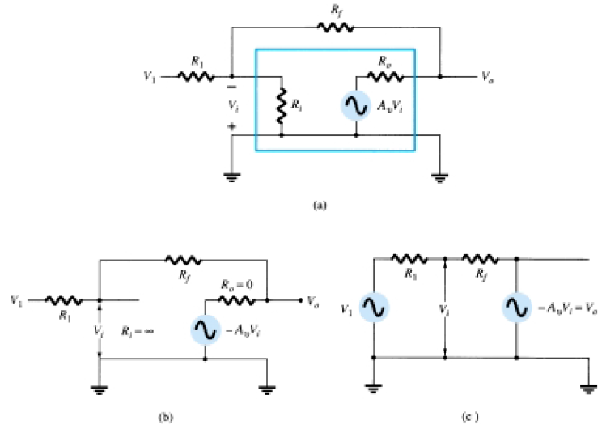

Slide 19



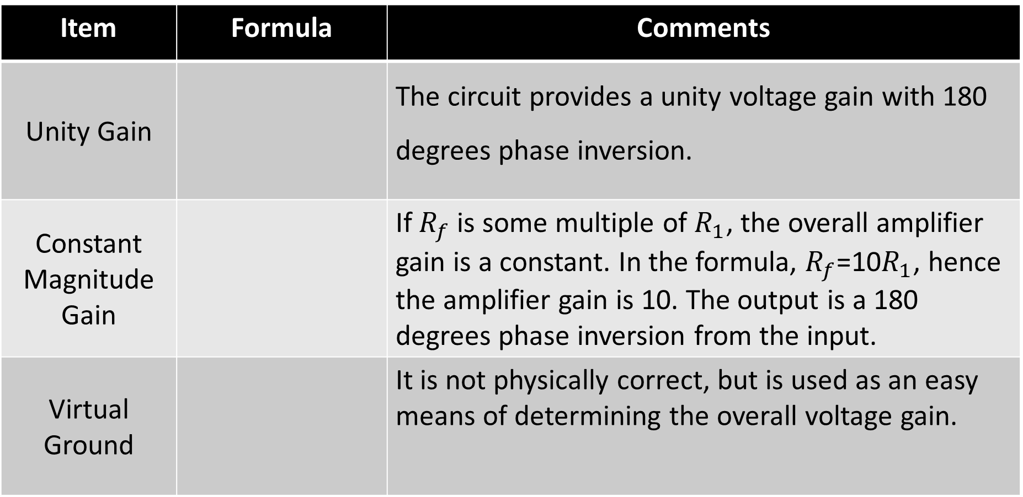
Item | Formula | Comments
Unity Gain |  | The circuit provides a unity voltage gain with 180 degrees phase inversion.
Constant Magnitude Gain |  | If $R_{f}$ is some multiple of $R_{1}$, the overall amplifier gain is a constant. In the formula, $R_{f}$=10$R_{1}$, hence the amplifier gain is 10. The output is a 180 degrees phase inversion from the input.
Virtual Ground |  | It is not physically correct, but is used as an easy means of determining the overall voltage gain.

Slide 20
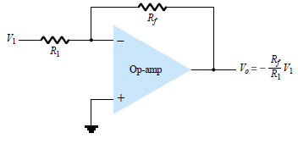
Practical Op-Amp Circuits
Inverting Amplifier :
Output is the product of a fixed gain with input. Also, it is iverted.

Slide 21


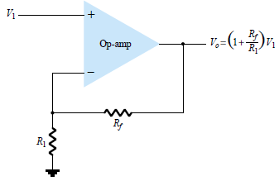
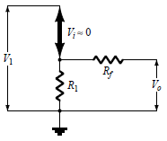
Practical Op-Amp Circuits
Non-Inverting Amplifier:
It is a constant gain multiplier.
Or
Equivalent AC Circuit is

Slide 22
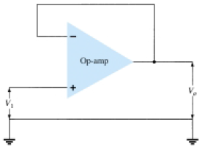
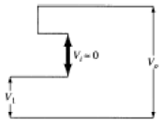
Practical Op-Amp Circuits
Unity Follower:
This Op-Amp provides a gain of unity, (i.e.- 1) with no inversion.
Equivalent AC Circuit

Slide 23

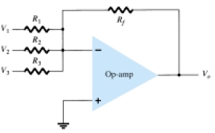
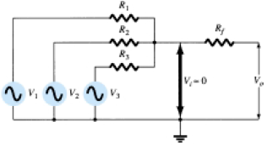
Practical Op-Amp Circuits
Summing Amplifier:
Used the most. Is a 3 input summing amplifier circuit and algebraically sums the output amplified voltages being multiplied by a constant gain.
Or

Slide 24

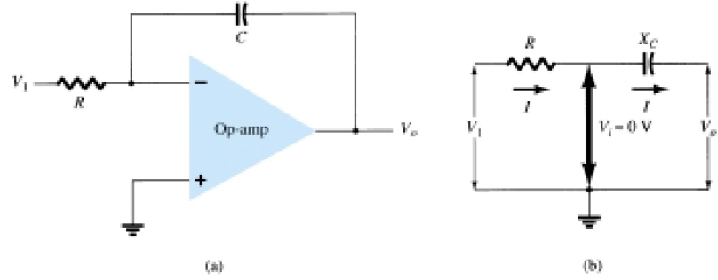
Practical Op-Amp Circuits
Integrator:
Similar structure as the previous, only a capacitor is placed instead of the feedback resistor. The capacitive impedance is:

Slide 25
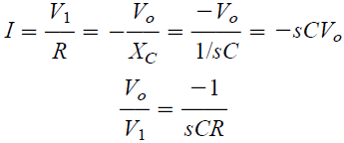

Practical Op-Amp Circuits
Integrator:
Similar structure as the previous, only a capacitor is placed instead of the feedback resistor. The capacitive impedance is:

Slide 26
Practical Op-Amp Circuits
Integrator:
Similar structure as the previous, only a capacitor is placed instead of the feedback resistor. The output is the integral of the input, with an inversion and scale multiplier of 1/RC. This ability to integrate a given signal provides the analog computer with the ability to solve differential equations and therefore provides the ability to electrically solve analogs of physical system operation. If a fixed voltage is input to this circuit, the output grows in time (from above equation), hence providing a ramp voltage.

Slide 27
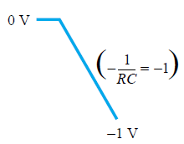
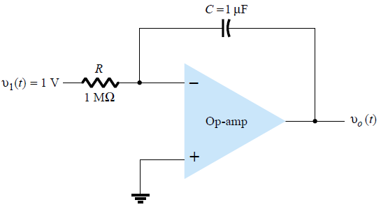
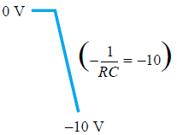
Practical Op-Amp Circuits
Integrator:

Slide 28
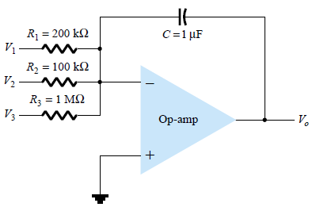
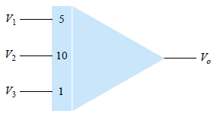
Practical Op-Amp Circuits
Summing Integrator Circuit:
Analog-computer integrator-circuit representation

Slide 29
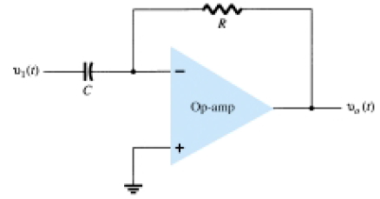

Practical Op-Amp Circuits
Differentiator

Slide 30
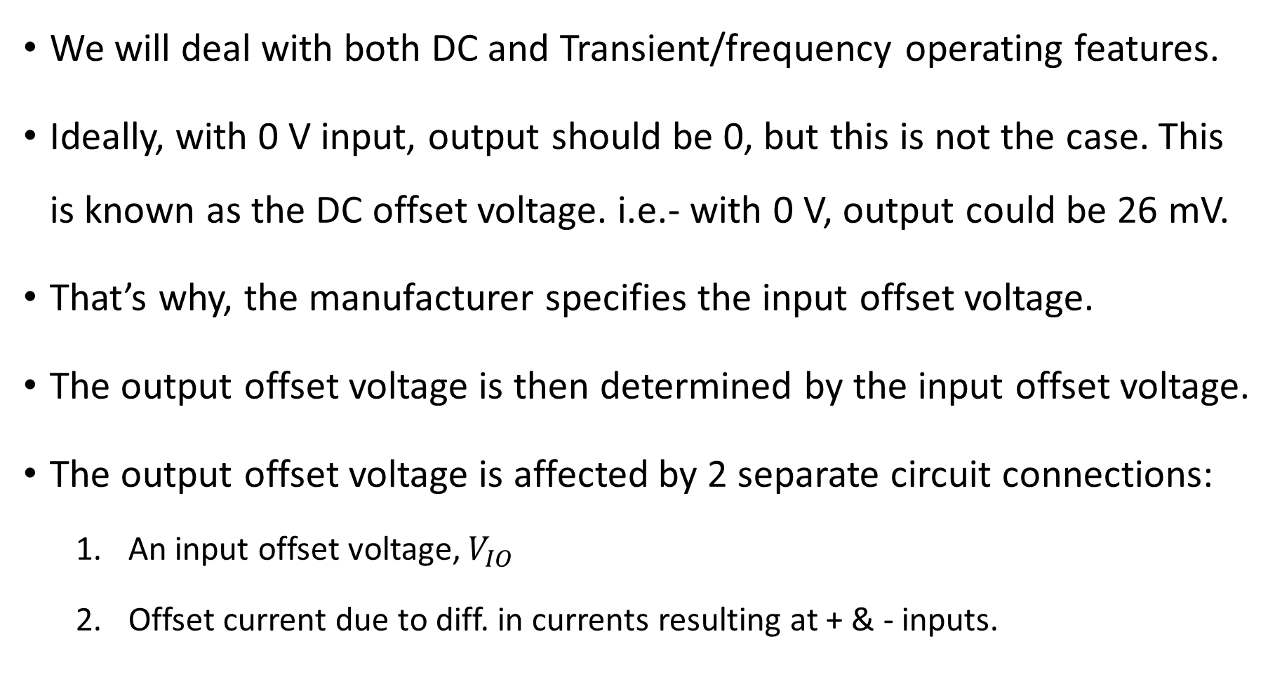
Op-Amp spec. DC-Offset Parameters
We will deal with both DC and Transient/frequency operating features.
Ideally, with 0 V input, output should be 0, but this is not the case. This is known as the DC offset voltage. i.e.- with 0 V, output could be 26 mV.
That’s why, the manufacturer specifies the input offset voltage.
The output offset voltage is then determined by the input offset voltage.
The output offset voltage is affected by 2 separate circuit connections:
An input offset voltage, $V_{IO}$
Offset current due to diff. in currents resulting at + & - inputs.

Slide 31



Op-Amp spec. DC-Offset Parameters
Input Offset Voltage, $V_{IO}$
Using $V_{0}=AV_{i}$, it can be written,
Therefore, we can write:

Slide 32



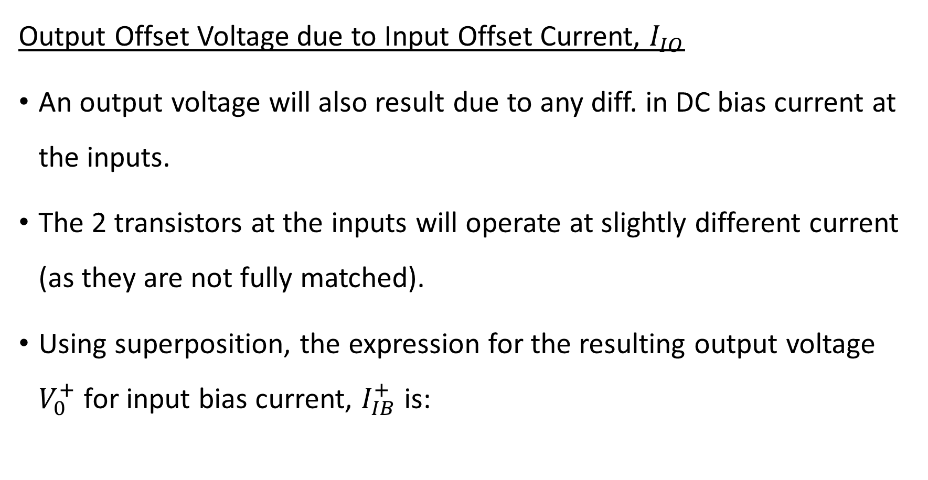
Op-Amp spec. DC-Offset Parameters
Output Offset Voltage due to Input Offset Current, $I_{IO}$
An output voltage will also result due to any diff. in DC bias current at the inputs.
The 2 transistors at the inputs will operate at slightly different current (as they are not fully matched).
Using superposition, the expression for the resulting output voltage $V_{0}^{+}$ for input bias current, $I_{IB}^{+}$ is:
&

Slide 33
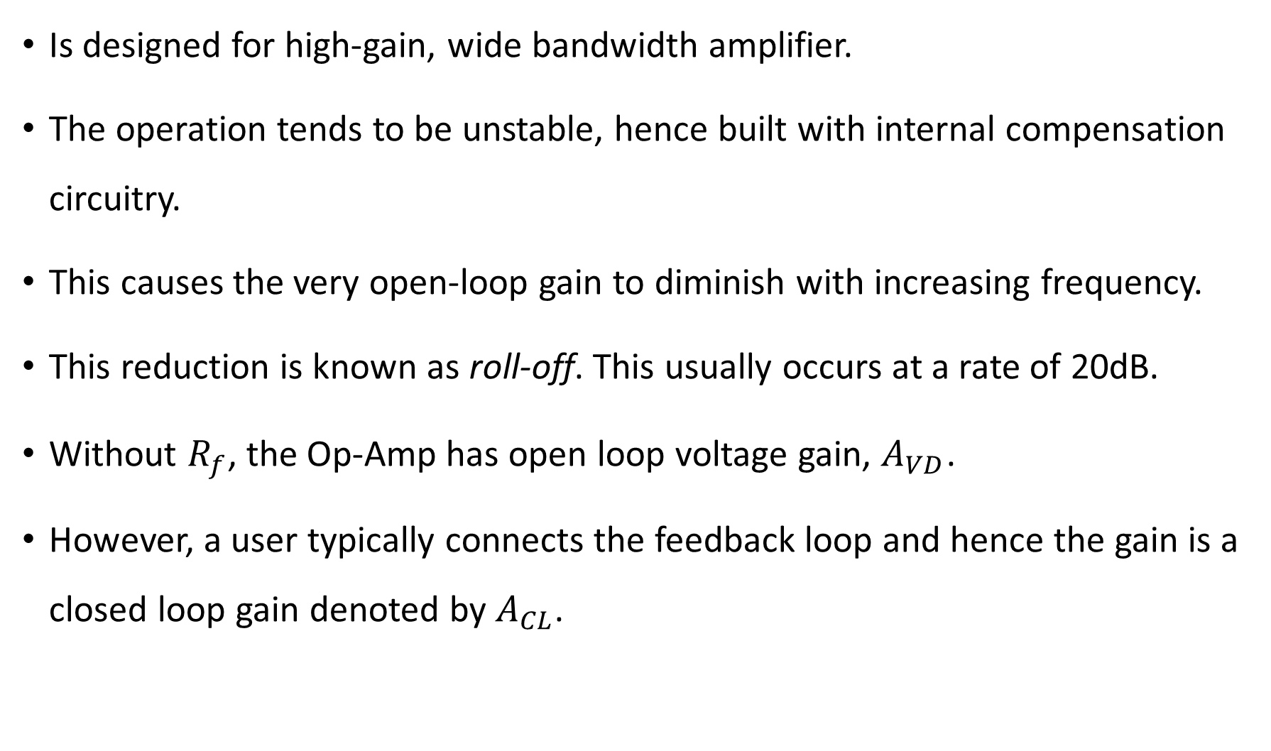
Op-Amp spec- Frequency Parameters
Is designed for high-gain, wide bandwidth amplifier.
The operation tends to be unstable, hence built with internal compensation circuitry.
This causes the very open-loop gain to diminish with increasing frequency.
This reduction is known as roll-off. This usually occurs at a rate of 20dB.
Without $R_{f}$, the Op-Amp has open loop voltage gain, $A_{VD}$.
However, a user typically connects the feedback loop and hence the gain is a closed loop gain denoted by $A_{CL}$.

Slide 34
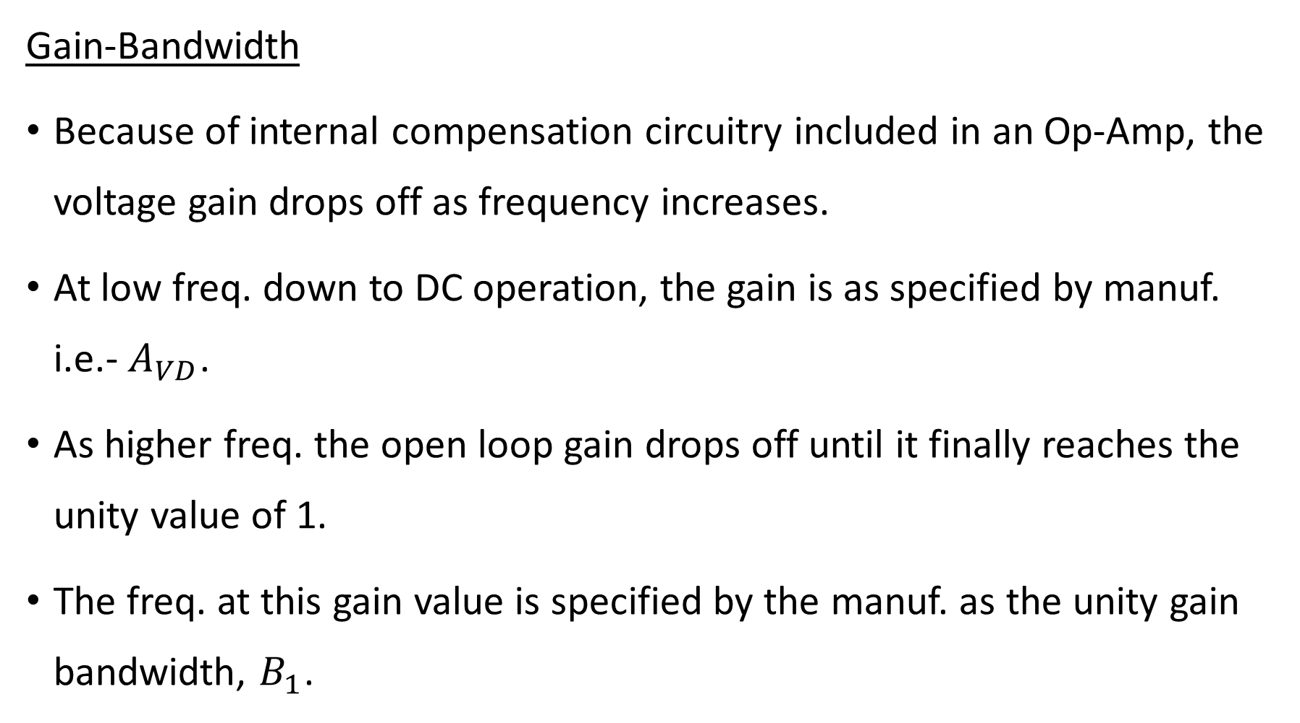
Op-Amp spec- Frequency Parameters
Gain-Bandwidth
Because of internal compensation circuitry included in an Op-Amp, the voltage gain drops off as frequency increases.
At low freq. down to DC operation, the gain is as specified by manuf. i.e.- $A_{VD}$.
As higher freq. the open loop gain drops off until it finally reaches the unity value of 1.
The freq. at this gain value is specified by the manuf. as the unity gain bandwidth, $B_{1}$.

Slide 35
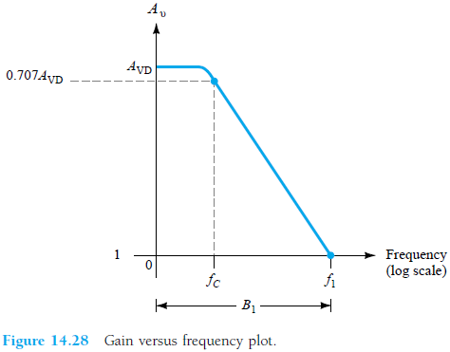
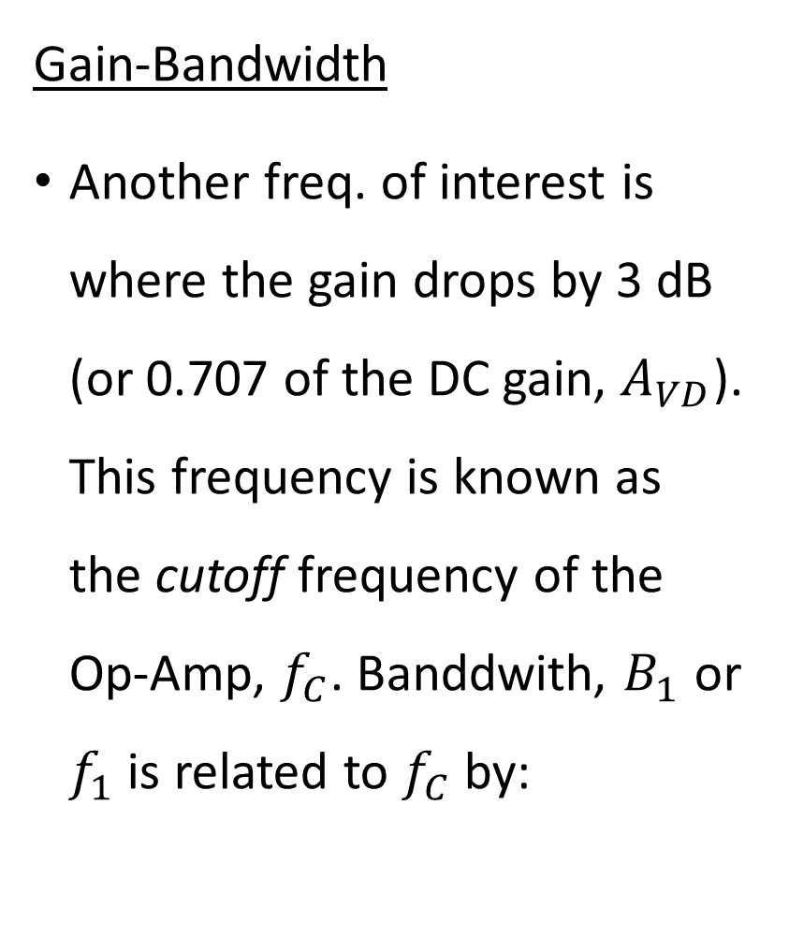
Op-Amp spec- Frequency Parameters
Gain-Bandwidth
Another freq. of interest is where the gain drops by 3 dB (or 0.707 of the DC gain, $A_{VD}$). This frequency is known as the cutoff frequency of the Op-Amp, $f_{C}$. Banddwith, $B_{1}$ or $f_{1}$ is related to $f_{C}$ by:

Slide 36

Op-Amp spec- Frequency Parameters
Slew Rate (SR)
The slew rate provides a parameter specifying the max rate of change of the output voltage when driven by a large step-input signal. If one tried to drive the output at a rate of voltage change greater than the slew rate, the output would not be able to change fast enough and would not vary over the full range expected, resulting in a signal clipping or distortion. The output wouldn’t be an amplified duplicate of the input signal if the Op-Amp slew rate is exceeded.

Slide 37


Op-Amp spec- Frequency Parameters
Max. Signal Frequency
The max freq. that an Op-Amp may operate depends on both the BW and SR.
For a sinusoidal signal of the form the max. voltage rate of change = 2πfK V/s,
To prevent distortion at the output, the rate of change must also be less than the SR. i.e.
Hz
Rad/sec
OR

