Slide 1
Lecture 2 Op-Amp Applications
Chapter 15

Slide 2

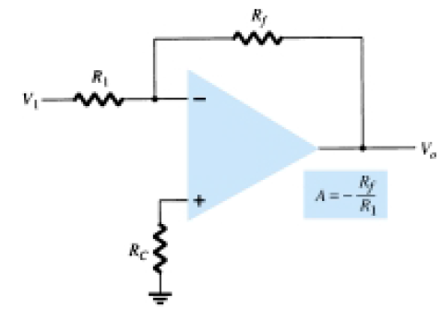

1a. Constant Gain Multiplier
Gain,
The basic circuit structure is:
Output Voltage, $V_{0}=AV_{i}$

Slide 3
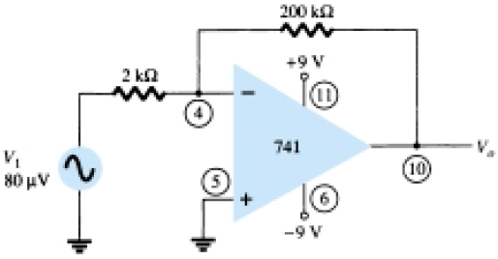
Class Example: 15.1

Slide 4

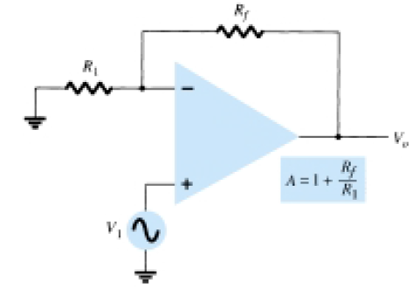

1b. Non-inverting Constant Gain Multiplier
Formula:
Output Voltage, $V_{0}=AV_{i}$
Circuit Schematic:

Slide 5
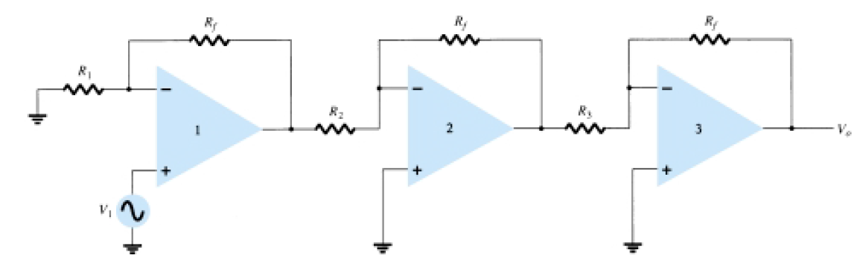
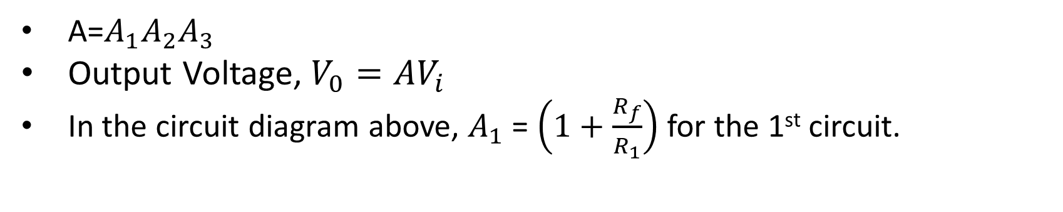
1c. Multi Stage Gains
A=$A_{1}A_{2}A_{3}$
Output Voltage, $V_{0}=AV_{i}$
In the circuit diagram above, $A_{1}$ = $\left(1+\frac{R_{f}}{R_{1}}\right)$ for the 1st circuit.

Slide 6

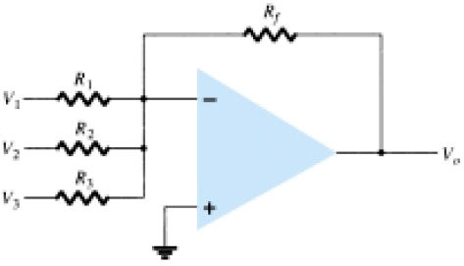
2a. Voltage Summing
Formula:
Circuit Schematic:

Slide 7
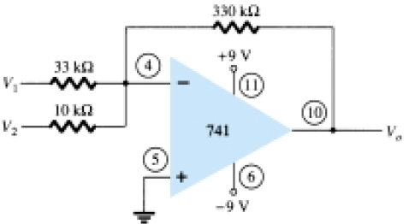
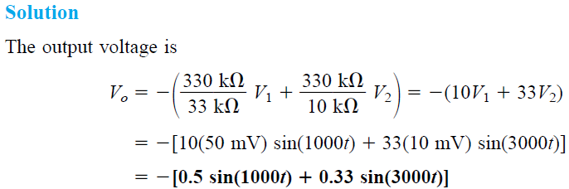
Class Example: 15.6

Slide 8

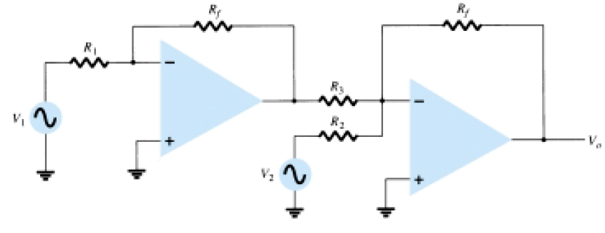
2bi. Voltage Subtraction
Formula:
Circuit Schematic:

Slide 9

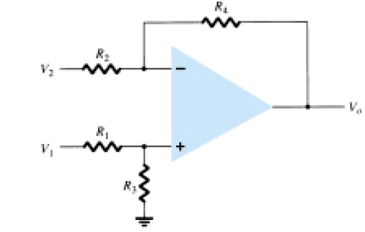
2bii. Voltage Subtraction
There is another way to do this. This method uses only one Op-Amp.
Formula:
Circuit Schematic:

Slide 10

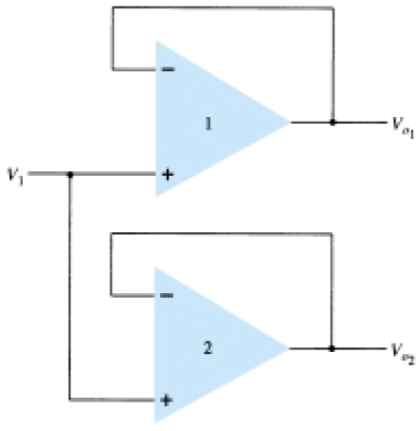
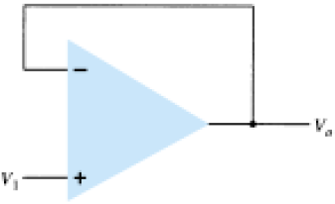
3. Voltage Buffer
This sort of Op-Amp connection is used when the input signal needs to be isolated from the load. This Op-Amp uses unity gain and hence the formula is:
Unity Gain Buffer Amp.
Use of buffer Amp. to provide output signals.

Slide 11


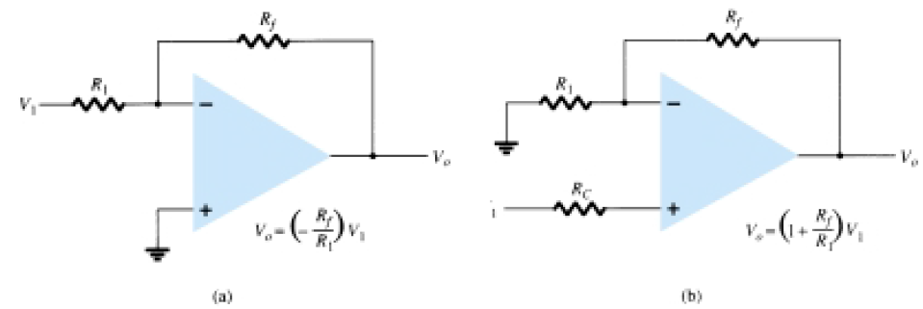
4. Controlled Sources
Definition: Input voltage/current to control the output voltage/current.
Usage: Various Instrumentation circuits.
Type 1: Voltage-Controlled Voltage Source.
Formula:
Circuit Schematic:
For (a), where k is the output gain factor.
For (b)

Slide 12

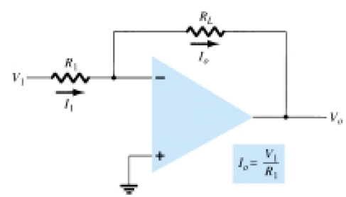
4. Controlled Sources
Definition: Input voltage/current to control the output voltage/current.
Usage: Various Instrumentation circuits.
Type 2: Voltage-Controlled Current Source.
Formula:
Circuit Schematic:

Slide 13

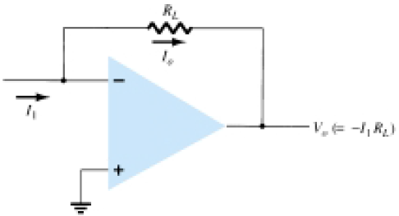
4. Controlled Sources
Definition: Input voltage/current to control the output voltage/current.
Usage: Various Instrumentation circuits.
Type 3: Current-Controlled Voltage Source.
Formula:
Circuit Schematic:

Slide 14

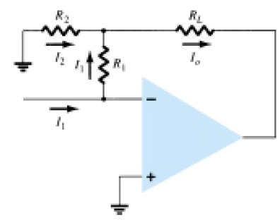
4. Controlled Sources
Definition: Input voltage/current to control the output voltage/current.
Usage: Various Instrumentation circuits.
Type 4: Current-Controlled Current Source.
Formula:
Circuit Schematic:

Slide 15
5. Active Filters
Op-Amps are also used in filters.
A filter circuit is constructed using passive elements like R and C.
An active filter uses these passive elements in conjunction with Op-Amps to provide signal isolation, voltage amplification or buffering.
Mostly used in communication and signal processing.
More covered in later chapters.

Slide 16
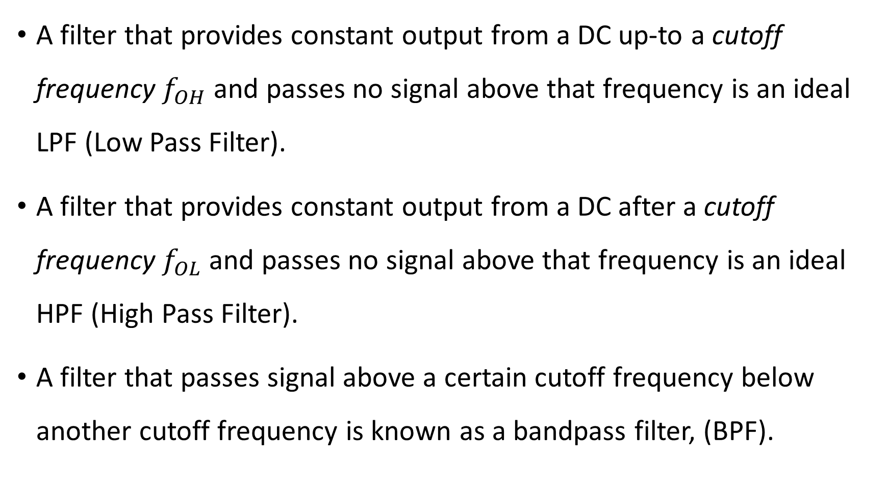
5. Filter Classification
A filter that provides constant output from a DC up-to a cutoff frequency $f_{OH}$ and passes no signal above that frequency is an ideal LPF (Low Pass Filter).
A filter that provides constant output from a DC after a cutoff frequency $f_{OL}$ and passes no signal above that frequency is an ideal HPF (High Pass Filter).
A filter that passes signal above a certain cutoff frequency below another cutoff frequency is known as a bandpass filter, (BPF).

Slide 17
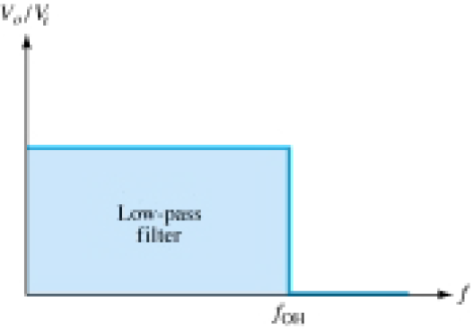
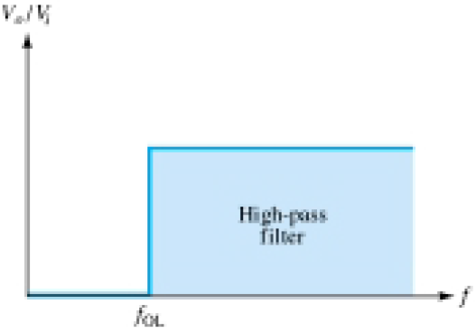
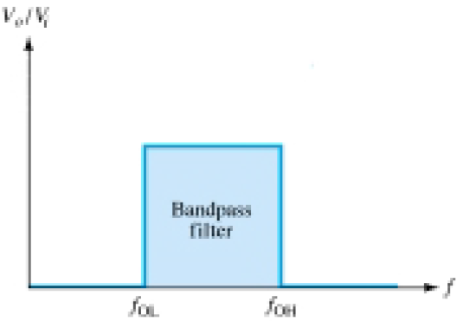



5. Filter Response
(a) LPF Response (b) HPF Response (c) BPF Response

Slide 18
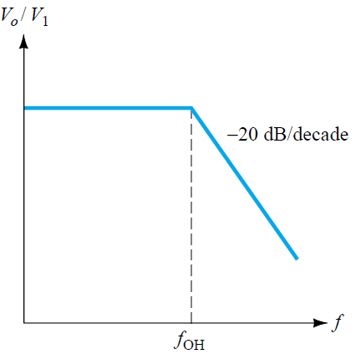
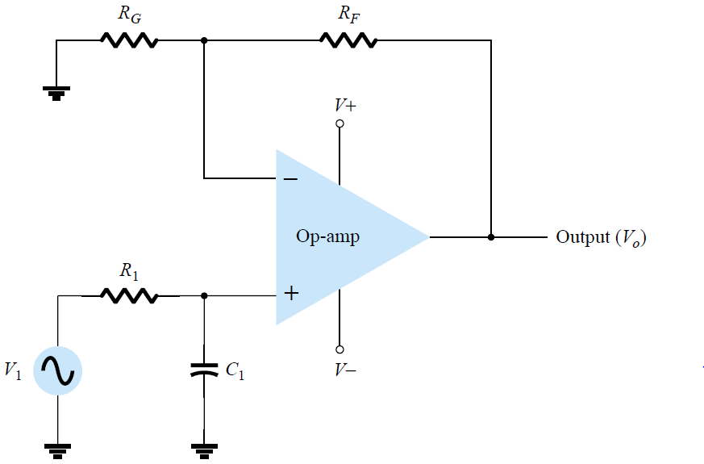
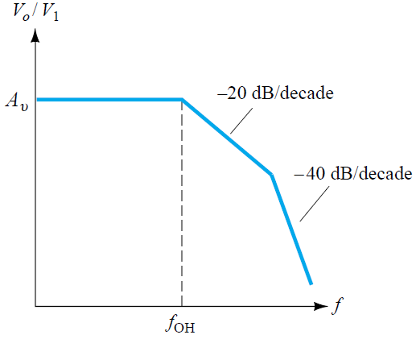
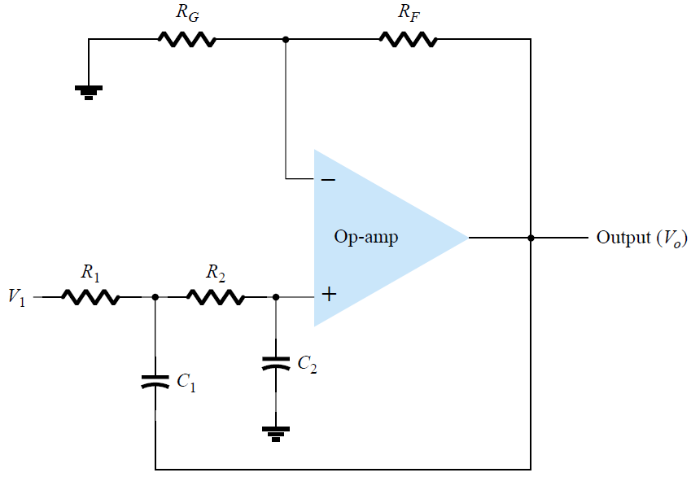
5. LPF
(a) 1st Order LPF
(b) 2nd Order LPF

Slide 19
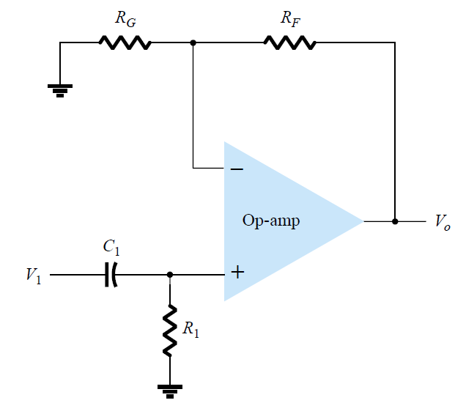
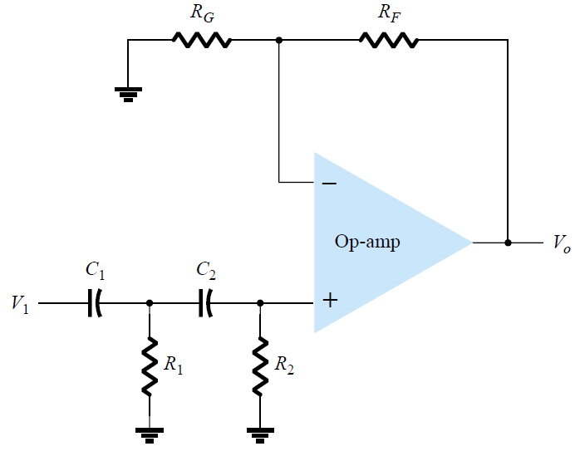
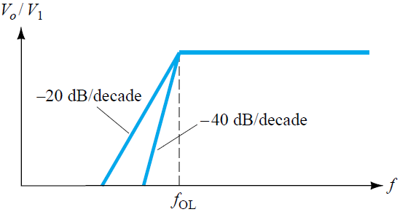
5. HPF
(a) 1st Order LPF
(b) 2nd Order LPF

Slide 20
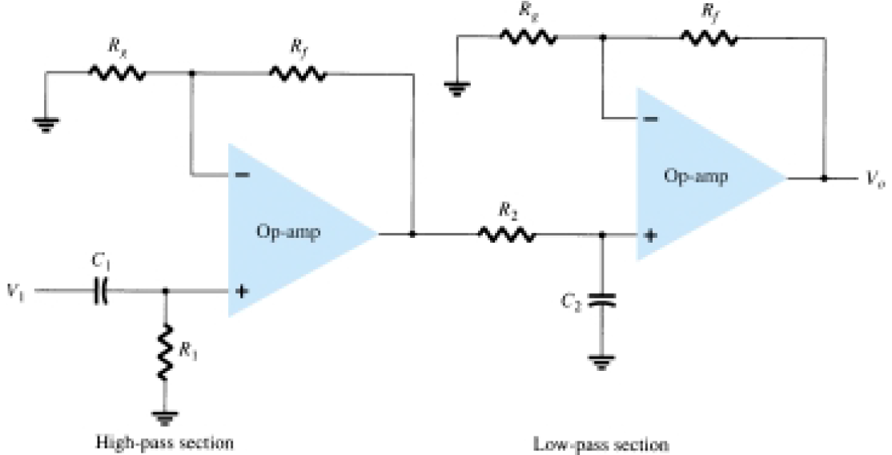
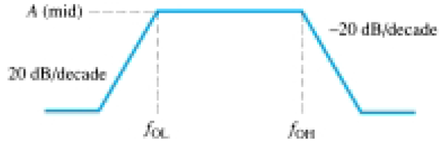
5. BPF

Slide 21
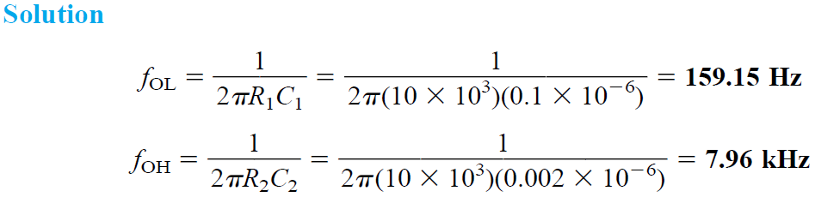
Class Example

