Slide 1
Propositional Calculus
CS 270: Mathematical Foundations of Computer Science
Jeremy Johnson

Slide 2
Propositional Calculus
Objective: To provide students with the concepts and techniques from propositional calculus so that they can use it to codify logical statements and to reason about these statements. To illustrate how a computer can be used to carry out formal proofs and to provide a framework for logical deduction.
2
Notes:
September 4, 1997
2

Slide 3
Propositional Calculus
Topics
Motivation
Boolean functions and expressions
Rules of Boolean Algebra
Tautologies and automatic verification of tautologies

Slide 4
Word Problem
Tom likes Jane if and only if Jane likes Tom. Jane likes Bill. Therefore, Tom does not like Jane.
Let p denote “Tom likes Jane”
Let q denote “Jane likes Tom”
Let r denote “Jane likes Bill”
((p ≡ q) ∧ r)→ ¬p encodes the above claim
The claim is not valid as the assignment p = true, q = true, and r = true evaluates to false

Slide 5
Programming Example
Boolean expressions arise in conditional statements. It is possible to abstract the relations with boolean variables (propositions that are either true or false). Using this abstraction one can reason and simplify conditional statements.
if ((a < b) || ((a >= b) && (c == d)) then { … } else { … }
Let p denote the relation (a<b) and q denote the relation (c == d). The above expression is then equal to
p || !p && q
5

Slide 6
Programming Example (cont)
The previous expression is equivalent (two expressions are equivalent if they are true for the same values of the variables occurring in the expressions) to a simpler expression
(p || !p && q) ≡ p || q
We can see this since if p is true both expressions are true, and if p is false, then !p is true and (!p && q) is true exactly when q is true.
6

Slide 7
Limitations of Propositional Calculus
Propositions hide the information in the predicates they abstract.
Sometimes properties of the hidden information is required to make further deductions.
E.G. for integers a,b, and c, (a < b) && (b < c) implies that a < c; however, this can not be deduced without using the order properties of the integers.
The predicate calculus allows the use of predicates to encode this additional information.
E.G. we can introduce a parameterized predicate lt(a,b) to encode the predicate a < b. Properties such as lt(a,b) && lt(b,c) ≡ lt(a,c) can be asserted. This type of notation and deduction is called predicate calculus and will be discussed later.
7

Slide 8
Boolean Functions
A Boolean variable has two possible values (true/false) (1/0).
A Boolean function has a number of Boolean input variables and has a Boolean valued output.
A Boolean function can be described using a truth table.
There are 2^{2n} Boolean function of n variables.
s x₀ x₁ f
0 0 0 0
0 0 1 0
0 1 0 1
0 1 1 1
1 0 0 0
1 0 1 1
1 1 0 0
1 1 1 1
x₀
f
x₁
s
Multiplexor function
8
Notes:
September 4, 1997
8

Slide 9
Boolean Expressions
BExpr :=
Constant: T|F
Variable
Negation: ¬ BExpr
And: BExpr ∧ BExpr
Or: BExpr ∨ BExpr
9
Notes:
September 4, 1997
9

Slide 10
Expression Trees
Boolean expressions can be represented by a binary tree
Internal nodes are operators
Leaf nodes are operands
Consider p ∧ (T ∨ ¬ q):
∧
p
∨
T
¬
q

Slide 11
Example Derivation
BExpr →
∧
→
∧
→
∧
BExpr
BExpr
Variable
BExpr
p
BExpr
→
∧
→
∧
→
∧
p
∨
p
∨
p
∨
BExpr
BExpr
Constant
BExpr
T
BExpr

Slide 12
Example Derivation
→
∧
→
∧
→
∧
p
∨
p
∨
p
∨
T
BExpr
T
¬
T
¬
→
∧
BExpr
Constant
p
∨
T
¬
p ∧ (T ∨ ¬ q)
q

Slide 13
Predicate for Boolean Expressions
define isBooleanExpr(expr)
return true if the input expr is a Boolean expression
if constant return true
if variable return true
if isNegation(expr) and isBooleanExpr(operand(expr)) return true
if isDisjunction(expr) and isBooleanExpr(firstOperand(expr)) and
isBooleanExpr(secondOperand(expr)) then return true
if isConjunction(expr) and isBooleanExpr(firstOperand(expr)) and
isBooleanExpr(secondOperand(expr)) then return true
else return false
13
Notes:
September 4, 1997
13

Slide 14
Semantics of Boolean Expressions
An expression built up from variables, and, or, and not.
x y x ∧ y
0 0 0
0 1 0
1 0 0
1 1 1
x y x ∨ y
0 0 0
0 1 1
1 0 1
1 1 1
x ¬x
0 1
1 0
and
or
not
14
Notes:
September 4, 1997
14

Slide 15
Evaluating Expression Trees
Assume p = T and q = F
∧
∧
∧
T
p=T
∨
p=T
∨
p=T
T
T
¬
T
T
q=F

Slide 16
Evaluation
define booleanEval(expr, env)
Input: expr is a Boolean Expression, env is an environment of variable assignments to T or F. Assume all variables in expr are defined in env
Output: true if expr evaluates to true and false if expr evaluates to false
if isConstant(expr) return expr
if isVariable(expr) return lookup(expr,env)
if isNegation(expr) return not booleanEval(operand(expr))
if isDisjunction(expr) return booleanEval(firstOperand(expr)) or booleanEval(secondOperand(expr))
if isConjunction(expr) return booleanEval(firstOperand(expr)) and booleanEval(secondOperand(expr))

Slide 17
Short Circuit Evaluation
define booleanEval(expr, env)
Input: expr is a Boolean Expression, env is an environment of variable assignments to T or F. Assume all variables in expr are defined in env
Output: true if expr evaluates to true and false if expr evaluates to false
if isConstant(expr) return expr
if isVariable(expr) return lookup(expr,env)
if isNegation(expr) return not booleanEval(operand(expr))
if isDisjunction(expr)
if booleanEval(firstOperand(expr)) return true else return booleanEval(secondOperand(expr))
if isDisjunction(expr)
if not booleanEval(firstOperand(expr)) return false else return booleanEval(secondOperand(expr))

Slide 18
Disjunctive Normal Form
A Boolean expression is a Boolean function
Any Boolean function can be written as a Boolean expression
Write a Boolean expression that evaluates to true for each row in the truth table that is true and false for other rows.
The Boolean expression for a given row is the conjunction of the variables that are true and the negation of variables that are false.
Take the disjunction of all such rows.
E.G. (multiplexor function)
s x₀ x₁ f
0 0 0 0
0 0 1 0
0 1 0 1
0 1 1 1
1 0 0 0
1 0 1 1
1 1 0 0
1 1 1 1
(¬s ∧ x₀ ∧ ¬x₁ ) ∨ (¬s ∧ x₀ ∧ x₁ ) ∨ (s ∧ ¬x₀ ∧ x₁ ) ∨ (s ∧ x₀ ∧ x₁ )
18
Notes:
September 4, 1997
18

Slide 19
Boolean Algebra
The Boolean operators ∨ and ∧ are analogous to addition and multiplication with true and false playing the roles of 1 and 0. Complement is used for negation.
This provides a compact notation and suggests appropriate algebraic simplification
Similar properties hold such as the associative, commutative, and distributive identities.

Slide 20
Sums of Products
Disjunctive normal form, using the notation of Boolean Algebra, corresponds to a sum of products
E.G. (multiplexor function)
s x₀ x₁ f
0 0 0 0
0 0 1 0
0 1 0 1
0 1 1 1
1 0 0 0
1 0 1 1
1 1 0 0
1 1 1 1
20
Notes:
September 4, 1997
20

Slide 21

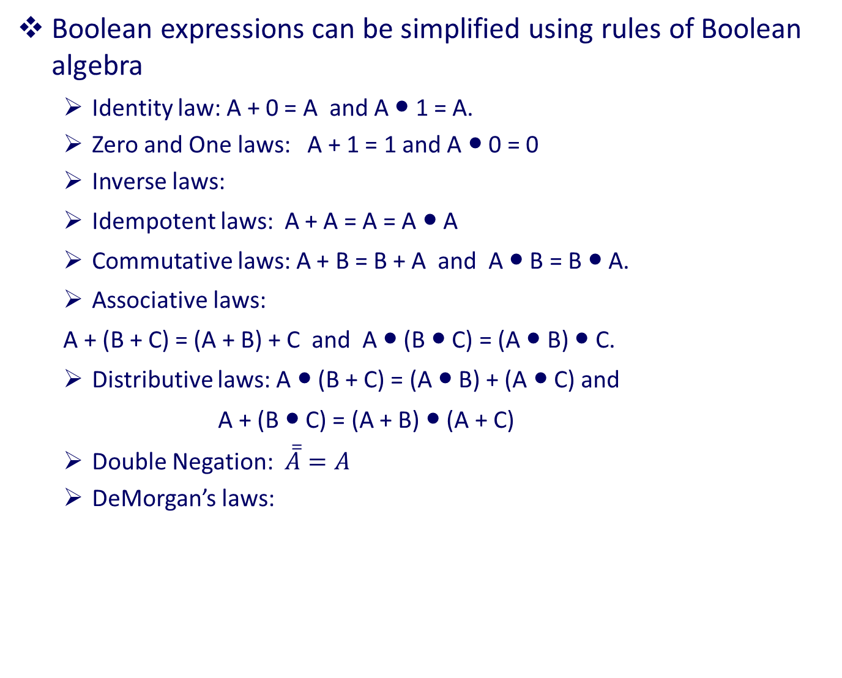
Properties of Boolean Algebra
Boolean expressions can be simplified using rules of Boolean algebra
Identity law: A + 0 = A and A ● 1 = A.
Zero and One laws: A + 1 = 1 and A ● 0 = 0
Inverse laws:
Idempotent laws: A + A = A = A ● A
Commutative laws: A + B = B + A and A ● B = B ● A.
Associative laws:
A + (B + C) = (A + B) + C and A ● (B ● C) = (A ● B) ● C.
Distributive laws: A ● (B + C) = (A ● B) + (A ● C) and
A + (B ● C) = (A + B) ● (A + C)
Double Negation: $\overline{\overline{A}}=A$
DeMorgan’s laws:

Slide 22
Simplification of Boolean Expressions
Simplifying multiplexor expression using Boolean algebra
Equational reasoning: replace subexpressions by equivalent expressions
Verify that the boolean function corresponding to this expression as the same truth table as the original function.
22
Notes:
September 4, 1997
22

Slide 23




Nand is functionally complete
All boolean functions can be implemented using nand gates (and, or and not can be implemented using nand)
not:
and:
or:
x y x | y
0 0 1
0 1 1
1 0 1
1 1 0

Slide 24
Additional Notation
Several additional Boolean functions of two variables have special meaning and are given special notation. By our previous results we know that all boolean functions can be expressed with not, and, and or; so the additional notation is simply a convenience.
x y x → y
0 0 1
0 1 1
1 0 0
1 1 1
x y x ≡ y
0 0 1
0 1 0
1 0 0
1 1 1
x y x ⊕ y
0 0 0
0 1 1
1 0 1
1 1 0
implication
equivalence
xor
24

Slide 25
Tautologies
A tautology is a boolean expression that is always true, independent of the values of the variables occurring in the expression. The properties of Boolean Algebra are examples of tautologies.
Tautologies can be verified using truth tables. The truth table below shows that x → y ≡ ¬ x ∨ y
x y x → y ¬ x ∨ y
0 0 1 1
0 1 1 1
1 0 0 0
1 1 1 1
25

Slide 26
Exercise
Derive the tautology
x → y ≡ ¬ x ∨ y
from the sum of products expression obtained from the truth table for x → y. You will need to use properties of Boolean algebra to simplify the sum of products expression to obtain the desired equivalence.
26

Slide 27
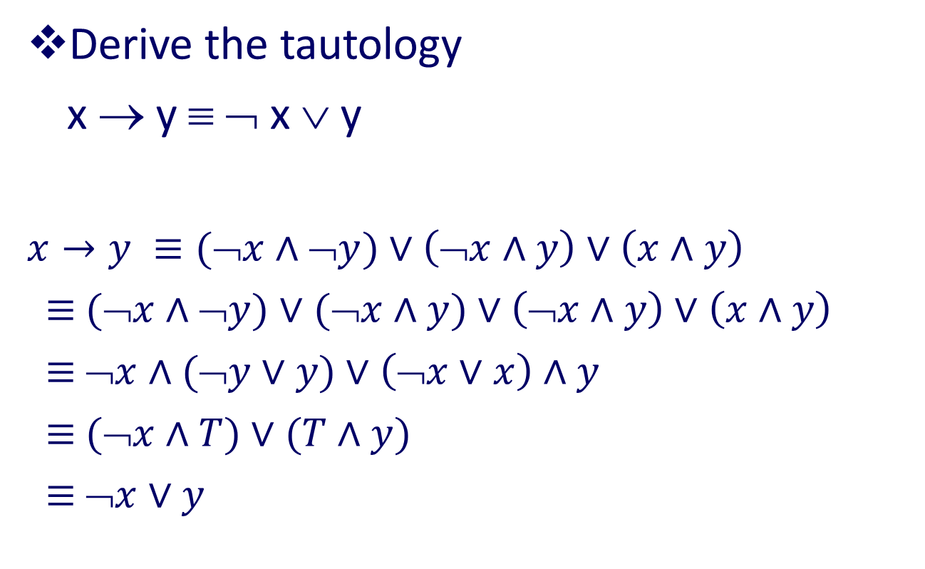
Solution
x y x → y
0 0 1
0 1 1
1 0 0
1 1 1
Derive the tautology
x → y ≡ ¬ x ∨ y
$x→y ≡(\text{¬}x∧\text{¬}y)∨$ $\left(\text{➢}x∧y\right)∨\left(x∧y\right)$
$≡$ $(\text{➢}x∧\text{¬}y)∨$ $(\text{➢}x∧y)∨$ $\left(\text{➢}x∧y\right)∨\left(x∧y\right)$
$≡$ $\text{➢}x∧\text{(}\text{¬}y∨y)∨\left(\text{¬}x∨x\right)∧y$
$≡$ $(\text{➢}x∧T)∨\text{(}T∧y)$
$≡$ $\text{➢}x∨y$
27

Slide 28
Tautology Checker
A program can be written to check to see if a Boolean expression is a tautology.
Simply generate all possible truth assignments for the variables occurring in the expression and evaluate the expression with its variables set to each of these assignments. If the evaluated expressions are always true, then the given Boolean expression is a tautology.
A similar program can be written to check if any two Boolean expressions E1 and E2 are equivalent, i.e. if E1 ≡ E2. Such a program has been provided.
28

