Slide 1

Welcome
TPL & Message Pumps
webinar
Notes:
A warm welcome to part II webinar in the async webinar series.
Today we talk about the task parallel library and message pumps

Slide 2

Solution Architect
Enthusiastic Software Engineer
Microsoft MVP for systems integration
@danielmarbach
particular.net/blog
planetgeek.ch
Notes:
I’m Daniel, Solution Architect…
I live in central Switzerland. If you want to know more about me listen to episode 77 of developer on fire
You can reach me on twitter under @danielmarbach
I blog on the particular blog and on my personal blog
Subscribe after this webinar

Slide 3
Use Task.Run, Factory.StartNew for CPU-bound work Use Task directly for IO-bound work
Use async Task instead of async void
Recap
reminder

Slide 4
Recap
Libraries and frameworks should use ConfigureAwait(false)
Async all the way, don’t mix blocking and asynchronous code
reminder

Slide 5
Goals
Combine async/await with the TPL
Throttling your concurrent operations
Graceful shutdowns
target
Notes:
Deal with non-true asynchronous code paths
Avoid unpleasant surprises when combining Async/Await with the Task Parallel Library
Achieve "graceful" shutdowns by applying cancellation to asynchronous operations
Achieve throttling with your concurrent operations without needless blocking

Slide 6
The Pump
Code
WrapUp
Notes:
This webinar is divided into three parts
The pump
Code and WrapUp including Q&A
This webinar will be much more code centric and the complexity level of the practices shown here might be higher than the previous webinar. Don’t worry. At the end of this webinar you’ll get a link to the code samples I’m showing and you’ll be able to walk through the code step-by-step on your own. Of course I’ll be also available to answer your questions even after this webinar series is over.

Slide 7
The Pump
Code
WrapUp
Notes:
So let’s talk about the message pump first

Slide 8
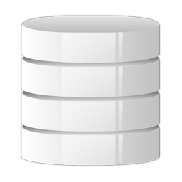

Your code
Message Pump
Queue
Notes:
The message pump is an infrastructure piece which concurrently consumes messages from a message queue. When there are message in the queue the message is picked up, inspected and based on the information on the message a corresponding piece of code in your system is invoked. A message pump could be consuming messages from queuing technologies like MSMQ, RabbitMQ, Azure Service Bus and many more. In NServiceBus the code which is invoked follows a certain convention like it implements an interface called IHandleMessages. But since we are looking at a generic message pump we will just assume that the pump will call any arbitrary method.
Message pumps are not only useful for queuing technologies. They are applicable to much more. For example in an actor based system a pump could be responsible to dispatch calls to existing actor instances. Other examples of message pumps can be found in Windows Forms for example. The UI thread is basically pumping window messages to controls which handle those messages.
It is a pull based model and not a push based model. So in world with reactive queue we would not use a pump

Slide 9
The Pump
Code
WrapUp
Notes:
Now that we now what a message pump is, we can dive into code and build a simple pump on our own.

Slide 10
Demo
await
Notes:
Let me switch over to visual studio.

Slide 11

Semaphore
gated
Notes:
We will be using a counting semaphore. I counting semaphore can be compare to a toll booth. Like in the picture on the right side we have eight lanes and toll booths. So the count of the semaphore would be eight. Everytime a car passes the semaphore the count is decreased. When the counter reaches zero then no cars can pass the toll booths. Cars will eventually queue up behind other cars until free slots become available again.
Only SemaphoreSlim supports async Wait calls

Slide 12
Demo
await
Notes:
So let’s go back to our code example

Slide 13
The Pump
Code
WrapUp

Slide 14
Prefer Task.Run over Factory.StartNew Use CancellationToken to cancel operations inside tasks
Use SemaphoreSlim to throttle instead of a custom TaskScheduler
Recap
reminder

Slide 15
Recap
Don’t use LongRunning or AttachToParent for Tasks with async operations
Non-blocking all the way, to maximize throughput
reminder

Slide 16
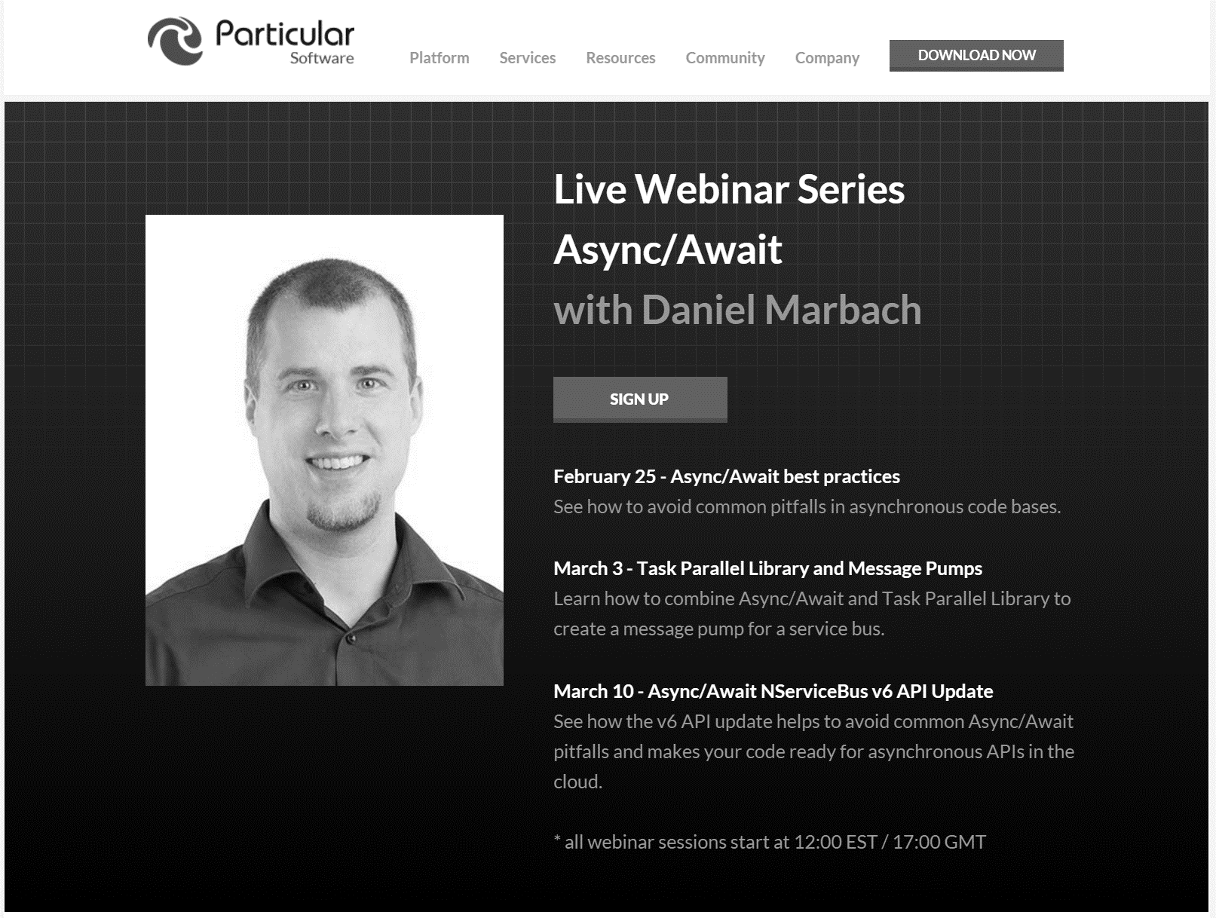
particular.net/async-await-webinar-series
Next
Notes:
See how the v6 API update helps to avoid common Async/Await pitfalls and makes your code ready for asynchronous APIs in the cloud.
Join again, invite your friends.

Slide 17
Slides, Links…
github.com/danielmarbach/03-03-2016-AsyncWebinar
Notes:
Questions that can be answered in blog posts

Slide 18
Q & A
await
Notes:
Q & A

Slide 19
Thanks
Notes:
Thank you very much for listening and see you next time

