Slide 1
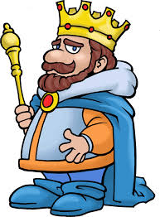
King-Survival-4

Slide 2
Table of contents
About our team
About the game
Refactoring of the code we made
Design patterns we used
Solid principles we covered
Problems we had

Slide 3
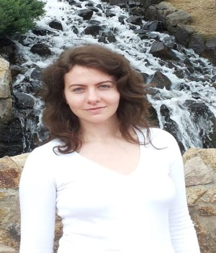


Our team
Elena Pitsin
Izabel Gandileva
Mirela Zaharieva

Slide 4
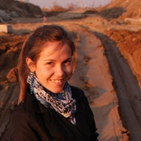
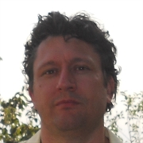
Our team(2)
Silvena Miteva
Mihail Bonev
Other (didn’t join us) : Jivka Stoeva, Jivko Jelqzkov

Slide 5
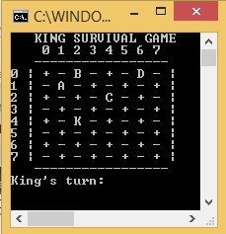
About the game

Slide 6
Refactoring
Proper names of all variables
Extracted short methods and classes with single responsibility
Documentation of the code
No duplicate code
Unit testing
Open for extensions code

Slide 7
Design patterns
Creational
Singleton
Simple factory
Prototype
Structural
Facade
Decorator
Bridge
Behavioral
Observer
Memory

Slide 8
Solid principles
Low coupling/strong cohesion
Open-close
Liskov Substitution
DRY
Dependency Inversion
Interface Segregation

Slide 9

Problems we had
Which design patterns to use
Debugging so many classes
Encounter deep bugs
Arrange our time to work together

Slide 10
Thank you for your attention!

Slide 11
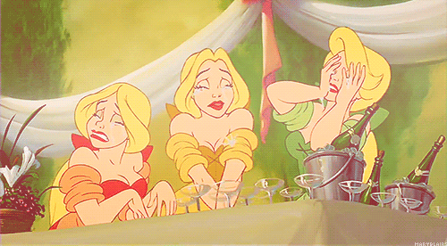
Trainers, please be kind…

