Slide 1
Lumment Gradient
Here is where your presentation begins

Slide 2
Table of Contents
01
04
02
05
03
06
Objectives
Treatment
Here you could describe the topic of the section
Here you could describe the topic of the section
Key Numbers
Result Analysis
Here you could describe the topic of the section
Here you could describe the topic of the section
Patient Care
Conclusion
Here you could describe the topic of the section
Here you could describe the topic of the section

Slide 3
Whoa!
This could be the part of the presentation where you can introduce yourself, write your email…

Slide 4
—Someone Famous
“This is a quote, words full of wisdom that someone important said and can make the reader get inspired.”

Slide 5
01
Objectives
You can enter a subtitle here if you need it

Slide 6
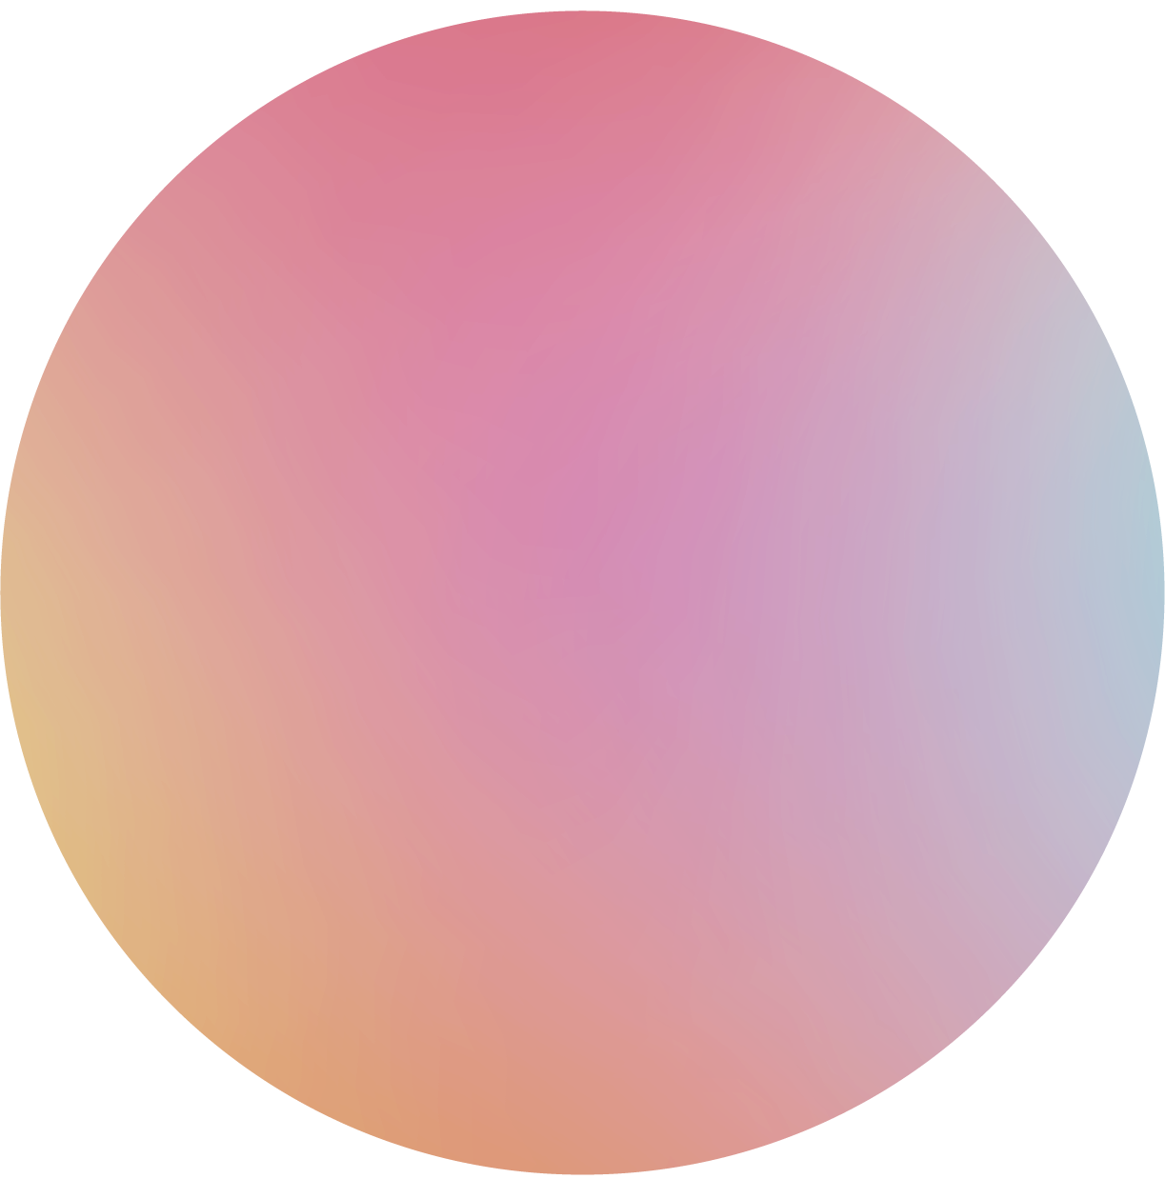


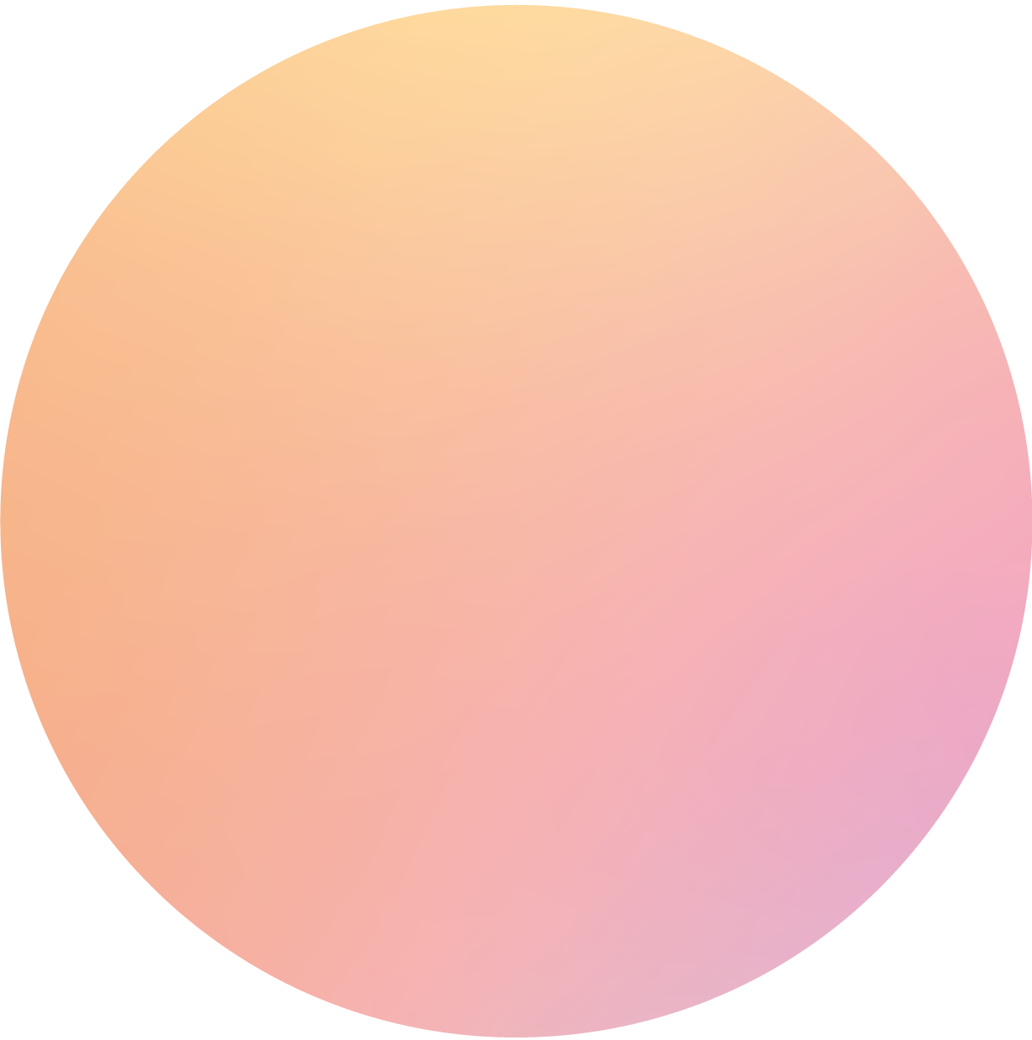
The Slide Title Goes Here!
Do you know what helps you make your point clear? Lists like this one:
They’re simple
You can organize your ideas clearly
You’ll never forget to buy milk!
And the most important thing: the audience won’t miss the point of your presentation

Slide 7
Maybe You Need to Divide the Content
Mercury
Venus
Mercury is the closest planet to the Sun and the smallest one in the Solar System
Venus is the second planet from the Sun. It’s terribly hot—even hotter than Mercury

Slide 8
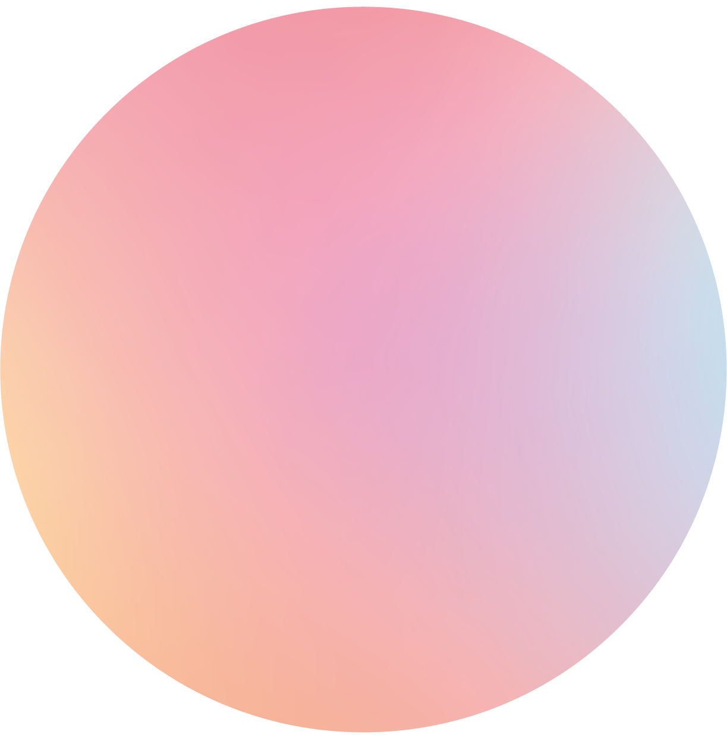
You Could Use Three Columns, Why Not?
Mars
Saturn
Mercury
It’s a cold place. The planet is full of iron oxide dust
Saturn is composed mostly of hydrogen and helium
Mercury is the smallest one in the Solar System

Slide 9
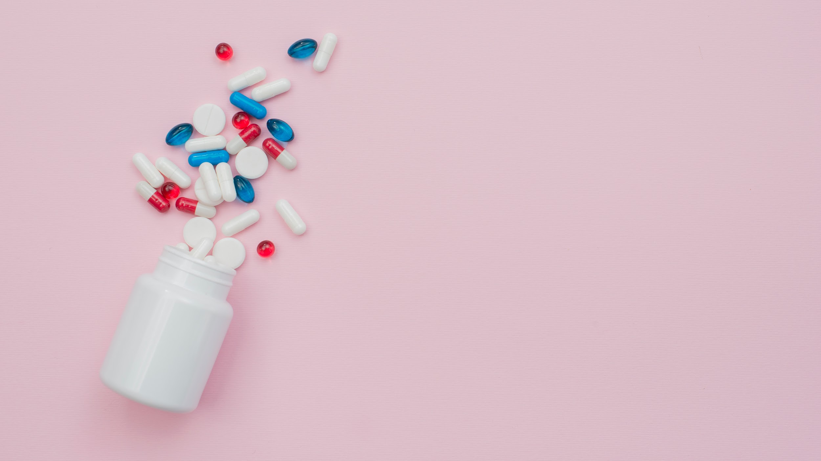

A Picture Is Worth a Thousand Words

Slide 10
Awesome Words

Slide 11
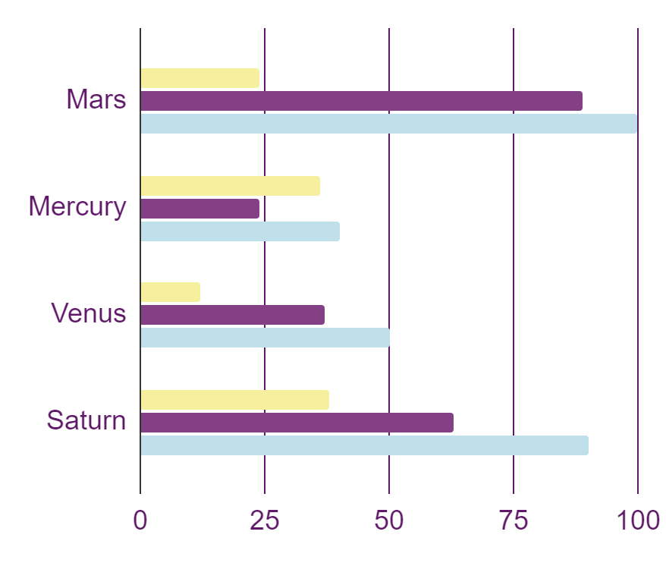
This Is a Graph
Mars
It’s a cold place. The planet is full of iron oxide dust
Venus
Saturn is composed mostly of hydrogen and helium
Saturn
Mercury is the smallest one in the Solar System
To modify this graph, click on it, follow the link, change the data and paste the new graph here

Slide 12
Sometimes, Reviewing Concepts Is a Good Idea
Mercury
Jupiter
Neptune
Mercury is the smallest planet
Jupiter is the biggest planet
Neptune is the farthest planet
Mars
Venus
Saturn
Mars is a very cold place
Venus is the second planet
Saturn is the ringed one

Slide 13
Researches and Publications
01
02
03
It’s a cold place. The planet is full of iron oxide dust
Saturn is composed mostly of hydrogen and helium
Mercury is the smallest one in the Solar System
By Mars
By Venus
By Mercury

Slide 14
Infographics Make Your Idea Understandable…
+ 20%
Neptune is the farthest planet
123 268
569 635
158 962
Mercury is the smallest planet
Jupiter is the biggest planet
Earth is where we all live on
60%
Mercury
25%
50%
75%
40%
Jupiter
Mars
Venus
Earth

Slide 15
…And the Same Goes for Tables
 | Mass (earths) | Diameter (earths) | Surface Gravity (earths)
Mercury | 0.06 | 0.38 | 0.38
Mars | 0.11 | 0.53 | 0.38
Saturn | 95.2 | 9.4 | 1.16

Slide 16
This Is a Map
Mercury
Mercury is the smallest one in the Solar System
Saturn
Saturn is composed mostly of hydrogen and helium

Slide 17
A Timeline Always Works Well
Step 1
Step 2
Step 3
Step 4
Mercury is the smallest planet
Mars is a very cold place
Jupiter is the biggest planet
Neptune is the farthest planet

Slide 18
4,498,300
Big numbers catch your audience’s attention

Slide 19
Our Numbers
333,000.00
386,000 km
24h 37m 23s
earths is the sun’s mass
is the distance to the Moon
is Jupiter’s rotation period

Slide 20
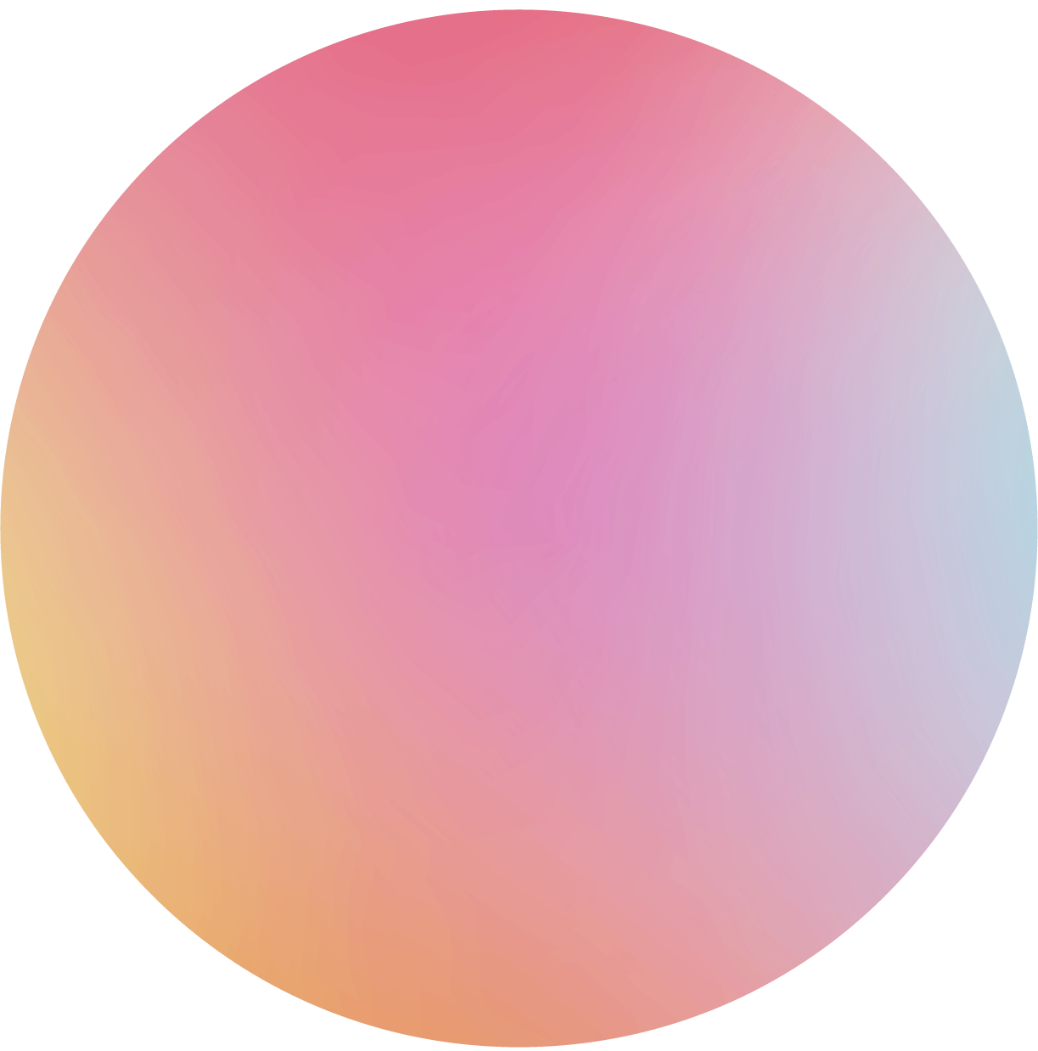

Medical History
Background
Summary
Age: 25
Gender: Female
Allergies: None
Mercury is the smallest one in the Solar System
2010
2015
2020
Mercury is the smallest planet
Jupiter is the biggest planet
Neptune is the farthest planet

Slide 21
Physical Examination
Mars
Saturn
It’s a cold place. The planet is full of iron oxide dust
Saturn is composed mostly of hydrogen and helium
Mercury
Venus
Mercury is the smallest one in the Solar System
Venus is the second planet from the Sun. It’s terribly hot

Slide 22
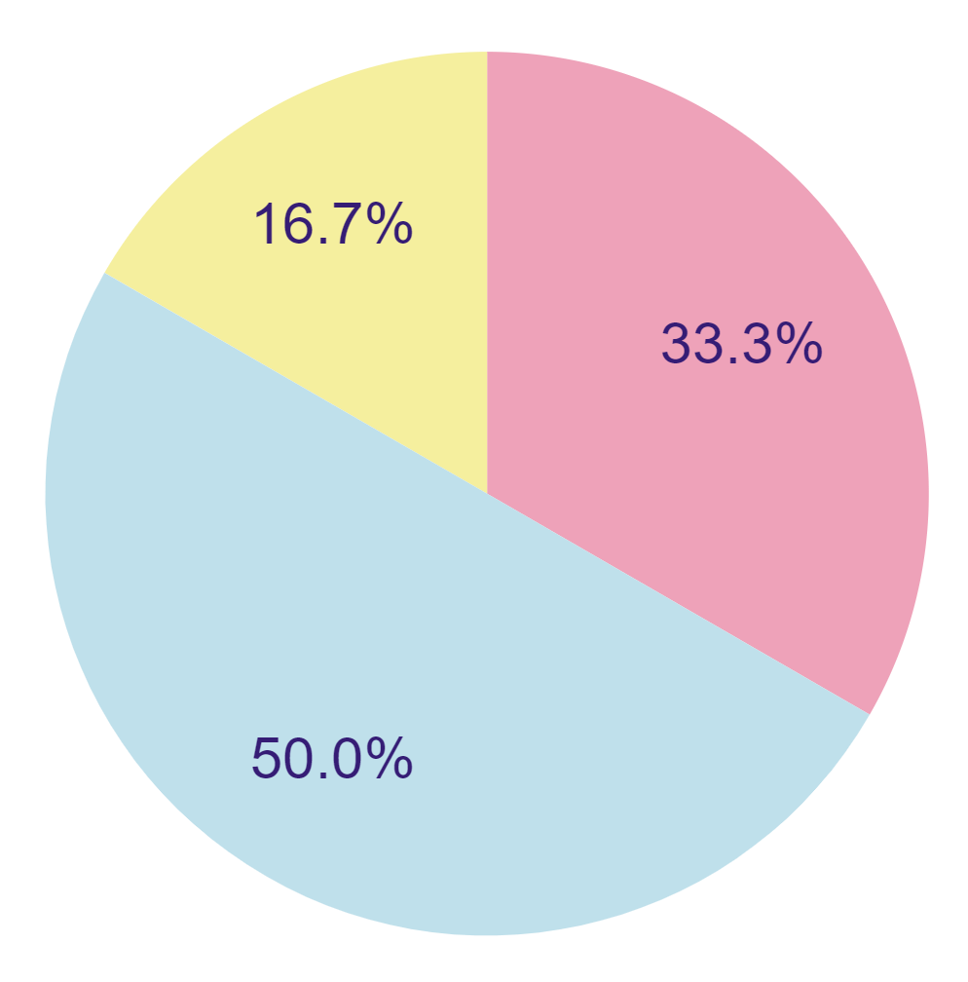
Patient Monitoring
Week 1
Week 2
Week 3
Mars
Mercury
Venus
75%
55%
65%
To modify this graph, click on it, follow the link, change the data and paste the new graph here
70%
40%
85%

Slide 23
Our Areas of Expertise
Mars
Saturn
It’s a cold place. The planet is full of iron oxide dust
Saturn is composed mostly of hydrogen and helium
Mercury
Venus
Mercury is the smallest one in the Solar System
Venus is the second planet from the Sun. It’s terribly hot

Slide 24
Risk Factors
Saturn
Saturn is composed mostly of hydrogen and helium
Mars
Mercury
It’s a cold place. The planet is full of iron oxide dust
Mercury is the smallest one in the Solar System

Slide 25
Case History
January
February
March
April
Symptom 1
Symptom 2
Symptom 3

Slide 26
Treatment
Mars
01
02
Saturn
It’s a cold place. The planet is full of iron oxide dust
Saturn is composed mostly of hydrogen and helium
Mercury
03
04
Venus
Mercury is the smallest one in the Solar System
Venus is the second planet from the Sun. It’s terribly hot

Slide 27
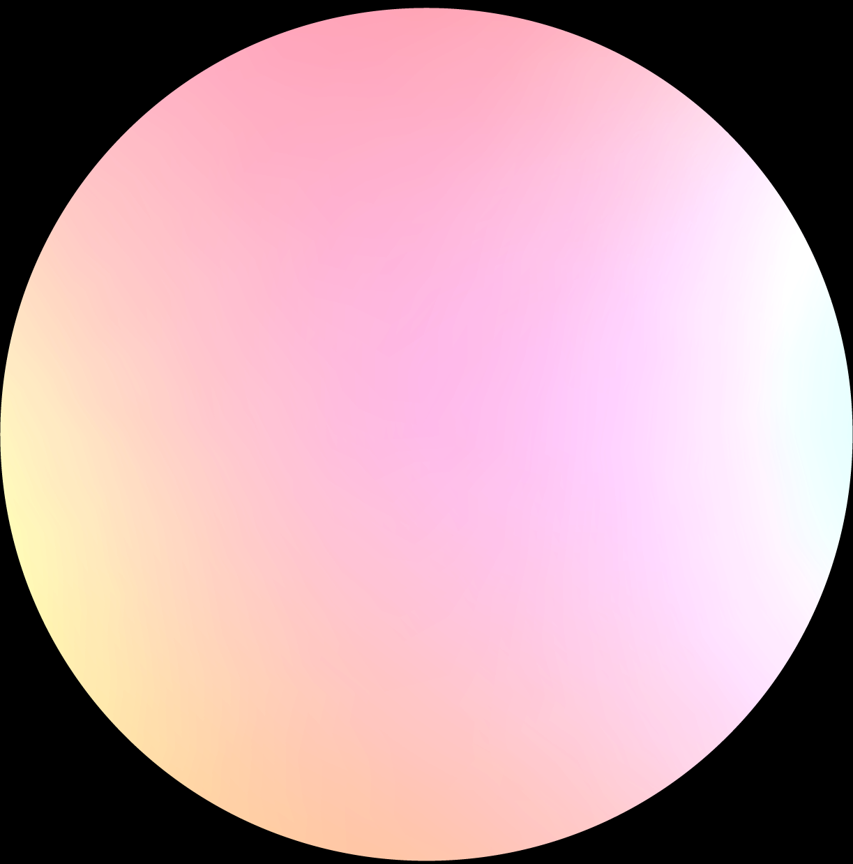


Our Team
Jenna Doe
Sam Patterson
Here you can talk a bit about this person. Replace the image too!
Here you can talk a bit about this person. Replace the image too!

Slide 28
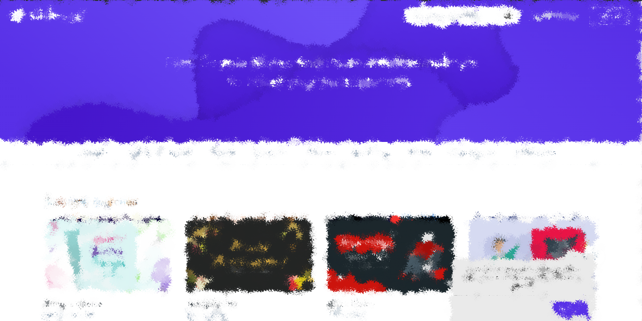
Sneak Peek
Mercury
You can replace the image on the screen with your own work. Just delete this one, add yours and center it properly

Slide 29
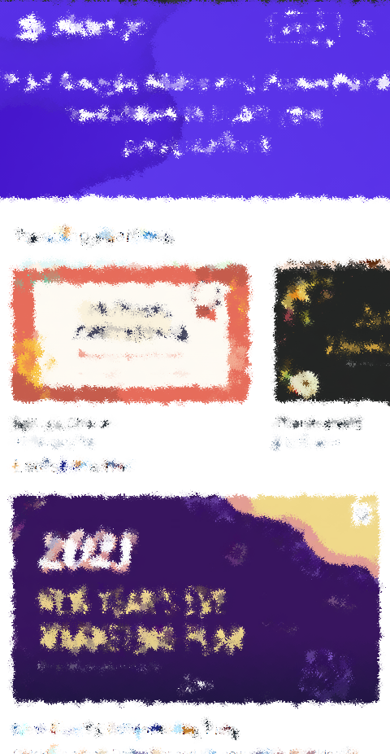
Sneak Peek
Mercury
You can replace the image on the screen with your own work. Just delete this one, add yours and center it properly

Slide 30
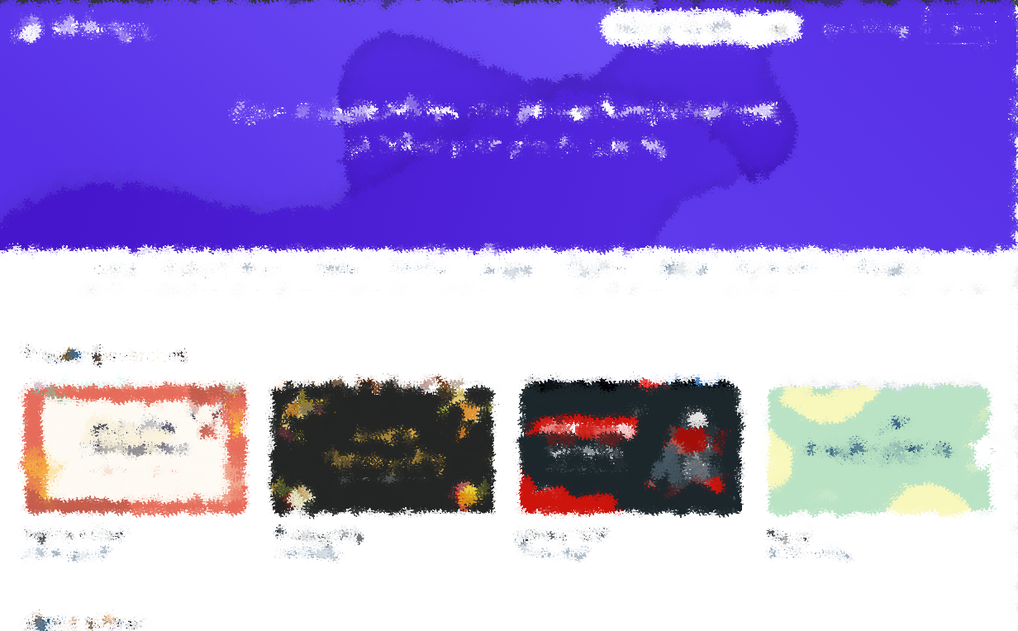
Sneak Peek
Mercury
You can replace the image on the screen with your own work. Just delete this one, add yours and center it properly

Slide 31
Thanks!
Do you have any questions?
addyouremail@freepik.com
+91 620 421 838
yourcompany.com
Please keep this slide for attribution

