Slide 1
Modern Shapes Math Lesson
Here is where your presentation begins

Slide 2
—Someone Famous
“This is a quote, words full of wisdom that someone important said and can make the reader get inspired.”

Slide 3
Whoa!
This can be the part of the presentation where you can introduce yourself, write your email…

Slide 4
01
02
03
04
Algebra
Arrays
Here you can describe the topic of the section
Here you can describe the topic of the section
Square Roots
Statistics
Here you can describe the topic of the section
Here you can describe the topic of the section

Slide 5
01
Algebra
You can enter a subtitle here if you need it

Slide 6
About Algebra
Do you know what helps you make your point clear?
Lists like this one:
They’re simple
You can organize your ideas clearly
You’ll never forget to buy milk!
And the most important thing: the audience won’t miss the point of your math presentation
a
b
c

Slide 7
Functions
Mercury
Jupiter
It’s the closest planet to the Sun and the smallest one
Jupiter is a gas giant and the biggest planet
Venus
It has a nice name and is the second planet

Slide 8
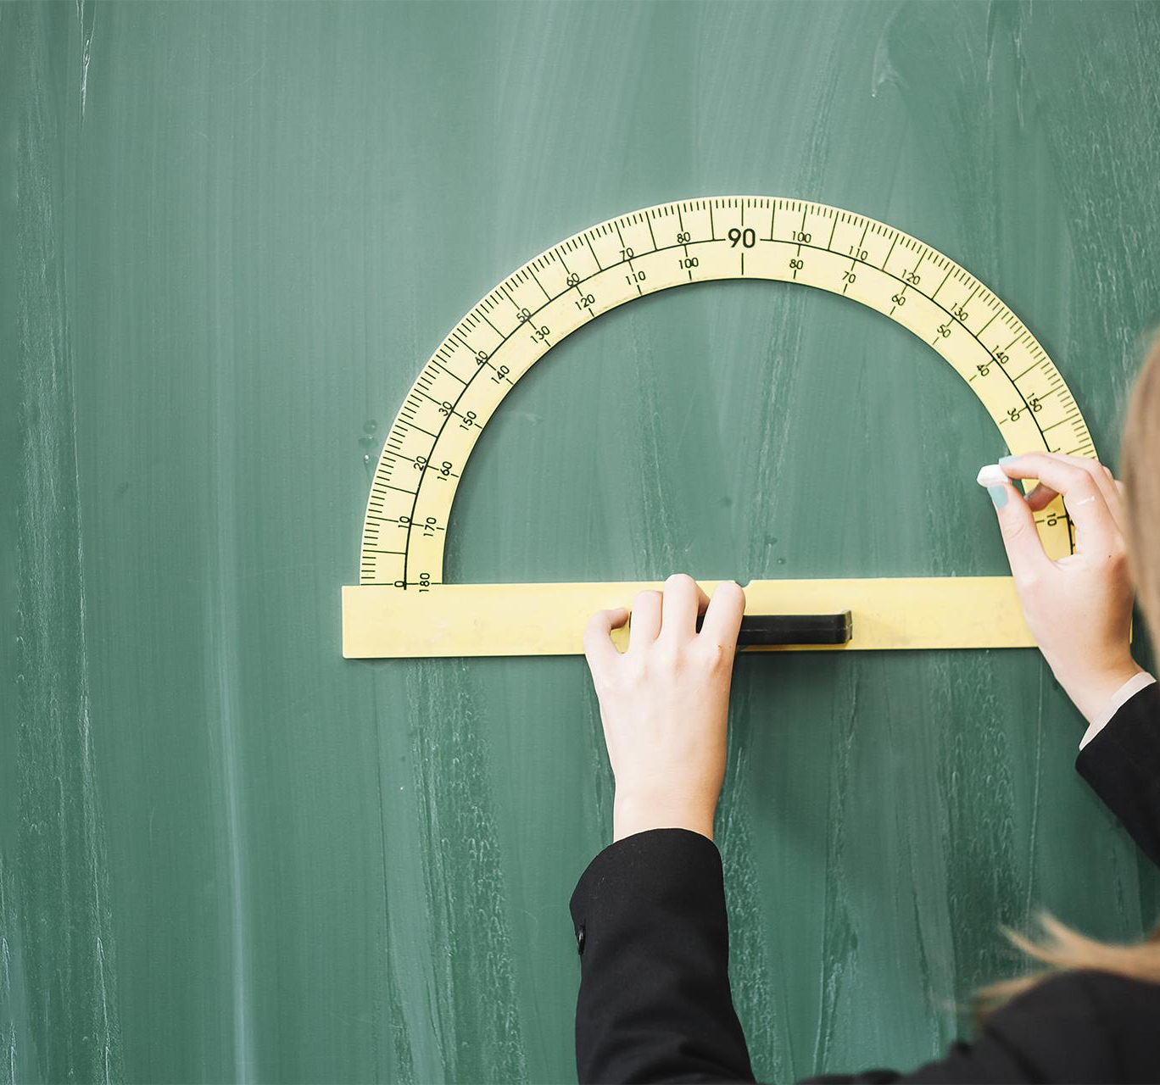
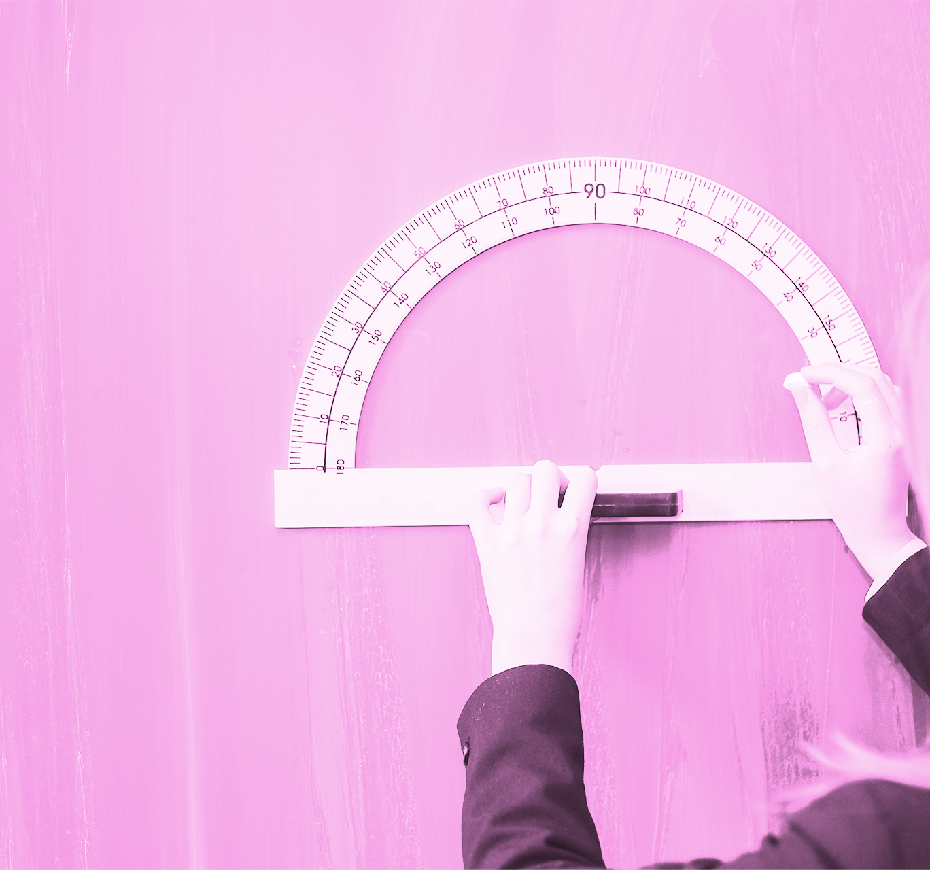
A Picture Always Reinforces the Concept
Images reveal large amounts of data, so remember: use an image instead of a long text. Your audience will appreciate that

Slide 9
Awesome Words

Slide 10
Geometry
Mercury
Venus
Mercury is the closest planet to the Sun and the smallest one in the Solar System
Venus has a beautiful name and is the second planet from the Sun. It’s terribly hot

Slide 11
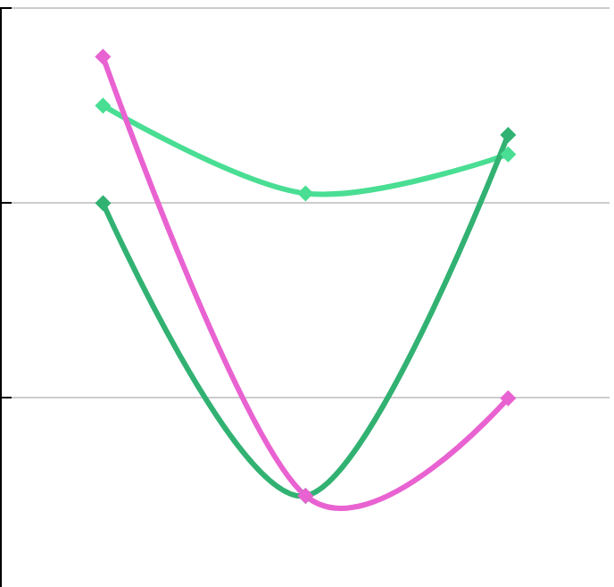
Statistics
60
Mercury
Mercury is the closest planet to the Sun
40
Venus
20
Venus has a nice name and is the second planet
0
01
02
03
Earth
To modify this graph, click on it, follow the link, change the data and paste the new graph here
Earth is the only one that harbors life

Slide 12


A Picture Is Worth a
Thousand Words

Slide 13
Math Symbols
Mars
Mercury
Mars is actually a very cold place
Mercury is the closest planet to the Sun
Jupiter
Venus
Jupiter is a gas giant and the biggest planet
Venus has a nice name and is the second planet
Saturn
Earth
It's composed mostly of hydrogen and helium
It is the only one that harbors life

Slide 14
Exercise
Fill the following gaps. You can use the formula
45
45
30
70
90
45
30
Cos | Tan | Sin
70 | _ | _
Cos | Tan | Sin
_ | 90 | _

Slide 15
Probability
Diamonds
Hearts
Ovals
Despite being red,
Mars is a cold place
Jupiter is a gas giant and the biggest
Neptune is the farthest planet
First Move
Third Move
Fifth Move
50%
23%
80%
Second Move
Fourth Move
Sixth Move
20%
50%
20%

Slide 16
Algebra
⨍(x)＝tan x
Mars
Venus
Mercury
Despite being red, Mars is actually a cold place
Venus has a beautiful name and is the second
Mercury is the closest planet to the Sun
Neptune
Saturn
Neptune is the farthest planet from the Sun
Saturn is a gas giant and has several rings

Slide 17
Geometry
Mercury
Saturn
Mercury is the closest planet to the Sun
Saturn is a gas giant and has several rings
Venus
Jupiter
Venus has a beautiful name and is the second
Jupiter is a gas giant and the biggest planet

Slide 18
Percentages
50%
Mercury
75%
Neptune
Mercury is the closest planet to the Sun
Neptune is the farthest planet from the Sun
25%
Saturn
60%
Earth
Saturn is a gas giant and has several rings
Earth is the planet where we live on

Slide 19
Statistics
Saturn is a gas giant and has several rings. It's composed mostly of hydrogen and helium

Slide 20
Calculus
y
Saturn
ƒ(x)
ƒ(x)
Saturn is a gas giant and has several rings
s
Neptune
s
Neptune is the farthest planet
a
b
x

Slide 21
02
Arrays
You can enter a subtitle here if you need it

Slide 22
150,000
Big numbers catch your audience’s attention

Slide 23
20,000
5,000
It’s the closest planet to the Sun
Venus is the second planet from the Sun

Slide 24
Calendar
08
Neptune is the farthest
Mon | Tue | Wed | Thu | Fri | Sat | Sun
01 | 02 | 03 | 04 | 05 | 06 | 07
08 | 09 | 10 | 11 | 12 | 13 | 14
15 | 16 | 17 | 18 | 19 | 20 | 21
22 | 23 | 24 | 25 | 26 | 27 | 28
29 | 30 | 31
11
Jupiter is a gas giant
20
Pluto is a dwarf planet
31
Mercury is the smallest

Slide 25
Geometric Shapes
Jupiter
Venus
It’s a gas giant and the biggest planet
Venus has a beautiful name
a
b
d
Saturn
Mars
c
Saturn is the ringed planet
Mars is actually a cold place

Slide 26
This Is a Map
Americas
10%
60%
Asia
Mercury is the smallest planet
Jupiter is the biggest planet
50%
80%
Africa
Oceania
Despite being red, It is a cold place
Saturn is the ringed planet

Slide 27
History of Math
Mercury is the smallest planet of them all
Venus is the second planet from the Sun
It’s the biggest object in the Solar System
2015
2017
2020
01
02
03
04
05
Neptune is the farthest planet from the Sun
Despite being red, Mars is a cold place
2016
2019

Slide 28
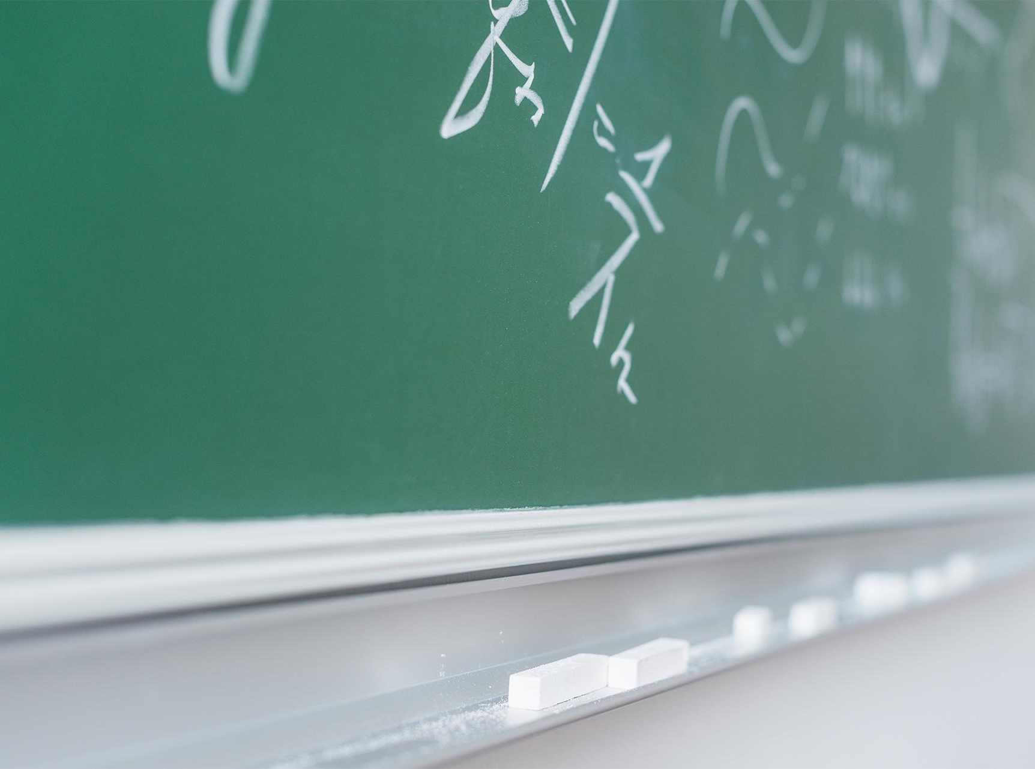
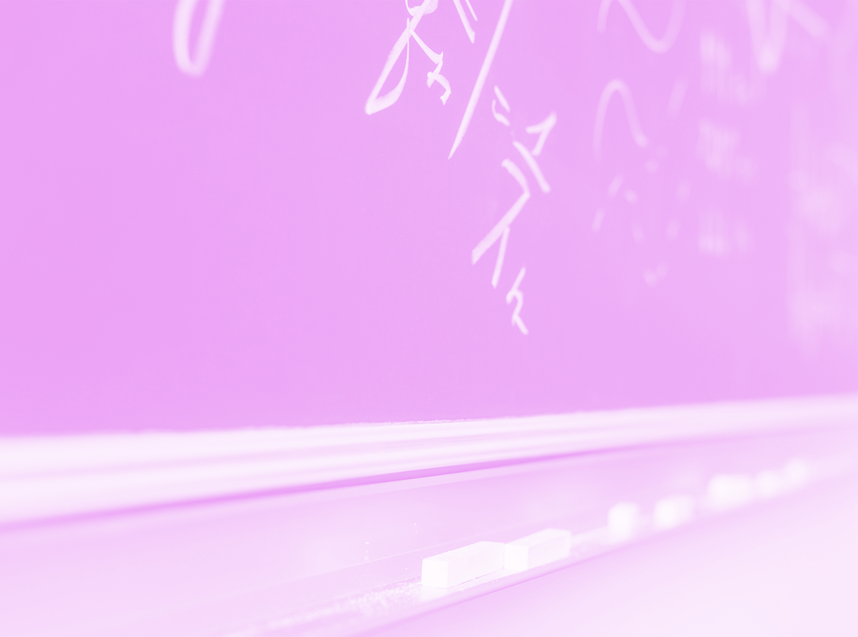
Multimedia
If you want, you can insert your multimedia content here

Slide 29
Our Teachers
Sarah Patt
John Doe
Here you can talk a bit about this person
Here you can talk a bit about this person

Slide 30
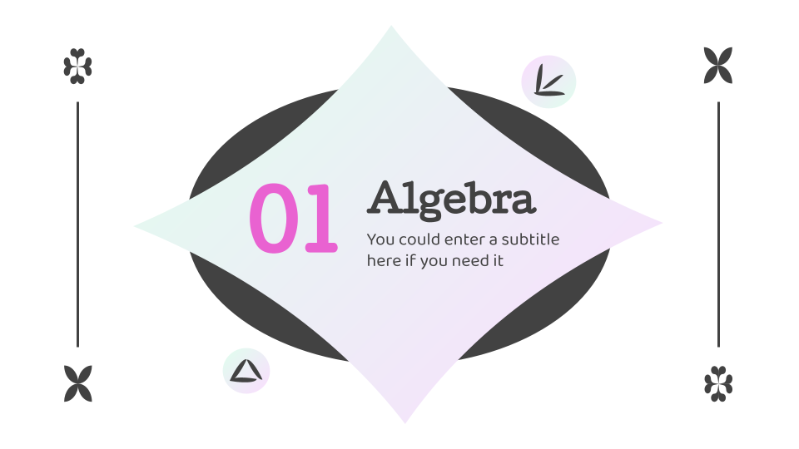
Desktop Web
You can replace the image on the screen with your own work. Just delete this one, add yours and center it properly

Slide 31

Tablet App
You can replace the image on the screen with your own work. Just delete this one, add yours and center it properly

Slide 32
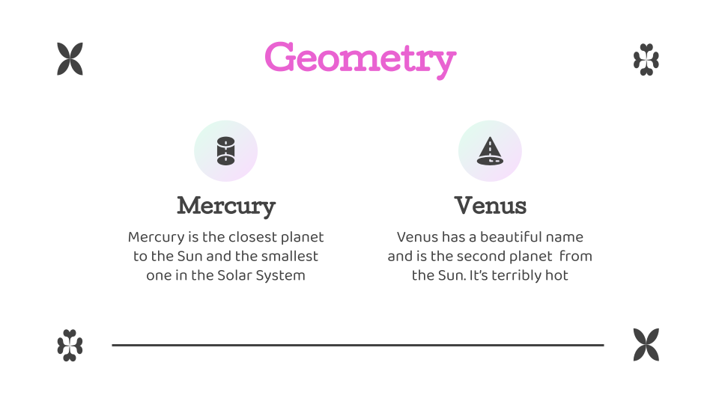
Mobile App
You can replace the image on the screen with your own work. Just delete this one, add yours and center it properly

Slide 33
Thanks
Do you have any questions?
Add youremail@freepik.com
+91 620 421 838
yourcompany.com
Please keep this slide for attribution

Slide 34
Math

Slide 35
Alternative Resources

