Slide 1
Nana Gradients
Here is where your
digital campaign begins

Slide 2
—Someone Famous
“This is a quote, words full of wisdom that someone important said and can make the reader get inspired.”

Slide 3

Whoa!
This can be the part of the presentation where you can introduce yourself, write your email…

Slide 4
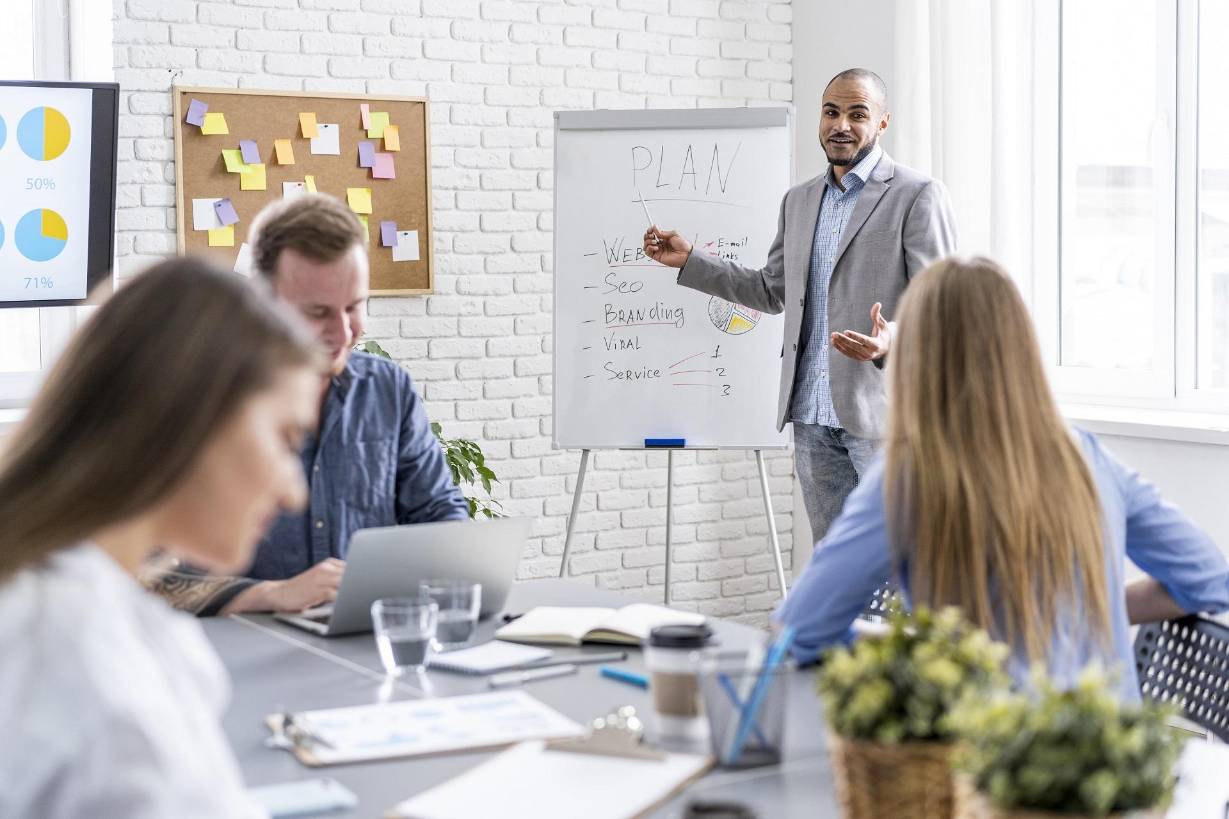
Purpose Of This Meeting
Meetings are held to achieve certain goals, namely:
Submit information
Get input in the form of criticism or suggestions
Solve the problem
Establish cooperation
Take decisions fairly

Slide 5
Meeting Objectives
Mercury
Mars
Mercury is the closest planet to the Sun and the smallest one in the Solar System—it’s only a bit larger than the Moon
Despite being red, Mars is a cold place, not hot. It’s full of iron oxide dust, which gives the planet its reddish cast

Slide 6
01
04
Project Schedule
Upcoming Report
02
05
Project Timeline
Analysis
03
06
Status Report
My Team
Here you can describe the topic of the section
Here you can describe the topic of the section
Here you can describe the topic of the section
Here you can describe the topic of the section
Here you can describe the topic of the section
Here you can describe the topic of the section

Slide 7
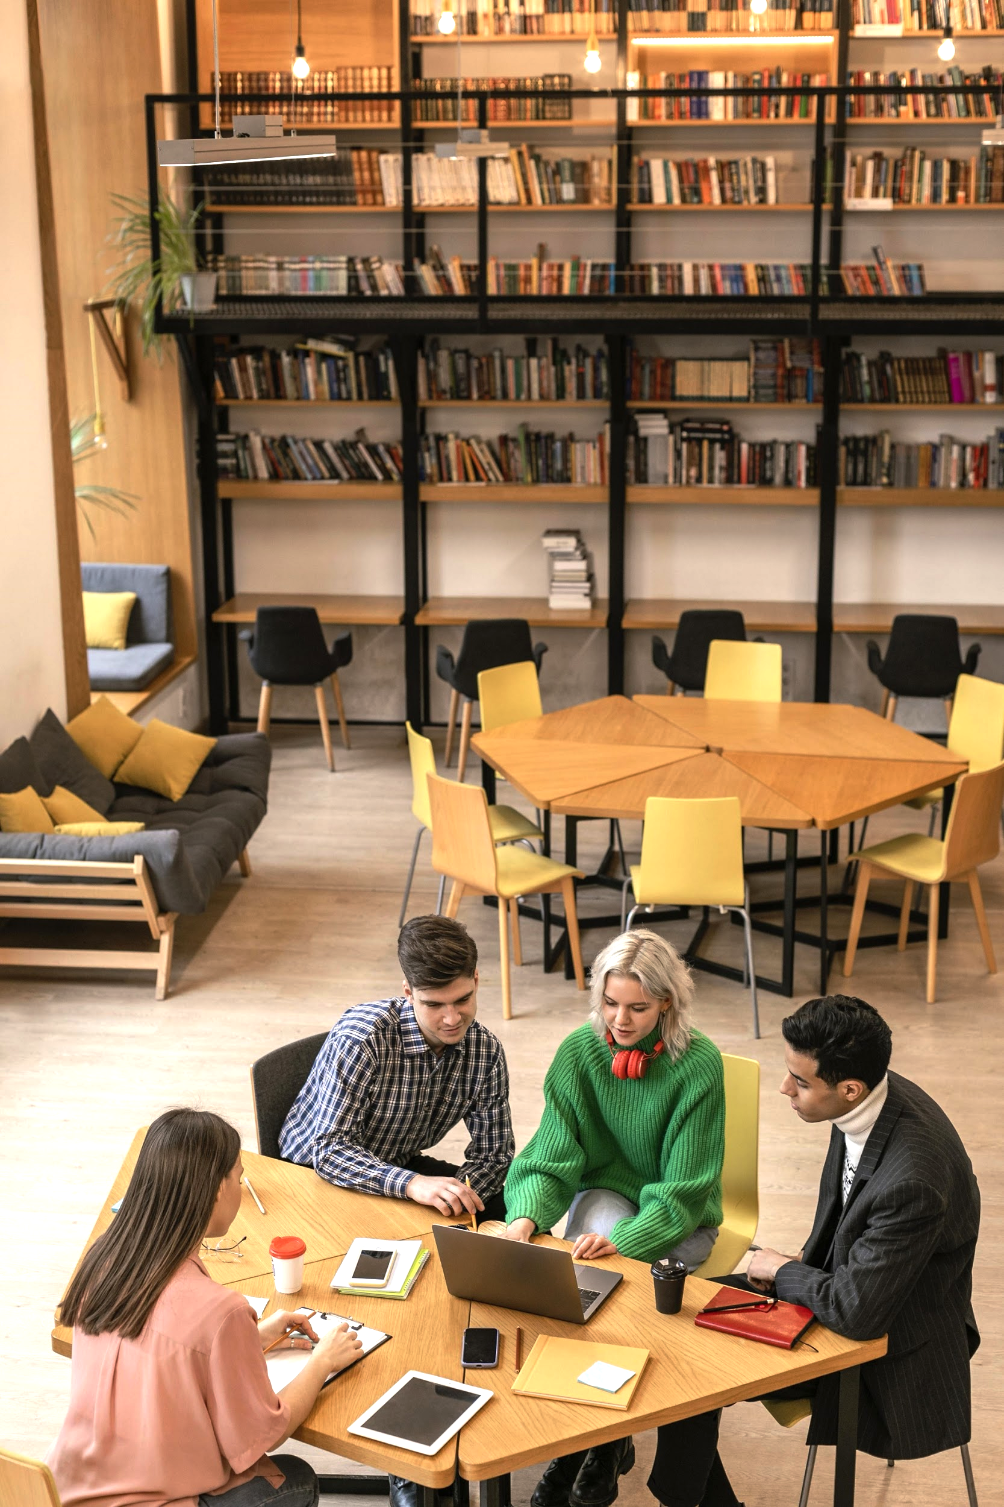
About The Project
Mercury is the closest planet to the Sun and the smallest one in the Solar System—it’s only a bit larger than the Moon.

Slide 8
01
Project Schedule
You can enter a subtitle here if you need it

Slide 9
Project Schedule
Monday | Tuesday | Wednesday | Thursday | Friday | Saturday | Sunday
1 | 2 | 3 | 4 | 5 | 6 | 7
8 | 9 | 10 | 11 | 12 | 13 | 14
15 | 16 | 17 | 18 | 19 | 20 | 21
22 | 23 | 24 | 25 | 26 | 27 | 28
29 | 30 | 31
Saturn is a gas giant
Mars is actually a cold place

Slide 10
Project Timeline
Phase 2
Phase 4
Phase 1
Phase 3
Venus is the second planet from the Sun
Saturn is the ringed one and a gas giant
Mercury is the closest planet to the Sun
Saturn is the biggest one in the Solar System

Slide 11
Checklist
 | Strategy 1 | Strategy 2 | Strategy 3 | Strategy 4
Describe Here Your Task 1
Describe Here Your Task 2
Describe Here Your Task 3
Describe Here Your Task 4

Slide 12
Awesome Words

Slide 13
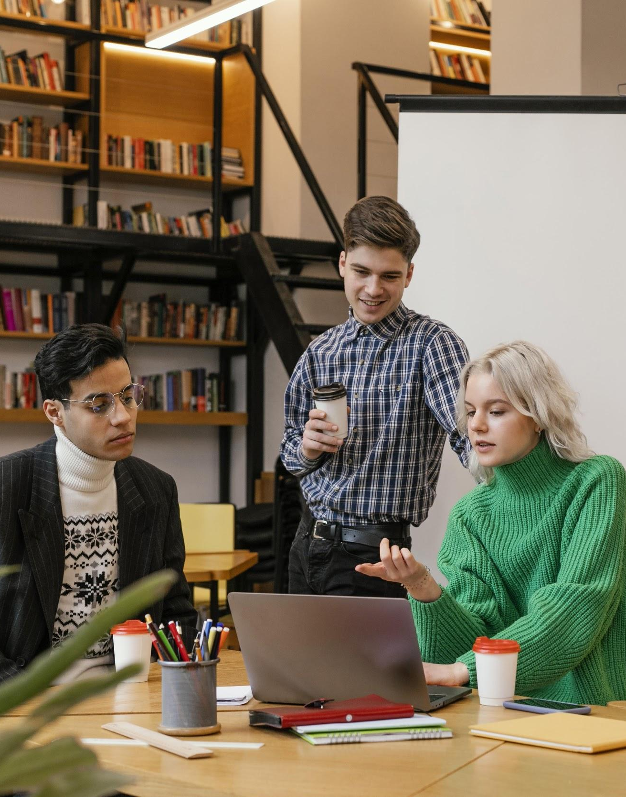
Main Priorities
Mercury
Mars
Saturn is the ringed one. It’s a gas giant, composed mostly of hydrogen and helium
Despite being red, Mars is a cold place. The planet is full of iron oxide dust

Slide 14
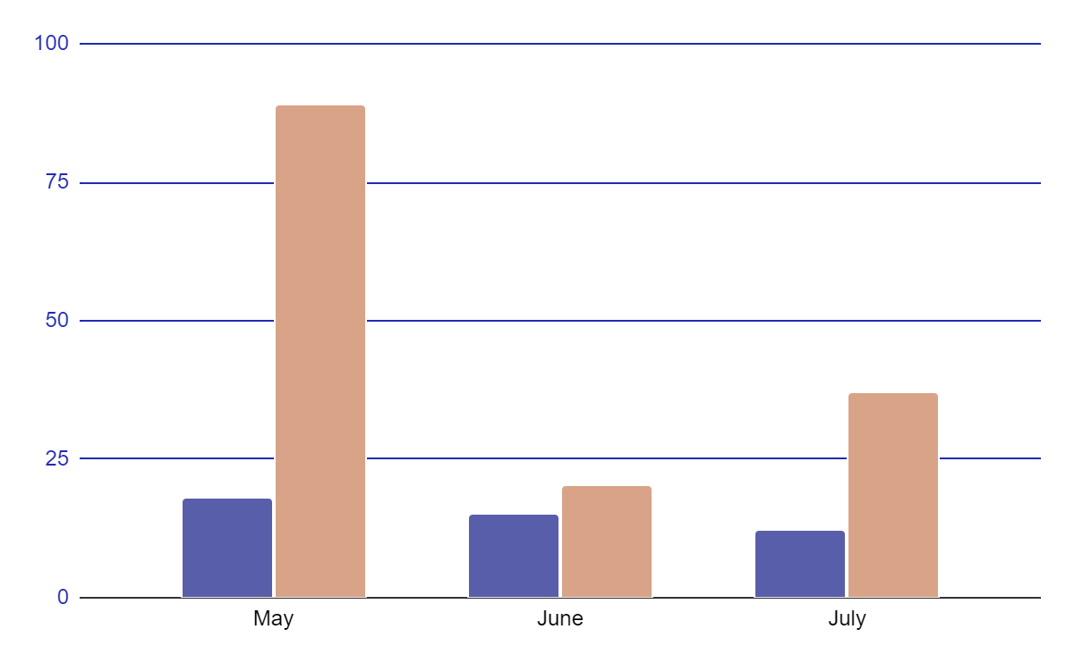
KPI Dashboard
40%
60%
28,880
17,554
It’s the biggest one in the Solar System
Saturn is the ringed one and a gas giant
To modify this graph, click on it, follow the link, change the data and replace it
Mars is actually a cold place
It’s the biggest one in the Solar System
Saturn is the ringed one and a gas giant
Saturn is a gas giant

Slide 15
Project Progress
55%
20%
25%
Mercury
Jupiter
Saturn
Mercury is the smallest planet of them all
It’s the biggest one in the Solar System
Saturn is the ringed one and a gas giant

Slide 16
Status Report
Schedule |  | The project schedule is on track
Resourcing |  | Resourcing is adequate
Budget |  | Project is within budget
Risks |  | All project risks are under control
Issues |  | Project issues need to be solved

Slide 17
Raid Summary
Risk
Issues
Assumptions
Dependencies
Venus is the second planet from the Sun
Saturn is the ringed one and a gas giant
Mercury is the closest planet to the Sun
It’s the biggest one in the Solar System

Slide 18
Our Goals
Where We Are
Where We Want to Be
Mercury is the closest planet to the Sun and the smallest one in the Solar System—it’s only a bit larger than the Moon
Despite being red, Mars is a cold place, not hot. It’s full of iron oxide dust, which gives the planet its reddish cast

Slide 19
Reports
Mercury
Venus
Mars
Jupiter
Saturn
Neptune
Mercury is the smallest planet of them all
Venus is the second planet from the Sun
Despite being red,Mars is a cold place
It’s the biggest one in the Solar System
Saturn is the ringed one and a gas giant
It’s the farthest planet from the Sun

Slide 20
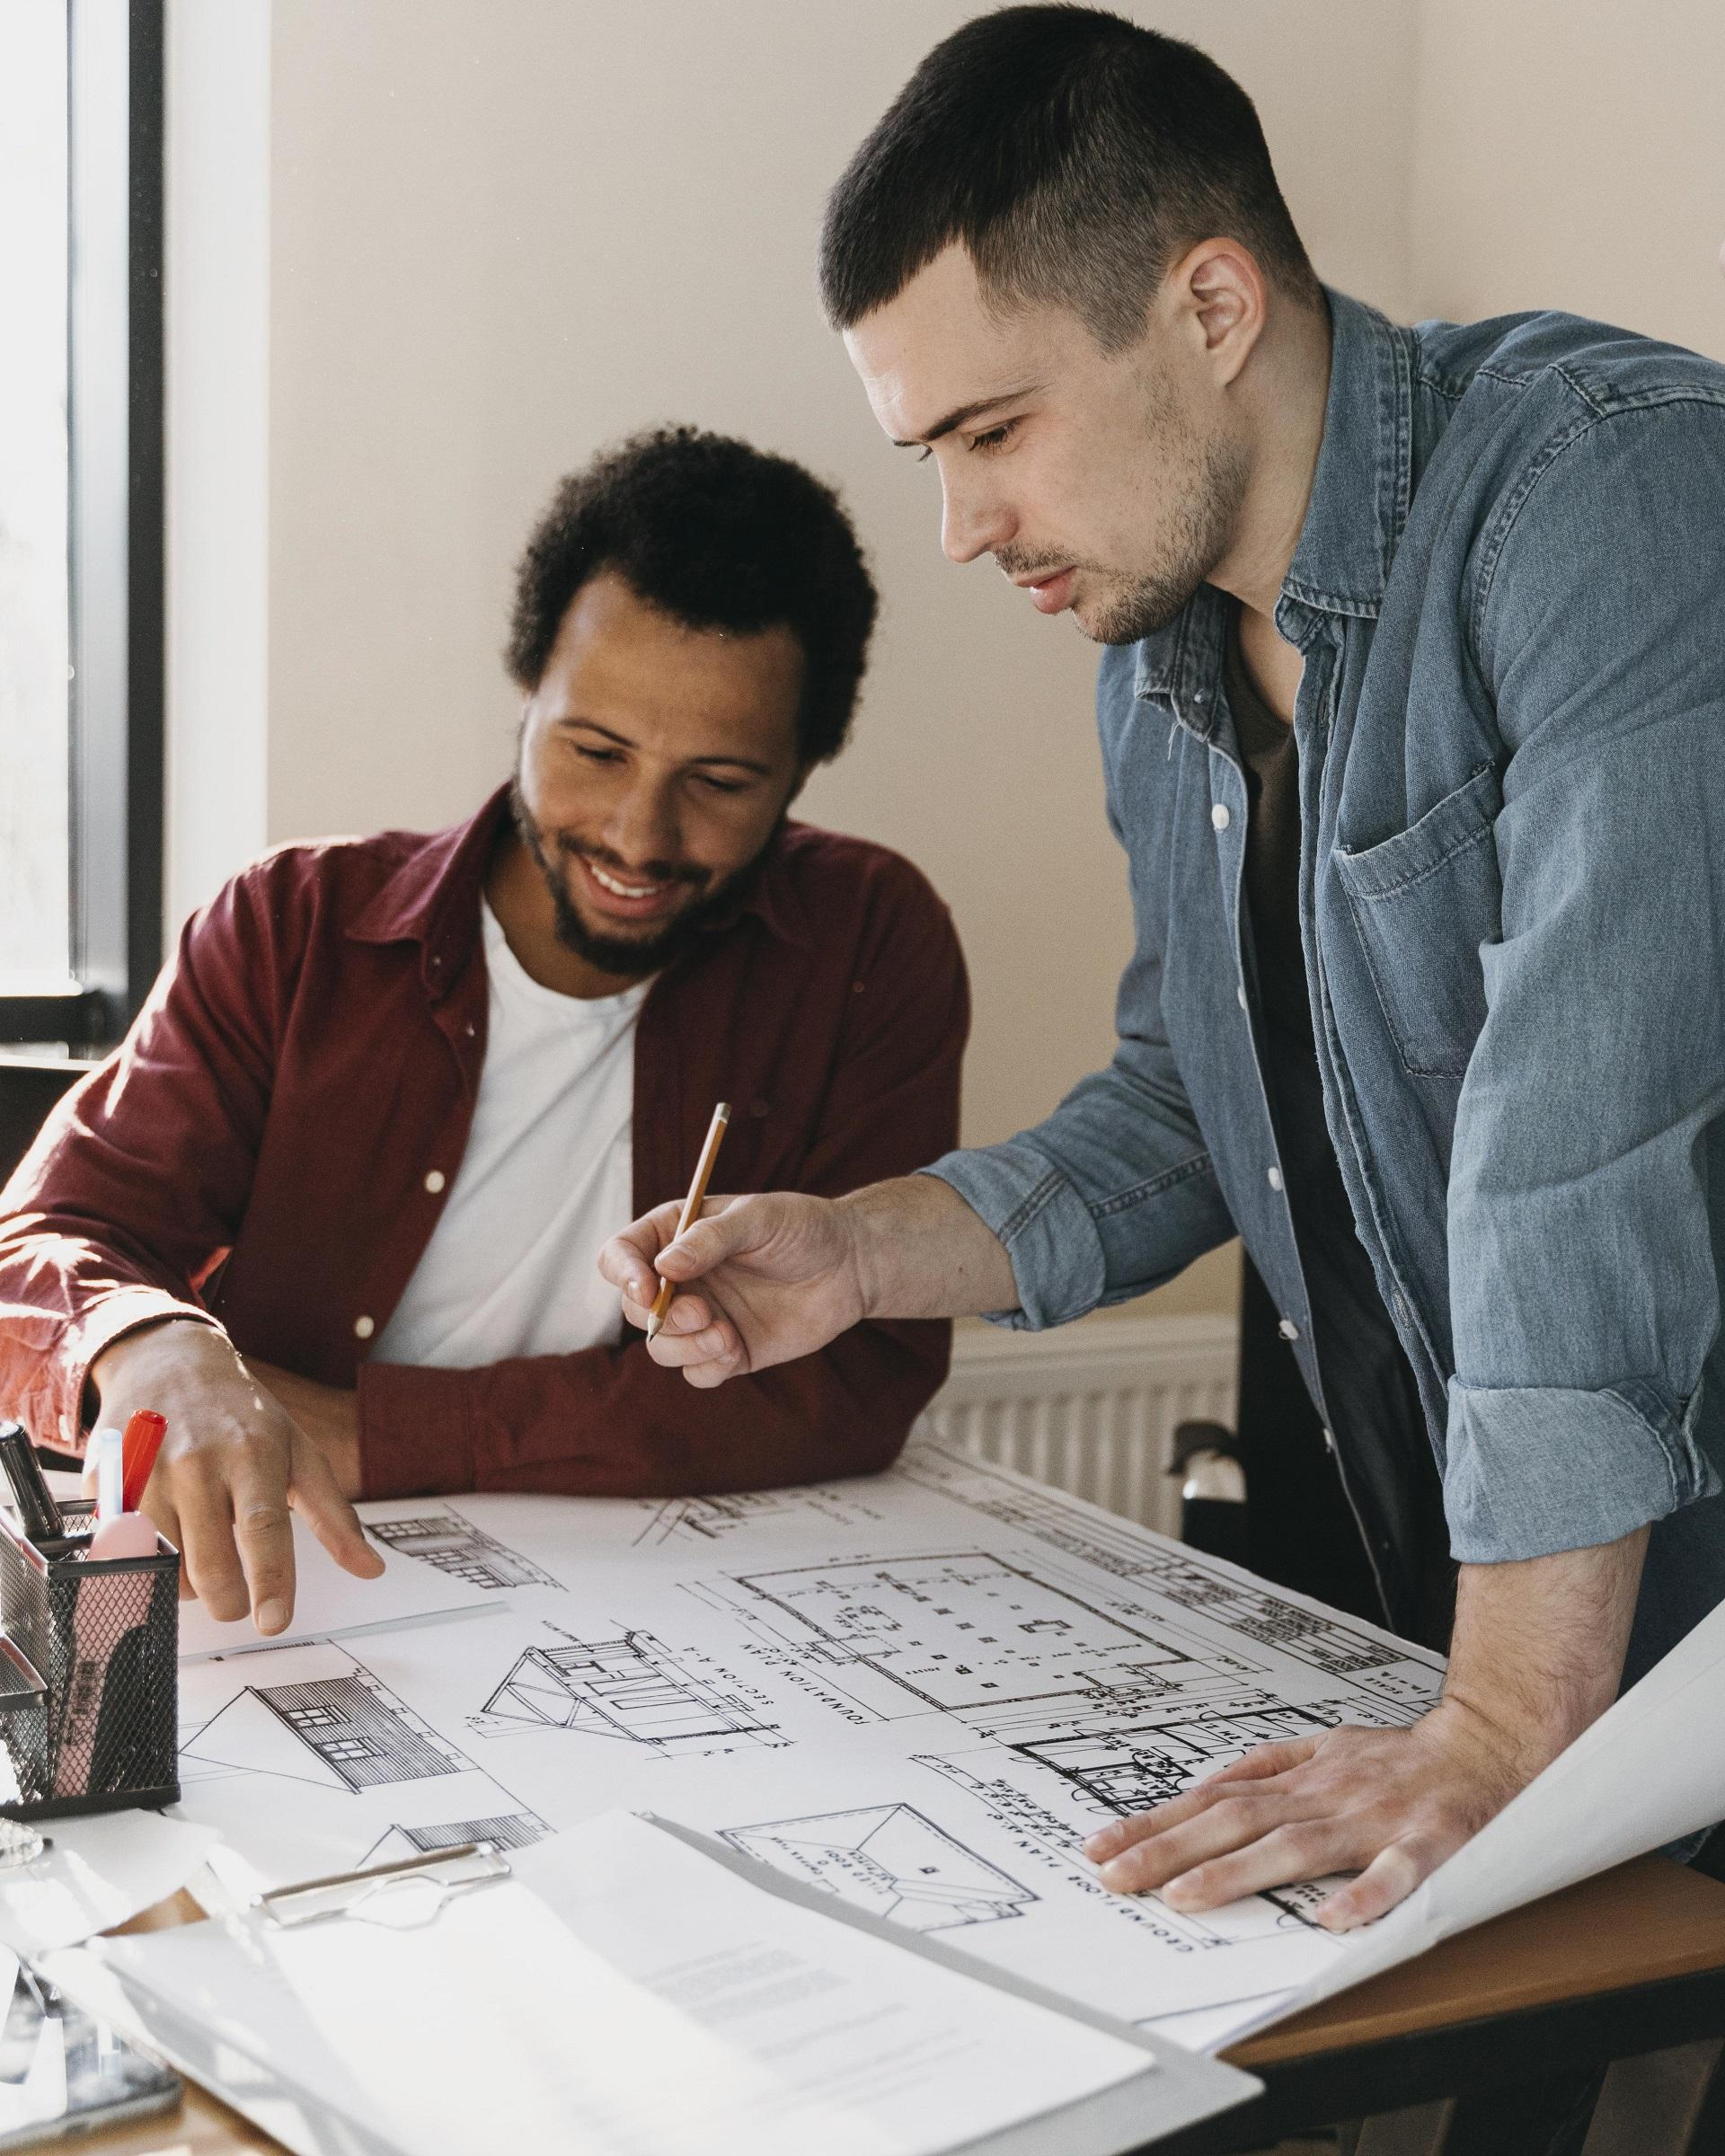
Four Surefire Strategies
Mercury
Mars
Venus
Jupiter
Mercury is the smallest planet of them all
Despite being red, Mars is a cold place
Venus is the second planet from the Sun
It’s the biggest one in the Solar System

Slide 21
Upcoming Events
Venus
Mercury
Venus is the second planet from the Sun
Mercury is the closest planet to the Sun

Slide 22

A picture is worth a thousand words

Slide 23

500,000
Mercury is the closest planet to the Sun and the smallest one in the Solar System

Slide 24



Our Team
Maria
Robert
Silvia
Here you can talk a bit about this person
Here you can talk a bit about this person
Here you can talk a bit about this person

Slide 25

Multimedia
Mercury is the closest planet to the Sun and the smallest one in the Solar System—it’s only a bit larger than the Moon

Slide 26

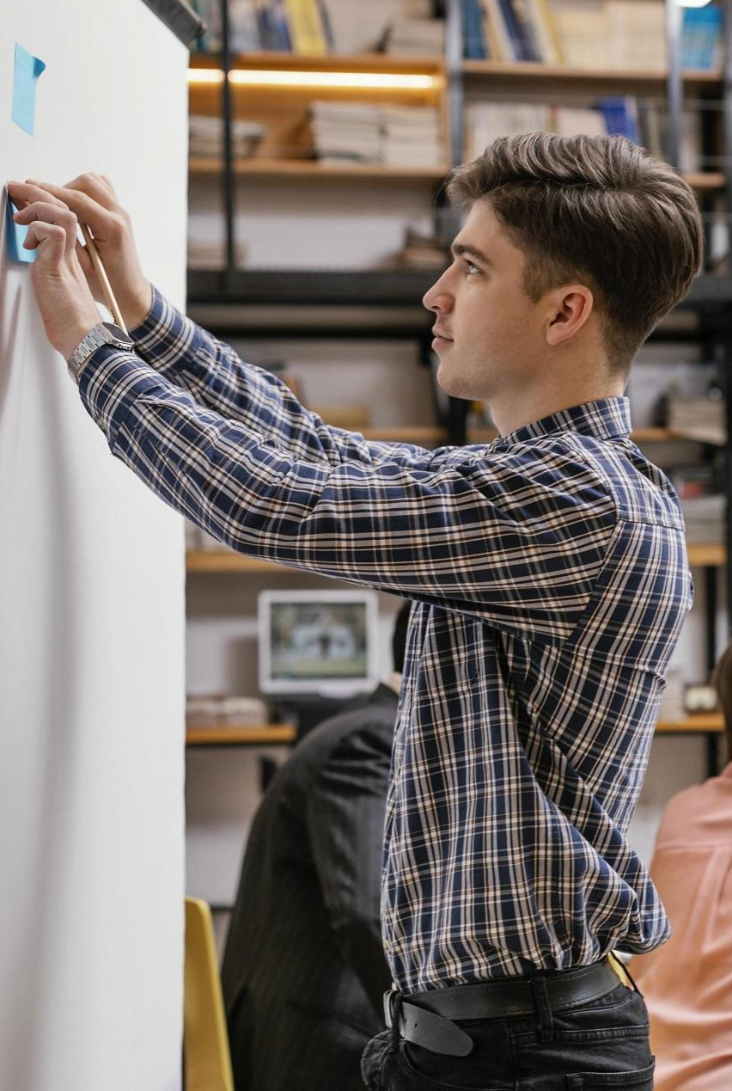
Thanks
Do you have any questions? youremail@freepik.com
+91 620 421 838 | yourcompany.com
Please keep this slide for attribution

Slide 27
Alternative Icons

