Slide 1
Topic 2: Part II Interactive Graphics Programming

Slide 2
Question
输入一组整数，按照要求分别对其按照从小到大和从大到小的顺序进行排序（用“冒泡法”）。
“冒泡法”排序基本原理（假设有n个数）：
分别对这组n个数做n-1轮扫描：
每一轮扫描，分别比较相邻两个数，若前一个数大于（或小于）后一个数，则将此相邻两个数交换位置。
每一轮比较，都会将当前最大的整数调整到后面——“冒”出来。
经过n-1轮后，所有的整数都被调整到它们应该在的位置上。

Slide 3
Main function
#include <stdio.h>
static int array[10]={6,3,5,7,4,2,9,8,0,1};
void BubbleA(int array[ ], int n); /*Sort in an ascending order*/
void BubbleB(int array[ ], int n); /*Sort in a descending order*/
main()
{
int k;
printf(“Ascending(0) or Descending(1) order? “);
scanf(“%d”, &k);
if (k == 0)
BubbleA(array, 10);
else if (k == 1)
BubbleB(array, 10);
for (k=0; k<10; k++) printf(“%d “, array[k]);
}

Slide 4
Bubble functions
void BubbleA(int array[ ], int n)
{
int i, j, t;
for (j = 0; j < n-1; j++) {
for (i = 0; i < n-1-j; i++) {
if (array[i] > array[i+1]) {
t = array[i];
array[i] = array[i+1];
array[i+1] = t;
}
}
}
void BubbleB(int array[ ], int n)
{
int i, j, t;
for (j = 0; j < n-1; j++) {
for (i = 0; i < n-1-j; i++) {
if (array[i] < array[i+1]) {
t = array[i];
array[i] = array[i+1];
array[i+1] = t;
}
}
}

Slide 5
Can we define ONLY one set function?
void Bubble(int array[ ], int n, ……)
{
int i, j, t;
for (j = 0; j < n-1; j++) {
for (i = 0; i < n-1-j; i++) {
if (compare(array[i],array[i+1])) {
t = array[i];
array[i] = array[i+1];
array[i+1] = t;
}
}
}
int Large(int a, int b)
{ return (a>b); }
The KEY problem is : how to declare the formal parameter?
int Less(int a, int b)
{ return (a<b); }
main()
{ ……
if (flag == 0)
Bubble(array, 10, Large);
else if (flag == 1)
Bubble(array, 10, Less);
……
}
The answer is: YES!

Slide 6


Function Pointer
What is the function name?
int f(int a, int b);
function name is address (a constant).
that is a pointer!
How to declare a pointer variable to a function?
int *funptr; ?
int *funptr(int a, int b); ?
int (*funptr)(int a, int b); ?
if : funptr = f; then: (*funptr)(a, b) ; <==> f(a, b);
What is: int (*funptr[5])(int a, int b); ?

Slide 7
Declare function pointer as parameter!
void Bubble(int array[ ], int n, int (*compare)(int a, int b))
{
int i, j, t;
for (j = 0; j < n-1; j++) {
for (i = 0; i < n-1-j; i++) {
if ((*compare)(array[i],array[i+1])) {
t = array[i];
array[i] = array[i+1];
array[i+1] = t;
}
}
}
main()
{ ……
if (flag == 0)
Bubble(array, 10, Large);
else if (flag == 1)
Bubble(array, 10, Less);
……
}

Slide 8
call on value
if ( a==0 )
a0();
else if ( a==1 )
a1();
else if ( a== 2 )
a2();
switch ( a ) {
case 0: a0();break;
case 1: a1();break;
case 2: a2();break;}
void (*fa[])() = {a0,a1,a2};
if ( a>=0 && a < sizeof(fa)/sizeof(fa[0]))
(*fa [a])();
Extensibility is the KING!

Slide 9
Main: use function pointer array
#include <stdio.h>
#include <string.h>
static int array[10]={6,3,5,7,4,2,9,8,0,1};
int Large(int a, int b);
Int Less(int a, int b);
typedef struct {
char* name;
void (*cmd)();
} SC;
SC cmds[] = {
{“Ascending", Large},
{“Descending", Less}
};
char cmdstring[20];

Slide 10
Main: use function pointer array
main()
{
int k;
printf("Ascending or Descending? ");
scanf("%s", cmdstring);
for (k = 0; k < sizeof(cmds)/sizeof(cmds[0]); k++) {
if (strcmp(cmdstring, cmds[k].name) == 0)
Bubble(array, 10, cmds[k].cmd);
}
for (k=0; k<10; k++) printf("%d ", array[k]);
printf("\n");
}

Slide 11
typedef
将C语言中的已有类型（包括已定义过的自定义类型）重新命名
新的名称可以代替已有数据类型
常用于简化对复杂数据类型定义的描述
typedef <已有类型名> <新类型名>;
typedef int INTEGER;
INTEGER i, j; <====> int i, j;
typedef char* string;
string p1; <====> char *p1;

Slide 12
用typedef定义新类型名的一般步骤：
定义变量 int i；
变量名→新类型名 i → INTEGER；
加上 typedef typedef int INTEGER；
用新类型名定义变量 INTEGER i;
定义一个具有10个整型元素的数组类型NUM：
int num[10]；
int NUM[10]；
typedef int NUM[10]；
NUM a； <===> int a[10]；
思考：用 typedef 写出新类型名POINT的定义_________，使得POINT代表 含有10个元素的整型指针数组类型。

Slide 13
typedef
如何定义如下函数的指针类型 FunPtr？
void fun(int a, int b);
typedef void (*FunPtr)(int a, int b);
void (*fptr)(int a, int b);
void (*FunPtr)(int a, int b);
typedef void (*FunPtr)(int a, int b);
FunPtr fptr; <==> void (*fptr)(int a,int b);

Slide 14
Different Programming Model
legacy code: reads input when the program wants
event-driven code: reacts when user inputs

Slide 15
callback
when something happens, call my function back
1. Register a callback function to the place where something will happed in the future.
2. When something happens, that function will be called.
It is usually used in event handling, where the code which knows an event -- like key stroke or mouse moving -- happens, calls the function which is able to deal the situation.

Slide 16
Four Categories of Callbacks
Keyboard messages callback
void KeyboardEventProcess(int key, int event);
/*key for which key，event for down/up*/
Character messages callback
void CharEventProcess(char c);/*c for which character(ASCII)*/
Mouse messages callback
void MouseEventProcess(int x, int y, int button, int event);
/*x,y for position, button for which key, event for down/up/move*/
Timer messages callback
void TimerEventProcess(int timerID);
/*timerID for the timer which have been open */

Slide 17
The Callbacks
typedef void (*KeyboardEventCallback) (int key, int event);
typedef void (*CharEventCallback) (int key);
typedef void (*MouseEventCallback) (int x, int y, int button, int event);
typedef void (*TimerEventCallback) (int timerID);

Slide 18
Keyboard
typedef void (*KeyboardEventCallback) (int key, int event);
void registerKeyboardEvent(KeyboardEventCallback callback);
typedef enum {
KEY_DOWN,
KEY_UP
} ACL_Keyboard_Event;

Slide 19
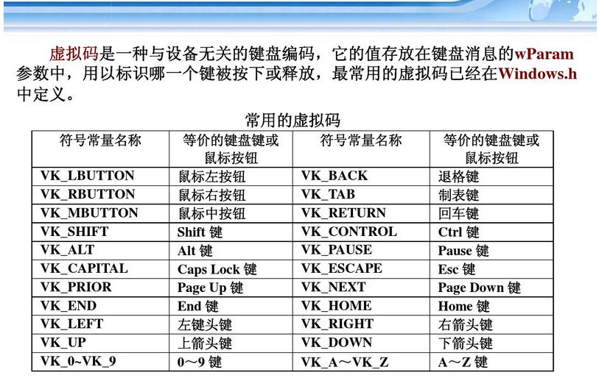
Keyboard
typedef void (*KeyboardEventCallback) (int key, int event);
void registerKeyboardEvent( KeyboardEventCallback callback);
typedef enum {
KEY_DOWN,
KEY_UP
} ACL_Keyboard_Event;

Slide 20
Char
typedef void (*CharEventCallback) (int key);
void registerCharEvent(CharEventCallback callback);

Slide 21
Mouse
typedef void (*MouseEventCallback) (int x,int y,int button,int event);
void RegisterMouseEvent(MouseEventCallback callback);
typedef enum
{
NO_BUTTON = 0,
LEFT_BUTTON,
MIDDLE_BUTTON,
RIGHT_BUTTON
} ACL_Mouse_Button;
typedef enum
{
BUTTON_DOWN,
BUTTON_DOUBLECLICK,
BUTTON_UP,
ROLL_UP,
ROLL_DOWN,
MOUSEMOVE
} ACL_Mouse_Event;

Slide 22
Timer
typedef void (*TimerEventCallback) (int timerID);
void RegisterTimerEvent(TimerEventCallback callback);
void startTimer(int timerID, int timeinterval);
void cancelTimer(int timerID);

Slide 23
References
Read the introductions of these grahics functions in the interface files “graphics.h” and “extgraph.h”, and understand their meanings and usages.
Demo of Interactive Graphics Programming: igp.c

Slide 24
Summary
understand the console window
understand the principles of function pointers
understand the event-driven programming model
learn how to use the callback functions

Slide 25
Homework:
1. 做一个随笔画程序，当鼠标左键按下拖动时，在窗口中随着鼠标位置画出轨迹，当鼠标左键抬起时则不画。
2. 做一个在图形窗口的输入程序。当用户按键时，在图形窗口出现按下的键所代表的字符，并像图形界面的输入框一样自动向右递进，按下回车键结束输入，将用户输入的内容在终端窗口显示出来。
并在此基础上，实现当前位置光标闪烁，并支持左右方向键和两个删除键。

Slide 26
Project:
编写一个小型CAD程序:
支持直线、矩形、椭圆和文字四种图形元素；
实现放置以及选中后删除、选中后改变大小、选中后移动三种功能；
每种图形元素都支持绘制任意个数。

Slide 27
The End

