Slide 1
Statistics and Quantitative Analysis U4320
Segment 12:
Extension of Multiple Regression Analysis
Prof. Sharyn O’Halloran

Slide 2
Key Points
Dummy Variables
  Shift in the intercept
Difference of Means Test
  Are two groups significantly different
Interactive Terms
  Shift in the Slope

Slide 3
I. Introduction to Dummy Variables
A. Definition:
Any dichotomous variable that is coded zero-one
  Examples:
    Gender: 1 for female
    O for male
    Employment: 1 if employed
    0 if unemployed
    Religion: 1 if Catholic
    0 otherwise

Slide 4
I. Introduction to Dummy Variables
B. Example
    Suppose that a certain drug is suspected of raising blood pressure.
    One way to test this hypothesis is to conduct a controlled experiment.
    For example, suppose we randomly sample 10 women, 6 take the drug, 4 do not take the drug.

Slide 5
I. Introduction to Dummy Variables (cont.)
B. Example
  1. Variables
    We represent this information by a dummy variable.
      Y = Level of Blood Pressure
      D = number of doses of this drug daily
        D = 1 if she took the drug
        D = 0 if she did not (i.e., was a control)

Slide 6
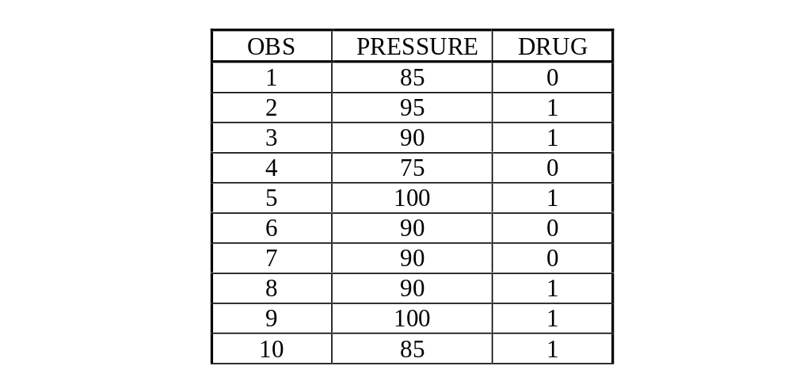
I. Introduction to Dummy Variables (cont.)
B. Example
  2. Data

Slide 7
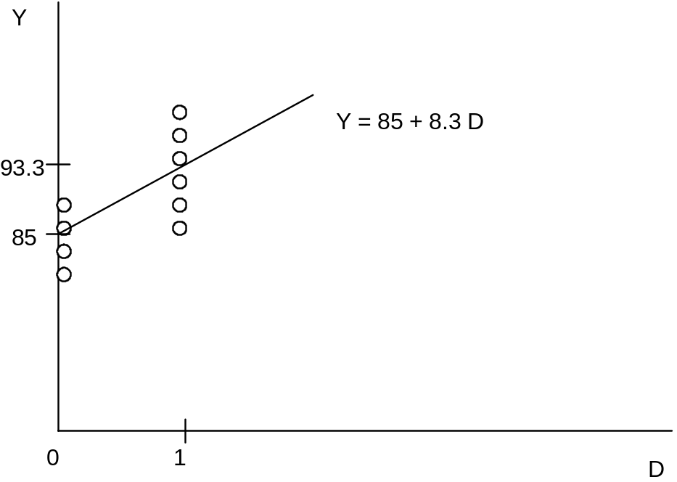
I. Introduction to Dummy Variables (cont.)
B. Example
  3. Graph

Slide 8
I. Introduction to Dummy Variables (cont.)
B. Example
  4. Results
      There are four observations when D = 0. The mean of these observations is 85.
      There are six observations when D = 1. The mean of these observations is 93.3.

Slide 9
I. Introduction to Dummy Variables (cont.)
B. Example
  4. Results (cont.)
    So how do we get a regression line from these data?
      To draw the regression line, we just connect the means of each group!
      This minimizes the sum of the squared distances from the data points to the line.

Slide 10

I. Introduction to Dummy Variables (cont.)
B. Example
  4. Results (cont.)
    The equation would be:

Slide 11
I. Introduction to Dummy Variables (cont.)
B. Example
  5. Interpretation
    The intercept is the average blood pressure level for those who did not take the drug
      The group of all people who did not take the drug is called the reference group, or the control group.
      The intercept is the average of the dependent variable when the dummy variable is 0.

Slide 12
I. Introduction to Dummy Variables (cont.)
B. Example
  5. Interpretation (cont.)
    The coefficient on the Dummy variable states by how much an individual’s blood pressure increases, on average, when given the drug.

Slide 13
I. Introduction to Dummy Variables (cont.)
C. Difference of Means Test
  1. Slope
    What is the difference between the means when the sample is divided into those who took the drug and those who did not?
      As the dummy variable goes from 0 to 1, the value of Y rises by 8.33 points.
        The difference between the means is 8.33.

Slide 14

I. Introduction to Dummy Variables (cont.)
C. Difference of Means Test
  2. Significant Difference
    Now, how can we tell if this slope is significantly different from zero?
      a. Hypothesis

Slide 15
I. Introduction to Dummy Variables (cont.)
C. Difference of Means Test
  2. Significant Difference (cont.)
    b. t-statistic
    c. Accept of Reject
      the variable is significant at the 5% level.

Slide 16
I. Introduction to Dummy Variables (cont.)
C. Difference of Means Test
  3. Interpretation
    What does it mean that the slope is significant?
    People who took the drug did have a significantly higher blood pressure than those who didn't.

Slide 17
I. Introduction to Dummy Variables (cont.)
D. SPSS Example 1:
    Does education vary according to a respondent's religion?
    I investigated whether Catholics had more or less education than the general population.
  1. Hypothesis

Slide 18
I. Introduction to Dummy Variables (cont.)
D. SPSS Example 1:
  1. Hypothesis (cont.)
    1. Commands
      I made my own variable called Catholic.
      I recoded it and gave it value labels, so that all Catholics were coded 1 and all others got a 0.
      I then made a variable for education, called Smarts.
      Finally, I specified my regression.

Slide 19
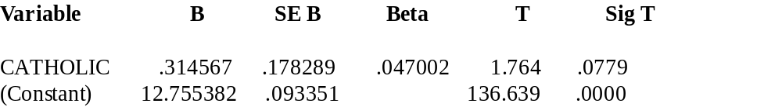
I. Introduction to Dummy Variables (cont.)
D. SPSS Example 1:
  1. Hypothesis
    2. Regression Results

Slide 20
I. Introduction to Dummy Variables (cont.)
D. SPSS Example 1:
  1. Hypothesis
    2. Regression Results (cont.)
      What was the average education level of non-Catholics in the population?
      What's the average education level of Catholics?

Slide 21
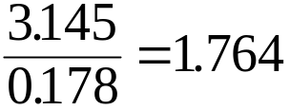
I. Introduction to Dummy Variables (cont.)
D. SPSS Example 1:
  1. Hypothesis
    3. Significance
      Is the coefficient significant at the 5% level?

Slide 22
I. Introduction to Dummy Variables (cont.)
D. SPSS Example 1:
  1. Hypothesis
    4. Difference of Means Results
      For comparison, I did a difference of means test on the same data.
        Is There A Significant Difference Between Catholics
And The Rest Of The Population?

Slide 23
I. Introduction to Dummy Variables (cont.)
D. SPSS Example 1:
  1. Hypothesis
    4. Difference of Means Results (cont.)
      T-TEST /GROUPS CATHOLIC (0,1) /VARIABLES SMARTS.
--------------------------------------------
      Independent samples of CATHOLIC
      Group 1: CATHOLIC EQ .00 Group 2: CATHOLIC EQ 1.00
      t-test for: SMARTS

Slide 24
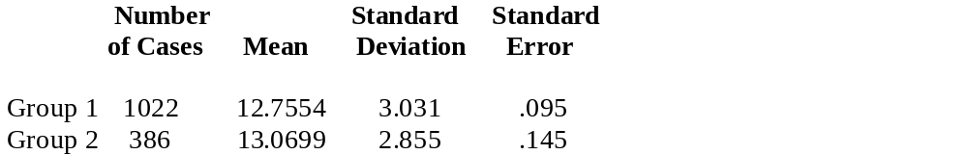
I. Introduction to Dummy Variables (cont.)
D. SPSS Example 1:
  1. Hypothesis
    4. Difference of Means Results (cont.)

Slide 25
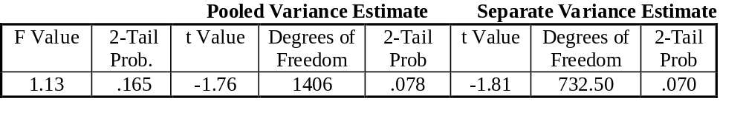
I. Introduction to Dummy Variables (cont.)
D. SPSS Example 1:
  1. Hypothesis
    4. Difference of Means Results (cont.)

Slide 26
I. Introduction to Dummy Variables (cont.)
D. SPSS Example 1:
  1. Hypothesis
    5. Interpretation
      The results suggest that there is no significant difference between Catholics and the rest of the population.

Slide 27
II. More than One Dummy Variable
A. Sample Equation
  If we had many different drugs that we thought might cause high blood pressure, then we could write:
  Then b₁, b₂, b₃, the slope coefficient on the dummy variables, are the difference between the blood pressure of someone taking that drug and a control group which takes none of the drugs.

Slide 28
II. More than One Dummy Variable (cont.)
B. 1. Example: More than One Dummy Variable
    Say that we rerun the regression from before, but we allow religion to be either Protestant, Catholic, Jewish, or Other.
    We create separate variables for each category.

Slide 29
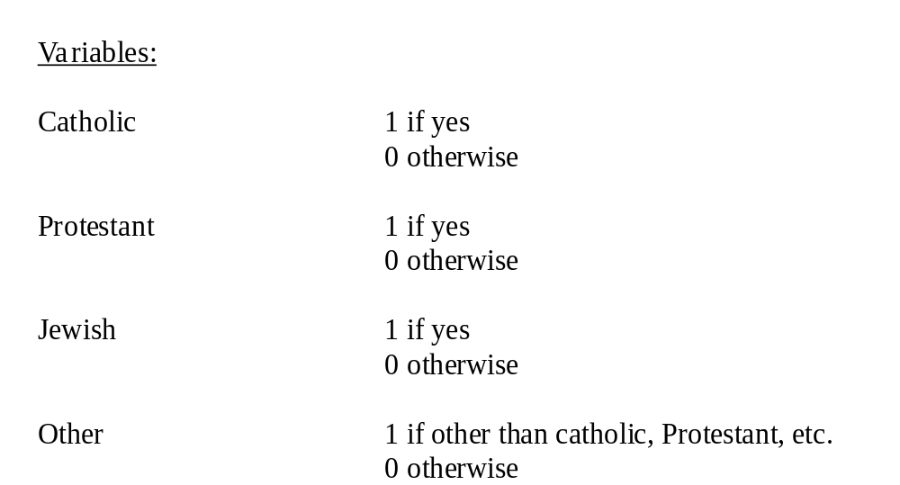
II. More than One Dummy Variable (cont.)
B. 1. Example: More than One Dummy Variable (cont.)

Slide 30
II. More than One Dummy Variable (cont.)
  2. Question:
    Can we run a regression that looks like this:
    Y = b₀ + b₁ Catholic + b₂ Protestant, + b₃ Jewish + b₄ Other ?

Slide 31
II. More than One Dummy Variable (cont.)
  3. Model Specification
    Let's have Catholic be our base group.
    Then the correct equation is:
    Y = b₀ + b₁ Protestant + b₂Jewish + b₃Other.

Slide 32
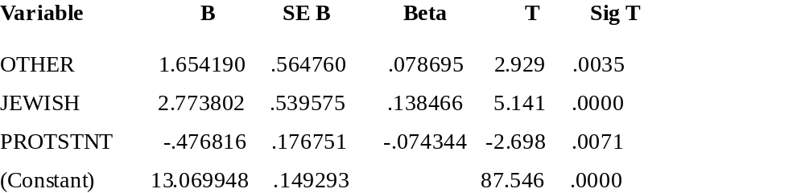
II. More than One Dummy Variable (cont.)
C. Difference of Means
  1. Results

Slide 33
II. More than One Dummy Variable (cont.)
C. Difference of Means
  2. Interpretation
      The intercept is the average education of the reference group.
        It is 13.06. This agrees with our earlier results when we just did Catholic as our single category.
    Slopes is the difference in years of education from the base case.

Slide 34
II. More than One Dummy Variable (cont.)
C. Difference of Means
  3. Differences between other groups
    We can also use these results to tell the difference between any two groups.
    For instance, the education difference between Jewish and Other is:

Slide 35
II. More than One Dummy Variable (cont.)
C. Difference of Means
  3. Differences between other groups (cont.)
    However, to tell if this difference is significant, we'd have to re-run the regression, using either Jewish or Other as the reference group.

Slide 36
III. Dummy Variables and Confounding Variables
  We may think that our results are confounded by other factors.
A. Parallel Lines for Two Categories
  1. Blood Pressure Example
    What we want to do is compare the blood pressure of those women who take the drug against those who do not.
    In testing the effect of the drug, however, we will also want to control for age.

Slide 37
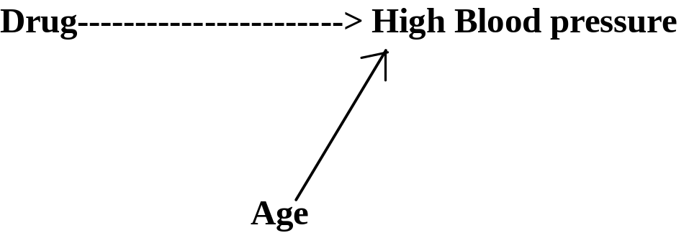
III. Dummy Variables and Confounding Variables (cont.)
A. Parallel Lines for Two Categories
  2. Path Diagram
  3. Data

Slide 38
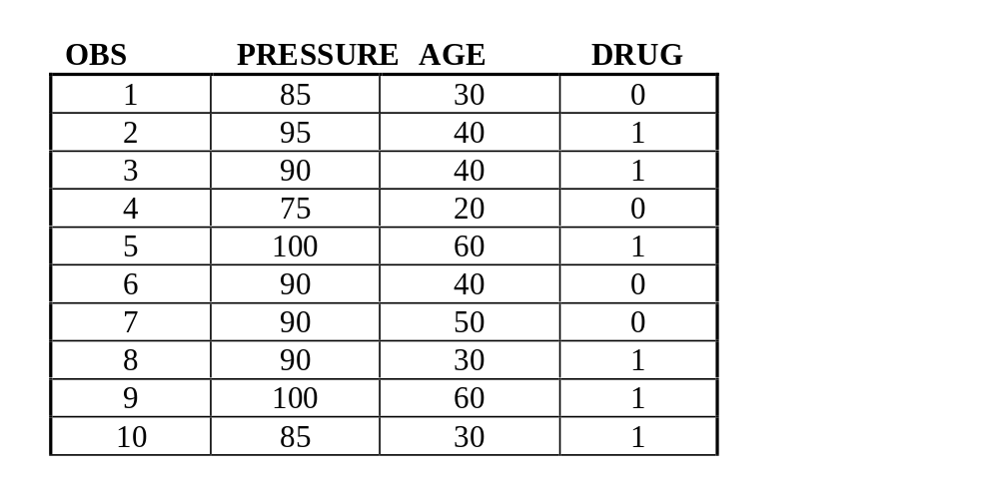
III. Dummy Variables and Confounding Variables (cont.)
A. Parallel Lines for Two Categories
  3. Data

Slide 39
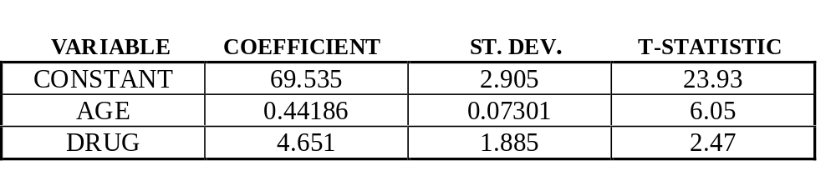
III. Dummy Variables and Confounding Variables (cont.)
A. Parallel Lines for Two Categories
  4. Results
    a. Regression
      Suppose after we run a regression line then the results look like this
      Blood Pressure = b₀ + b₁AGE + b₂DRUG

Slide 40
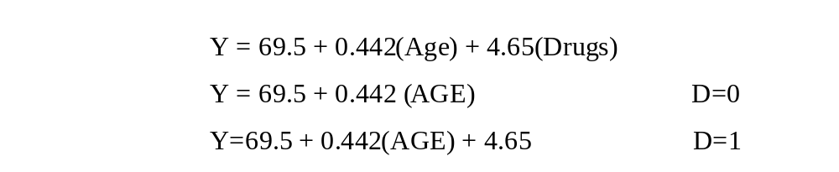
III. Dummy Variables and Confounding Variables (cont.)
A. Parallel Lines for Two Categories
  4. Results
    a. Regression (cont.)
      Our regression equation is

Slide 41
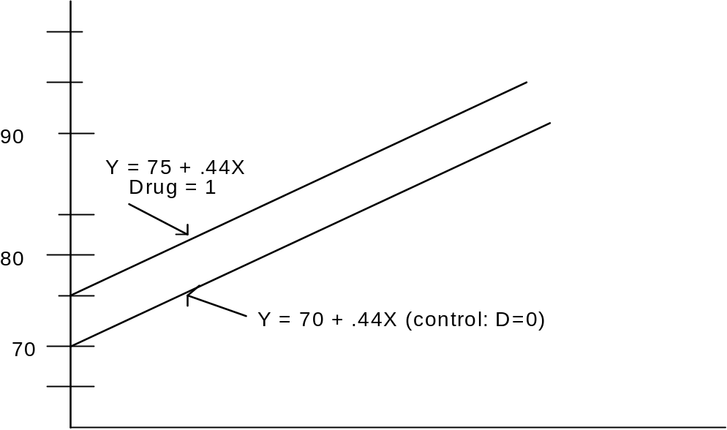
III. Dummy Variables and Confounding Variables (cont.)
A. Parallel Lines for Two Categories
  4. Results
    b. Graph
      What is the regression
      line then, for those
      women who take
      the drug?

Slide 42
III. Dummy Variables and Confounding Variables (cont.)
A. Parallel Lines for Two Categories
  4. Results
    c. Interpretation
      How do we interpret the coefficient?
        The coefficient on Drugs is the change in Blood pressure that accompanies a unit change in Drugs, while age remains constant.

Slide 43
III. Dummy Variables and Confounding Variables (cont.)
A. Parallel Lines for Two Categories
  4. Results
    c. Interpretation
      How do we interpret the coefficient? (cont.)
        There is an increase in blood pressure of 5 units as we go from a woman without the drug (D=0) to a woman of the same age with the drug (D=1).

Slide 44

III. Dummy Variables and Confounding Variables (cont.)
A. Parallel Lines for Two Categories
  5. Construct a 95% confidence interval
    a. State hypothesis

Slide 45
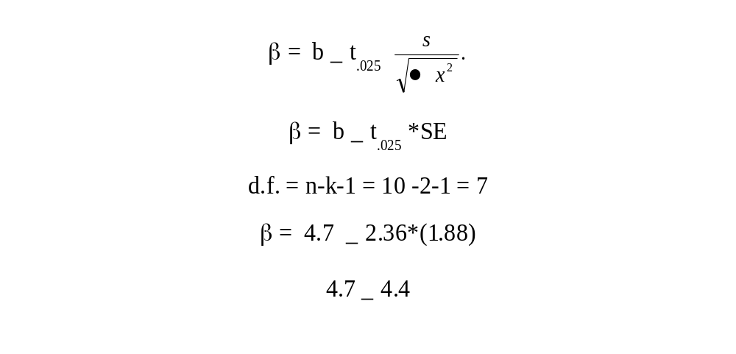
III. Dummy Variables and Confounding Variables (cont.)
A. Parallel Lines for Two Categories
  5. Construct a 95% confidence interval
    b. Confidence Interval

Slide 46
III. Dummy Variables and Confounding Variables (cont.)
A. Parallel Lines for Two Categories
  5. Construct a 95% confidence interval
    c. Accept or Reject
      So can we reject the null hypothesis that the
      difference is 0?

Slide 47
III. Dummy Variables and Confounding Variables (cont.)
A. Parallel Lines for Two Categories
  5. Construct a 95% confidence interval
    d. Interpretation
      This suggests that on average women taking the drug have significantly higher blood pressure than those who do not.

Slide 48
III. Dummy Variables and Confounding Variables (cont.)
A. Parallel Lines for Two Categories
  5. Construct a 95% confidence interval
    e. Note
      We should note, however, that this does not suggest that the drug causes high blood pressure.

Slide 49
III. Dummy Variables and Confounding Variables (cont.)
A. Parallel Lines for Two Categories
  5. Construct a 95% confidence interval
    e. Note (cont.)
      Other confounding factors, such as stress levels, eating and exercise habits, may also influence blood pressure.

Slide 50
III. Dummy Variables and Confounding Variables (cont.)
B. Parallel Lines for Several Categories
  1. Data
    What if we are now testing two drugs, A and B, against a control C, with a sample of 30 patients.
    In measuring drugs, we use two dummy variables.
D_{A} = 1 if drug A given; 0 otherwise
D_{B} = 1 if drug B given ; 0 otherwise

Slide 51
III. Dummy Variables and Confounding Variables (cont.)
B. Parallel Lines for Several Categories
  2. Estimates
    Suppose the regression line turned out to be:
      Y = 70 + 5D_{A} + 8D_{B} + .44AGE + ......
    From this regression, we can easily write down three separate equations for the three groups:
      For the control group, set D_{A} = 0, D_{B} = 0: Y = 70 + .44(AGE)
      For the group on Drug A, set D_{A} = 1, D_{B} = 0: Y = 75 + .44(AGE)
      For the group on Drug B, set D_{A} = 0, D_{B} = 1: Y = 78 + .44(AGE)

Slide 52
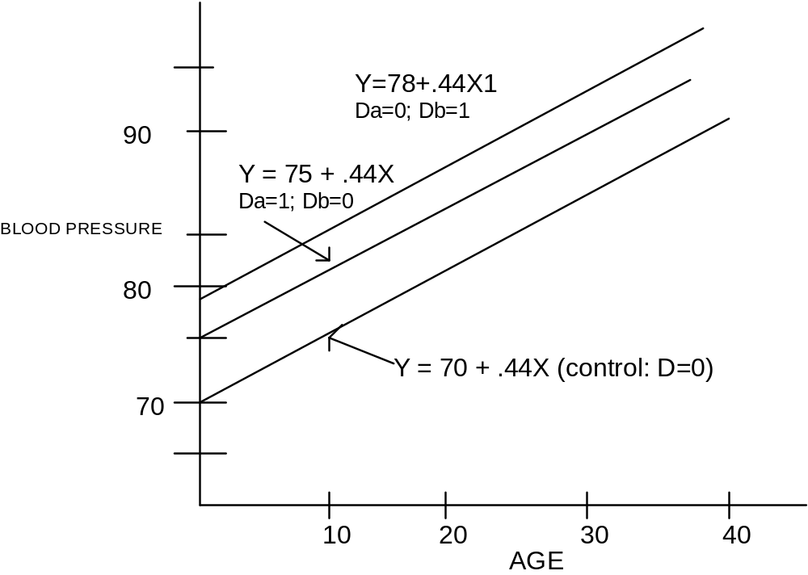
III. Dummy Variables and Confounding Variables (cont.)
B. Parallel Lines for Several Categories
  3. Graph
    The easiest
    way to interpret
    these results
    by a graph.

Slide 53
III. Dummy Variables and Confounding Variables (cont.)
B. Parallel Lines for Several Categories
  4. Interpretation
    The results show that the group on drug A exceeds the controls by 5 units-- the coefficient on D_{A}.
    Similarly, the group on Drug B exceeds the controls by 8 units-- the coefficient of D_{B}.

Slide 54
III. Dummy Variables and Confounding Variables (cont.)
B. Parallel Lines for Several Categories
  NOTE
    Again, in designing our models we need to make sure that we identify our equation. That is, we need to have a least one category left as a reference group.

Slide 55
IV. Different Slopes as Well as Intercepts:
Interactive Terms
A. Interactive Terms
    What if the relation between age and the drug is not additive but multiplicative?
      That is, not only does the intercept change, but so does the slope of the regression line.

Slide 56
IV. Different Slopes as Well as Intercepts:
Interactive Terms (cont.)
A. Interactive Terms
  1. Definition
    What if the drug had a greater impact on your blood pressure as a person gets older.
      We can investigate this possibility by adding a multiplicative term to the regression.
        Y = c + Drug + Age +Age*Drug ......
  The term Age*Drug is called an interactive term.

Slide 57
IV. Different Slopes as Well as Intercepts:
Interactive Terms (cont.)
A. Interactive Terms
  1. Definition(cont.)
    Interactive terms captures the possibility that the effect of one independent variable might vary with the level of another independent variable.
        In this case, the effect of the drug on your blood pressure depends on your age.

Slide 58
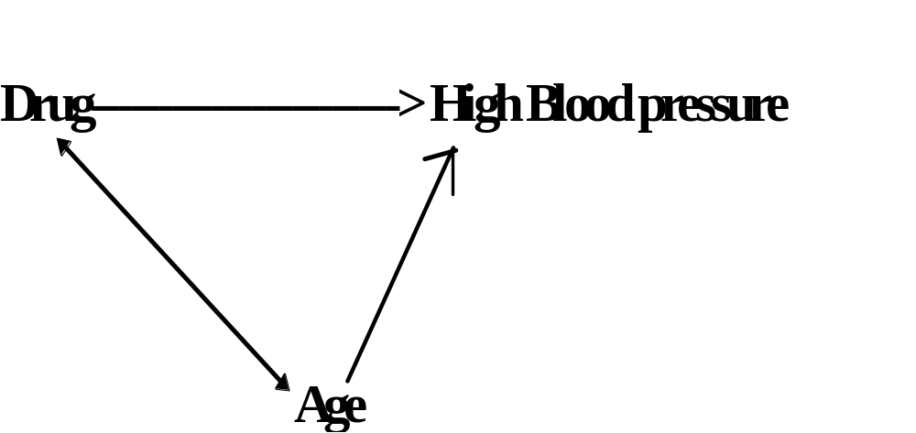
IV. Different Slopes as Well as Intercepts:
Interactive Terms (cont.)
A. Interactive Terms
  1. Definition (cont.)

Slide 59
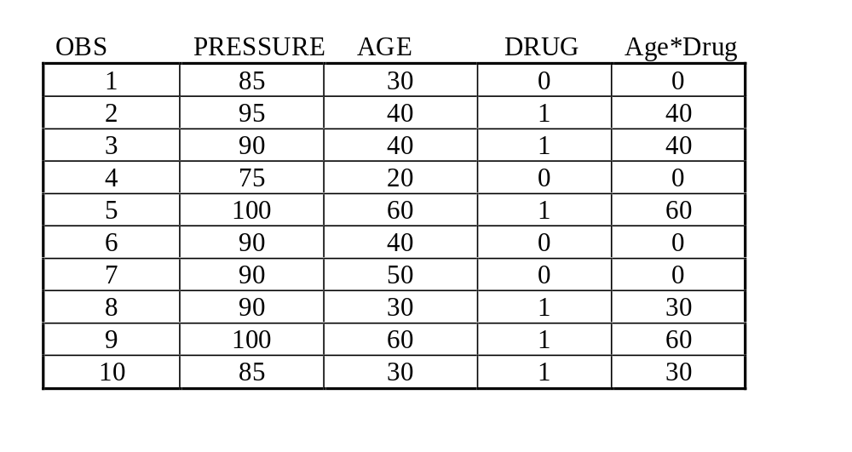
IV. Different Slopes as Well as Intercepts:
Interactive Terms (cont.)
A. Interactive Terms
    1. Definition (cont.)
      2. Data

Slide 60
IV. Different Slopes as Well as Intercepts:
Interactive Terms (cont.)
A. Interactive Terms
    2. Results
      Suppose that when we run a regression, we get the following results:
      Again we set D = 0 for the control group and D = 1 for those taking the drug.
        Y = 70 + 5(Drug) + .44(Age) + .21(Drug*Age)
    We obtain two separate equations for the two groups:
        set D = 0: Y = 70 + .44Age
        Set D = 1: Y = 75 + .65Age

Slide 61
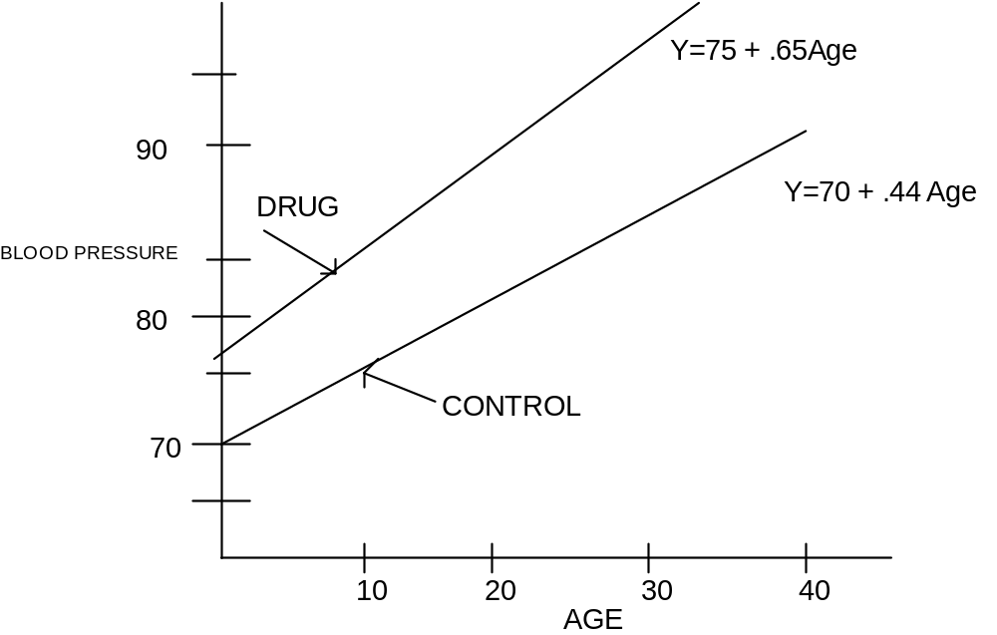
IV. Different Slopes as Well as Intercepts:
Interactive Terms (cont.)
A. Interactive Terms
    3. Graph

Slide 62
IV. Different Slopes as Well as Intercepts:
Interactive Terms (cont.)
A. Interactive Terms
    4. Interpretation
      Note that for those taking the drug not only does the intercept increase (that is, the average level of blood pressure), but so does the slope.
      Interpretation of an interactive term -- The effect of one independent variable (DRUG) depends on the level of another independent variable (AGE).

Slide 63
IV. Different Slopes as Well as Intercepts:
Interactive Terms (cont.)
A. Interactive Terms
    1. Definition
    2. Results
    3. Graph
    4. Interpretation (cont.)
      The results here suggest that for people not taking the drug, each additional year adds .44 units to blood pressure.
      For people taking the drug, each additional year increases blood pressure by .65 units.

Slide 64
IV. Different Slopes as Well as Intercepts:
Interactive Terms (cont.)
B. Example 3:
  1. Setup
  PARTYID = C + MONEY + MALE + MONEY*MALE (MANBUCKS)
    What is the interpretation of this interactive variable between Money and Gender?
      As a male’s income increases are they more likely to identify themselves as a Republican than are women?

Slide 65
IV. Different Slopes as Well as Intercepts:
Interactive Terms (cont.)
B. Example 3:
  2. Commands
    The next two pages of your handout give the results.
    First, I made variables for everything that I want to analyze.
    MYPARTY is party ID.
    MONEY is income.

Slide 66
IV. Different Slopes as Well as Intercepts:
Interactive Terms (cont.)
B. Example 3:
  2. Commands (cont.)
    MALE is whether or not you're a male.
    And MANBUCKS is the interactive term for MALE and MONEY.

Slide 67
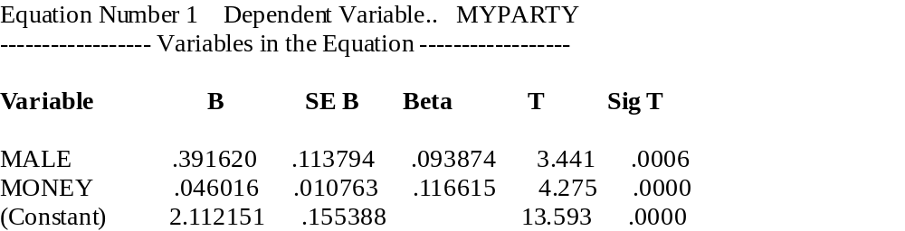
IV. Different Slopes as Well as Intercepts:
Interactive Terms (cont.)
B. Example 3:
  3. Results
    1. No Interactive Effect
      Notice that both MALE and MONEY are significant determinants of Party ID.

Slide 68
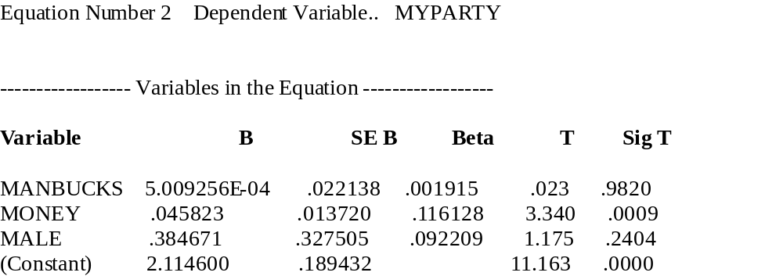
IV. Different Slopes as Well as Intercepts:
Interactive Terms (cont.)
B. Example 3:
  3. Results
    2. Interactive Effect
      Now we put in the interactive term. Is it significant?

Slide 69
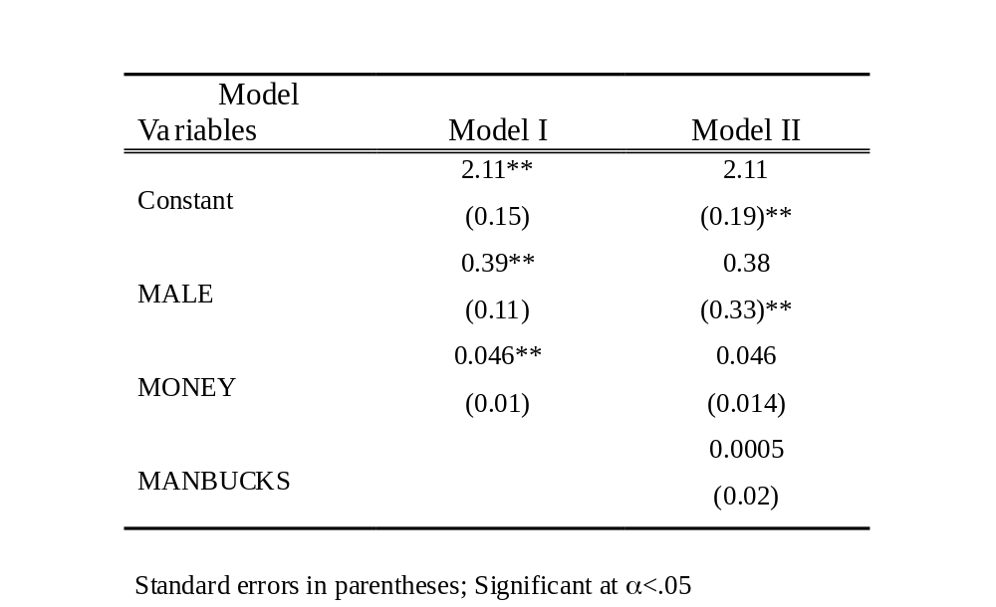
IV. Different Slopes as Well as Intercepts:
Interactive Terms (cont.)
B. Example 3:
  3. Results
    3. Presentation
    of Results

Slide 70
IV. Different Slopes as Well as Intercepts:
Interactive Terms (cont.)
B. Example 3:
  3. Results
    4. Interpretation
      So we conclude that as men and women' s income increases, they become Republican at the same rate.
      Men and women are equally as likely to become Democrats as they get poor.

Slide 71
IV. Different Slopes as Well as Intercepts:
Interactive Terms (cont.)
B. Example 3:
  3. Results
    5. Notice
      Notice that the t-statistics for the other two variables went haywire when we added the interactive term into the equation.
      This is an important general point; you can use the t-value for the interactive term, but the other t-values become meaningless.

Slide 72
VII. Term Paper
1. Clearly state your hypothesis.
    Use a path diagram to present the causal relation.
    Use the correlations to help you determine what causes what.
    State the alternative hypothesis.
2. Present descriptive statistics.

Slide 73
VII. Term Paper (cont.)
3. Estimate your model.
  You can do simple regression, or include interactive terms, or do path analysis, or use dummy variables; whatever is appropriate to your hypothesis.
4. Present your results.
5. Interpret your results.

Slide 74
VII. Term Paper (cont.)
6. Draw out the policy implications of your
analysis.
7. The paper should begin with a brief which
states the basic project and your main
findings.

