Slide 1
Lets Learn Python Just Like Magic!
Lets make this learning journey fun!
Day1: Aug 01 2020

Slide 2
Whoa!
I am Smile Gupta!
A Frontend Engineer at Konfhub!
I am been mentoring beginners since 2019
LinkedIn: smilegupta
Twitter:smilegupta@@@

Slide 3
Do you have any prior expectation from me? If Yes! Feel free to tell me.

Slide 4
My Approch of Delivering the content
Practical
Implementation
Theory
Real World Use-age

Slide 5
Topics for today!
01
02
03
What is python
Installing Python
Introduction to Coding

Slide 6
while(! ( succeed = try( ) );
— Magical Spell to ace in Programming

Slide 7
01
Coding
Lets deep dive into coding! Why what and how

Slide 8
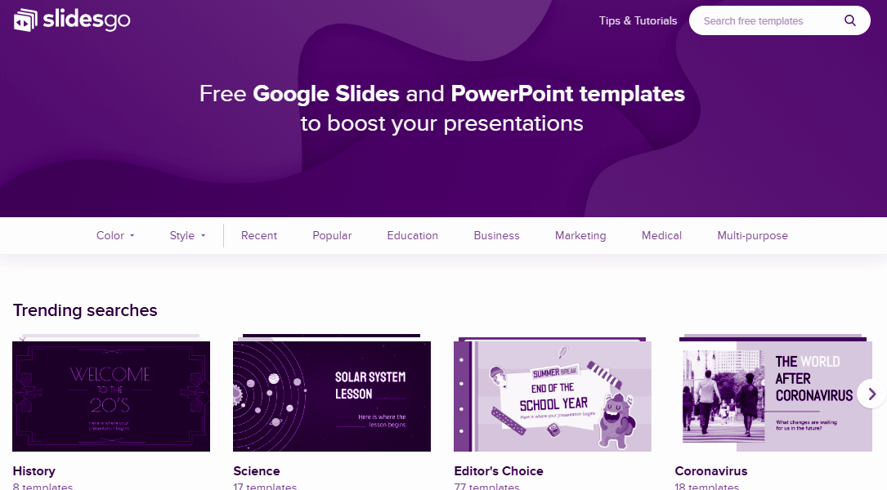
Coding vs Programming

Slide 9
Installing Python
Installing python is just like a cake walk:
https://www.python.org/
Choose your Operating System
Check your Operating System version
Open Link Windows x86-64 executable installer
Open the downloaded file and don’t forget to add path
And do next next and everything is done
Bingo Installation is completed
Notes:
Video for reference: https://www.youtube.com/watch?v=pfPCV7DXc5w

Slide 10
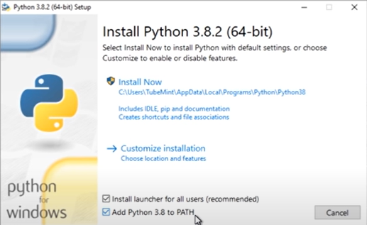

Slide 11
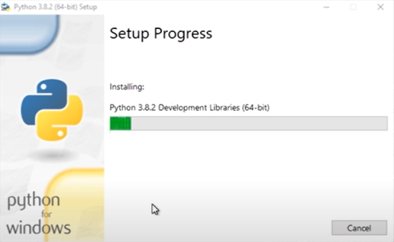

Slide 12
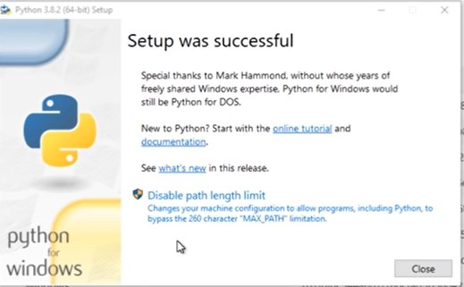

Slide 13

Command to check if python is installed or not
python -v

Slide 14
Hello world

Slide 15
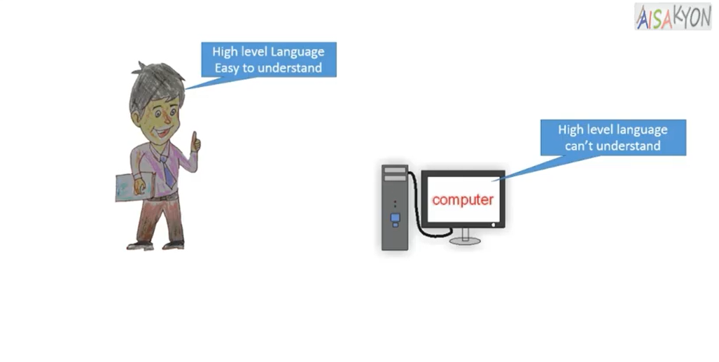

Slide 16
110011000111

Slide 17
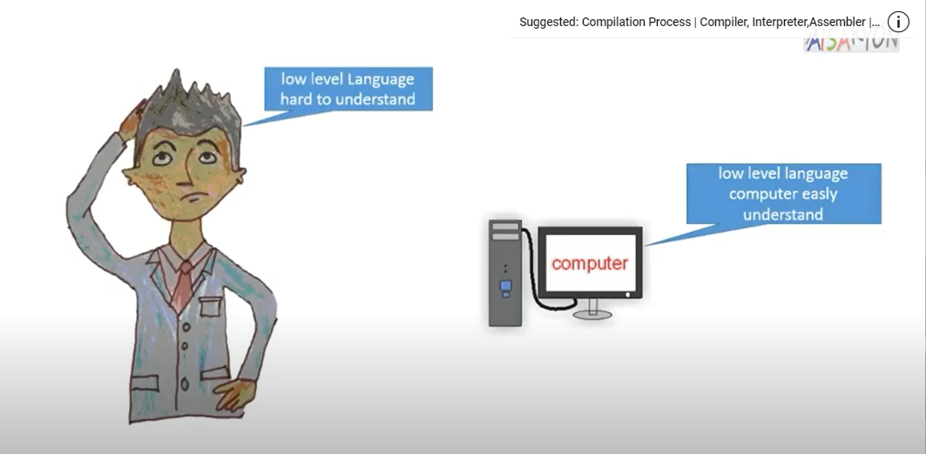

Slide 18
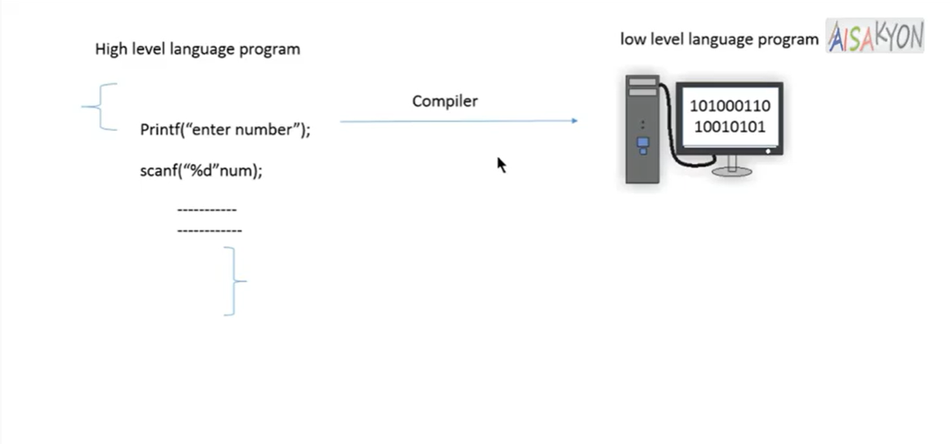

Slide 19
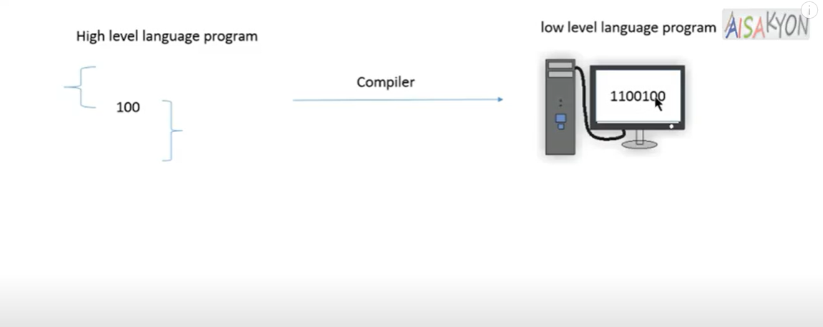

Slide 20
What is Python
Python is an interpreted, high-level, general-purpose programming language.
Created by Guido van Rossum and first released in 1991
For example: YouTube and Instagram
Notes:
High level language and Low level Language: https://www.youtube.com/watch?v=3nLUHFk2SN4

Slide 21
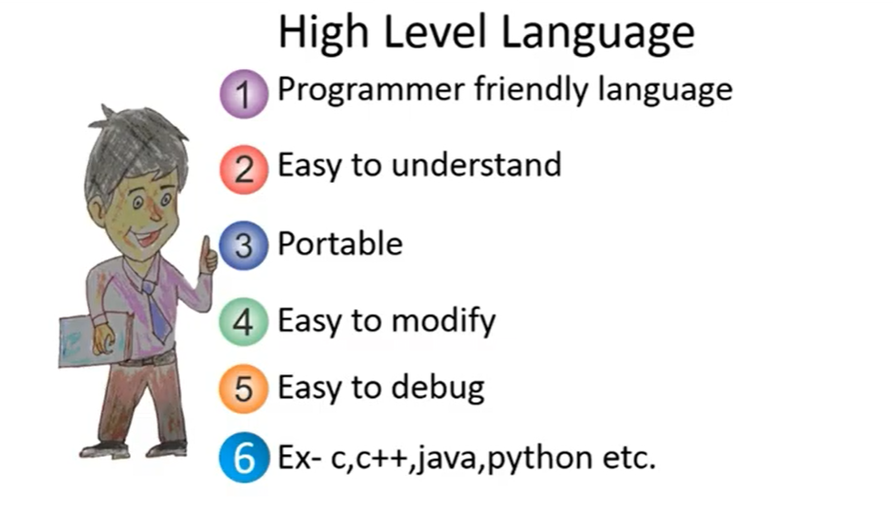

Slide 22
Writing your first program
print (“Hello World”)
name=input(“Enter your name”)
Number= int(input(“Enter the number”)

Slide 23
Thanks
Smile Gupta
@smilegupta
Konfhub
Please keep this slide for attribution

