Slide 1

--your personal lifestyle portfolio
Prepared By: Maggie, netta, jenny

Slide 2
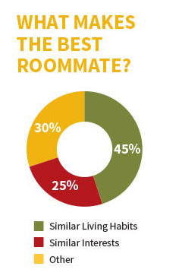
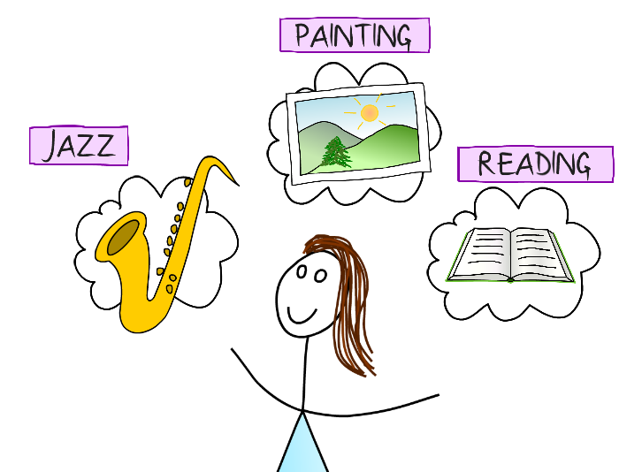

Slide 3
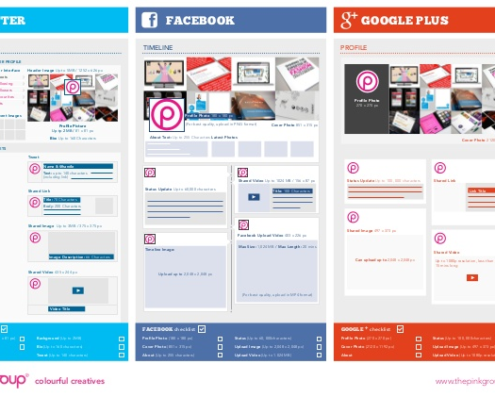
Problem
Written in words
No one pays attention

Slide 4
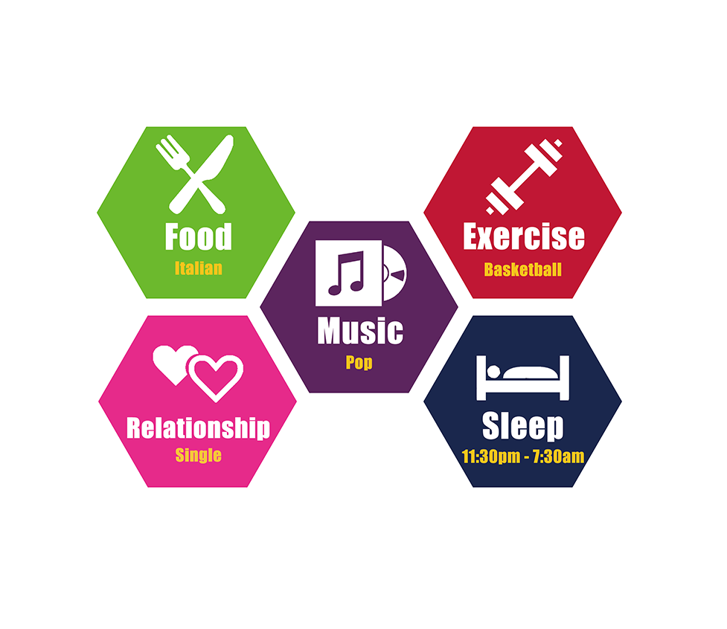
Our solution ---
Customized
Visual representation
Simple

Slide 5
Your personal lifestyle portfolio.

