Slide 1
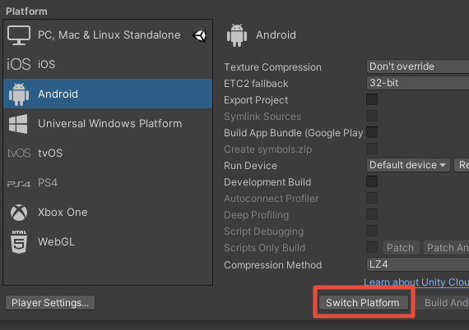
유니티 새 프로젝트를 만든다

Slide 2
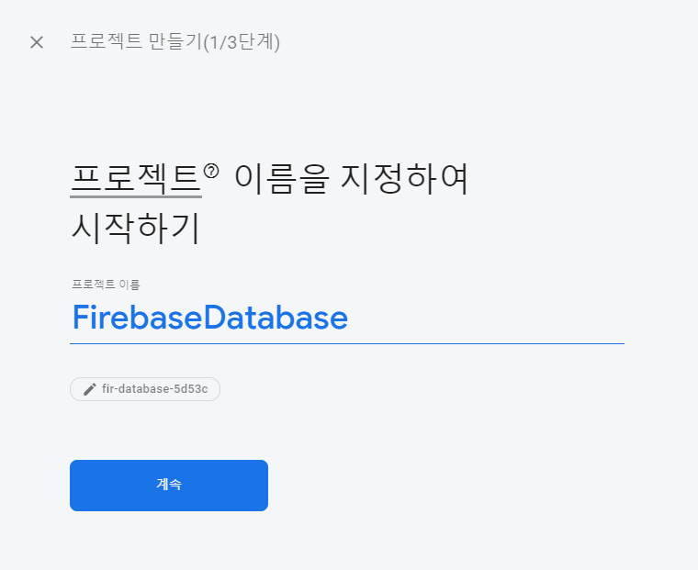
Firebase 콘솔 프로젝트를 생성

Slide 3
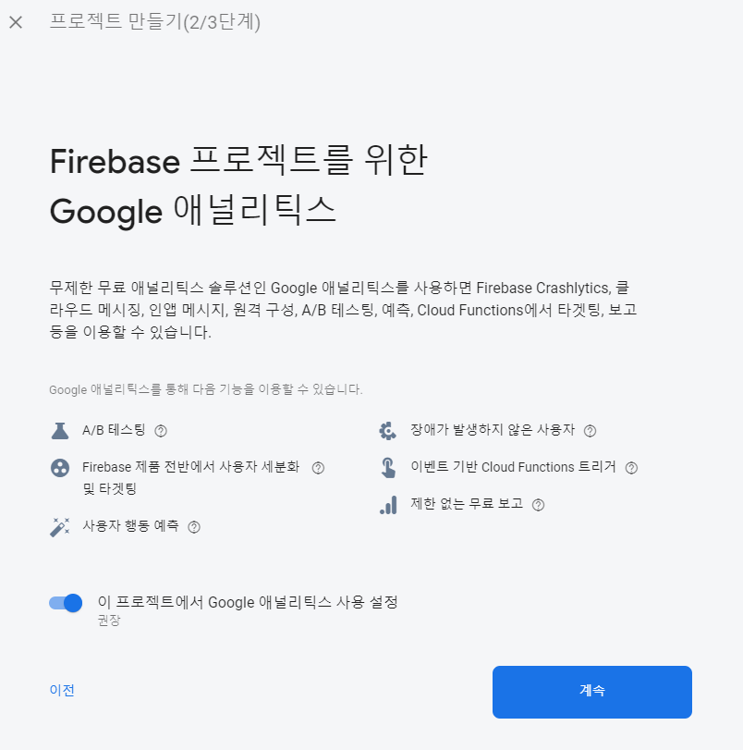

Slide 4
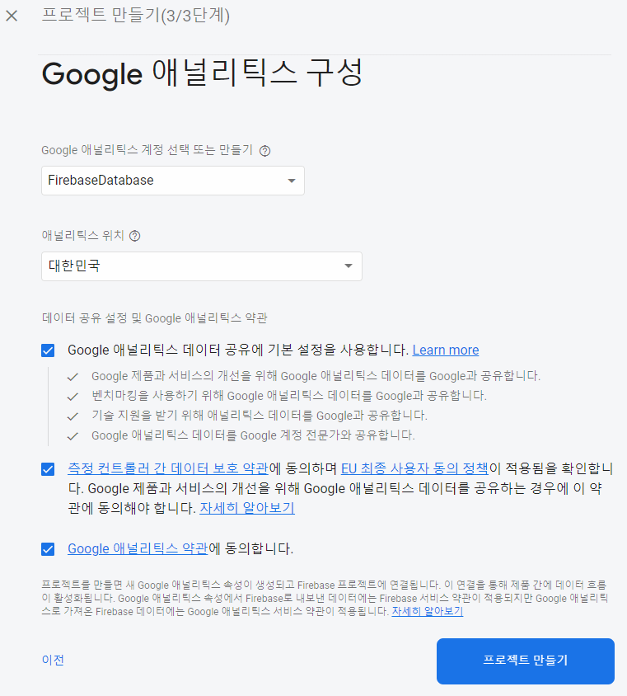

Slide 5
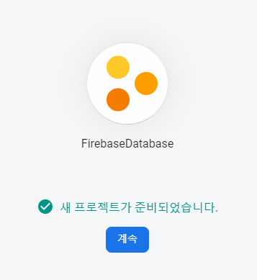

Slide 6
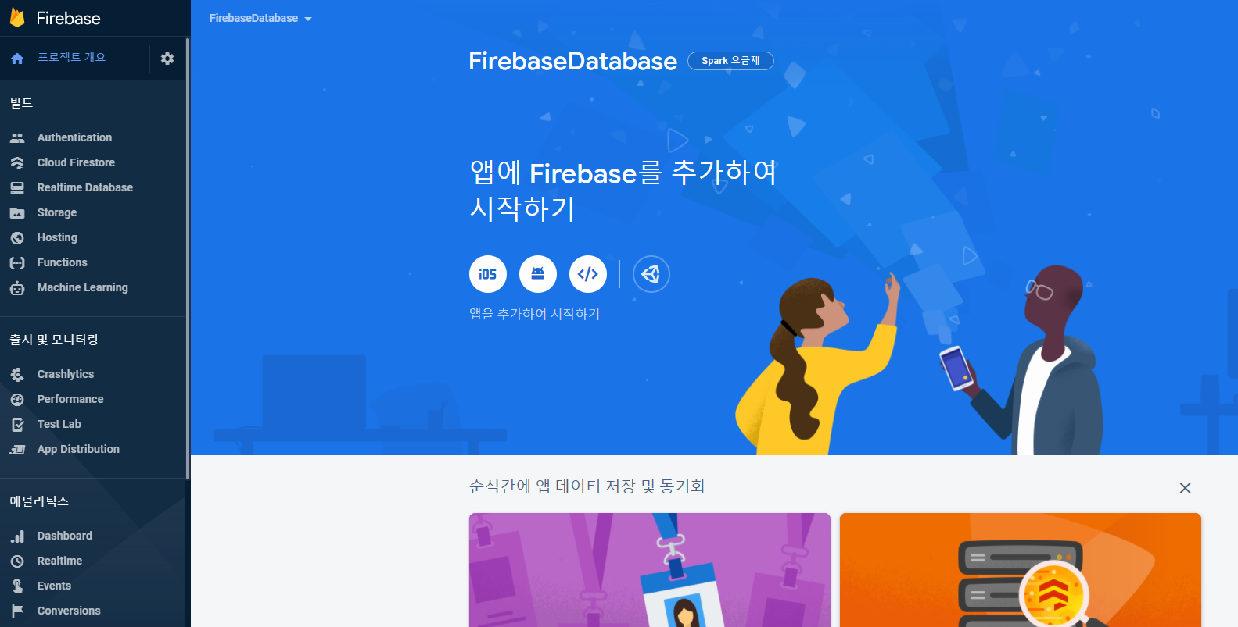

Slide 7
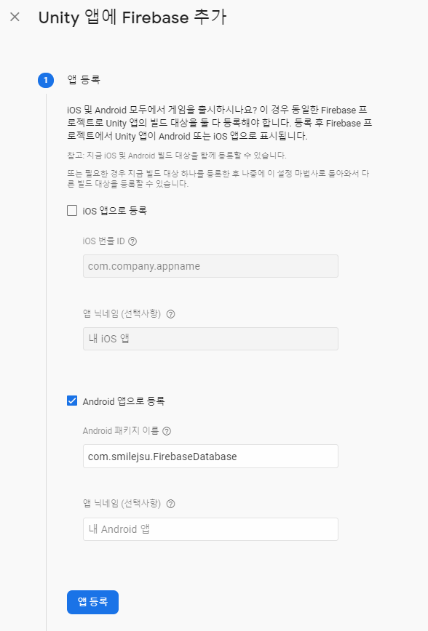

Slide 8
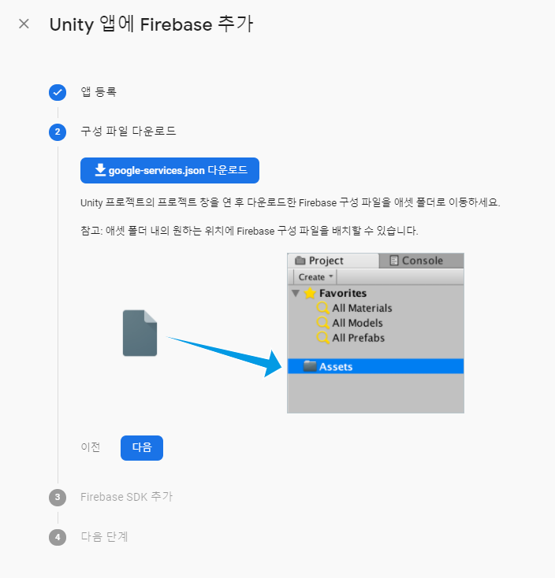
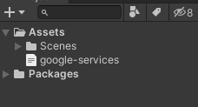

Slide 9
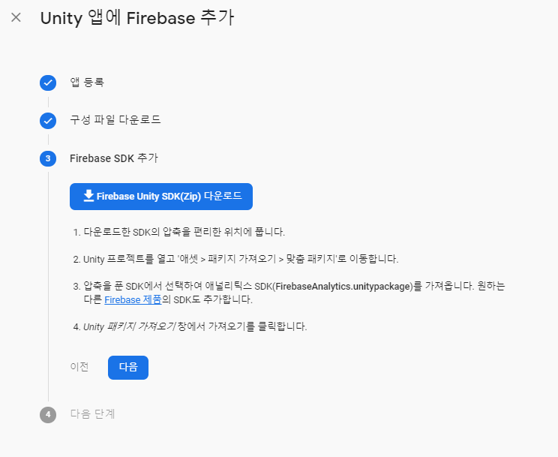

Slide 10
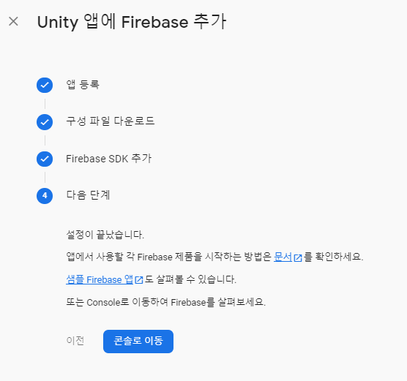

Slide 11
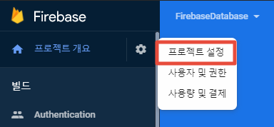

Slide 12
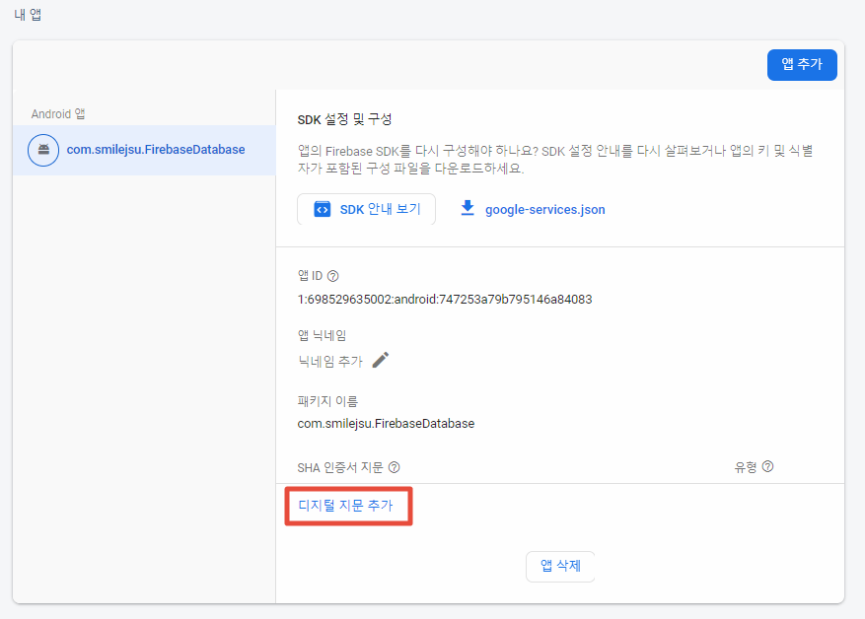

Slide 13
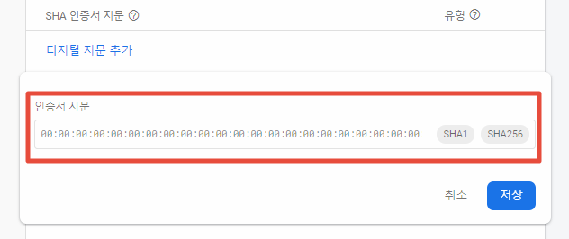

Slide 14
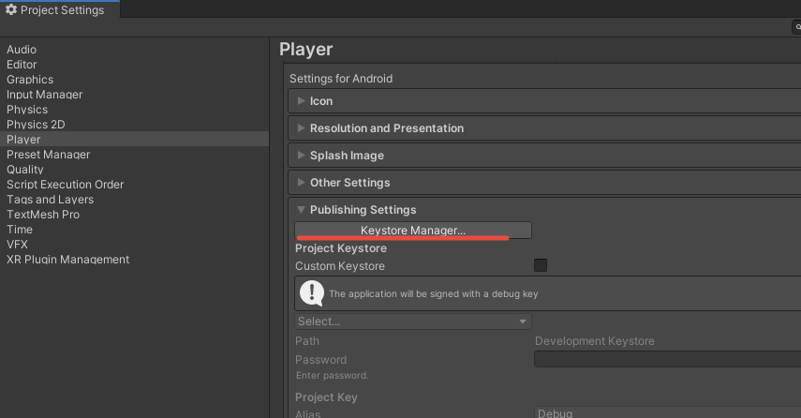
keystore를 만든다

Slide 15
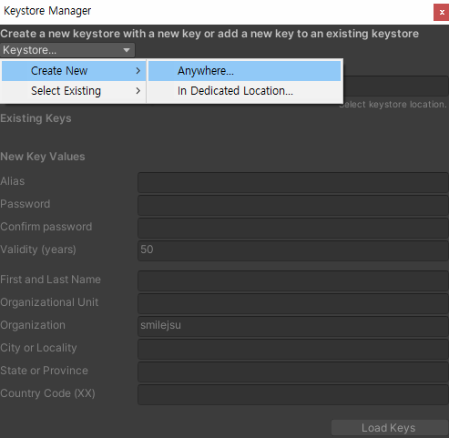
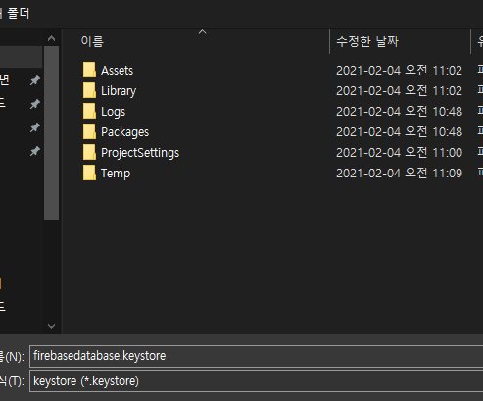

Slide 16
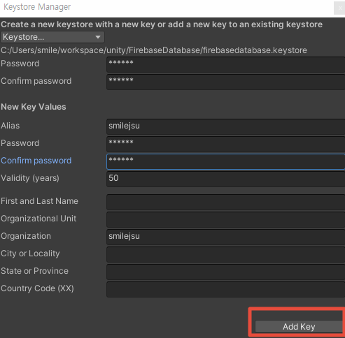

Slide 17
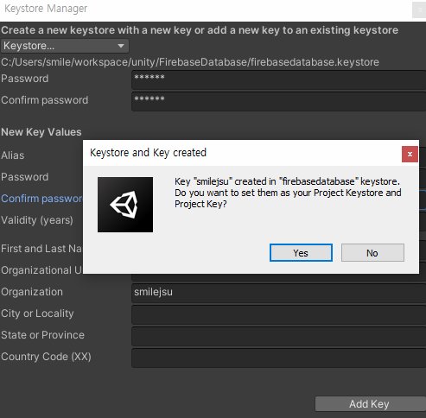

Slide 18
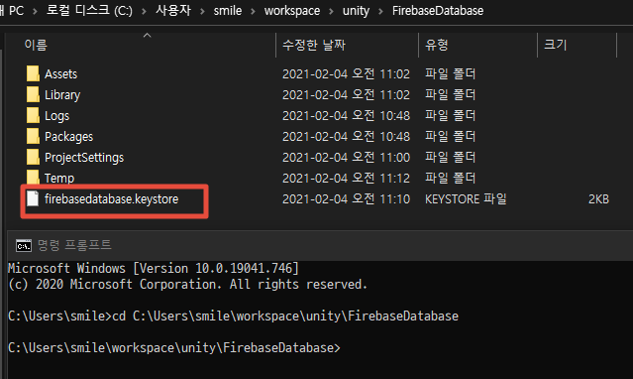
keystore가 있는 위치에서 cmd창 실행

Slide 19
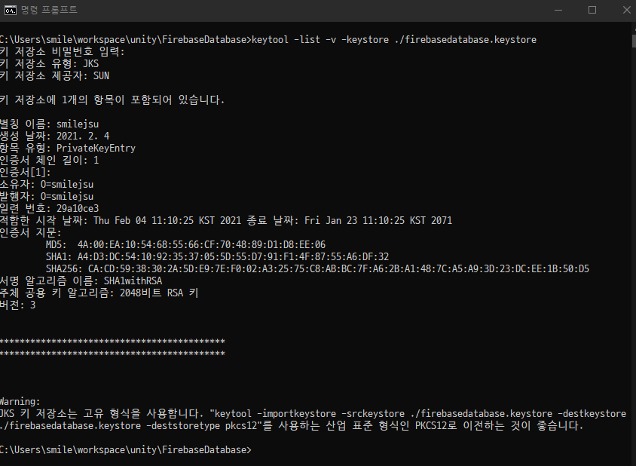
keytool -list -v -keystore {keystore path}
keytool -list -v -keystore ./firebasedatabase.keystore

Slide 20
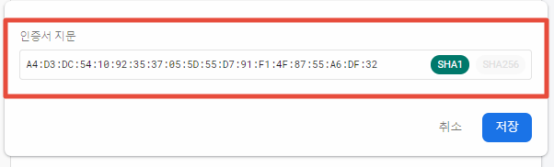

sha1또는 sha256 둘 중 하나 복사해서 인증서 지문에 입력

Slide 21
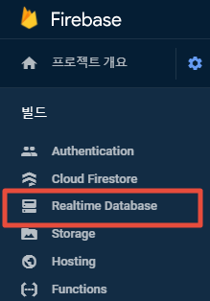

Slide 22
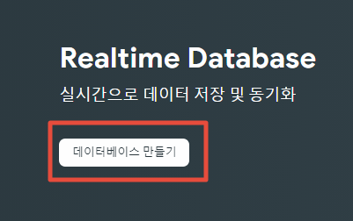

Slide 23
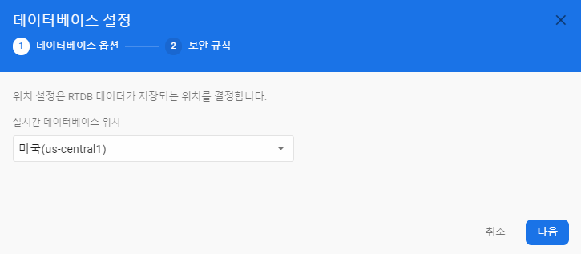

Slide 24
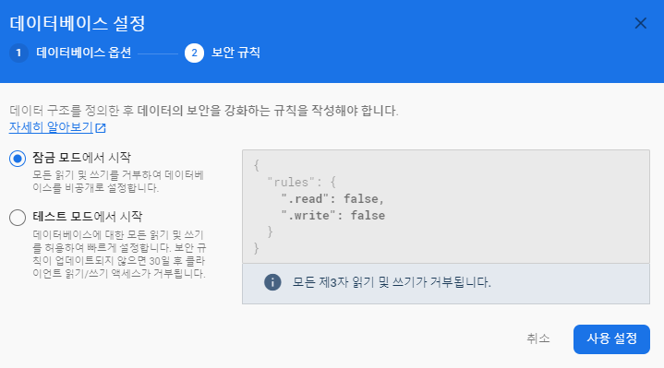
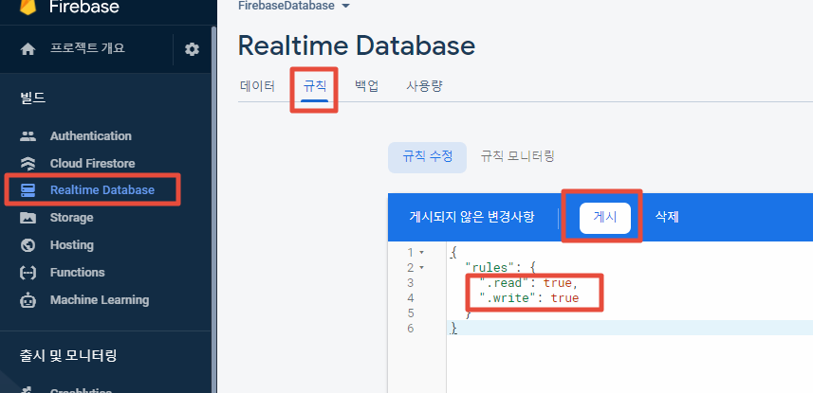

Slide 25
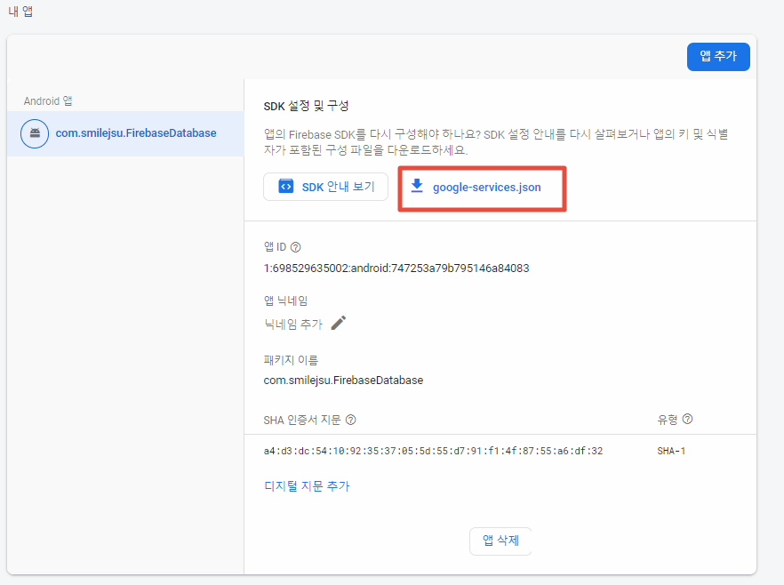


Slide 26
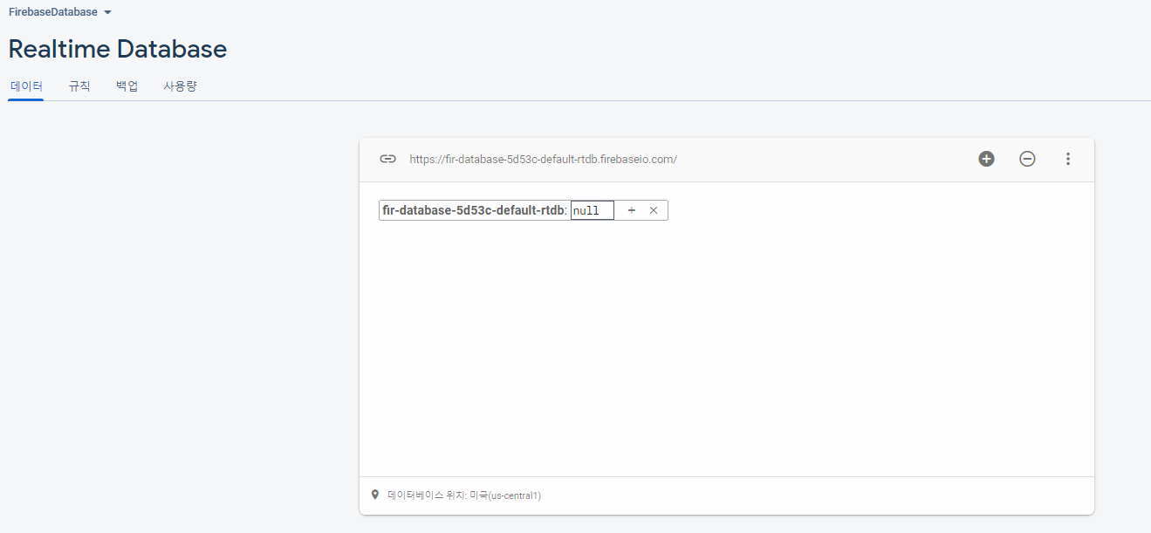

Slide 27
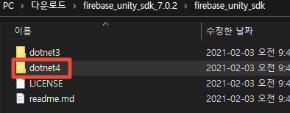
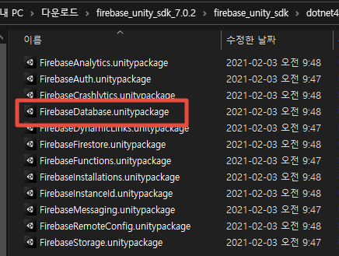
dotnet4 > FirebaseDatabase.unitypackage import

Slide 28
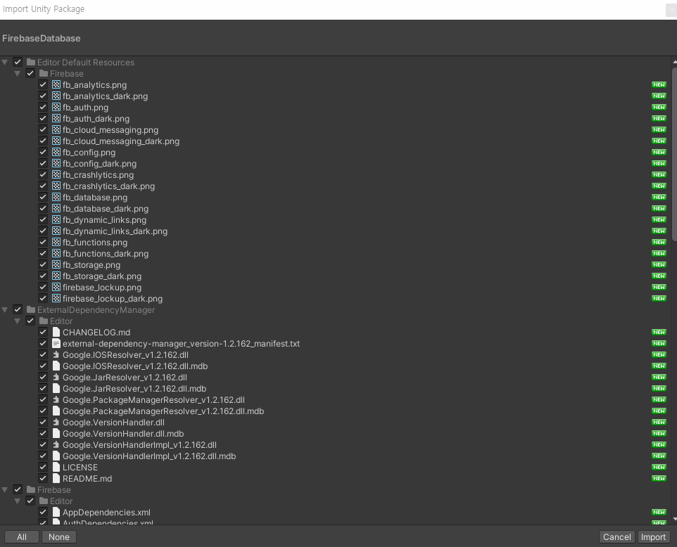

Slide 29
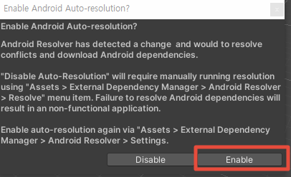

Slide 30
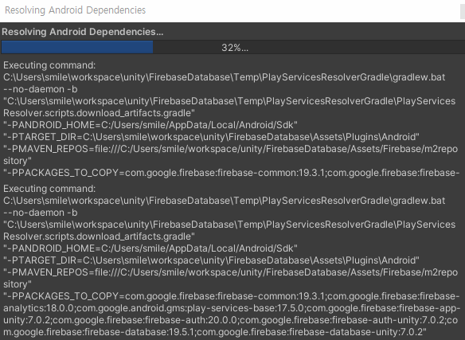
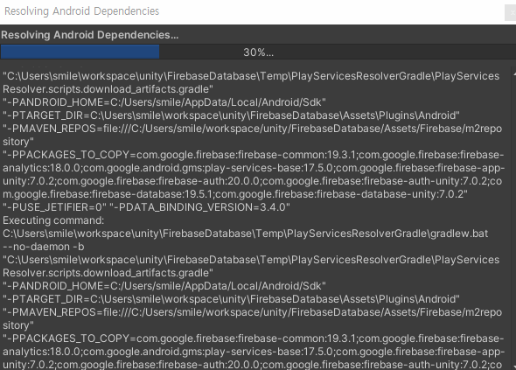

Slide 31
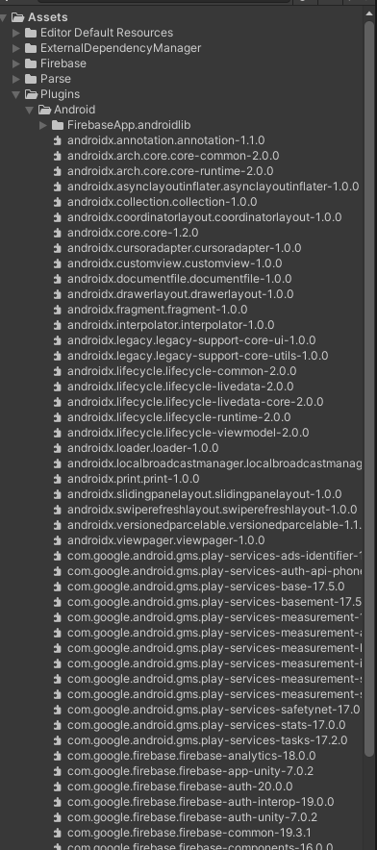

Slide 32
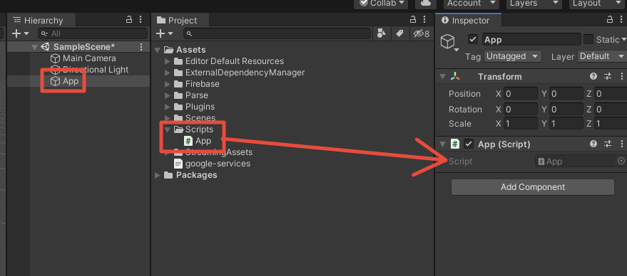

Slide 33
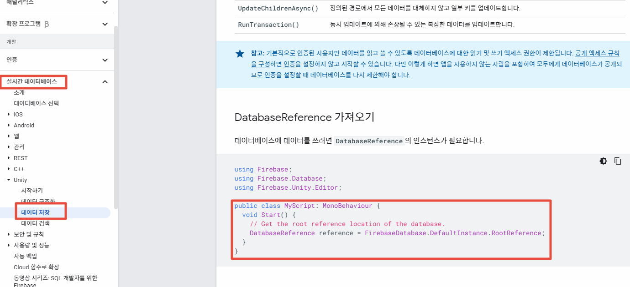

Slide 34
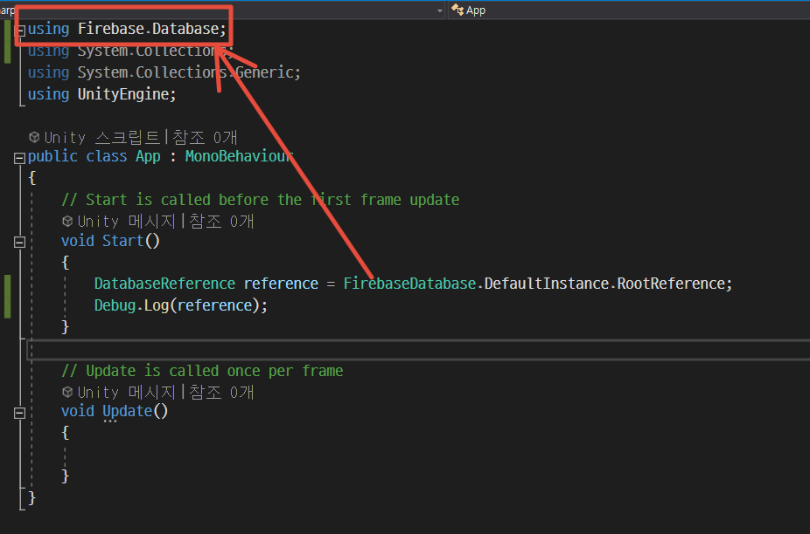
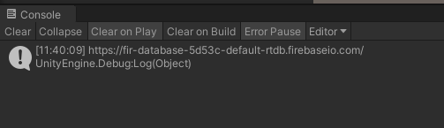

Slide 35
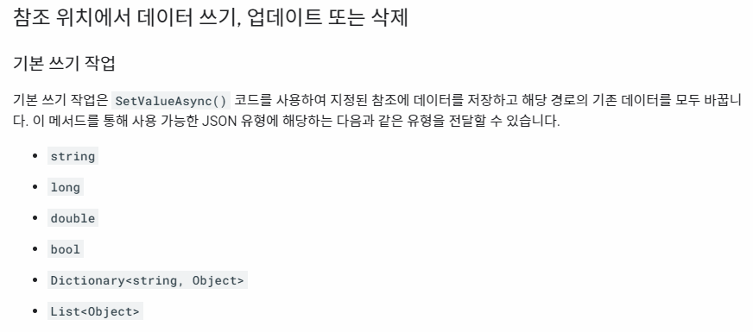

Slide 36
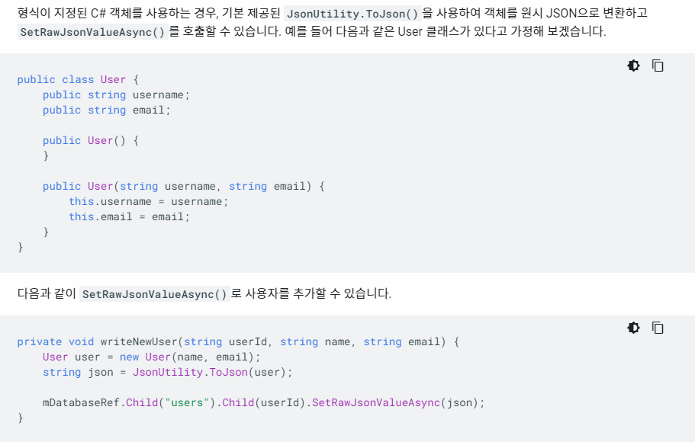

Slide 37
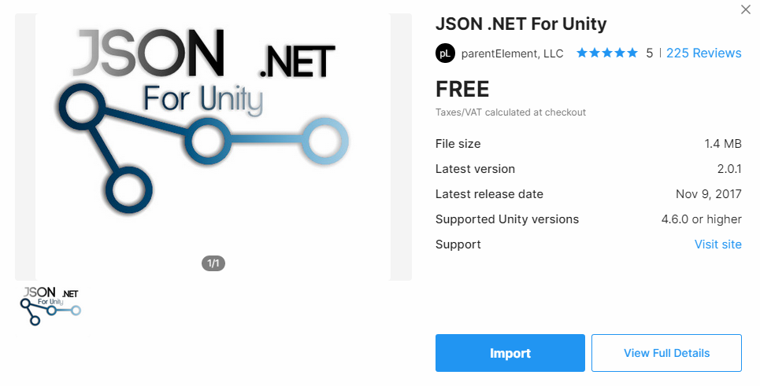

Slide 38
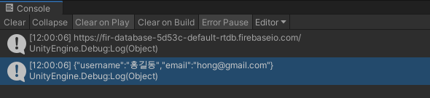
using Firebase.Database;
using System.Collections;
using System.Collections.Generic;
using UnityEngine;
using Newtonsoft.Json;
public class User
{
public string username;
public string email;
public User()
{
}
public User(string username, string email)
{
this.username = username;
this.email = email;
}
}
public class App : MonoBehaviour
{
// Start is called before the first frame update
void Start()
{
DatabaseReference reference = FirebaseDatabase.DefaultInstance.RootReference;
Debug.Log(reference);
string userId = System.Guid.NewGuid().ToString();
string name = "홍길동";
string email = "hong@gmail.com";
this.WriteNewUser(userId, name, email);
}
private void WriteNewUser(string userId, string name, string email)
{
User user = new User(name, email);
string json = JsonConvert.SerializeObject(user);
Debug.Log(json);
//mDatabaseRef.Child("users").Child(userId).SetRawJsonValueAsync(json);
}
}

Slide 39
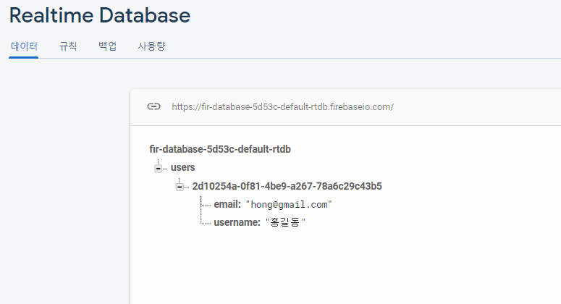

Slide 40
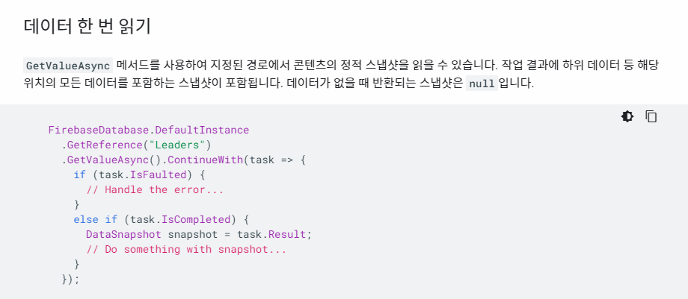

Slide 41
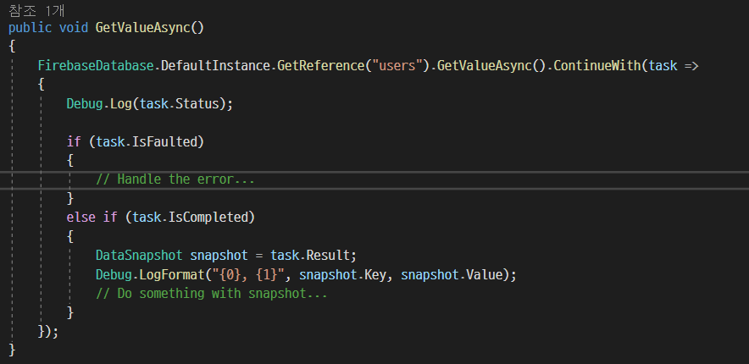
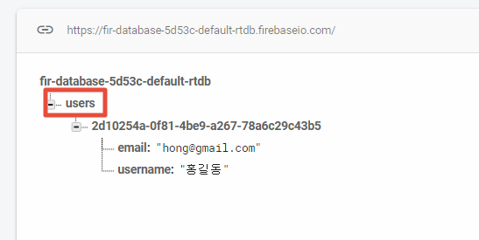

Slide 42
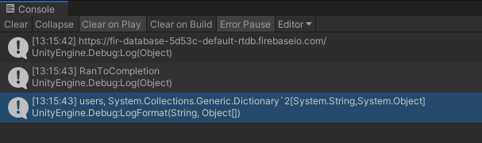

Slide 43
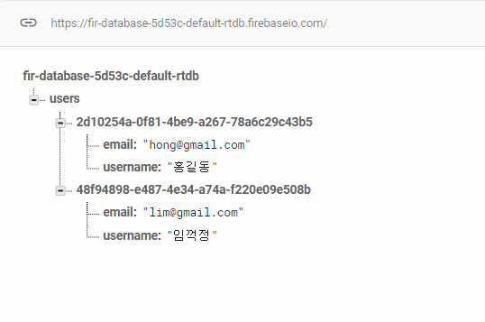
string userId = System.Guid.NewGuid().ToString();
string name = "임꺽정";
string email = "lim@gmail.com";
this.WriteNewUser(userId, name, email);

Slide 44

데이터를 다음과 같이 출력 하세요.

Slide 45
public void GetValueAsync()
{
FirebaseDatabase.DefaultInstance.GetReference("users").GetValueAsync().ContinueWith(task =>
{
Debug.Log(task.Status);
if (task.IsFaulted)
{
// Handle the error...
}
else if (task.IsCompleted)
{
DataSnapshot snapshot = task.Result;
// Do something with snapshot...
var json = snapshot.GetRawJsonValue();
Debug.Log(json);
var children = snapshot.Children;
var enumerator = children.GetEnumerator();
while (enumerator.MoveNext()) {
var user = JsonConvert.DeserializeObject<User>(enumerator.Current.GetRawJsonValue());
var userId = enumerator.Current.Key;
Debug.LogFormat("{0} {1} {2}", userId, user.username, user.email);
}
}
});
}

Slide 46


챌린지
데이터를 다음과 리스트로 보여 주세요
https://stackoverflow.com/questions/65224002/for-loop-stops-when-calling-function-in-firebase-for-unity-c-sharp

