Slide 1
SpaceShooter2D

Slide 2
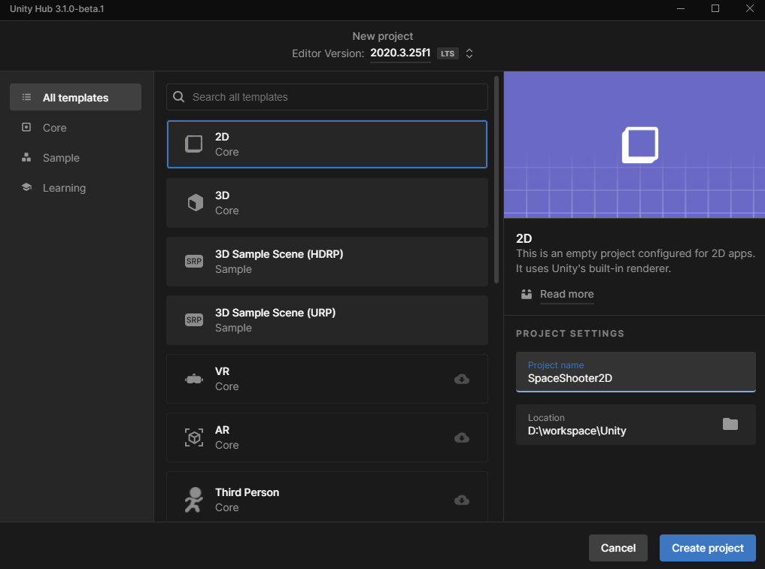

Slide 3
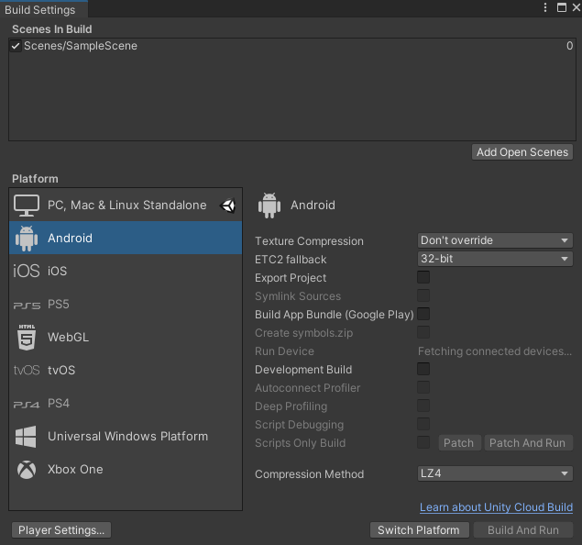

Slide 4
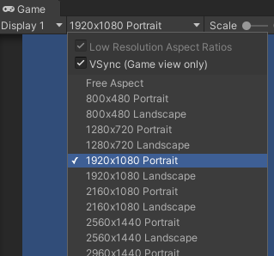

Slide 5
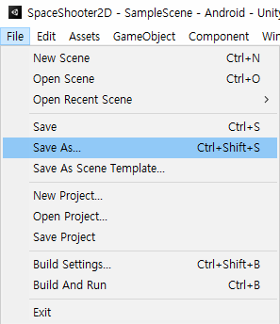

Slide 6
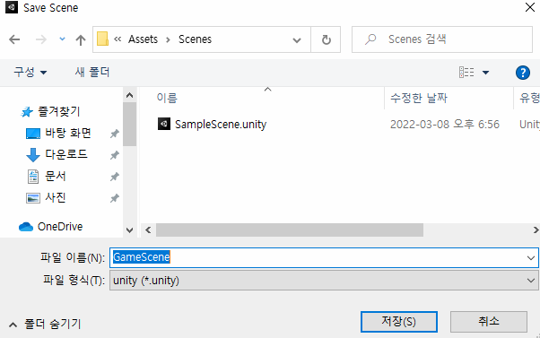

Slide 7
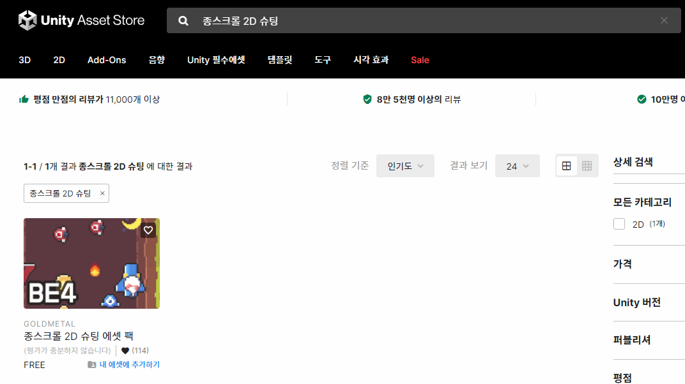

Slide 8
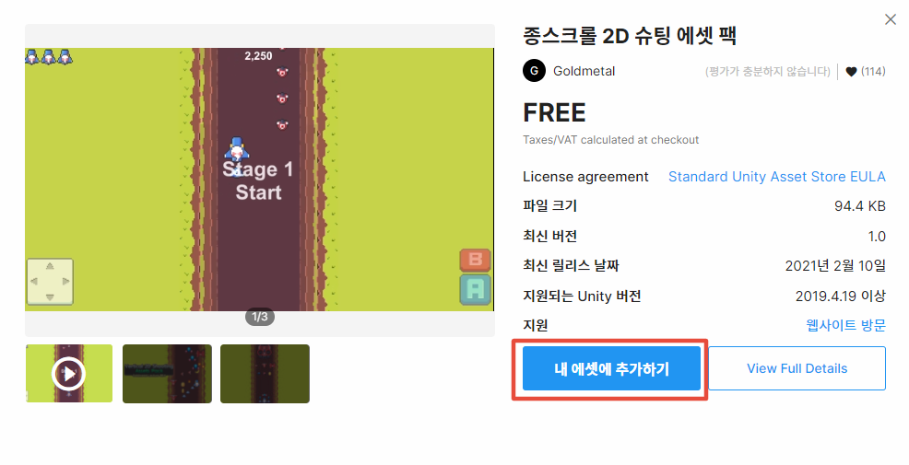

Slide 9
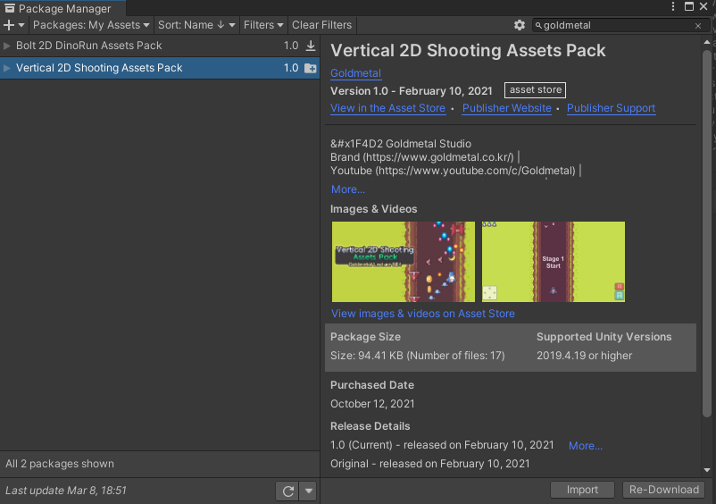

Slide 10
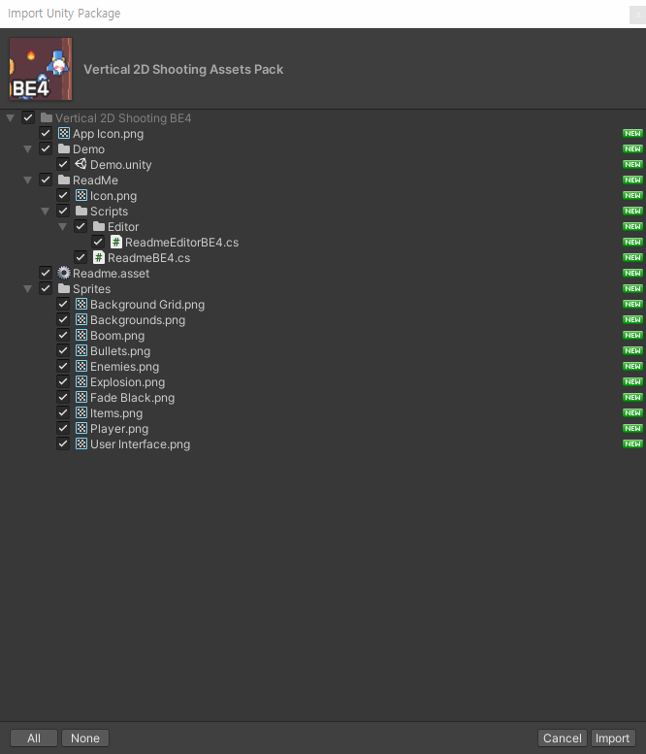

Slide 11
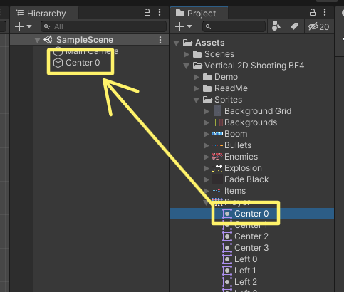

Slide 12
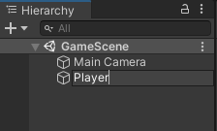

Slide 13
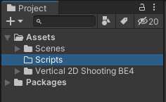

Slide 14
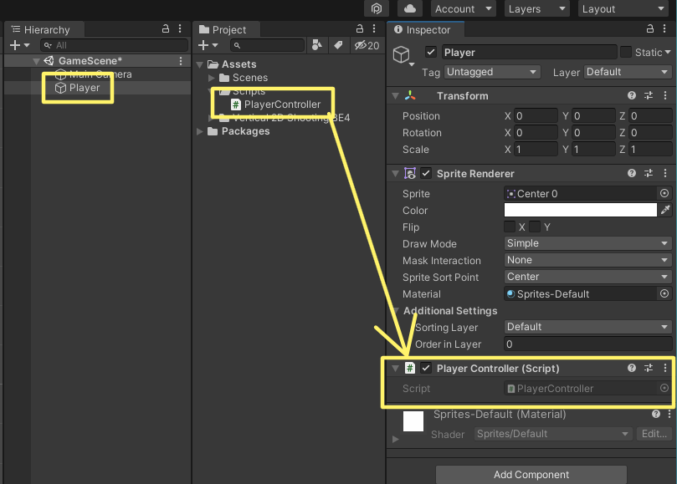

Slide 15
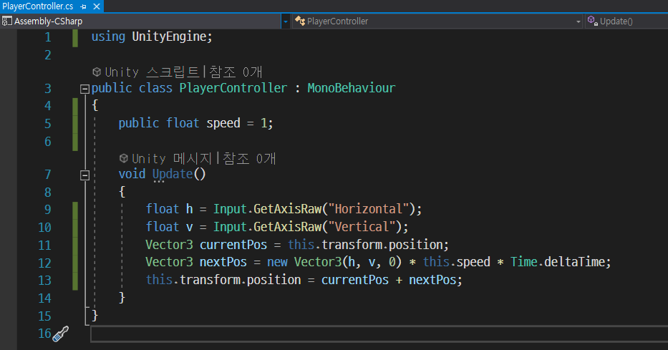
Vector3 nextPos = new Vector3(h, v, 0).normalized * this.speed * Time.deltaTime;

Slide 16


Slide 18
https://www.youtube.com/watch?v=ETYzjbnLixY&list=PLO-mt5Iu5TeYtWvM9eN-xnwRbyUAMWd3b
https://github.com/smilejsu82/learn-shooting-game
https://assetstore.unity.com/?q=%EC%A2%85%EC%8A%A4%ED%81%AC%EB%A1%A4%202D%20%EC%8A%88%ED%8C%85&orderBy=1

