Slide 1
Kubernetes Storage

Slide 2
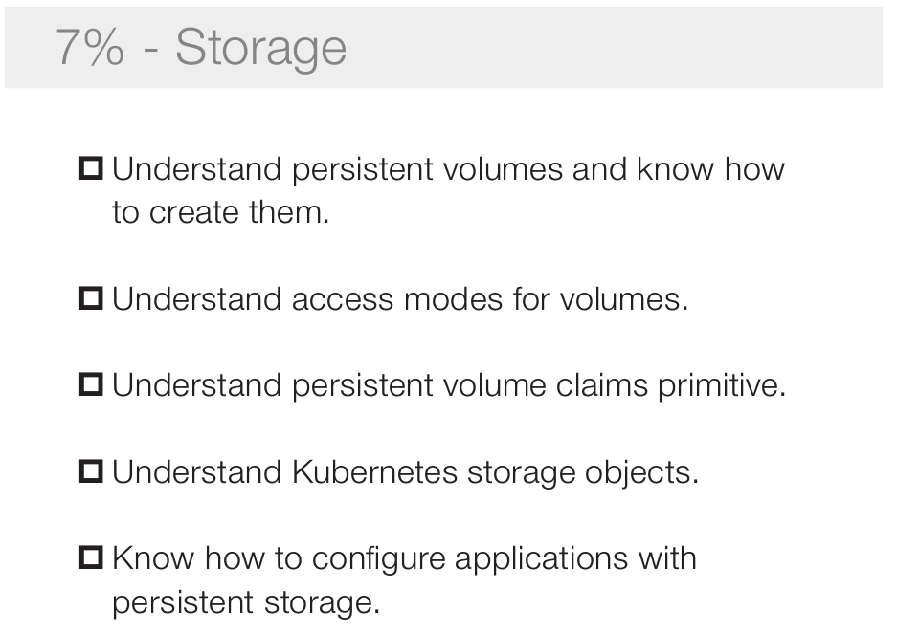

Slide 3
Content
What is volume and why need volume?
How to keep data persistence in k8s?
Why k8s need PVC and PV ?
What is StorageClass and dynamically provision?
Why we use Statefulset?
Technical deep dive
Demo

Slide 4
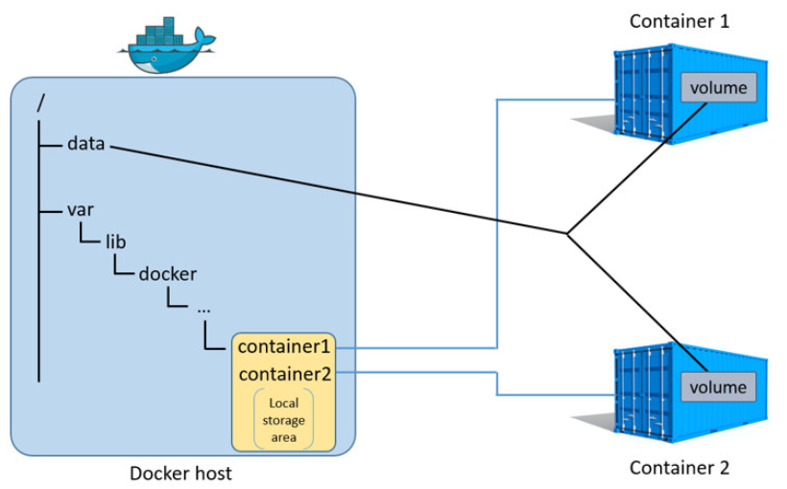
docker run -v data:volume
mount --rbind /data /var/lib/docker/.../{container1}/volume
Notes:
1. container的生命周期
- 应用写在镜像中, 数据随容器销毁
- 数据写在外部
2.

Slide 5
migrate
Pod1
Pod1
c1
c2
c3
c1
c2
c3
container
v1
v2
v3
v1
v2
v3
data
Node A
Node B
- 容器重启volume不会销毁
- pod在创建的时候创建volume, 删除时销毁volume
Notes:
1. container的生命周期
- 应用写在镜像中, 数据随容器销毁
- 数据写在外部
2.

Slide 6
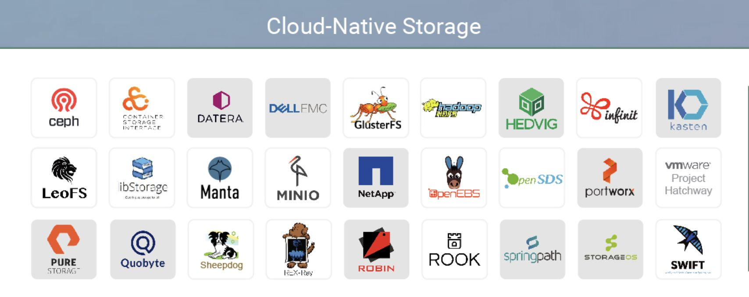

Slide 7
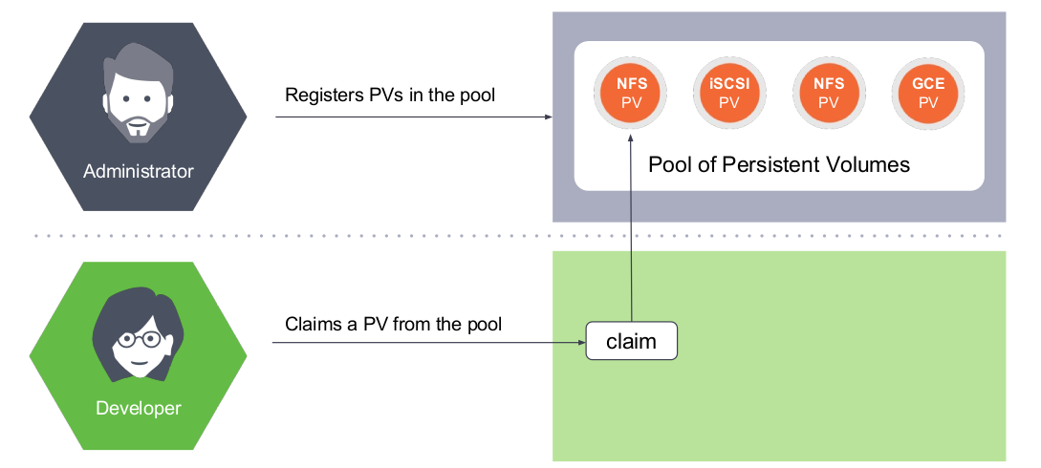
Kubernetes storage mode: PV and Claims
PersistentVolume: an abstract resource to represent persistence storage
PersistentVolumeClaim: a method to request and reclaim persistent storage
Notes:
1. 解释pv 和 pvc
2. 管理员如何部署pv和pvc
3. 局限性:
- 手动关联
-横向扩展不好
- 使用者需要知道背后pv的详细信息.
3.

Slide 8
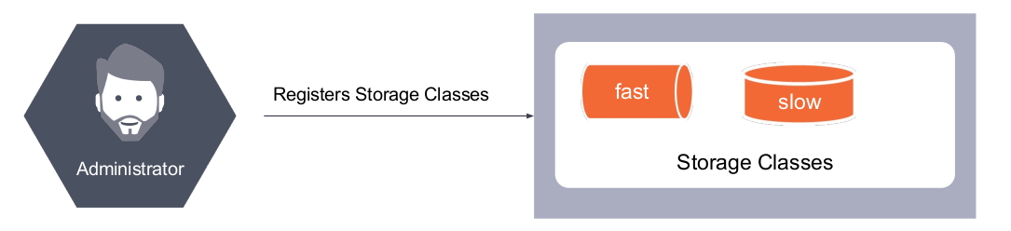
Request Different Storage Class

Slide 9
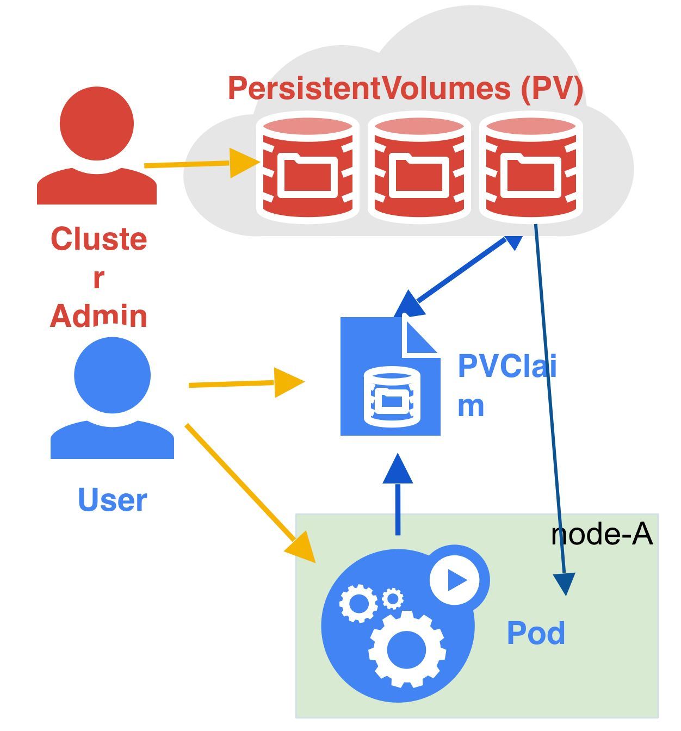
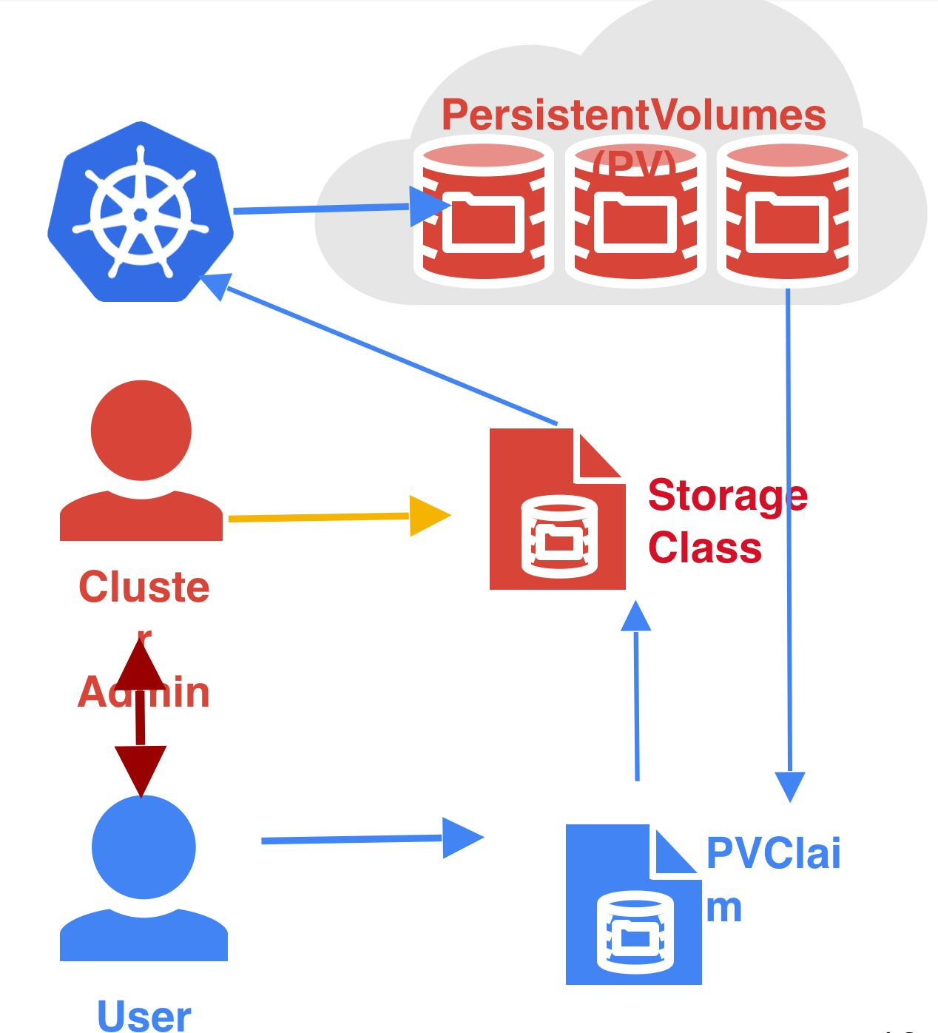
Dynamically Provision
statically provision
dynamically provision

Slide 10
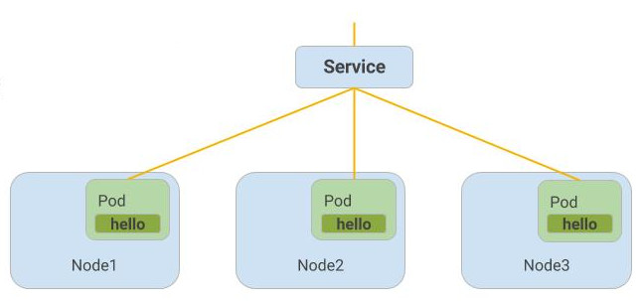
Kubernetes Application
1. Stateless Application
- Service + Pod, Deployment

Slide 11
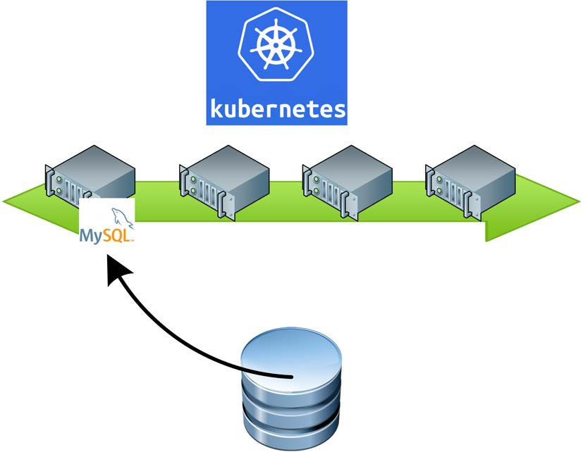
Kubernetes Application
2. Normal Stateful Application
- Volume, PV + Pod, Deployment

Slide 12
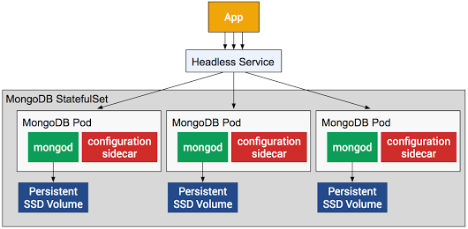
Kubernetes Application
3. Stateful Cluster Application
- StorageClass + HeadlessService + Statefulset

Slide 13
Statefulset
Auto create pvc if not
Ordered pod creation
Stable network and storage
Scale up and scale down
Non-Cascading and cascading deletion
Deletion will not to delete pvc

Slide 14
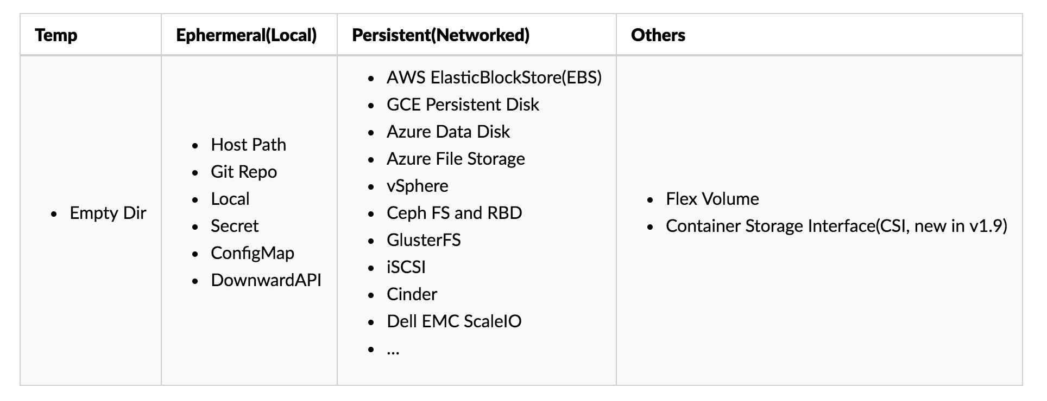
K8s Volume Plugin Type
In-tree out-of-tree

Slide 15
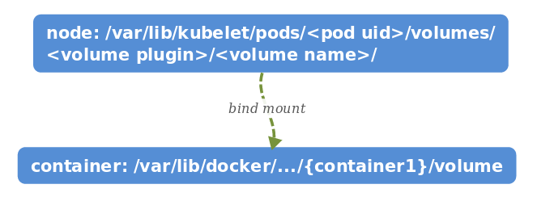
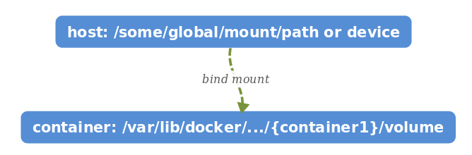
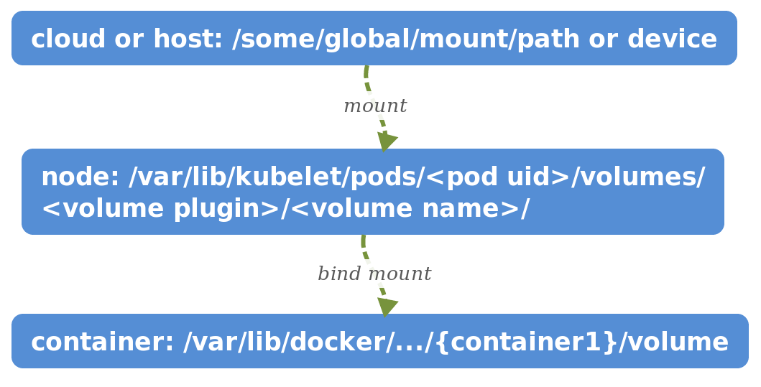
Methods to Mount in K8s
empty dir, secret, config map and git repo
host path
other methods

Slide 16
Technical Deep Dive

Slide 17
Pod

Slide 18
Statefulset

Slide 19
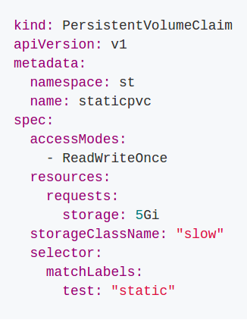
PVC
Request.Storage - request size of pv
Access Modes - request pv with specified access mode
- ReadWriteOnce – the volume can be mounted as read-write by a single node
- ReadOnlyMany – the volume can be mounted read-only by many nodes
- ReadWriteMany – the volume can be mounted as read-write by many nodes
Selector – choose pv by label
Class – storageclass name
Namespace – pvc is namespaces' resource

Slide 20
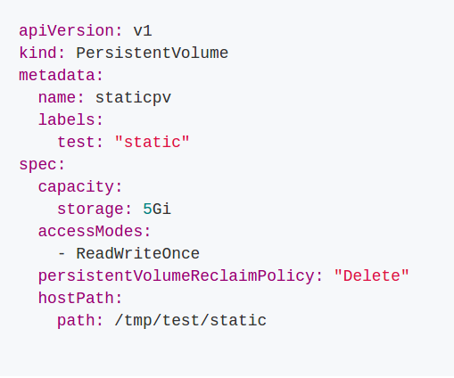
PV
Reclaim Policy – the policy when delete pvc
- Retaining – retain pv with “release”
- Recycling – recycle environment
- Deleting – delete pv and storage
Capacity – size of pv
Access Modes - mode with access to pv
PersistentVolumeSource – volume plugin
MountOptions - specify additional mount options for when a Persistent Volume is mounted on a node

Slide 21
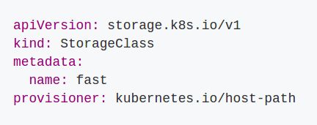
StorageClass
Name – class name
Provisioner - specify storage provisioner name
Parameters – used by plugin
ReclaimPolicy – pv reclaim policy
MountOptions – options with mount to container

Slide 22
Reclaim Policy
Retain
Do nothing
Default policy to statically provision
Recycle
Running a 'recycler pod' to clean up environment
Delete that Pod after 'running'
Need to specify file path to pod definition in Controller-Manager:
--pv-recycler-pod-template-filepath-hostpath string
--pv-recycler-pod-template-filepath-nfs string
Delete
Delete storage by plugin
Default policy to dynamically provision

Slide 23
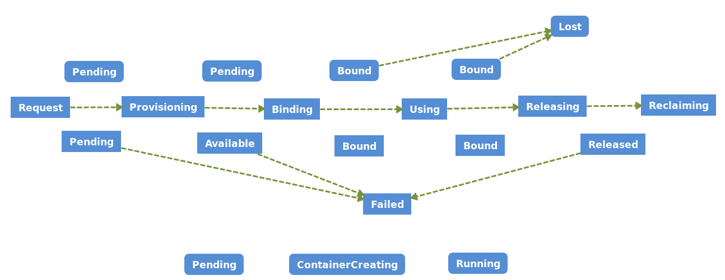
Lifecycle of Volume and Claim
PVC
Lifecycle
PV
Pod

Slide 24
Troubleshooting
Controller-manager
- create pv and pvc
- bound pv to pvc
Kubelet
- create storage
- mount storage to pod/volume directory
- bind mount directory to container

Slide 25
Review

Slide 26
References
K8s volumes: https://v1-8.docs.kubernetes.io/docs/concepts/storage/volumes/
Docker image and driver: https://docs.docker.com/engine/userguide/storagedriver/imagesandcontainers/#related-information
Dynamic provisioning: https://kubernetes.io/docs/concepts/storage/dynamic-provisioning/
StorageClass: https://kubernetes.io/docs/concepts/storage/storage-classes/
Storage introduction: https://mp.weixin.qq.com/s?__biz=MzA5OTAyNzQ2OA==&mid=2649696599&idx=1&sn=800b83de2ee6b11144618f06d56f6726&chksm=88931634bfe49f22fcbc5fe1cb1541466238a8d7fa822f25be3c0b0a86e3b499f3622403882f&mpshare=1&scene=1&srcid=0122AbGPF5C8bBWGXHs4Ybrz&pass_ticket=iOWF41J8nmDrrQDOSBDDfRkMr%2FrXV8eNokFohMYf1zztG94ac90VhHt1giuoo0SP#rd
FlexVolume: https://github.com/kubernetes/community/blob/master/contributors/devel/flexvolume.md
CSI: http://blog.kubernetes.io/2018/01/introducing-container-storage-interface.html

Slide 27
Demo

Slide 28
Demo
Directly request
Static provision
Readonly
Access mode match
Reclaim policy
- delete
- retain
- recycle
Dynamically provision
Statefulset

