Slide 1

WELCOME
Smart India Hackathon
Thank U
Teams
Problem
Category
Organization
2022

Slide 2
ALL India Council For Technical Software Domain
Bucket Smart Education
Organization
Teams
Thank U
Problem
Category
AICTE

Slide 3



Software
1
2
3
Thank U
Institute share students data
Data is categorized on the basis of skills
Corporates can easily access to this data
Teams
Problem
Category
Organization

Slide 4
Problem Statement
As on today, in our country we are not having any master data base regarding campus placement in technical institute and Universities throughout the country. By mapping the entire placement details throughout the county, the percentage of un-employability can be identified in various fields of education. This will help the policy makers to come out with appropriate solution through framing of policies for tackling the un-employability in the country. Provision of common platform in which the entire data base of campus placement of all technical institutes/ Universities throughout the country by interlinking it will be extremely useful for the following: 1. Government/Policy makers to come out with appropriate solutions. 2. Corporates to have access to the students through a central database Summary: An integrated platform should be developed where in all the universities/Colleges can share the resources for campus placement and the corporates can also access this database for recruiting students for the available vacancies
Thank U
Teams
Problem
Category
Organization

Slide 5
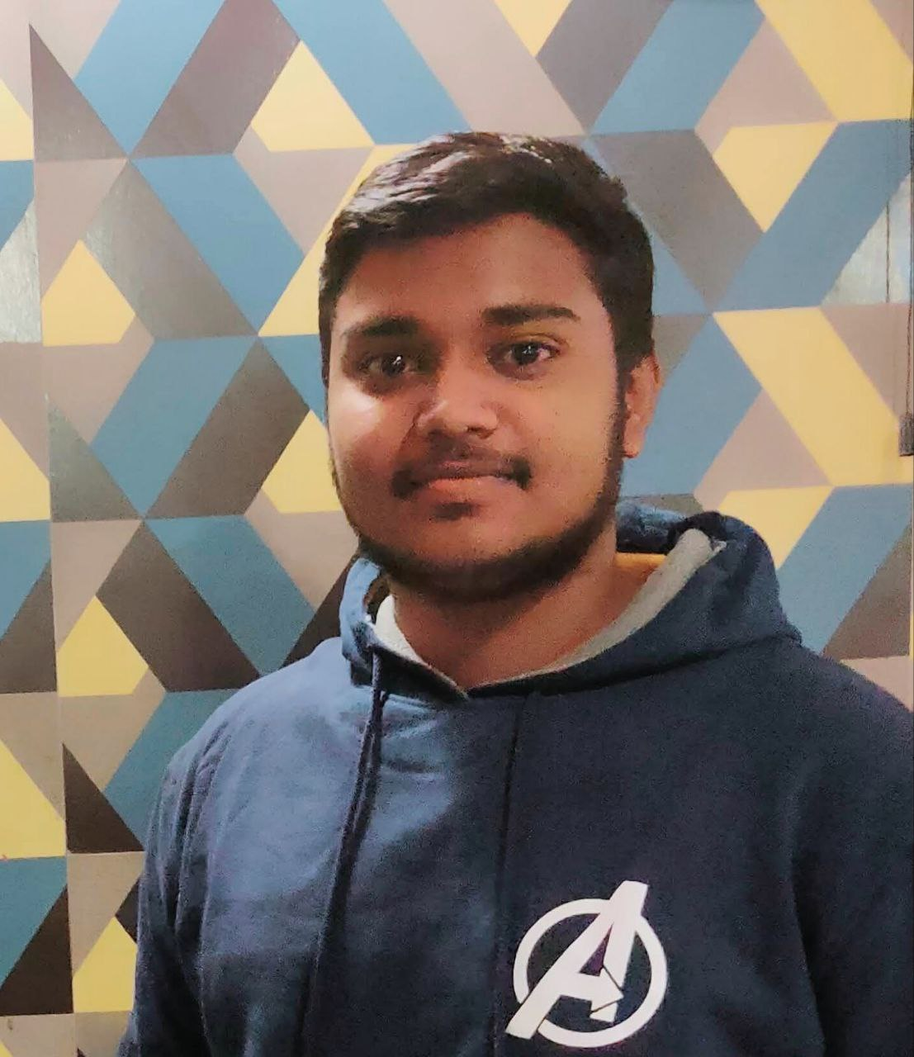





Algomers
01
02
Abhinav shakya
Ayush upadhyay
Shailja
Thank U
Problem
Teams
Category
Organization
Vipul kumar
Shivam shrivastav
Abhishek singh
(Team Lead )

