Slide 1

Rise-up Learning Hub: Empowering Tulsa's Workforce, Transforming Lives

Slide 2

Unlocking Potential, One Learner at a Time
Our Mission
Our Impact
We provide accessible, flexible, and practical learning opportunities for adults in Tulsa and beyond. Every program is designed to meet you where you are and take you where you want to go.
Career advancement, lifelong growth, and building a stronger community workforce. We don't just teach skills – we transform lives and strengthen our entire region's economic future.

Slide 3

Learning Without Limits
Every barrier removed. Every dream within reach. Every learner empowered to rise up.

Slide 4
Breaking Barriers to Education
Innovative Programs
Wrap-Around Support
Employer Partnerships
Designed specifically for busy adults balancing work, family, and education. Evening, weekend, and online options fit your schedule.
Comprehensive assistance including tutoring, coaching, childcare support, and technology access to remove every obstacle.
Strong connections with local businesses ensure relevant skills training and direct pathways to meaningful employment.

Slide 5
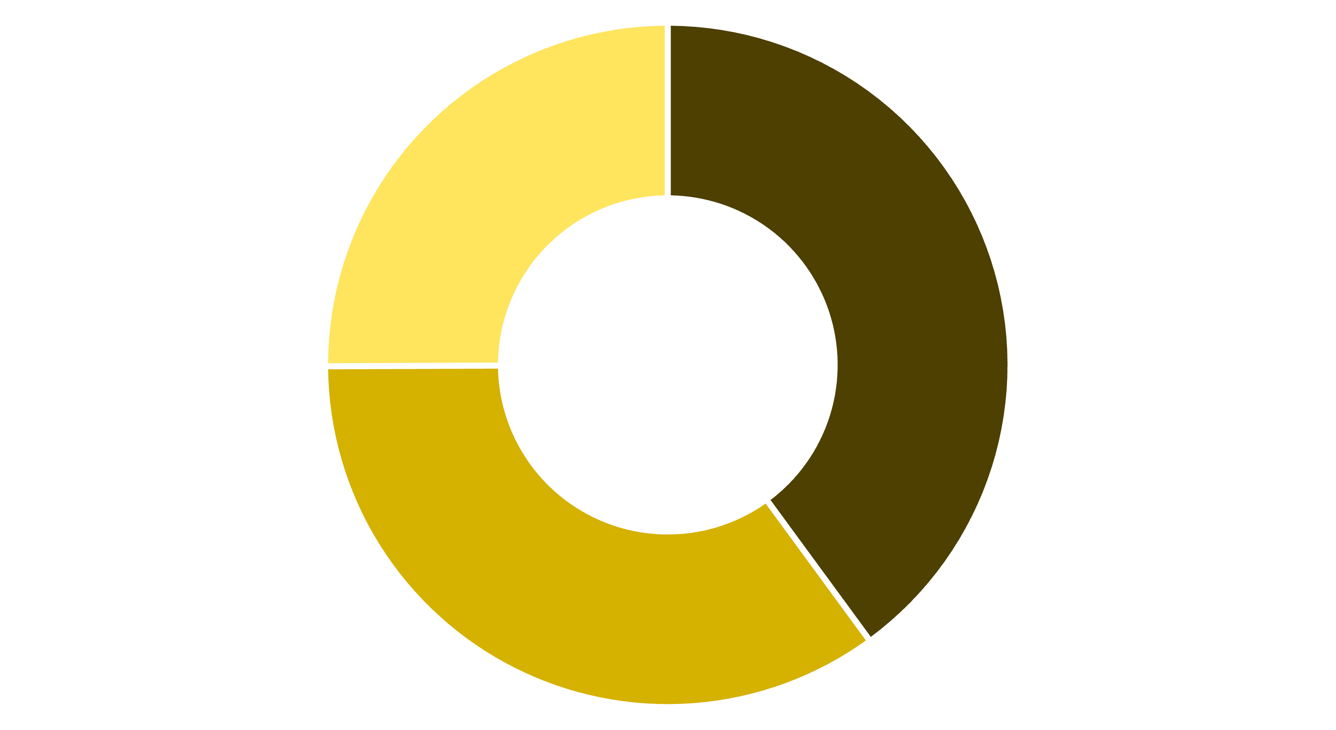
Tulsa's Workforce Needs Are Changing Fast
Post-Secondary Required
High School Sufficient
Skills Gap Areas
The Challenge
Our Solution
Local employers report a 30% skills gap in critical industries like healthcare, technology, and advanced manufacturing.
Rise-up Learning Hub bridges this gap through tailored training programs and direct employer collaboration.

Slide 6


Real Stories, Real Impact
Maria's Journey
John's Transformation
A single mom who earned her healthcare certification through our evening program and landed a promotion that doubled her salary. Now she's building a secure future for her family.
A military veteran who retrained through our technology program and now works as an IT specialist. From uncertainty to expertise in just eight months.
Together, Maria and John represent the thousands we've helped rise up and transform their lives through education and opportunity.

Slide 7

Our Programs: Flexible, Practical, Career-Focused
01
02
Flexible Scheduling
Industry Certifications
Evening and weekend classes, plus online and hybrid options. Education that adapts to your life, not the other way around.
Programs in healthcare, information technology, manufacturing, and emerging fields. All credentials are industry-recognized and employer-validated.
03
Career Support
Comprehensive career coaching, resume building, interview preparation, and direct job placement assistance with our partner employers.

Slide 8

Strong Partnerships, Stronger Futures
We work directly with Tulsa's top employers to ensure our graduates have the exact skills companies need and clear pathways to rewarding careers.

Slide 9



Join Us in Building a Thriving Tulsa
For Learners
For Employers
For Supporters
Start your transformative journey today with Rise-up Learning Hub. Take the first step toward the career and future you deserve.
Partner with us to develop your future workforce. Access skilled, motivated graduates ready to contribute from day one.
Help us expand access and impact through donations, advocacy, and community partnerships. Together, we can transform lives.

Slide 10

Rise-up Learning Hub: Your Pathway to Growth and Opportunity
Rise Up
Empower yourself. Strengthen our community. Transform Tulsa's future.
Visit: riseuplearninghub.org
Follow us: @RiseUpTulsa
Call: (555) 123-4567
Email: info@riseuplearninghub.org

