Slide 1



MVP BRIEF
Turning Culinary Passion into Profit Through Cost Clarity
PRESENTED BY: LATOYA LARKIN & JASON PARKER

Slide 2
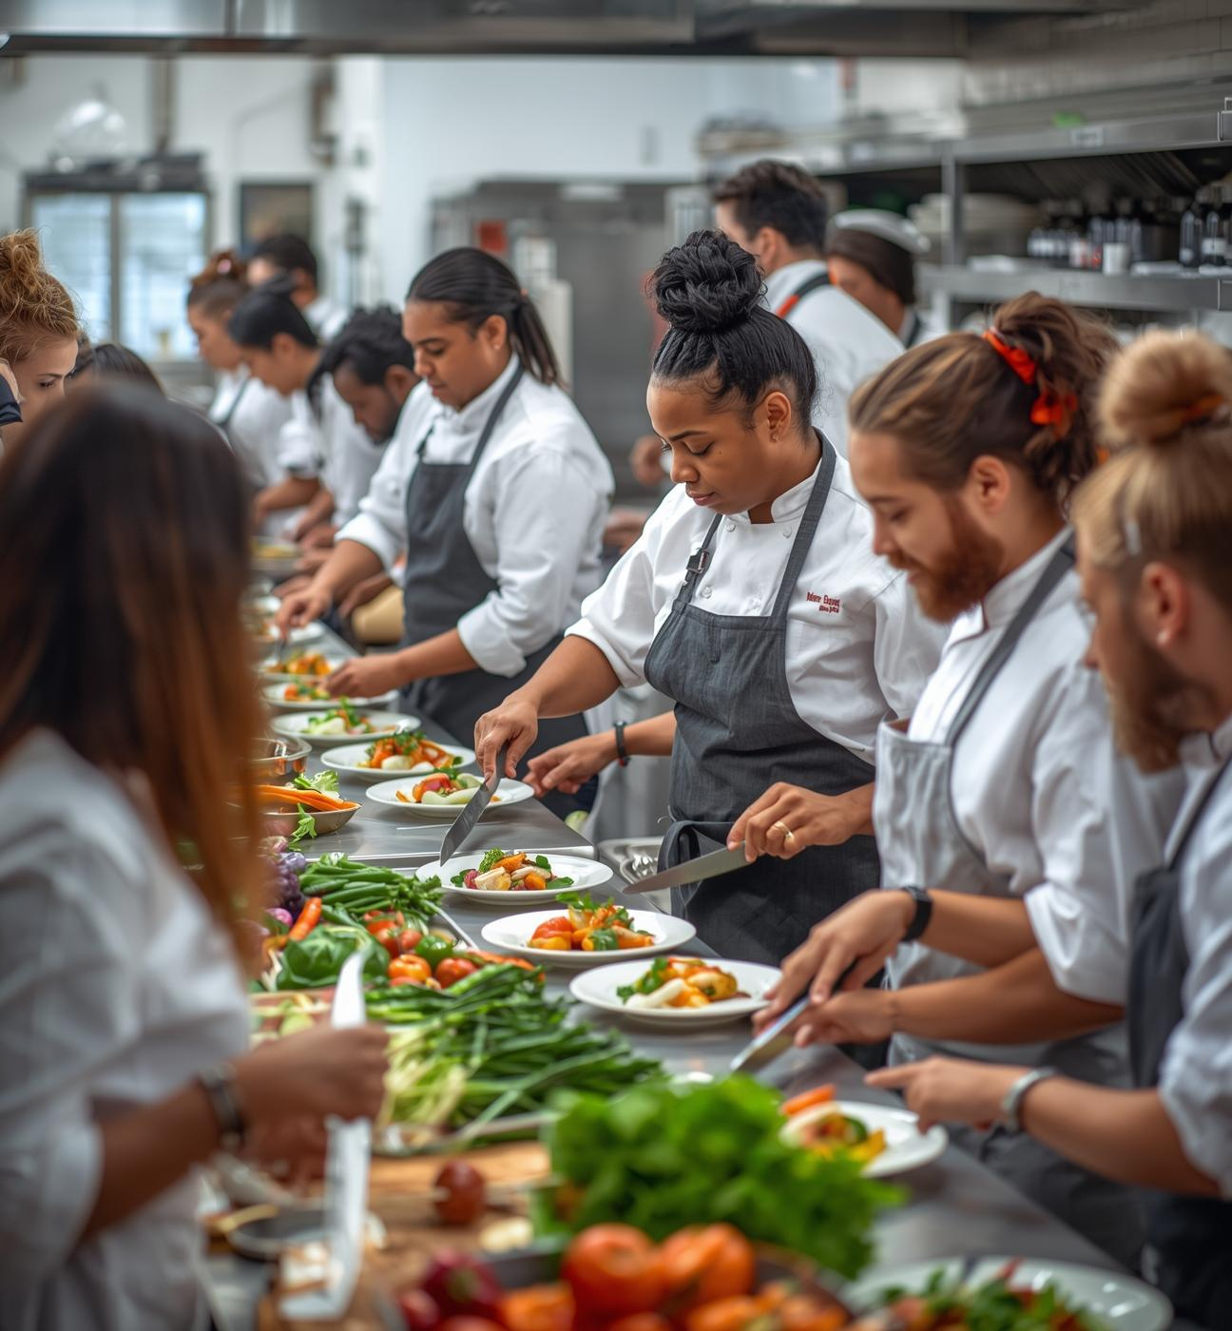
Vision
Our vision is to empower small food founders with financial clarity and control, democratizing access to culinary financial insights, and foster a thriving food entrepreneurship community to confidently navigate their culinary journeys.

Slide 3


THE CHALLENGE OF COST AWARENESS
True Costs Exposed
Understanding hidden expenses is critical for success
40-55% small food & CPG business owners overlook key expenses when tracking true costs, that affect profitability leading to inflated expenses and poor financial decisions. This lack of clarity can hinder growth, sustainability, and lead to stress of an uncertain future. While highlighting a significant gap in culinary financial management.

Slide 4


Innovation Gap
Navigating Tools that Fail Foodpreneurs
Current tools for small food businesses often lack usability; they are either overly complex leaving foodpreneurs overwhelmed,
lacking essential features for effective cost management,
or too primitive to offer meaningful insights, leaving curators uninformed creating a significant barrier to success for daily operations.

Slide 5
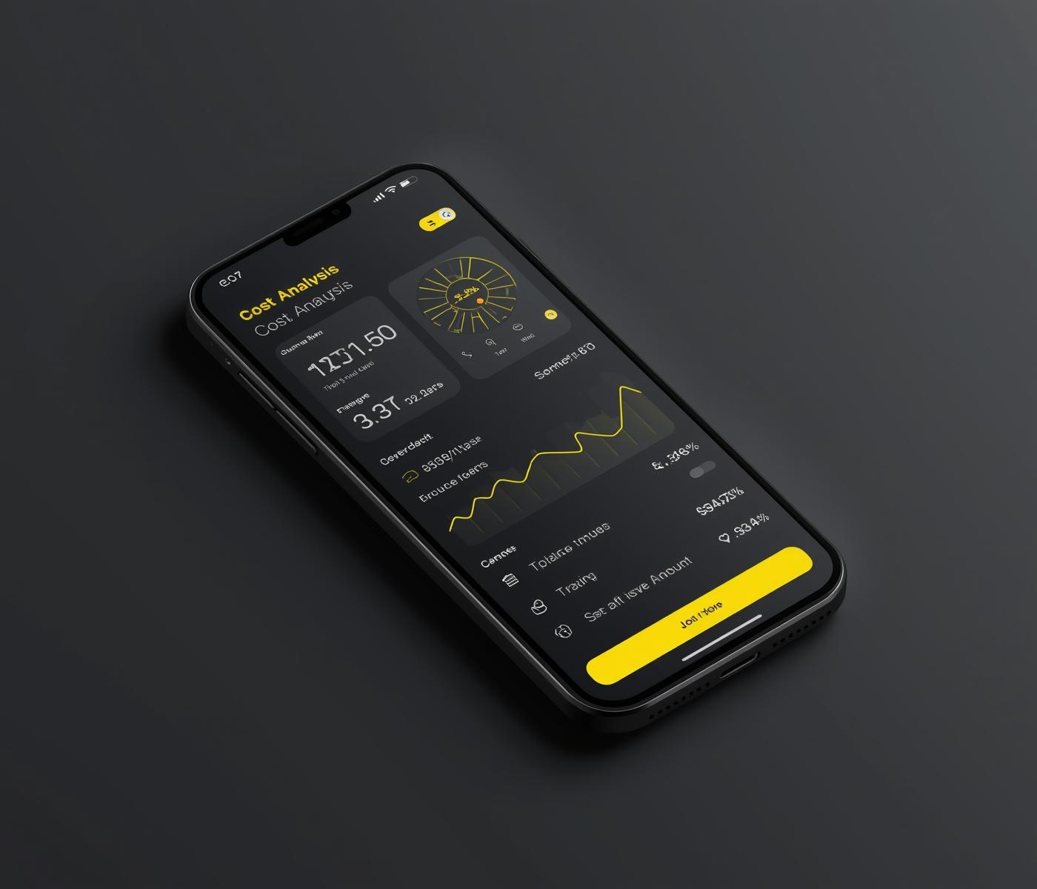
AI-Powered Clarity
Simplifying Cost Management for Foodpreneurs
Mise en Cost harnesses AI techology in a mobile app that provides effortless cost clarity and real-time cost analysis for every food entrepreneur, empowering them with insights and tools to make informed financial decisions and optimize their operations for greater profitability.

Slide 6
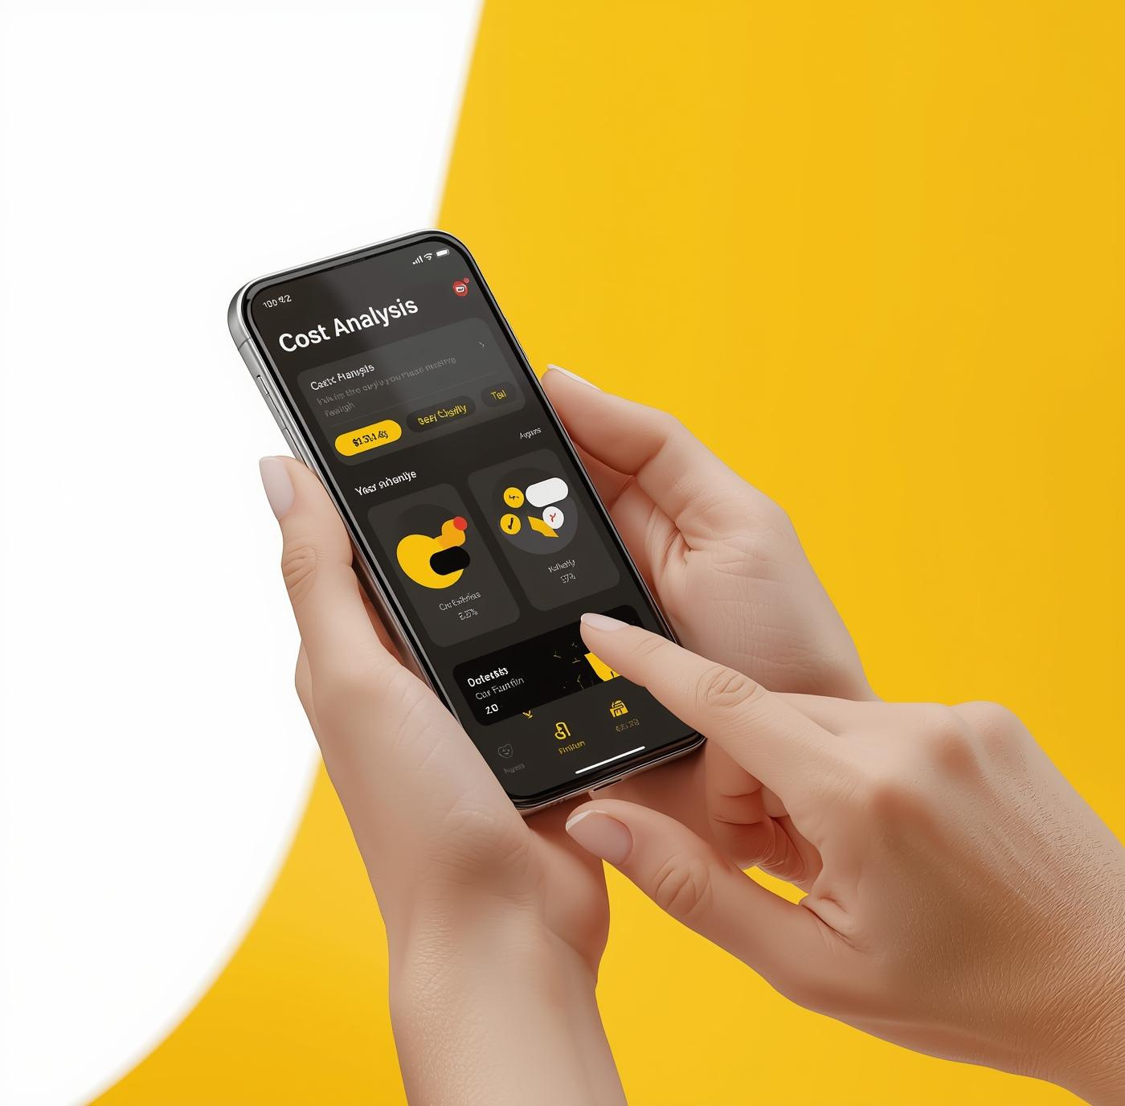
How It Works
Users engage with a simple and intuitive app, gaining instant insights into food cost management.
01
02
03
Receipt OCR
AI Calculates Costs
Optimize for Profit
Captures all ingredients and quantities.
Instant insights on total expenses.
Adjust pricing for maximum returns.

Slide 7

Validation: Proof of Demand
How It Works
Insights from Real Foodpreneurs
Our early adopters, real foodpreneurs, have expressed overwhelming enthusiasm for Mise en Cost. They appreciate the simplicity and clarity our platform provides, empowering them to gain control over their costs. User feedback emphasizes the platform's vital role in enhancing their culinary ventures.
50+
90%
Beta Users
User Satisfaction
Over fifty chefs joined our beta.
Ninety percent of users recommend our solution.

Slide 8
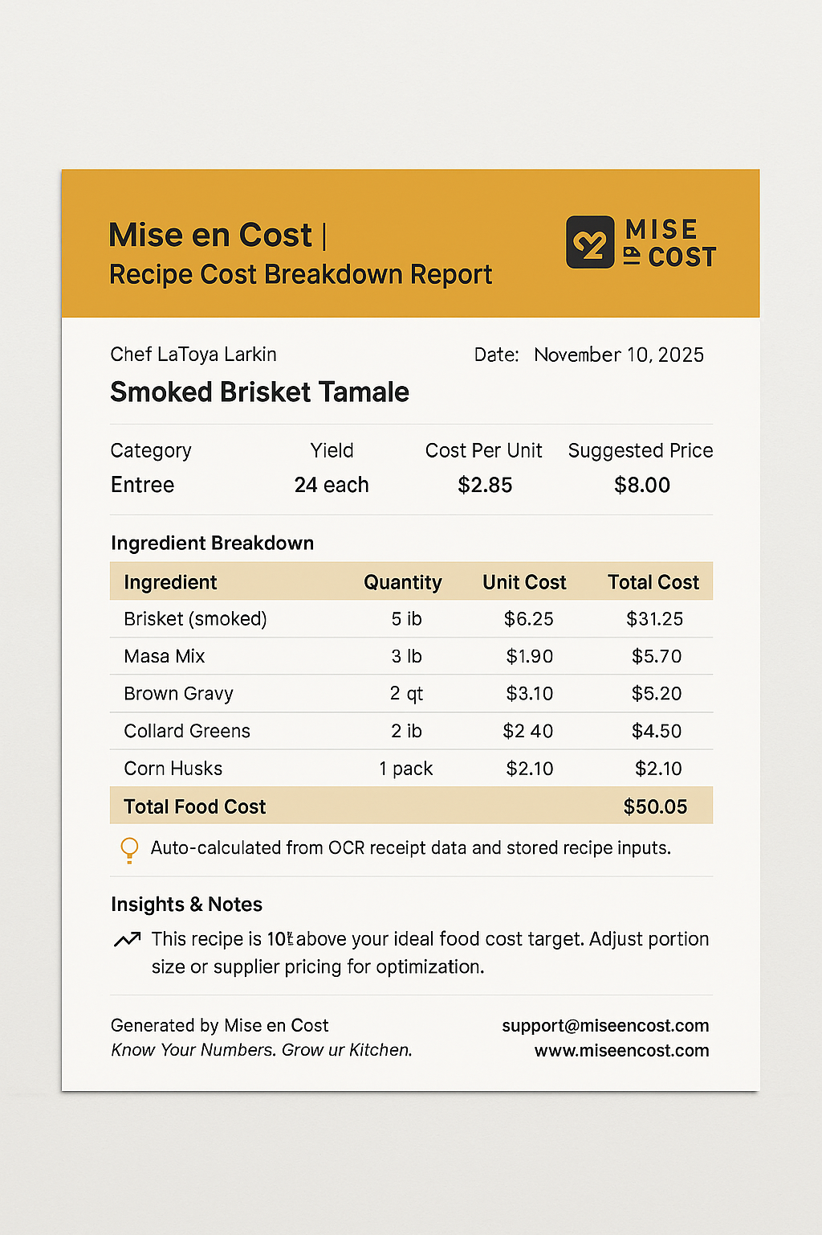

MVP Core Features
Receipt OCR (Optical Character Recognition)
Automatically reads and extracts data from receipts (prices, product name, and vendor) that speeds up food cost entry
Essential tools for foodpreneurs' success
PDF/Email Reporting
System automatically generates PDF report with ingredient breakdowns, total recipe COGS, suggested menu pricing, and profit margin.
AI-Powered Profit Dashboard
Visualize profits and track financial performance to reduce waste and maximize profits.
User-Friendly Interface
Intuitive design ensures effortless navigation and accesibility.

Slide 9
Untapped Potential in Food Entrepreneurship
Market Opportunity
The Culinary Creator Economy is RAPIDLY Growing
Yet, many aspiring food entrepreneurs lack the necessary tools to manage costs effectively. Our solution fills this critical gap.
$100B
50M
Total Market Value
Potential Users
Represents the size of the market.
Number of aspiring food entrepreneurs available.

Slide 10
Business Model
Unlocking potential through flexible pricing options
Premium Features
Advanced tools for enhanced profitability and insights
Enterprise Solutions
Customized packages for larger food businesses
Subscription Tiers
Flexible plans to suit various culinary needs

Slide 11



Roadmap
Key Milestones for Launch and Growth
MVP LAUNCH PHASE
USER FEEDBACK LOOP
PUBLIC RELEASE
Initial product release to early adopters.
Gathering insights to enhance features.
Refining offerings to elevate the user experience and target broader market segments.

Slide 12
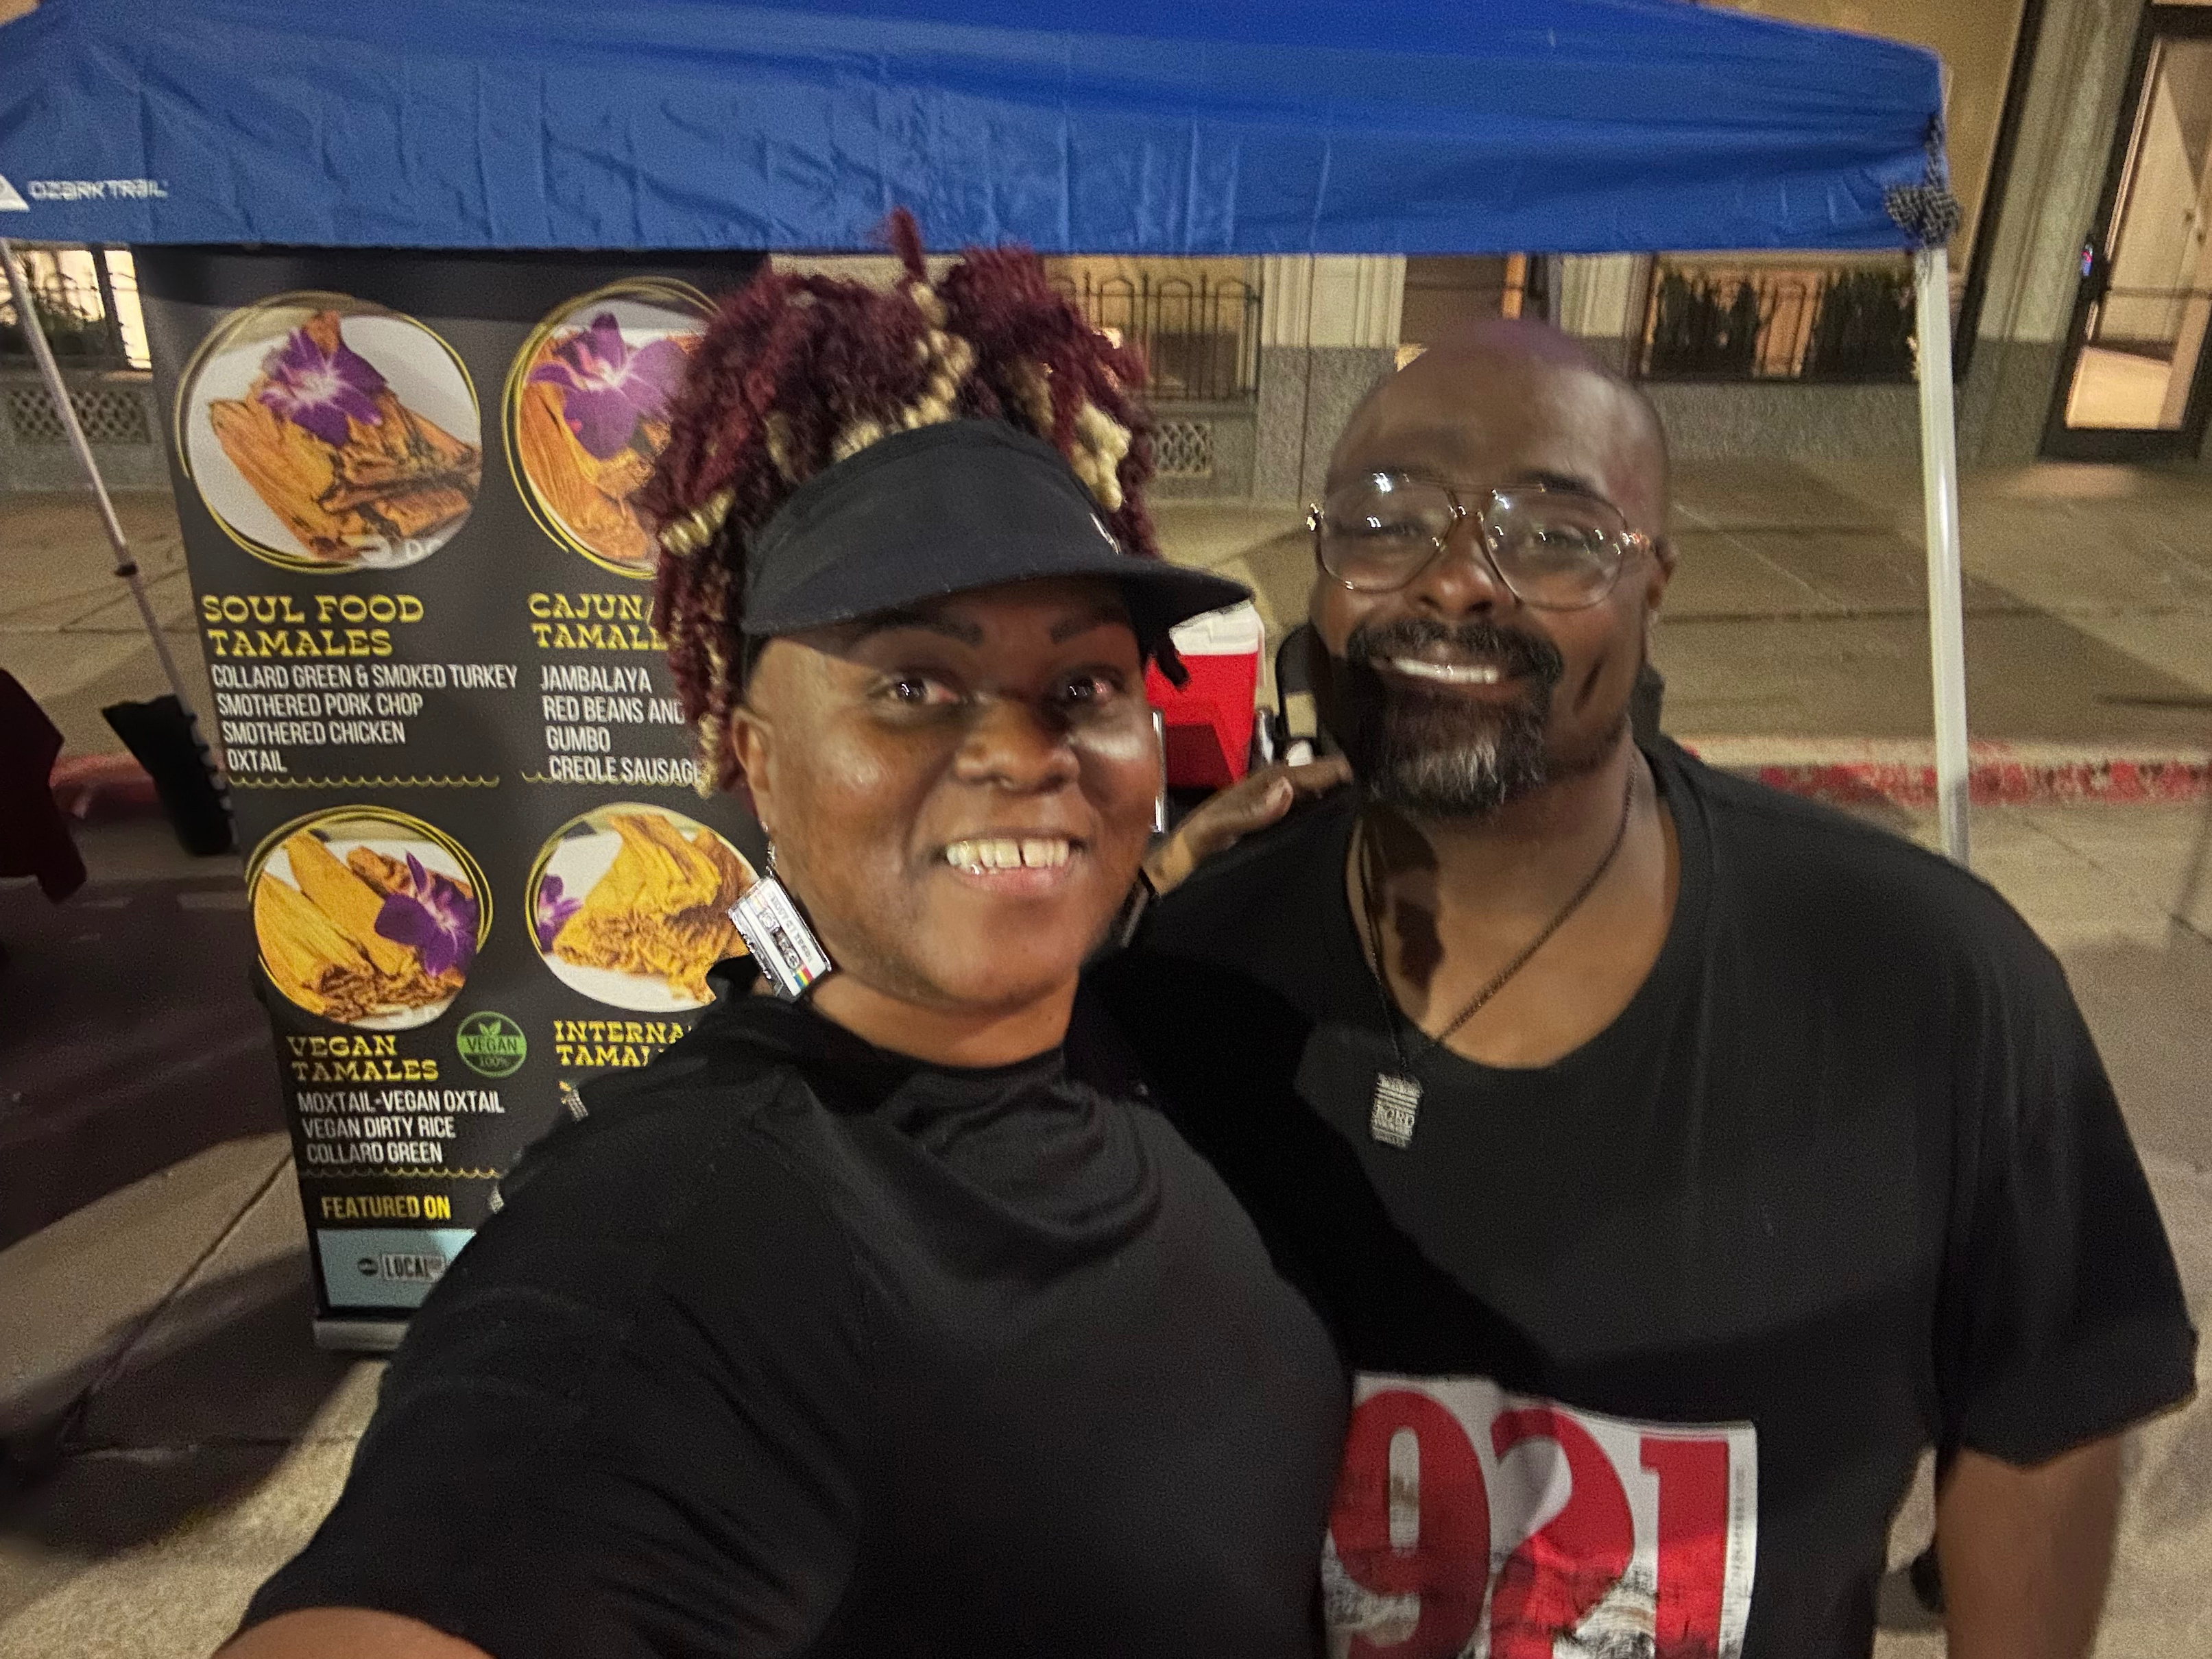
Our Team
Chef LaToya Larkin, MBA, CCE
Founder & CEO
Chef Larkin founder of Black Girl Tamales, brings over 25 years of experience as a classically trained, award-winning chef, hospitality consultant, and culinary educator. Her industry background includes:
15+ years of consulting on menu development, standardized recipes, and COGS improvement.
10+ years as a culinary educator and curriculum writer, teaching students and foodpreneurs cost control, kitchen management, and recipe accuracy.
Jason Parker, MHA
Co-Founder
Jason is a detail-oriented finance professional with over 15 years of corporate hands-on experience across accounts payable, accounts receivable, revenue cycle operations, and financial reconciliation.

Slide 13
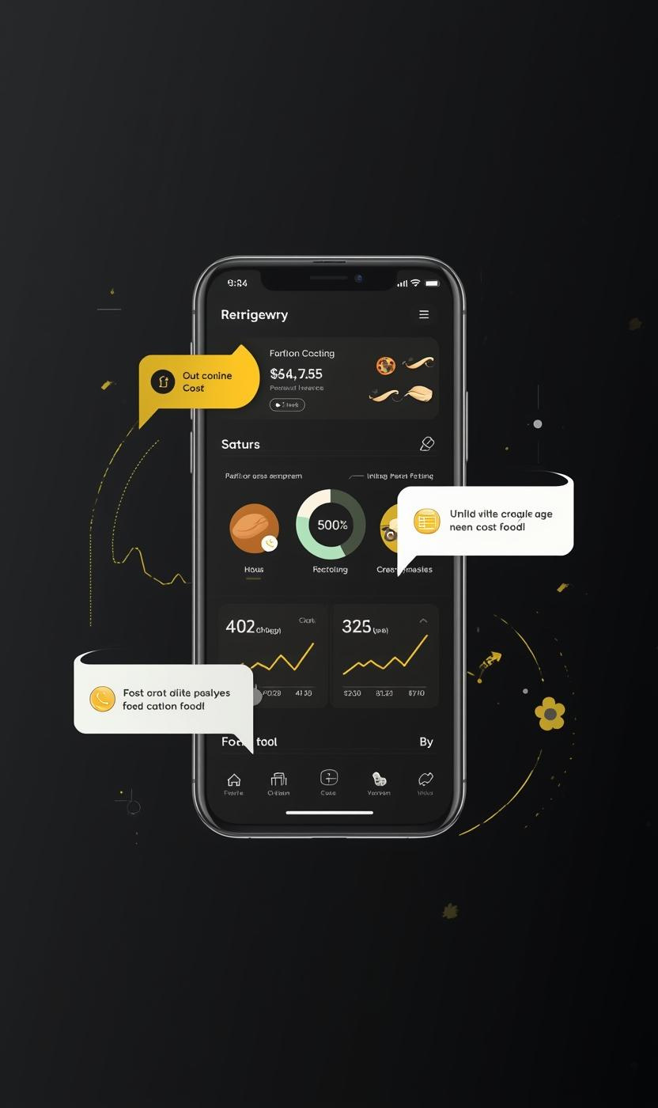
Culinary Cost Clarity Recap
The Mise en Cost app addresses a significant issue: nearly 40–55% of self-taught chefs fail to track their true food costs. Current tools are often either too complicated or too simplistic, leaving foodpreneurs without essential insights into their expenses. This gap creates uncertainty and hinders profitability in a competitive market, necessitating a modern solution that empowers home cooks and small businesses alike.
Our AI-powered mobile app offers instant cost clarity, enabling users to input recipes, utilize receipt OCR technology, and generate comprehensive PDF or email reports. These core MVP features streamline financial management, providing a robust tool for culinary enthusiasts eager to optimize their food costs and improve their bottom line.
Validation experiments have demonstrated a clear demand for our solution, with over 15 submissions and 70% data utilization from participants. This feedback affirms the application's potential to foster trust and reliability among users. Our vision is to democratize culinary financial clarity, empowering small food founders to gain control over their finances and confidently navigate their culinary journeys.
By offering insights into food costing, the Mise en Cost app is positioned to become an essential resource for aspiring chefs and food entrepreneurs. The call to action for investors is clear: join us in transforming culinary passion into profit through innovative financial tools tailored to the unique needs of the food industry.

Slide 14

Let's Connect
Revolutionize your cost management strategy
today with “Mise en Cost”
Email
blackgirltamales@gmail.com
Social Media
FB @BlackGirlTamales
IG @BlackGirlTamales
TikTok @BlackGirlTamales
Phone
918-409-4091

