Slide 1


Slide 2
Welcome to Snapshots:
1.Introduction
2.Objectives of Snapshots
3.Scope of Snapshots
4.Tools and Technology used
5.Results
6.Conclusion

Slide 3
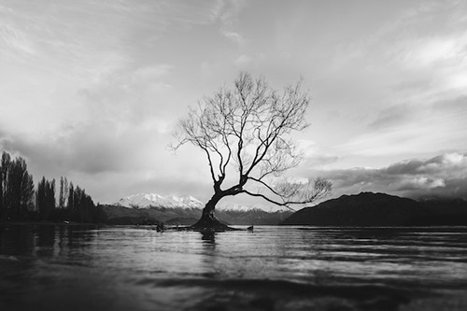
Introduction:
A photography website is a showcase for photos. Snapshots is a photography website where you can find many pictures which are uploaded by users.
For example: Picture of Nature , anime , art , black and white pictures , and many more.

Slide 4

Objectives of SnapShots:
The main objective of our photography site is to allow users to upload picture they like or they have captured.
A person can upload a picture of anything s/he likes and can also delete it .

Slide 5

Scope of Snapshot:
Photography is not just restricted to any particular sector but has scope across various ambits such as:
Wildlife Photography,
Fashion Photography,
Wedding Photography,
Advertising Photography
and many more

Slide 6

Tools & Technology used:
The list are listed below:
HTML
PHP
CSS
JavaScript
MySQL

Slide 7
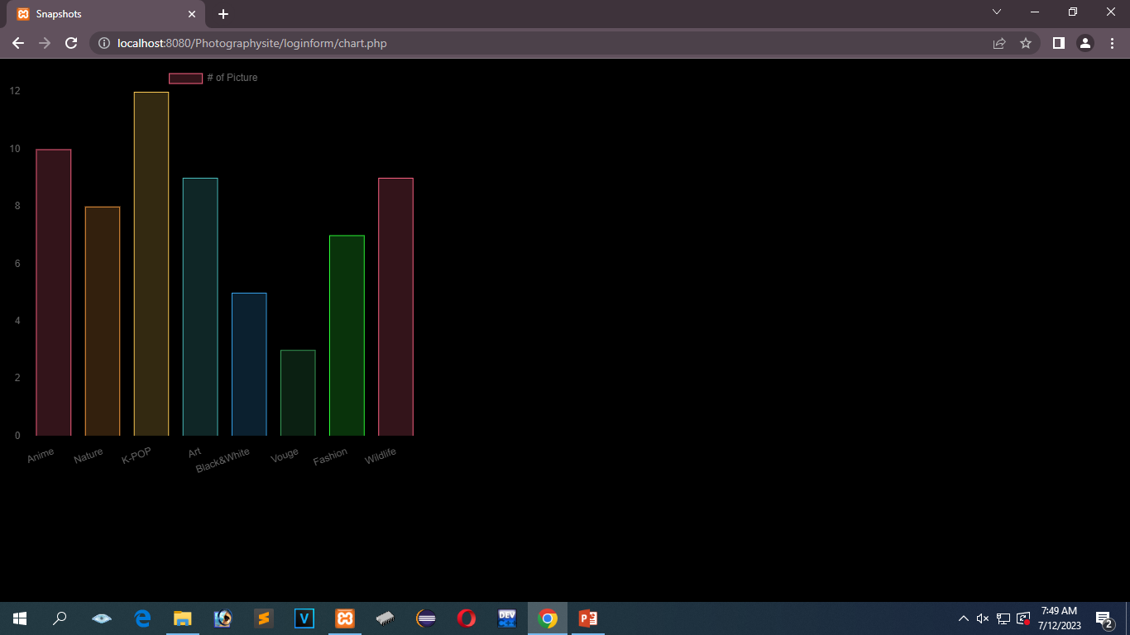
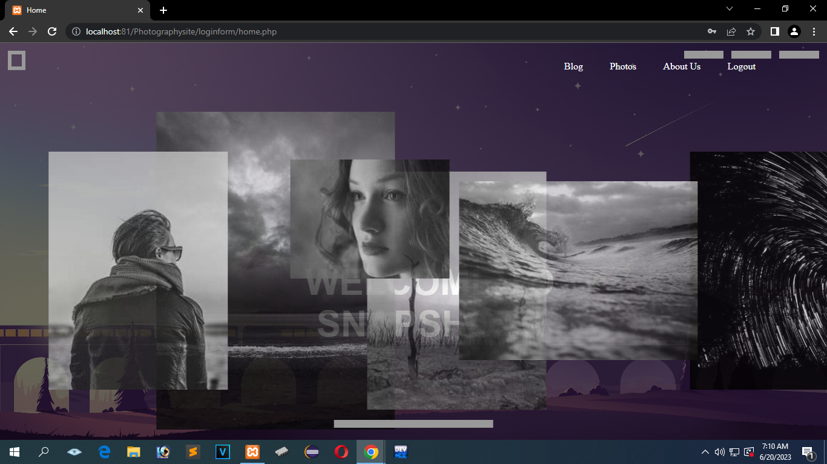
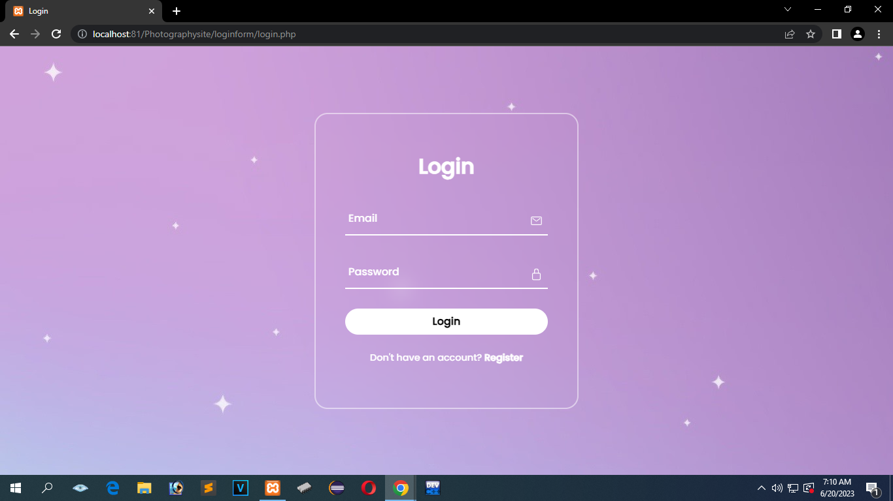
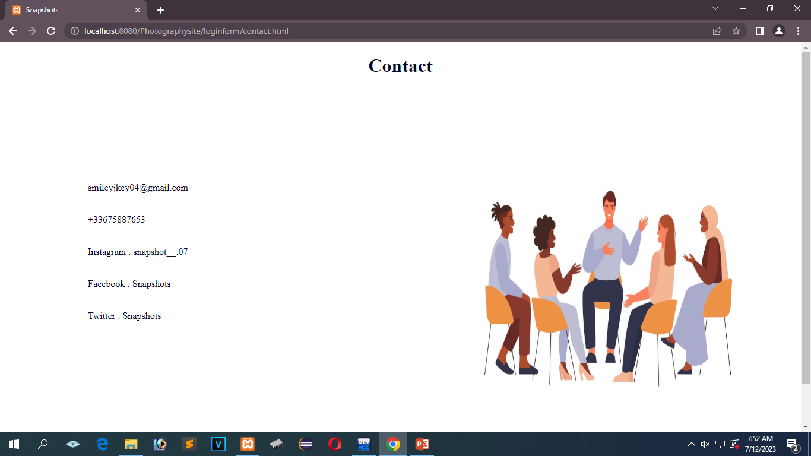
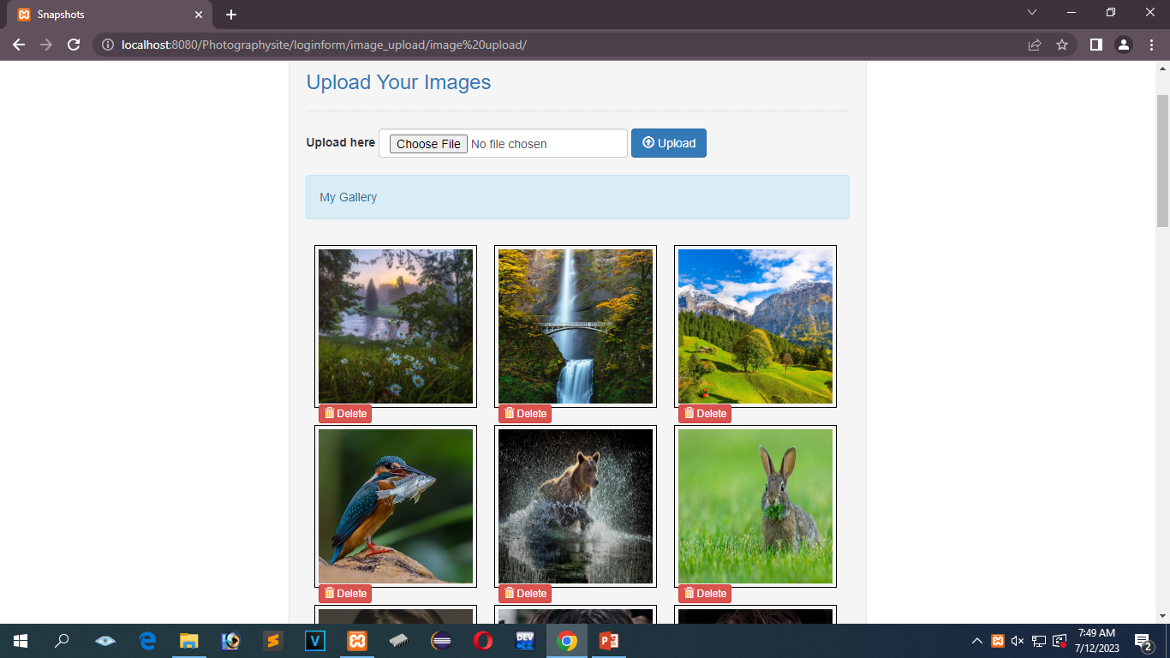
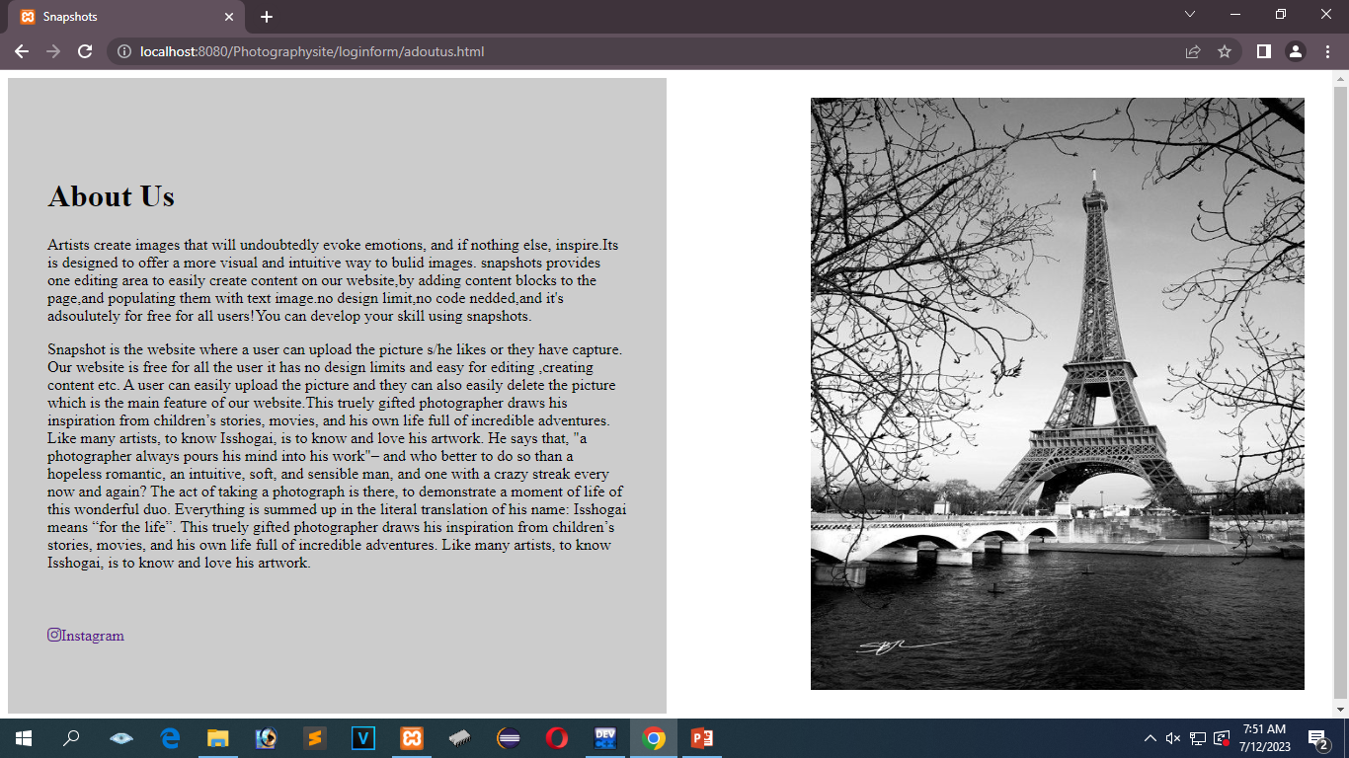
Results:

Slide 8
Team Recognition:
There is a vital role of each member who has work hardly to create this project .
Because of their hard work and creative ideas our project has been completed.
The team members are :
Satyawati Basnet
Shreeya Sigdel
Karan Rai
Shreeshma Chaudari and
Mamata BK

Slide 9

Conclusion:
Photography is the art, application, and practice of creating durable images.
It has opened more job opportunities and careers and also made them easier whether they be, professional fashion photographer, professional wedding photographer or even professional sports photographer.

Slide 10
Thank You!

