Slide 1
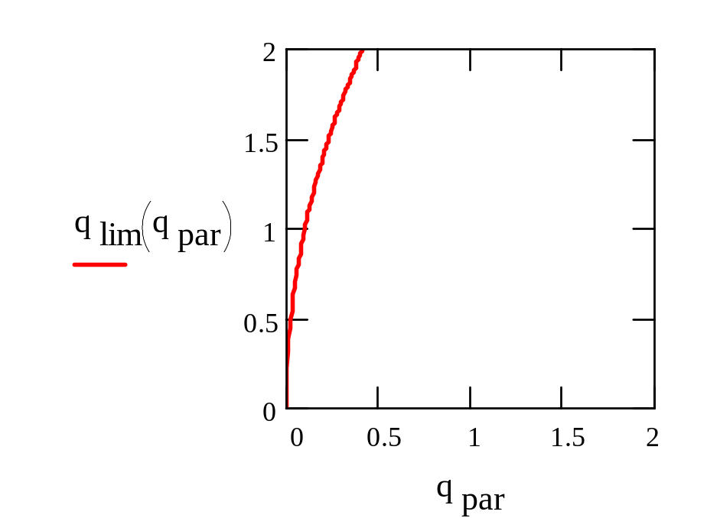
diffuse
scattering
only
Bragg
scattering
possible

