Slide 1
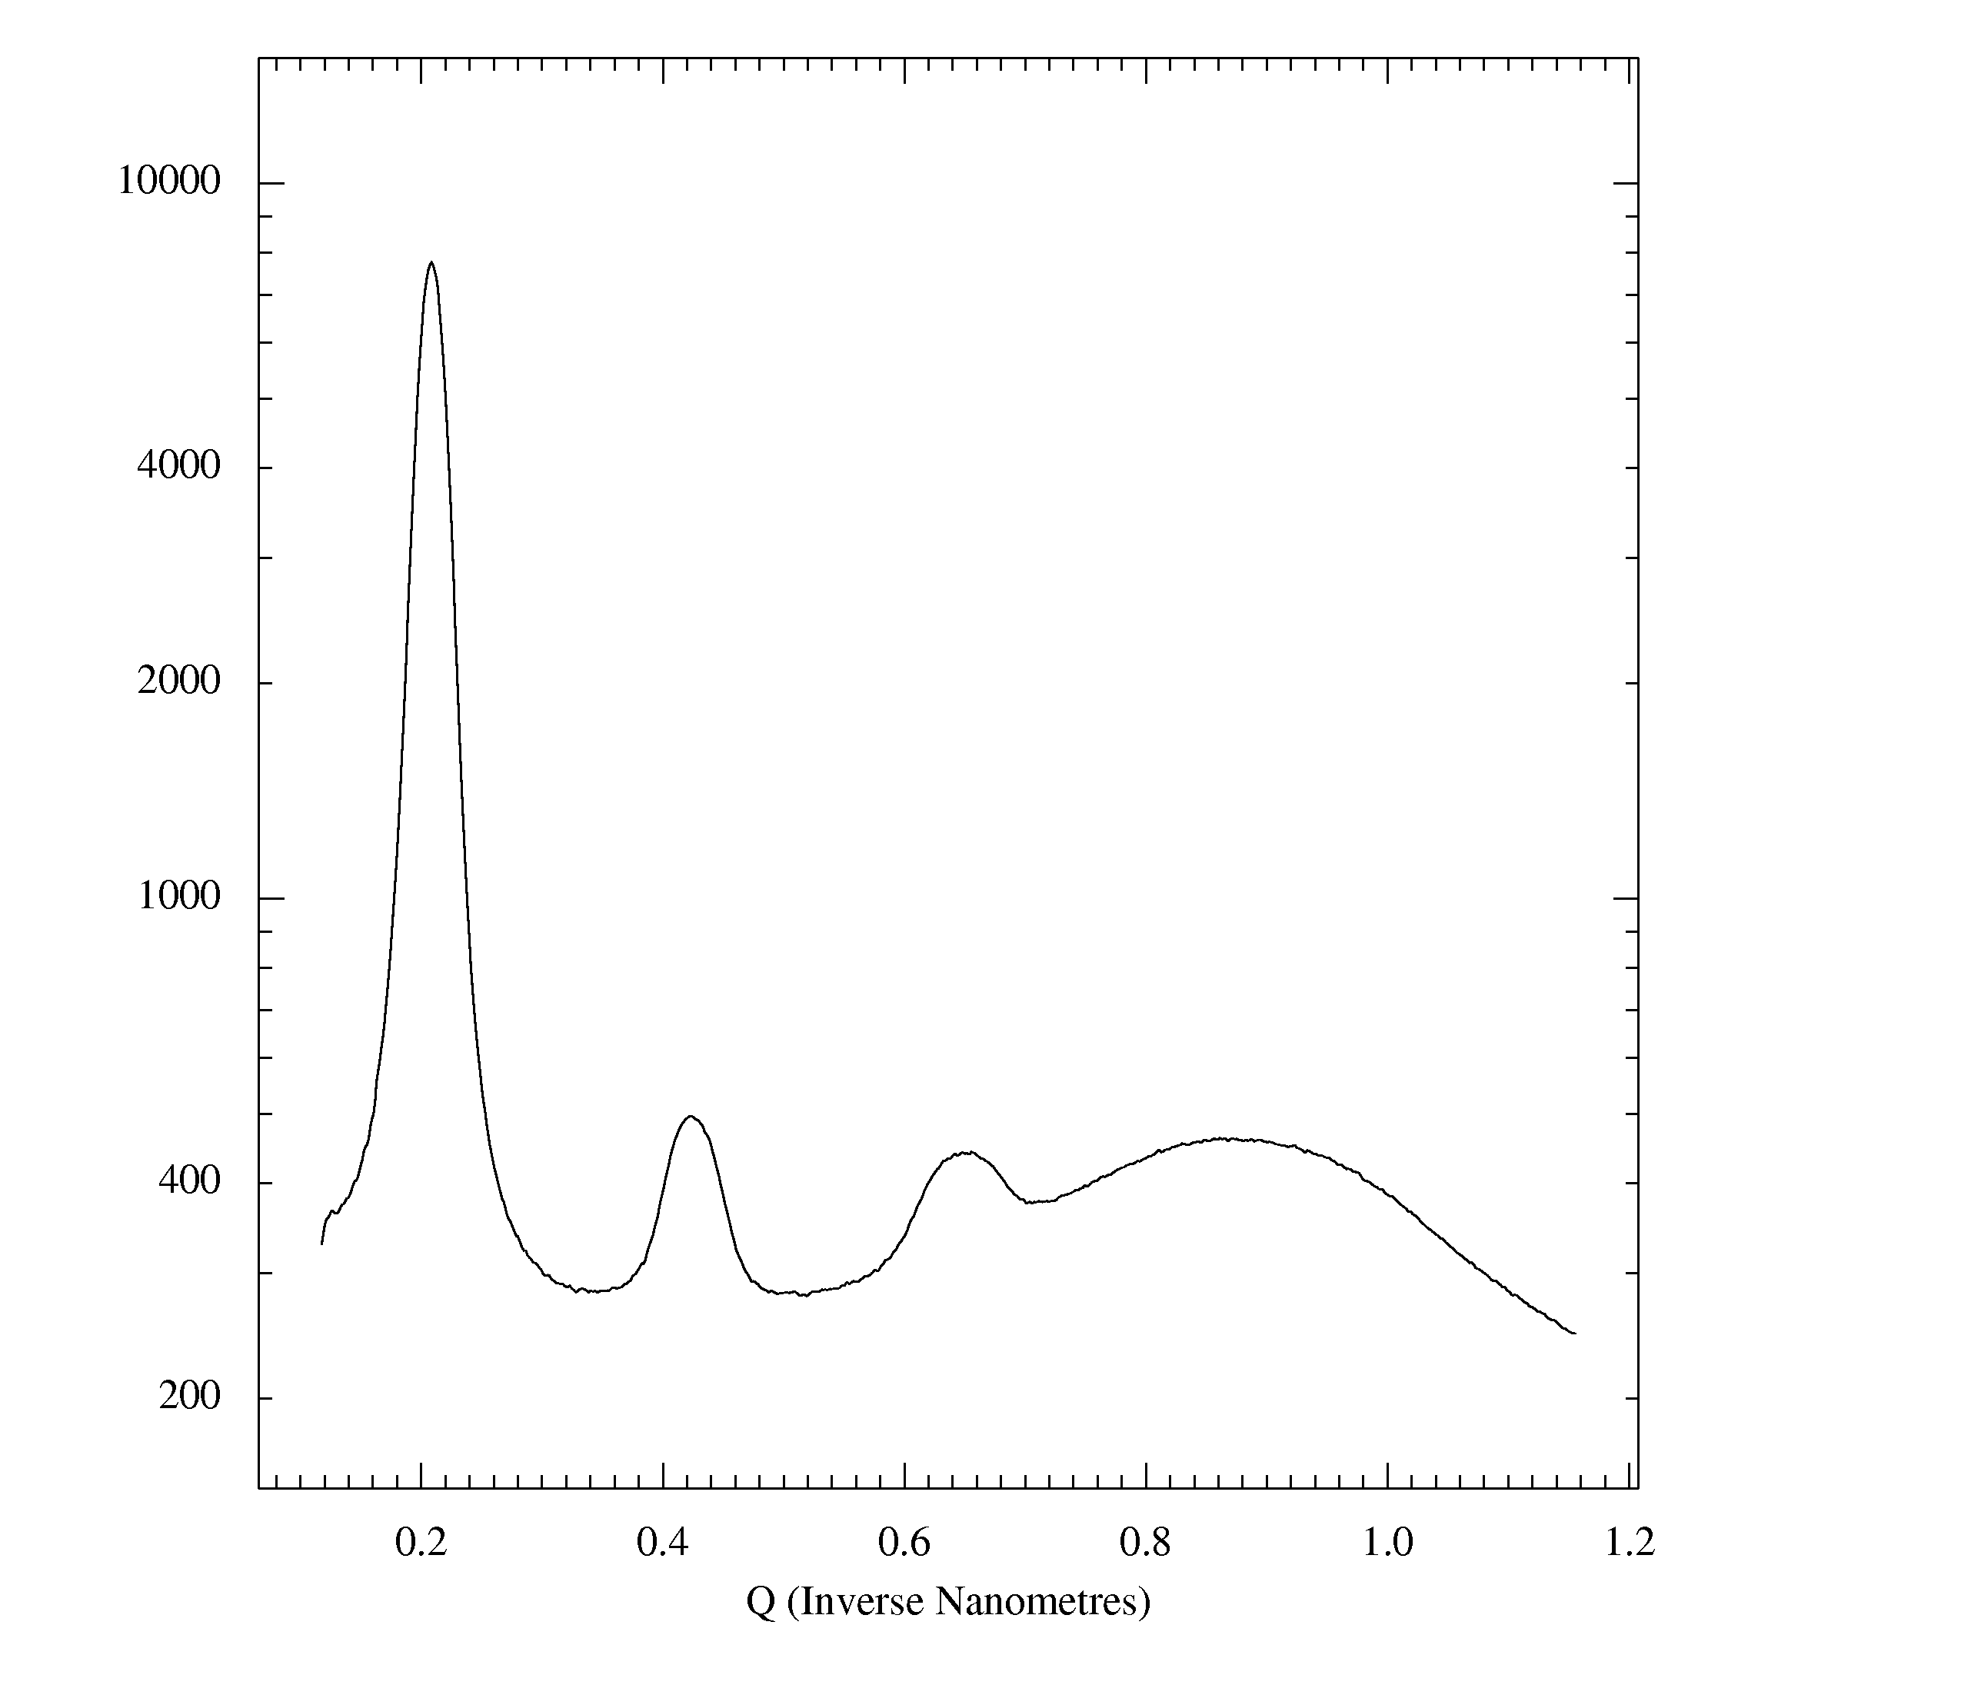
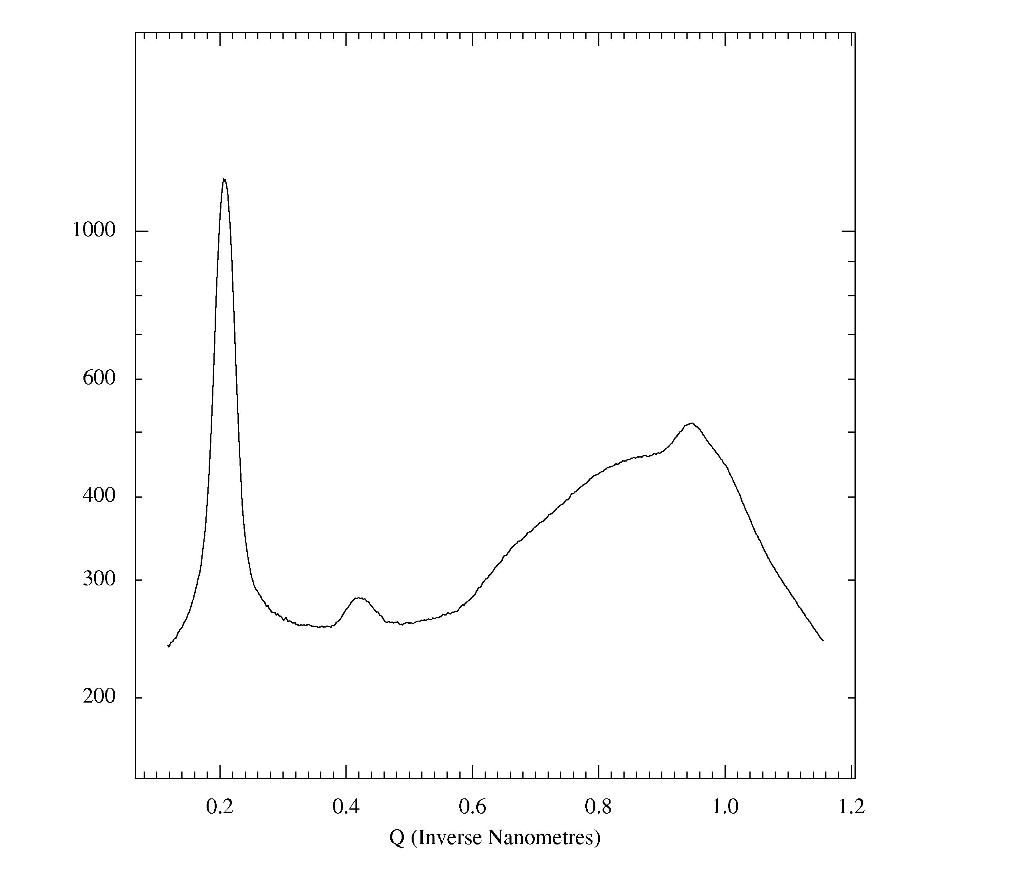
perpendicular
to the film
parallel
to the film
(001)
powder
ring
(001)
(a)
(100)
(002)
powder
ring
(002)
(003)
silicon oxide
powder ring
silicon oxide
powder ring

Slide 2
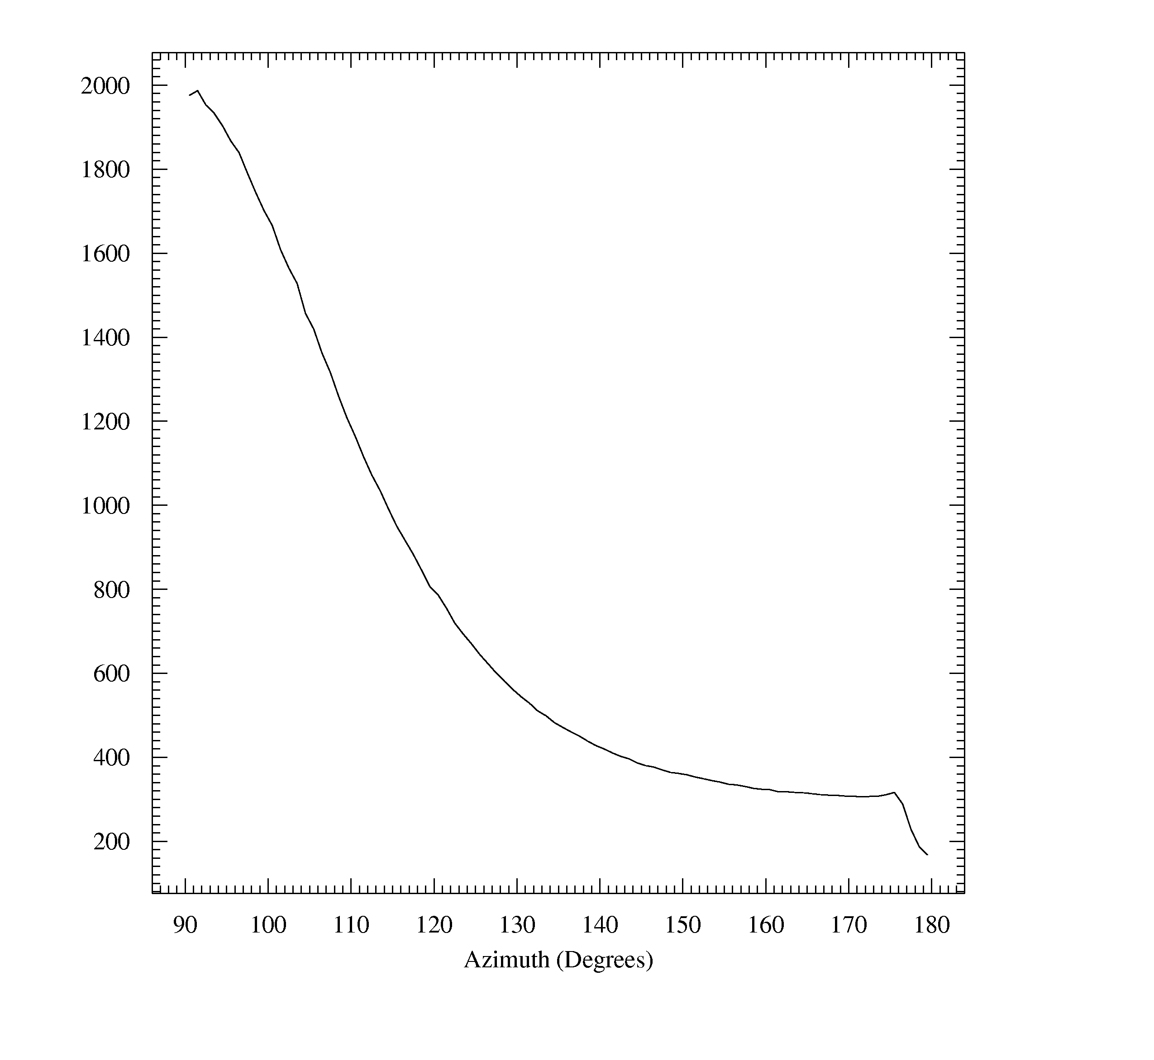
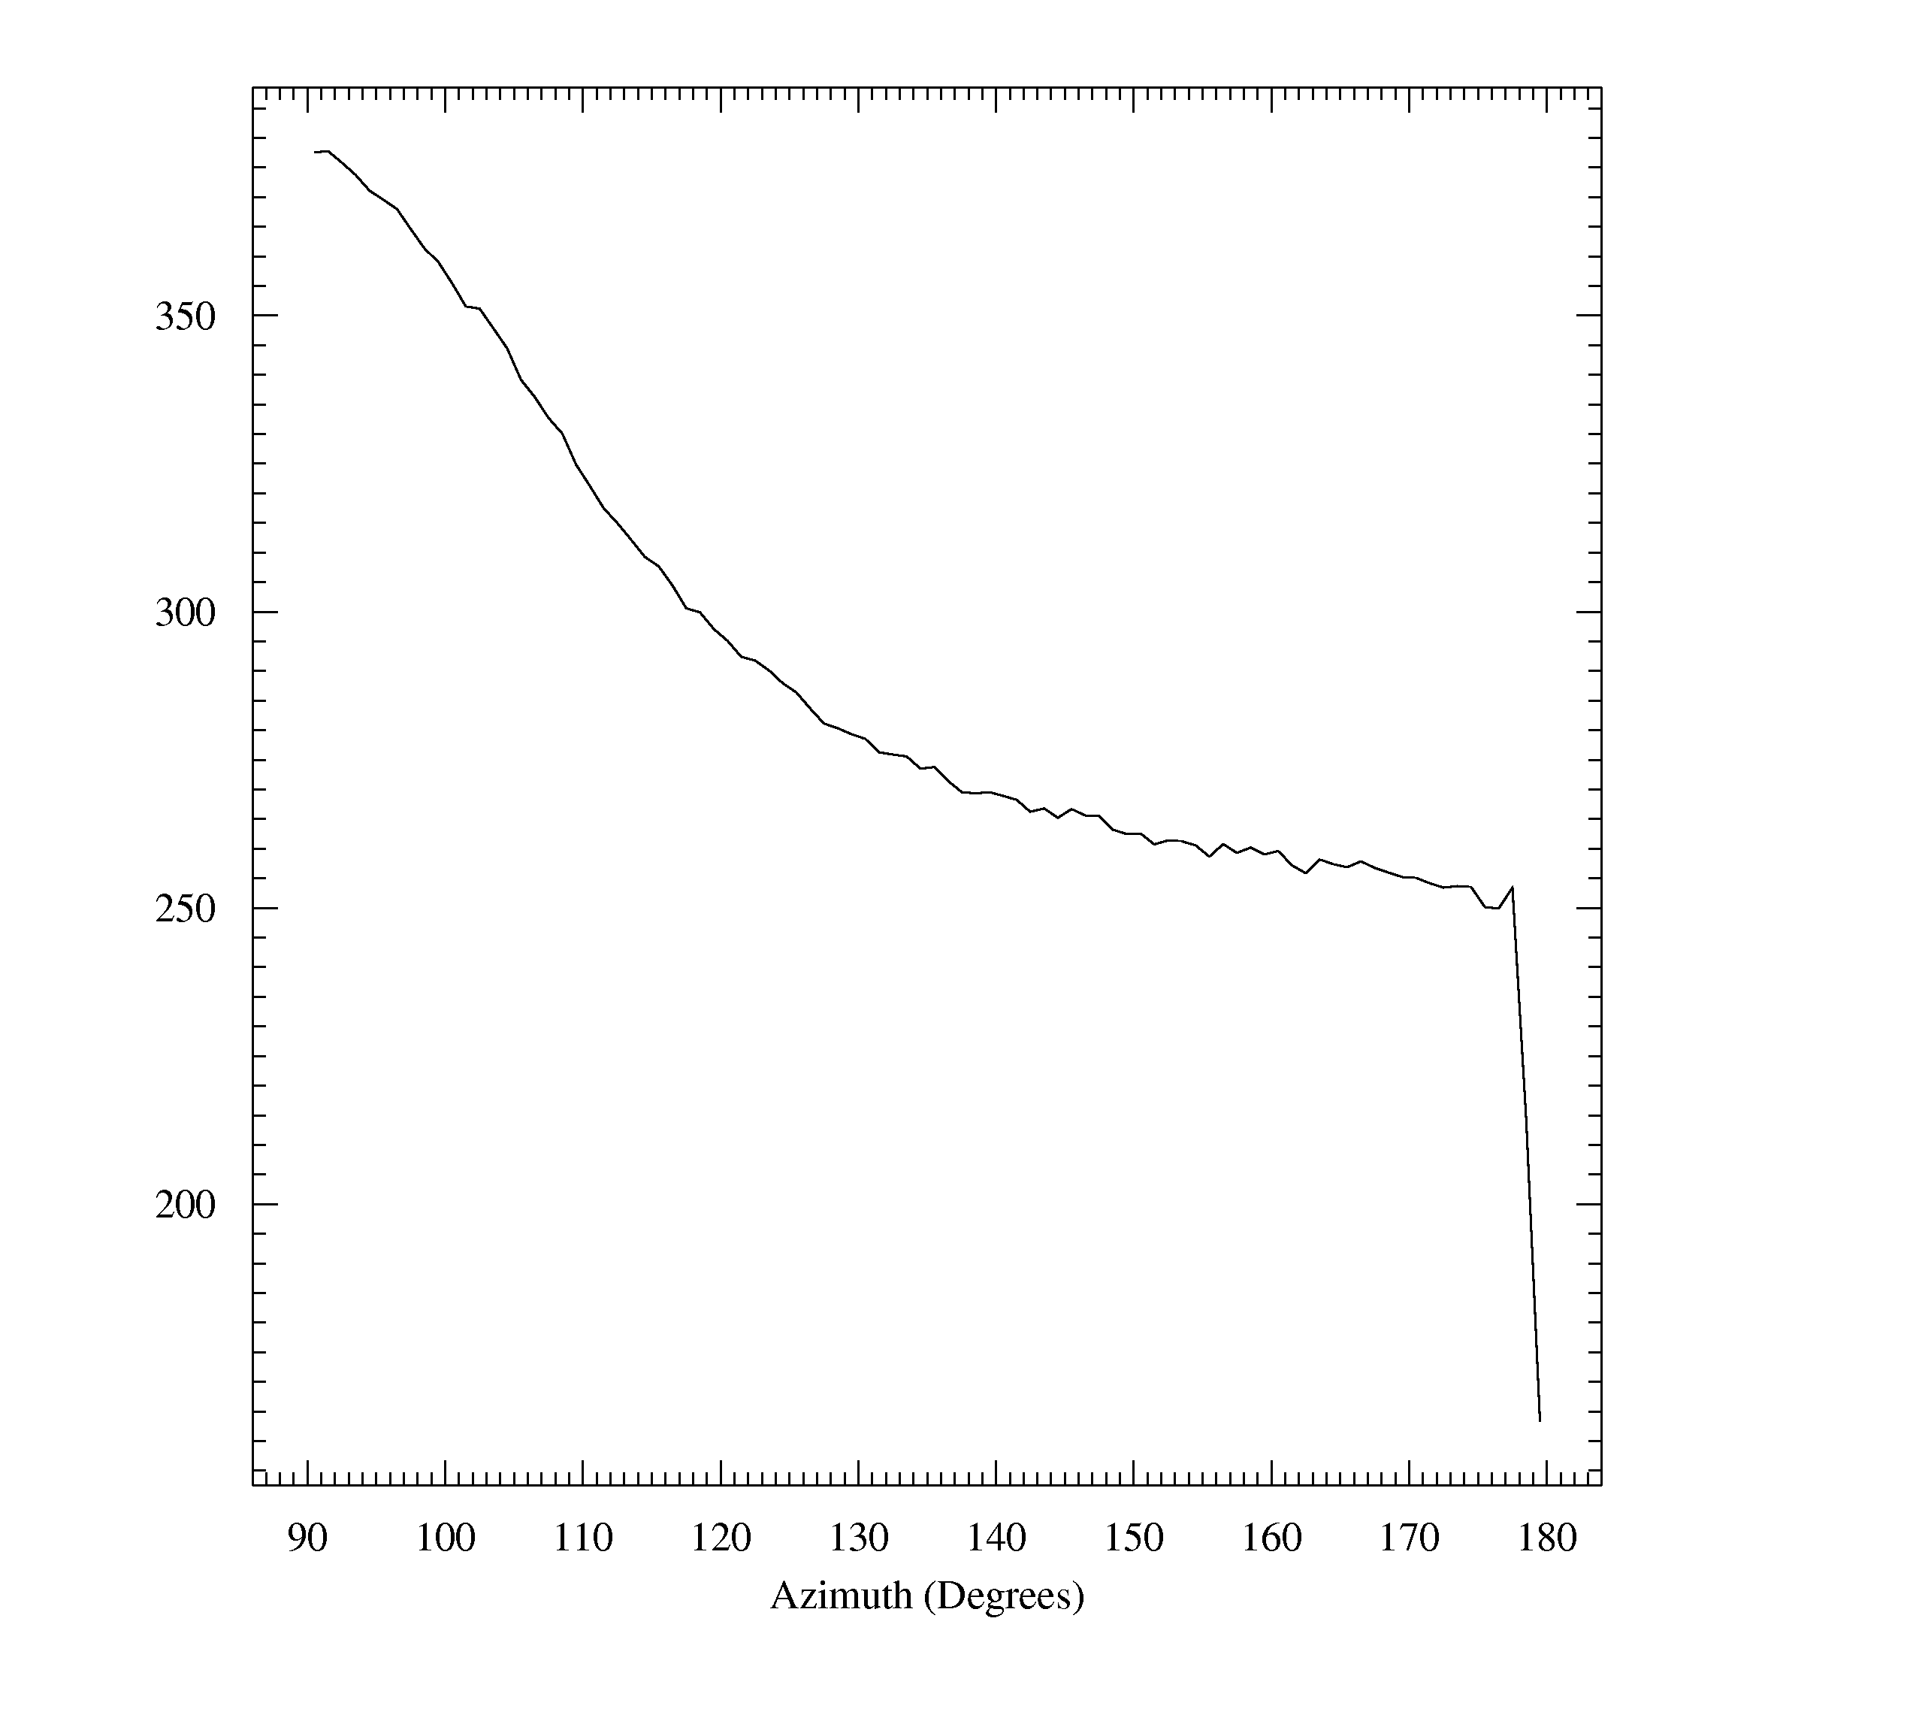
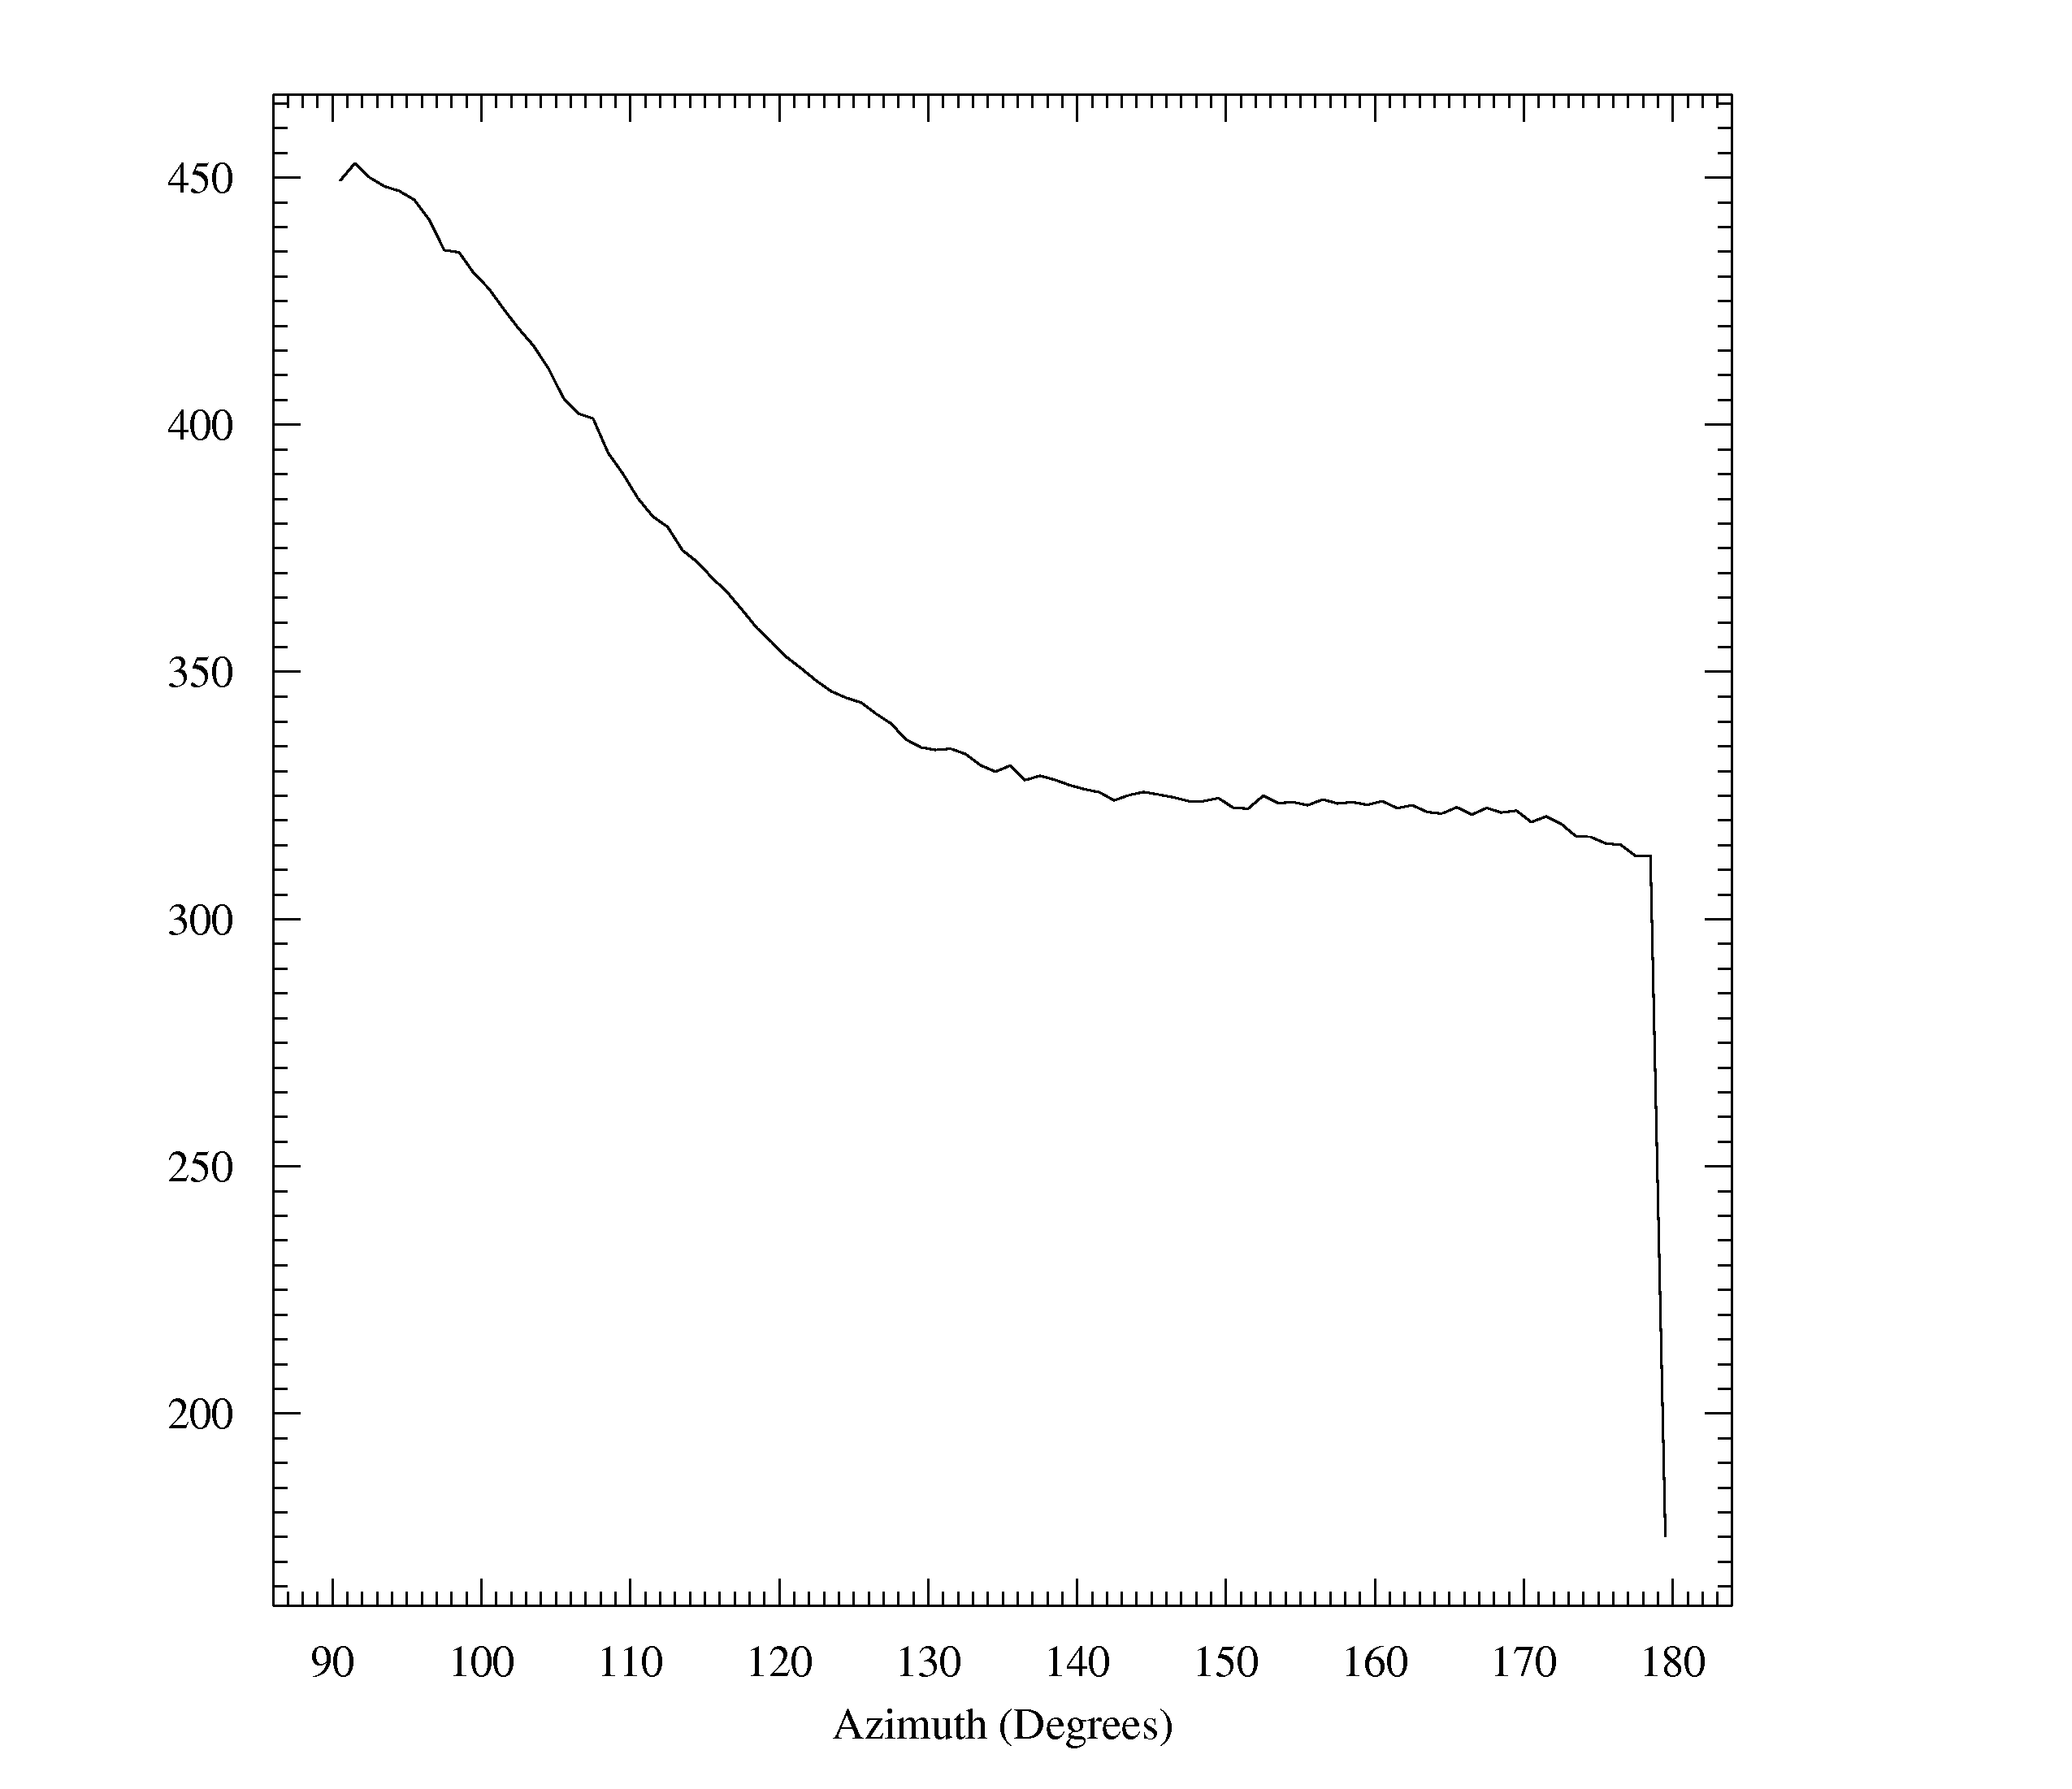
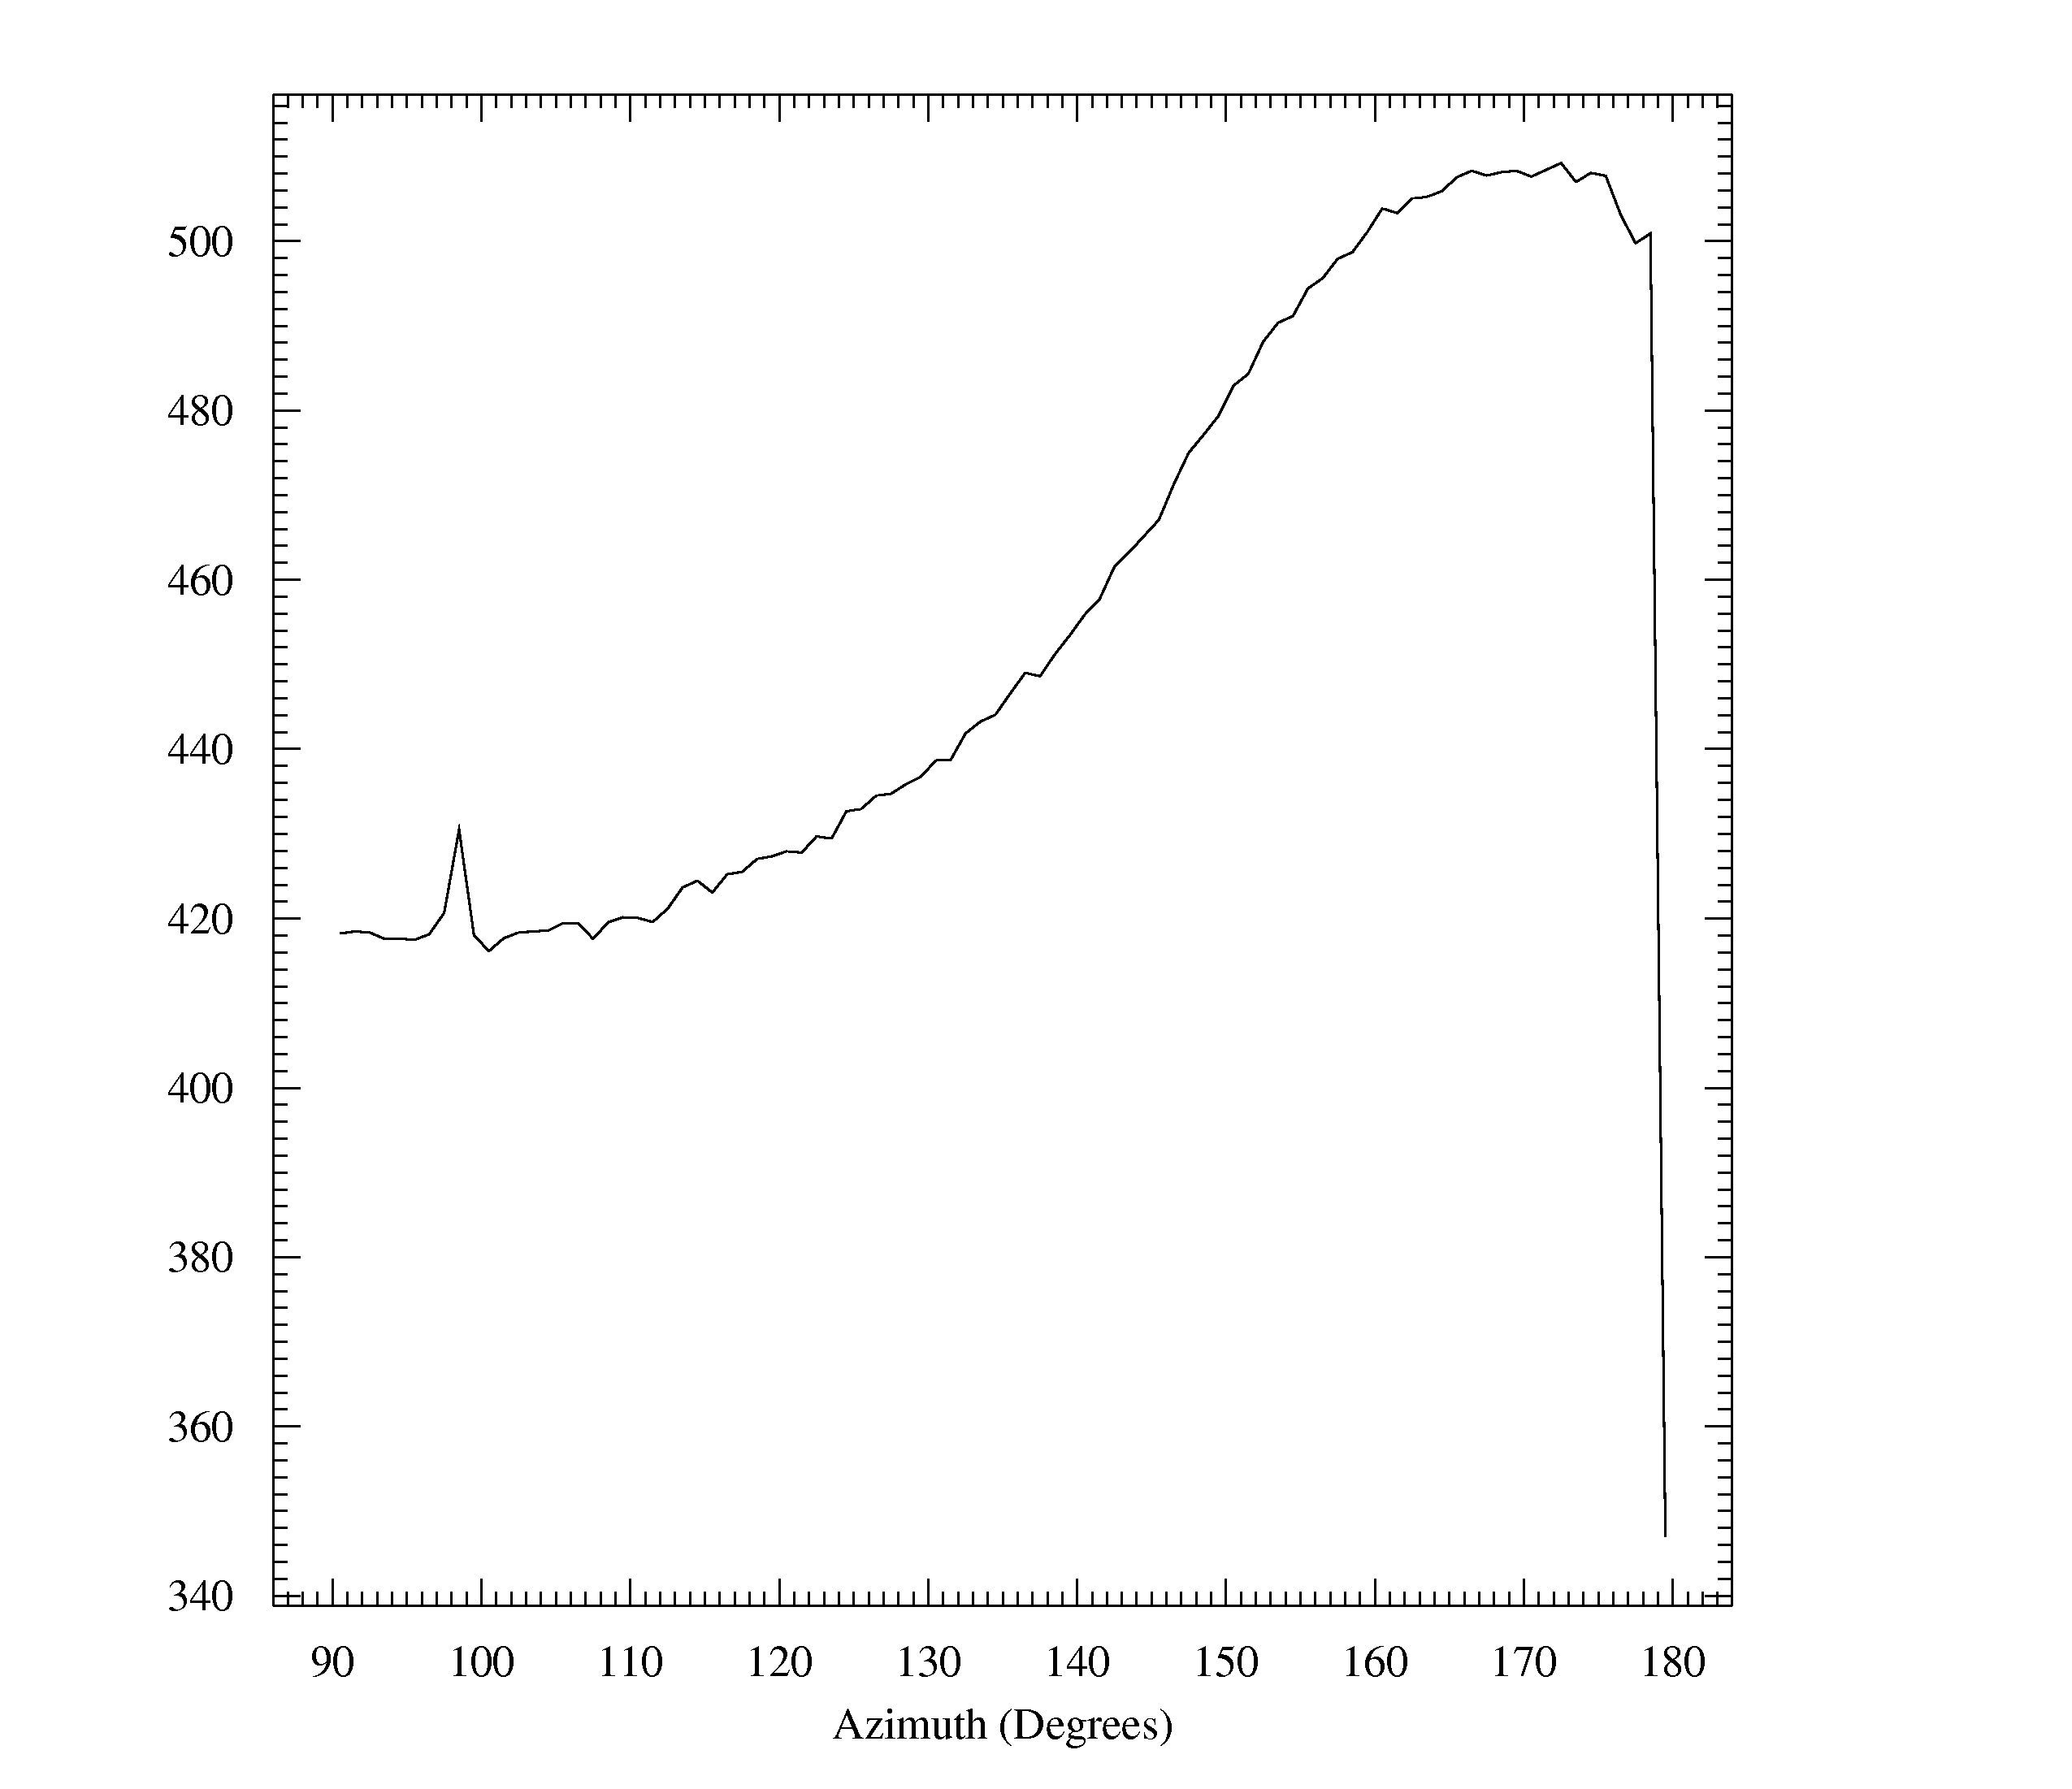
(a)
(b)
(c)
(d)

