Slide 1
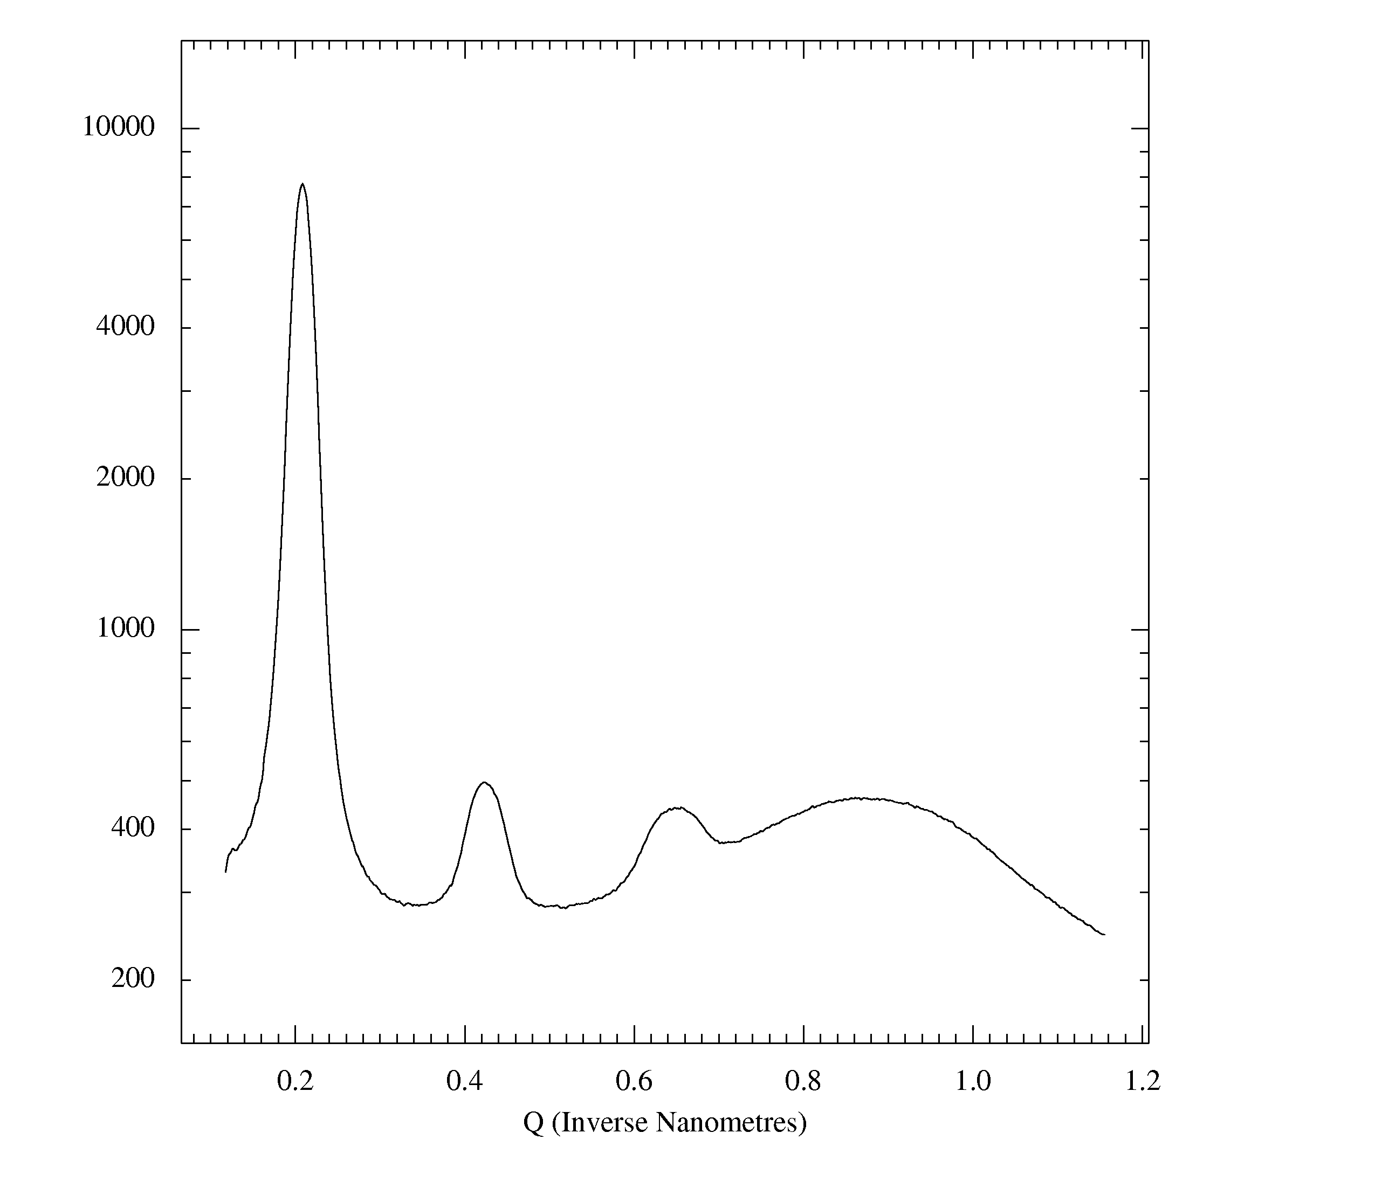
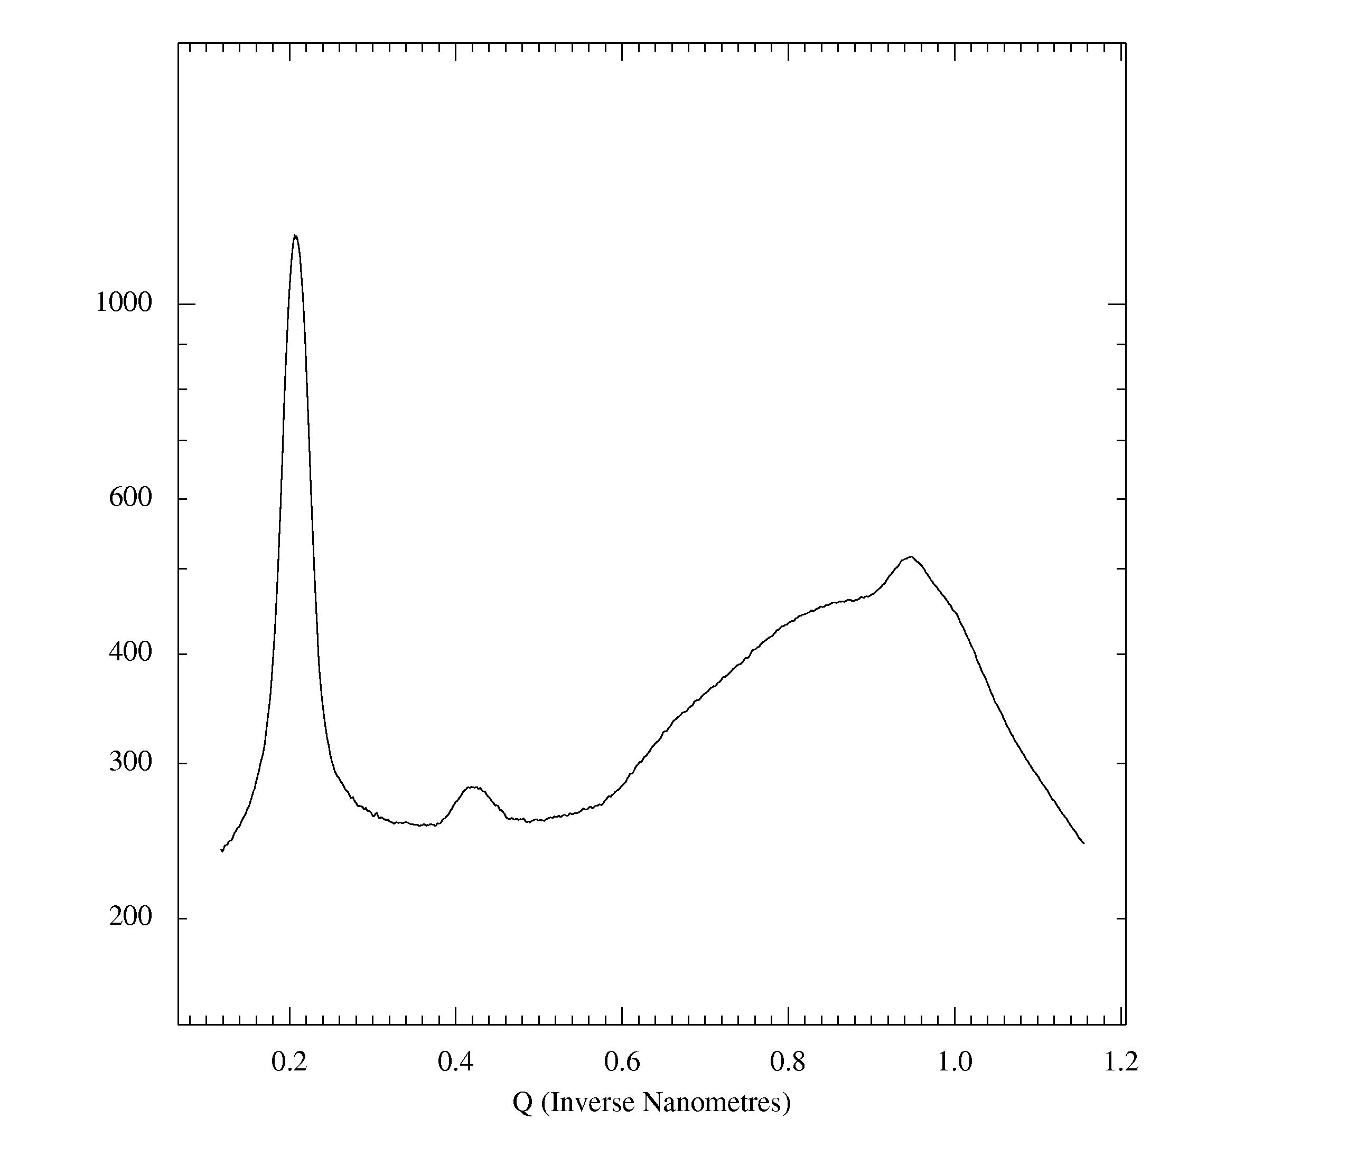
perpendicular
to the film
parallel
to the film
(100)
powder
ring
(100)
(a)
(010)
(200)
powder
ring
(200)
(300)
silicon oxide
powder ring
silicon oxide
powder ring

