Slide 1
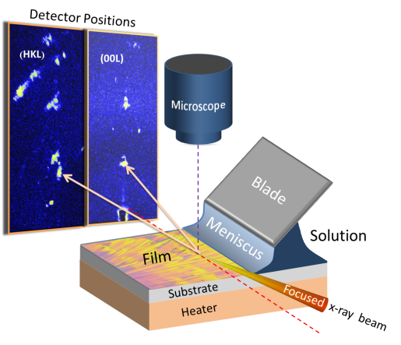
Smilgies 1/14

