Slide 1
Search Engine Optimization
By Holly Olson

Slide 2
What is search engine optimization?
The process of maximizing the number of visitors to a particular website by ensuing that the SITE Appears high on the list of results returned by a search engine.

Slide 3
Warning
The process of optimization is not a one time process, but that it requires maintenance, tuning, and continuous testing and monitoring.

Slide 4
Your SEO Checklist: 4 Steps to Optimizing Your Website by Jon Rognerud
Step 1: target market business analysis
Website analysis.
Competitive analysis.
Initial keyword nomination.

Slide 5
Occam’s razor By Avinash Kaushik
Step #1: Visit the website. Note objectives, customer experience, suckiness. Step #2: how good is the acquisition strategy? Traffic sources report. Step #3: how strongly do visitors orbit the website? Visitor loyalty & recency. Step #4: what can I find that is broken and quickly fixable? Top landing pages. Step #5: what content makes us most money? $Index value metric. Step #6: how sophisticated is their search strategy? Keyword tag clouds. Step #7: are they making money or making noise? Goals & goal values. Step #8: can the marketing budget be optimized? Campaign conversions/outcomes. Step #9: are we helping the already convinced buyers? Funnel visualization. Step #10: what are the unknown unknowns I am blind to? Analytics intelligence.

Slide 6
Your SEO Checklist: 4 Steps to Optimizing Your Website by Jon Rognerud
Step 2: Keyword research and development
Keyword analysis
Baseline ranking assessment.
Goals and objectives.

Slide 7
2 Nephi 28:30
For behold, thus saith the lord god: I will give unto the children of men line upon line, ªprecept upon precept, here a little and there a little; and blessed are those who hearken unto my precepts, and lend an ear unto my counsel, for they shall learn ^{b}wisdom; for unto him that ^{c}receiveth I will give ^{d}more; and from them that shall say, we have enough, from them shall be taken away even that which they have.

Slide 8
Your SEO Checklist: 4 Steps to Optimizing Your Website by Jon Rognerud
Step 3: Content optimization and submission
Create page titles
Create meta tags.
Place strategic search phrases on pages.

Slide 9
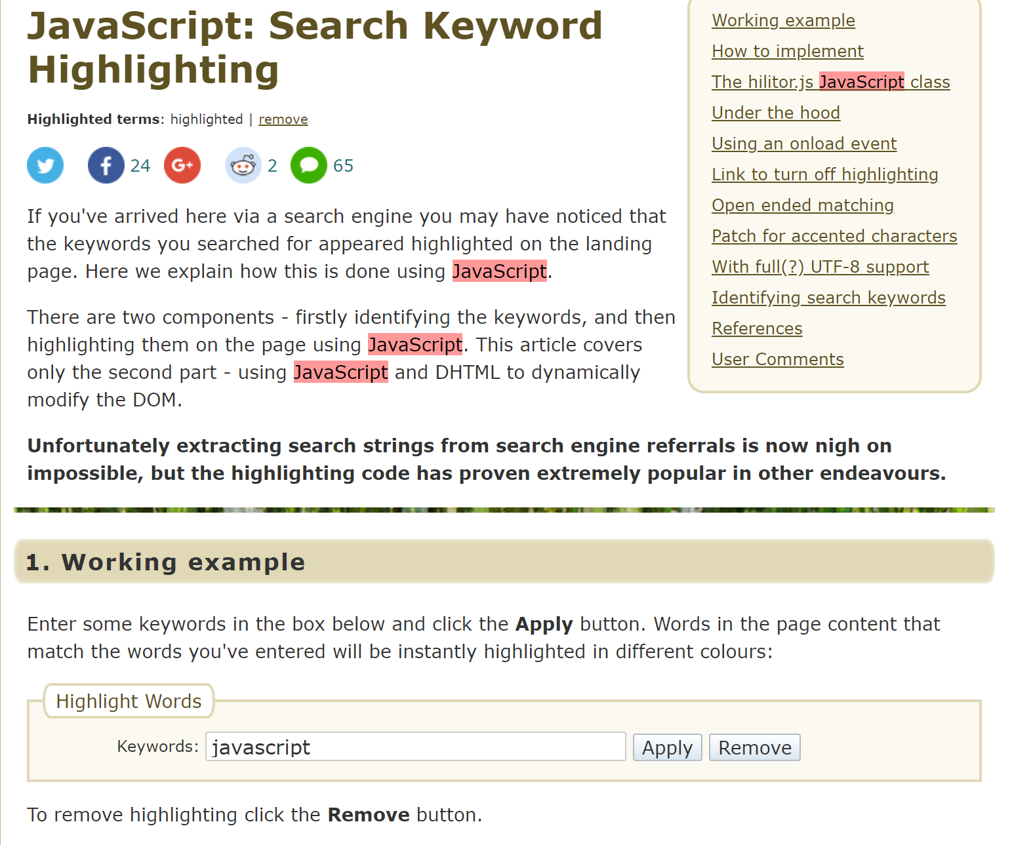
How I was able to understand about placing strategic search phrases and keywords.

Slide 10
Your SEO Checklist: 4 Steps to Optimizing Your Website by Jon Rognerud
Step 4: Continuous testing and measuring
Test and measure.
Maintenance.

Slide 11
Resources
Dictionary - https://www.google.com/search?q=Dictionary
Your SEO Checklist: 4 Steps to Optimizing Your Website - https://www.entrepreneur.com/article/231235
Beginner's Guide To Web Data Analysis: Ten Steps To Love & Success
- https://www.kaushik.net/avinash/beginners-guide-web-data-analysis-ten-steps-tips-best-practices/
JavaScript: Search Keyword Highlighting - http://www.the-art-of-web.com/javascript/search-highlight/
The Book Of Mormon 2 nephi 28:30 - https://www.lds.org/languages/eng/content/scriptures/bofm/2-ne/28

