Slide 1


NammaTrip AI
KANNADA DIGITAL INNOVATION HACKATHON 2026
“Your Budget. Your Journey. Your Karnataka.”
AI Travel Planner for Kannada
Theme: Code. Create. Celebrate Kannada.
Organised by HackerRank Campus Crew and NIE Mysuru
Developer: smiling-coder
Notes:
Hello everyone. This is NammaTrip AI, my project for the Kannada Digital Innovation Hackathon 2026. The theme is Code, Create, Celebrate Kannada. My chosen problem statement is an AI Travel Planner for Kannada. The tagline is: Your Budget, Your Journey, Your Karnataka. In the next few minutes I will show the problem, the solution, how I built it, and a live demo.

Slide 2



Problem Statement
Easier planning helps more people discover Karnataka in their own language.
Scattered information
Manual budgeting
Language preference
Destination and trip details can be spread across many sources.
Costs are often compared and estimated by hand.
Kannada speakers may prefer a more Kannada-friendly experience.
Who could benefit
First-time visitors
Kannada speakers
Budget travellers
Families & students
Notes:
Let us start with the problem. When someone plans a trip, they often collect information from many places. They also compare costs and make budget estimates by hand. And many Kannada speakers may prefer a Kannada-friendly experience. This can help first-time visitors, Kannada speakers, students, families, and budget travellers. Good planning should be simple and available in your own language.

Slide 3







Existing System & Its Gaps
How people plan today
Possible limitations
Searching travel websites
Scattered information
Using maps to find places
Time-consuming comparison
Reading separate info sources
Manual budgeting
Adding up costs by hand
Language preferences
Many travel platforms do these things well. These are common pain points, not true for every platform.
Notes:
How do people plan trips today? Usually they search travel websites, use maps, read different information sources, and calculate costs by hand. This can lead to scattered information, comparisons that take time, manual budgeting, and sometimes language preferences are not met. Please note: many travel platforms are very good. These are only common pain points, not problems of every platform.

Slide 4
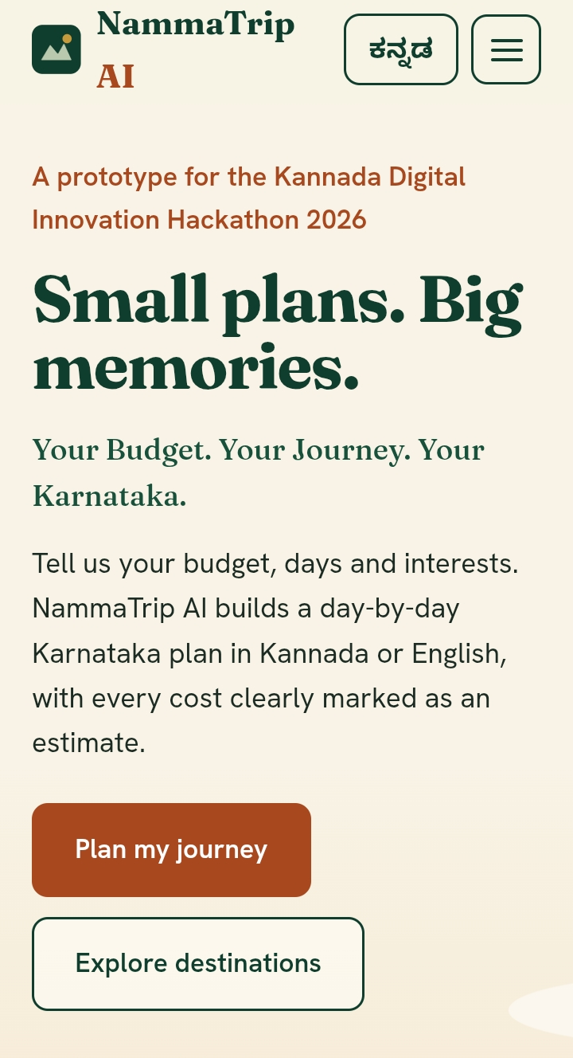
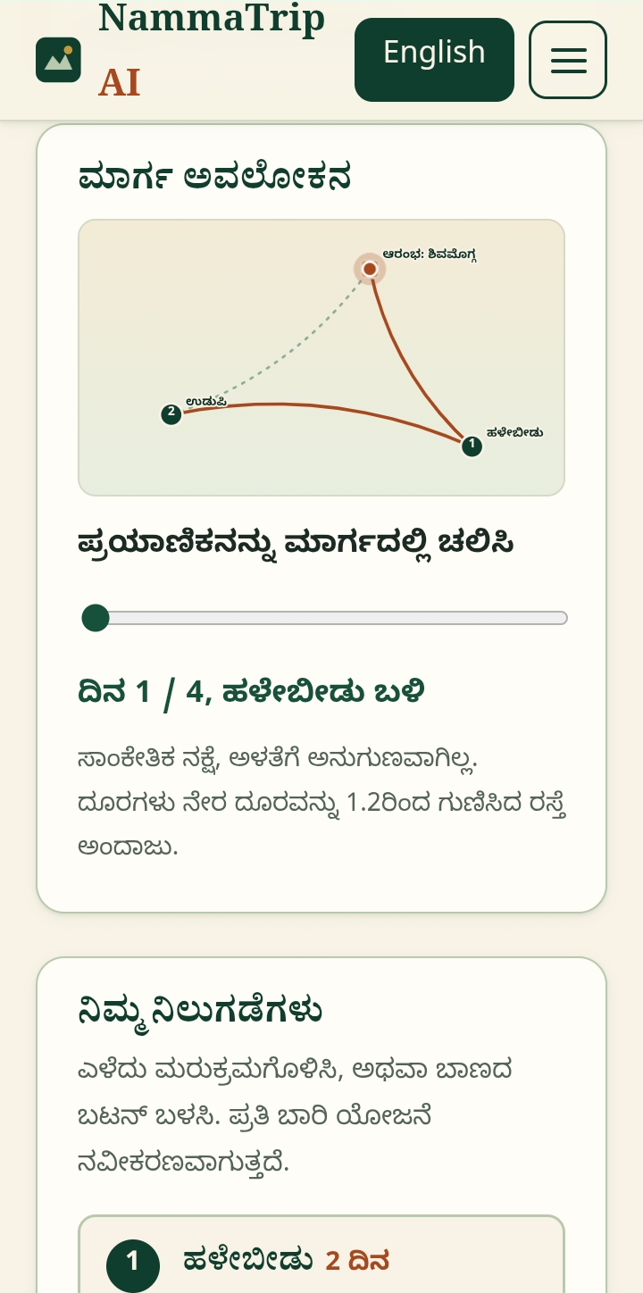
Our Solution
A simple, Karnataka-focused trip-planning prototype
1
Your preferences
Budget, days and interests
2
Destination suggestions
Matched to your interests
3
Budget estimate
Split into cost categories
4
Explore & map link
Open places in Google Maps
Home screen
Route overview
Notes:
This is our solution: NammaTrip AI, a simple Karnataka-focused trip-planning prototype. The journey has four steps. One, the user gives preferences like budget, days, and interests. Two, the app suggests destinations. Three, it shows a budget estimate. Four, the user can explore places and open them in Google Maps. On the right you can see screenshots of the real website.

Slide 5




Features & Differentiation
Kannada + English
Trip preference form
13 destinations
Switch the interface language
City, days, budget, interests
Browse and filter curated places
Day-by-day plan
Budget estimates
Culture corner
Suggested activities for each day
Rule-based split, not live prices
Food, history and Kannada phrases
Karnataka focus • Kannada-first • Beginner-friendly • Map links • Responsive
Notes:
These are the features that work in the current version. You can switch between Kannada and English. There is a trip form where you enter your starting city, days, budget, and interests. You can browse thirteen curated Karnataka destinations. The app creates a day-by-day plan and a budget split. There is also a culture corner with local food, history, and useful Kannada phrases. Our focus is Karnataka, Kannada accessibility, and beginner-friendly planning. The budget numbers are estimates, not live prices.

Slide 6






Approach & Methodology
1
2
3
Identify the need
Plan UI & flow
Build with HTML
Karnataka trip planning in Kannada
Design the form and results
Page structure and trip form
6
5
4
Test & deploy
Add JavaScript
Style with CSS
Publish on GitHub Pages
Language switch, plans, budgets
Colours, layout, responsive
Notes:
This is how I built the project in six steps. One, I identified the need: easy Karnataka trip planning in Kannada. Two, I planned the screens and the user flow. Three, I built the page structure with HTML. Four, I styled it with CSS so it looks good and works on small screens. Five, I added JavaScript for the language switch, trip plans, and budget estimates. Six, I tested the website and published it on GitHub Pages.

Slide 7








Tech Stack & Architecture
FRONTEND PROTOTYPE | no backend, no database, no AI service
Runs in the traveller’s web browser
Interface
JavaScript logic
Results shown
Traveller
HTML structure + CSS design
Rules, curated data, budget maths
Plan, costs, map links
Google Maps
external link
HTML
Page structure
CSS
Design, responsive
JavaScript
Interactions, logic
Web browser
Runs the frontend
Notes:
Here is the technology. HTML builds the page structure. CSS gives the design and makes it responsive. JavaScript handles the interactions and the recommendation logic. Everything runs in the traveller's web browser. The traveller uses the interface, JavaScript applies the rules and the curated destination data, and the results are shown on screen. A destination can open in Google Maps. This is a frontend prototype. There is no backend, no database, and no AI service.

Slide 8


Live Demo
smiling-coder.github.io/NammaTripAI
Live project
https://smiling-coder.github.io/NammaTripAI/
GitHub profile
https://github.com/smiling-coder
Repository
https://github.com/smiling-coder/NammaTripAI
Demo flow
1
Open the site and show the interface
2
Enter budget, days and interests
3
Press “Create my plan”
4
Show the day plan and budget split
Live site on a phone
5
Open a destination map link
Notes:
Now the live demo. The website is on GitHub Pages, and the code is public on my GitHub repository. In the demo I will open the website and show the interface. Then I enter a budget, number of days, and my interests, and press Create my plan. I will show the day-by-day plan and the budget split. At the end, I will open a destination link in Google Maps. You can also switch the language between Kannada and English.

Slide 9
Conclusion & Future Scope
NammaTrip AI aims to make Karnataka trip planning easier, more accessible and Kannada-friendly.
Current limitations
Future scope
Rule-based, not generative AI
13 curated destinations
Costs are estimates, not live prices
No bookings, weather or backend
Real AI-based itineraries
More verified destinations
Better costs from reliable data
Weather integration
Saved trip plans
“NammaTrip AI — Your Budget. Your Journey. Your Karnataka.”
Thank You!
Notes:
To conclude, NammaTrip AI aims to make Karnataka trip planning easier, more accessible, and more Kannada-friendly. I want to be honest about the limits: it is a rule-based prototype, not a generative AI system. It has thirteen curated destinations, its costs are estimates and not live prices, and it has no bookings, weather, or backend. In future, I would like to add real AI-based itineraries, more verified destinations, better cost data, weather, and saved trip plans. NammaTrip AI: Your Budget, Your Journey, Your Karnataka. Thank you!

