Slide 2



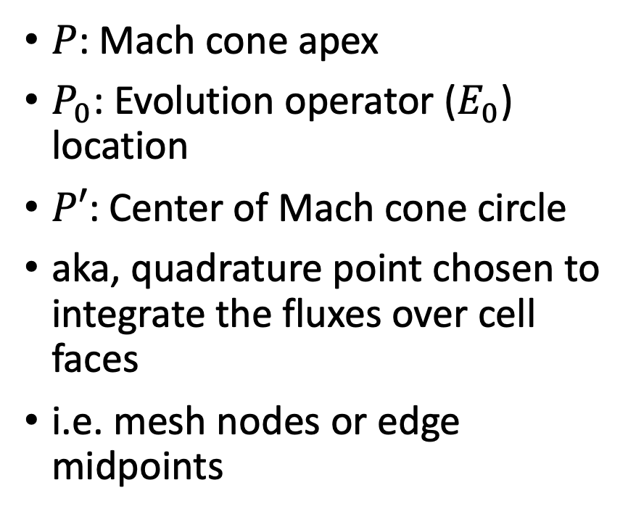



$$P(x,y,t+τ)$$
$P$: Mach cone apex
$P_{0}$: Evolution operator ($E_{0}$) location
$P′$: Center of Mach cone circle
aka, quadrature point chosen to integrate the fluxes over cell faces
i.e. mesh nodes or edge midpoints
$$t$$
$$y$$
$$x$$
$$\tilde{a}τ$$
$$P′(x,y)$$

Slide 3


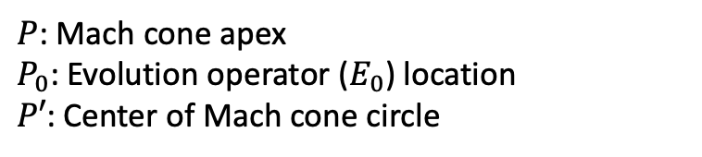



$$P(x,y,t+τ)$$
$P$: Mach cone apex
$P_{0}$: Evolution operator ($E_{0}$) location
$P′$: Center of Mach cone circle
$$t$$
$$y$$
$$x$$
$$P′(x,y)$$

Slide 4

















Local Evolution Operator ($E_{0}$)
$$y$$
$$Ω_{1,2}$$
$$y$$
$$x$$
$$θ_{ib}$$
$$Ω_{2,2}$$
$$\vec{e_{1}}$$
$${P,P}_{0}$$
$$P′$$
$$x$$
$Q(θ_{ib}$)
$$Ω_{1,1}$$
$$θ_{ie}$$
$$\vec{e_{2}}$$
$Q(θ_{ie}$)
$$Ω_{2,1}$$

Slide 5






Local Evolution Operator ($E_{0}$)
$$y$$
$$Ω_{1,2}$$
$$y$$
$$x$$
$$Ω_{2,2}$$
$${P,P}_{0}$$
$$P′$$
$$x$$
$$θ_{ie}$$
$$\vec{e_{2}}$$
$$Ω_{1,1}$$
$Q(θ_{ie}$)
$$\vec{e_{1}}$$
$$θ_{ib}$$
$Q(θ_{ib}$)
$$Ω_{2,1}$$

Slide 6






Local Evolution Operator ($E_{0}$)
$$y$$
$$Ω_{1,2}$$
$$y$$
$$x$$
$$\vec{e_{1}}$$
$$θ_{ie}$$
$Q(θ_{ib}$)
$$Ω_{2,2}$$
$$θ_{ib}$$
$$\vec{e_{2}}$$
$${P,P}_{0}$$
$Q(θ_{ie}$)
$$P′$$
$$x$$
$$Ω_{1,1}$$
$$Ω_{2,1}$$

Slide 7

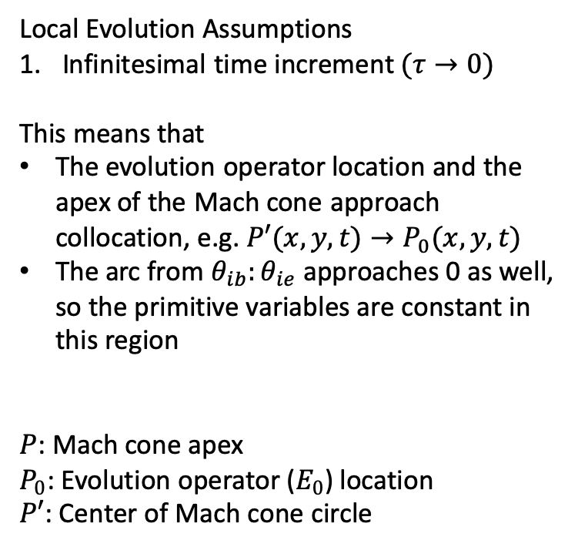





Local Evolution Operator ($E_{0}$)
$$y$$
$$Ω_{1,2}$$
$$y$$
Local Evolution Assumptions
Infinitesimal time increment$(τ→0)$
This means that
The evolution operator location and the apex of the Mach cone approach collocation, e.g. $P′(x,y,t)→P_{0}(x,y,t)$
The arc from $θ_{ib}:θ_{ie}$ approaches 0 as well, so the primitive variables are constant in this region
$P$: Mach cone apex
$P_{0}$: Evolution operator ($E_{0}$) location
$P′$: Center of Mach cone circle
$$x$$
$Q(θ_{ie}$)
$$\vec{e_{2}}$$
$$Ω_{2,2}$$
$$θ_{ie}$$
$${P,P}_{0}$$
$$P′$$
$$x$$
$$θ_{ib}$$
$$\vec{e_{1}}$$
$Q(θ_{ib}$)
$$Ω_{1,1}$$
$$Ω_{2,1}$$

