Slide 1
JSR107 Come, Code, Cache, Compute!
Steve Millidge

Slide 2
Agenda
Basic Caching
Cache API
Cache Configuration
Cache Events
Cache Computations

Slide 3
What is JSR107?
JCACHE JavaTM Temporary Caching API

Slide 4
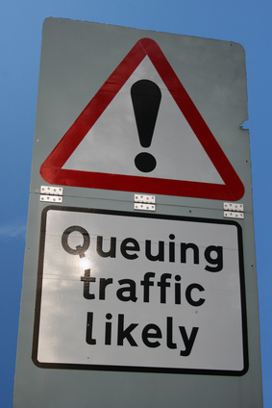
LATENCY
Time delay in requesting an operation and it being initiated

Slide 5

1Gb Ethernet : 25 – 30MB/s
10Gb Ethernet : 250 – 350MB/s
Infiniband : 6GB/s (maybe)

Slide 6

PING TIMES
Local : 57µs
LAN segment : 300µs LAN: switches : 4ms
UK : 30ms
USA : 100ms
3G : 100s ms

Slide 7
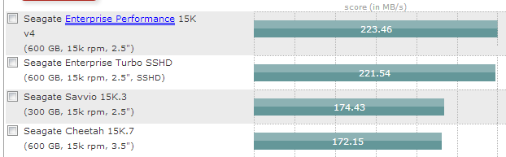

Spinning Rust
Source: tomshardware.com
Disk BUS Speeds
SATA 1.0 : 150MB/s
SATA 2.0 : 300MB/s
SATA 3.0 : 600MB/s
SAS : 600MB/s
Fibre Channel : 1GB/s
Infiniband : 1GB/s
Typical SSD Speed
540MB/s

Slide 8
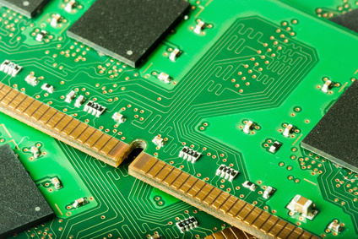
DDR3 1600 : 12.8GB/s

Slide 9
MEMORY
IS
FAST!
Cache Data
In
Memory

Slide 10
Caching Concepts
Caching Provider
Cache Manager
Cache
Entry
Key
Value

Slide 11
Core Concepts
CachingProvider
Retrieves and closes Cache Managers
CacheManager
Creates and destroys caches
Cache
Contains Objects in Key Value Pairs

Slide 12
Simple Cache Code Architecture
Coherence
Cache Node
(Simple Code)
Stock
Coherence
Cache Node
(Get Example)
Coherence
Cache Node
(Put Example)

Slide 13
Code Interlude

Slide 14
CachingProvider cp = Caching.getCachingProvider();
CacheManager cm = cp.getCacheManager();
MutableConfiguration<String, Stock> config
= new MutableConfiguration<>();
config.setStoreByValue(true)
.setTypes(String.class,Stock.class)
.setManagementEnabled(true)
.setStatisticsEnabled(true);
Cache<String, Stock> cache = cm.createCache("J12014", config);
System.out.println(cache.get("PAYA"));

Slide 15
Further Cache Methods
cache.replace("PAYA",new Stock(28.0,"PAYA");
cache.remove(“PAYA”);
stock = cache.getAndPut("PAYA", new Stock(27.0,"PAYA"));
stock = cache.getAndReplace("PAYA",new Stock(28.0,"PAYA"));
stock = cache.getAndRemove("PAYA");
cache.putIfAbsent("PAYA", stock);

Slide 16
Events

Slide 17
Core Concepts Events
CacheEntryListener
Receives Events relating to specific Keys
Subinterfaces for Created, Expired, Updated, Removed
CacheEntryEventFilter
Filters Events Before Delivery
Useful in distributed caches

Slide 18
Events API
Coherence
Cache Node
(Simple Code)
Listener
Stock
Coherence
Cache Node
(Stock Ticker)
Coherence
Cache Node
(PriceTicker)

Slide 19
Code Interlude

Slide 20
CachingProvider cp = Caching.getCachingProvider();
CacheManager cm = cp.getCacheManager();
MutableConfiguration<String, Stock> config
= new MutableConfiguration<>();
config.setStoreByValue(true)
.setTypes(String.class, Stock.class)
.setManagementEnabled(true).
setStatisticsEnabled(true);
Cache<String, Stock> cache = cm.createCache("J12014", config);
while (true) {
cache.put("PAYA", new Stock(Math.random() * 20.0d, "PAYA"));
Thread.sleep(1000);
}

Slide 21
public class StockListener implements CacheEntryUpdatedListener<>, Serializable{
@Override
public void onUpdated(Iterable<> itrbl) throws CacheEntryListenerException
{
Iterator<CacheEntryEvent<> i = itrbl.iterator();
while (i.hasNext()) {
System.out.println(i.next().getValue());
}
}
}

Slide 22
MutableCacheEntryListenerConfiguration<> lConf
= new MutableCacheEntryListenerConfiguration<>(
FactoryBuilder.factoryOf(new StockListener()),
null, false, false);
cache.registerCacheEntryListener(lConf);
while (true) {
Thread.sleep(1000);
}

Slide 23
Listerner Interfaces
CacheEntryCreatedListener<K,V>
onCreated()
CacheEntryExpiredListener<K,V>
onExpired()
CacheEntryRemovedListener<K,V>
onRemoved()
CacheEntryUpdatedListener<K,V>
onUpdated()

Slide 24
Listener semantics
Are fired after the entry is mutated in the cache
if synchronous are fired, for a given key, in the order that events occur
block the calling thread until the listener returns, where the listener was registered as synchronous
that are asynchronous iterate through multiple events with an undefined ordering, except that events on the same key are in the order that the events occur.

Slide 25
Events Demo
http://demo.c2b2.co.uk:7080/

Slide 26
Compute!

Slide 27
Compute Architecture
Coherence
Cache Node
(Simple Code)
Coherence
Cache Node
(Simple Code)
Stock
Entry Processor
Entry Processor
Stock
Stock
Stock
Stock
Stock
Stock
Stock
Coherence
Cache Node
(FindStock)
Coherence
Cache Node
(Revalue)

Slide 28
Key Cache Methods
invoke(Key,EntryProcessor,args)
invokeAll(Set<Key>,EntryProcessor,args)
Entry Processor Interface
T process(MutableEntry<K,V>,Object … args)

Slide 29
Code Interlude

Slide 30
public class PrintStock implements EntryProcessor<String, Stock, String>, Serializable {
@Override
public String process(MutableEntry<String, Stock> me, Object... os) throws EntryProcessorException
{
System.out.println(me.getValue() + " IS HERE ........... ");
return null;
}
}

Slide 31
CachingProvider cp = Caching.getCachingProvider();
CacheManager cm = cp.getCacheManager();
MutableConfiguration<String,Stock> config = new MutableConfiguration<>();
config.setStoreByValue(true)
.setTypes(String.class,Stock.class)
.setManagementEnabled(true)
.setStatisticsEnabled(true);
Cache<String,Stock> cache = cm.createCache("J12014",config);
cache.invoke("PAYA", new PrintStock());

Slide 32
Other JSR107 Features
Cache Loader and Cache Writers
Implements Read through and write through caching for persistence stores
Statistics
JMX Statistics (demo)
CDI Integration
Annotations for automatic cache interactions

Slide 33
CacheLoader and CacheWriter
Integrate with external resource
JPA Caching
Memcached integration
NoSQL integration
Provide read through and write through capability

Slide 34
CacheLoader and CacheWriter
CacheLoader for read through
load(Key)
loadAll(Iterable<Key>)
Added to Cache Configuration
CacheWriter for write through
write, writeAll
delete, deleteAll
Added to Cache Configuration

Slide 35
JSR 107 Annotations
@CacheDefaults
@CacheResult
@CachePut
@CacheRemove
@CacheRemoveAll

Slide 36
Example Annotations
package my.app;
@CacheDefaults(cacheName="domainCache")
public class DomainDao {
@CacheResult
public Domain getDomain(String domainId, int index) {
...
}
@CacheRemove
public void deleteDomain(String domainId, int index) {
...
}
@CacheResult(cacheName="allDomains")
public List<Domain> getAllDomains() {
...
}
}

Slide 37
Example Annotations
package my.app;
public class DomainDao {
@CachePut(cacheName="domainCache")
public void updateDomain(String domainId, int index, @CacheValue Domain
domain) {
...
}
}

Slide 38
Learn More
https://jcp.org/en/jsr/detail?id=107
https://github.com/jsr107
https://groups.google.com/forum/#!forum/jsr107

Slide 39
?

