Slide 1
Chapter 4
Client-Side Programming: the JavaScript Language
WEB TECHNOLOGIES
A COMPUTER SCIENCE PERSPECTIVE
JEFFREY C. JACKSON

Slide 2
JavaScript History and Versions
JavaScript was introduced as part of the Netscape 2.0 browser
Microsoft soon released its own version called JScript
ECMA developed a standard language known as ECMAScript
ECMAScript Edition 3 is widely supported and is what we will call “JavaScript”

Slide 3
JavaScript Introduction
Let’s write a “Hello World!” JavaScript program
Problem: the JavaScript language itself has no input/output statements(!)
Solution: Most browsers provide de facto standard I/O methods
  alert: pops up alert box containing text
  prompt: pops up window where user can enter text

Slide 4
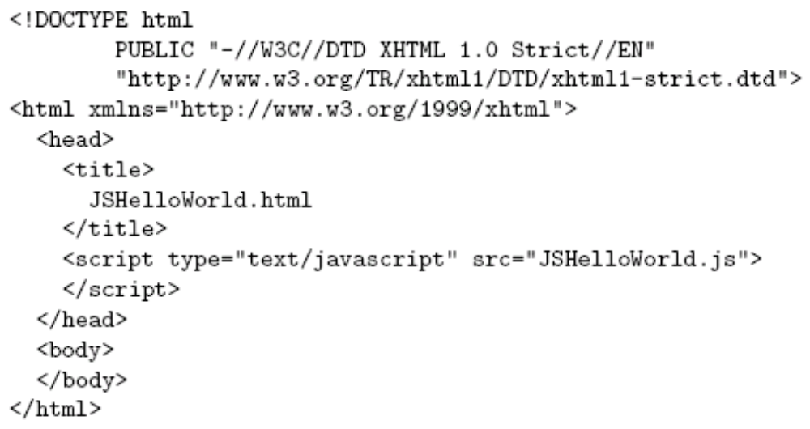
JavaScript Introduction
File JSHelloWorld.js:
HTML document executing this code:
script element used
to load and execute
JavaScript code

Slide 5
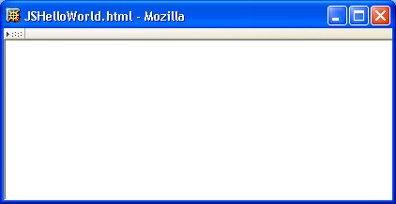
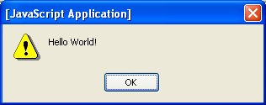
JavaScript Introduction
Web page and alert box generated by JSHelloWorld.html document and JSHelloWorld.js code:

Slide 6
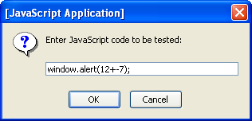
JavaScript Introduction
Prompt window example:

Slide 7
JavaScript Properties
Note that JavaScript code did not need to be compiled
  JavaScript is an interpreted language
  Portion of browser software that reads and executes JavaScript is an interpreter
Interpreted vs. compiled languages:
  Advantage: simplicity
  Disadvantage: efficiency

Slide 8
JavaScript Properties
JavaScript is a scripting language: designed to be executed within a larger software environment
JavaScript can be run within a variety of environments:
  Web browsers (our focus in next chapter)
  Web servers
  Application containers (general-purpose programming)

Slide 9
JavaScript Properties
Components of a JavaScript implementation:
  Scripting engine: interpreter plus required ECMAScript functionality (core library)
  Hosting environment: functionality specific to environment
    Example: browsers provide alert and prompt
    All hosting environment functionality provided via objects

Slide 10
JavaScript Properties
All data in JavaScript is an object or a property of an object
Types of JavaScript objects
  Native: provided by scripting engine
    If automatically constructed before program execution, known as a built-in object (ex: window)
  Host: provided by host environment
    alert and prompt are host objects

Slide 11
Developing JavaScript Software
Writing JavaScript code
  Any text editor (e.g., Notepad, Emacs)
  Specialized software (e.g., MS Visual InterDev)
Executing JavaScript
  Load into browser (need HTML document)
  Browser detects syntax and run-time errors
    Mozilla: JavaScript console lists errors
    IE6: Exclamation icon and pop-up window

Slide 12
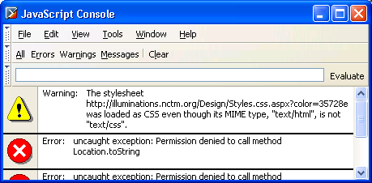
Developing JavaScript Software
Mozilla JavaScript console (Tools | Web Development | JavaScript Console):

Slide 13
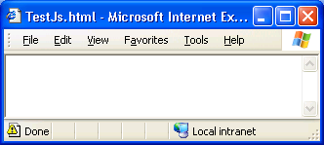
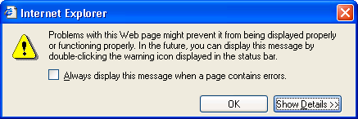
Developing JavaScript Software
IE6 error window:
Error indicator;
double-clicking icon
opens error window
Click to see
error messages

Slide 14
Developing JavaScript Software
Debugging
  Apply generic techniques: desk check, add debug output (alert’s)
  Use specialized JavaScript debuggers: later
Re-executing
  Overwrite .js file
  Reload (Mozilla)/Refresh (IE) HTML document that loads the file

Slide 15
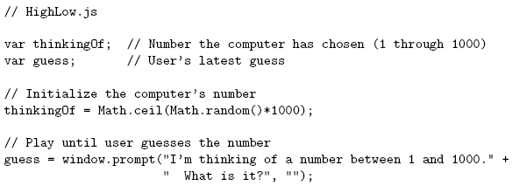
Basic JavaScript Syntax

Slide 16
Basic JavaScript Syntax
Notice that there is no main() function/method

Slide 17
Basic JavaScript Syntax
Comments like Java/C++ (/* */ also allowed)

Slide 18
Basic JavaScript Syntax
Variable declarations:
Not required
Data type not specified

Slide 19
Basic JavaScript Syntax
Semi-colons are usually
not required, but always
allowed at statement end

Slide 20
Basic JavaScript Syntax
Arithmetic operators same as Java/C++

Slide 21
Basic JavaScript Syntax
String concatenation operator
as well as addition

Slide 22
Basic JavaScript Syntax
Arguments can be any expressions
Argument lists are comma-separated

Slide 23
Basic JavaScript Syntax
Object dot notation for method calls as in Java/C++

Slide 24
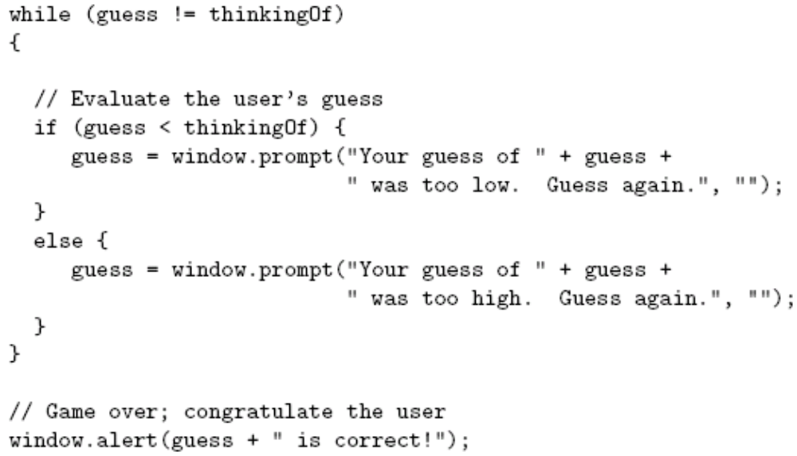
Basic JavaScript Syntax

Slide 25
Basic JavaScript Syntax
Many control constructs and use of
{ } identical to Java/C++

Slide 26
Basic JavaScript Syntax
Most relational operators syntactically
same as Java/C++

Slide 27
Basic JavaScript Syntax
Automatic type conversion:
guess is String,
thinkingOf is Number

Slide 28
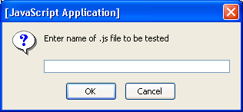
Running Examples
Browse to TestJs.html in examples download package
Enter name of .js file (e.g., HighLow.js) in prompt box:

Slide 29
Variables and Data Types
Type of a variable is dynamic: depends on the type of data it contains
JavaScript has six data types:
  Number
  String
  Boolean (values true and false)
  Object
  Null (only value of this type is null)
  Undefined (value of newly created variable)
Primitive data types: all but Object

Slide 30
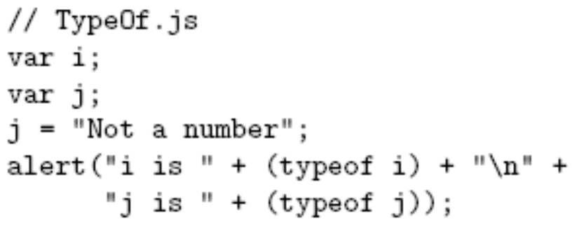
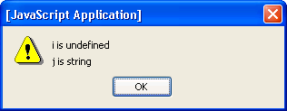
Variables and Data Types
typeof operator returns string related to data type
  Syntax: typeof expression
Example:

Slide 31
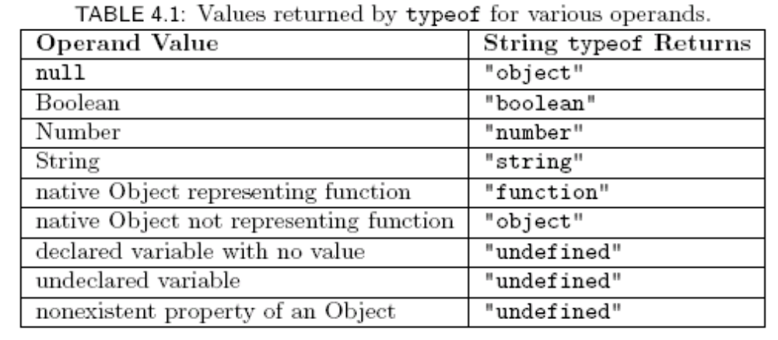
Variables and Data Types

Slide 32
Variables and Data Types
Common automatic type conversions:
  Compare String and Number: String value converted to Number
  Condition of if or while converted to Boolean
  Array accessor (e.g., 3 in records[3]) converted to String

Slide 33
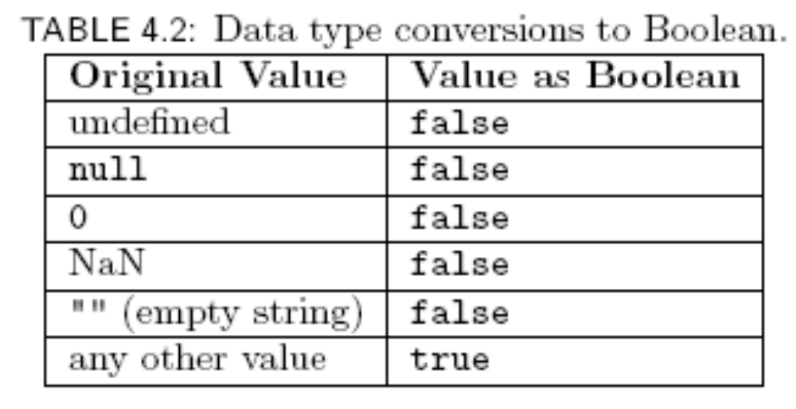
Variables and Data Types

Slide 34
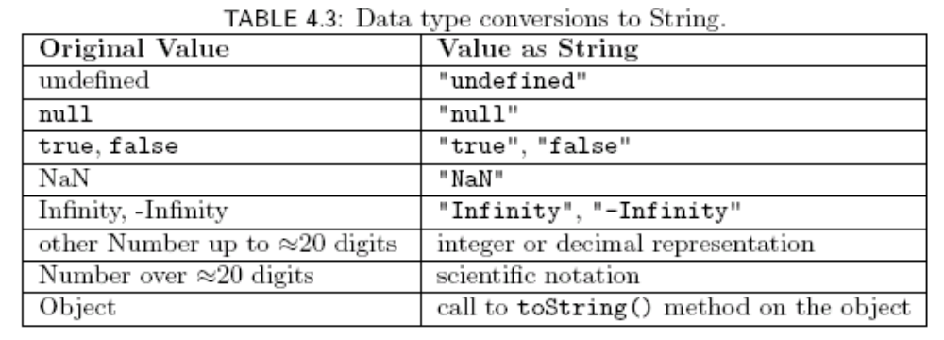
Variables and Data Types

Slide 35
Variables and Data Types
Special Number values (“Not a Number” and number too large to represent)

Slide 36
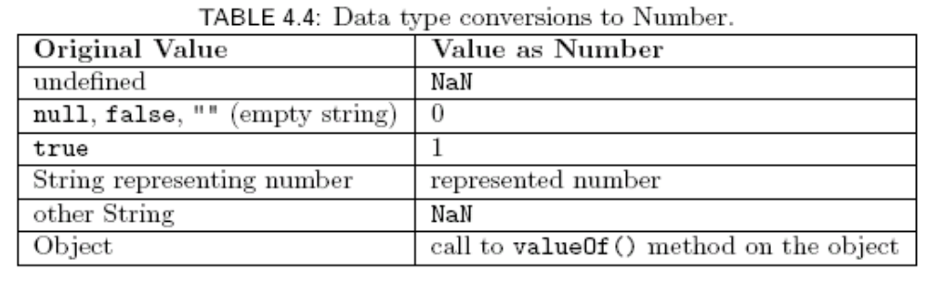
Variables and Data Types

Slide 37
Variables and Data Types
Syntax rules for names (identifiers):
  Must begin with letter or underscore ( _ )
  Must contain only letters, underscores, and digits (or certain other characters)
  Must not be a reserved word

Slide 38
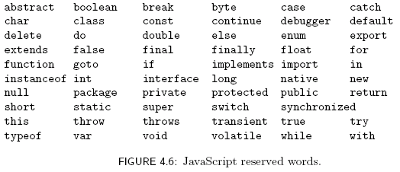
Variables and Data Types

Slide 39

Variables and Data Types
A variable will automatically be created if a value is assigned to an undeclared identifier:
Recommendation: declare all variables
  Facilitates maintenance
  Avoids certain exceptions
var is not
required

Slide 40
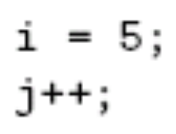
JavaScript Statements
Expression statement: any statement that consists entirely of an expression
  Expression: code that represents a value
Block statement: one or more statements enclosed in { } braces
Keyword statement: statement beginning with a keyword, e.g., var or if

Slide 41

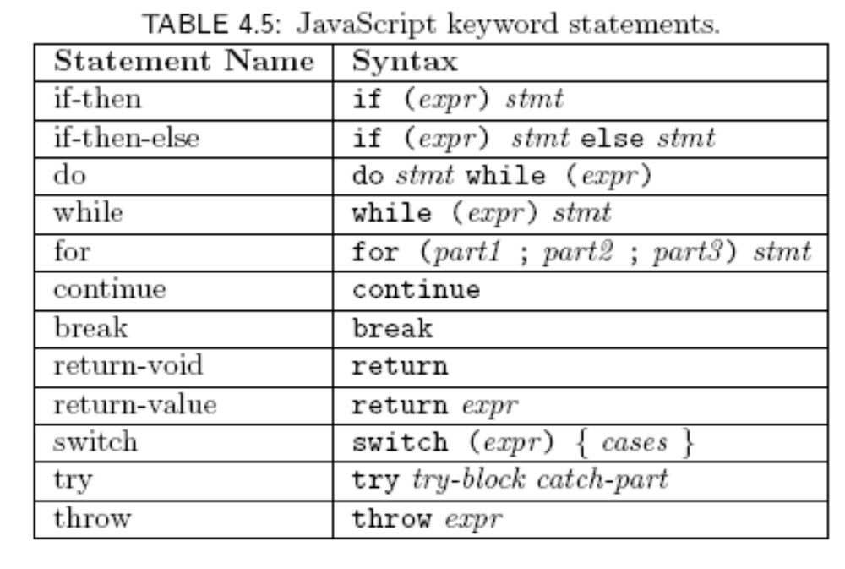
JavaScript Statements
var syntax:
Java-like keyword statements:
Comma-separated declaration list with
optional initializers

Slide 42
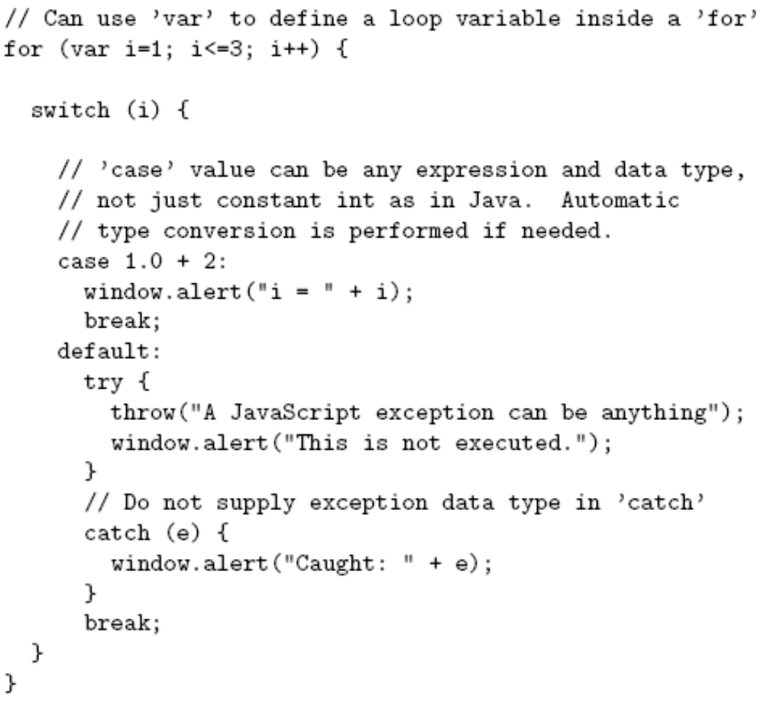
JavaScript Statements
JavaScript
keyword
statements
are very similar
to Java with
small exceptions

Slide 43
JavaScript Statements

Slide 44
JavaScript Statements

Slide 45
JavaScript Statements

Slide 46
JavaScript Operators
Operators are used to create compound expressions from simpler expressions
Operators can be classified according to the number of operands involved:
  Unary: one operand (e.g., typeof i)
    Prefix or postfix (e.g., ++i or i++ )
  Binary: two operands (e.g., x + y)
  Ternary: three operands (conditional operator)

Slide 47
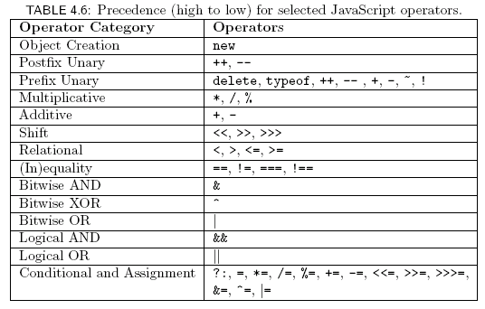
JavaScript Operators

Slide 48

JavaScript Operators
Associativity:
  Assignment, conditional, and prefix unary operators are right associative: equal-precedence operators are evaluated right-to-left:
  Other operators are left associative: equal-precedence operators are evaluated left-to-right

Slide 49
JavaScript Operators:
Automatic Type Conversion
Binary operators +, -, *, /, % convert both operands to Number
  Exception: If one of operands of + is String then the other is converted to String
Relational operators <, >, <=, >= convert both operands to Number
  Exception: If both operands are String, no conversion is performed and lexicographic string comparison is performed

Slide 50
JavaScript Operators:
Automatic Type Conversion
Operators ==, != convert both operands to Number
  Exception: If both operands are String, no conversion is performed (lex. comparison)
  Exception: values of Undefined and Null are equal(!)
  Exception: instance of Date built-in “class” is converted to String (and host object conversion is implementation dependent)
  Exception: two Objects are equal only if they are references to the same object

Slide 51
JavaScript Operators:
Automatic Type Conversion
Operators ===, !== are strict:
  Two operands are === only if they are of the same type and have the same value
  “Same value” for objects means that the operands are references to the same object
Unary +, - convert their operand to Number
Logical &&, ||, ! convert their operands to Boolean (normally)

Slide 52
JavaScript Operators
Bit operators
  Same set as Java:
    Bitwise NOT, AND, OR, XOR (~, &, |, ^)
    Shift operators (<<, >>, >>>)
  Semantics:
    Operands converted to Number, truncated to integer if float, treated as if two’s complement, truncated to low-order 32 bits
    Operators then applied as if in 32-bit registers
    Result of >>> treated as unsigned, others signed

Slide 53


JavaScript Operators
Example bit operators:
-2
4294967294 (2³² – 2)

Slide 54
JavaScript Numbers
Syntactic representations of Number
  Integer (42) and decimal (42.0)
  Scientific notation (-12.4e12)
  Hexadecimal (0xfa0)
Internal representation
  Approximately 16 digits of precision
  Approximate range of magnitudes
    Smallest: 10⁻³²³
    Largest: 10³⁰⁸ (Infinity if literal is larger)

Slide 55
JavaScript Strings
String literals can be single- or double-quoted
Common escape characters within Strings
  \n newline
  \” escaped double quote (also \’ for single)
  \\ escaped backslash
  \uxxxx arbitrary Unicode 16-bit code point (x’s are four hex digits)

Slide 56
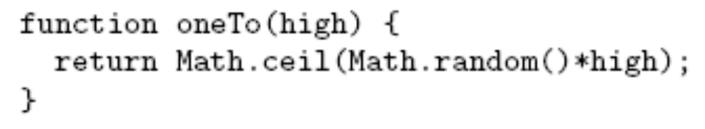
JavaScript Functions
Function declaration syntax

Slide 57
JavaScript Functions
Function declaration syntax
Declaration
always begins
with keyword
function,
no return type

Slide 58
JavaScript Functions
Function declaration syntax
Identifier representing
function’s name

Slide 59
JavaScript Functions
Function declaration syntax
Formal parameter list

Slide 60
JavaScript Functions
Function declaration syntax
One or more statements representing
function body

Slide 61

JavaScript Functions
Function call syntax

Slide 62
JavaScript Functions
Function call syntax
Function call is an expression, can
be used on right-hand side of assignments,
as expression statement, etc.

Slide 63
JavaScript Functions
Function call syntax
Function name

Slide 64
JavaScript Functions
Function call syntax
Argument list

Slide 65
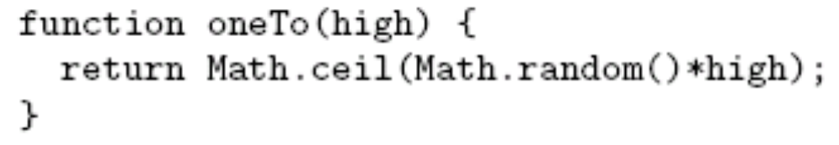
JavaScript Functions
Function call semantics:

Slide 66
JavaScript Functions
Function call semantics:
Argument value(s)
associated with corresponding
formal parameters

Slide 67
JavaScript Functions
Function call semantics:
Expression(s) in body
evaluated as if formal
parameters are variables
initialized by argument
values

Slide 68
JavaScript Functions
Function call semantics:
If final statement executed
is return-value, then value of
its expression becomes value
of the function call

Slide 69
JavaScript Functions
Function call semantics:
Value of function call is then used
in larger expression containing
function call.

Slide 70

JavaScript Functions
Function call semantics details:
  Arguments:
    May be expressions:
    Object’s effectively passed by reference (more later)
  Formal parameters:
    May be assigned values, argument is not affected
  Return value:
    If last statement executed is not return-value, then returned value is of type Undefined

Slide 71
JavaScript Functions
Number mismatch between argument list and formal parameter list:
  More arguments: excess ignored
  Fewer arguments: remaining parameters are Undefined

Slide 72
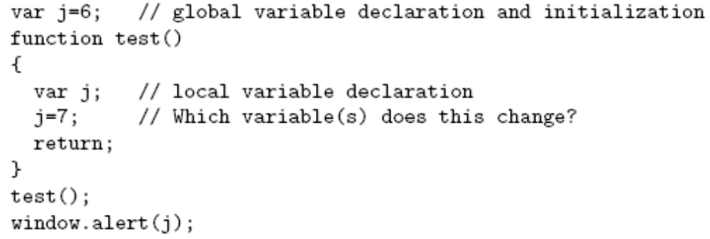
JavaScript Functions
Local vs. global variables
Global variable: declared outside any function

Slide 73
JavaScript Functions
Local vs. global variables
Local
variable
declared
within
a function

Slide 74
JavaScript Functions
Local vs. global variables
Local
declaration
shadows
corresponding
global
declaration
Output is 6

Slide 75

JavaScript Functions
Local vs. global variables
In browsers,
global
variables
(and functions)
are stored as properties
of the window built-in object.
Output is 7

Slide 76
JavaScript Functions
Recursive functions
  Recursion (function calling itself, either directly or indirectly) is supported
  C++ static variables are not supported
  Order of declaration of mutually recursive functions is unimportant (no need for prototypes as in C++)

Slide 77
JavaScript Functions
Explicit type conversion supplied by built-in functions
  Boolean(), String(), Number()
  Each takes a single argument, returns value representing argument converted according to type-conversion rules given earlier

Slide 78
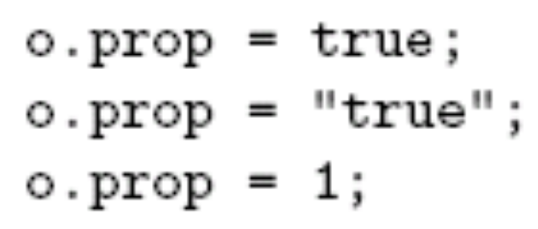
Object Introduction
An object is a set of properties
A property consists of a unique (within an object) name with an associated value
The type of a property depends on the type of its value and can vary dynamically
prop is Boolean
prop is now String
prop is now Number

Slide 79
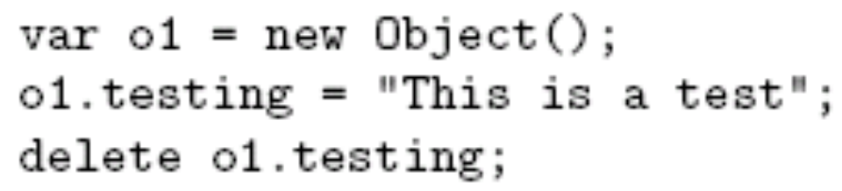
Object Introduction
There are no classes in JavaScript
Instead, properties can be created and deleted dynamically
Create an object o1
Create property testing
Delete testing property

Slide 80

Object Creation
Objects are created using new expression
A constructor is a function
  When called via new expression, a new empty Object is created and passed to the constructor along with the argument values
  Constructor performs initialization on object
    Can add properties and methods to object
    Can add object to an inheritance hierarchy
Constructor and argument list

Slide 81
Object Creation
The Object() built-in constructor
  Does not add any properties or methods directly to the object
  Adds object to hierarchy that defines default toString() and valueOf() methods (used for conversions to String and Number, resp.)

Slide 82
Property Creation
Assignment to a non-existent (even if inherited) property name creates the property:
Object initializer notation can be used to create an object (using Object() constructor) and one or more properties in a single statement:

Slide 83
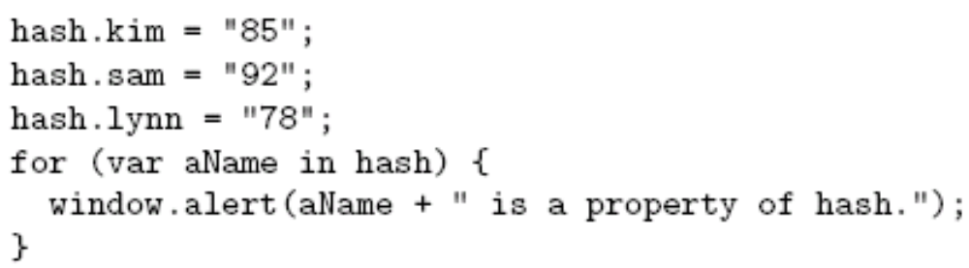
Enumerating Properties
Special form of for statement used to iterate through all properties of an object:
Produces three
alert boxes;
order of names
is implementation-dependent.

Slide 84

Accessing Property Values
The JavaScript object dot notation is actually shorthand for a more general associative array notation in which Strings are array indices:
Expressions can supply property names:
Converted to String
if necessary

Slide 85
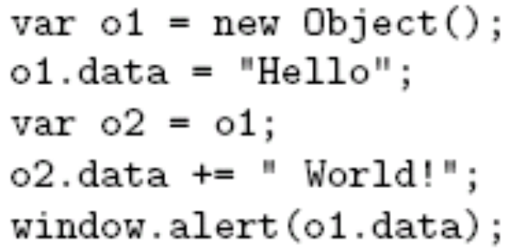
Object Values
Value of Object is reference to object:

Slide 86
Object Values
Value of Object is reference to object:
o2 is another
name for o1

Slide 87
Object Values
Value of Object is reference to object:
o1 is
changed

Slide 88
Object Values
Value of Object is reference to object:
Output is Hello World!

Slide 89
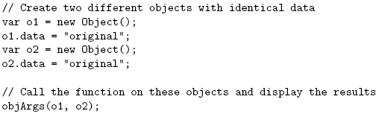
Object Values
Object argument values are references
...}

Slide 90
Object Values
Object argument values are references
...}

Slide 91
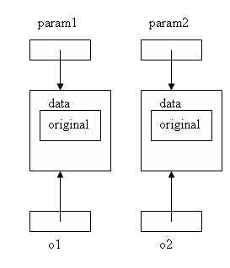
Object Values
Object argument values are references

Slide 92
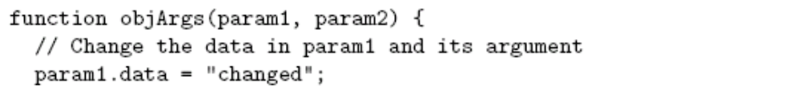
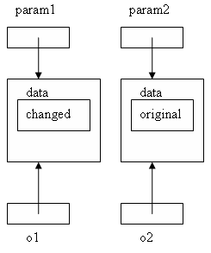
Object Values
Object argument values are references

Slide 93
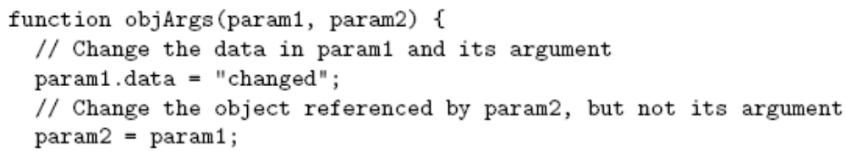
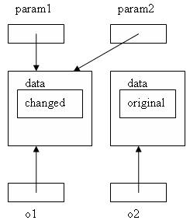
Object Values
Object argument values are references

Slide 94
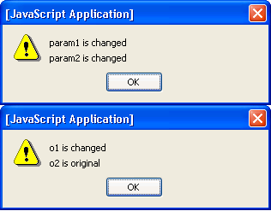
Object Values
Object argument values are references

Slide 95
Object Methods
JavaScript functions are stored as values of type Object
A function declaration creates a function value and stores it in a variable (property of window) having the same name as the function
A method is an object property for which the value is a function

Slide 96
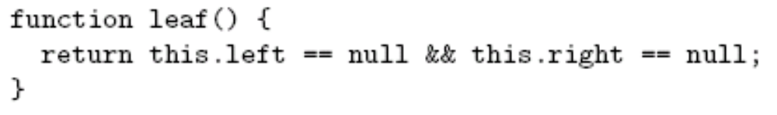
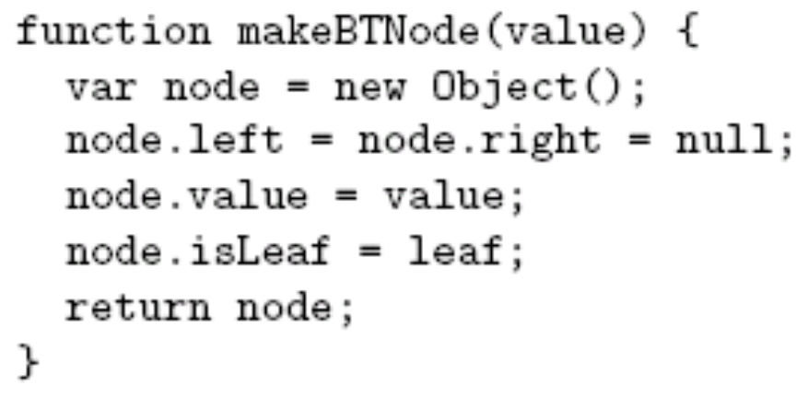
Object Methods

Slide 97
Object Methods
Creates global variable named leaf with function value

Slide 98
Object Methods
Creates isLeaf() method that is
defined by leaf() function

Slide 99
Object Methods
Refers to object that “owns” method when
leaf() is called as a method

Slide 100
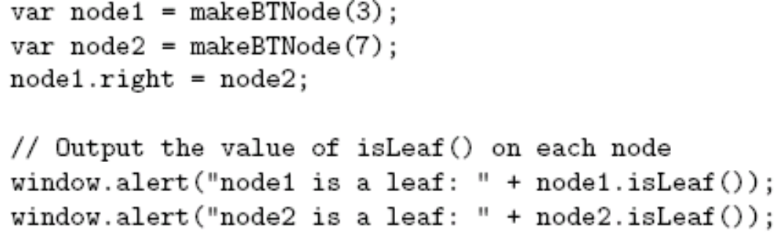
Object Methods

Slide 101
Object Methods
Creates two objects each with
method isLeaf()

Slide 102
Object Methods
Calls to isLeaf() method

Slide 103
Object Methods
Original version: leaf() can be called as function, but we only want a method

Slide 104
Object Methods
Alternative:
Function expression syntactically
the same as function declaration but
does not produce a global variable.

Slide 105
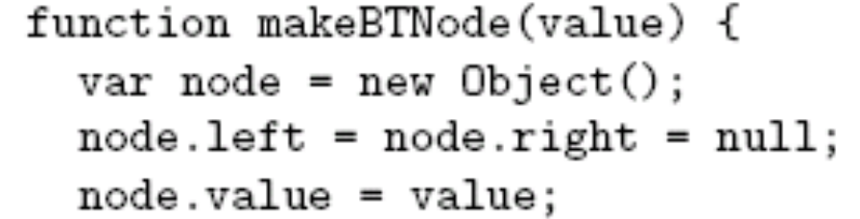

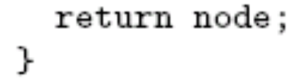
Object Methods
Alternative

Slide 106
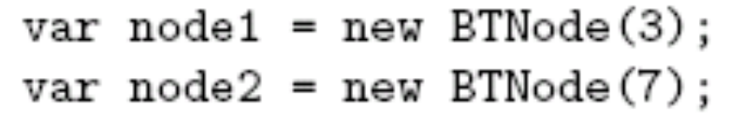
Object Constructors
User-defined constructor is just a function called using new expression:
Object created using a constructor is known as an instance of the constructor
Constructor

Slide 107
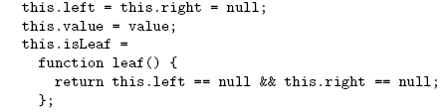
Object Constructors
Original
function
Function
intended
to be used
as constructor

Slide 108
Object Constructors
Object is
constructed
automatically
by new
expression

Slide 109
Object Constructors
Object
referenced
using this
keyword

Slide 110
Object Constructors
No need
to return
initialized
object

Slide 111
Object Constructors
Object created using a constructor is known as an instance of the constructor
instanceof operator can be used to test this relationship:
Instances of BTNode
Evaluates to true

Slide 112

JavaScript Arrays
The Array built-in object can be used to construct objects with special properties and that inherit various methods
ary1
length (0)
Properties
Inherited
methods
toString()
sort()
shift()
…

Slide 113
JavaScript Arrays
The Array built-in object can be used to construct objects with special properties and that inherit various methods
ary2
length (3)
“0” (4)
“1” (true)
“2” (“OK”)
Accessing array elements:
ary2[1]
ary2[“1”]
ary2.1
Elements
of array
Must follow identifier
syntax rules
toString()
…

Slide 114

JavaScript Arrays
The Array constructor is indirectly called if an array initializer is used
Array initializiers can be used to create multidimensional arrays
ttt[1][2]

Slide 115

JavaScript Arrays
Changing the number of elements:
Creates a new element dynamically,
increases value of length
ary2
length (4)
“0” (4)
“1” (true)
“2” (“OK”)
“3” (-12.6)
toString()
…

Slide 116

JavaScript Arrays
Changing the number of elements:
Decreasing length can delete elements
ary2
length (2)
“0” (4)
“1” (true)
toString()
…

Slide 117
JavaScript Arrays
Value of length is not necessarily the same as the actual number of elements
var ary4 = new Array(200);
Calling constructor with single argument
sets length, does not create elements
ary4
length (200)
toString()
sort()
shift()
…

Slide 118
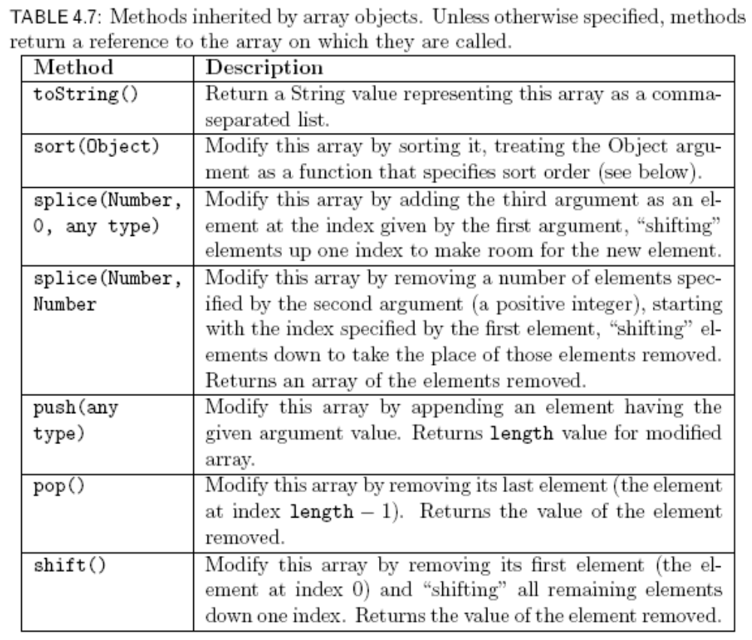
JavaScript Arrays

Slide 119
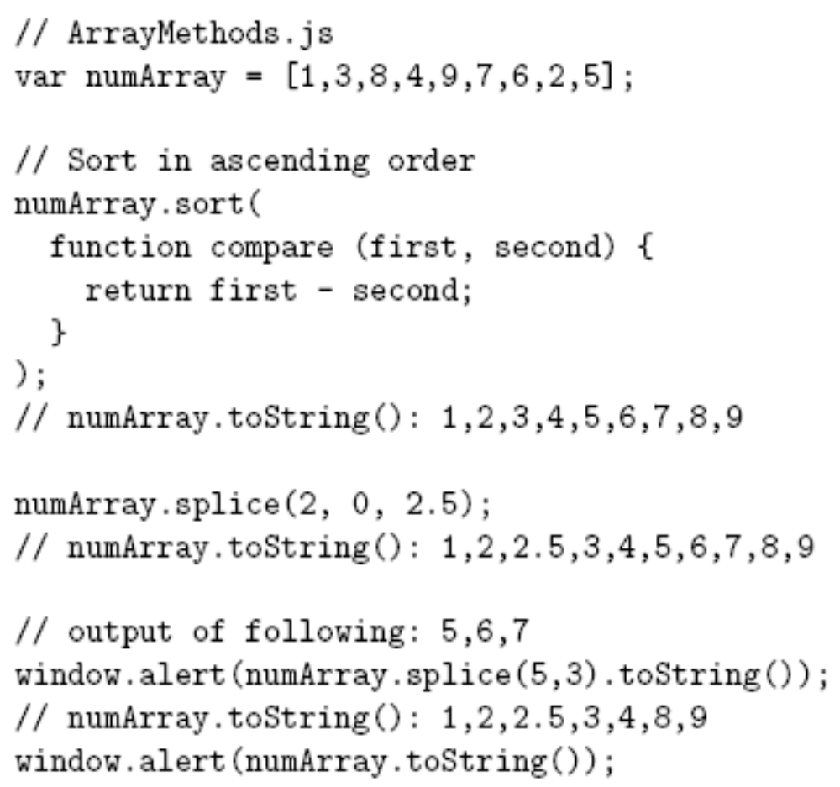
JavaScript Arrays

Slide 120
JavaScript Arrays
Argument to sort
is a function

Slide 121
JavaScript Arrays
Return negative if first value should
come before second after sorting

Slide 122
JavaScript Arrays
Add element with value 2.5 at
index 2, shift existing elements

Slide 123
JavaScript Arrays
Remove 3 elements starting
at index 5

Slide 124

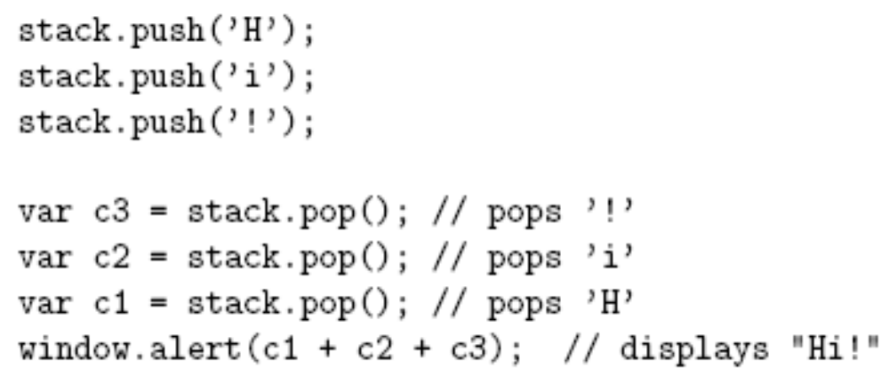
JavaScript Arrays

Slide 125
JavaScript Arrays
push() adds an element to the end of the
array

Slide 126
JavaScript Arrays
pop() deletes and returns last
element of the array

Slide 127
JavaScript Arrays
Use shift() instead to implement queue

Slide 128
Built-in Objects
The global object
  Named window in browsers
  Has properties representing all global variables
  Other built-in objects are also properties of the global object
    Ex: initial value of window.Array is Array object
  Has some other useful properties
    Ex: window.Infinity represents Number value

Slide 129
Built-in Objects
The global object and variable resolution:
This is why we can refer to built-in objects (Object, Array, etc.) without prefixing with window.
i = 42;
What does i refer to?
Search for local variable or formal parameter
named i
If none found, see if global object (window)
has property named i

Slide 130
Built-in Objects
String(), Boolean(), and Number() built-in functions can be called as constructors, created “wrapped” Objects:
Instances inherit valueOf() method that returns wrapped value of specified type:
Output is “number”

Slide 131
Built-in Objects
Other methods inherited by Number instances:
Outputs
5.63
5.63e+0
101.101
Base 2

Slide 132
Built-in Objects
Properties provided by Number built-in object:
  Number.MIN_VALUE: smallest (absolute value) possible JavaScript Number value
  Number.MAX_VALUE: largest possible JavaScript Number value

Slide 133
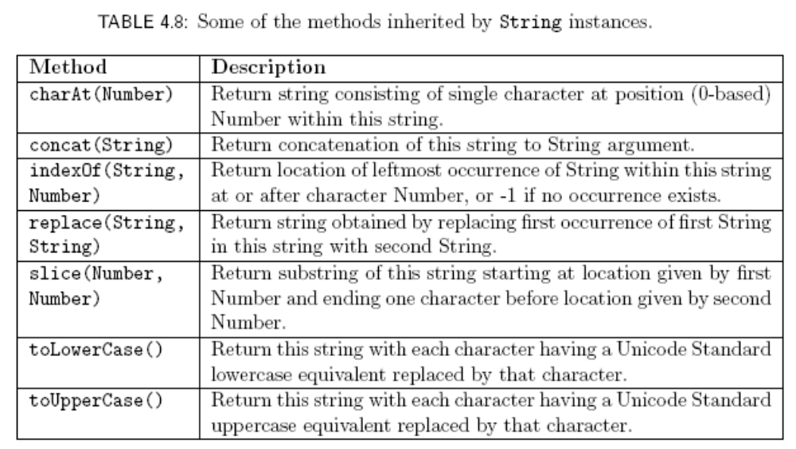
Built-in Objects

Slide 134
Built-in Objects
Instances of String have a length property (number of characters)
JavaScript automatically wraps a primitive value of type Number or String if the value is used as an object:
Output is “Str”

Slide 135
Built-in Objects
The Date() built-in constructor can be used to create Date instances that represent the current date and time
Often used to display local date and/or time in Web pages
Other methods: toLocaleDateString() , toLocaleTimeString(), etc.
var now = new Date();
window.alert(“Current date and time: “
+ now.toLocaleString());

Slide 136

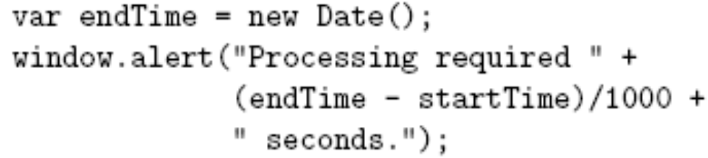
Built-in Objects
valueOf() method inherited by Date instances returns integer representing number of milliseconds since midnight 1/1/1970
Automatic type conversion allows Date instances to be treated as Numbers:

Slide 137

Built-in Objects
Math object has methods for performing standard mathematical calculations:
Also has properties with approximate values for standard mathematical quantities, e.g., e ( Math.E ) and π (Math.PI)

Slide 138
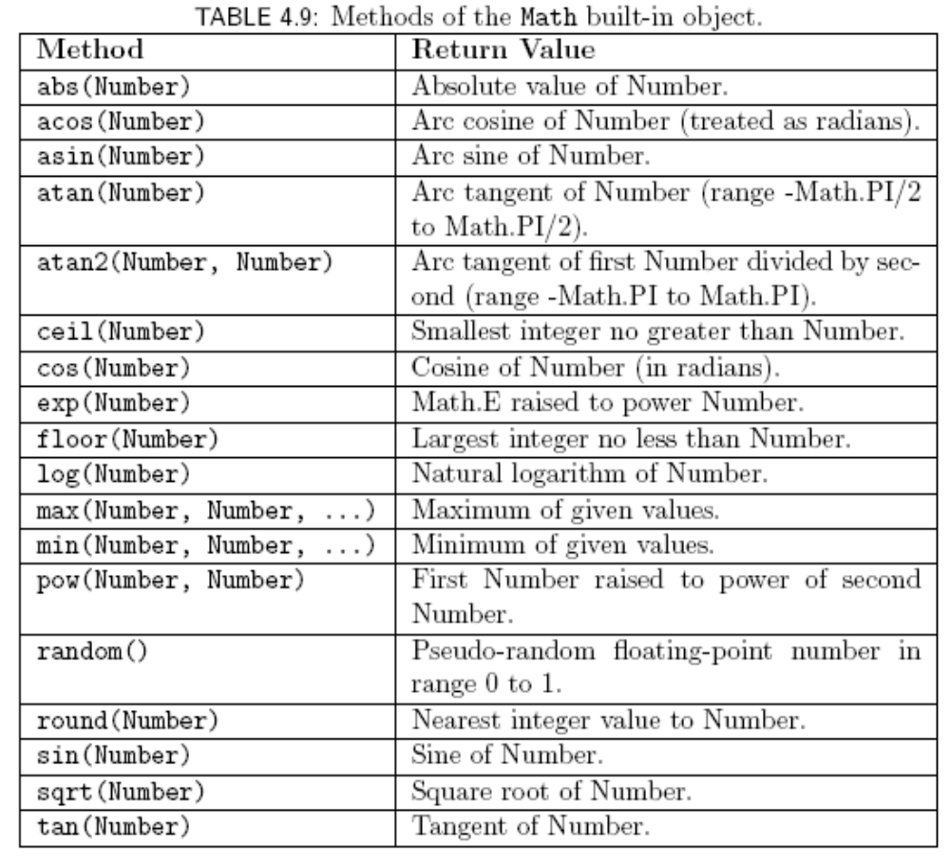
Built-in Objects

Slide 139

JavaScript Regular Expressions
A regular expression is a particular representation of a set of strings
  Ex: JavaScript regular expression representing the set of syntactically-valid US telephone area codes (three-digit numbers):
    \d represents the set {“0”, “1”, …, “9”}
    Concatenated regular expressions represent the “concatenation” (Cartesian product) of their sets

Slide 140
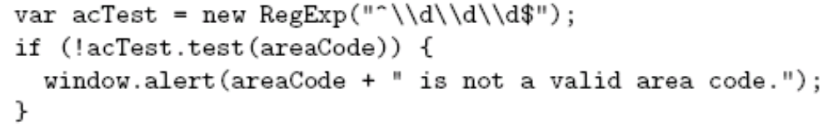
JavaScript Regular Expressions
Using regular expressions in JavaScript

Slide 141
JavaScript Regular Expressions
Using regular expressions in JavaScript
Variable containing string to be tested

Slide 142
JavaScript Regular Expressions
Using regular expressions in JavaScript
Regular expression as String (must escape \)

Slide 143
JavaScript Regular Expressions
Using regular expressions in JavaScript
Built-in constructor

Slide 144
JavaScript Regular Expressions
Using regular expressions in JavaScript
Method inherited by RegExp instances:
returns true if the argument contains a
substring in the set of strings represented by
the regular expression

Slide 145
JavaScript Regular Expressions
Using regular expressions in JavaScript
Represents beginning of string
Represents end of string
This expression matches only strings with
exactly three digits (no other characters,
even white space)

Slide 146
JavaScript Regular Expressions
Using regular expressions in JavaScript
Alternate syntax:
Represents all strings that begin
with three digits
Regular expression literal.
Do not escape \.

Slide 147
JavaScript Regular Expressions
Simplest regular expression is any character that is not a special character:
  Ex: _ is a regular expression representing {“_”}
Backslash-escape d special character is also a regular expression
  Ex: \$ represents {“$”}

Slide 148
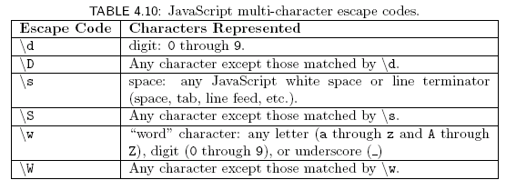
JavaScript Regular Expressions
Special character . (dot) represents any character except a line terminator
Several escape codes are regular expressions representing sets of chars:

Slide 149
JavaScript Regular Expressions
Three types of operations can be used to combine simple regular expressions into more complex expressions:
  Concatenation
  Union (|)
  Kleene star (*)
XML DTD content specification syntax based in part on regular expressions

Slide 150


JavaScript Regular Expressions
Concatenation
  Example:
    String consisting entirely of four characters:
    Digit followed by
    A . followed by
    A single space followed by
    Any “word” character
  Quantifier shorthand syntax for concatenation:

Slide 151



JavaScript Regular Expressions
Union
  Ex:
  Union of set of strings represented by regular expressions
    Set of single-character strings that are either a digit or a space character
Character class: shorthand for union of one or more ranges of characters
  Ex: set of lower case letters
  Ex: the \w escape code class

Slide 152



JavaScript Regular Expressions
Unions of concatenations
  Note that concatenation has higher precedence than union
Optional regular expression

Slide 153

JavaScript Regular Expressions
Kleene star
  Ex: any number of digits (including none)
  Ex:
    Strings consisting of only “word” characters
    String must contain both a digit and a letter (in either order)

