Slide 1
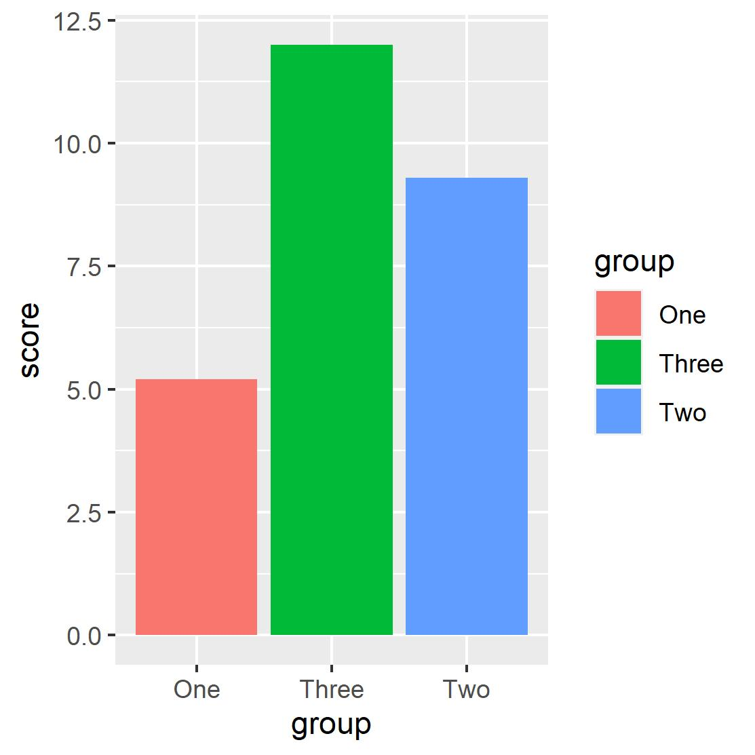
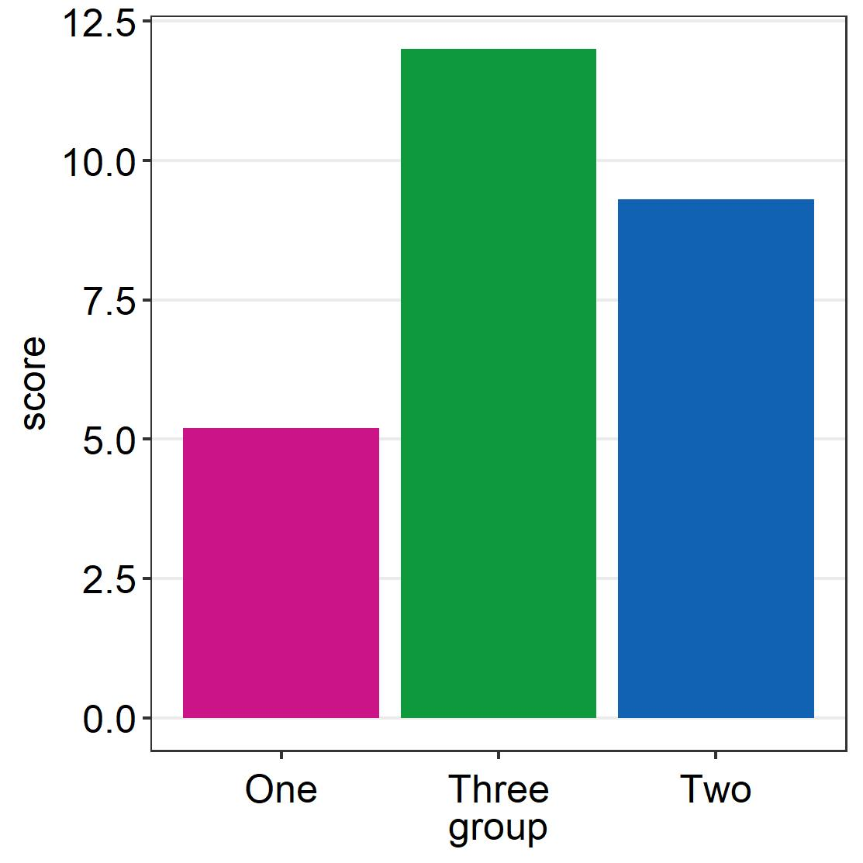
A default bar graph (p1)
A SES bar graph (p2)

Slide 2
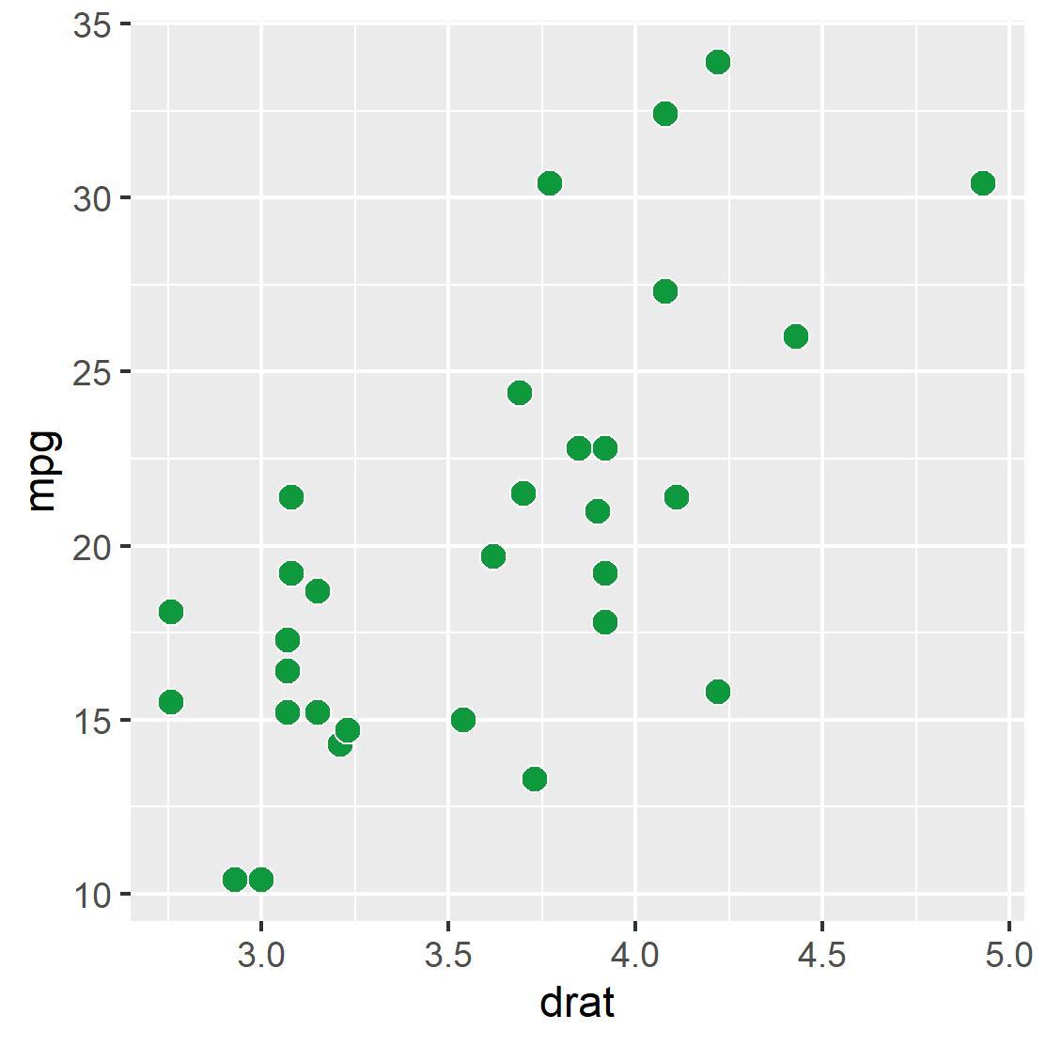
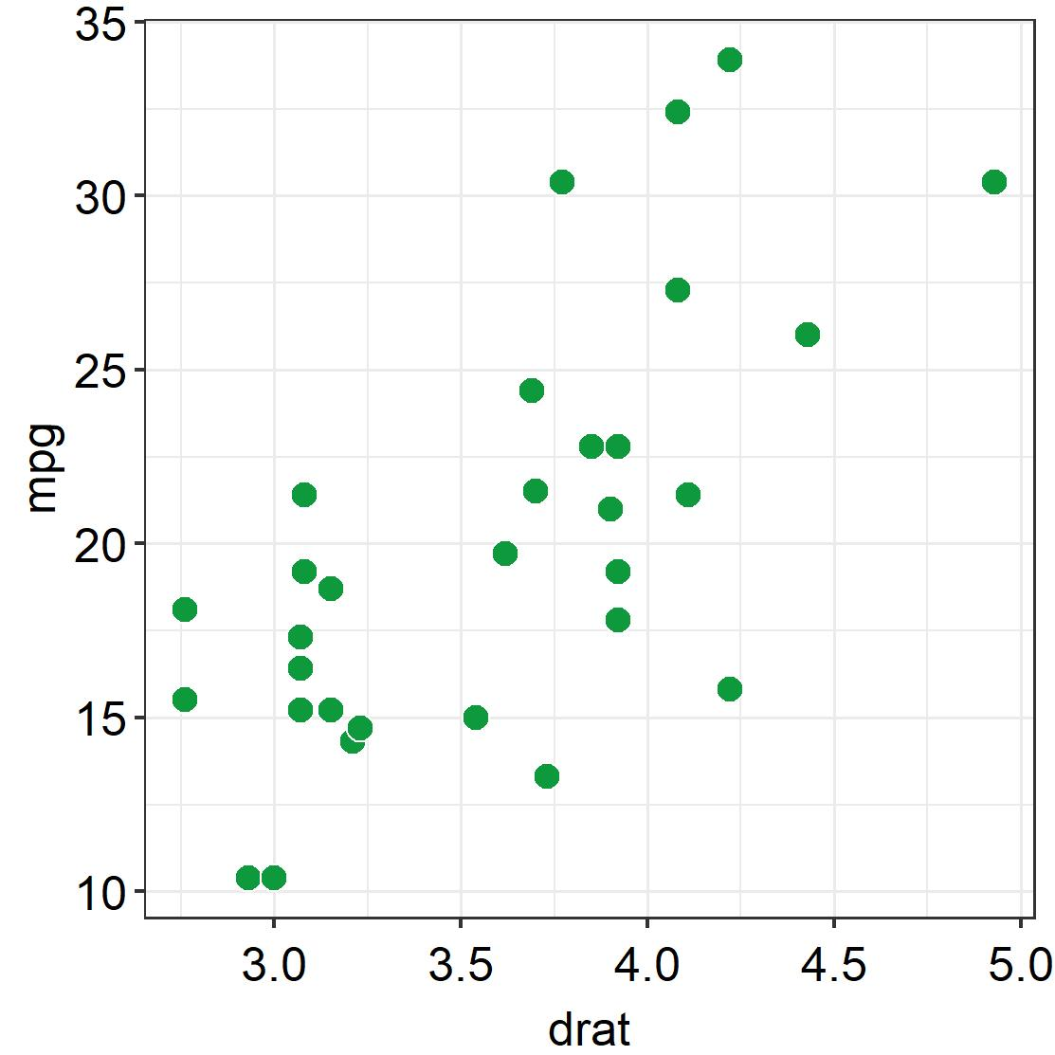
A default scatterplot (p3)
A SES scatterplot (p4)

Slide 3
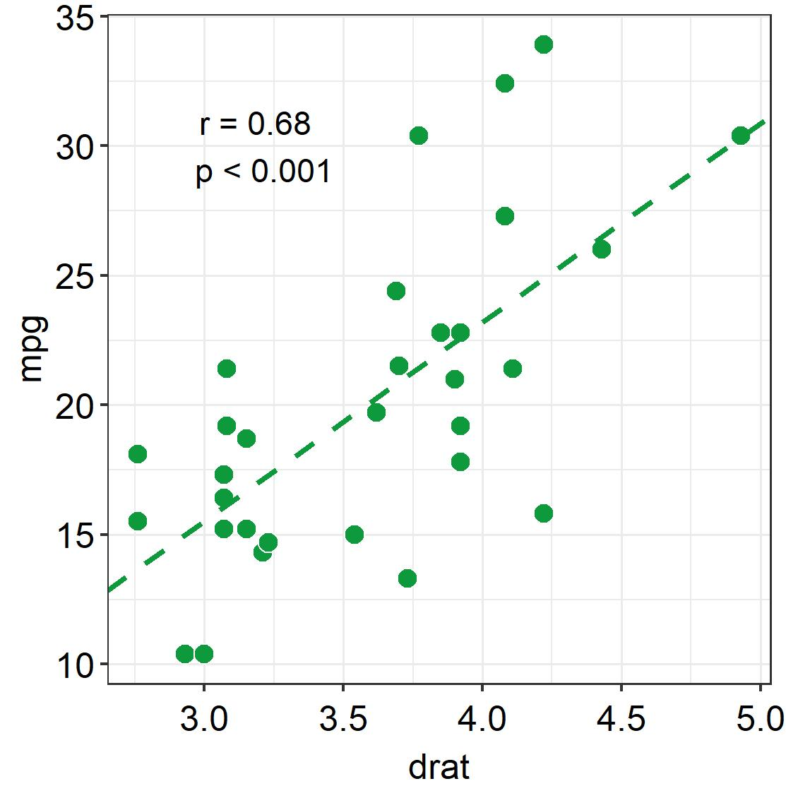
p4 + ses_corrtext() + ses_corrline()

Slide 4
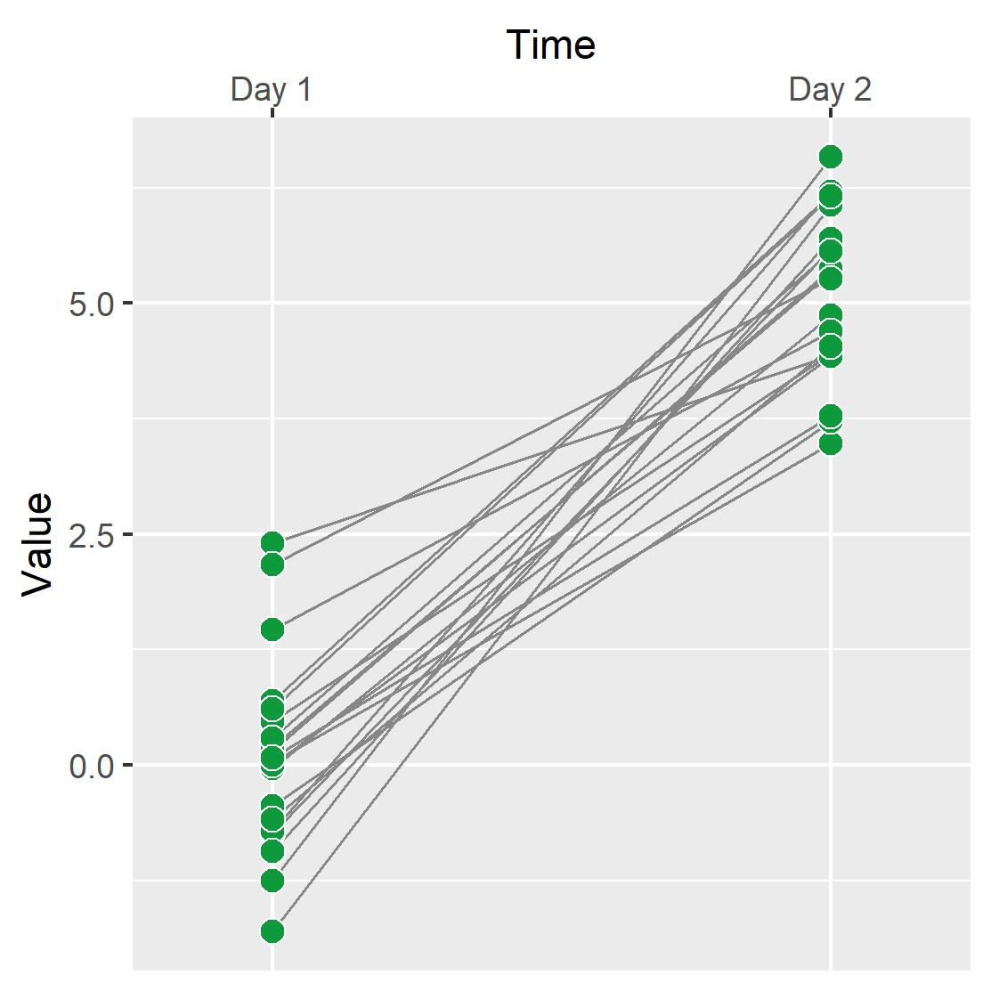
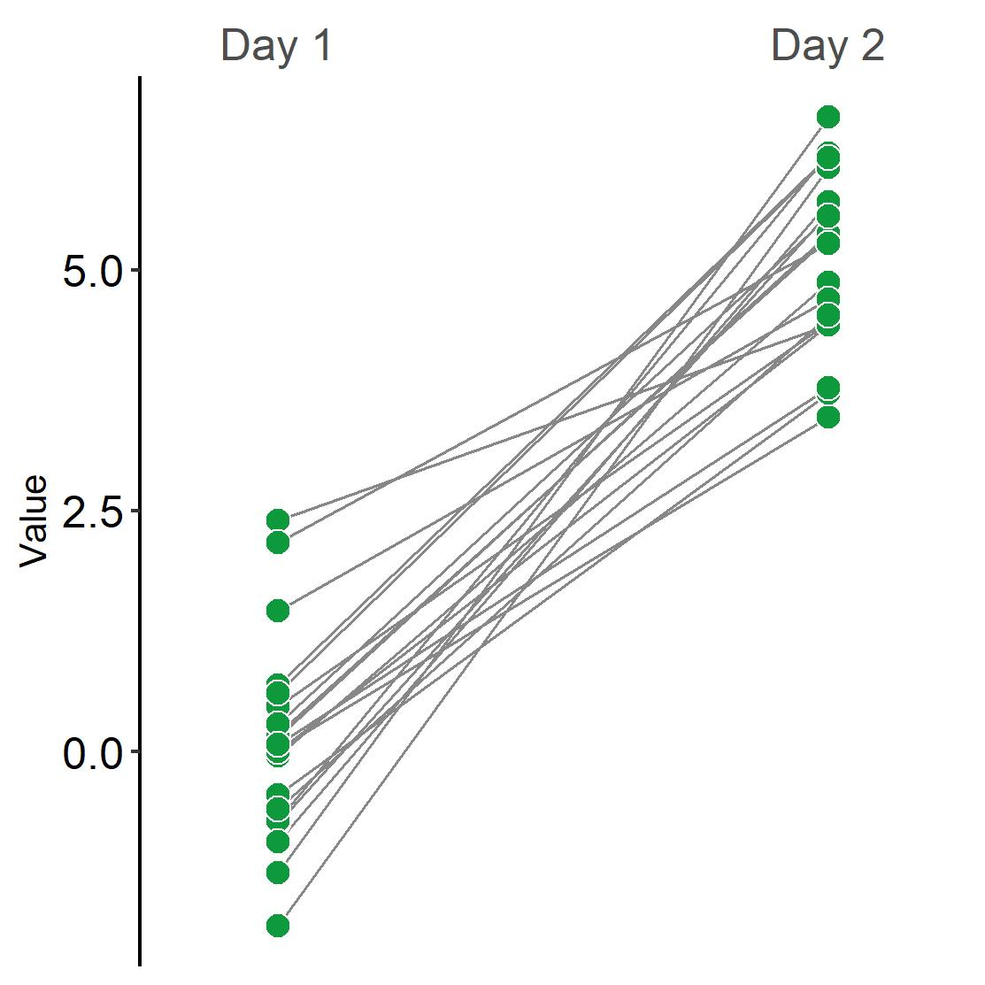
A default slope chart (p5)
A SES slope chart (p6)

