Slide 1


Linux in a Light Bulb
How far are we on tinification?
Linux
inside
Pieter Smith
Philips Innovation Services / Nobleo

Slide 2
What is software (kernel) bloat?
Software (kernel) bloat is the process
  whereby:
  successive versions become slower, more resource hungry, or require better hardware
  whilst:
  making only dubious user-perceptible improvements or feature creep.

Slide 3
Why does software bloat?
Software inefficiency:
  (Intentionally) prioritize developer efficiency.
  Unnecessary / badly designed abstractions.
  Code duplication.
  Unused feature accretion.

Slide 4
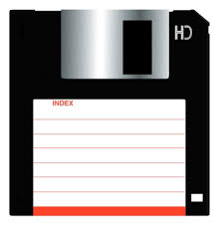
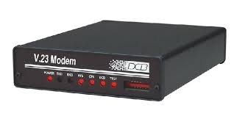
A brief history on kernel size
Linux on a floppy-disc:
2001: v2.2.19 @ 977KB compressed
2004: v2.4.27 @ 797KB compressed
2004: v2.6.8 @ 1073KB compressed
Debian-installer
Linux v 2.4.27

Slide 5
A brief history on kernel size
Core kernel:
2007: v2.6.21 @ 1.06MB (baseline)
2008: v2.6.25 @ 1.12MB (+14%)

Slide 6
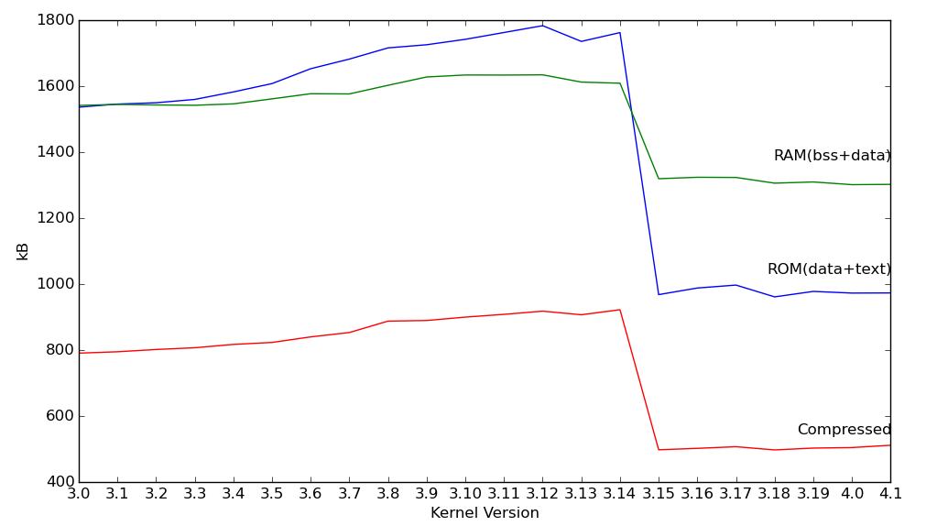
Kernel size history

Slide 7
Enter linux-tiny
2003: Started by Matt Mackall
  First patch-set for v2.6.0
2005/2006: CELF sponsorship
  Top 17 patches mainlined

Slide 8
Dither linux-tiny
2006: Mostly abandoned
2007: Revived by CELF
  Michael Opdenacker volunteers
  http://elinux.org/Linux_Tiny
  http://elinux.org/Kernel_Size_Tuning_Guide

Slide 9
Wither linux-tiny
2007: Last patch release @ v2.6.23
2008: Focus only on mainlining
  Most promising (51) patches only
2008: Mailing-list archive ends
Today: 2 / 51 patches mainlined

Slide 10
Bloatwatch
2008: Matt Mackall
TODO: More info

Slide 11
RCU Tiny

Slide 12
Linux tinification

Slide 13
Why a light bulb?

Slide 14
Why Linux?

Slide 15
Why is this challenging?
Price-point
  Samsung Galaxy S6 @ €570
  TODO: Affordable smartphone
  TODO: Home router
  TODO: Lightbulb

Slide 16
Why is this challenging?
Price-point
  Samsung Galaxy S6 @ €570
  TODO: Affordable smartphone
  TODO: Home router
  TODO: Lightbulb

Slide 17
Why is this challenging?
Thermal design
  Samsung Galaxy S6 @ €570
  TODO: Affordable smartphone
  TODO: Home router
  TODO: Lightbulb

Slide 18
How far have we come?

Slide 19
Demo time

Slide 20
References
Linux tiny
  http://events.linuxfoundation.org/sites/events/files/slides/tiny.pdf
  https://lwn.net/Articles/608945/
  http://elinux.org/images/5/5c/Linux-tiny-revival-jamboree16.pdf
  http://lwn.net/Articles/63516/
  http://elinux.org/Linux_Tiny_Patch_Details
Linux tinification effort
  https://tiny.wiki.kernel.org/start
  https://lwn.net/Articles/608945/
Size tuning
  http://elinux.org/index.php?title=Kernel_Size_Tuning_Guide

