Slide 1
Mind-KEyboard
Prerequisites:
-Emotiv headset (aprox. 300 $)
- Head (you should have one)

Slide 2
Mind 2Keyboard
How to use:
Connect Emotiv EEG to a computer
Run the data broadcaster on the same computer
Inspect sent data using the RAW EEG Viewer
If everything works use the MindKeyboard to type words
Broadcaster
RAW EEG Viewer
MindKeyboard

Slide 3
BROADCASTER

Slide 4
Broadcaster
The broadcaster receives encrypted data directly from the USB dongle, decrypts it and send it over the network using the TCP protocol.
Receive data
Decrypt data
Send over network

Slide 5
RAW EEG Viewer

Slide 6
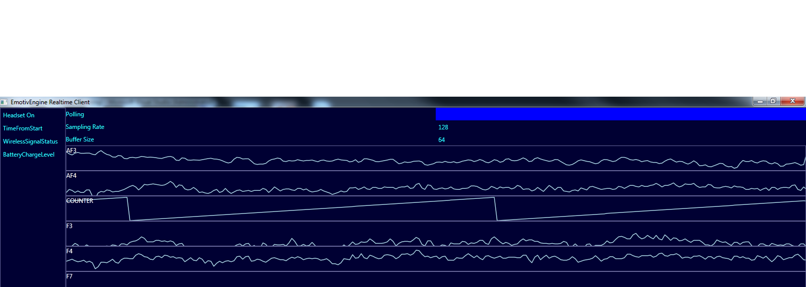
RAW EEG Viewer
The next step is to view the RAW EEG data in a graph. This shows the data that will be used by the MindKeyboard

Slide 7
MindKeyboard

Slide 8
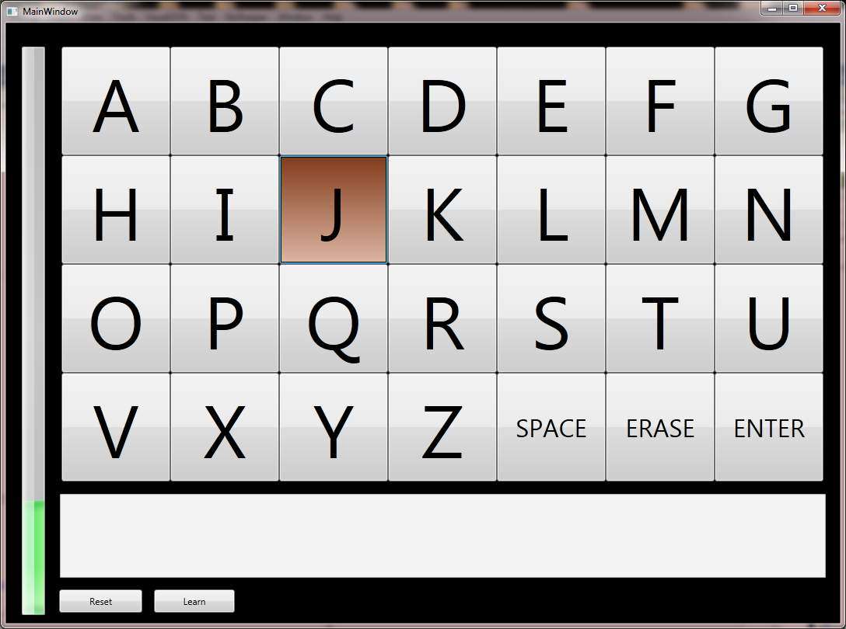
MindKeyboard
The MindKeybaord application uses the same data as the RAW EEG Viewer presented earlier.
It enables the user to select a letter by using the gyro controls of the headset.
What remains to be done: develop a machine learning algorithm that can differentiate between normal brain activity and user attempt to click.

Slide 9
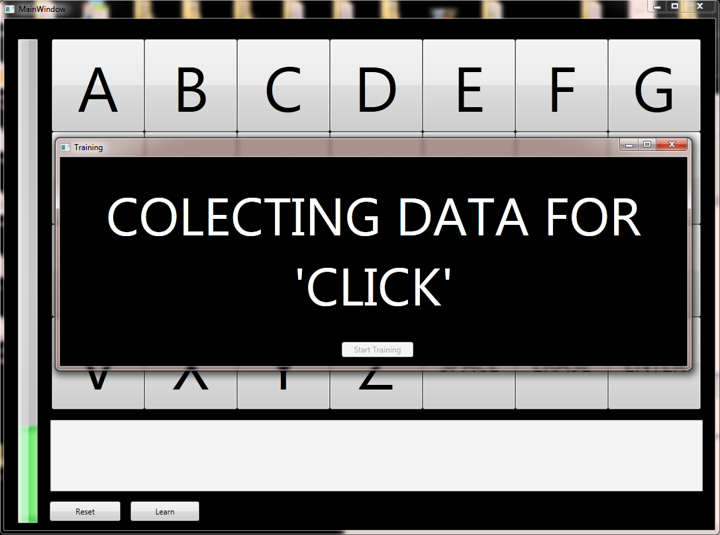
Q&A

