Slide 1
Problems in Bioinformatics
Motif Search & Protein Alignment
Hariharane Ramasamy

Slide 2
Motif Search Tool
Problem
Current Tools
Cluster Motif Search Tool
Protein Sequence Alignment
Problem
Smith Waterman
Amino Acids Properties Example (WEB)
Application (Protein Alignment)
Questions

Slide 3
Motif Search Tool

Slide 4
5 to 20
≈ 3KB
Gene
Sequences of length 5-20 bases (exist on either side of the gene) control the
gene transcription. Such sequences often are over represented near the gene they
regulate. They co-ordinate in controlling the gene transcription. It is believed
such short motifs are highly preserved due to their functionality and are transferred
across organisms with minor changes.

Slide 5
Current Motif Tools
Prediction Tool
Predict motif sites from the frequency of occurrence in the sequence. Use background distributions model to ascertain the confidence in the motif.
Search Tools
  User type their desired sequences along with some constraints provided by the program.

Slide 6
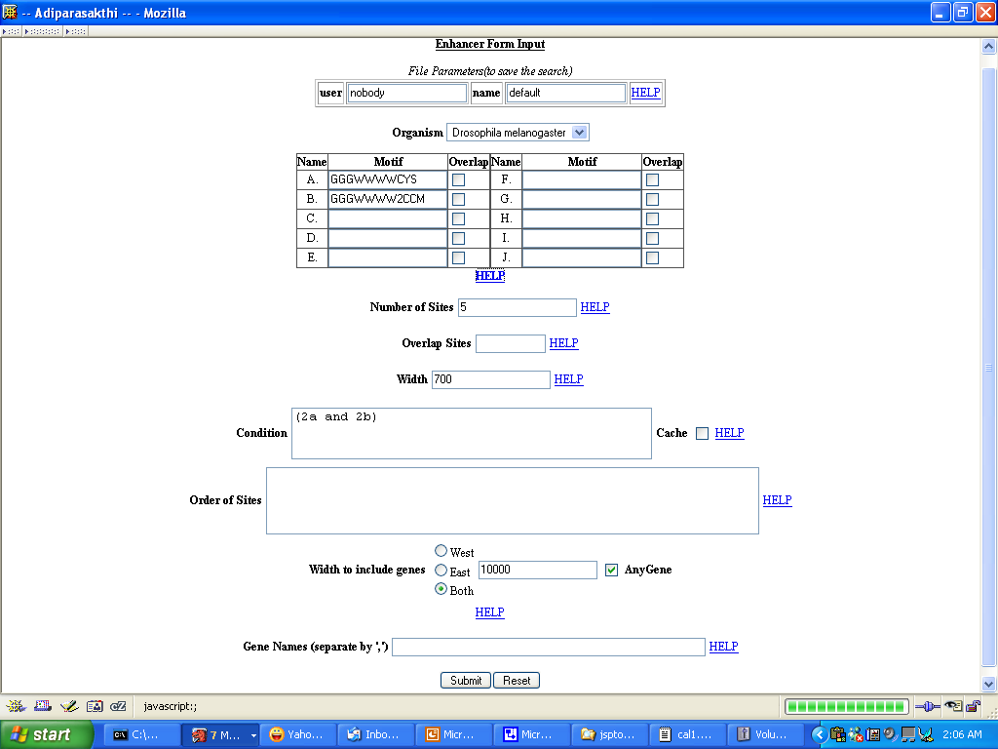

Slide 7
B | C | G | T
D | A | G | T
H | A | C | T
K | G | T
M | A | C
N | A | C | G | T
R | A | G
S | C | G
V | A | C | G
W | A | T
Y | C | T
GGGWWW3CYS | reg exp. e.g

Slide 8
Logical Expression
Any combination using ‘and’ , ‘or’, ‘not’ and
a special case where combination could be
expressed. For. e.g
(2A and 2B) or (2A and 2E) – at least two of A
along with two of either B or E
2(ABC) – two of any combinarion of A or B or C
for e.g AA, AB, AC, BB, BC, CC are valid

Slide 9
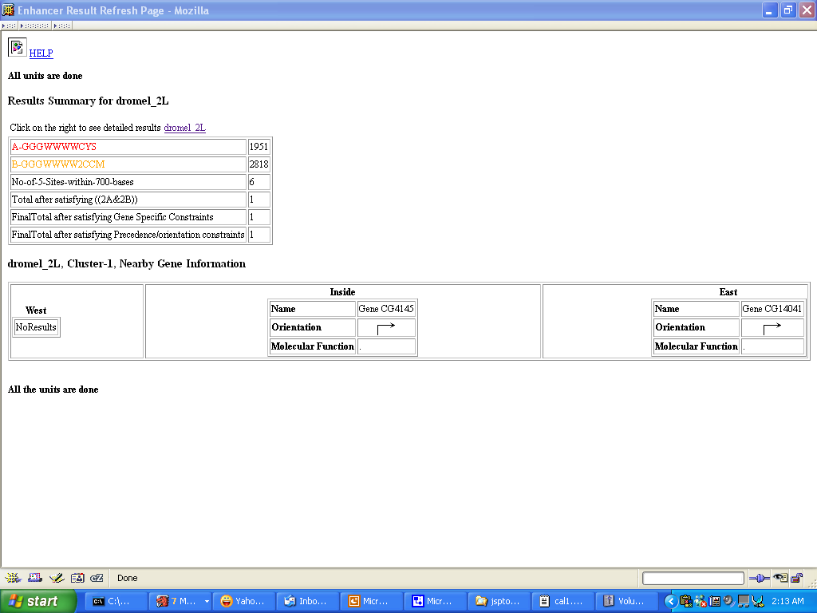

Slide 10
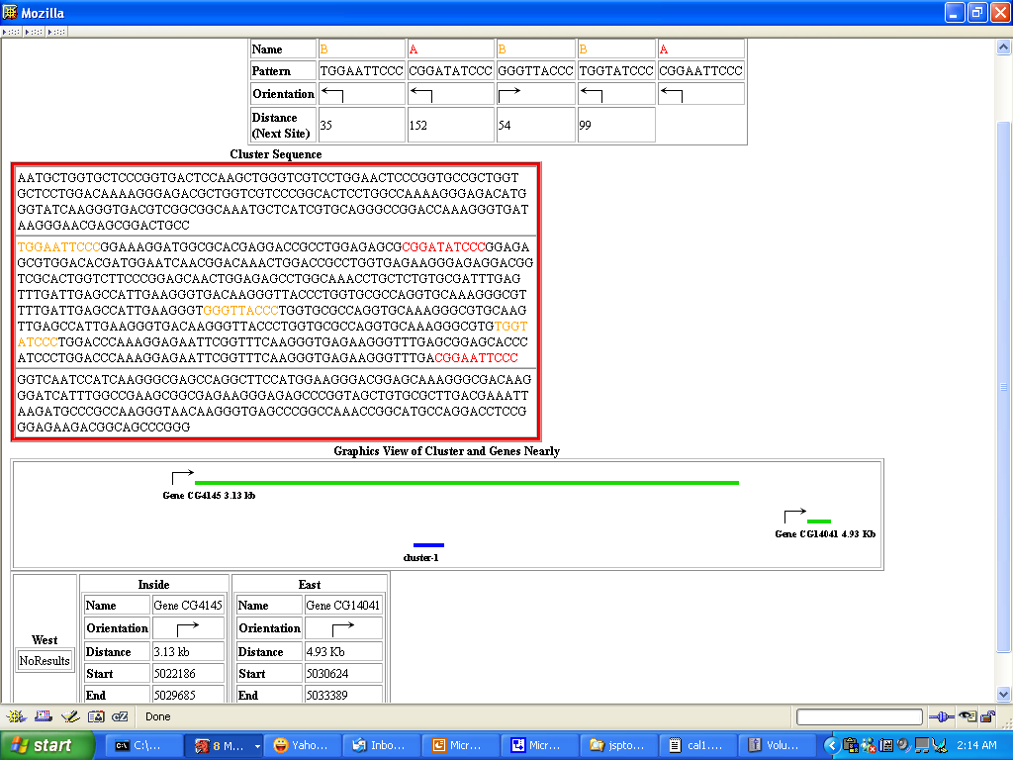

Slide 11
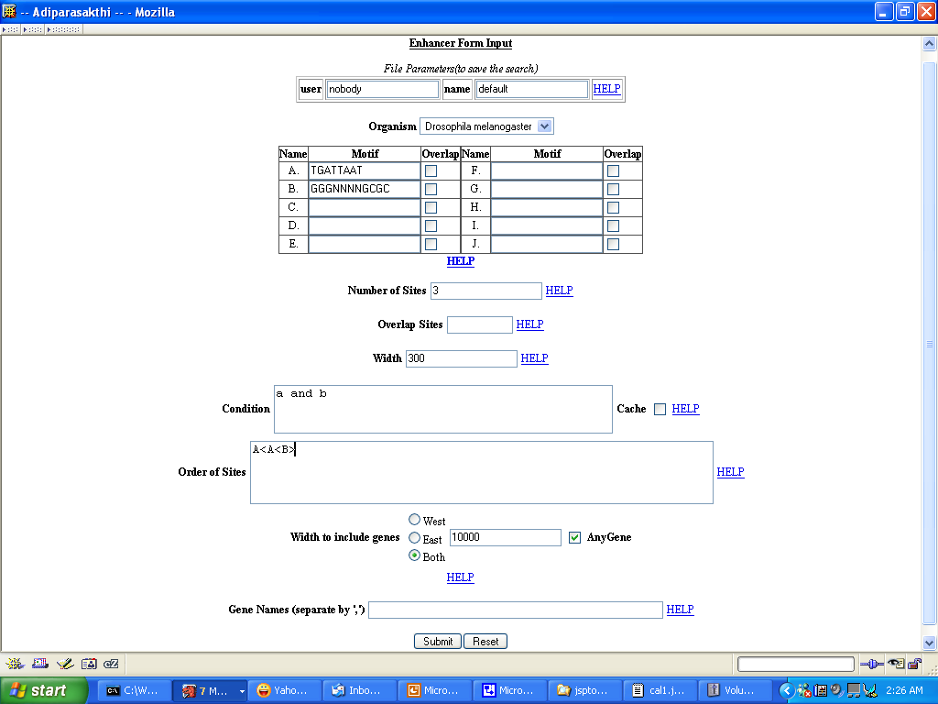

Slide 12
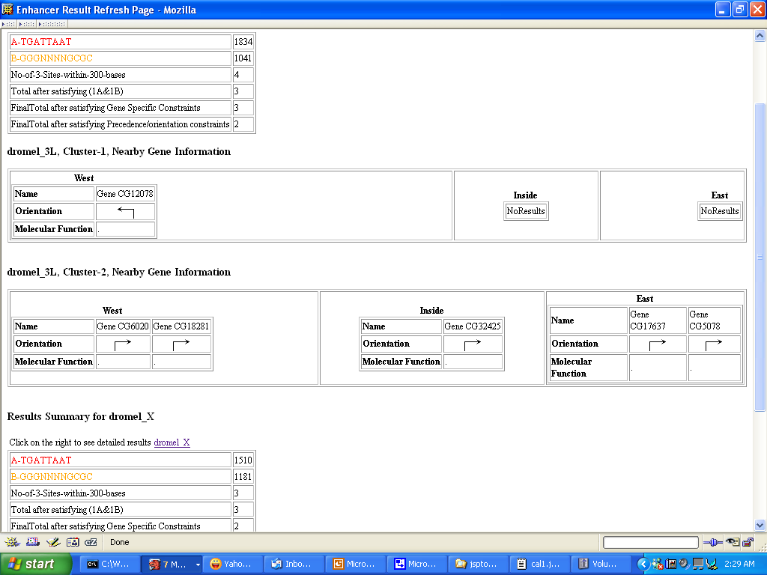

Slide 13
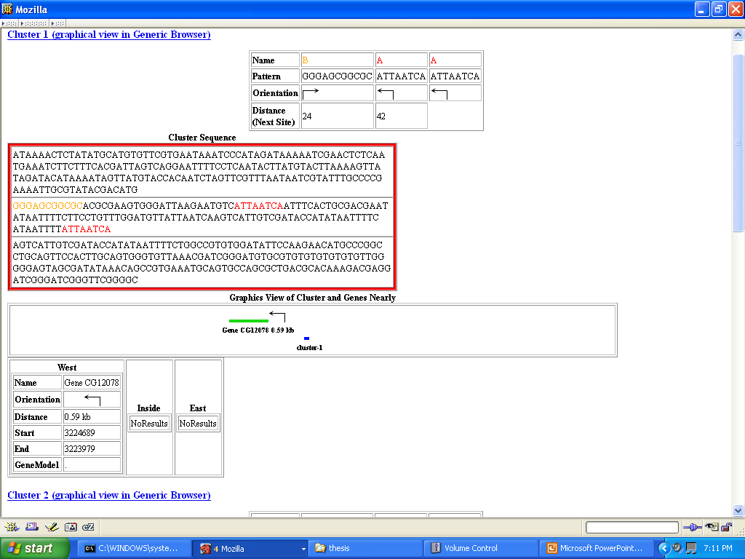

Slide 14
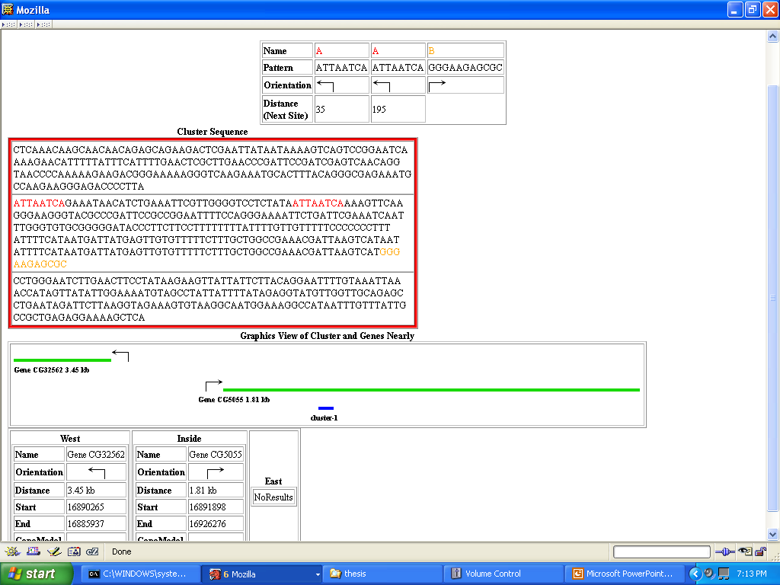

Slide 15
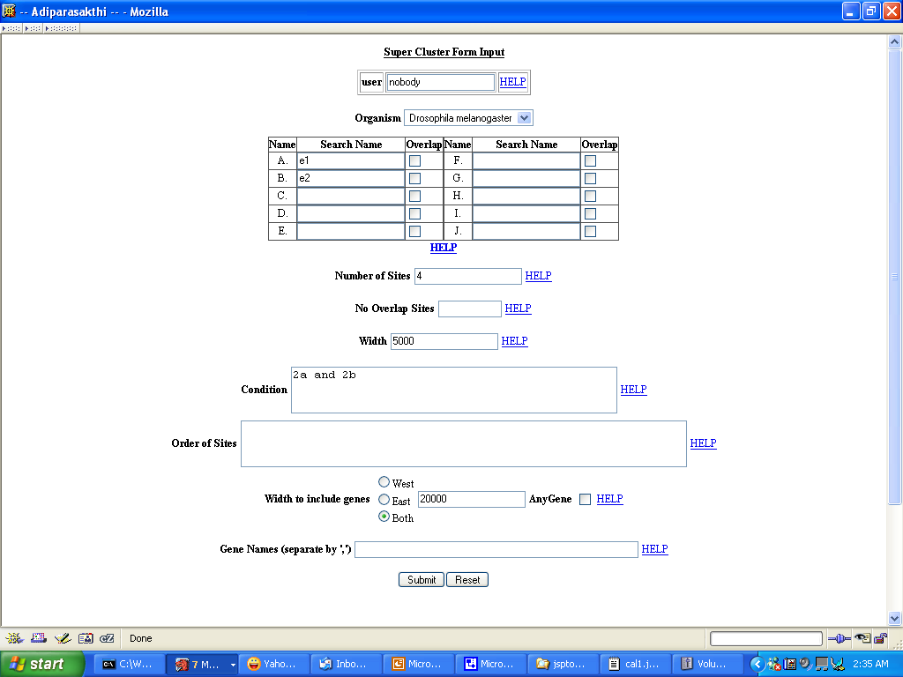

Slide 16
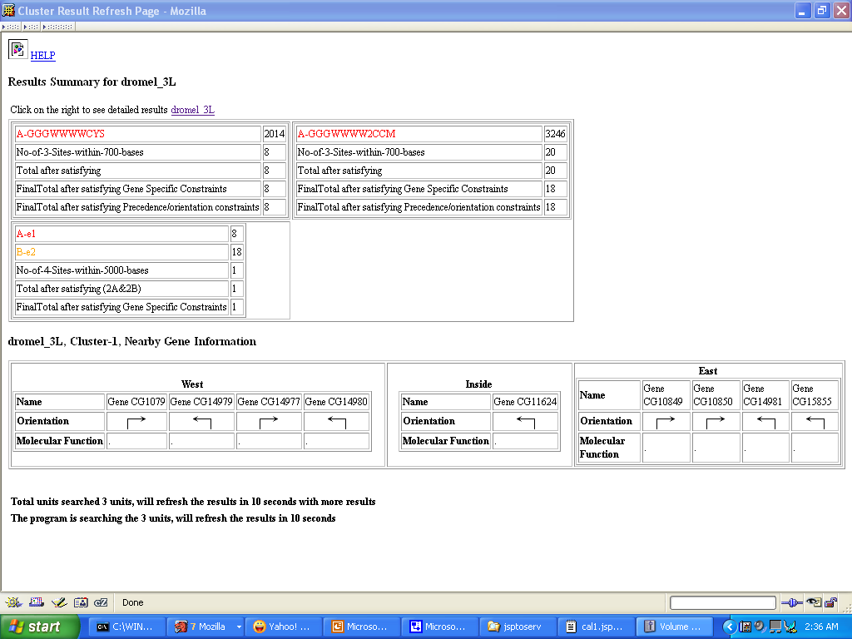

Slide 17
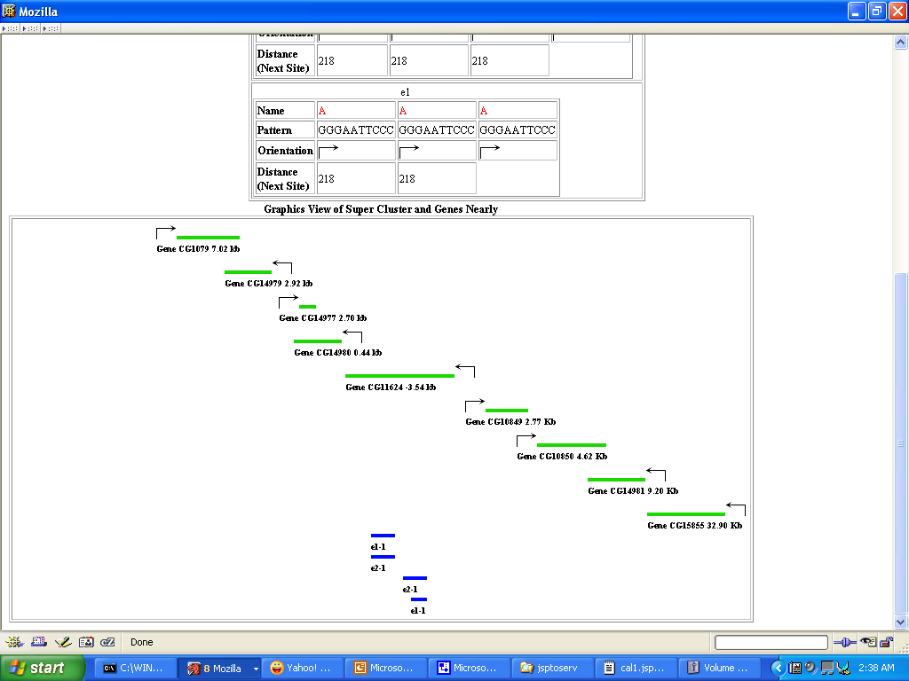

Slide 18
Protein Sequence Alignment

Slide 19
Problem
Given the primary sequence of a protein, how one can deduce the structure?
Answer
One of the ways is to perform alignment of a protein sequence with a protein whose structure is known

Slide 20
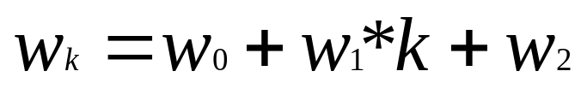
Smith Waterman Algorithm
Where D_{ij} denotes the element in the matrix
S_{ij} represents the similarity score between two
amino acids. The similarity value is obtained by
the number of properties common between two
amino acids. (32 bit vector is use with 32nd bit
denoting the gap bit.
w_{k} and w_{l} represents penalty for introducing gap

Slide 21
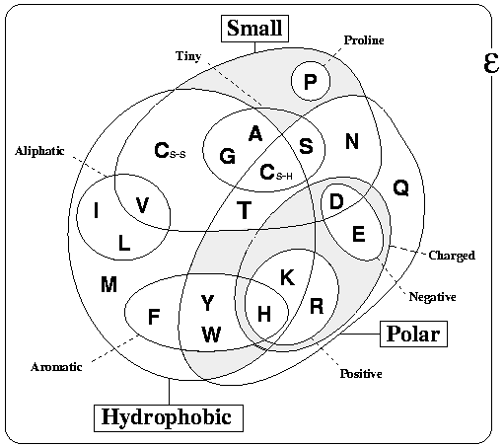

Slide 22
Pattern Library
For every sequence found in pdb, perform a
blast against swissprot. Filter for any bad hits in
the list
2) Using the protein sequences from (1) perform
clustering. Clustering is performed using the
dynamic programming for the similarity score .
3) Using the clustered information from step 2,
perform alignment until the pattern you obtain
from multiple alignment stays above threshold.
This is needed to have a good information
content.
4) Store the pattern in the library.

