Slide 1
Data Mining – Homework 1
Samantha L. Misurda
smisurda@andrew.cmu.edu

Slide 2
Question 1, Part B

Slide 3
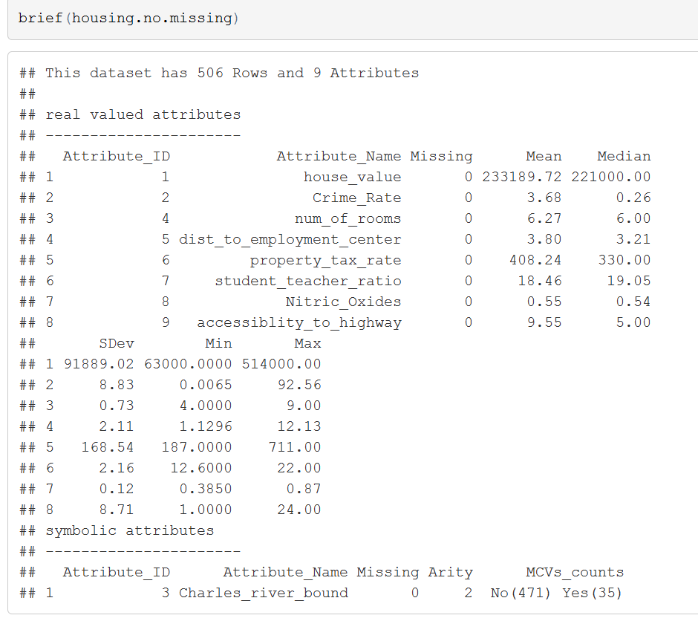
Data Summary
Presented to the right is the output of a high level briefing function. This function captures descriptive statistics for numeric types, as well as most common values for factor types.
It has been scaled to fit the page, but a nicely formatted version is available in the R Markdown file.

Slide 4
Potential Questions
Although this is by no means exhaustive, we may want to consider some questions such as:
How much are homes worth?
Does being bound by the Charles River affect home prices?
What is the relationship between Student/Teacher Ratio and Property Tax Rate?

Slide 5
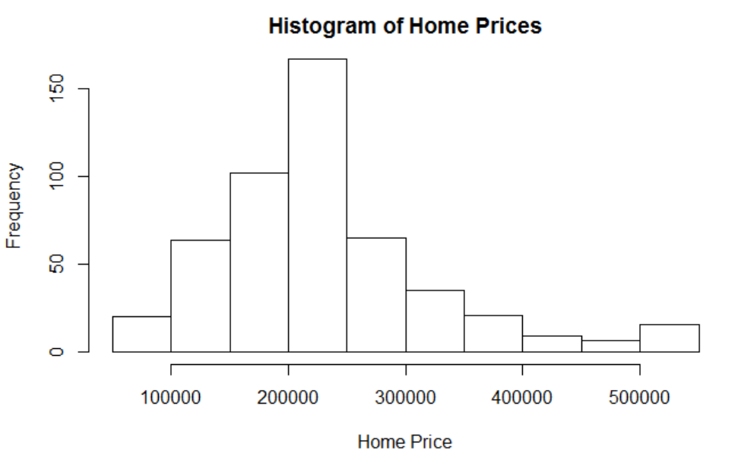
How Much are Homes Worth?
The histogram shows the distribution of all home prices in our dataset.
Most of our homes appear to be under $300,000. From our brief() function, we know that the mean value was around $230,000, and the maximum value was over $500,000.

Slide 6
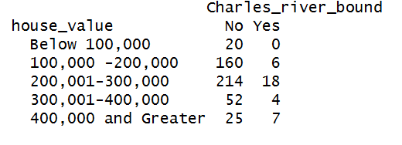
Does being bound by the Charles River affect home prices?
The contingency table on the right shows how many respondents fall into each category. For example, there are 160 homes NOT bound by the Charles River in the $100,000 – $200,000 range, and only 6 that were.
Simply looking at this table, it’s difficult to tell, as there is a small amount of homes bound by the river. However, a larger percentage of those that were bound by the river did fall in the brackets above the median home price.

Slide 7
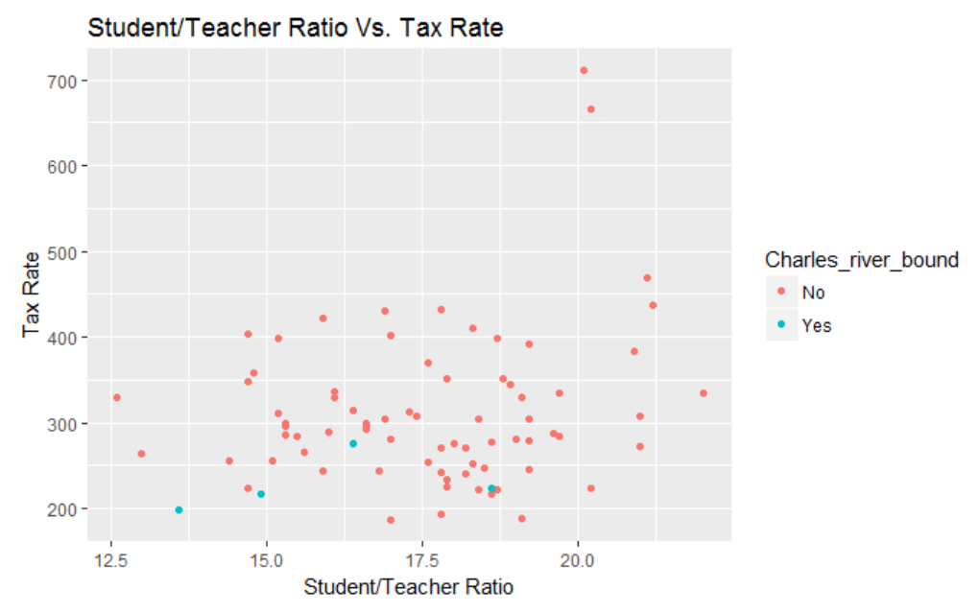
What is the relationship between Student/Teacher Ratio and Property Tax Rate?
The plot to the right demonstrates the relationship (if any) between student/teacher ratio and property tax rate. For an added bonus, each data point also indicates whether or not it is a home bound by the river.
A relationship is not as obvious as I would have suspected, but there does seem to be a slight correlation. Calculations indicate a correlation coefficient of .461

Slide 8
Future Work
Using our existing dataset, examining the effect of Nitric Oxides would be a logical next step. I can surmise that this negatively affects air quality, which in turn could decrease home prices.
With a more detailed dataset, it would also be interesting to perform a detailed dive into the lower, middle, and upper class residents. For example, we could look into the types of crimes committed, as opposed to just a simple crime rate. Similarly, investigating points such as household income or education level.

Slide 9
Question 2, Part B

Slide 10
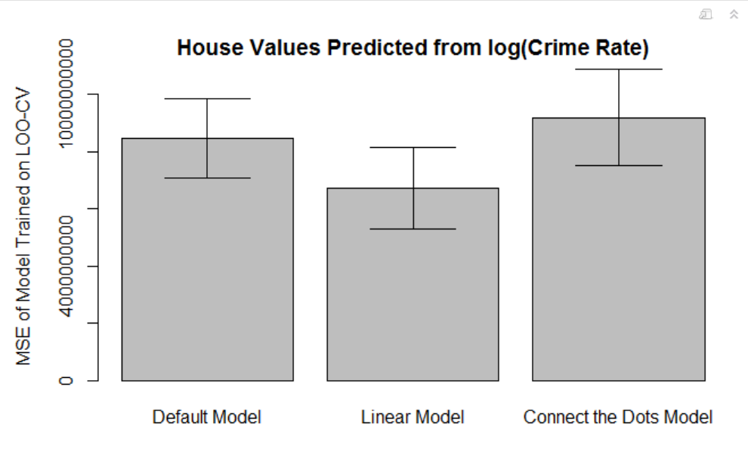
*Note that the bar chart represents the mean value from the Leave One Out Cross Validation. There was a little confusion from discussion on Piazza.
The Connect the Dots model produced the largest confidence interval, as well as the largest mean of MSE values. The Default Model, which we would like to treat as our “naïve case”, selected the smallest confidence interval. The Linear Model on the other hand predicted the smallest average value.
More clearly, the least error comes from the Linear model. This is logical due to how the Linear model is built – with the intention of minimizing least squares error.

