Slide 1
Clipping
Aaron Bloomfield
CS 445: Introduction to Graphics
Fall 2006
(Slide set originally by David Luebke)

Slide 2
Outline
Review
Clipping Basics
Cohen-Sutherland Line Clipping
Clipping Polygons
Sutherland-Hodgman Clipping
Perspective Clipping

Slide 3
Recap: Homogeneous Coords
Intuitively:
  The w coordinate of a homogeneous point is
  typically 1
  Decreasing w makes the point “bigger”, meaning further from the origin
  Homogeneous points with w = 0 are thus “points at infinity”, meaning infinitely far away in some direction. (What direction?)
  To help illustrate this, imagine subtracting two homogeneous points: the result is (as expected) a vector

Slide 4
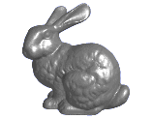
Recap: Perspective Projection
When we do 3-D graphics, we think of the
screen as a 2-D window onto the 3-D world:
How tall should
this bunny be?

Slide 5
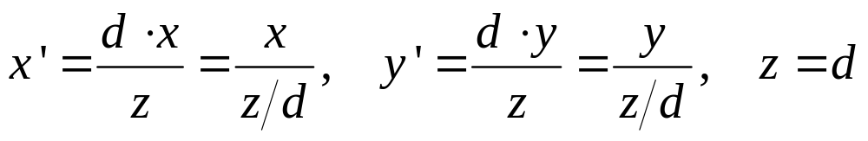
Recap: Perspective Projection
The geometry of the situation:
Desired
result:
X
View
plane
P (x, y, z)
(0,0,0)
x’ = ?
Z
d

Slide 6
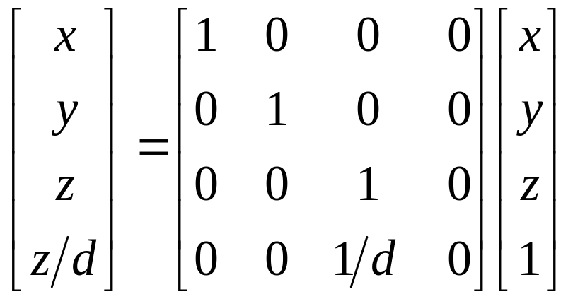
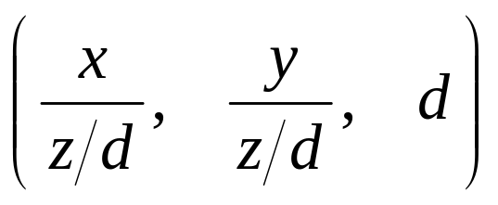
Recap: Perspective Projection Matrix
Example:
Or, in 3-D coordinates:

Slide 7
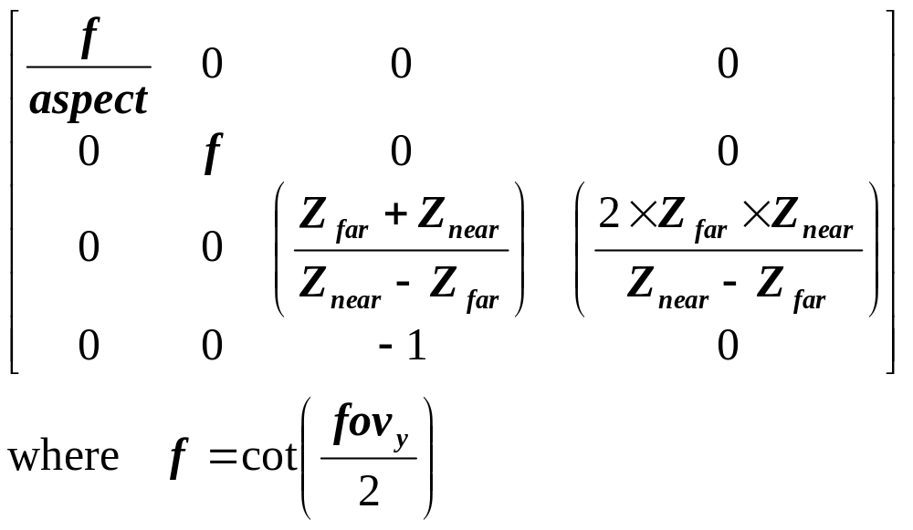
Recap: OpenGL’s Persp. Proj. Matrix
OpenGL’s gluPerspective() command generates a slightly more complicated matrix:
  Can you figure out what this matrix does?

Slide 8
Projection Matrices
Now that we can express perspective foreshortening as a matrix, we can composite it onto our other matrices with the usual matrix multiplication
End result: can create a single matrix encapsulating modeling, viewing, and projection transforms
  Though you will recall that in practice OpenGL separates the modelview from projection matrix (why?)

Slide 9
Outline
Review
Clipping Basics
Cohen-Sutherland Line Clipping
Clipping Polygons
Sutherland-Hodgman Clipping
Perspective Clipping

Slide 10
Next Topic: Clipping
We’ve been assuming that all primitives (lines, triangles, polygons) lie entirely within the viewport
In general, this assumption will not hold

Slide 11
Clipping
Analytically calculating the portions of primitives within the viewport

Slide 12
Why Clip?
Bad idea to rasterize outside of framebuffer bounds
Also, don’t waste time scan converting pixels outside window

Slide 13
Clipping
The naïve approach to clipping lines:
  for each line segment
  for each edge of viewport
  find intersection points
  pick “nearest” point
  if anything is left, draw it
What do we mean by “nearest”?
How can we optimize this?

Slide 14
Trivial Accepts
Big optimization: trivial accept/rejects
How can we quickly determine whether a line segment is entirely inside the viewport?
A: test both endpoints.
x_{min}
x_{max}
y_{max}
y_{min}

Slide 15
Trivial Rejects
How can we know a line is outside viewport?
A: if both endpoints on wrong side of same edge, can trivially reject line
x_{min}
x_{max}
y_{max}
y_{min}

Slide 16
Outline
Review
Clipping Basics
Cohen-Sutherland Line Clipping
Clipping Polygons
Sutherland-Hodgman Clipping
Perspective Clipping

Slide 17
Cohen-Sutherland Line Clipping
Divide viewplane into regions defined by viewport edges
Assign each region a 4-bit outcode:
x_{min}
x_{max}
1001
1000
1010
y_{max}
0001
0000
0010
y_{min}
0101
0100
0110

Slide 18
Cohen-Sutherland Line Clipping
To what do we assign outcodes?
How do we set the bits in the outcode?
How do you suppose we use them?
x_{min}
x_{max}
1001
1000
1010
y_{max}
0001
0000
0010
y_{min}
0101
0100
0110

Slide 19
Cohen-Sutherland Line Clipping
Set bits with simple tests
  x > x_{max} y < y_{min} etc.
Assign an outcode to each vertex of line
  If both outcodes = 0, trivial accept
  bitwise AND vertex outcodes together
  If result ≠ 0, trivial reject
    As those lines lie on one
    side of the boundary lines
1001
1000
1010
y_{max}
0001
0000
0010
y_{min}
0101
0100
0110

Slide 20
Cohen-Sutherland Line Clipping
If line cannot be trivially accepted or rejected, subdivide so that one or both segments can be discarded
Pick an edge that the line crosses (how?)
Intersect line with edge (how?)
Discard portion on wrong side of edge and assign outcode to new vertex
Apply trivial accept/reject tests; repeat if necessary

Slide 21
Cohen-Sutherland Line Clipping
Outcode tests and line-edge intersects are quite fast (how fast?)
But some lines require multiple iterations:
  Clip top
  Clip left
  Clip bottom
  Clip right
Fundamentally more efficient algorithms:
  Cyrus-Beck uses parametric lines
  Liang-Barsky optimizes this for upright volumes

Slide 22
Outline
Review
Clipping Basics
Cohen-Sutherland Line Clipping
Clipping Polygons
Sutherland-Hodgman Clipping
Perspective Clipping

Slide 23
Clipping Polygons
We know how to clip a single line segment
  How about a polygon in 2D?
  How about in 3D?
Clipping polygons is more complex than clipping the individual lines
  Input: polygon
  Output: polygon, or nothing
When can we trivially accept/reject a polygon as opposed to the line segments that make up the polygon?

Slide 24
Why Is Clipping Hard?
What happens to a triangle during clipping?
Possible outcomes:
Triangle→triangle
Triangle→quad
Triangle→5-gon
How many sides can a clipped triangle have?

Slide 25
Why Is Clipping Hard?
A really tough case:

Slide 26
Why Is Clipping Hard?
A really tough case:
concave polygon→multiple polygons

Slide 27
Outline
Review
Clipping Basics
Cohen-Sutherland Line Clipping
Clipping Polygons
Sutherland-Hodgman Clipping
Perspective Clipping

Slide 28
Sutherland-Hodgman Clipping
Basic idea:
  Consider each edge of the viewport individually
  Clip the polygon against the edge equation
  After doing all planes, the polygon is fully clipped

Slide 29
Sutherland-Hodgman Clipping
Basic idea:
  Consider each edge of the viewport individually
  Clip the polygon against the edge equation
  After doing all planes, the polygon is fully clipped

Slide 30
Sutherland-Hodgman Clipping
Basic idea:
  Consider each edge of the viewport individually
  Clip the polygon against the edge equation
  After doing all planes, the polygon is fully clipped

Slide 31
Sutherland-Hodgman Clipping
Basic idea:
  Consider each edge of the viewport individually
  Clip the polygon against the edge equation
  After doing all planes, the polygon is fully clipped

Slide 32
Sutherland-Hodgman Clipping
Basic idea:
  Consider each edge of the viewport individually
  Clip the polygon against the edge equation
  After doing all planes, the polygon is fully clipped

Slide 33
Sutherland-Hodgman Clipping
Basic idea:
  Consider each edge of the viewport individually
  Clip the polygon against the edge equation
  After doing all planes, the polygon is fully clipped

Slide 34
Sutherland-Hodgman Clipping
Basic idea:
  Consider each edge of the viewport individually
  Clip the polygon against the edge equation
  After doing all planes, the polygon is fully clipped

Slide 35
Sutherland-Hodgman Clipping
Basic idea:
  Consider each edge of the viewport individually
  Clip the polygon against the edge equation
  After doing all planes, the polygon is fully clipped

Slide 36
Sutherland-Hodgman Clipping
Basic idea:
  Consider each edge of the viewport individually
  Clip the polygon against the edge equation
  After doing all planes, the polygon is fully clipped

Slide 37
Sutherland-Hodgman Clipping
Basic idea:
  Consider each edge of the viewport individually
  Clip the polygon against the edge equation
  After doing all planes, the polygon is fully clipped
Will this work for non-rectangular clip regions?
What would
3-D clipping
involve?

Slide 38
Sutherland-Hodgman Clipping
Input/output for algorithm:
  Input: list of polygon vertices in order
  Output: list of clipped polygon vertices consisting of old vertices (maybe) and new vertices (maybe)
Note: this is exactly what we expect from the clipping operation against each edge
This algorithm generalizes to 3-D
  Show movie…

Slide 39
Sutherland-Hodgman Clipping
We need to be able to create clipped polygons from the original polygons
Sutherland-Hodgman basic routine:
  Go around polygon one vertex at a time
  Current vertex has position p
  Previous vertex had position s, and it has been added to the output if appropriate

Slide 40
Sutherland-Hodgman Clipping
Edge from s to p takes one of four cases:
  (Purple line can be a line or a plane)
inside
outside
inside
outside
inside
outside
inside
outside
p
s
p
s
p
s
p
s
p output
i output
no output
i output
p output

Slide 41
Sutherland-Hodgman Clipping
Four cases:
  s inside plane and p inside plane
    Add p to output
    Note: s has already been added
  s inside plane and p outside plane
    Find intersection point i
    Add i to output
  s outside plane and p outside plane
    Add nothing
  s outside plane and p inside plane
    Find intersection point i
    Add i to output, followed by p

Slide 42
Point-to-Plane test
A very general test to determine if a point p is “inside” a plane P, defined by q and n:
  (p - q) • n < 0: p inside P
  (p - q) • n = 0: p on P
  (p - q) • n > 0: p outside P
q
q
q
n
n
n
p
p
p
P
P
P

Slide 43
Point-to-Plane Test
Dot product is relatively expensive
  3 multiplies
  5 additions
  1 comparison (to 0, in this case)
Think about how you might optimize or special-case this

Slide 44
Finding Line-Plane Intersections
Use parametric definition of edge:
  E(t) = s + t(p - s)
  If t = 0 then E(t) = s
  If t = 1 then E(t) = p
  Otherwise, E(t) is part way from s to p

Slide 45
Finding Line-Plane Intersections
Edge intersects plane P where E(t) is on P
  q is a point on P
  n is normal to P
  (E(t) - q) • n = 0
  (s + t(p - s) - q) • n = 0
  t = [(q - s) • n] / [(p - s) • n]
  The intersection point i = E(t) for this value of t

Slide 46
Line-Plane Intersections
Note that the length of n doesn’t affect result:
  t = [(q - s) • n] / [(p - s) • n]
Again, lots of opportunity for optimization

Slide 47
Outline
Review
Clipping Basics
Cohen-Sutherland Line Clipping
Clipping Polygons
Sutherland-Hodgman Clipping
Perspective Clipping

Slide 48
3-D Clipping
Before actually drawing on the screen, we have to clip (Why?)
Can we transform to screen coordinates first, then clip in 2D?
  Correctness: shouldn’t draw objects behind viewer
  What will an object with negative z coordinates do in our perspective matrix?

Slide 49
Recap: Perspective Projection Matrix
Example:
Or, in 3-D coordinates:
Multiplying by the projection matrix gets us the 3-D coordinates
The act of dividing x and y by z/d is called the homogeneous divide

Slide 50
Clipping Under Perspective
Problem: after multiplying by a perspective matrix and performing the homogeneous divide, a point at
(-8, -2, -10) looks the same as a point at (8, 2, 10).
Solution A: clip before multiplying the point by the projection matrix
  I.e., clip in camera coordinates
Solution B: clip after the projection matrix but before the homogeneous divide
  I.e., clip in homogeneous screen coordinates

Slide 51
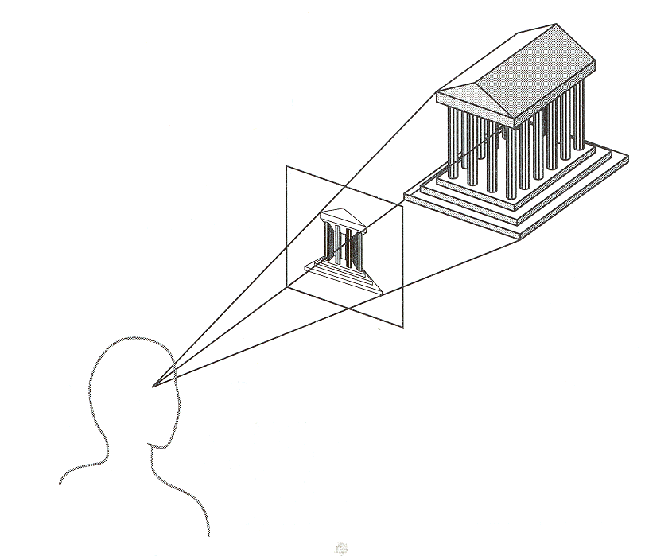
Clipping Under Perspective
We will talk first about solution A:
Clipped world
coordinates
Canonical screen
coordinates
Clip against
view volume
Apply projection
matrix and
homogeneous
divide
Transform into
viewport for
2-D display
3-D world
coordinate
primitives
2-D device
coordinates

Slide 52
Recap: Perspective Projection
The typical view volume is a frustum or truncated pyramid
x or y
z

Slide 53
Perspective Projection
The viewing frustum consists of six planes
The Sutherland-Hodgeman algorithm (clipping polygons to a region one plane at a time) generalizes to 3-D
  Clip polygons against six planes of view frustum
  So what’s the problem?
The problem: clipping a line segment to an arbitrary plane is relatively expensive
  Dot products and such

Slide 54
Perspective Projection
In fact, for simplicity we prefer to use the canonical view frustum:
x or y
1
Back or yon plane
Front or
hither plane
-1
z
Why is this going to be
simpler?
-1
Why is the yon plane
at z = -1, not z = 1?

Slide 55
Clipping Under Perspective
So we have to refine our pipeline model:
Note that this model forces us to separate projection from modeling & viewing transforms
Apply
normalizing
transformation
Clip against
canonical
view volume
projection
matrix;
homogeneous
divide
Transform into
viewport for
2-D display
3-D world
coordinate
primitives
2-D device
coordinates

Slide 56
Clipping Homogeneous Coords
Another option is to clip the homogeneous coordinates directly.
  This allows us to clip after perspective projection:
  What are the advantages?
Apply
projection
matrix
Clip
against
view
volume
Homogeneous
divide
Transform into
viewport for
2-D display
3-D world
coordinate
primitives
2-D device
coordinates

Slide 57
Clipping Homogeneous Coords
Other advantages:
  Can transform the canonical view volume for perspective projections to the canonical view volume for parallel projections
    Clip in the latter (only works in homogeneous coords)
    Allows an optimized (hardware) implementation
  Some primitives will have w ≠ 1
    For example, polygons that result from tesselating splines
    Without clipping in homogeneous coords, must perform divide twice on such primitives

Slide 58
Clipping Homogeneous Coords
So how do we clip homogeneous coordinates?
Briefly, thus:
  Remember that we have applied a transform to normalized device coordinates
    x, y  [-1, 1]
    z  [0, 1]
  When clipping to (say) right side of the screen (x = 1), instead clip to (x = w)
Can find details in book or on web

Slide 59
Clipping: The Real World
In some renderers, a common shortcut used to be:
But in today’s hardware, everybody just clips in homogeneous coordinates
Clip against
hither and
yon planes
Projection
matrix;
homogeneous
divide
Transform into
screen coordinates
Clip in 2-D screen coordinates

