Slide 1
2IV60 Computer graphics set 5: Viewing
Jack van Wijk
TU/e

Slide 2
Viewing
Transformation world→screen
Clipping: Removing parts outside screen
2D (chapter 8)
3D (chapter 10)

Slide 3
2D Viewing pipeline 1
World:
Screen:
Clipping window
Viewport
yw_{max}
yv_{max}
yw_{min}
yv_{min}
xw_{min}
xw_{max}
xv_{min}
xv_{max}
Clipping window:
What do we want to see?
Viewport:
Where do we want to see it?
H&B 8-1:258-259

Slide 4
2D Viewing pipeline 2
World:
Screen:
Clipping window
Viewport
yw_{max}
yv_{max}
yw_{min}
yv_{min}
xw_{min}
xw_{max}
xv_{min}
xv_{max}
Clipping window:
Panning…
H&B 8-2:259-261

Slide 5
2D Viewing pipeline 2
World:
Screen:
Clipping window
Viewport
yw_{max}
yv_{max}
yw_{min}
yv_{min}
xw_{min}
xw_{max}
xv_{min}
xv_{max}
Clipping window:
Panning…
H&B 8-2:259-261

Slide 6
2D Viewing pipeline 3
World:
Screen:
Viewport
yw_{max}
yv_{max}
yw_{min}
yv_{min}
xw_{min}
xw_{max}
xv_{min}
xv_{max}
Clipping window:
Zooming…
H&B 8-2:259-261

Slide 7
2D Viewing pipeline 3
World:
Screen:
yw_{max}
Viewport
yv_{max}
yv_{min}
yw_{min}
xw_{min}
xw_{max}
xv_{min}
xv_{max}
Clipping window:
Zooming…
H&B 8-2:259-261

Slide 8
2D Viewing pipeline 4
MC: Modeling Coordinates
WC: World Coordinates
VC: Viewing Coordinates
NC: Normalized Coordinates
DC: Device Coordinates
Apply model transformations
Determine visible parts
To standard coordinates
Clip and determine pixels
H&B 8-2:259-261

Slide 9

Clipping window
Clipping window
yw_{max}
yw_{max} − yw_{min}
yw_{min}
xw_{min}
xw_{max}
xw_{max}− xw_{min}
Clipping window usually an axis-aligned rectangle
Sometimes rotation
From world to view coordinates:
possibly followed by rotation
More complex in 3D
H&B 8-2:259-261

Slide 10
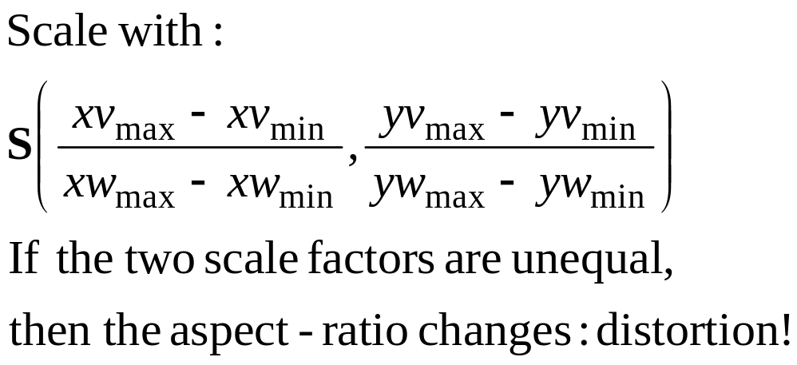
To normalized coordinates 1
yw_{max} -yw_{min}
yv_{max} -yv_{min}
xw_{max}-xw_{min}
xv_{max}-xv_{min}
H&B 8-3:261-265

Slide 11
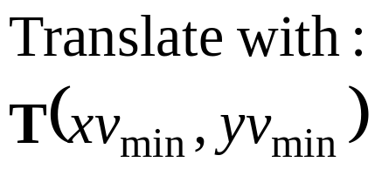
To normalized coordinates 2
1
Viewport
yv_{max}
yv_{max} -yv_{min}
yv_{min}
xv_{max}-xv_{min}
xv_{min}
xv_{max}
1
H&B 8-3:261-265

Slide 12
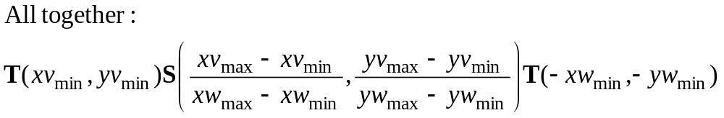
To normalized coordinates 3
Clipping window
1
yw_{max}
Viewport
yv_{max}
yw_{min}
yv_{min}
xw_{min}
xw_{max}
xv_{min}
xv_{max}
1
H&B 8-3:261-265

Slide 13
OpenGL 2D Viewing 1
Specification of 2D Viewing in OpenGL:
Standard pattern, follows terminology.
First, this is about projection. Hence, select and the Projection Matrix (instead of the ModelView matrix) with:
glMatrixMode(GL_PROJECTION);
H&B 8-4:265-267

Slide 14
OpenGL 2D Viewing 2
Next, specify the 2D clipping window:
gluOrtho2D(xwmin, xwmax, ywmin, ywmax);
xwmin, xwmax: horizontal range, world coordinates
ywmin, ywmax: vertical range, world coordinates
ywmax
ywmin
xwmin
xwmax
H&B 8-4:265-267

Slide 15
OpenGL 2D Viewing 3
Finally, specify the viewport:
glViewport(xvmin, yvmin, vpWidth, vpHeight);
xvmin, yvmin: coordinates lower left corner (in pixel coordinates);
vpWidth, vpHeight: width and height (in pixel coordinates);
vpHeight
vpWidth
(xvmin, yvmin)
H&B 8-4:265-267

Slide 16
OpenGL 2D Viewing 4
In short:
glMatrixMode(GL_PROJECTION);
gluOrtho2D(xwmin, xwmax, ywmin, ywmax);
glViewport(xvmin, yvmin, vpWidth, vpHeight);
To prevent distortion, make sure that:
(ywmax – ywmin)/(xwmax – xwmin) = vpWidth/vpHeight
H&B 8-4:265-267

Slide 17
Clipping
Clipping window
yw_{max}
yw_{min}
xw_{min}
xw_{max}
Clipping: removing parts outside clipping window
Many algorithms: points, lines, fill-area, curves,…
H&B 8-5:274

Slide 18
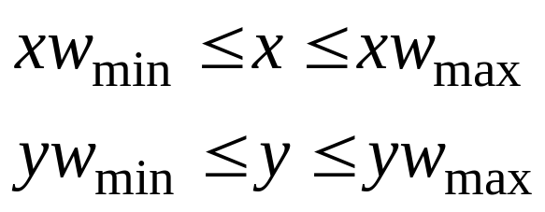
2D Point Clipping
Clipping window
yw_{max}
yw_{min}
xw_{min}
xw_{max}
Trivial: Save point P = (x,y) if it’s in the box:
H&B 8-5:274-275

Slide 19
2D Line Clipping 1
yw_{max}
yw_{min}
xw_{min}
xw_{max}
H&B 8-6:275-281

Slide 20
2D Line Clipping 2
yw_{max}
Basic algorithm:
Determine interval (u₀, u₁) in
rectangle, by calculating
crossings with edges of window.
Q
u
yw_{min}
P
xw_{min}
xw_{max}
Line segment:
X(u) = P + u (Q−P),
with 0 <= u <= 1
H&B 8-6:275-281

Slide 21
2D Line Clipping 3
u₀ := 0; u₁ = 1;
(* Right side: *)
If Px=Qx then
If Px > xw_{max} then return empty
else
u := (xw_{max} – Px)/(Qx-Px)
if Px < Qx then
begin if u < u₁ then u₁ := u end
else if u > u₀ then u₀ := u;
If u₀ > u₁ then return empty
yw_{max}
Q
u
u₁
yw_{min}
P
xw_{min}
xw_{max}
Line segment:
X(u) = P + u (Q-P),
with 0 <= u <= 1
H&B 8-6:275-281

Slide 22
2D Line Clipping 4
(* Left side: *)
If Px=Qx then
If Px < xw_{min} then return empty
else
u := (xw_{min} – Px)/(Qx-Px)
if Px < Qx then
begin if u > u₀ then u₀ := u end
else if u < u₁ then u₁ := u;
If u₀ > u₁ then return empty
(* Lower and upper side idem *)
yw_{max}
Q
u
u₁
yw_{min}
P
xw_{min}
xw_{max}
Line segment:
X(u) = P + u (Q-P),
with 0 <= u <= 1
H&B 8-6:275-281

Slide 23
2D Line Clipping 5
yw_{max}
yw_{min}
xw_{min}
xw_{max}
Expensive: calculation crossings
Avoid this by using position end points
For instance: If end points in window, then line in window
H&B 8-6:275-281

Slide 24
2D Line Clipping 6
1000 1010
0001 0000 0010
0101 0100 0110
yw_{max}
bit 4 bit 3 bit 2 bit 1
Top Right
Bottom Left
yw_{min}
xw_{min}
xw_{max}
Cohen-Sutherland algorithm:
Assign to each point a four-bit region code C;
1 is outside, 0 is inside
H&B 8-6:275-281

Slide 25
2D Line Clipping 7
1000 1010
0001 0000 0010
0101 0100 0110
yw_{max}
bit 4 bit 3 bit 2 bit 1
Top Right
Bottom Left
yw_{min}
xw_{min}
xw_{max}
Fast test on status end points line with codes C₀ en C₁ :
C₀ bitwise-or C₁ = 0000: then completely in;
C₀ bitwise-and C₁ <> 0000: then completely out;
Else: fast intersection-calculation using codes.
H&B 8-6:275-281

Slide 26
3D Viewing
Viewing: virtual camera
Projection
Depth
Visible lines and surfaces
Surface rendering
H&B 10-1:332-334

Slide 27
3D Viewing pipeline 1
Similar to making a photo
  Position and point virtuele camera, press button;
Projection plane aka
Viewing plane
Pipeline has +/− same structure as in 2D
H&B 10-1:332-334

Slide 28
3D Viewing pipeline 2
MC: Modeling Coordinates
WC: World Coordinates
VC: Viewing Coordinates
PC: Projection Coordinates
NC: Normalized Coordinates
DC: Device Coordinates
Apply model transformations
To camera coordinates
Project
To standard coordinates
Clip and convert to pixels
H&B 10-2:334-335

Slide 29
3D viewing coordinates 1
z_{vp}
Specification of projection:
P₀ : View or eye point
P_{ref} : Center or look-at point
V: View-up vector (projection along vertical axis)
z_{vp} : positie view plane
y_{w}
P₀
N
V
P_{ref}
x_{w}
z_{w}
P₀, P_{ref} , V: define viewing coordinate system
Several variants possible
H&B 10-3:336-338

Slide 30
3D viewing coordinates 2
x_{view}
y_{view}
y_{w}
z_{view}
P₀
N
V
P_{ref}
x_{w}
z_{w}
P₀, P_{ref} , V: define viewing coordinate system
Several variants possible
H&B 10-4:338-340

Slide 31
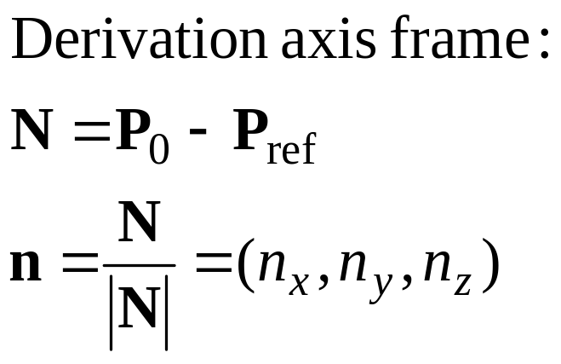
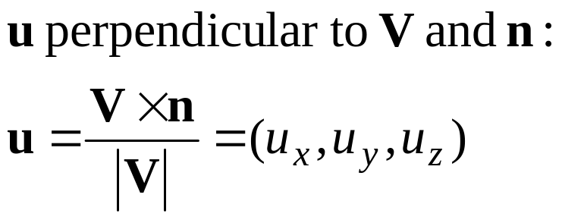
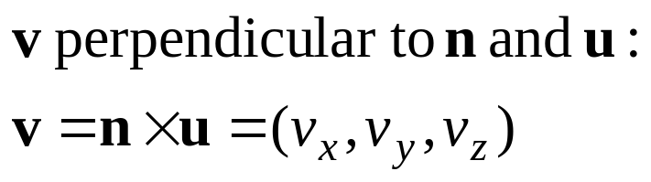
3D view coordinates 3
x_{view}
y_{view}
u
y_{w}
v
z_{view}
n
N
P₀
V
P_{ref}
x_{w}
z_{w}
H&B 10-4:338-340

Slide 32
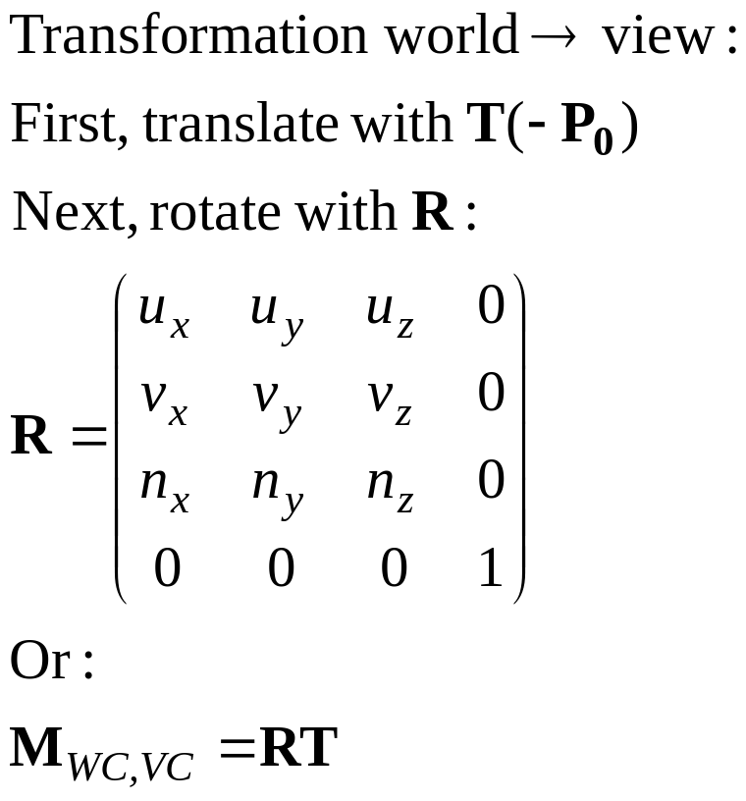
3D viewing coördinaten 4
x_{view}
y_{view}
u
y_{w}
v
z_{view}
n
N
P₀
V
P_{ref}
x_{w}
z_{w}
H&B 10-4:338-340

Slide 33
Projection transformations
View plane
View plane
P₂
P₂
P₁
P’₂
P’₂
P₁
P’₁
P’₁
Parallel projection
Perspective projection
H&B 10-6:340-345

Slide 34
Orthogonal projections 1
P₂
P’₂
Parallell projection:
Projection lines are parallel
Orthogonal projection:
Projection lines are parallel and
perpendicular to projection plane
Isometric projection:
Projection lines are parallel,
perpendicular to projection plane,
and have the same angle with axes.
P₁
P’₁
P₂
P₁
P’₂
P’₁
z
y
x
H&B 10-6:340-345

Slide 35
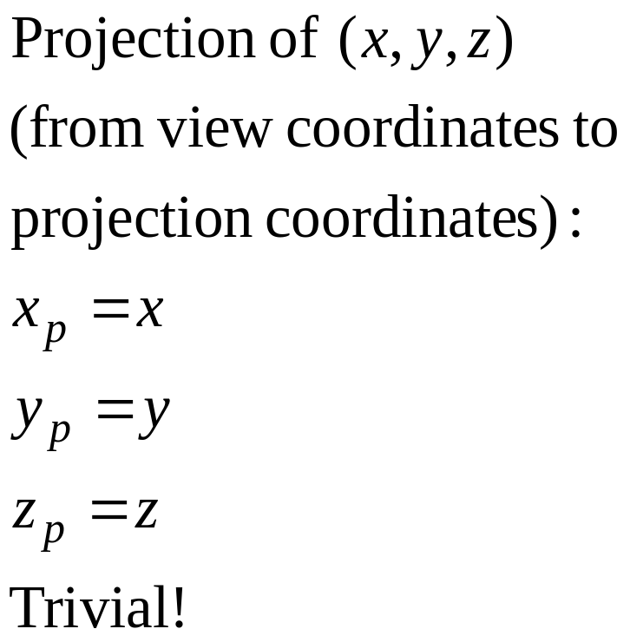
Orthogonal projections 2
P₂
Orthogonal projection:
P₁
P’₂
P’₁
H&B 10-6:340-345

Slide 36
Orthogonal projections 3
View volume
Clipping
window
y_{view}
x_{view}
Far plane
z_{view}
Near plane
H&B 10-6:340-345

Slide 37
Orthogonal projections 4
View volume
(xw_{max}, yw_{max}, z_{far})
y_{view}
x_{view}
z_{view}
(xw_{min}, yw_{min}, z_{near})
H&B 10-6:340-345

Slide 38
Orthogonal projections 4
(xw_{max}, yw_{max}, z_{far})
(1,1,1)
z_{norm}
y_{norm}
y_{view}
x_{norm}
x_{view}
z_{view}
(xw_{min}, yw_{min}, z_{near})
(-1,-1,-1)
View volume
Normalized View volume
Translation
Scaling
From right- to left handed
H&B 10-6:340-345

Slide 39
Perspective projection 1
View plane: z = z_{vp}
P₂
P₁
P’₂
Projection reference point
P’₁
y_{view}
x_{view}
z_{view}
View plane: orthogonal to z_{view} axis.
H&B 10-8:351-364

Slide 40
Perspective projection 2
View plane: z = z_{vp}
P = (x, y, z)
R: Projection reference point
(x_{p}, y_{p}, z_{p})
(x_{r}, y_{r}, z_{r})
y_{view}
To simplify,
Assume R in origin
x_{view}
z_{view}
Question: What is the projection of P
on the view plane?
H&B 10-8:351-364

Slide 41
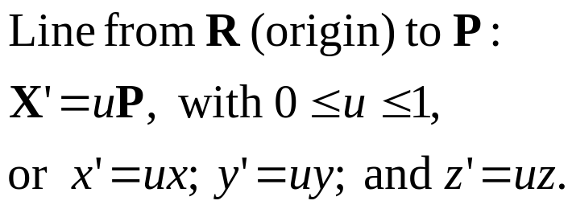
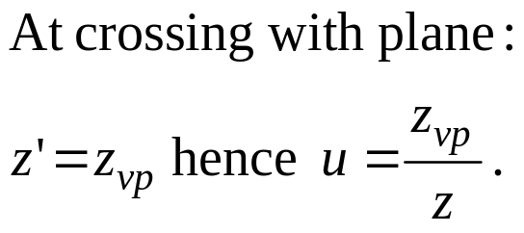
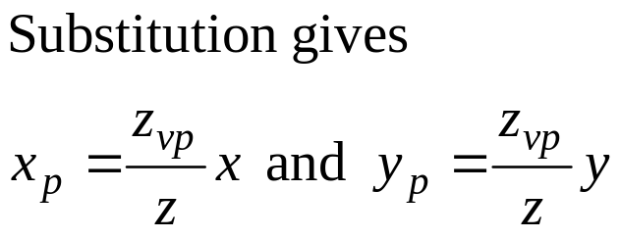
Perspective projection 3
View plane: z = z_{vp}
P = (x, y, z)
y_{view}
(x_{p}, y_{p}, z_{p})
x_{view}
R=
(0,0, 0)
z_{view}
H&B 10-8:351-364

Slide 42
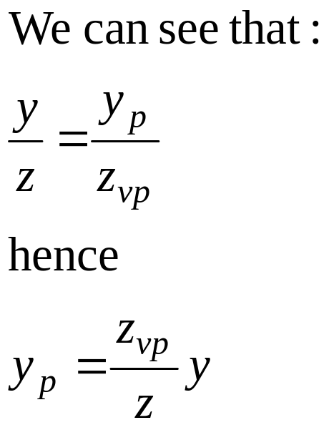
Perspective projection 4
P = (x, y, z)
View plane
y_{view}
y
y_{p}
R
z_{vp}
z_{view}
z
Viewed from the side
H&B 10-8:351-364

Slide 43
Perspective projection 5
Clipping window
in View plane
Ratio between
W=w_{max}−w_{min} and z_{vp}
determines strenght perspective
P = (x, y, z)
w_{max}
y_{view}
R
W
z_{vp}
z_{view}
w_{min}
Viewed from the side
H&B 10-8:351-364

Slide 44
Perspective projection 6
Clipping window
in View plane
Ratio between
W=w_{max}−w_{min} and z_{vp}
determines strenght perspective.
This ratio is 2tan(φ/2),
with φ the view angle.
y_{view}
R
φ
z_{view}
Viewed from the side
H&B 10-8:351-364

Slide 45
Perspective projection 7
y_{view}
R
z_{view}
H&B 10-8:351-364

Slide 46
Perspective projection 7
y_{view}
R
z_{view}
H&B 10-8:351-364

Slide 47
Perspective projection 7
R
H&B 10-8:351-364

Slide 48
Perspective projection 8
y_{view}
Option 1: Specify view angle φ.
R
φ
z_{view}
W
z_{vp}
How to specify the ratio between W en z_{vp}?
How to specify ‘how much’ perspective I want to see?
H&B 10-8:351-364

Slide 49
Perspective projection 9
y_{view}
R
24 mm
z_{view}
W
z_{vp}
f (mm)
Use camera as metaphor. User specifies focal length f .
(20 mm – wide angle, 50 mm – normal, 100 mm – tele).
Application adjusts W and/or z_{vp}, such that W/z_{vp} = 24/f.
For x: W/z_{vp} = 36/f.
H&B 10-8:351-364

Slide 50
View volume orthogonal…
View volume
Clipping
window
y_{view}
x_{view}
Far
clipping plane
z_{view}
Near
clipping plane
H&B 10-8:351-364

Slide 51
View volume perspective
View volume
Clipping
window
y_{view}
x_{view}
Far
clipping plane
R
z_{view}
Near
clipping plane
H&B 10-8:351-364

Slide 52
To Normalized Coordinates…
(1,1,1)
z_{norm}
y_{norm}
y_{view}
x_{norm}
x_{view}
R
z_{view}
(−1, −1, −1)
Rectangular frustum
View Volume
Normalized View volume
H&B 10-8:351-364

Slide 53
Perspective projection 10
y_{norm}
y_{view}
R
z_{norm}
z_{view}
Side view Front view
Perspective transformation:
Distort space, such that perpendicular projection gives
an image in perspective.
H&B 10-8:351-364

Slide 54
Perspective projection 10
y_{norm}
y_{view}
2r
R
z_{norm}
z_{view}
z_{n}
z_{f}
Simplest case:
Square window,
clipping plane coincides with view plane:
z_{n}=z_{vp}
H&B 10-8:351-364

Slide 55
Perspective projection 11
((z_{f} /z_{n})r, (z_{f} /z_{n})r, z_{f} )
y_{norm}
(1,1,1)
y_{view}
2r
R
z_{norm}
z_{view}
(-1,-1,-1)
(-r, -r, z_{n})
z_{n}
z_{f}
H&B 10-8:351-364

Slide 56
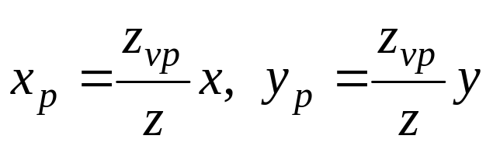
Perspective projection 11
(rz_{f} /z_{n}, rz_{f} /z_{n}, z_{f} )
y_{norm}
(1,1,1)
y_{view}
R
z_{norm}
z_{view}
(−1, −1, −1)
(−r, − r, z_{n})
Earlier:
How to put this transformation in the pipeline?
How to process division by z?
H&B 10-8:351-364

Slide 57
Homogeneous coordinates (reprise)
Add extra coordinate:
P = (p_{x} , p_{y} , p_{z} , p_{h}) or
x = (x, y, z, h)
Cartesian coordinates: divide by h
x = (x/h, y/h, z/h)
Points: h = 1 (temporary…)
perspective: h = −z !
H&B 10-8:351-364

Slide 58
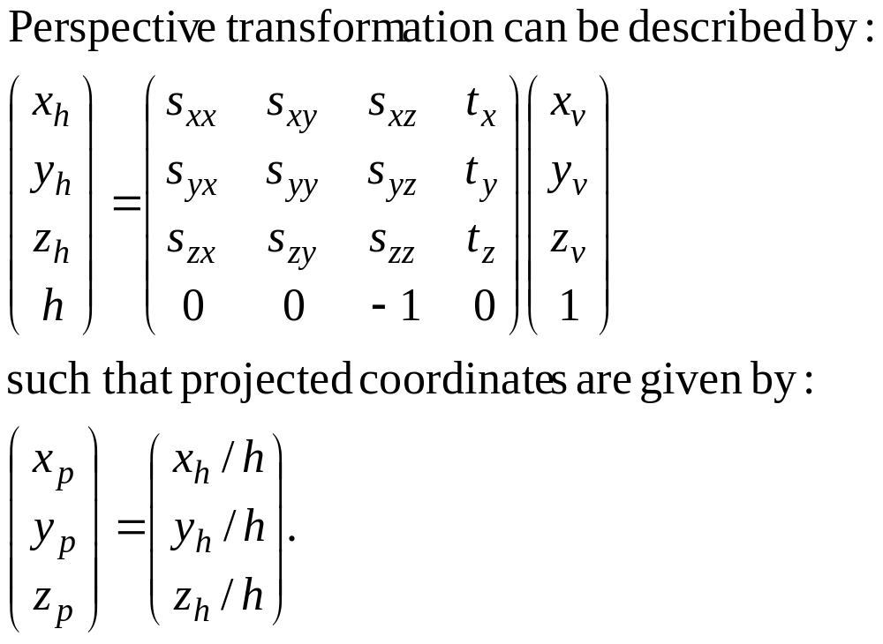
Homogeneous coordinates (reprise)
H&B 10-8:351-364

Slide 59
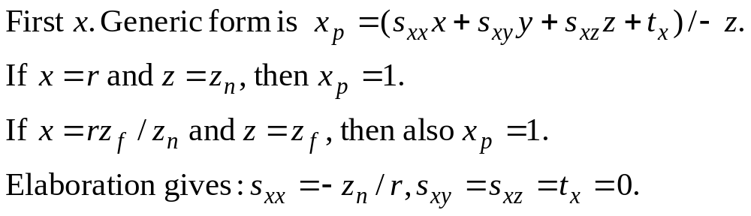
Perspective projection 12
(rz_{f} /z_{n}, rz_{f} /z_{n}, z_{f} )
y_{norm}
(r, r, z_{n})
(1,1,1)
x_{view}
R
z_{norm}
z_{view}
(−1, −1, −1)
(−r, −r, z_{n})
H&B 10-8:351-364

Slide 60
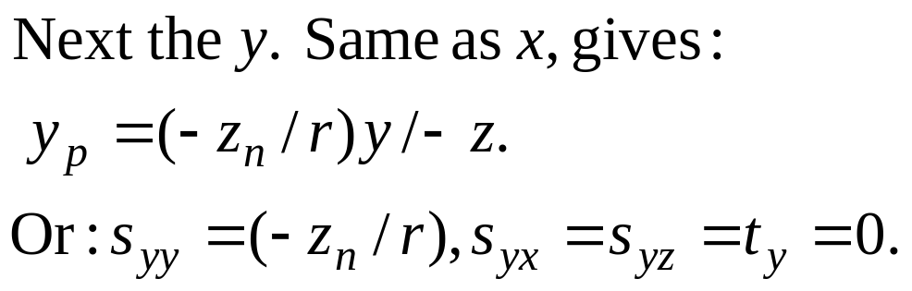
Perspective projection 13
(rz_{f} /z_{n}, rz_{f} /z_{n}, z_{f} )
y_{norm}
(1,1,1)
y_{view}
R
z_{norm}
z_{view}
(−1, −1, −1)
(−r, −r, −z_{n})
H&B 10-8:351-364

Slide 61
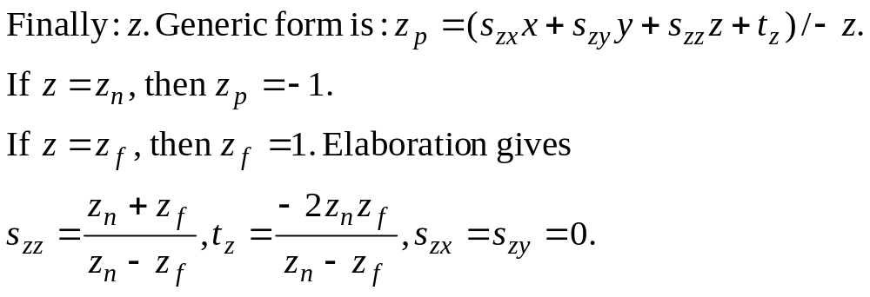
Perspective projection 14
(rz_{f} /z_{n}, rz_{f} /z_{n}, z_{f} )
y_{norm}
(1,1,1)
y_{view}
R
z_{norm}
z_{view}
(−1, −1, −1)
(−r, −r, z_{n})
H&B 10-8:351-364

Slide 62
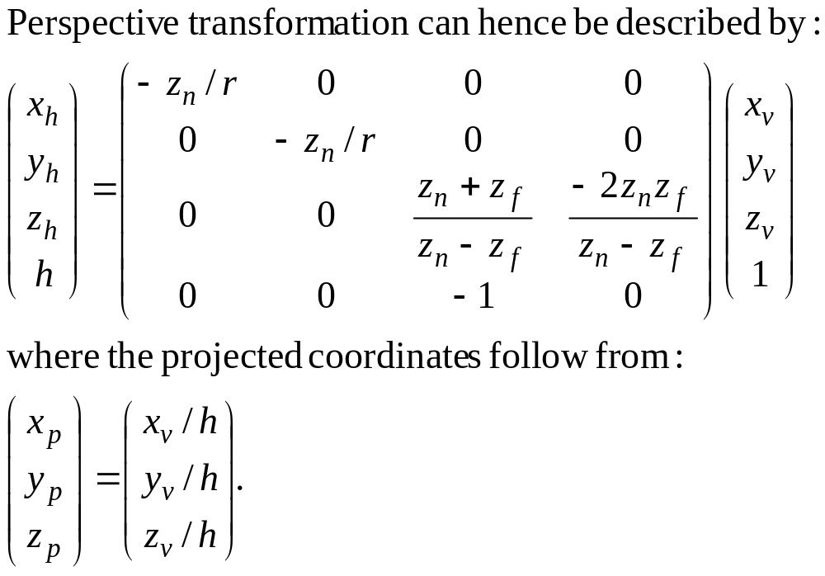
Perspective projection 15
H&B 10-8:351-364

Slide 63
3D Viewport coordinates 1
(1,1,1)
(xv_{max}, yv_{vmax}, 1)
y_{v}
z_{norm}
y_{norm}
z_{v}
x_{v}
x_{norm}
scaling
translation
(−1, −1, −1)
(xv_{min}, yv_{min}, 0)
Normalized View volume
3D screen
H&B 10-9:365-365

Slide 64
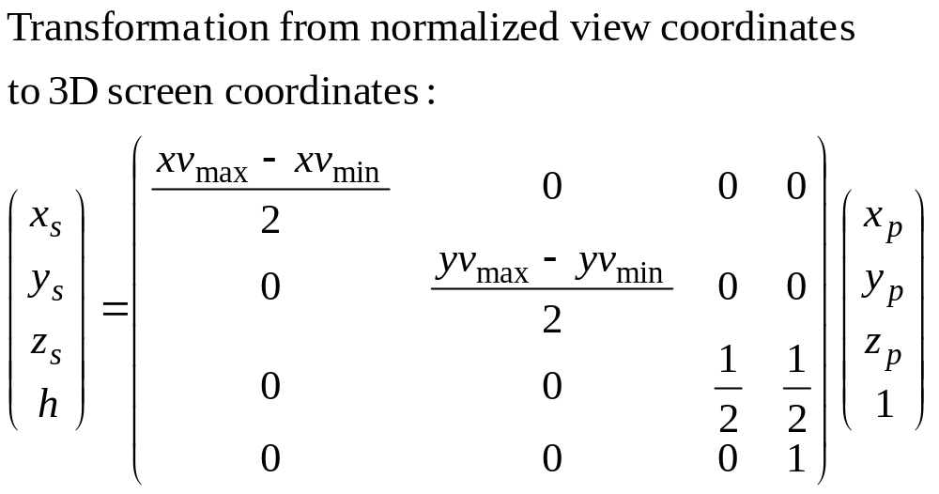
3D Viewport coordinaten 2
H&B 10-9:365-365

Slide 65
OpenGL 3D Viewing 1
3D Viewing in OpenGL:
Position camera;
Specify projection.
H&B 10-10:365-371

Slide 66
OpenGL 3D Viewing 2
View volume
y
x
z
Camera always in origin, in direction of negative z-axis.
Convenient for 2D, but not for 3D.
H&B 10-10:365-371

Slide 67
OpenGL 3D Viewing 3
Solution for view transform: Transform your model such that you look at it in a convenient way.
Approach 1: Do it yourself. Apply rotations, translations, scaling, etc., before rendering the model. Surprisingly difficult and error-prone.
Approach 2: Use gluLookAt();
H&B 10-10:365-371

Slide 68
OpenGL 3D Viewing 4
MatrixMode(GL_MODELVIEW);
gluLookAt(x0,y0,z0, xref,yref,zref, Vx,Vy,Vz);
x0,y0,z0: P₀, viewpoint, location of camera;
xref,yref,zref: P_{ref}, centerpoint;
Vx,Vy,Vz: V, view-up vector.
Default: P₀ = (0, 0, 0); P_{ref} = (0, 0, −1); V=(0, 1, 0).
H&B 10-10:365-371

Slide 69
OpenGL 3D Viewing 5
Orthogonal projection:
MatrixMode(GL_PROJECTION);
glOrtho(xwmin, xwmax, ywmin, ywmax, dnear, dfar);
xwmin, xwmax, ywmin,ywmax:
specification window
dnear: distance to near clipping plane
dfar : distance to far clipping plane
dfar
dnear
y
ywmax
x
Select dnear and dfar right:
dnear < dfar,
model fits between clipping planes.
z
ywmin
xwmax
xwmin
H&B 10-10:365-371

Slide 70
OpenGL 3D Viewing 6
Perspective projection:
MatrixMode(GL_PROJECTION);
glFrustrum(xwmin, xwmax, ywmin, ywmax, dnear, dfar);
xwmin, xwmax, ywmin,ywmax:
specification window
dnear: distance to near clipping plane
dfar : distance to far clipping plane
dfar
y
dnear
ywmax
x
Select dnear and dfar right:
0 < dnear < dfar,
model fits between clipping planes.
ywmin
z
xwmax
xwmin
Standard projection: xwmin = -xwmax,
ywmin = -ywmax
H&B 10-10:365-371

Slide 71
OpenGL 3D Viewing 7
Finally, specify the viewport (just like in 2D):
glViewport(xvmin, yvmin, vpWidth, vpHeight);
xvmin, yvmin: coordinates lower left corner (in pixel coordinates);
vpWidth, vpHeight: width and height (in pixel coordinates);
vpHeight
vpWidth
(xvmin, yvmin)
H&B 8-4:265-267

Slide 72
OpenGL 2D Viewing 8
In short:
glMatrixMode(GL_PROJECTION);
glFrustrum(xwmin, xwmax, ywmin, ywmax, dnear, dfar);
glViewport(xvmin, yvmin, vpWidth, vpHeight);
glMatrixMode(GL_MODELVIEW);
gluLookAt(x0,y0,z0, xref,yref,zref, Vx,Vy,Vz);
To prevent distortion, make sure that:
(ywmax – ywmin)/(xwmax – xwmin) = vpWidth/vpHeight
Make sure that you can deal with resize/reshape of the (OS) window.
H&B 8-4:265-267

Slide 73
Next…
We now know how to project objects.
But how to model objects?

