Slide 1
Internet Protocol
Presented By
Baljit Saini

Slide 2
INTRODUCTION
The Internet Protocol (IP) is the transmission mechanism used by the TCP/IP protocols at the network layer. IP is an unreliable and connectionless datagram protocol.

Slide 3
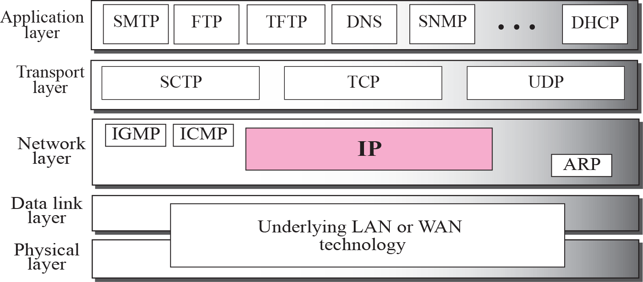
Position of IP in TCP/IP protocol suite

Slide 4
DATAGRAM
Packets in the network (internet) layer are called
datagrams.
A datagram is a variable-length packet consisting of two parts: header and data.
The header is 20 to 60 bytes in length and contains information essential to routing and delivery.

Slide 5
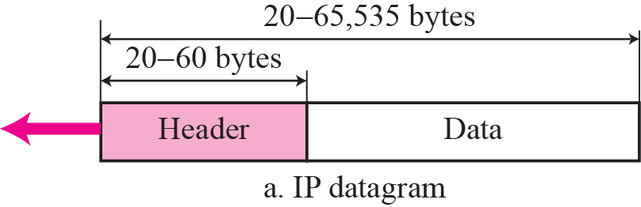
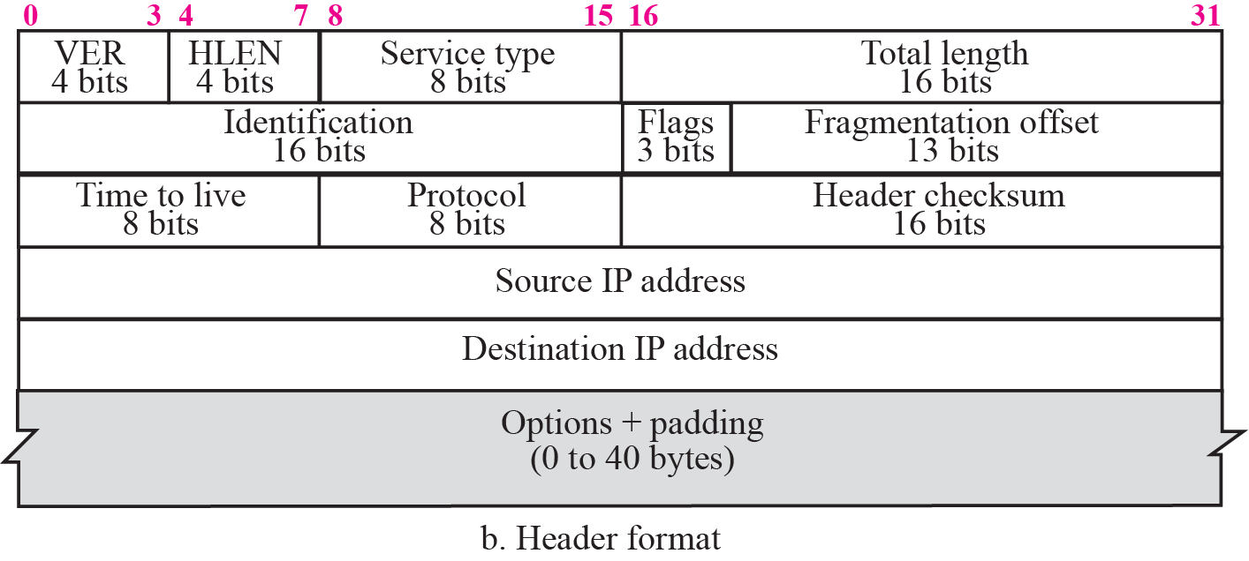
IP datagram

Slide 6
VER (4 bits): Version of the IP protocol in use (typically 4).
• HLEN (4 bits): Length of the header, expressed as the number of 32-bit words.
• Total Length (16 bits): Length in bytes of the datagram, including headers. Maximum datagram size is 65536 bytes.
• Service Type (8 bits): Allows packet to be assigned a priority. Router can use this field to route packets. Not universally used.
• Time to Live (8 bits): Prevents a packet from traveling forever in a loop. Senders sets a value, that is decremented at each hop. If it reaches zero, packet is discarded.
• Protocol: Defines the higher level protocol that uses the service of the IP layer
• Source IP address (32 bits): Internet address of the sender.
• Destination IP address (32 bits): Internet address of the destination.
• Identification, Flags, Fragment Offset: Used for handling fragmentation.
• Options (variable width): Can be used to provide more functionality to the IP datagram
• Header Checksum (16 bits):

Slide 7
Datagram
Version: this 4 bit field defines the version of the IP protocol
Header Length(HLEN):this 4 bit field defines the total length of the datagram header
Differentiated Services(DS):This is a 8bits field. Earlier it is called service type ,now is called differentiated services
Precedence TOS Bits
Service Type
D:minimize Delay T:Maximize throughput
R:Maximize reliability C:Minimize Cost
 |  |  | D | T | R | C

Slide 8
Service Type
Precedece:it is a 3-bit subfield ranging from 0 (000)to 7(111).it defines the priority of the datagram
TOS:it is a 4-bit subfield with each bit having a special meaning. Application programs can request a specific type of service
TOS bits | Description
0000 | Normal(Default)
0001 | Minimize Cost
0010 | Maximize reliability
0100 | Maximize throughput
1000 | Minimize delay

Slide 9
Differentiated Services
In this interpretation first 6 bits make up the code point subfield
Last 2 bits are not used
When 3 right most bits are 0’s.it is compatible with the old interpretation
When 3 right most bits are not all 0’s.then 6 bits define 64 services based on the priority assignment by the internet or local authorities

Slide 10
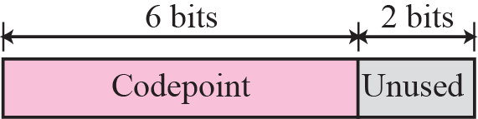
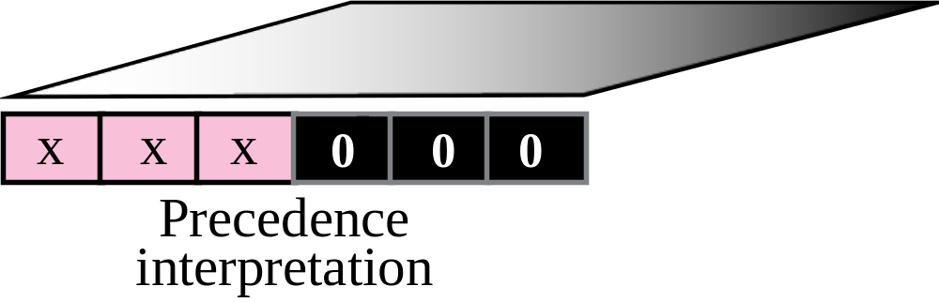
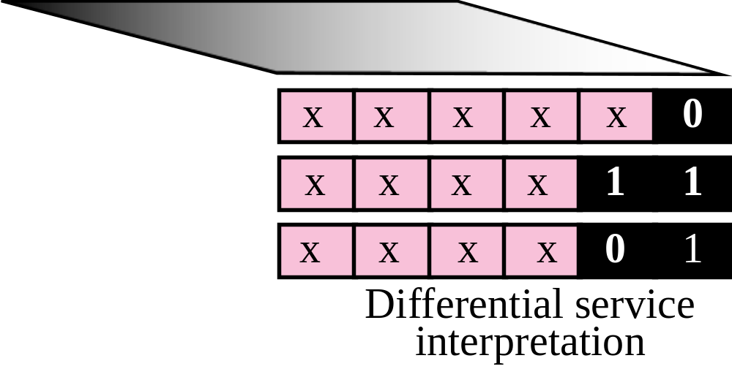
Service type

Slide 11
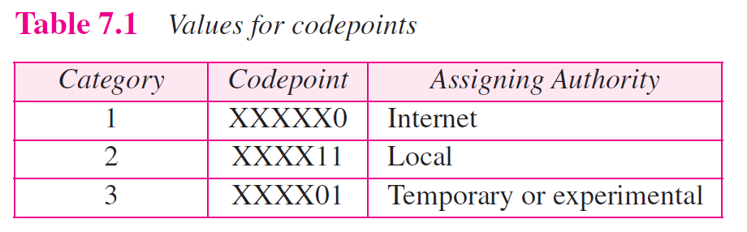

Slide 12
Total Length
This is a 16 bit field that defines the total length of the IP datagram in
Bytes
Total Length field is used to determine how much is really data and how much is padding
Total length field defines the total length of the datagram including the header

Slide 13
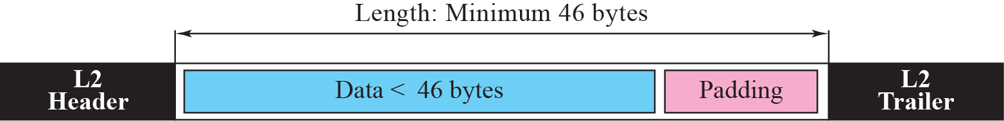
Encapsulation of a small datagram in an Ethernet frame

Slide 14
Datagram Format
Identification
Flags
Fragmentation offset
Time to Live: this field limits the lifetime of a datagram. This field hold a timestamp, which was decremented by each visited router. The datagram was discarded when the value became zero
checksum
Source address: define the 32 bit IP address of the source
Destination address: define 32 bit IP address of the destination
Protocols: this 8 bit field defines the higher level protocol that uses the services of the IP layer.IP datagram can encapsulate data from several higher level protocols such as TCP,UDP,ICMP ,IGMP

Slide 15
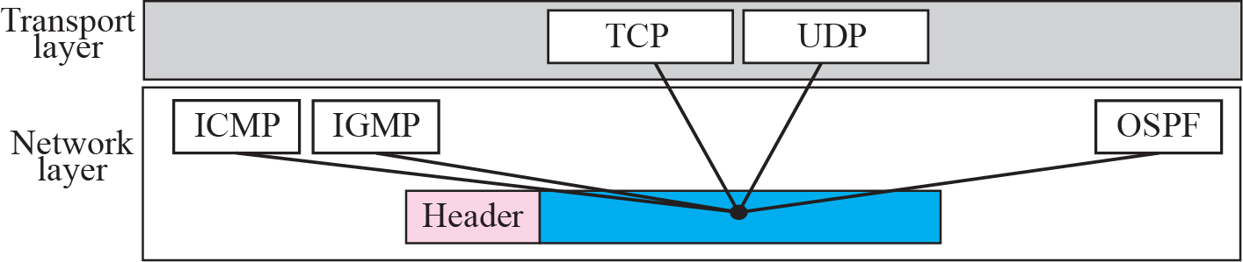
Multiplexing

Slide 16
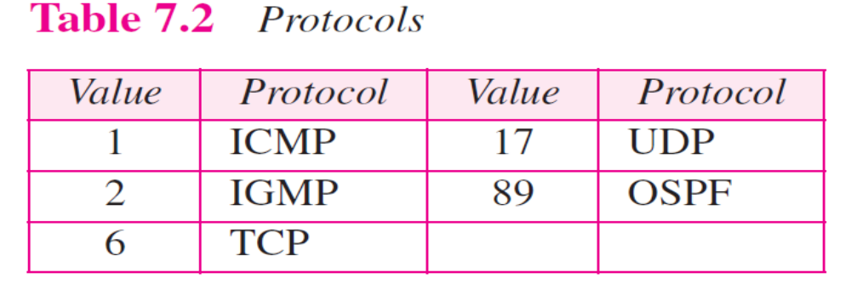
Value of protocol field for higher levels protocols

Slide 17
FRAGMENTATION
A datagram can travel through different networks. Each router decapsulates the IP datagram from the frame it receives, processes it, and then encapsulates it in another frame. The format and size of the received frame depend on the protocol used by the physical network through which the frame has just traveled. The format and size of the sent frame depend on the protocol used by the physical network through which the frame is going to travel.

Slide 18
Maximum transfer unit(MTU)
Each data link layer protocol has its own frame format in most protocols
One of the fields defined in the format is the maximum size of the data field
When a datagram is encapsulated in a frame ,the total size of the datagram must be less than the max size

Slide 19

Figure 7.6 MTU
TCP/IP Protocol Suite

Slide 20
MTU’s for some networks
PROTOCOL | MTU
Hyper channel | 65535
Token Ring(16Mbps) | 17914
Token ring(4Mbps) | 4464
FDDI | 4352
Ethernet | 1500
x.25 | 576
PPP | 296

Slide 21
Fragmentation
Datagram is divided to make it possible to pass it through physical networks. This is called fragmentation
Each fragment has its own header
Fragmented datagram may be itself fragmented if it encounters a network with an even smaller MTU.
datagram can be fragmented several times before it reaches the final destination
Fragmented datagram can travel through different routes

Slide 22

Note
Only data in a datagram is fragmented.
TCP/IP Protocol Suite

Slide 23
Fields related to Fragmentation
Host or router that fragments the datagram must change the
values of three fields:identification,Flags,fragmentation offset
Identification:
this 16 bit field identifies a datagram originating from source host
The combination of the identification and source address must uniquely define a datagram as it leaves the source host
When a datagram is fragmented the value in the identification field is copied into all fragments
Identification number helps the destination in reassembling the datagram

Slide 24
Fields related to Fragmentation(2)
Flags:
This is a3 bit field
First bit is reserved
Second bit is called don’t fragment bit.(if its value is 1),the machine must not fragment the datagrams,if it can’t pass the datagram through any physical network. It discards the datagram and sends an ICMP error message to the source host.
Third bit is called more fragment bit(if it is 1,it means datagram is not the last fragment, there are more fragments after this).if it is 0 means this is the last or only fragment

Slide 25

Figure 7.7 Flags field
TCP/IP Protocol Suite

Slide 26
Fields related to Fragmentation(3)
Fragmentation offset
This 13 bit field shows the relative position of this fragment with respect to the whole datagram
It is the offset of the data in the original datagram measured in 8 bytes. Length of the offset field is 13 bit long and can’t represent a sequence of bytes greater than 8191
Size of each fragment will be divisible by 8

Slide 27
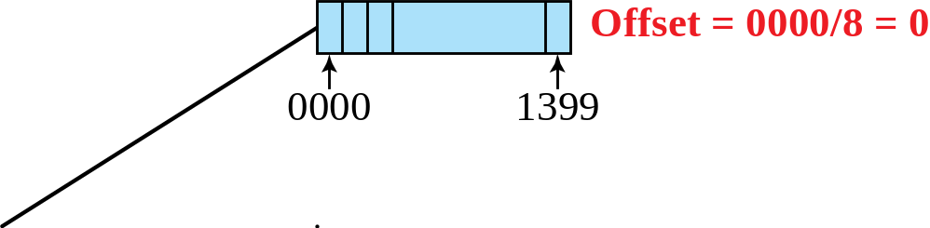
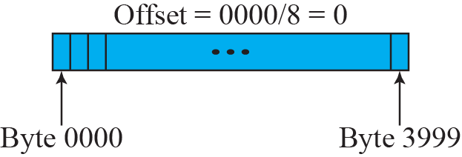
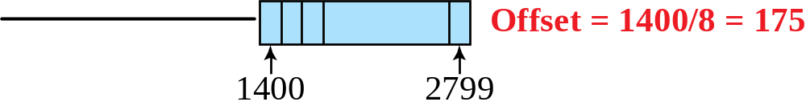
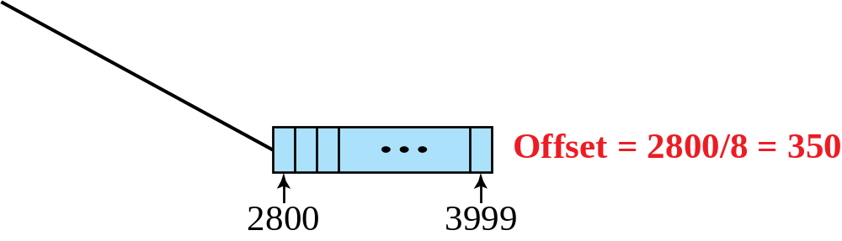
Figure 7.8 Fragmentation example
TCP/IP Protocol Suite

Slide 28
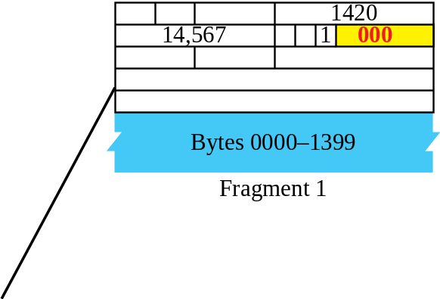
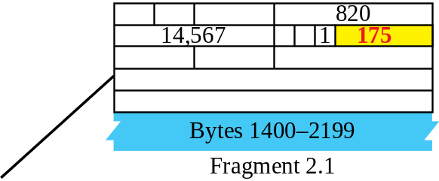
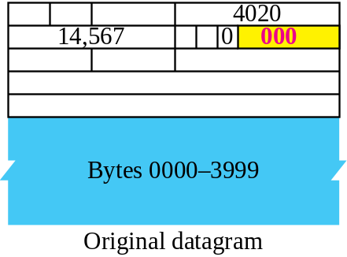
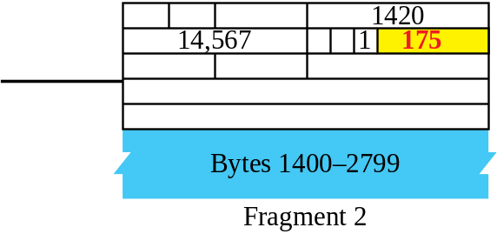
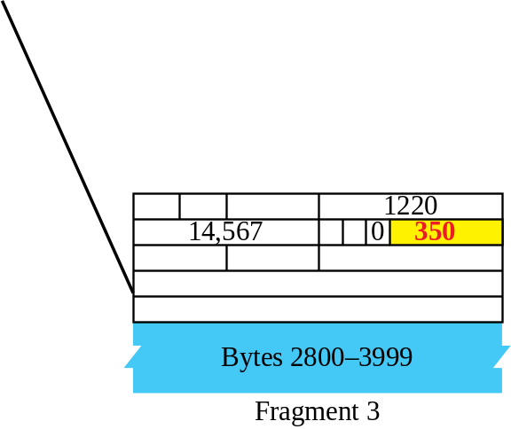
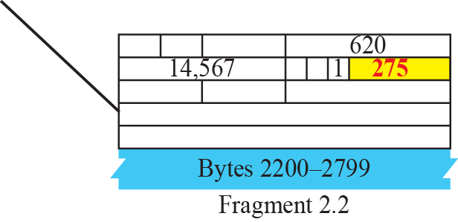
Figure 7.9 Detailed fragmentation example
TCP/IP Protocol Suite

Slide 29
7-4 OPTIONS
The header of the IP datagram is made of two parts: a fixed part and a variable part. The fixed part is 20 bytes long and was discussed in the previous section. The variable part comprises the options, which can be a maximum of 40 bytes.
Options, as the name implies, are not required for a datagram. They can be used for network testing and debugging. Although options are not a required part of the IP header, option processing is required of the IP software.

Slide 30
CHECKSUM
The error detection method used by most TCP/IP protocols is called the checksum. The checksum protects against the corruption that may occur during the transmission of a packet. It is redundant information added to the packet. The checksum is calculated at the sender and the value obtained is sent with the packet. The receiver repeats the same calculation on the whole packet including the checksum. If the result is satisfactory (see below), the packet is accepted; otherwise, it is rejected.

Slide 31
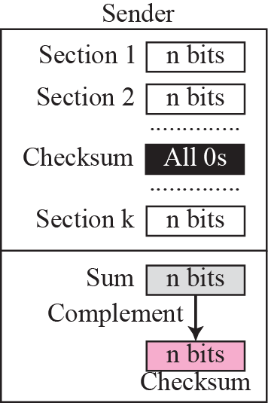
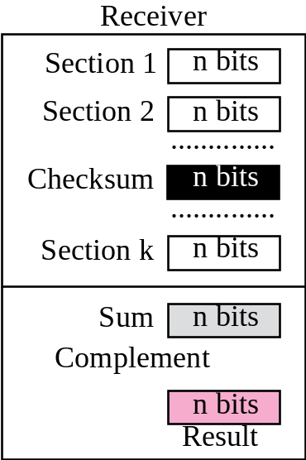
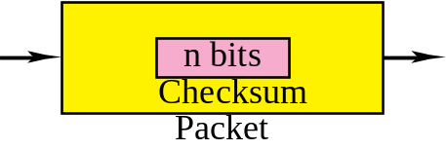

Figure 7.22 Checksum concept
TCP/IP Protocol Suite

Slide 32
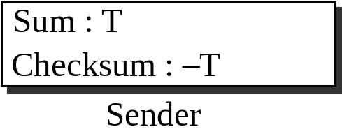
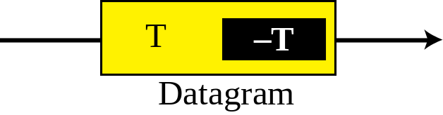
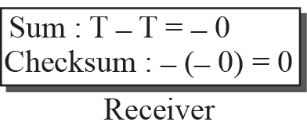
Figure 7.23 Checksum in one’s complement arithmetic
TCP/IP Protocol Suite

Slide 33
Checksum in IP packet
First value of checksum field is set to 0
Entire header is divided into 16sections and added together
Result is complemented and inserted into the checksum field

Slide 34
Checksum in IP covers only the header, not the data.
All higher level protocols that encapsulate data in the IP datagram have a checksum field that covers the whole packet
Header of the IP packet changes with each visited router but the data does not
Checksum include only the part that has changed

Slide 35
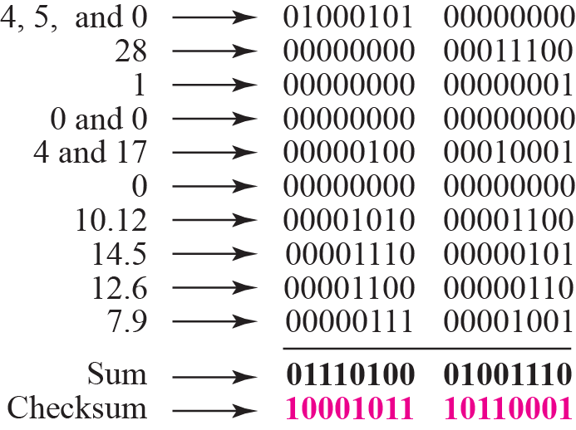
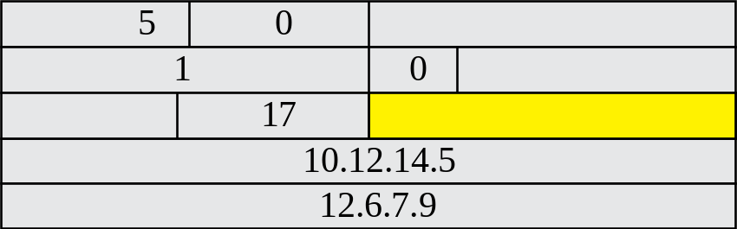
Figure 7.24 Example of checksum calculation at the sender
TCP/IP Protocol Suite
Notes:
Substitute for 012.6.7.917015010.12.14.50028Substitute for 012.6.7.917015010.12.14.50028Substitute for 0Substitute for 0

Slide 36
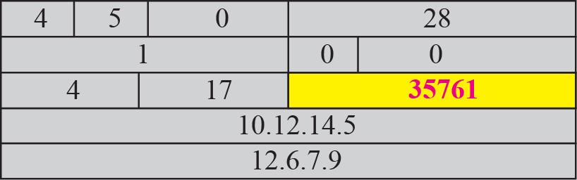
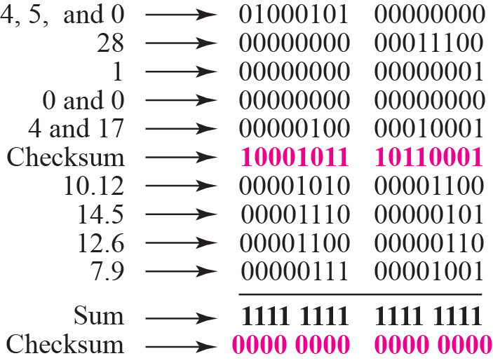
Figure 7.25 Example of checksum calculation at the receiver
TCP/IP Protocol Suite

Slide 37
Thank You

