Slide 1
Computer Graphics Viewing
Shmuel Wimer
Bar Ilan Univ., School of Engineering
May 2010

Slide 2








Clipping Window
World Coordinates
The clipping window is mapped into a viewport.
Viewing world has its own coordinates, which may be a non-uniform scaling of world coordinates.
Viewport
Viewport Coordinates
May 2010

Slide 3
2D viewing transformation pipeline
Construct World-Coordinate Scene From Modeling-Coordinate Transformations
Modeling Coordinates
World Coordinates
Convert World- Coordinates to Viewing- Coordinates
Viewing Coordinates
Transform Viewing-Coordinates to Normalized- Coordinates
Normalized Coordinates
Device Coordinates
Map Normalized- Coordinates to Device-Coordinates
May 2010

Slide 4
Normalization and Viewport Transformations
First approach:
  Normalization and window-to-viewport transformations are combined into one operation.
  Viewport range can be in [0,1] x [0,1].
  Clipping takes place in [0,1] x [0,1].
  Viewport is then mapped to display device.
Second approach:
  Normalization and clipping take place before viewport transformation.
  Viewport coordinates are specified in screen coordinates.
May 2010

Slide 5










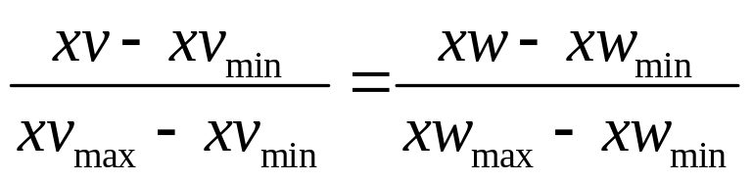
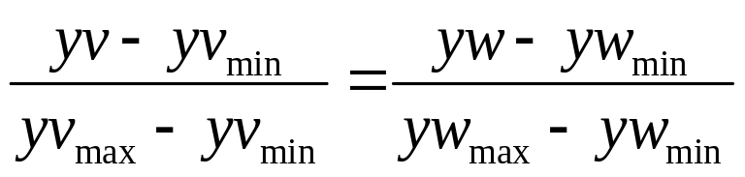
1
Clipping Window
Normalized Viewport
0
1
Maintain relative size and position between clipping window and viewport.
May 2010

Slide 6
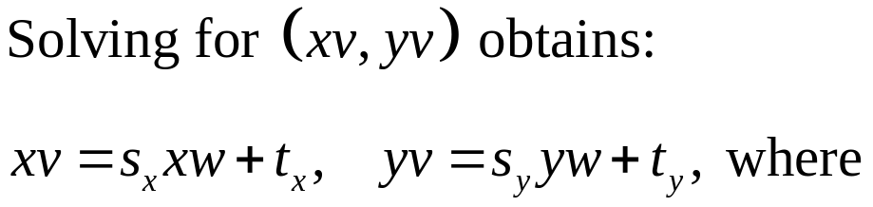
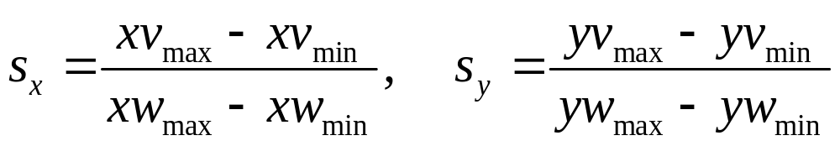
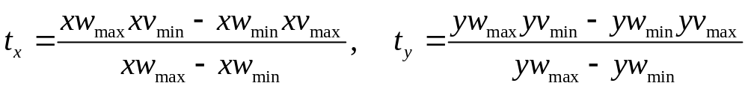
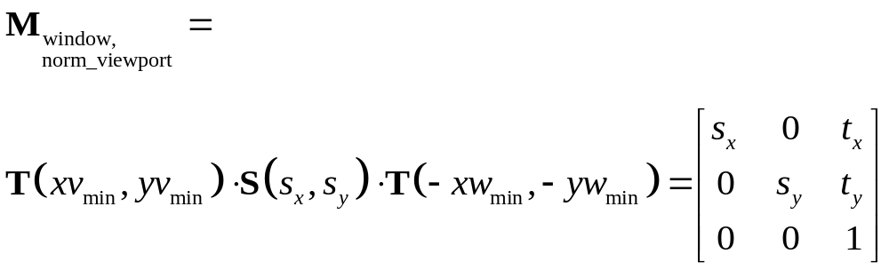
Scaling factors:
Translation factors:
This can also be obtained by composing transformations:
May 2010

Slide 7
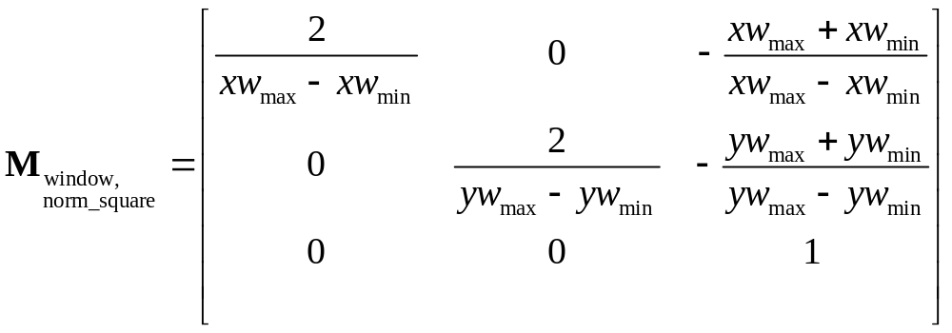
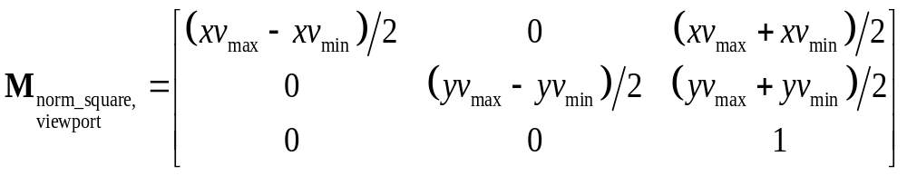
World clipping window can first be mapped to normalized square between -1 and +1, where clipping algorithm takes place, and then transform the scene into viewport given in display coordinates.
May 2010

Slide 8













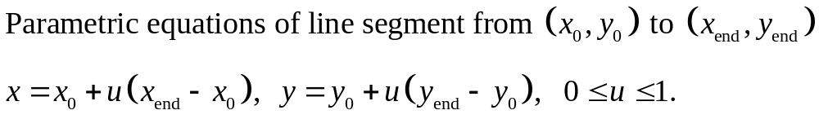
Clipping Algorithms
Before Clipping
After Clipping
May 2010

Slide 9
Cohen-Sutherland Line Clipping Algorithm
Intersection calculations are expensive. Find first lines completely inside or certainly outside clipping window. Apply intersection only to undecided lines.
Perform cheaper tests before proceeding to expensive intersection calculations.
May 2010

Slide 10
Cohen-Sutherland Line Clipping Algorithm
Assign code to every endpoint of line segment.
  Borderlines of clipping window divide the plane into two halves.
  A point can be characterized by a 4-bit code according to its location in half planes.
  Location bit is 0 if the point is in the positive half plane, 1 otherwise.
  Code assignment involves comparisons or subtractions.
Completely inside / certainly outside tests involve only logic operations of bits.
May 2010

Slide 11




Top bit
Bottom bit
Right bit
Left bit
1
0
0
1
1
0
0
0
1
0
1
0
0
0
0
1
0
0
0
0
0
0
1
0
0
1
0
1
0
1
0
0
0
1
1
0
Endpoint codes are 0000 for both iff line is completely inside.
If endpoint codes has 1 in same bit, line is certainly outside.
May 2010

Slide 12
Lines that cannot be decided are intersected with window border lines.
Each test clips the line and the remaining is tested again for full inclusion or certain exclusion, until remaining is either empty or fully contained.
Endpoints of lines are examined against left, right, bottom and top borders (can be any order).
May 2010

Slide 13








1
0
0
1
1
0
0
0
0
0
0
1
0
0
0
0
0
1
0
1
0
1
0
0
May 2010

Slide 14






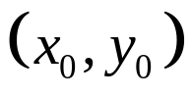

Liang-Barsky Line Clipping Algorithm
Treat undecided lines in Cohen-Sutherland more efficiently.
Define clipping window by intersections of four half-planes.
May 2010

Slide 15
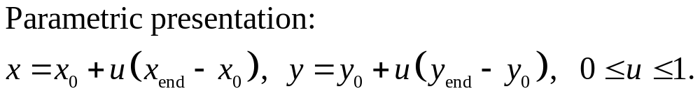
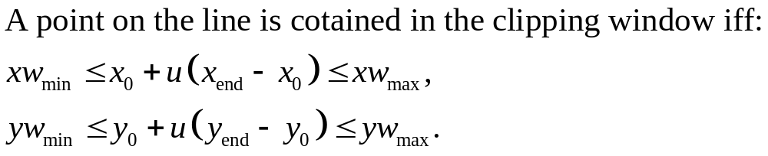
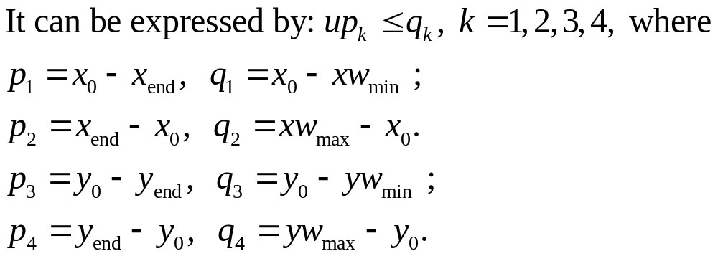
May 2010

Slide 16
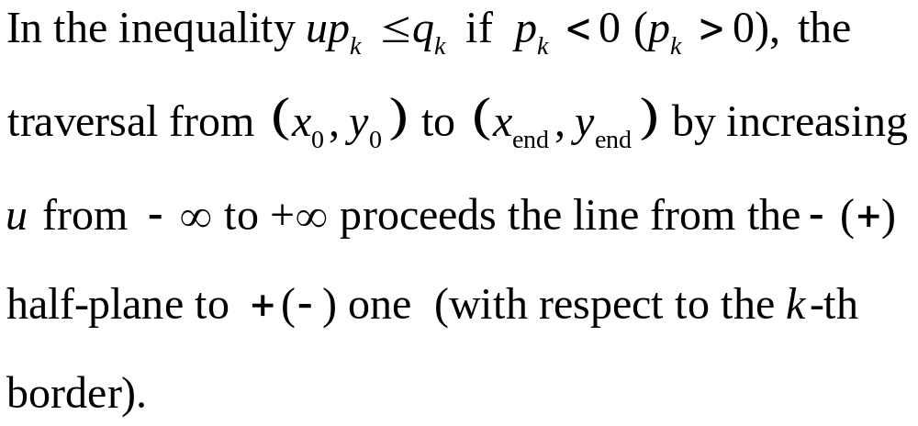
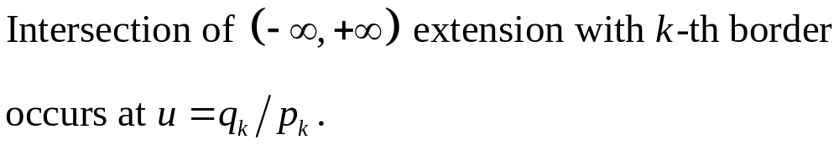
May 2010

Slide 17
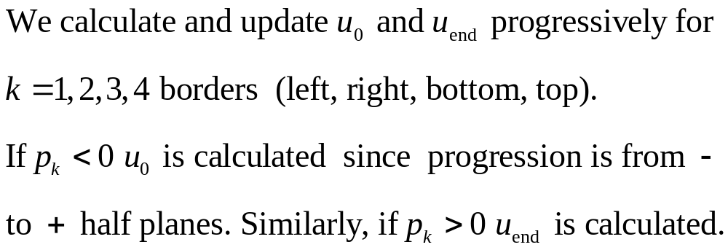
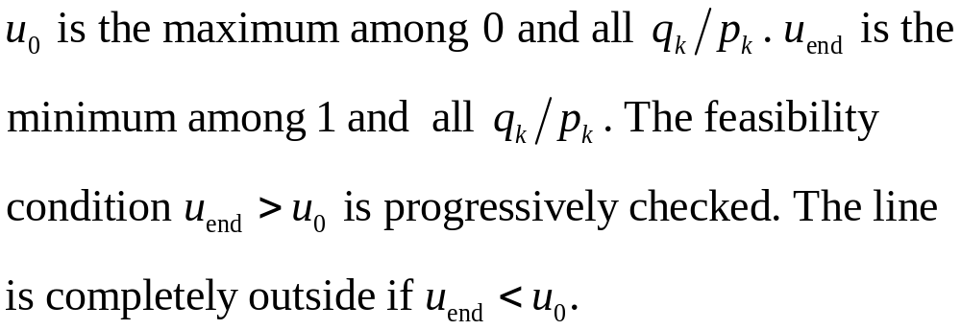
May 2010

Slide 18
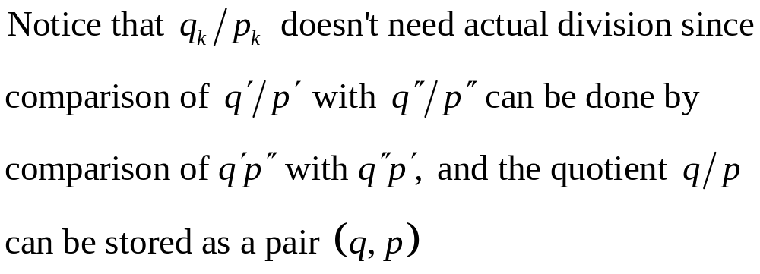
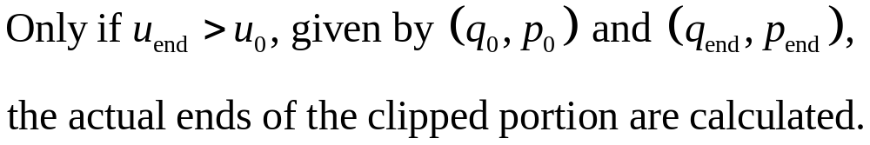
May 2010

Slide 19
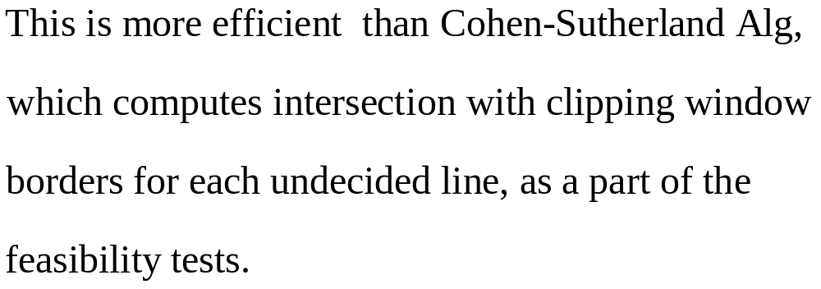
May 2010

Slide 20
Nicholl-Lee-Nicholl Line Clipping Algorithm
Creates more regions around clipping window to avoid multiple line intersection calculations.
Performs fewer comparisons and divisions than Cohen-Sutherland and Liang-Barsky, but cannot be extended to 3D, while they can.
For complete inclusion in clipping window or certain exclusion we’ll use Cohen-Sutherland.
May 2010

Slide 21

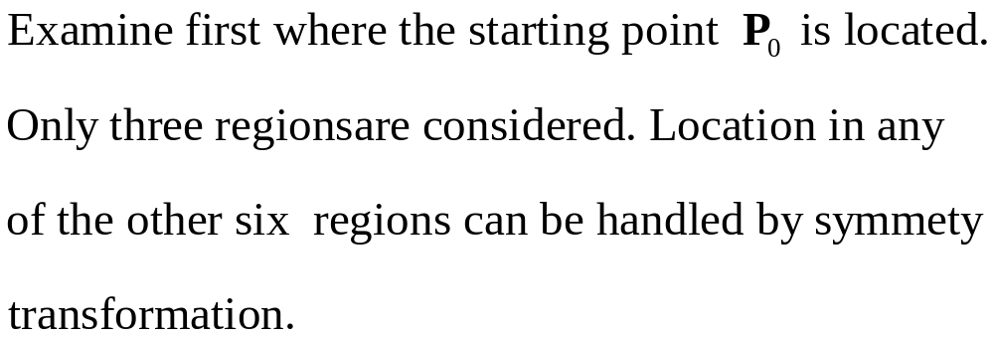
May 2010

Slide 22
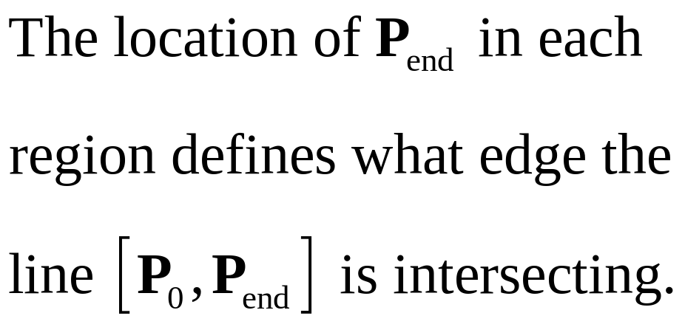
T
R
L
B
May 2010

Slide 23
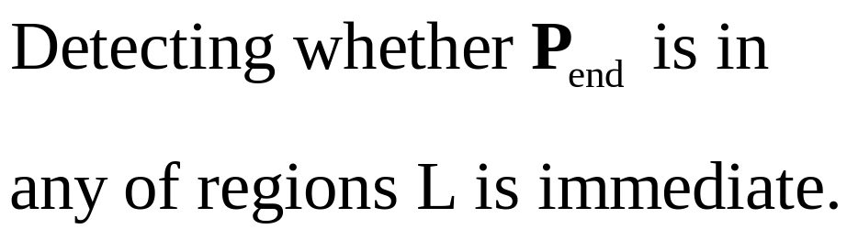
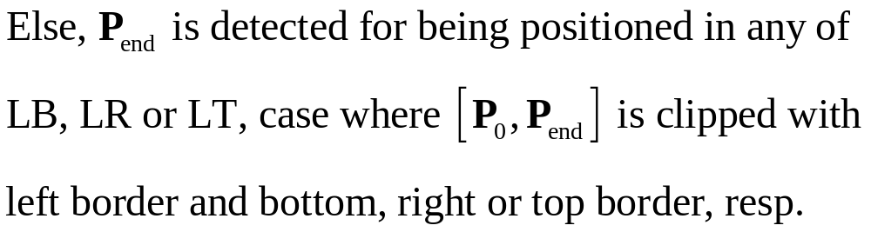
LT
L
L
LR
L
LB
May 2010

Slide 24

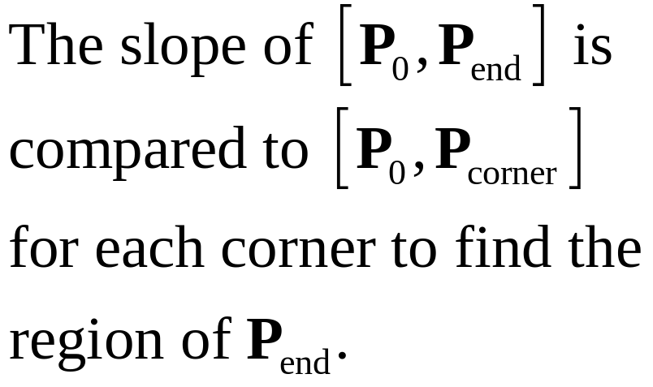
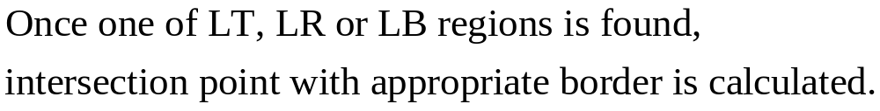
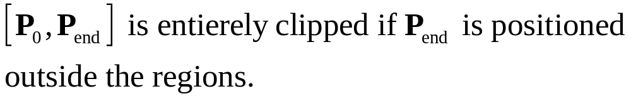
LT
L
L
LR
L
LB
May 2010

Slide 25
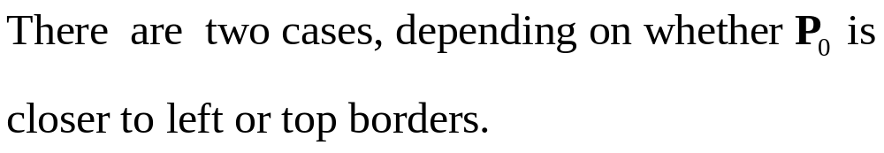
T
L
TR
L
LR
T
LB
T
TR
L
LB
TB
May 2010

Slide 26
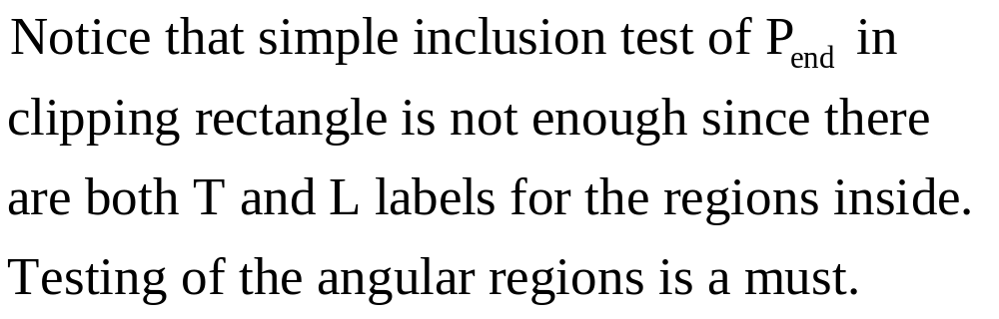
T
L
TR
L
LR
T
LB
T
TR
L
LB
TB
May 2010

Slide 27
Sutherland-Hodgman Polygon Clipping
1
1’’
1’’
1’
3’’
1’
3’’
Clipping
Clipping Window
3
3’
3’
2’
2’’
2’
2’’
2
Efficient algorithm for clipping convex polygons.
Edges are clipped against every border line of clipping window. Edges are processed successively.
Allows pipelining of edge clipping of polygons, as well as pipelining of different polygons.
May 2010

Slide 28




The four possible outputs generated by the left clipper, depending on the relative position of pair of edge endpoints.
out
in
in
in
output:
output:
out
out
output: none
in
out
output:
May 2010

Slide 29
2
2’
3
2”
1’
3’
1
Input | Left Clipper | Right Clipper | Bottom Clipper | Top Clipper
[1,2]: | (in-in)>{2}
[2,3]: | (in-out)>{2’} | [2,2’]:(in-in)>{2’}
[3,1]: | (out-in)>{3’,1} | [2’,3’]:(in-in)>{3’} | [2’,3’]:(in-out)>{2”}
 |  | [3’,1]:(in-in)>{1} | [3’,1]:(out-out)>{}
 |  | [1,2]:(in-in)>{2} | [1,2]:(out-in)>{1’,2} | [2”,1’]:(in-in)>1’}
 |  |  | [2,2’]:(in-in)>{2’} | [1’,2]:(in-in)>{2}
 |  |  |  | [2,2’]:(in-in)>{2’}
 |  |  |  | [2’,2”]:(in-in)>{2”}
May 2010

Slide 30
The four clippers can work in parallel.
  Once a pair of endpoints it output by the first clipper, the second clipper can start working.
  The more edges in a polygon, the more effective parallelism is.
Processing of a new polygon can start once first clipper finished processing.
  No need to wait for polygon completion.
May 2010

Slide 31
Convex Polygon Intersection
P
P∩Q
Q
Theorem: The intersection of an L-vertex convex polygon and an M-vertex convex polygon is a convex polygon of L+M vertices at most.
Proof: P∩Q is an intersection of L+M interior half planes determined by the two polygons.
Intersection of convex polygons can answer the question of whether two sets of points can be separated by a line.
May 2010

Slide 32
Theorem: The intersection of an L-vertex convex polygon and an M-vertex convex polygon can be found in θ(L+M) time.
Proof: Polygons are given in cyclic order of vertices. We start from the leftmost vertex of both polygons and progress along the border of both in a left-to-right fashion, defining O(L+M) slabs.
Inside a slab each polygon forms a trapezoid. The intersection of two trapezoids can be calculated in constant time.
May 2010

Slide 33
Another solution: The non empty intersection of two convex polygons forms a sequence of “sickles” enclosing the intersection. The border of a sickle comprises internal and external sequence of vertices originating from P and Q, which are alternating in every sickle.
sickle
R=P∩Q
P
Q
Let P: (p₁,p₂,…,p_{L}) and Q: (q₁,q₂,…,q_{M}) be counterclockwise cyclically ordered. The algorithm advances such that ∂P and ∂Q are “chasing” one another, adjusting their speeds so that they meet at every intersection.
May 2010

Slide 34
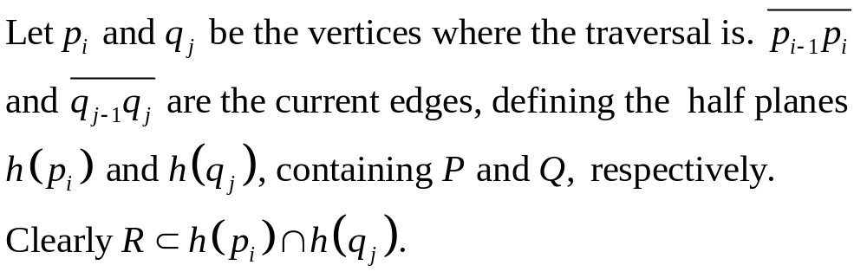
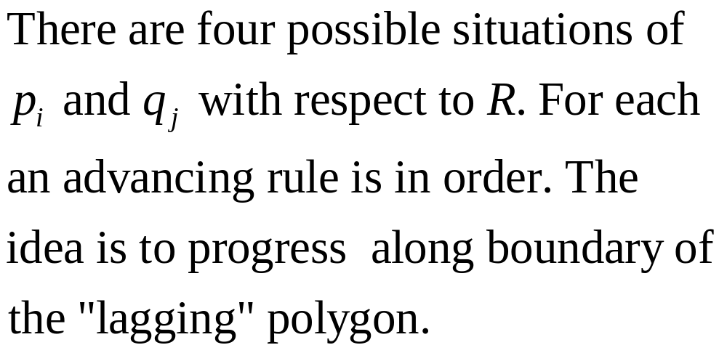


May 2010

Slide 35
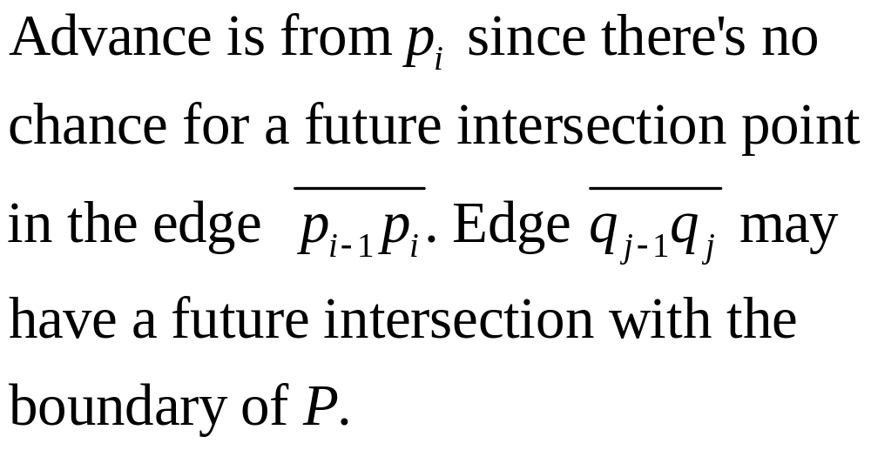
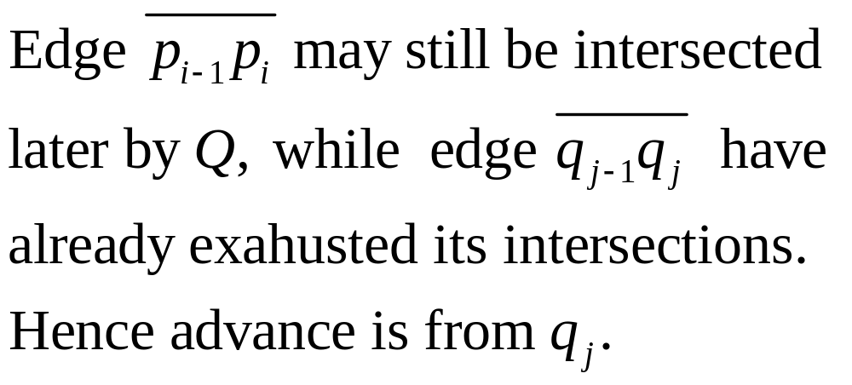
(a)
(b)
May 2010

Slide 36
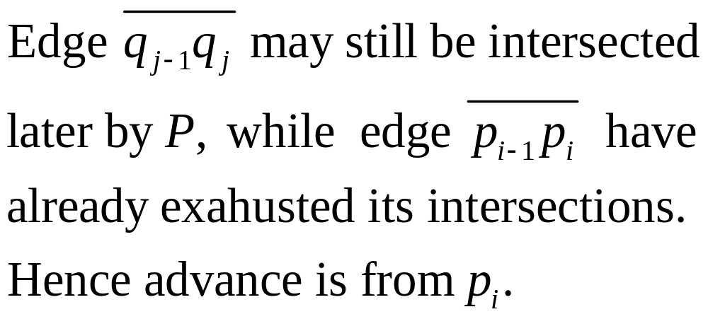
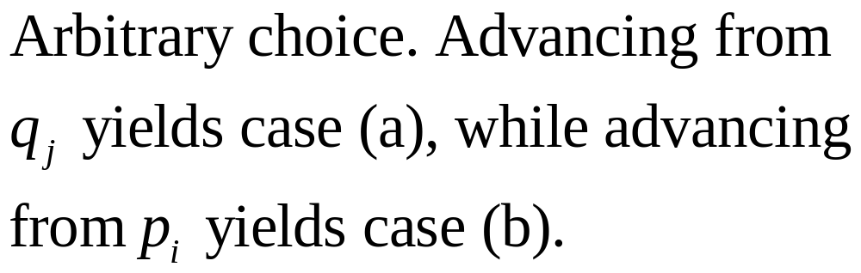
(c)
(d)
May 2010

Slide 37
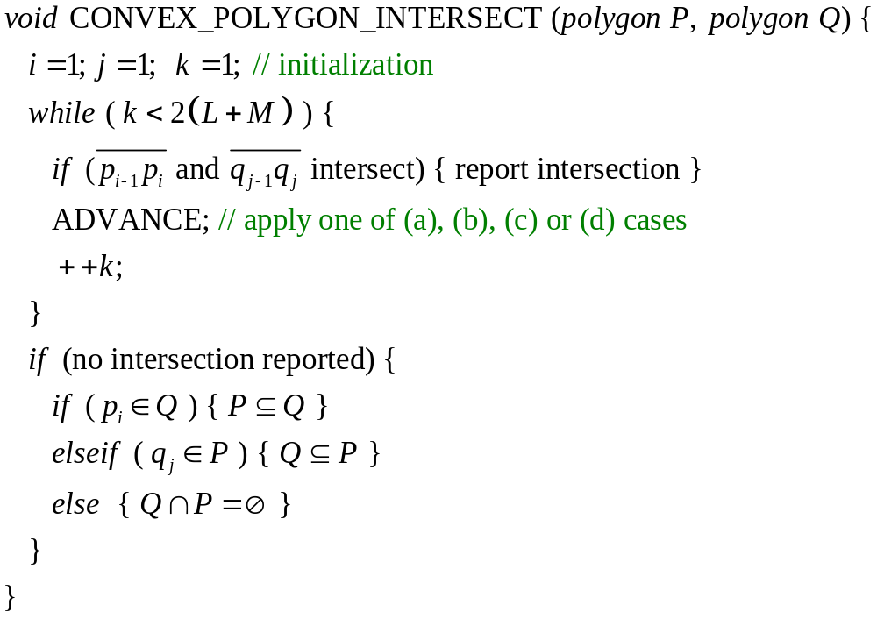
May 2010

Slide 38
May 2010

Slide 39
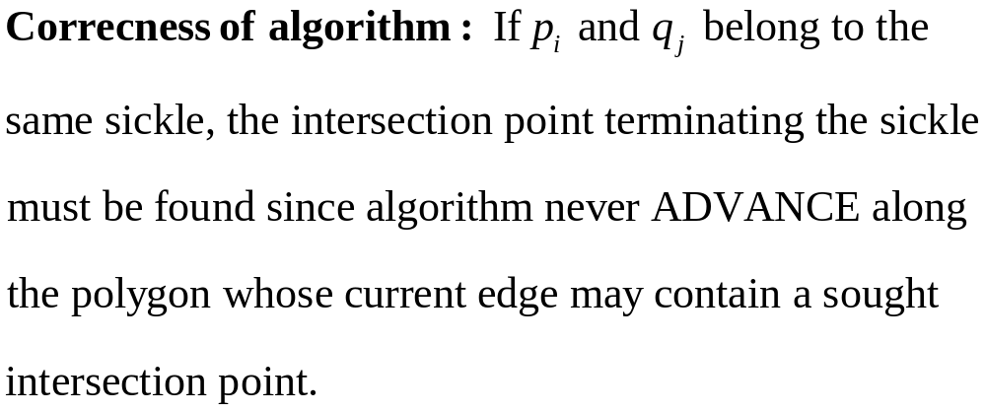
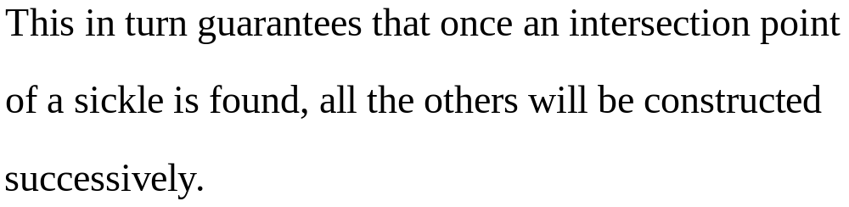
May 2010

Slide 40
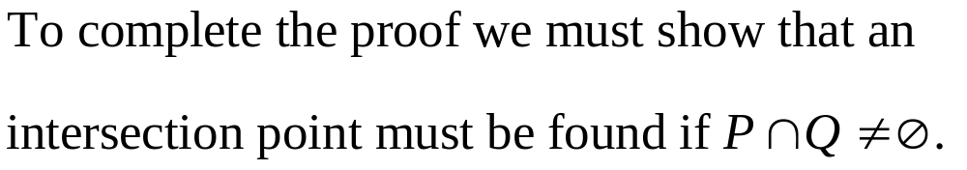
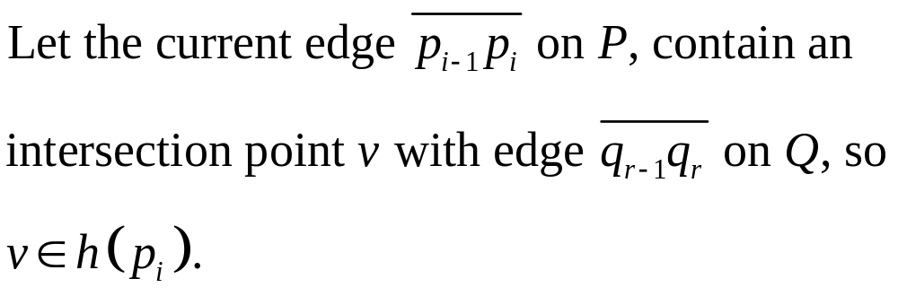
May 2010

Slide 41








farthest vertex
May 2010

Slide 42
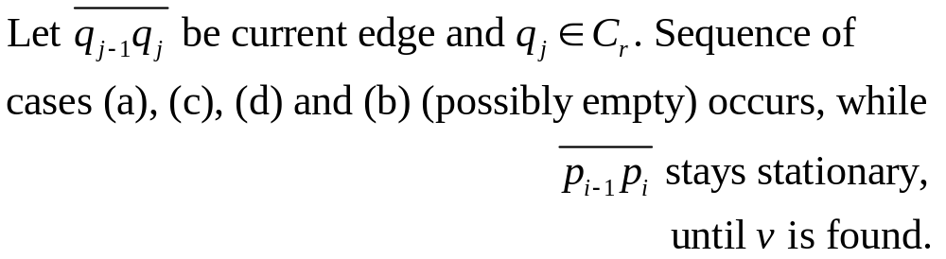
case (b)
case (d)
case (c)
case (a)
farthest vertex
May 2010

Slide 43
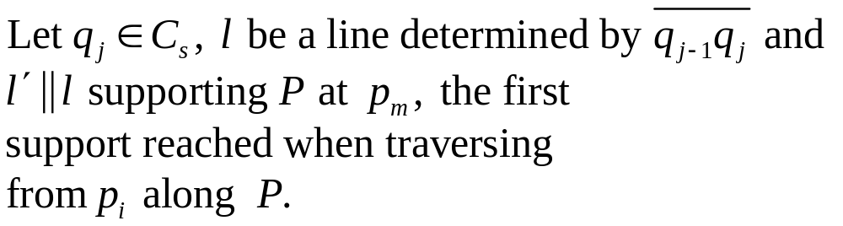



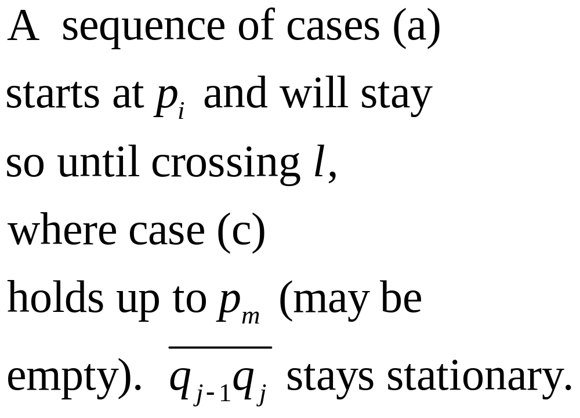






May 2010

Slide 44
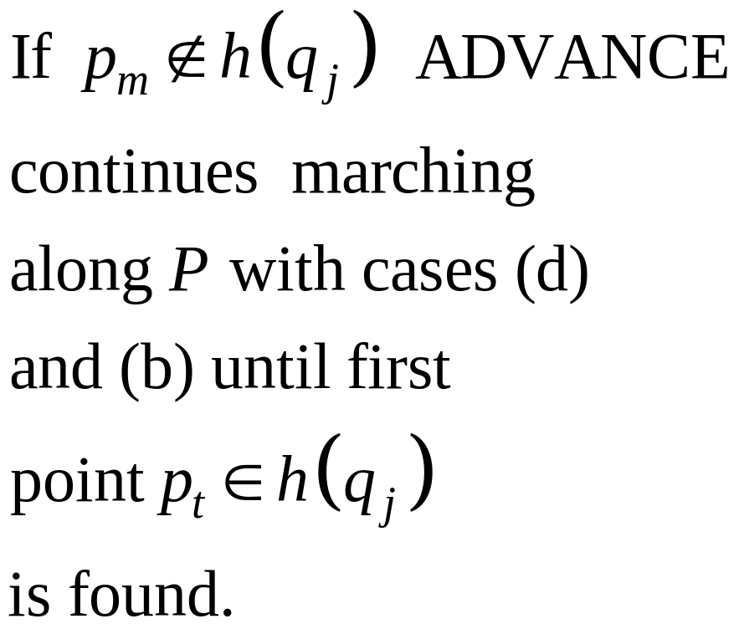

May 2010

Slide 45
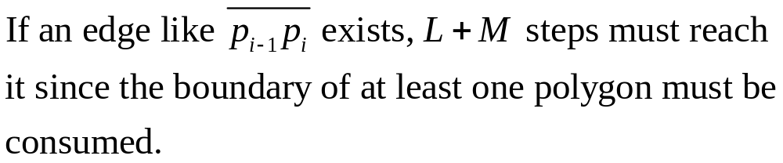
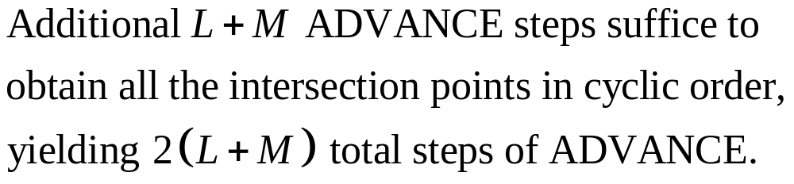
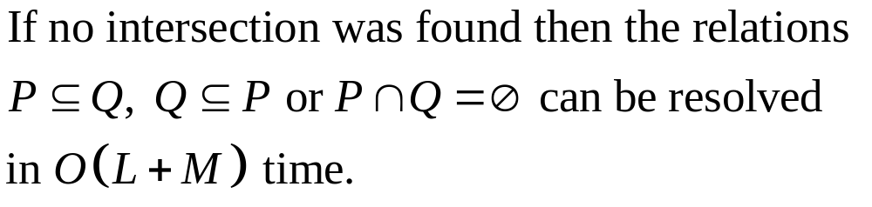
May 2010

Slide 46

3D Viewing Concepts
World Coordinate System
Viewing Coordinate System
May 2010

Slide 47
2D Reminder
Choose viewing position, direction and orientation of the camera in the world.
A clipping window is defined by the size of the aperture and the lens.
Viewing by computing offers many more options which camera cannot, e.g., parallel or perspective projections, hiding parts of the scene, viewing behind obstacles, etc.
May 2010

Slide 48
Clipping window: Selects what we want to see.
Viewport: Indicates where it is to be viewed on the output device (still in world coordinates).
Display window: Setting into screen coordinates.
In 3D the clipping is displayed on the view plane, but clipping of the scene takes place in the space by a clipping volume.
3D transformation pipeline is similar to 2D with addition of projection transformation.
May 2010

Slide 49
3D Viewing Transformation Pipeline
Modeling Coordinates
World Coordinates
Viewing
Coordinates
Construct World-Coordinate Scene From Modeling-Coordinate Transformations
Convert World- Coordinates to Viewing- Coordinates
Projection
Transformation
Projection Coordinates
Transform Projection-Coordinates to Normalized-Coordinates
Normalized Coordinates
Device Coordinates
Map Normalized- Coordinates to Device-Coordinates
May 2010

Slide 50
Model is given in model (self) coordinates.
Conversion to world coordinates takes place.
Viewing coordinate system which defines the position and orientation of the projection plane (film plane in camera) is selected, to which scene is converted.
2D clipping window (lens of camera) is defined on the projection plane (film plane) and a 3D clipping, called view volume, is established.
May 2010

Slide 51
The shape and size of view volume is defined by the dimensions of clipping window, the type of projection and the limiting positions along the viewing direction.
Objects are mapped to normalized coordinated and all parts of the scene out of the view volume are clipped off.
The clipping is applied after all device independent transformation are completed, so efficient transformation concatenation is possible.
Few other tasks such as hidden surface removal and surface rendering take place along the pipeline.
May 2010

Slide 52



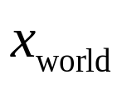



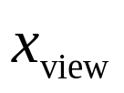
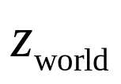
World to Viewing 3D Transformation
view point
p
view-up vector
0
May 2010

Slide 53


view point
p
view-up vector
0
world to viewing transformation
rotation
translation
May 2010

Slide 54
Projection Transformations
Next step in 3D viewing pipeline is projection of object to viewing plane
Parallel Projection
Coordinate are transferred to viewing plane along parallel lines.
View Plane
Preserves relative size of object’s portions.
Projection can be perpendicular or oblique to viewing plane.
May 2010

Slide 55
Perspective Projection
Projection lines converge in a point behind viewing plane.
Doesn’t preserve relative size but looks more realistic.
May 2010

Slide 56
Orthogonal (orthographic) projections
Projection lines are parallel to normal.
Plane View
Front Elevation View
Side Elevation View
Used in engineering and architecture. Length and angles can be measured directly from drawings.
May 2010

Slide 57



Clipping Window and View Volume
Orthogonal Projection View Volume
View Plane
Far Clipping Plane
Near Clipping Plane
Clipping window
May 2010

Slide 58







Normalizing Orthogonal Projection
Orthogonal Projection View Volume
Normalized View Volume
Display coordinate system is usually left-handed.
May 2010

Slide 59


May 2010

Slide 60






Oblique Parallel Projections
May 2010

Slide 61


Not orthogonal as viewed
The above is called shear transformation, where the displacement in x and y linearly increases with z.
May 2010

Slide 62

View Volume of Parallel Oblique Projection
View Plane
Clipping Window
View Volume
(Side)
Near Plane
View Volume
(Top)
Far Plane
May 2010

Slide 63


This is a 3D shear transformation.
x and y are displaced by amount proportional to z.
Normalization oblique projection is similar to orthogonal projection. The composite transformation is obtained by the product of the two.
May 2010

Slide 64






Perspective Projections
Closer objects look larger.
View Plane
Projection Reference Point
Projection Point
View Plane
May 2010

Slide 65



May 2010

Slide 66
The problem with the above representation is that Z appears in denominator, so matrix multiplication representation of X and Y on view plane as a function of Z is not straight forward.
Z is point specific, hence division will be computation killer.
Different representation is in order, so transformations can be concatenated
May 2010

Slide 67



Vanishing Points
Vanishing points occur when the viewing plane intersects with the axes of viewing coordinate system.
Vanishing Point
Principle axes for cube
One-Point perspective Projection
Parallel to Z lines of XZ plane and parallel lines to Z in YZ plane will vanish. Vanishing point on viewing plane correspond to infinity in world.
May 2010

Slide 68
Viewing plane is parallel to y-axis, intersecting both x-axis and z-axis
z-axis vanishing point
x-axis vanishing point
Vanishing points of all three axes occur when viewing plane intersects all three axes.
May 2010

Slide 69



Transformation Matrix
May 2010

Slide 70



Matrix Representation:
May 2010

Slide 71


May 2010

Slide 72

Perspective-Projection View Volume
View Plane
Rectangular Frustum View Volume
Far Clipping Plane
Clipping Window
Near Clipping Plane
Field-of-view Angle
Projection Reference Point
May 2010

Slide 73
Symmetric Frustum View Volume
Parallel Piped View Volume
Far Plane
Perspective Mapping
Near Plane
View Plane
Clipping Window
Projection Reference Point
May 2010

Slide 74


Oblique Frustum View Volume
Parallel Piped View Volume
Perspective Mapping
Projection Reference Point
May 2010

Slide 75



Oblique Perspective-Projection Frustum
May 2010

Slide 76


May 2010

Slide 77


May 2010

Slide 78


Normalized Perspective-Projection
May 2010

Slide 79


May 2010

Slide 80

No division by z!
May 2010

Slide 81

3D Viewport Transformation
May 2010

Slide 82
Settings of Perspective Projection
Perspective projection point
  Where the viewer (camera, eye) is positioned in the world.
Positioning viewing plane with respect to viewing coordinates
  Results vanishing points, one, two or three.
Clipping window on viewing plane
  Defines the infinite pyramid view volume.
Near and far clipping planes (parallel to view plane)
  Define the rectangular frustum view volume.
Scale and translation parameters of perspective matrix
  Define the normalization range.
May 2010

Slide 83


3D Clipping
Similar to 2D, we add two bits to code the far and near planes.
Far bit
Near bit
Top bit
Bottom bit
Right bit
Left bit
May 2010

Slide 84

Top
Far
Near
Bottom
Left
Right
011001 | 011000 | 011010
010001 | 010000 | 010010
010101 | 010100 | 010110
001001 | 001000 | 001010
000001 | 000000 | 000010
000101 | 000100 | 000110
101001 | 101000 | 101010
100001 | 100000 | 100010
100101 | 100100 | 100110
May 2010

Slide 85

A line is completely accepted if the codes of its ends are both 000000, or equivalently, if the logical OR between codes is zero.
A line is rejected if the codes of its ends has at least one 1 in same bit, or equivalently, if the logical AND between codes is nonzero.
Otherwise, the line is tested against each of the planes and the 2D Liang-Barsky algorithm can be extended to 3D.
May 2010

Slide 86


May 2010

