Slide 1

Basic Details of the Team and Problem Statement
Ministry/Organization Name/Student Innovation:
Dell Technologies, Bangalore, India.
PS Code: UP1261
Problem Statement Title:
Interpreting Doctors notes using handwriting recognition and Deep Learning techniques
Team Name: MI6
Team Leader Name: Sahil Mansuri
Institute Code: C-58356
Institute Name:
Faculty of Computer Applications and IT
Theme Name: MedTech / BioTech / HealthTech

Slide 2
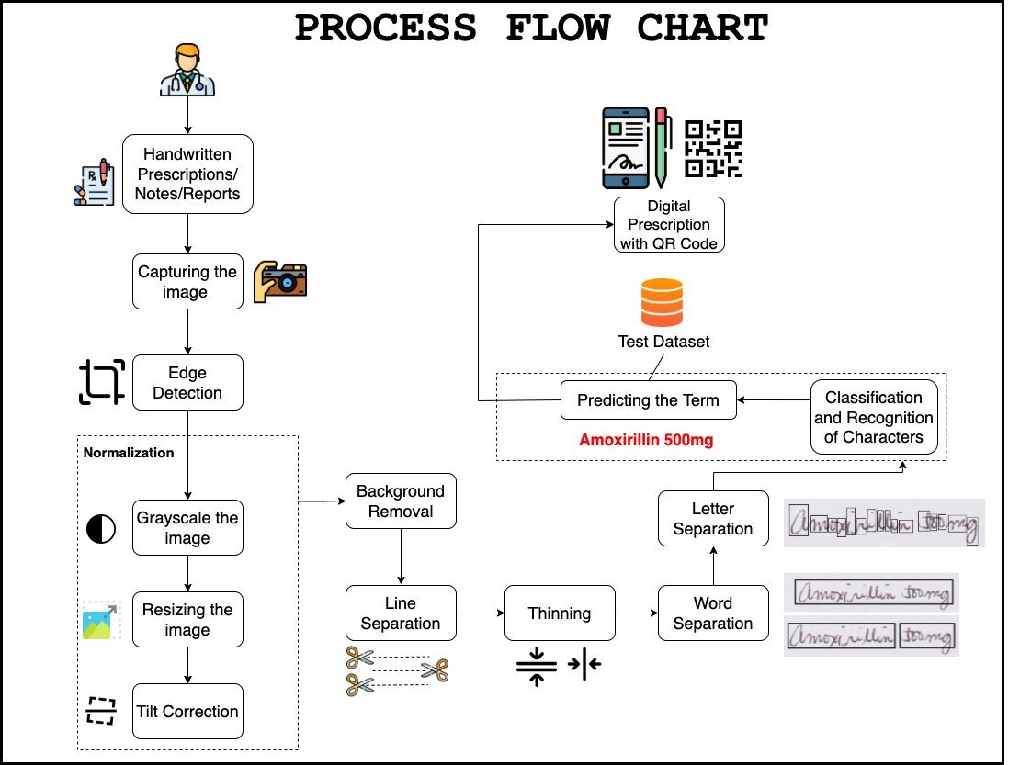
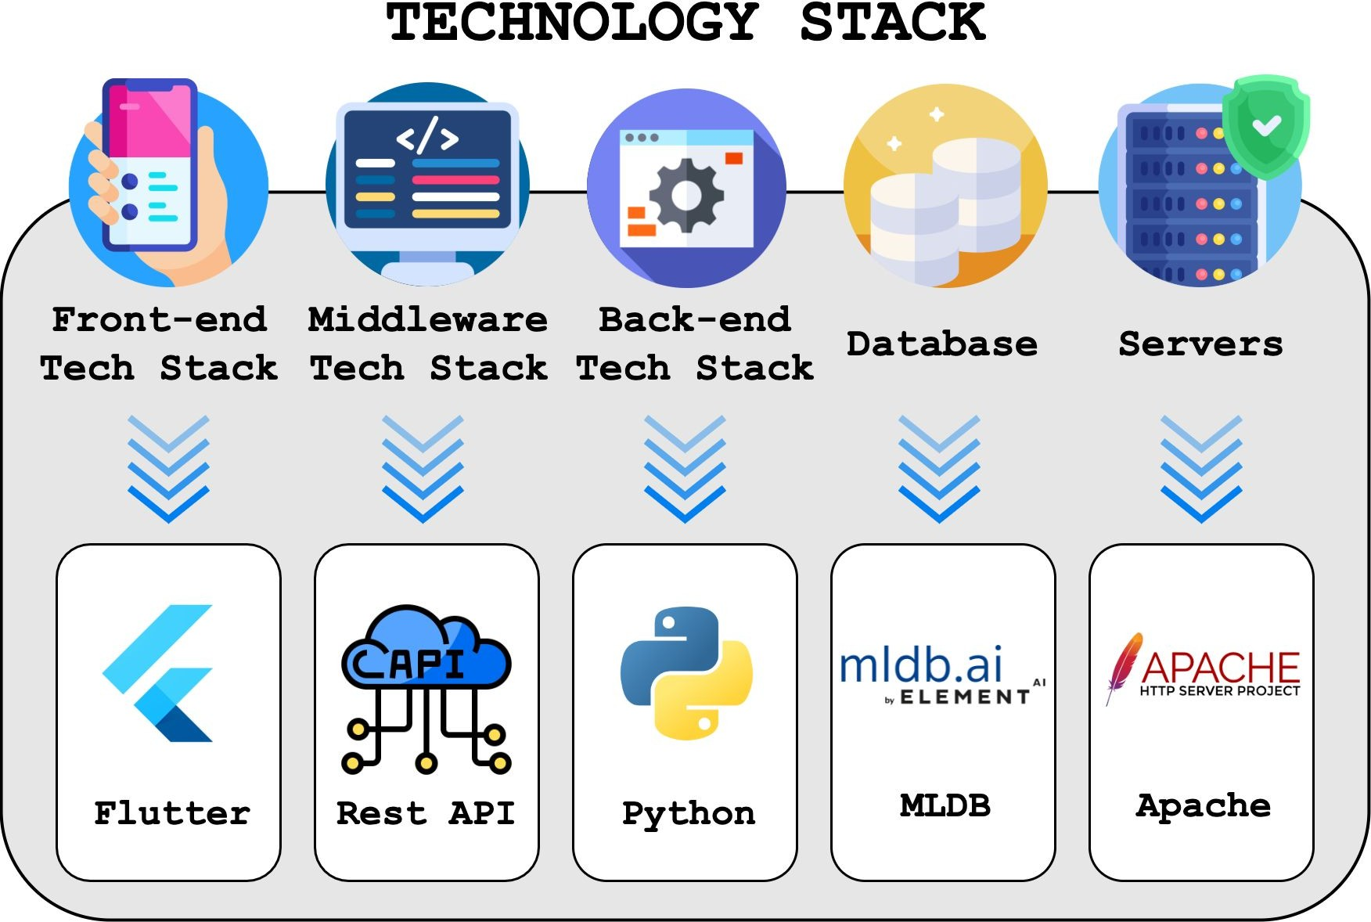
Idea/Approach Details
IDEA DESCRIPTION :
A mobile-app based solution for interpretation/recognition of handwritten text from photos captured from mobile devices. It uses computer vision and machine learning to recognise the written text on prescription/note.

Slide 3
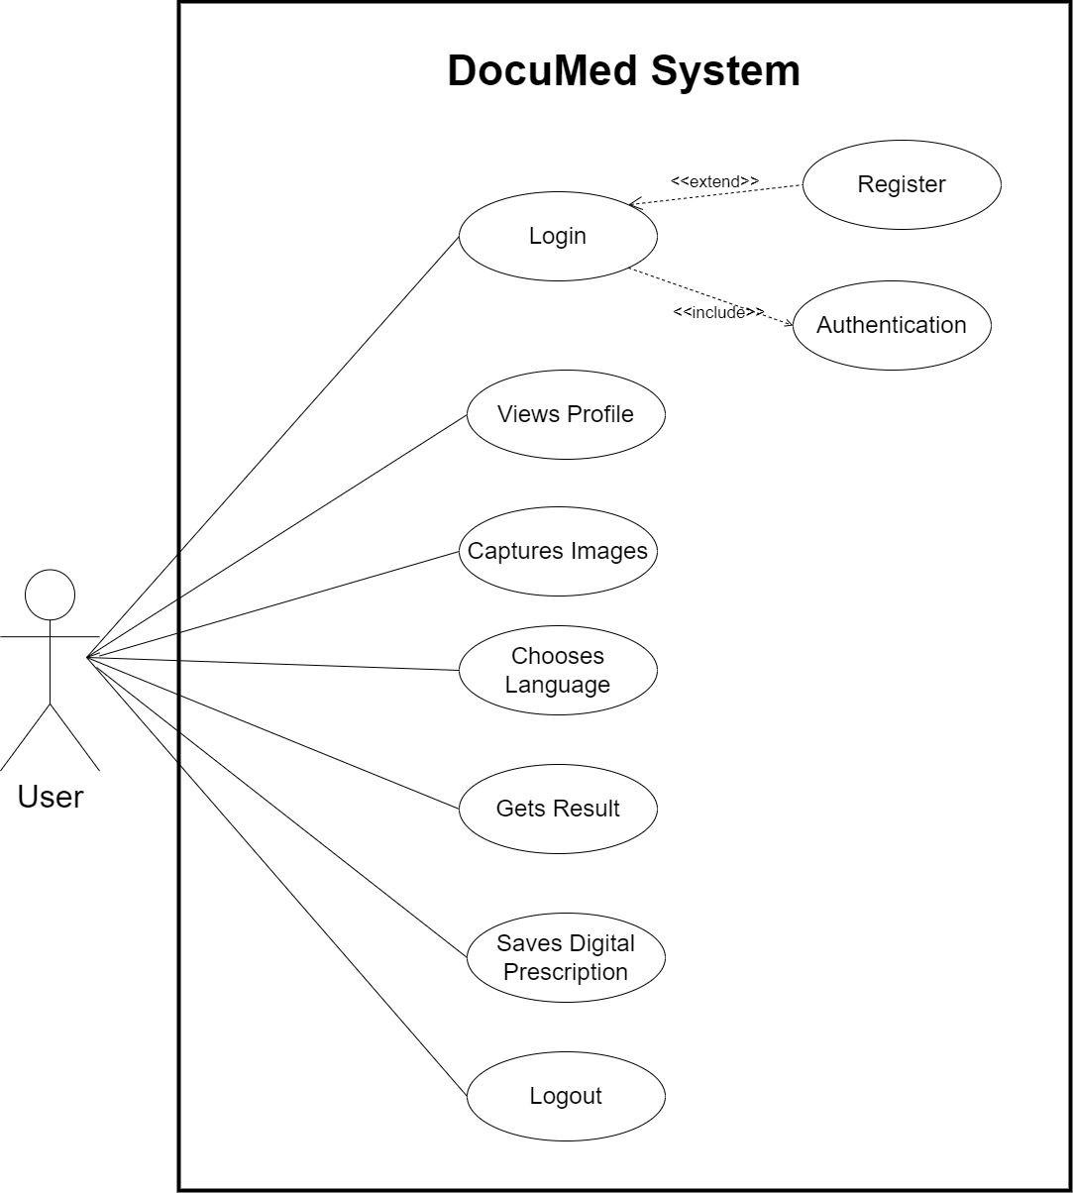
Idea/Approach Details
Use Case:

Slide 4
Team Member Details
Team Leader Name: SAHIL MANSURI
M.Sc. Stream (ECE, CSE etc): IT Team Member 1 Name: ROOHMA KADRI
M.Sc. Stream (ECE, CSE etc): IT Team Member 2 Name: KRUNAL CHOTALIYA
M.Sc. Stream (ECE, CSE etc): IT Team Member 3 Name: RUTVIK RANA
M.Sc. Stream (ECE, CSE etc): IT Team Member 4 Name: SHUBHAMSINH RAHEVAR M.Sc. Stream (ECE, CSE etc): IT Team Member 5 Name: NISHTHA SHAH
M.Sc. Stream (ECE, CSE etc): IT Team Mentor 1 Name: PROF. VISHAL NARVANI
Category: Academic Expertise: Mobile App Development Team Mentor 2 Name: Type Your Name Here
Year (I,II,III,IV): I
Year (I,II,III,IV): I
Year (I,II,III,IV): I
Year (I,II,III,IV): I
Year (I,II,III,IV): I
Year (I,II,III,IV): I
Domain Experience (in years): 8
Category (Academic/Industry): Expertise (AI/ML/Blockchain etc):
Domain Experience (in years):

