Slide 1
NoSQL

Slide 2
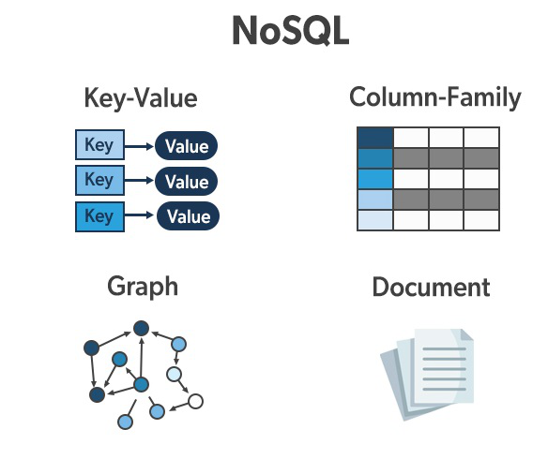
What is NoSQL?
NoSQL databases (aka "not only SQL") are non-tabular databases and store data differently than relational tables.
NoSQL databases come in a variety of types based on their data model. The main types are document, key-value, wide-column, and graph.
They provide flexible schemas and scale easily with large amounts of data and high user loads.

Slide 3
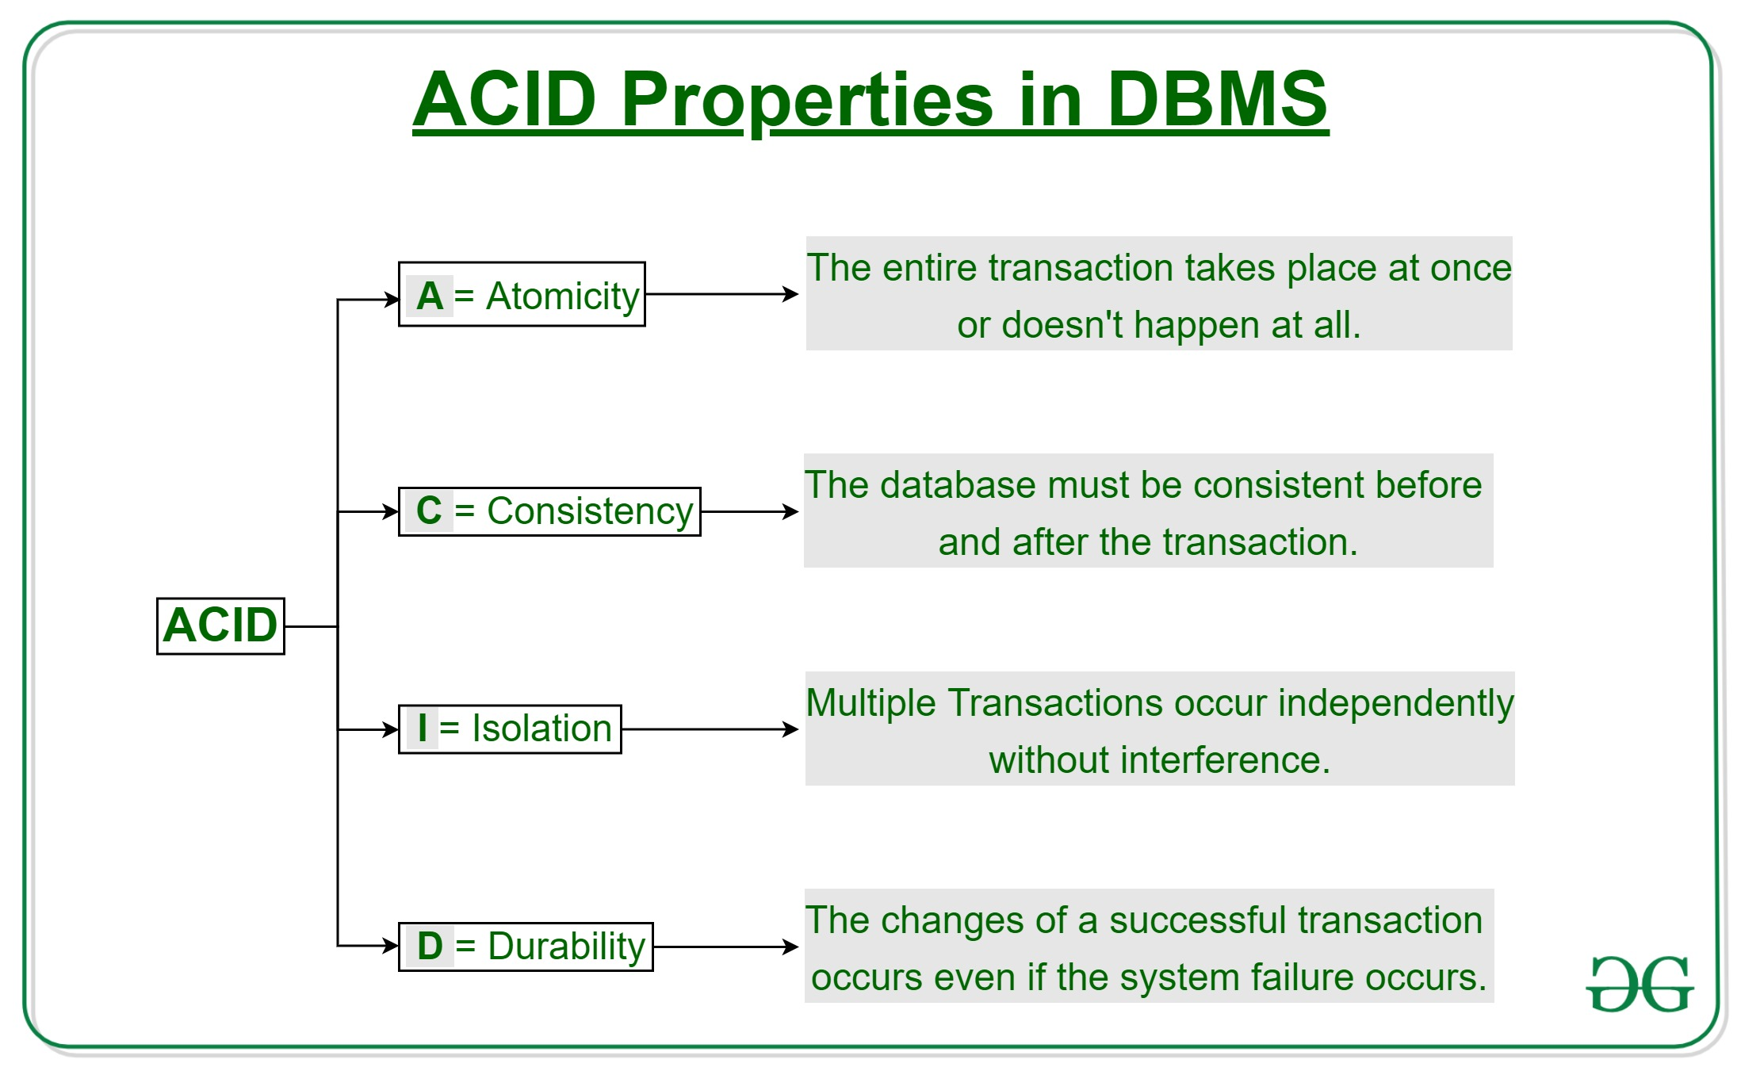

Slide 4
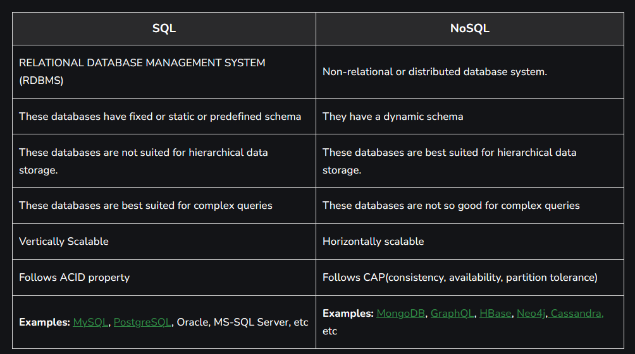

Slide 5
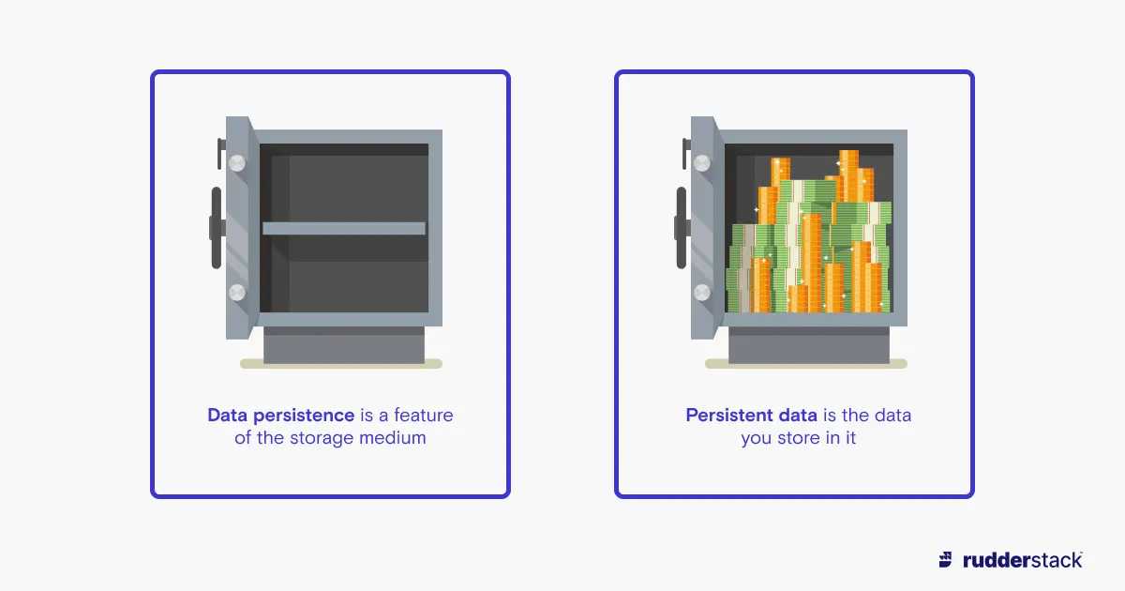
The Value of Relational Databases
Getting at Persistent Data
It doesn’t change and is not accessed very frequently.
Data that is set and recoverable whether in flash or memory backed.
The database allows more flexibility than a file system in storing large data.

Slide 6
The Value of Relational Databases
Concurrency – (multiple computations are happening at the same time)
Enterprise applications tend to have many people looking at the same body of data at once, possibly modifying that data. (double booking of hotel rooms)
Relational databases help handle this by controlling all access to their data through transactions. While this isn’t a cure-all (you still have to handle a transactional error when you try to book a room that’s just gone), the transactional mechanism has worked well to contain the complexity of concurrency.

Slide 7
The Value of Relational Databases
Integration
Shared database integration where multiple applications store their data in a single database. Using a single database allows all the applications to use each others’ data easily, while the database’s concurrency control handles multiple applications in the same way as it handles multiple users in a single application.

Slide 8
The Value of Relational Databases
A (Mostly) Standard Model
Relational databases have succeeded because they provide the core benefits we outlined earlier in a (mostly) standard way.
As a result, developers and database professionals can learn the basic relational model and apply it in many projects. Although there are differences between different relational databases, the core mechanisms remain the same: Different vendors’ SQL dialects(uses human-readable expressions to define query statements) are similar, transactions operate in mostly the same way.

Slide 9
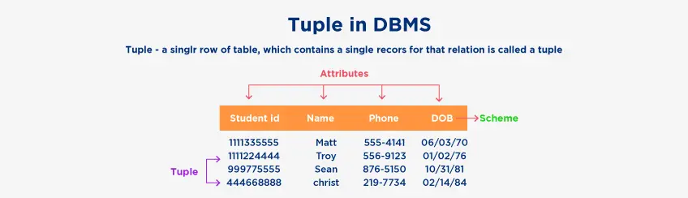
Impedance Mismatch
Impedance Mismatch: the difference between the relational model and the in-memory data structures.
The relational data model organizes data into a structure of tables and rows, or more properly, relations and tuples.
Tuple: is a set of name-value pairs and a relation is a set of tuples.

Slide 10
Impedance Mismatch
In particular, the values in a relational tuple have to be simple—they cannot contain any structure, such as a nested record or a list.
This limitation isn’t true for in-memory data structures, which can take on much richer structures than relations.
As a result, if you want to use a richer in memory data structure, you have to translate it to a relational representation to store it on disk.

Slide 11
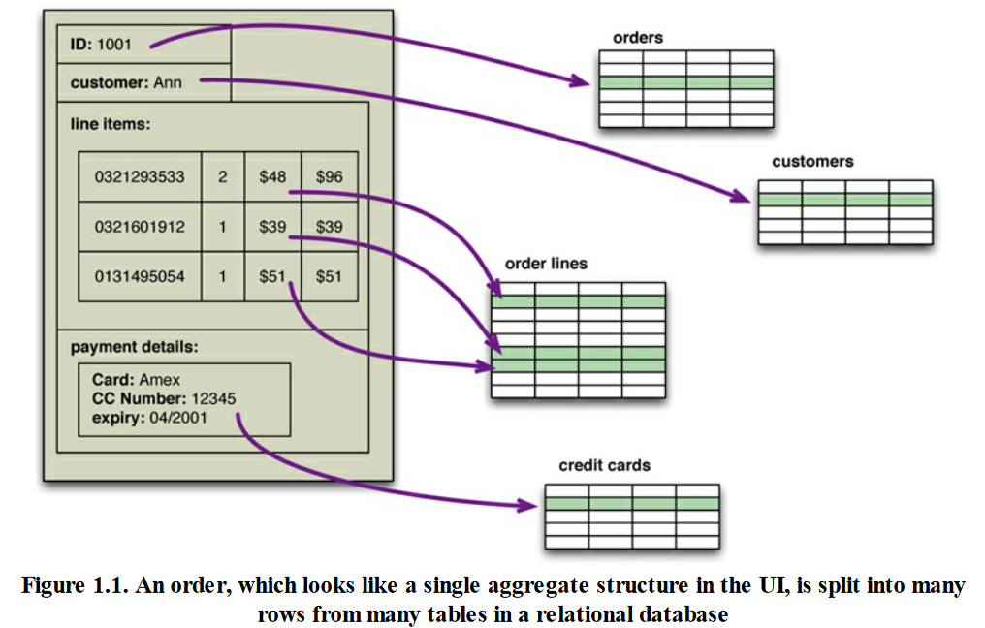

Slide 12
Impedance Mismatch
The impedance mismatch is a major source of frustration to application developers, and in the 1990s many people believed that it would lead to relational databases being replaced with databases that replicate the in-memory data structures to disk.
Object-oriented languages succeeded in becoming the major force in programming, but object-oriented databases faded into obscurity (unimportance).
Relational databases saw off the challenge by stressing their role as an integration mechanism, supported by a mostly standard language of data manipulation (SQL) and a growing professional divide between application developers and database administrators.
Impedance mismatch has been made much easier to deal with by the wide availability of object- relational mapping frameworks, such as Hibernate and iBATIS that implement well-known mapping patterns, but the mapping problem is still an issue. Object-relational mapping frameworks remove a lot of grunt work, but can become a problem of their own when people try too hard to ignore the database and query performance suffers.

Slide 13
Impedance Mismatch
Object-oriented programming languages became popular in 1990s, but object-oriented databases did not
Entrenched relational database vendors − Database as an integration mechanism − Standard data manipulation language (SQL) − Professional divide between application developers and database administrators − Object-relational mapping frameworks ease the grunt work
But often result in serious performance issues.

Slide 14
Application and Integration Databases
Integration databases are a convenient and powerful method for integrating multiple applications developed by different teams storing their data in a common database.
This improves communication because all the applications are operating on a consistent set of persistent data.
Integrate many applications becomes more complex than any single application needs
Different applications have different structural and performance needs, so an index required by one application may cause a problematic hit on inserts for another. − Different structural and performance needs for different applications. − Database integrity becomes an issue.
Instead, treat the database as an application database − Single application, single development team − Provide alternate integration mechanisms

Slide 15
Alternate Integration Mechanism: Services
During the 2000s we saw a distinct shift to web services, where applications would communicate over HTTP.
More recent push to use Web Services where applications integrate over HTTP communications
Results in more flexibility for exchange data structure − XML, JSON, etc. − Text-based protocols
Results in letting application developers choose database − Application databases − Relational databases are often still an appropriate choice

Slide 16
The Attack of the Clusters
The 2000s saw the web grow enormously − Web use tracking data, social networks, activity logs, mapping data, etc. − Huge websites serving huge numbers of visitors
To handle the increase in data and traffic required more computing resources
Instead of building bigger machines with more processors, storage, and memory, use clusters of small, commodity machines − Cheaper, more resilient
But relational databases are not designed to be run on clusters.

Slide 17
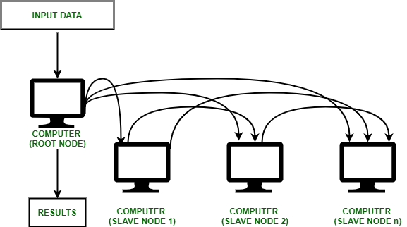

Slide 18
Clustered Relational Databases
Clustered relational databases such as Oracle Real Application Clusters (RAC) and Microsoft SQL Server still work against a single database disk subsystem − A cluster-aware file system and a highly-available disk subsystem − Disk subsystem is a single point of failure
Can also partition the database into functionally distinct subsets − Each application has to keep track of which database server to talk to for each bit of data − Lose cross-shard querying, referential integrity, transactions, or consistency control

Slide 19
Clustered Relational Databases
Clustered relational databases such as Oracle Real Application Clusters (RAC) and Microsoft SQL Server still work against a single database disk subsystem − A cluster-aware file system and a highly-available disk subsystem − Disk subsystem is a single point of failure
Can also partition the database into functionally distinct subsets − Each application has to keep track of which database server to talk to for each bit of data − Lose cross-shard querying, referential integrity, transactions, or consistency control
Commercial relational database licenses are typically per node, raising overall cost for clusters

Slide 20
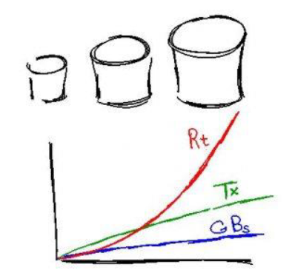
“Sharding”
Size and Transaction Volume (linear growth):
CPU
Memory
Disk
Response time (exponential growth)
Advantages (smaller databases):
Easier to manage
Faster
Reduce costs
Disadvantages (challenges):
Reliability (backups, redundancy, failover, disaster recovery)
Distributed queries (cross-shard joins)
Auto-increment key management
Multiple shard schemes (session/transaction or statement based sharding)

Slide 21
New Opportunities
The mismatch between relational databases and clusters led some organizations to consider alternative approaches to data storage. − Google and Amazon have been very influential − Large clusters and huge amounts of data − Google: BigTable paper; Amazon: Dynamo paper
Few organizations need the scale of Google or Amazon, but many organizations are seeing an exponential(mounting) increase in data storage and use
New styles of databases explicitly designed to run on clusters

Slide 22
The Emergence of NoSQL
Historical note: ‘NoSQL’ was first used to name an open-source relational database development led by Carlo Strozzi − Based on ASCII storage of tables manipulated through Unix shell scripts instead of SQL − No influence on databases under the current use of the term ‘NoSQL’
Current use of the phrase came from a conference meetup discussing “open-source, distributed, nonrelational databases” − Voldemort, Cassandra, Dynomite, HBase, Hypertable, CouchDB, MongoDB
No generally accepted definition of ‘NoSQL’ − Often “Not only SQL”

Slide 23
Characteristics of NoSQL Databases
They do not use SQL and the relational model
− Some do have query languages which are similar to SQL to be easy to learn and use
Mostly open-source projects
Designed to be distributed – clustered
− No expectation of ACID (atomicity, consistency, isolation, and durability) properties − Range of options for consistency and distribution
Schema free
− Freely add fields to records without having to define any changes in structure first − Non-uniform data and custom fields
A noDefinition of NoSQL: An ill-defined set of mostly open-source databases, mostly developed in the early 21st century, and mostly not using SQL

Slide 24
