Slide 1
Introduction to Data Models of NoSQL Databases

Slide 2
What are aggregates?
The relational model takes the information that we want to store and divides it into tuples (rows). A tuple is a limited data structure: It captures a set of values, so you cannot nest one tuple within another to get nested records, nor can you put a list of values or tuples within another.
Aggregate orientation is, if you want to operate on data in units that have a more complex structure than a set of tuples. It can be handy to think in terms of a complex record that allows lists and other record structures to be nested inside.
key-value, document, and column-family databases all make use of this more complex record. However, there is no common term for this complex record; in this book we use the term “aggregate.”
Aggregate is a term that comes from Domain-Driven Design. In Domain-Driven Design, an aggregate is a collection of related objects that we wish to treat as a unit.
The aggregate makes a natural unit for replication and sharding.

Slide 3
Example of Relations and Aggregates
Let’s assume we have to build an e-commerce website; we are going to be selling items directly to customers over the web, and we will have to store information about users, our product catalog, orders, shipping addresses, billing addresses, and payment data. We can use this scenario to model the data using a relation data store as well as NoSQL data stores and talk about their pros and cons.

Slide 4
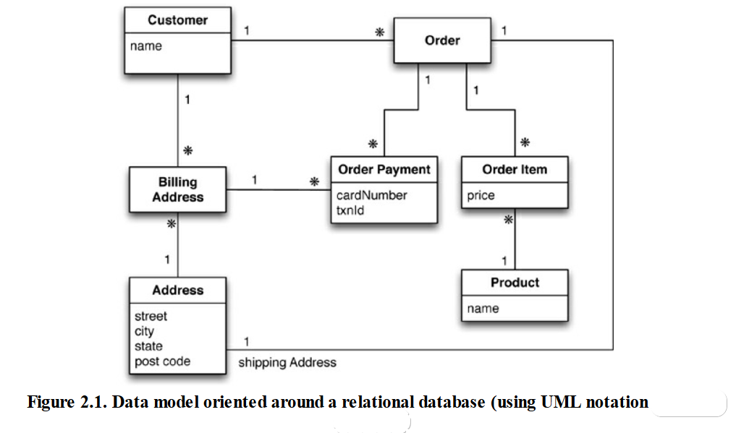

Slide 5
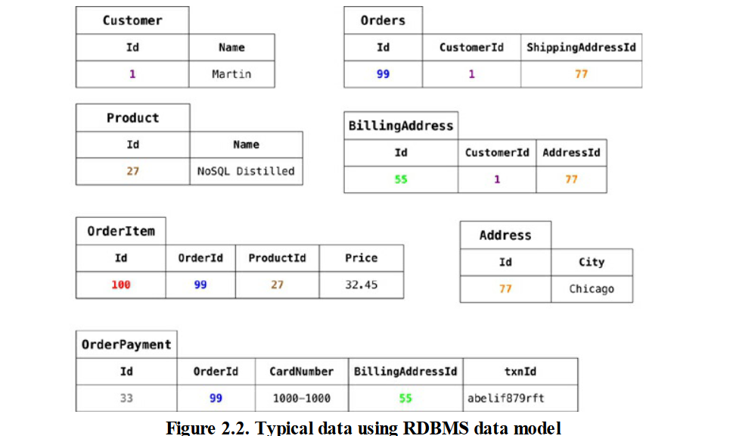

Slide 6
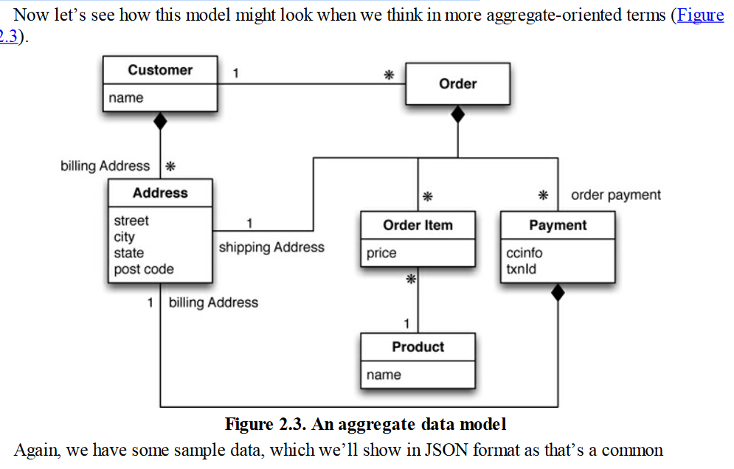
We’ve used the black-diamond composition marker in UML to show how data fits into the aggregation structure.
The link between the customer and the order isn’t within either aggregate—it’s a relationship between aggregates.

Slide 7
JSON format as that’s a common representation for data in NoSQL
// in customers { "id":1, "name":"Martin", "billingAddress":[{"city":"Chicago"}] } // in orders { "id":99, "customerId":1, "orderItems":[ { "productId":27, "price": 32.45, "productName": "NoSQL Distilled" } ], "shippingAddress":[{"city":"Chicago"}] "orderPayment":[ { "ccinfo":"1000-1000-1000-1000", "txnId":"abelif879rft", "billingAddress": {"city": "Chicago"} } ], }

Slide 8
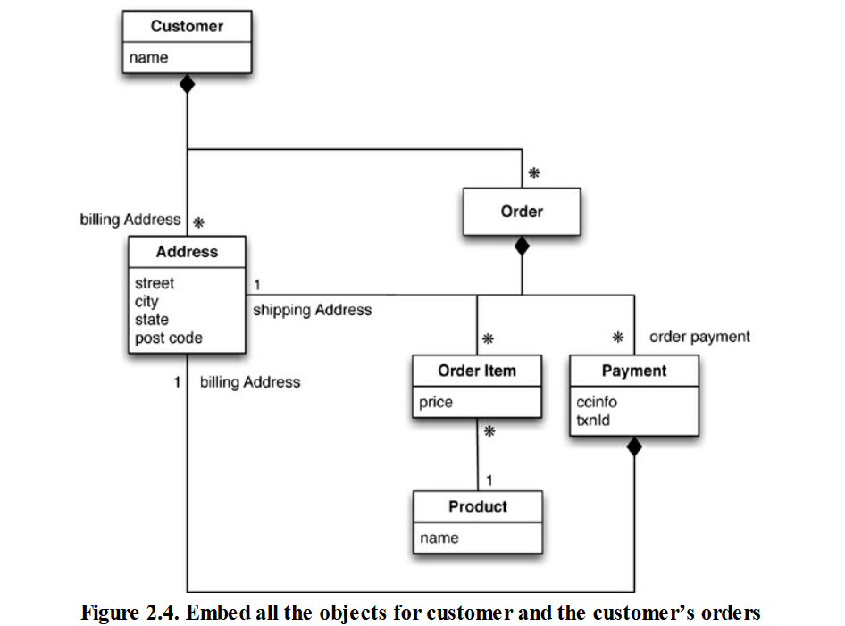

Slide 9
Using the above data model, an example Customer and Order would look like this:
{ "customer": { "id": 1, "name": "Martin", "billingAddress": [{"city": "Chicago"}], "orders": [ { "id":99, "customerId":1, "orderItems":[ { "productId":27, "price": 32.45, "productName": "NoSQL Distilled" } ], "shippingAddress":[{"city":"Chicago"}] "orderPayment":[ { "ccinfo":"1000-1000-1000-1000", "txnId":"abelif879rft", "billingAddress": {"city": "Chicago"} }],
}] } }

Slide 10
Consequences of Aggregate Orientation:
Aggregation is not a logical data property It is all about how the data is being used by applications.
An aggregate structure may be an obstacle for others but help with some data interactions.
It has an important consequence for transactions.
NoSQL databases don’t support ACID transactions thus sacrificing consistency.
aggregate-oriented databases support the atomic manipulation of a single aggregate at a time.

Slide 11
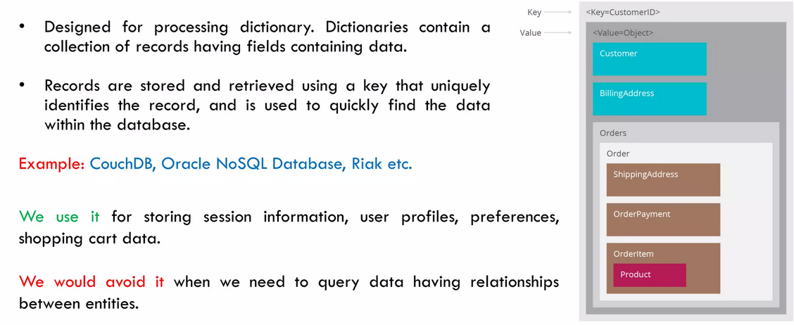
Key-Value

Slide 12
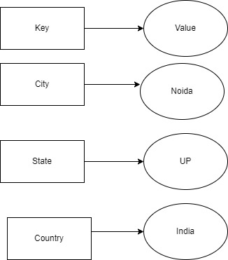
Key-Value
A key-value data model or database is also referred to as a key-value store. It is a non-relational type of database.
When to use a key-value database:
User session attributes in an online app like finance or gaming, which is referred to as real-time random data access.
Caching mechanism for repeatedly accessing data or key-based design.
The application is developed on queries that are based on keys.
Advantages:
It is very easy to use. Due to the simplicity of the database, data can accept any kind, or even different kinds when required.
Its response time is fast due to its simplicity, given that the remaining environment near it is very much constructed and improved.
Key-value store databases are scalable vertically as well as horizontally.
Built-in redundancy makes this database more reliable.
Disadvantages:
As querying language is not present in key-value databases, transportation of queries from one database to a different database cannot be done.
The key-value store database is not refined. You cannot query the database without a key

Slide 13
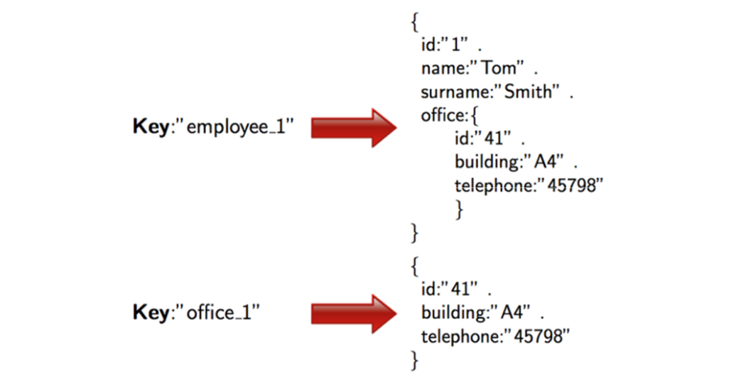
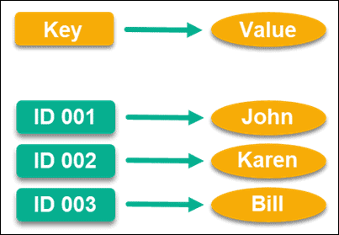
Keyvalue: example (JSON format)

Slide 14
Document Data Model: Features
Document Type Model: easy to map things in many programming languages.
Flexible Schema: not all documents in a collection need to have the same fields.
Distributed and Resilient: Document data models are very much dispersed which is the reason behind horizontal scaling and distribution of data.
Manageable Query Language: These data models are the ones in which query language allows the developers to perform CRUD (Create Read Update Destroy) operations on the data model.
Examples of Document Data Models :
Amazon DocumentDB
MongoDB
Cosmos DB
ArangoDB
Couchbase Server
CouchDB

Slide 15
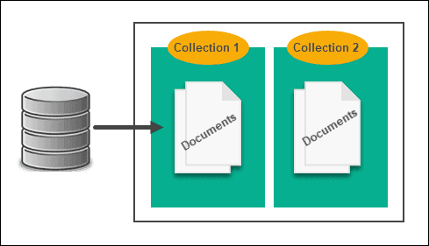
Document Data Model:
A Document Data Model is a lot different than other data models because it stores data in JSON, XML documents.
This is a data model which works as a semi-structured data model in which the records and data associated with them are stored in a single document which means this data model is not completely unstructured.
{ "Name" : "Yashodhra", "Address" : "Near Patel Nagar", "Email" : "yahoo123@yahoo.com", "Contact" : "12345" }

Slide 16
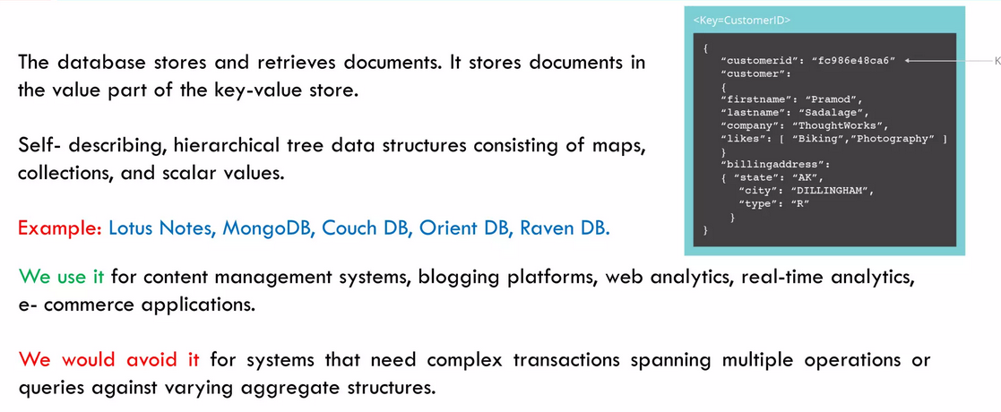

Slide 17
Document Database
Key Value
A database stores data in the form of documents, which can include nested data structures.
It support more advanced querying capabilities, and often have built-in support for indexing and searching.
It is more flexible in terms of data modeling, and allow for more complex data structures and relationships.
Document databases are well suited for storing semi-structured or unstructured data, and nested data structures, such as JSON or XML documents.
A database stores data as a collection of key-value pairs, where each key is a unique identifier and the value can be any type of data.
It typically have more limited querying capabilities and may not support advanced search or indexing features.
It has a simple data model that is based on key-value pairs and may not support complex data structures or relationships.
Key-value databases are well suited for storing data that can be easily partitioned, such as caching data or session data.

Slide 18
Column-Family Stores
NoSQL databases built for highly analytical, complex-query tasks. Unlike relational databases, columnar databases store their data by columns, rather than by rows. These columns are gathered to form subgroups.
Columns within the same column family, or cluster of columns, can have a different number of rows and can accommodate different types of data and names.
They are not fixed within a table, but have a dynamic schema.
Each column is stored separately.
If there are similar (related) columns, they are joined into column families and then the column families are stored separately from other column families.

Slide 19
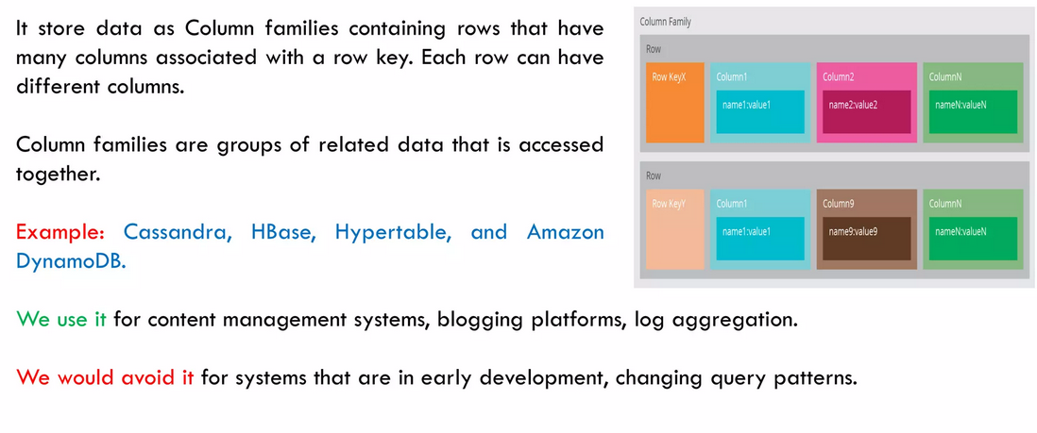
Column-Family Stores

Slide 20
Column-Family Stores
Column family stores are modeled on Google’s BigTable. The data model is based on a sparsely populated table whose rows can contain arbitrary columns.
Some popular Column Family stores are Cassandra, Hbase, Hypertable, and Amazon impleDB
Note: These databases with a bigtable-style data model are often referred to as column stores, and not column family stores, but that name has been around for a while to describe a different object: Pre-NoSQL column stores, such as C-Store or MonetDB, were happy with SQL and the relational model.
The thing that made them different was the way in which they physically stored data, based on columns rather than on rows as a unit for storage (this storage system is particularly suited to speed up read accesses)

Slide 21
Column Family Stores
The column-family model can be seen as a two-level aggregate structure – As with key-value stores, the first key is often described as a row identifier, picking up the aggregate of interest – This row aggregate is itself formed of a map of more detailed values. These second-level values are referred to as columns, each being a key-value pair
Columns are organized into column families. Each column has to be part of a single column family (data for a particular column family will be usually accessed together)
Each row identifier (i.e., first-level key) is unique in the context of a single Column Family.

Slide 22
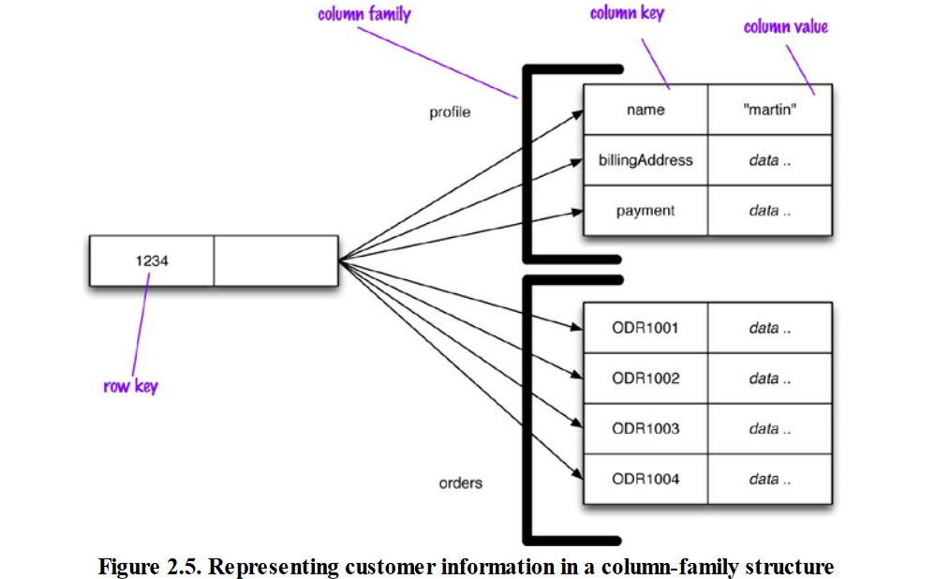

Slide 23
Column Family Stores: Cassandra
The terminology used so far is as established by Google Bigtable and HBase, but Cassandra looks at things slightly differently:
What we have called column family according to the Bigtable terminology is somehow equivalent to Cassandra supercolumns, i.e., columns that contain nested columns.
We can still use the term column family in Cassandra, and think of column families as tables, but now, each row in the table, besides possibly having different columns with respect to other rows, presents columns aggregated in supercolums. Also, a row in Cassandra only occurs in one column family.

Slide 24
Column Family Stores: Cassandra
Cassandra uses the terms “wide” and “skinny.”
Skinny rows have few columns with the same columns used across the many different rows.
In this case, the column family defines a record type, each row is a record, and each column is a field.
A wide row has many columns (perhaps thousands), with rows having very different columns.
A wide column family models a list, with each column being one element in that list.

Slide 25
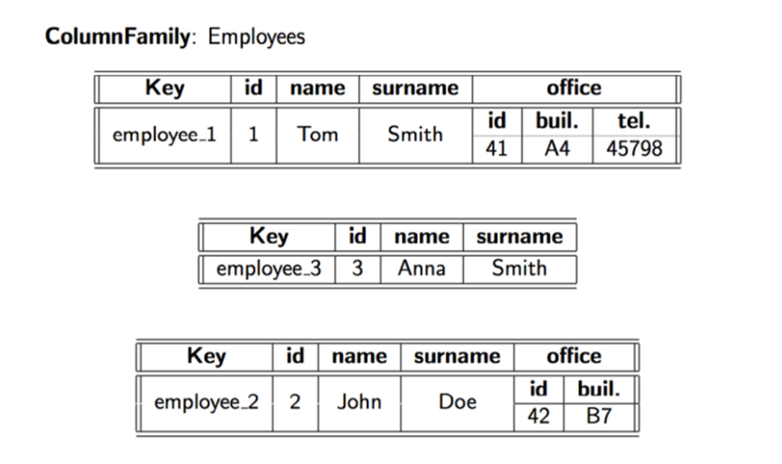
Column Family Stores: Cassandra terminology

Slide 26
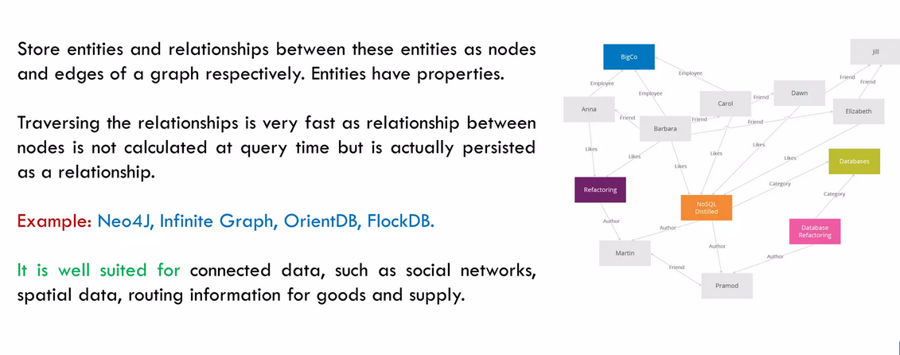
Graph Based

